Slide 1
Biochemistry
Important
Extra Information
Doctors slides
Doctors notes
Pathogenesis of cerebral infarction
Editing file

Slide 2
By the end of this lecture, the students should be able to:
Identify the possible cell death mechanisms implicated in the pathogenesis of ischemic brain injury
Acquire the knowledge of the important role played by oxidative stress and free radicals in the pathogenesis of cerebral infarction
Understand the various factors involved in ischemia-induced metabolic stress
Identify the Neurochemical changes involved in cerebral ischemia

Slide 3
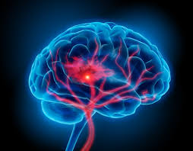
Cerebral Ischemia (Strokes) subtypes:
Stroke
Lack or reduction of blood perfusion in certain area in the brain causing death of the tissue
Hemorrhagic
With 32% global incidence
Intra-cerebral
Subarachnoid
Accumulation in this space the patients describe it as (the worst headache they ever had)
Ischemic
With 68% global incidence
Thrombotic
Embolic
The embolism travels from somewhere else mainly from the heart .
.

Slide 4
Risk factors of strokes:
Ischemic stroke risk factors
There are a number of risk factors for stroke:
Some increase the risk of one type of stroke (hemorrhagic or ischemic).
Some increase the risk of both types.
Occasionally, strokes occur in people who have no risk factors
Age older than 40 years
Heart disease
High blood pressure
Smoking & Diabetes
High blood cholesterol levels
Illegal drug use
Recent childbirth
Previous history of transient ischemic attack People usually survive from it but if it continue for 24 hours it’ll be dangerous.
Inactive lifestyle and lack of exercise
Obesity
Current or past history of blood clots
Family history of cardiac disease and/or stroke
Hemorrhagic stroke risk factors
High blood pressure
Smoking
Illegal drug use (especially cocaine and "crystal meth")
Use of warfarin or other blood thinning medicines
The cell death mechanisms implicated in the pathogenesis of ischemic brain injury

Slide 5
Cell death mechanisms in cerebral ischemia : Necrosis and Apoptosis:
Necrosis is commonly observed early after severe ischemic insults
Apoptosis occurs with more mild insults and with longer survival periods
The mechanism of cell death involves calcium-induced calpain-mediated proteolysis of brain tissue
“A condition where the intra-cellular calcium builds up”
Substrates for calpain include:
Cytoskeletal proteins, Membrane proteins and Regulatory and signaling proteins
Biochemical Responses to Ischemic Brain Injury :
Oxidative stress
Metabolic stress
Neurochemical response
the cell death can happen by 2 processes: 1- necrosis: it’s not programmed cell death and it’s abnormal condition .
2- apoptosis: normal and programmed cell death. Both happen after ischemia depending on the duration and the severity of the trauma which one of these two mechanism will happen .

Slide 6
Oxidative stress
During periods of increased neuronal activity, ROS & RNS diffuse to the myelin sheath of oligodendrocytes activating Protein kinase C (PKC) → posttranslational modification of myelin basic protein (MBP) by phosphorylation
They are required for essential processes as learning & memory formation
They regulate neuronal signaling in both central & peripheral nervous systems
They are mainly generated by microglia & astrocytes
They modulate synaptic transmission & non-synaptic communication between neurons & glia
The Role of Reactive Oxygen Species (ROS) & Reactive Nitrate Species (RNS) in Normal Brain Physiology:

Slide 7
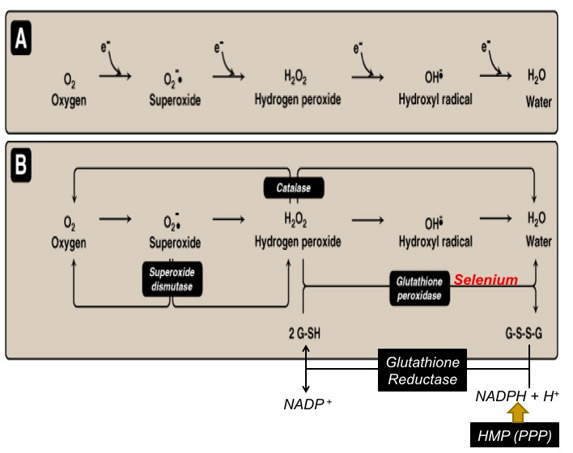
Oxidative stress
A condition in which cells are subjected to excessive levels of Reactive oxidizing species
(ROS or RNS) & they are unable to counterbalance their deleterious effects with antioxidants.
It has been implicated in the ageing process & in many diseases
(e.g., atherosclerosis, cancer, neurodegenerative diseases, stroke)
When you have less O₂ your mitochondria will not be able to produce enough ATP any type of them also there will be no glucose so, the body will go to anaerobic system but the amount of ATP are so much less and that leads to accumulation of lactate.
A molecule with one free electron called radicals there are very active and they can interact with fat .
There is oxidative stress after ischemia then ROS starts to accumulate .
IMPORTANT

Slide 8
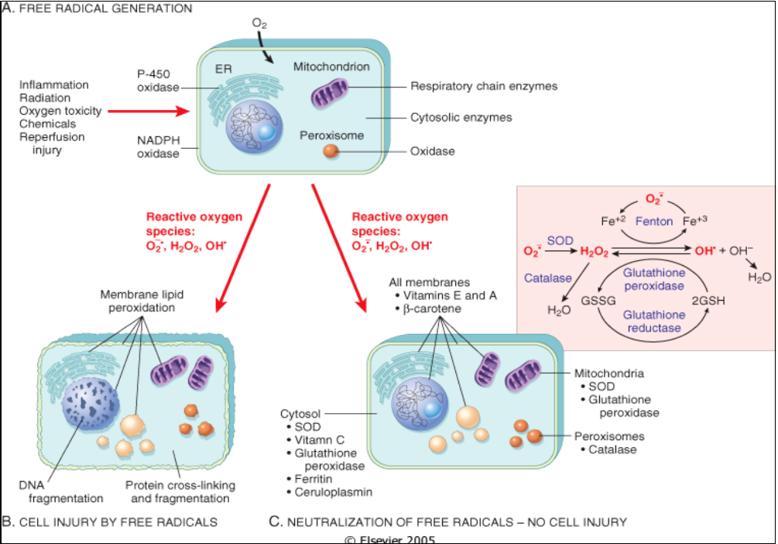
Generation of free radicals
The brain has a lot of iron and iron can produce free radicals in certain pathological condition.

Slide 9
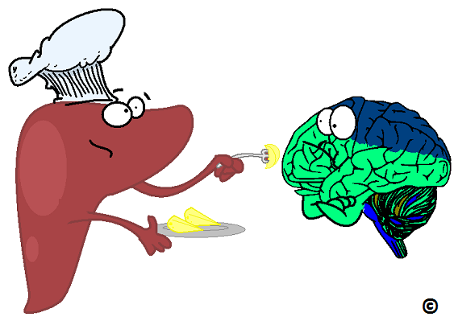
The brain and Oxidative stress:
The brain is highly susceptible to ROS-induced damage because of:
High concentrations of peroxidisable lipids
Saturated fatty acids that are normally produce free radicals and the brain has a lot of them.
Low levels of protective antioxidants
High oxygen consumption
High levels of iron (acts as pro-oxidants under pathological conditions)
The occurrence of reactions involving dopamine & Glutamate oxidase in the brain
ATP deficiency leads to shut down of NA/K pump because they are ATP dependent also the Ca⁺²/Na⁺ channels is also shutting down because there is no gradient difference.
this lead to accumulation Na and Ca inside the cell, then the water comes in leading swelling of the neuron, then it’ll release glutamate which will activate other near neuron, leading extra activation (excitement) of the neurons .

Slide 10
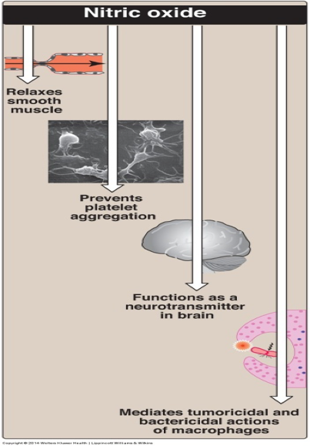
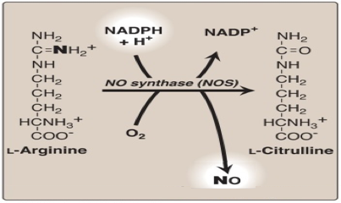
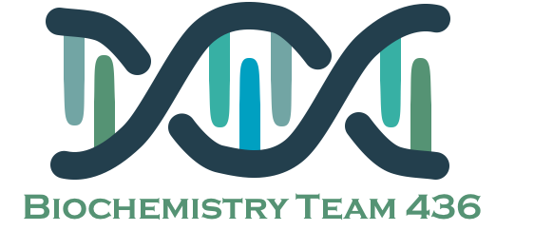
Effects of ROS and NO
Molecular & Vascular effects of ROS in ischemic stroke
The role of NO in the pathophysiology of cerebral ischemia
DNA damage
Lipid peroxidation of unsaturated fatty acids
Protein denaturation
Inactivation of enzymes
Cell signaling effects (e.g., release of Ca²⁺ from intracellular stores)
Cytoskeletal damage
Chemotaxis
Ischemia leads to abnormal production of Nitric oxide and this may be both beneficial and detrimental, depending upon “ when and where “ NO is released .
NO produced by endothelial NOS (eNOS) and causes improvement in vascular dilation and perfusion . In this situation its (beneficial) .
In contrast, NO production by neuronal NOS (nNOS) or by the inducible form of NOS (iNOS) has detrimental (harmful) effects .
Increased iNOS activity generally occurs in a delayed fashion after brain ischemia and trauma and is associated with inflammatory processes .
Molecular effects
Altered vascular tone and cerebral blood flow
Increased platelet aggregation
Increased endothelial cell permeability
Vascular effects

Slide 11
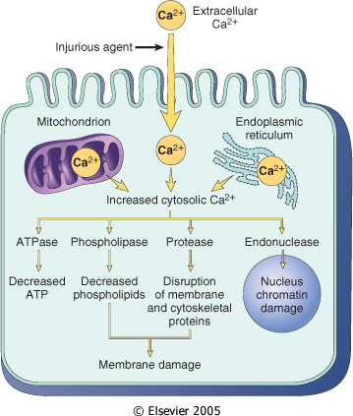
Metabolic stress ”The cell starts the anaerobic respiration that lead to acidosis”
Biochemical changes in The brain during ischemia
Sources & consequences of increased cytosolic Calcium in cell injury
Ischemia leads to interruption or severe reduction of blood flow, O2 & nutrients in cerebral arteries → energy depletion (depletion of ATP & creatine phosphate)
Energy depletion due to inhibition of “ ATP dependent ion pumps “ which effect membranes depolarization and Perturbance of transmembrane ion gradients .
Ca²⁺ Influx leads to activation of cellular proteases (Calpains) & lipases which further leads to breakdown of cerebral tissue
Na⁺ Influx
K⁺ efflux leading to K+-induced release of excitatory amino acids
Increased lactic acid in neurons leads to acidosis which promotes the pro-oxidant effect and increases the rate of conversion of O₂⁻ to H₂O₂ or to hydroxyperoxyl radical

Slide 12
Neurochemical response
The Blood tests in patients with brain ischemia or hemorrhage
Biochemical changes in The brain during ischemia
Complete blood count, including hemoglobin, hematocrit, white blood cell count, and platelet count
Prothrombin time, international normalized ratio (INR), and activated partial thromboplastin time
Thrombin time and/or ecarin clotting time if patient is known or suspected to be taking a direct thrombin inhibitor or a direct factor Xa inhibitor
Blood lipids, including total, high-density lipoprotein (HDL), and low-density lipoprotein (LDL) cholesterol, and triglycerides.
Cardiac enzymes and troponin
Following cerebral ischemia, extracellular levels of various neurotransmitters are increased
Glutamate “Main NT”
Glycine
GABA
Dopamine
Examples of Potential Biochemical Intervention in Cerebral Ischemia
Inhibitors of glutamate release.
Ca²⁺ channel blockers.
Nitric oxide synthase inhibitors & free radical inhibition.
Calpain inhibitors

Slide 13
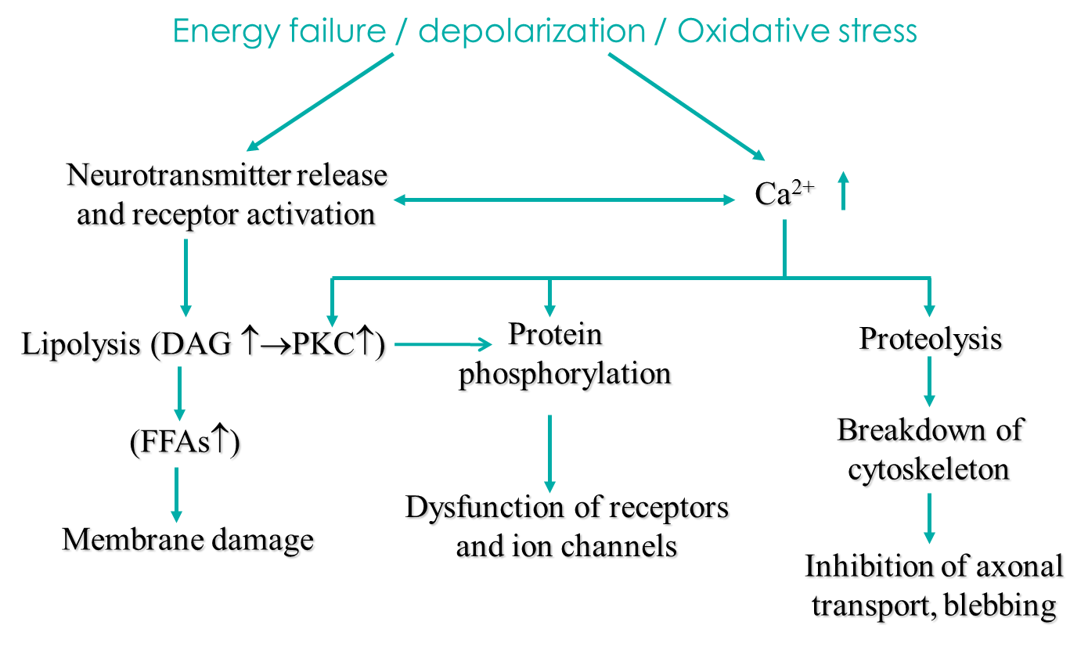
To summarize
Ischemic cascade
Consequences of brain ischemia
Lack of oxygen supply to ischemic neurones
ATP depletion
Malfunctioning of membrane ion system
Depolarization of neurons
Influx of calcium
Release of neurotransmitters, activation of proteases
Further depolarization of cells and calcium influx

Slide 14
Summary
The lecture talked about 3 main aspects:
1- Types of strokes and their risk factors: 3- The biochemical responses to Ischemic injury:
Stroke | Hemorrhagic | Ischemic
Types | 1- Intracerebral 2- Subarachnoid | 1- Thrombotic 2- Embolic
Risk Factors | Hypertension Smoking Illegal drug use
 | Blood thinning medications like Warfarin | Has much more risk factors, thus it occurs more commonly than the hemorrhagic type.
Oxidative stress | ROS & RNS have important functions in the nervous system. - When cells are exposed to amounts of ROS and RNS, and can’t fight them with antioxidants, oxidative stress occurs. - The brain is highly susceptible to ROS damage. - ROS has both molecular and cellular damaging effects. - NO has beneficial vascular effects but harmful neural effects.
Metabolic stress | - Ischemia eventually leads to energy depletion mainly due to inhibition of ATP dependent ion pumps which affects the cell membrane. - Influx: Ca²⁺, Na⁺ Outflux: K⁺ - Increased lactic acid ➤ acidosis ➤increases conversion of O₂⁻ to H₂O₂.
Neuro-chemical response | - Extracellular NTs are increased: Glutamate - Glycine - GABA - Dopamine - So as intervention we give inhibitors to Ca²⁺, Glutamate, NO, free radicals, and calpain.
Required Blood tests | Complete blood count Prothrombin time, INR, Activated partial thromboplastin time Thrombin time, Ecarin clotting time Blood lipids (HDL, LDL) - Cardiac enzymes and troponin
2- Cell death in ischemic injury:
Necrosis | Apoptosis
observed early after severe ischemic insults | In more mild insults and with longer survival periods
Involve calcium-induced calpain-mediated proteolysis of brain tissue, and Calpain includes many proteins; cytoskeletal, membranous, regulatory, and signaling.

Slide 15
Quiz
4) Which of the following is not an effect of ROS in an ischemic stroke ?
DNA damage
Decrease platelet aggregability
Increased endothelial permeability
Inactivation of enzymes
5) ROS & RNS are mainly generated by ?
Microglia and astrocytes
Oligodendrocytes
Schwann cells
Myelin sheath
1) Which of the following cell death mechanisms occurs with more mild insults and with longer survival periods ?
Necrosis
Phagocytosis
Apoptosis
None of them
2) Which of the following is not a risk factor for ischemic stroke ?
Recent child birth
Past history of blood clots
Warfarin usage
Heart disease
3) The enzyme that converts superoxide to hydrogen peroxide is ?
NADPH oxidase
Superoxide dismutase
Catalase
Glutathione peroxidase
Q : How can NO have beneficial and harmful effect ?
Q : Describe the ischemic cascade ?
Q: What are the vascular effects of ROS ?
1-B
2-C
3-B
4-B
5-A
Suggestions and recommendations

Slide 16
Qaiss almuhaideb
Haifa bin taleb
Shatha Algehib
Nourah Alshabib
Ameerah Nyazi

Slide 17
https://www.youtube.com/watch?v=lnYqZZgqxNs
Don’t forget to review the notes

