Slide 1
Biochemistry
Important
Extra Information
Doctors slides
Doctors notes
Alzheimer’s Disease
Editing file

Slide 2
By the end of this lecture, the students should be able to:
Define neurodegenerative disorders
Identify the clinical picture and diagnostic criteria of Alzheimer’s disease
Understand the different ways of processing of amyloid precursor protein leading to amyloid generation and accumulation
Differentiate between the neuritic plaques, neurofibrillary tangles and tau protein and their role in the pathogenesis of the disease
Understand the genetics of Alzheimer’s disease
Discuss ongoing research and therapeutic approach to treat these disorders

Slide 3
Mind map
Clinical Picture
MRI
Cortical Atrophy
Diagnosis
Intracellular
Neuroﬁbrillary Tangles
Alzheimer’s Disease
Microscopic (deﬁnitive)
Genetic Findings
Senile Plaques
Extracellular
Pathogenesis
Amyloid Angiopathy
Pathway
Treatment
Notes:
Mind map by 432 biochemistry team

Slide 4
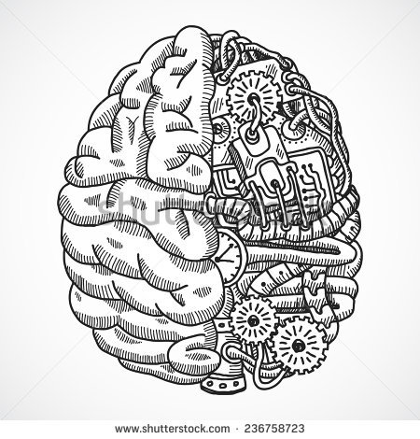
Neurodegenerative Diseases
Diseases of gray matter characterized principally by the progressive loss of neurons .
(so the neurons keep on dying and lead to symptoms)
The pattern of neuronal loss is selective affecting one or more groups of neurons leaving the others intact .
(depending upon what disease it is)
The diseases arise without any clear inciting event in patients without previous neurological deficits
A common theme is the development of protein aggregates that are resistant to normal cellular mechanisms of degradation
”they can not get cleared from the body because their structure changed and became modified”
The aggregated proteins are generally cytotoxic
Whenever the protein synthesis happens, proteins are folded and come to the functional states.
Sometimes it can produce misfolded proteins normally and they are going to be destructed by Ubiquitin machine.
If the body can not take care of these misfolded proteins it will make clusters (it wont be degraded) which are resistant to cellular machinery and this will lead to the inflammation which will cause the death of neurons.
helpful video

Slide 5
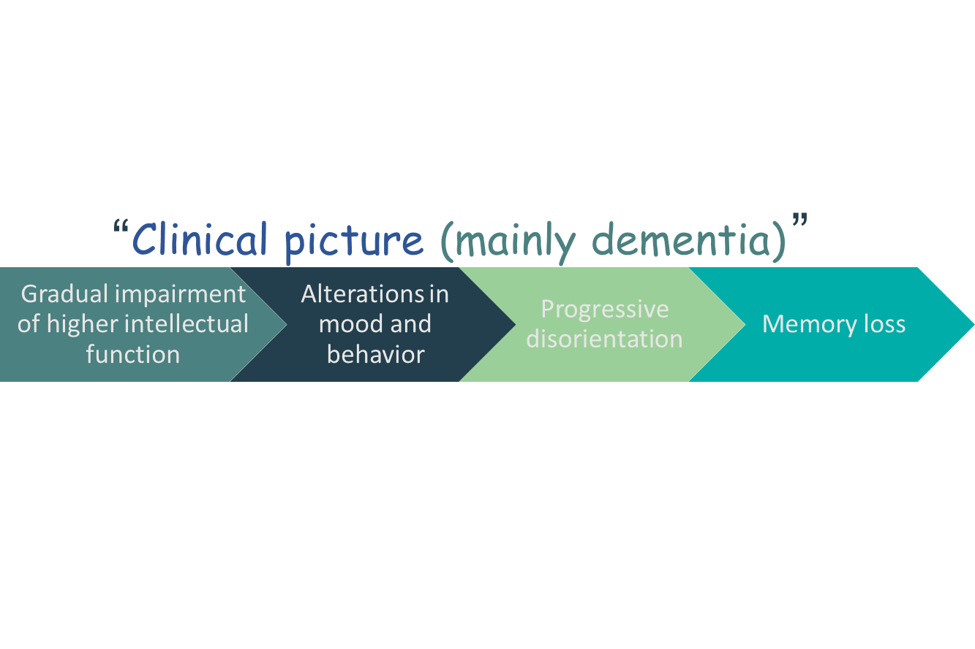
Alzheimer’s Disease
A degenerative disease with the prominent involvement of the cerebral cortex
Its principal clinical manifestation is dementia
Dementia is the progressive loss of cognitive function independent of the state of attention (the person is still attentive) (dementia is the main characteristic)
Patients rarely become symptomatic before 50 years of age but the incidence of disease rises with age .
(but dementia at any age is abnormal)
In 5-10 years, the patient becomes profoundly disabled, mute and immobile
Most cases are sporadic “ no genetic association “
At least 5-10% are familial
Diagnosis
يكون واعي بس ما فيه إدراك
Combination of clinical assessment and radiologic methods “MRI”
Pathologic examination of brain tissue is necessary for definitive diagnosis
Major microscopic abnormalities include: neuritic plaques (senile plaques) , neurofibrillary tangles and amyloid angiopathy

Slide 6
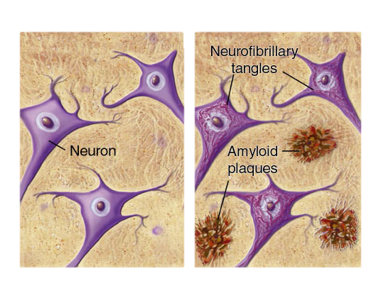
Microscopic findings : 1. Neuritic Plaques
Normal
Alzheimer’s
Spherical with 20-200 mm in diameter
Contain paired helical filaments as well as synaptic vesicles and abnormal mitochondria
The amyloid core contains several abnormal proteins
The dominant component of the plaque core is Aβ, a peptide derived from a larger molecule, amyloid precursor protein (APP)
“that is cleaved to produce AB –amyloid beta peptide- , this type of protein cannot be degraded by the body so it starts aggregating”
The two dominant species of Aβ, called Aβ40 and Aβ42 share an N-terminus and differ in length by two amino acids.
The brain normally has β amyloid protein which is susceptible to be cleared with normal enzymatic mechanisms but with dysregulation of this protein it becomes resistant to clearance hence it aggregates .
“ α1-Antichymotrypsin is a protease inhibitor, proteases are present in cells and they take care of these aggregates. So these plagues produce a1-antichymotrypsin to inhibit theses proteases to aggregate “
(when cytokines aggregations are formed they lead to pro-inflammatory and inflammatory processes)
Other less abundant proteins in the plaque:
Components of the complement cascade
Pro-inflammatory cytokines .
α1-Antichymotrypsin .
Apolipoproteins
(specifically Apolipoproteins E)
They are extracellular and are more important than neurofibrillary tangles

Slide 7
2. Neurofibrillary Tangles
3. Amyloid Angiopathy
What is it ?
What is it ?
Bundles of filaments in the cytoplasm of neurons that displace or encircle the nucleus
Amyloid proteins build up on the walls of the arteries in the brain
The condition increases the risk of hemorrhagic, stroke and dementia
An almost invariable accompaniment of Alzheimer’s disease but not specific for Alzheimer’s . “also in Parkinson's”
These filaments mainly contain:
Hyperphosphorylated forms of the tau protein
A protein that enhances microtubules assembly
(provides support, if it’s hyperphosphrylated it cannot bind to microtubules any more, instead, they bind together and form neurofibrillary tangles (intracellular) when the start tangling they form nodes together.)

Slide 8
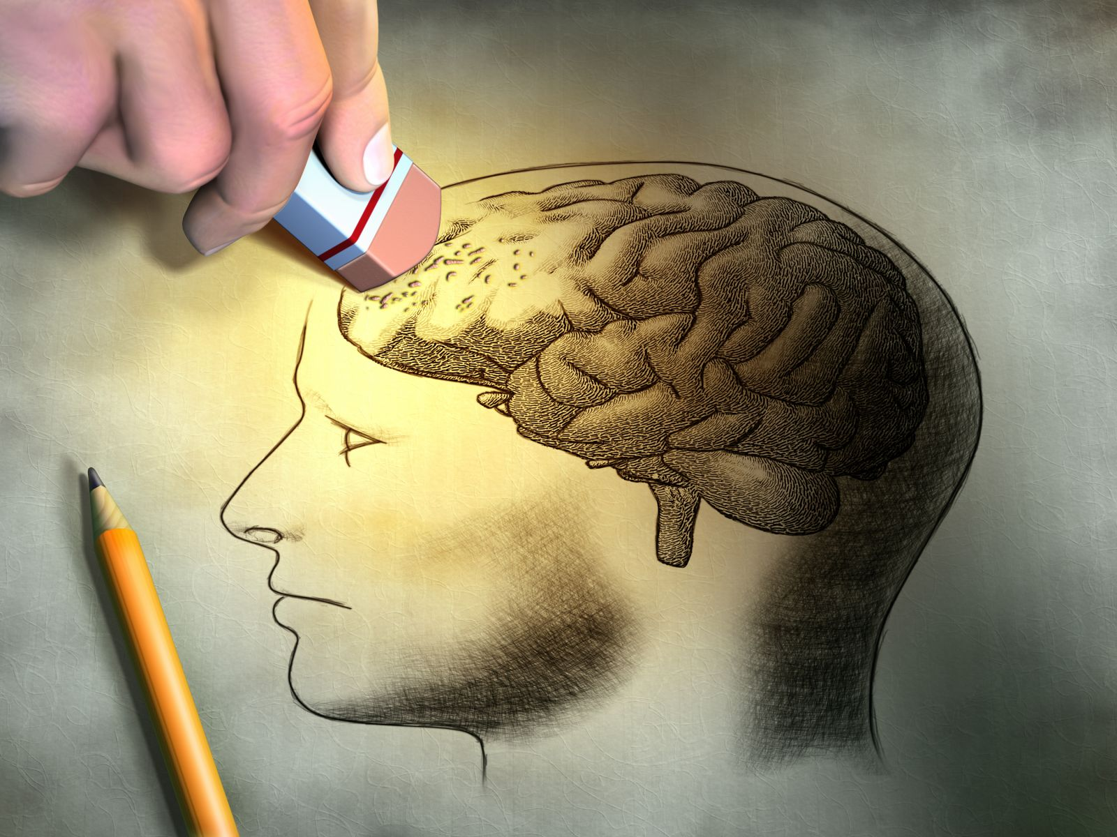
Pathogenesis of Alzheimer’s
Still being intensively studied
Strong correlation of number of neurofibrillary tangles with degree of dementia than neuritic plaques
Loss of synapses best correlates with severity of dementia
Include : Biochemical markers correlated to degree of dementia
Loss of choline acetyltransferase
Synaptophysin immunoreactivity
Amyloid burden
Extra
Neuritic plaques “that appears first” can not make the disease symptomatic there must be tangles in order to have symptoms
Loss of choline acetyltransferase is involved in synthesis in Ach, loss of it correlates with dementia)
Synaptophysin is one of the proteins of synaptic vesicles –p38- so when we have toxicity this leads to loss of synapses, so there is loss of synaptophysin in presynaptic vesicles (loss of immuno-reactivity), the way we test it is with the help of immuno-assay which is adding antibodies to synaptophysin and see if it’s positive (synaptophysin immuno-reactive) or negative)
Burden : overload because of aggregation

Slide 9
Aβ Peptides
What is it ?
APP is a protein of uncertain cellular function, It is synthesized with a single transmembrane domain and expressed on the cell surface
Aβ Peptides Derived from the processing of APP
Aβ is a critical molecule in the pathogenesis of Alzheimer’s disease
Aβ is produced inside the cells and have to go out to produce aggregates, and one of the hormones that helps in this movement is insulin, so people with diabetes are at more risk of getting Alzheimer's disease
Why?
The Aβ peptide forms β-pleated sheets and aggregates
(so beta peptides will be in alpha helical structure)
Resistant to degradation
Elicits a response from astrocytes and microglia
Can be directly neurotoxic
(astrocytes leads to inflammatory process, and microglia leads to formation of ROS – response to the Ab aggregates is coming mainly from microglia and astrocytes and are found to be accumulated in patients with Alzheimer's disease)

Slide 10
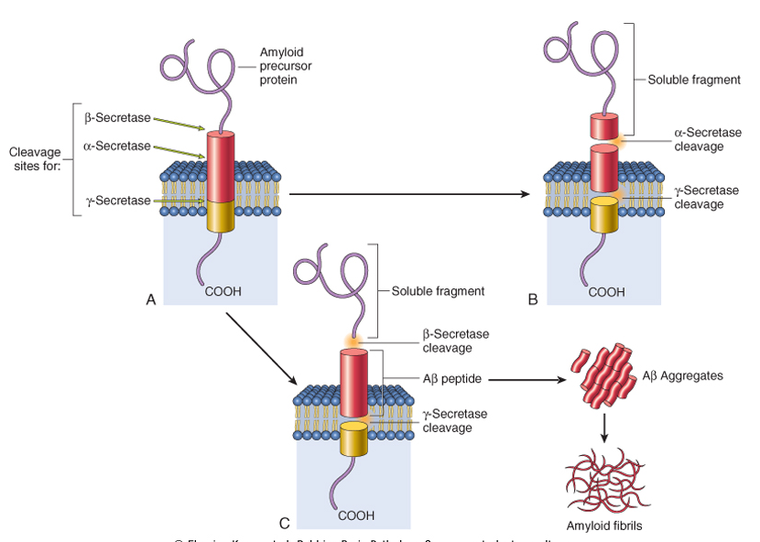
Two Pathways For APP Processing
1
When APP is cleaved by α-secretase subsequent cleavage by γ-secretase doesn’t yield Aβ ( normal )
This figure shows how it is a transmembrane and the cleavage process.
2
cleavage by β-secretase followed by γ-secretase results in production of Aβ
- Aβ can then aggregate and form fibrils
The Aβ domain extends from the extracellular side of protein into the transmembrane domain
APP has potential cleavage sites for three distinct enzymes:
(α, β, and γ-secretase)

Slide 11
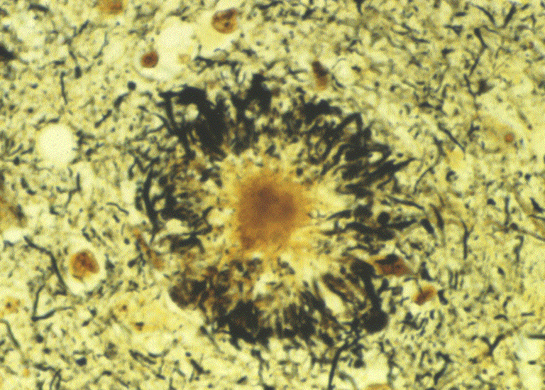
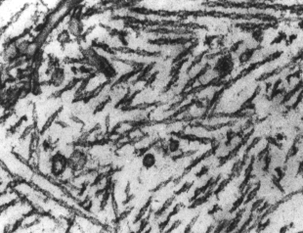
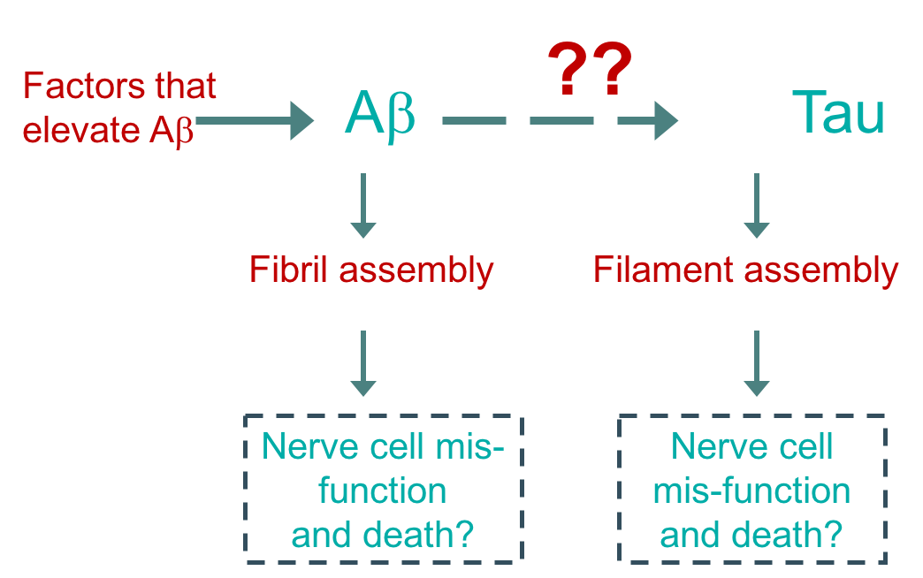
Accumulation of Aβ protein
The Tau Protein
Accumulation of Aβ protein affects neurons and neuronal function:
Small aggregates of Aβ alters neurotransmission
Aggregates can be toxic to neurons and synaptic endings
Larger deposits (plaques) also cause neuronal death
Elicit a local inflammatory response leading to further cell injury
Presence of Aβ causes hyper-phosphorylation of tau protein in neurons
This leads to redistribution and aggregation of tau protein into tangles in neurons (from axon into dendrites and cell body)
The process results in neuronal dysfunction and cell death
(these cannot bind to microtubules so instead they bind together and start forming nodes which makes filaments)
Aβ and Tau may both contribute to the pathogenesis of Alzheimer’s Disease

Slide 12
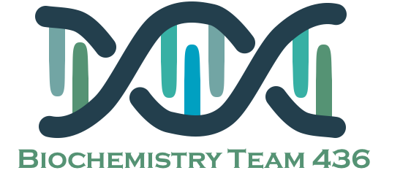
Genetics of Alzheimer’s
Mutations in APP gene
Mutations in γ-secretase (presenilin-1 or presenilin-2)
Both lead to early onset of familial Alzheimer’s disease due to high rate of Aβ accumulation
Alzheimer’s occurs in most patients with Down’s syndrome (trisomy 21) beyond 45 years of age
The gene encoding APP is located in chromosome 21
Due to APP gene dosage effects
Genes associated with typical, sporadic Alzheimer’s disease are being identified
not all are know but they found APO-E gene, which is present in mainly LDL, HDL, they can act as receptor as cholesterol which is abundantly present in myelin sheath (20% of membrane cholesterol is found in the brain, 80% of it is present in myelin sheath
This may provide new clues to pathogenesis of the disease
Chromosome | Gene | Consequences
21 “down syndrome patients are more susceptible“ | Amyloid Precursor Protein (APP) | Early onset FAD Increased Aβ production
14 | Presenilin-1 (PS1) gamma- secretase | Early onset FAD Increased Aβ production
1 | Presenilin-2 (PS2) gamma- secretase | Early onset FAD Increased Aβ production
19 | Apolipoprotein E (ApoE) (1,2,3,4 – 2 is protective but 1 and 4 are risk factors) | Increased risk for development of AD Decreased age at onset of AD

Slide 13
Treatment of Alzheimer
Pro-inflammatory responses may be countered through polyphenol(flavonoids present in green tea Supplementation of these natural compounds may provide a new therapeutic line of approach to this brain disorder.
Stem cells offer:
Cellular replacement and/or provide environmental enrichment to attenuate neurodegeneration.
Neurotrophic support to remaining cells or prevent the production or accumulation of toxic factors that harm neurons (reducing toxicity)
Continued Research on AD
Currently, no effective treatment for AD
regulating neurotransmitter activity e.g., Enhancing cholinergic function improves AD
Epidemiological studies showed that treatment with NSAIDs decreases the risk for developing AD. Unfortunately, clinical trials of NSAIDs in AD patients have not been very fruitful.
Cellular therapies using stem cells offer great promise for the treatment of AD
The small aggregates of Aβ and larger fibrils are directly neurotoxic
They can elicit oxidative damage and alterations in calcium homeostasis
How Aβ is correlated to neurodegeneration in AD? How it is linked to tangles and hyperphosphorylation of tau protein?
All remain open questions

Slide 14
summary
Alzheimer’s Disease
prominent involvement of the cerebral cortex , Its principal clinical manifestation is dementia , Most cases are sporadic the patient : become symptomatic before 50 years of age but the incidence of disease rises with age . becomes profoundly disabled, mute and immobile In 5-10 years, At least 5-10% are familial
Diagnosis | Combination of clinical assessment and radiologic methods microscopic abnormalities include: neuritic plaques, neurofibrillary tangles and amyloid angiopathy for definitive diagnosis : Pathologic examination of brain tissue
Treatment of AD | Currently, no effective treatment for AD regulating neurotransmitter activity clinical trials of NSAIDs in AD patients have not been very fruitful. Cellular therapies using stem cells offer great promise for the treatment of AD: Cellular replacement and/or provide environmental enrichment to attenuate neurodegeneration. Neurotrophic support to remaining cells or prevent the production or accumulation of toxic factors that harm neurons. Pro-inflammatory responses may be countered through polyphenol(flavonoids). Supplementation of these natural compounds may provide a new therapeutic line of approach to this brain disorder.

Slide 15
summary
Alzheimer’s Disease
Pathogenesis | Strong correlation of number of neurofibrillary tangles with degree of dementia than neuritic plaques Loss of synapses best correlates with severity of dementia Biochemical markers correlated to degree of dementia include: Loss of choline acetyltransferase , Synaptophysin immunoreactivity, Amyloid burden
 | Neuritic Plaques | Spherical with 20-200 mm in diameter. The dominant component of the plaque core is Aβ, a peptide derived from a larger molecule, amyloid precursor protein (APP) is a protein of uncertain cellular function, It is synthesized with a single transmembrane domain and expressed on the cell surface Aβ is a critical molecule in the pathogenesis of Alzheimer’s disease The two dominant species of Aβ, called Aβ40 and Aβ42 share an N-terminus and differ in length by two amino acids. Other less abundant proteins in the plaque: Components of the complement cascade ,Pro-inflammatory cytokines , α1-Antichymotrypsin, Apolipoproteins
 | Neurofibrillary Tangles | It is Bundles of filaments in the cytoplasm of neurons that displace or encircle the nucleus. Contain: Hyperphosphorylated forms of the tau protein , A protein that enhances microtubule assembly
 | Amyloid Angiopathy | It is build up on the walls of the arteries in the brain The condition increases the risk of hemorrhagic, stroke and dementia An almost invariable accompaniment of Alzheimer’s disease but not specific for Alzheimer’s

Slide 16
Quiz
1) Which ONE of the following is the main component of neuritic plaques ?
amyloid precursor protein
Tau proteins
Aβ peptides
All of the above
2) Which ONE of the following biochemical markers is not correlated with the degree of dementia in Alzheimer patients ?
Choline acetyltransferase
Synaptophysin
Amyloid burden
Troponin I
3) Alzheimer’s Disease is diagnosed with ?
Clinical assessment
Radiologic methods
Pathologic examination of brain tissue
All of the above
4) Neurofibrillary tangle has a protein that enhances microtubules assembly ?
True
False
Q : What are the main genes affected in Alzheimer ?
Q : Describe the pathway of Aβ peptides aggregation ?
1- C
2- D
3- D
4- A
Suggestions and recommendations

Slide 17
Mohannad alzahrani
Heba alnasser
Haneen Alsubki
Muneerah alzayed

Slide 18
https://www.youtube.com/watch?v=v5gdH_Hydes
Don’t forget to review the notes

