Slide 1
Biochemistry
Important
Extra Information
Doctors slides
Doctors notes
We can’t direct the wind, but we can adjust the sails
Cerebrospinal fluid
Editing file

Slide 2
By the end of this lecture, the students should be able to:
To identify the CSF functions, formation and circulation.
To recognize the method of CSF sampling, and the procedure for specimen collection, and processing
To identify the indications and contraindications of lumbar puncture and laboratory investigation of CSF
To recognize and explain the normal and abnormal findings of physical and biochemical examination of CSF (with special emphasis on the glucose, protein, electrolytes and cellular content of CSF)
To interpret CSF electrophoresis pattern
To define expressions describing abnormal locations of CSF as otorrhea and rhinorrhea
Key principles:
CSF overview Functions, circulation … etc.
CSF investigations and specimen collection
Types and components of CSF examination
Electrophoresis
Abnormal pathological conditions effect

Slide 3
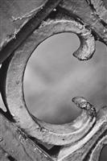
CSF Definition & Functions:
CSF definition :
The liquid surrounding the brain and spinal cord, that flows in subarachnoid space (the area between arachnoid & pia matter)
Main Functions:
Provides a controlled chemical environment → nutrient supply & waste removal
Physical support & protection
CSF also has a certain transportation functions

Slide 4
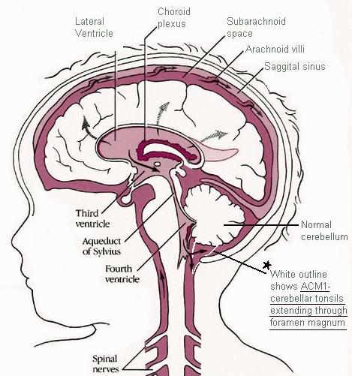
CSF Formation & Circulation:
CSF is formed at the choroid plexuses & by the cells lining the ventricles.
Normal blood brain barrier is important for the normal chemistry results of CSF
Mechanism of formation
Selective ultrafiltration of plasma
Active secretion by epithelial membranes
Mechanism of excretion (absorption)
From CSF to the blood
Excretion volume = production volume → constant CSF volume
Absorption occurs at the arachnoid villi protruding through the dura to the venous sinuses of the brain→ bloodstream
Rate of formation :
500 ml/day
The rule of equilibrium is production = excretion, but in CSF our absorption is instead excretion

Slide 5
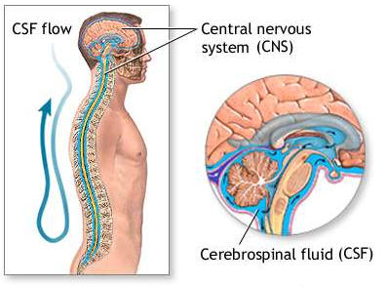
CSF Formation & Circulation:
CSF Circulation:

Slide 6
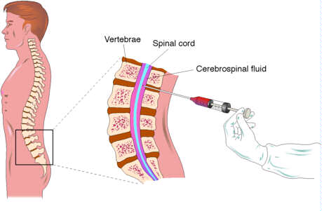
CSF Formation & Circulation:
Method of CSF Sampling:
The person taking the CSF sample should be professional to prevent traumatic tap (rupturing the blood vessels), because CSF is considered as a precious sample since its difficult to obtain.
We always start with the non invasive procedures like taking blood and urine specimens, and then if we needed CSF we may take it.
To differentiate between traumatic tap and hemorrhage:
1\ the blood is bright. 2\ the more CSF we withdrawal the lighter the blood becomes because it’s a new rupture made to the blood vessel from the needle.
Sample is taken by a needle from between the lumbar vertebras “L3-L4”

Slide 7
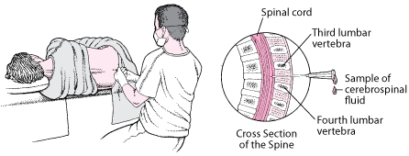
CSF Specimen Collection:
Obtained by lumbar puncture (At the interspace L3-4, or lower)
Using aseptic technique
“ Because CSF has low defense against microbes ”
CSF is separated into 2 aliquots:
for chemistry & serology
for microbiology “ and hematology “
Immediate analysis
It’s a precious sample: Preserve any remaining sample
Extra
Extra

Slide 8
CSF investigation
Indications for laboratory investigation of CSF:
CNS infection
Demyelinating diseases
Contraindications for performing lumbar puncture:
Bleeding diathesis
Increased intracranial pressure
CNS Malignancy
Infection at site of needle insertion
Hemorrhage
If the patient has a skin infection at the normal obtaining sites of lumbar puncture what to do ?
If the condition is so serious and can not wait then an expert should perform the LP even at the levels of spinal cord “ above L3 “ and it has a specific technique ..
Otherwise they have to wait until the infection is treated “
e.g. MS

Slide 9
Examination of CSF
1- Physical examination
If CSF is cloudy (turbid)
→ perform microscopic examination:
Cloudy appearance is usually due to leukocytes
And may be due to micro-organisms
Normal CSF:
Free of blood
Free of clots
Clear
Colorless

Slide 10
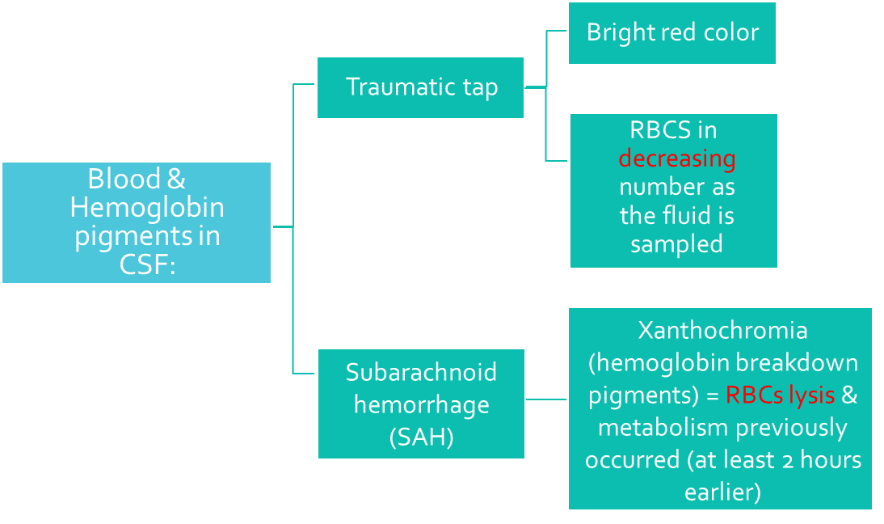
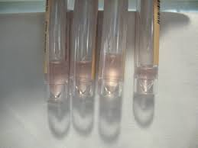
Blood & Hemoglobin pigments in CSF:
“ IMPORTANT SLIDE ”
Extra
It’s important to differentiate between the traumatic and SAH in the blood.
When would Xanthochromia indicate hemorrhage?
If you exclude:
Xantho :تغير Chromia : لون
Hemoglobin has heme (which has a ring that would break down giving us the changing color from red to green) -> like what happens in bruising.
Also its not bright, and is color changing
Prior traumatic tap
Hyperbilirubinemia (bilirubin > 20 mg/dL)
A "traumatic tap" occurs if the needle inadvertently has entered an epidural vein during insertion. A yellowish tinge to the CSF fluid is called xanthochromia.
Xanthochromia is usually caused by red blood cell degeneration in the CSF as would be seen in subarachnoid hemorrhage (SAH).

Slide 11
Examination of CSF
Tests of interest
Protein
Total
Specific : 1) Albumin
2) Immunoglobulin
3) Others (e.g. myelin basic protein; MBP)
Glucose
Lactate
2- Biochemical analysis of CSF:
Glucose and specific protein tests are the most reliable diagnostically &
accessible analytically
Specimens are sent to the microbiology lab to differentiate whether its bacterial\viral meningitis and glucose\protein are measured in the biochemistry lab. → the case will be half micro half biochemistry in the final
Lactate not tested any more

Slide 12
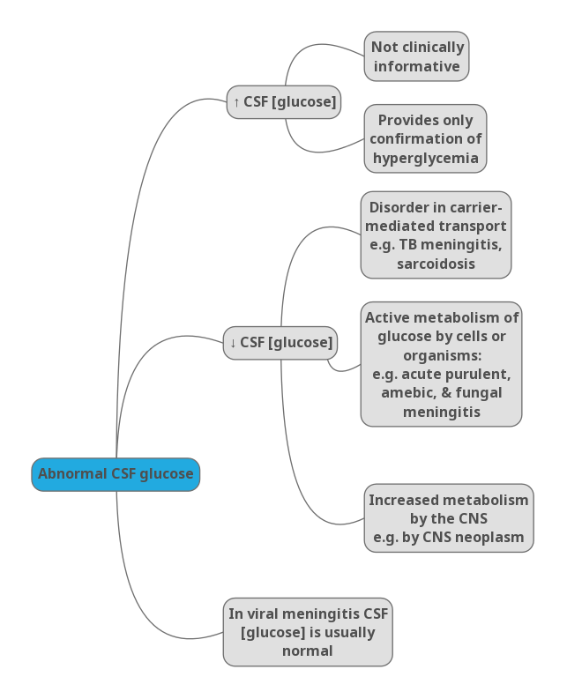
CSF Glucose
Abnormal CSF glucose “IMPORTANT”
Glucose enters CSF via facilitative transporter (GLUT) “ Sodium independent ”
CSF [glucose] is ~ 2/3 that of plasma
50 - 80 mg/dl
A plasma sample must be obtained ~ 2-4 hours before CSF sample
In hypoglycemia: [CSF glucose] may be very low
In hyperglycemia: [CSF glucose] is raised.
Measure CSF [Glucose]:
Immediately
Or preserve the specimen with and antiglycolytic
e.g. fluoride ion
Microorganisms eat the glucose and secrete proteins.
Usually they call it a grey tap tube and it has fluoride that would inhibit glycolysis. --> this info is just for your information.
A question can be asked: CSF in glucose is more or less than plasma? It is 2/3 glucose of plasma because it enters CSF via facilitative transporter.

Slide 13
CSF proteins
Abnormal CSF proteins
Proteins, mostly albumin are found in the CSF (0.15-0.45 g/L)
Source of CSF proteins:
80% from plasma by ultrafiltration
20% from intrathecal synthesis
We must know how to compare for example if the patient has nephrotic syndrome then his protein levels ↓ .
“ Albumin which is small in size “
“ Immunoglobulin protein which is quite big “
First we exclude traumatic tap. It will have high protein
CSF Albumin
Albumin is produced solely in the liver
Its presence in CSF must occur through BBB
If albumin is normal and IGP is high -> local synthesis disease -> MS (demyelinating disease)
SSPE is less common, usually tests in lab are made for MS

Slide 14
CSF proteins
CSF Immunoglobulin
What to do if ↑ CSF [protein] was detected ?
Glucose enters CSF via facilitative transporter CSF IgG can arise:
from plasma cells within CSF
from the blood through BBB
↑ [IgG] and normal [Alb] of CSF suggests local production of IgG, e.g.,
Multiple sclerosis (MS)
Subacute sclerosing panencephalitis (SSPE)
Perform electrophoretic separation
If multiple banding (oligo-clonal bands) of the γ-globulin is detected, the following differential diagnosis is suspected:
MS
SSPE
Inflammatory diseases

Slide 15
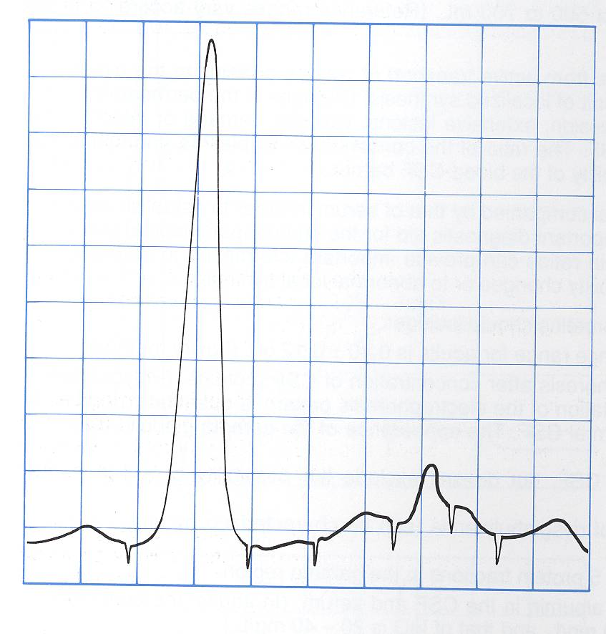
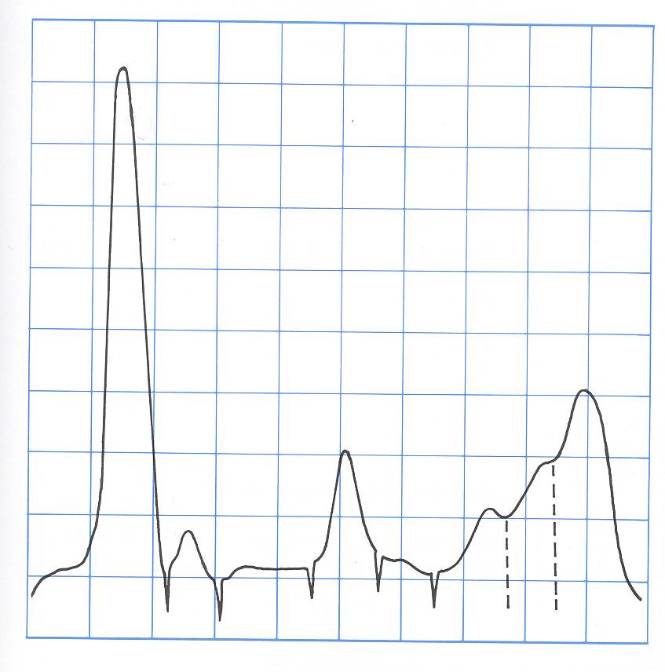
CSF electrophoresis
“ IMPORTANT SLIDE ”
Normal pattern
Oligo-clonal banding
“MS or SSPE”
Electrophoresis is a techniques used in labs to separate proteins or immunoglobulins in a specimen (urine – blood – CSF).
Oligo clonal bands are for diagnosing MS
Oligo clonal means multiple bands
We don’t have to know the bands or explain the electrophoresis. We just need to know that oligo clonal gamma means MS and in the normal is a one big spike of monoclonal albumin band and small bands.
albumin
albumin
Oligoclonal-γ
β1
β1
prealbumin
α2
β2
γ
α1
prealbumin
α1
α2
β2

Slide 16
Other Chemical Components of CSF
Normal composition of CSF
Clear ,Colorless | Appearance
<5/mm3 | Lymphocytes
Nil | Polymorphs
7.4 | pH
100 - 150 ml | Total Volume
450 - 500 ml | Daily Secretion
1.006 - 1.007 | Specific Gravity
0.15 – 0.45 g/L | Protein
50 - 80 mg/dL (2.8-4.2 mmol/L) (>50% plasma level) | Glucose
115 - 130 mmol /L | Chloride
1.0 - 1.40 mmol/L | Calcium
0.4 - 0.7 mmol/L | Phosphorus
1.2 - 1.5 mmol/L | Magnesium
2.6 - 3.0 mmol/L | Potassium
CSF [Calcium], [Potassium] & [Phosphates] are lower than their levels in the blood
CSF [Chloride] & [Magnesium] are higher than their levels in the blood
Abnormal CSF [Chloride]
marked reduction in acute bacterial meningitis
slight reduction in viral meningitis & brain tumors
In TB meningitis chloride and glucose are LOW and protein HIGH.
Don’t memorize numbers normal ranges are given in test!

Slide 17
Abnormal findings of CSF in some pathological conditions
Condition |  |  | Parameter
Viral Meningitis | Tuberculous Meningitis | Bacterial Meningitis (pyogenic)
Usually clear | Often fibrin web | Often turbid | Appearance
Mononuclear (lymphocytes) | Mononuclear (lymphocytes) | Polymorphs | Predominant cell
50 - 1000 | 10 - 1000 | 90 - 1000+ | Cell count/mm3
negative smear or culture | Often none in smear | +ve smear & culture | Bacteria/virus
<1 (Normal) | 1-5 (↑ ↑) | > 1.5 (↑ ↑) | Protein (0.15 - 0.45 g/L)
>1/2 plasma (Normal or slightly ↓) | <1/2 plasma (↓ ↓) | <1/2 plasma (↓ ↓) | Glucose (2.8 - 4.2 mmol/L)
Normal or ↓ | ↓ ↓ | ↓ ↓ | Chlorides (115 - 130 mmol/L)

Slide 18
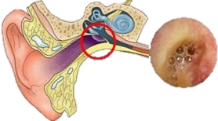
Otorrhea & Rhinorrhea
Otorrhea : leakage of CSF from the ear
Rhinorrhea : leakage of CSF into the nose
Extra
Extra
In Otorrhea blood tests are outdated => MRI is done instead because its faster.
Otorrhea happens to people who had a trauma.

Slide 19
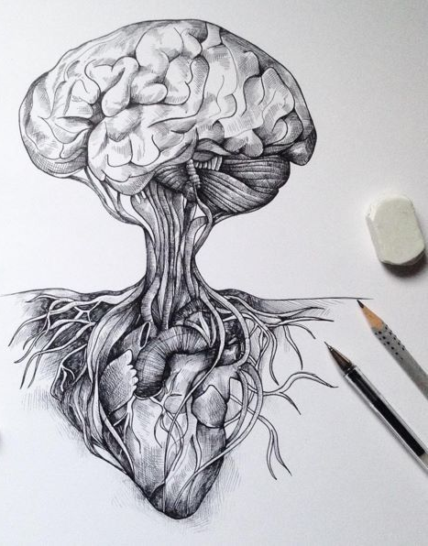
Take home messages
CSF is formed in the choroid plexus
It is essential for the physical protection of the CNS
The physical & chemical analysis of CSF is essential for diagnosis of certain diseases
Good luck doctors

Slide 20
Summary
Analysis of CSF
Physical
Clear & colorless
Chemical
Glucose
CSF glu is 2/3 of plasma
from plasma By “GLUT “
Protein
Albumin & IgG
↑:
Hyperglycemia
↓:
-disorders in carrier mediated trans
( meningeal TB & sarcoidosis)
-active metabolism by microorganism :
cute purulent, amebic, & fungal meningitis
-increased metabolism by cns :
Neoplasm
Total protein↑:
-Traumatic tap
-↑ permeability :
Bacterial &fungal infection
Cerebral hemorrhage
-↑production by CNS:
MS& SSPE
-Obstruction :
Tumors& abcess
If IgG is high and albumin in normal :
MS& SPPE
*IF oligoclonal bands of Y-globin (MS)
Function of the CSF (Normal blood brain barrier is important for the normal chemistry results of CSF) | 1-Physical support& protection 2-controlled chemical environment .
Formed by | Choroid plexuses &ventricle cells (500 ML/day)
Mechanism of formation | 1-Selective ultrafiltration of plasma 2-Active secretion by epithelial membranes
Excretion (absorption) | arachnoid villi→ venous sinuses →blood stream Excretion volume = production volume
Collection of specimen by | Lumber puncture (L3-L4)
indications | 1- CNS infection 2-hemorrhage 3-CNS malignance 4-demylination
Contraindications | 1-Bleeding diathesis 2. ↑ intracranial pressure 3. Infection at site of needle

Slide 21
Quiz
1) In which of the following situations the lumbar puncture is contraindicated ?
CNS infection
Multiple sclerosis
Elevated intracranial pressure
CNS hemorrhage
2) The appearance of CSF in bacterial meningitis is ?
Turbid
Fibrin web
Clear
None of the above
3) Xanthochromia indicates which of the following ?
Subacute sclerosing panencephalitis (SSPE)
Sarcoidosis
Subarachnoid hemorrhage
Hyperglycemia
4) What is the situation of CSF glucose level if the patient has bacterial meningitis ?
Elevated
Decreased
Depends on the type of the bacteria
Normal
Q : When would Xanthochromia indicate hemorrhage ?
Q : What is the normal range of CSF proteins ?
1- C
2- A
3- C
4- B
Suggestions and recommendations

Slide 22
Zaina alkaff
Haifa alwael

Slide 23
https://www.youtube.com/watch?v=sO1z6Ns3pBg
Don’t forget to review the notes

