Slide 1
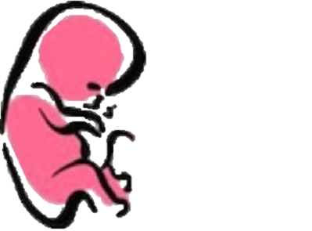
Development of cerebral hemisphere and cerebellum
﴿ إِنَّا خَلَقْنَا الإنسان مِنْ نُطْفَةٍ أَمْشَاجٍ نَبْتَلِيهِ فَجَعَلْنَاهُ سَمِيعًا بَصِيرًا ﴾ [الإنسان: 2].
Embryology
436
Important
Dr. notes Explanation
M E D I C I N E
KING SAUD UNIVERSITY
- We recommend you to study anatomy of cerebrum and cerebellum

Slide 2
O B J E C T I V E
Describe the formation of the neural tube.
List the 3 brain vesicles and their derivatives.
Describe the brain flexures.
Describe briefly the development of the cerebrum.
Describe briefly the development of the cerebellum.
Enumerate some congenital anomalies in development of CNS.

Slide 3
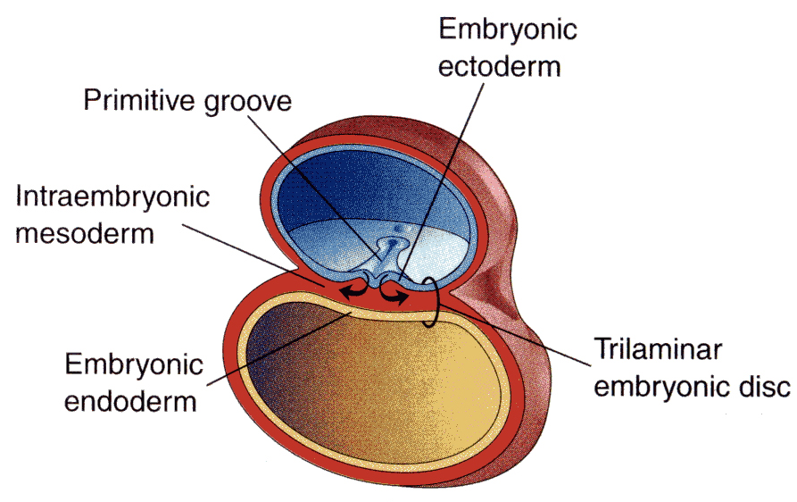
Development of Cerebrum And Cerebellum
Remember..
By the beginning of the 3rd week(15days) of development, three germ cell layers become established
The Three Germ Layers:
1- Ectoderm 2-Mesoderm 3-Endoderm
(outer) (middle) (inner)
- Early devolpment
During the middle of the 3rd week(16-17 days)the dorsal midline ectoderm undergoes thickening to form the neural plate (neuroectoderm).
The 2 margins of the plate elevate, forming neural folds
a longitudinal, midline depression, called the neural groove is formed.
The 2 neural folds approximate then fuse together, thus sealing the neural groove and
creating the neural tube. (complete close)
- Formation of neural tube is completed by the middle of 4th week.
ectoderm تكون النيورال تيوب من خلال 3 مراحل
أول شيء خلايا الاكتوديرم(من جهة الدورسال ميدلاين) تتكثف وتكون neural plate
بعدين تبدأ ترتفع طبقة الخلايا من الجهتين (الاطراف) وتصير كأنها زبدية (صحن عميق)وتكون neural groove
آخر الشيء الجهتين المرتفعة تكون neural folds وتلتحم سوا وتكون ال neural tube
.

Slide 4
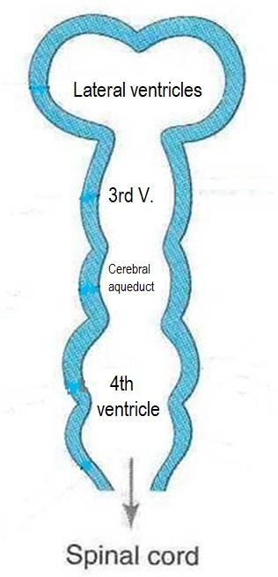
Neural Tube Development
Recall: Brain develops from cranial 1/3 of neural tube.
- يعني كل المراحل الجاية اللي حتصير في النيورال تيوب رح تكون في الكرينال بارت
نقسم المراحل الجاية حلتين (مرحلة أي و مرحلة بي):-
(A)-Three- primary brain vesicles stage (end of 4th week) (28days)
Neural tube upper end dilates and shows 3 vesicles
This 3 vesicles are: (from up to down)
1- prosencephalon 2- mesencephalon* 3-Rhombencephalon
(forebrain) (midbrain) (hindbrain)
(B)-five secondary brain vesicles stage (5th week)
Prosencephalon divides into: (two lateral parts and the other part in the middle between them)
1-telencephalon it is two lateral
2-diencephalon
Rhombencephalon divides into:
1-metencephalon 2- myelencephalon
(تكملة انقسامات ال برايمري فينتركلز)
(وحدة باليمين والثانيه باليسار(
)تكون بالوسط بين الجزئين من التيلنس سيفلون)
Mesencephalon -*نلاحظ ان
هي الوحيدة الي ما انقسمت
Cranial 1/3 of neural tube
Prosencephalon (forebrain)
telencephalon
(cerebrum)
2 lateral parts
diencephalon
thalamus
Mesencephalon (midbrain)
midbrain
زي ماعرفنا انها مارح تنقسم زي باقي الاجزاء
metencephalon
(cerebellum+pons)
Rhombencephalon
(hindbrain)
A
myelencephalon
B
(medulla)
don’t confuse : the blue area around the cavities is the one responsible of formation of grey and white matter.(Cavities will latterly form the ventricles of the brain)

Slide 5
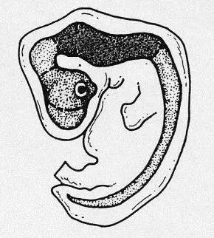
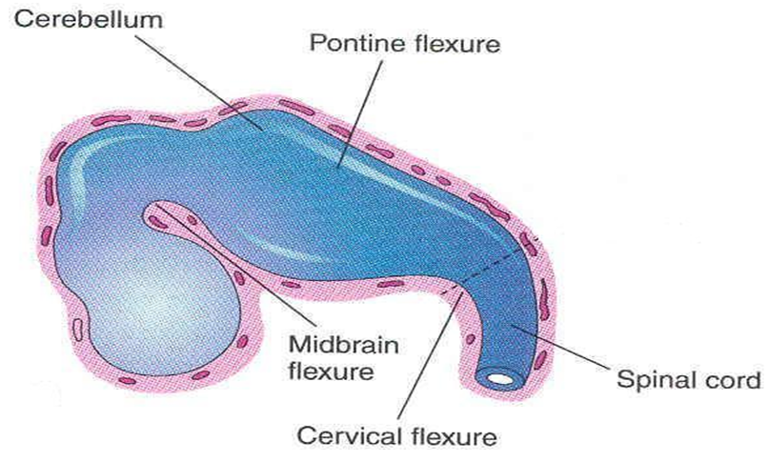
Brain Flexures
- By the 4 week, the neural tube grows rapidly and faster than cranial cavity. (This lead to form brain flexures)
(هذي الانثناءات تزود مساحة سطح البرين
-There are 3 brain flexures) : انثناءات
1- Cervical flexure (ventral) 2- Midbrain flexure (ventral) 3- Pontine flexure (dorsal flexure)
- The neural tube grows rapidly and bends ventrally, producing two flexures:
1-Cervical flexure: Between the hind brain and the spinal cord.
2- Midbrain flexure: between the prosencephalon and the mesencephalon (midbrain).
عندي هذول ال 2 فليكشرز يتكونوا اول شي(فينترال) وبعدهم يتكون اخر واحد(دورسال ))
3- Pontine flexure (dorsal flexure): appears later in the hindbrain,
in the opposite direction, thinning of the roof of the hindbrain.
.
هذا معنى ان البونتابن فليكشر يسوي
Thinning of the roof

Slide 6
Derivatives of Brain Vesicles
*This slide is very impotant ☺*
- Its important to know the origin of each derivative
Primary Brain Vesicles | Secondary Brain Vesicles | Derivates In Mature Brain
Prosencephalon (forebrain) | 1-Diencephalon- (median part) | thalamus
 | 2-Two telencephalon (lateral part) | Cerebral hemisphere
Mesencephalon (midbrain) | 1-mesencephalon | midbrain
Rhombencephalon (hindbrain) | 1-metencephalon | Pons (anterior part) Cerebellum (posterior part)
 | 2- myelencephalon | Medulla ablongata

Slide 7
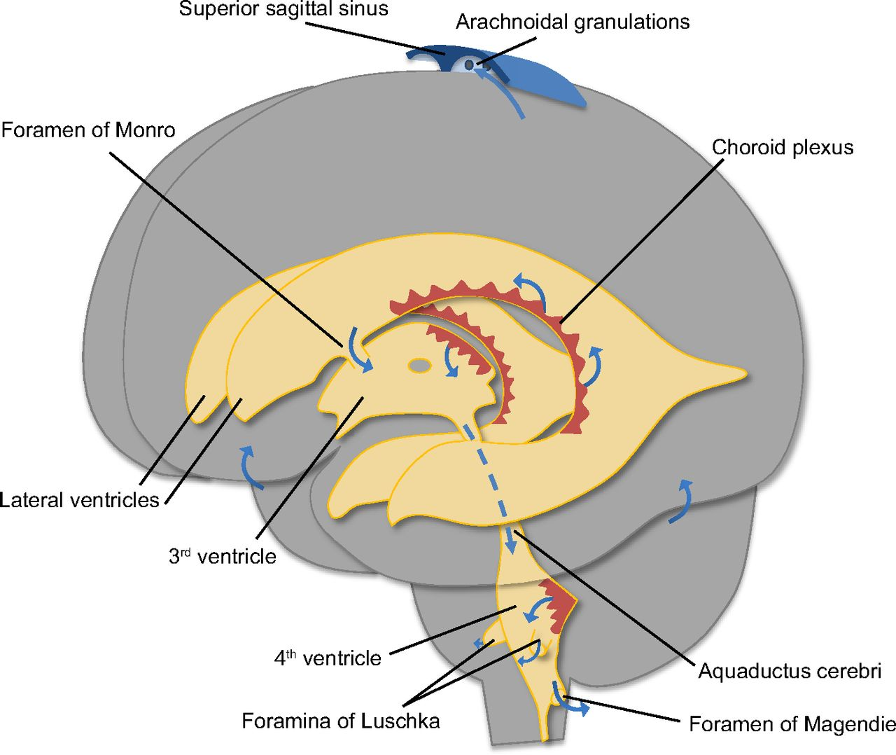
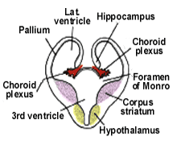
Development of The Cerebrum
-The (prosencephalon) or the forebrain vesicle differentiates into a:
1-Telencephalon (medial part) (it’s cavity forms two lateral ventricles).
2-Diencephalon (lumen) (it’s cavity forms 3rd ventricle).
-Both cavities communicating with each other through a wide interventricular foramen(foramen of monro)
-The cerebral hemispheres first appear on the day 32( بعد شهر ويومين (of pregnancy as a pair of bubble-like outgrowths of the Telencephalon.
By 16 weeks((بعد 4 شهور, the rapidly growing hemispheres are oval and have expanded back to cover the diencephalon. (يعني يتمدد من كل اتجاه ويغطي الدينسيفالون)
اعرفوا ان في البداية يكون شكلها اوفال لان ف سلايد 9 حيتغير شكلها
-The cerebral hemispheres expand in all directions.
-Its medial wall becomes thin, flat and it is the site of choroid plexus of the lateral ventricle.
وبتكبر الهيمسفير وتمدد وراح يكون فيها منطقه مسطحة يتكون فيها
choroid plexus to produce (CSF)
- By the end of the 3rd month the surfaces of the cerebral hemispheres are ( smooth and no gyri)
- By the 4th month ,grey matter is growing faster than white matter
folding of the cortex > formation of gyri and sulci.
the cortex becomes folded into gyri separated by sulci.
-The gyri and sulci effectively increase the surface area of the brain.
- The detailed pattern of gyri and sulci varies between individuals

Slide 8
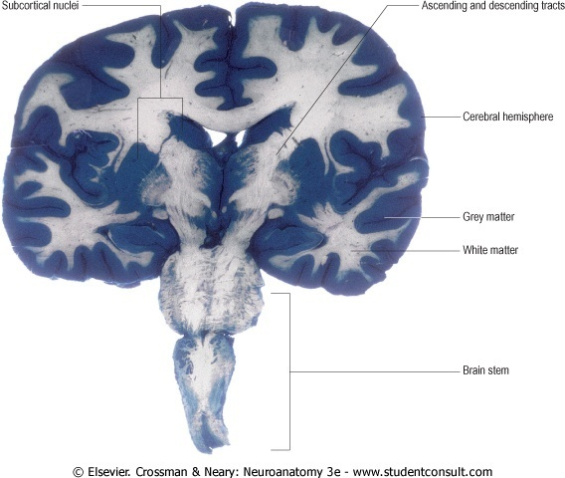
Development of The Cerebrum
-The wall of the telencephalon is formed of 3 layers :
1- Ependymal(inner): (lining the cavity of the lateral ventricle).
2- Mantel (middle): nerve cells forming the grey matter.
3- Marginal (outer): nerve fibers forming the white matter.
-As development proceeds, the following changes occur as:
- Most of the nerve cells in mantel layer migrate to the marginal layer forming the cerebral cortex.
-Some cells do not migrate and remains to form the basal ganglia.
فينتريكال والمارجينال بالخارج وتحتوي على نيرف وهي تكون الوايت ماتر اما المينتال تكون بالداخل وهي اللي بتكون لي القري ماتر بعدين راح تهاجر المانتال لبرا عشان تكون السيربرال كورتيكس ويبقى منها جزء صغير ما يهاجر هذا الجزء راح يكون البيسل قانقليا
Corpus striatum: (it is nuclei of basal ganglia)
- appears in 6th week in the floor of each hemisphere.
- Cell bodies in the cortex differentiate and their fibers passing (as internal capsule) through (corpus striatum)
to divide it into caudate and lentiform nuclei.
-This fiber pathway forms( the internal capsule).

Slide 9
Development of The Cerebrum
Rapid growing (sulci and gyri + C-shape + Insula)
- في البداية عندي 3 أشياء مع التكوين رح وتاخد شكل ال حرف ال سي:
1-كودال نيوكليس
2- لاترال فينتريكال
3-الهيمسفسر :نتذكر كان شكله قبل ( oval
-Further expansion of hemispheres gives it C- shape as well as its cavity (lateral ventricle).
including caudate nucleus which elongates to assume the C- shape
- The cortex covering the surface of the corpus striatum grows slowly compering to other area , and that will push this area (called insula) inside to the depth of the lateral sulcus of the brain.
- So, the insular lobe is a portion of cerebral cortex that has invaginated to lie deep within the lateral sulcus.
الكورتيكس اللي تغطي الكوربس سترايتوم يكون نموها أبطئ من أي جزي ثاني من الكورتيكس عشان كذا بيتمدد كل اجزاء الكورتيكس ما عدا هي بتكون متكونه داخل وتكون لي ال
insula
Cerebral commissures:
-Cerebral cortex develops fibers connect between the corresponding regions in right and left hemisphere.
These are :
Optic chiasma
Anterior and posterior commissures.
Hippocampal commissure.
Habenular commissure.
Lamina terminalis.
Corpus callosum:(is a major commissural fibres that connect the two cerebral hemispheres).
)اعرفوهم كأسماء فقط لا تدخلون بالتفاصيل)

Slide 10
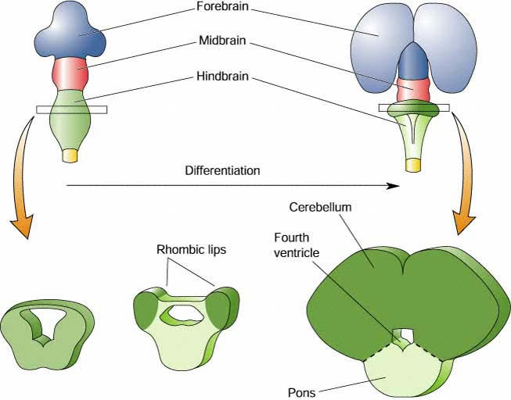
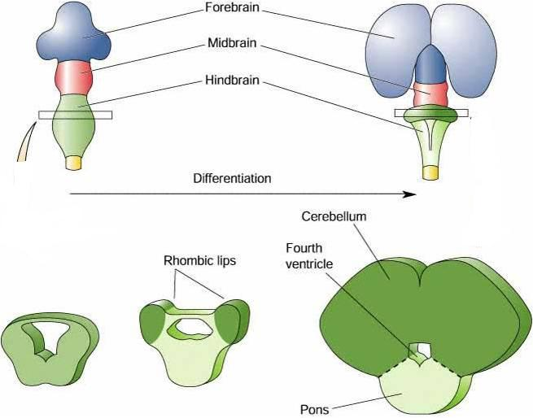
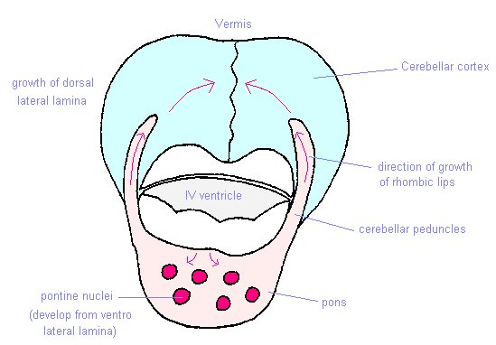
Development of The Cerebellum
*This silde is very important☺ *
*انتبهوا هنا حنبدأ نتكلم عن المخيخ خلاص خلصنا تكوين المخ*
-The metencephalon develops into:
1- pons (anterior part) 2- cerebellum (dorsal part).
Extra
1
Pontine flexure
results in:In the middle of pone
Moving 2 the alar plates laterally then pending medially.
Stretching and thinning of the roof
plate
Widening of the cavity to form the 4th ventricle
Every pontine flexure has (2 basal plate and 2 alar plate)
احنا يهمنا 2الار بليتس...
البونتاين فليكشر يتكون عندي من نص البون
ليش البون ؟ لان البون والسيريبلم يطلعوا من نفس المكان وجنب بعض
المهم 2 الاار بليتس تتحرك لاترال لبرا لو تلاحظوا ف الصورة الثانية وبعدين تميل ميديالي من تحت
الرووف من فوق يصيرله استريتس ,وبكدا
وبكذا احنا كبرنا مساحة ال كافتي ف النص عشان يكونلي ال فينتركال الرابع
2
-The dorsal parts thicken to form Rhombic lips , that will give rise to the cerebellum. (very important)
-Some neuroblasts migrate from the mantel layer to the marginal layer and form the cerebellar cortex .نفس فكرة السريبرال كورتيكس ) )
-Others remains in the mantel layer and give rise to the cerebellar nuclei (نفس فكرة البيزال قانقليا ي السريبرم)
- The cerebellar peduncles develop later on, as the axons of the neurons of the cerebellar nuclei grow out to reach the brain stem

Slide 11
Cont..
3
As the cerebellar hemispheres develops they undergo a complicated process of transverse folding to form closely packed, leaf-like transverse gyri called folia.
- اثناء تكون السيريبلم يكون معاها فولدنق ع شكل افقي وطريقة تفرعها وشكلها تشبه تفرعات ورق الشجر
-These processes of fissure formation and foliation continue throughout:(3stages)
1- Embryonic
2- Fetal
3-postnatal life
and they vastly increase the surface area of the cerebellar cortex.
- عملية التفرعات والفولدنق تستمر في تكوينها من بداية مايكون المخلوق جنين الى لما يولد والى بعد الولادة
- هذي التفرعات تزيد من مساحة سطح الكورتكس
الصور الجاية بس تورينا الزيادة ف الفولدنق والتفرعات في مرحلة ال
Embryonic
35 Days
50 Days
90 Days
150 Days

Slide 12
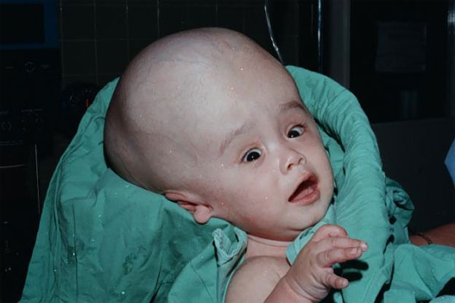
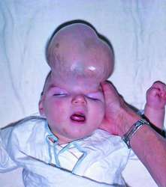
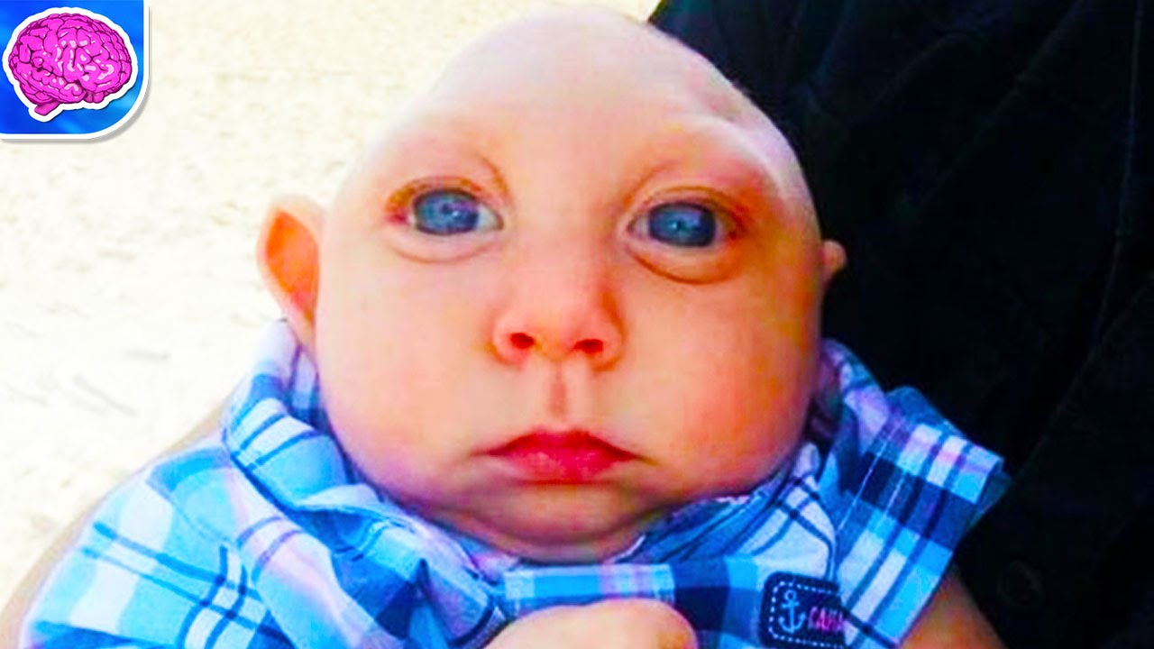
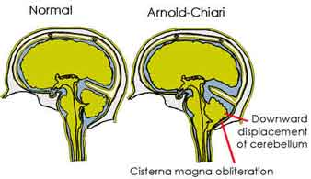
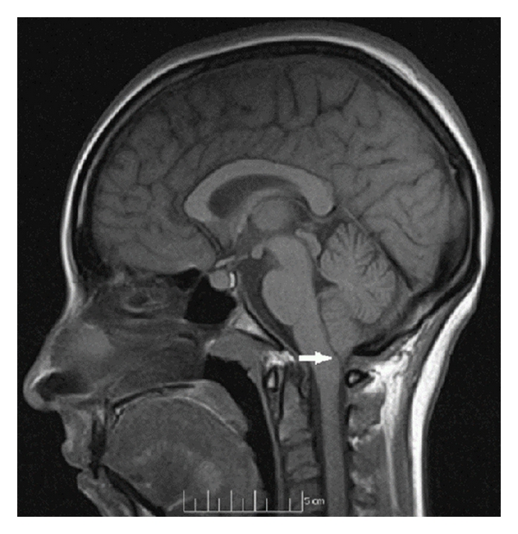
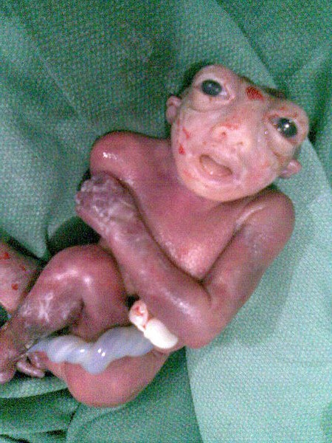
Congenital Anomalies of The Brain
*This slide is very important ☺*
Extra
1- Hydrocephalus:
Increase secretion of (CSF) and
decrease absorption of it .
accumulation of cerebrospinal fluid
بالتالي نلاقي انه في زيادة في حجم الدماغ
2- Cranium bifidum:
with or without meningocele (the meninges are exposed)
and meningoencephalocele (the meninges with some brain tissue are exposed)
3- Microcephaly: (تكوين الدماغ غير مكتمل)
(abnormal smallness of the head, a congenital condition associated with incomplete brain development).
4- Arnold-Chiari malformation :
(herniated part of cerebellum (tonsils)through the foramen magnum leading to (CSF obstruction ,and hydrocephalus )
also in aqueductal stenosis and in brain tumours.
5- Anencephaly: (no brain)
It is due to failure of closure of the cranial neuropore of the neural tube.
the brain and skull are minute and the infant does not usually survive.
The frequency of this case 1:1000.
هو جدا نادر .. يحدث في ولادة واحدة من كل 1000 ولادة
مايقدر يعيش بعد الولادة الا كم ساعه ثم يموت ☹
(يصير تونسلايتس تتحرك من مكانها وتنزل عند الفورمان ماجنم وتسوي كل المضاعفات الي قولنا عليها)
6-Mental retardation. تخلف عقلي ))
7- Seizures (changes in electrical activity).
8- Cerebral palsy. شلل كامل))
9- Agenesis of corpus callosum.)
Neural tube has upper and lower opening .
-The upper opening close at 23-26day , if it not close it will cause anencephaly
-Lower will close at 27 dayes , if it not close , it will cause spinal bifid.
Only in boys slide
(من الجهتين ما ارتبطوا ببعض او ماتكون أساسا)

Slide 13
SUMMARY
Time | Changes
Beginning of the 3rd week | Formation of 3 germ cell layers (ectoderm,mesoderm,endoderm)
Middle of 3rd week | Forming Neural plate (Beginning of neural tube formation)
4th week | Forming brain flexures
Middle of the 4th week | End of neural tube formation
End of 4th week | Three vesicles stage (3 primary vesicles)
5th week | Five vesicles stage (2ry brain vesicles)
Development of The Cerebrum
Day 32 (between 4th and 5th week) | Cerebral hemispheres appear as pair of bubble-like outgrowths
6th week | Formation of corpus striatum
16 week | Cerebral hemispheres are oval and have expanded back to cover the diencephalon
The end of 3rd month | Smooth Surfaces of the cerebral hemispheres
4th month | The cortex become folded into gyri separated by sulci
- تأكدوا انكم فاهمين كويس السلايدات اللي جنبها نجمة

Slide 14
MCQ’S
1- which part of the embryonic ectoderm will thicken to form the neuroectoderm ?
a- inner cell layers b- margins of the dorsal ectoderm c- the dorsal midline ectoderm
2- the 2 cerebral hemispheres will be developed from :
a- Prosencephalon by 5th week b- telencephalon after the end of 5th week c- diencephalon by the 5th week
3- the cerebellar peduncle will be developed from :
a- cerebellar cortex reaching brainstem b- cerebellar nuclei reaching brain stem c- cerebral nuclei reaching cerebellum
4- cerebellar growth will continue:
a- before fetal life b- after postnatal life c- until postnatal life
5- what also can cause hydrocephalus beside herniated cerebellum ?
a- brain tumor b- aqueductal stenosis c- both a and b are correct
1- c
2- B
3- b
4- c
5- c

Slide 15
References
ANY SUGGESTION OR ISSUE
Dr.slides (male and female).
USEFUL VIDEOS
https://www.youtube.com/watch?v=AWYNmUsfKWc
https://www.youtube.com/watch?v=lhapeOo6laA&feature=youtu.be
@Embryology436
Embryology
436
Embryology436@gmail.com
Editing file
Your Suggestion here

Slide 16
TEAM MEMBERS
TEAM LEADERS :
B O Y S :
Mohammed Almutlaq
Muhanned Alzahrani
Yazeed Al-mutairi
Nehal Beyari.
G I R L S :
Razan Alotaibi
Thikrayat Omar
Do’aa Walid
Ohood Abdullah
Nouf Aloqili

