Slide 1
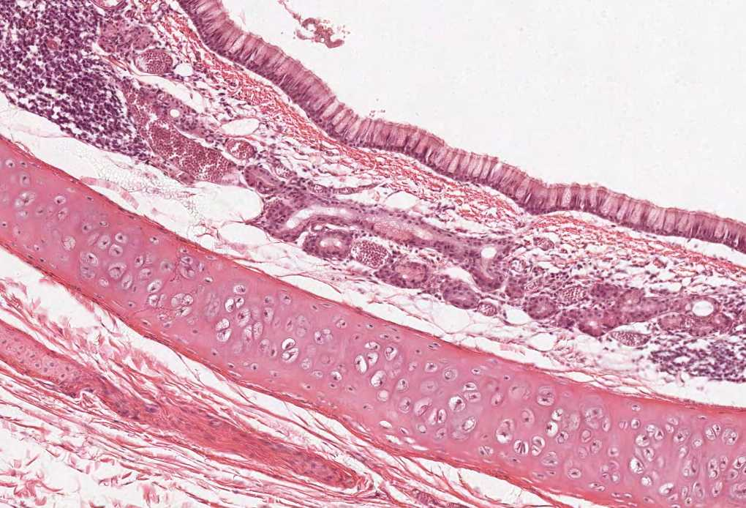
NORMAL CELLS OF THE
CNS
Color index:
Slides.. Important ..Notes ..Extra..

Slide 2
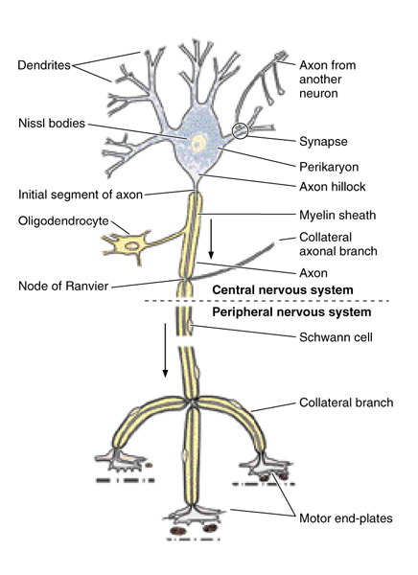
Objectives:
At the end of this lecture, you should describe the microscopic structure and the function of:
1- Neurons:
Cell body (perikaryon).
Processes: An axon and dendrites.
2- Neuroglia:
Astrocytes.
Oligodendrocytes.
Microglia.
Ependymal cells.

Slide 3
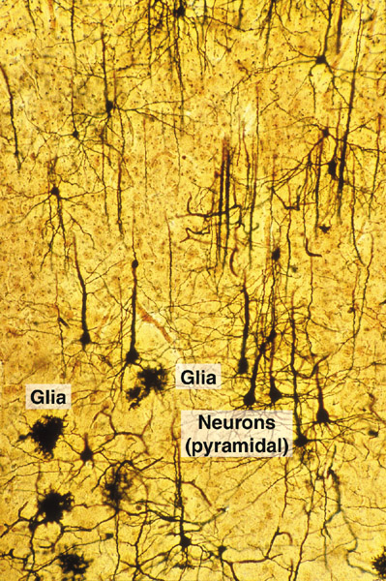
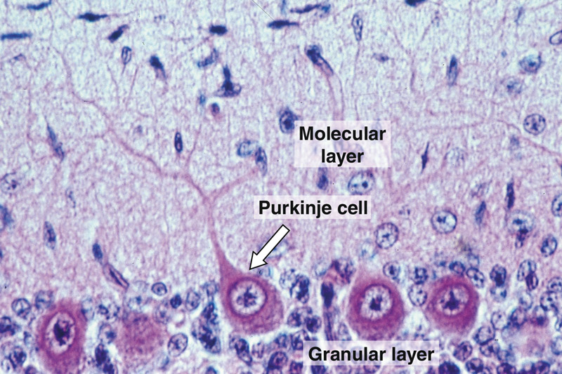
Neuron components
Processes
Axon: only one
Dendrites: one or more
Cell body (Perikaryon)
Types of neurons based on number of processes:
Unipolar neuron (Pseudounipolar) (rounded neuron) Not directly connected to the cell body | Has one process only, that divides into two branches; one acts as a dendrite and the other as an axon. e.g. Mesencephalic nucleus of trigeminal nerve and dorsal root (spinal) ganglion.
Bipolar Neuron (spindle-shaped neuron) like having 2 necks | Has two processes (one arising from each pole of the cell body) One of them is the dendrite and the other is the axon. e.g. retina & olfactory epithelium.
Multipolar neuron: Has one axon and multiple dendrites. -Its outline is irregular in shape -Neuroglial cells are much more number than neurons in the CNS they can divide and regenerate normally. | Stellate Neurons (star shape) | Pyramidal Neurons (wide base) | Pyriform Neurons
 | - The commonest type. - Distributed in most areas of CNS e.g. anterior horn cells of the spinal cord. | - Distributed in motor area 4 of the cerebral cortex. | - Pear-shaped e.g. Purkinje cells of cerebellar cortex.

Slide 4
Cell body (perikaryon)
Cytoplasm:
Cytoplasm with mitochondria and ribosomes and rough ER only in dendrites not in axons
Its main components include:
Nucleus:
Single, usually central, rounded and vesicular with prominent nucleolus.
Nissl bodies
Neuro-filaments
Micro-tubles
Golgi apparatus
Mito-chondria
Centriole
Pigments
Depend on age
Other
Are basophilic patches of rough Endoplasmic Reticulum (rER) and free ribosomes in the cell body and bases of wide dendrites
* Are intermediate filaments which are bundled together to form neurofibrils. * Are found in the cell body, axon and dendrites
Are found in the cell body, axon, & dendrites.
Surrounds the nucleus all around.
Are numerous.
Most adult neurons have only one rudimentary centriole, so they cannot divide.
*lipofuscin pigment: in old age
*Melanin pigments: in neurons of substantia nigra of the midbrain
Nigra = Black
Some fat and glycogen granules

Slide 5
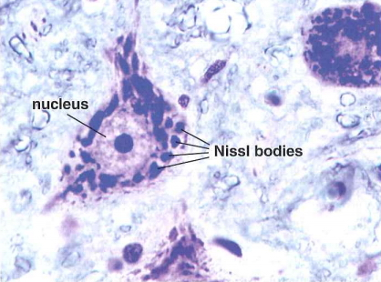
Nissl bodies
Lipofuscin pigments
we can differentiate between the axon and the dendrite by Nissl bodies
*Axons DO not contain Nissl bodies

Slide 6
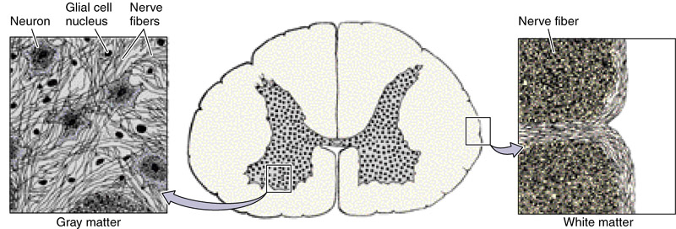
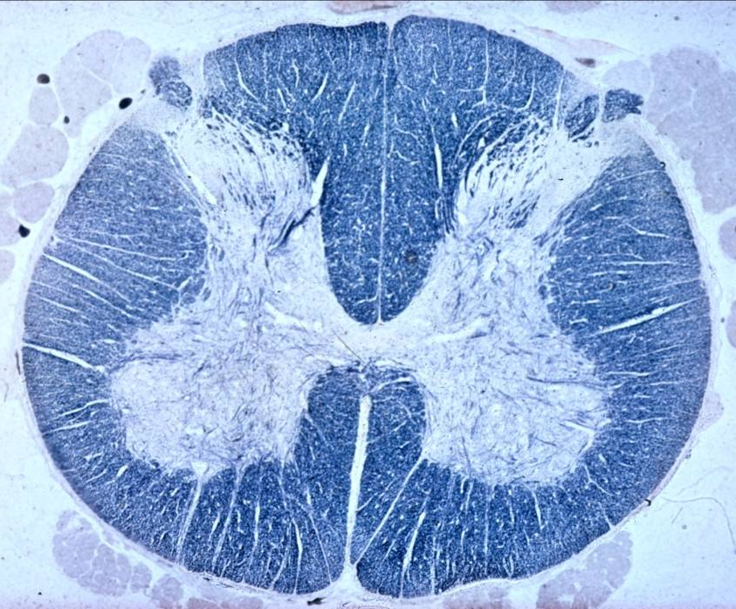
TYPES OF NERVE FIBERS IN CNS
1- Unmyelinated without neurilemmal sheath
(in grey matter).
2- Myelinated without neurilemmal sheath (in white matter).
Inside the CNS the oligodendrocytes create the Myelin sheath unlike the PNS we have the Schwann cells which produce myelin sheath

Slide 7
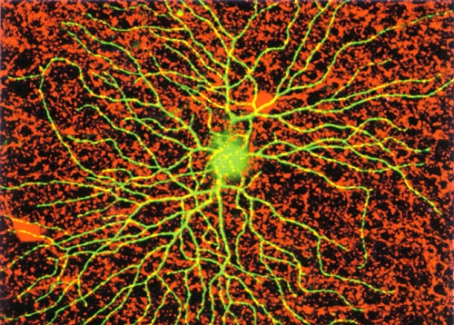
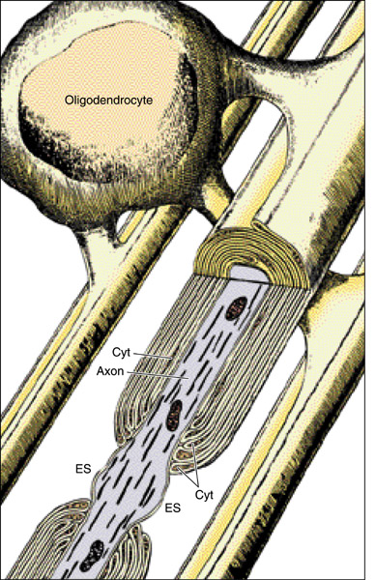
NEUROGLIA
Definition: Are group of cells that act as the supportive tissue of CNS.
Types: 1- Astrocytes 2- Oligodendrocytes 3- Microglia 4- Ependyma
2. Oligodendrocytes. | 1. Astrocytes
Are branching cells with few, short processes. They are distributed in the grey and white matter of CNS. | They are the commonest type of neuroglial cells. They are found in both the grey and white matter. They are star-shaped cells with numerous long processes. | General information
1. Formation of myelin sheath in the CNS. 2. Insulation of nerve fibers. | 1. Repair of injury of CNS tissue (gliosis). 2. Supportive and nutritive functions to the neurons. 3. Participate in the formation of blood-brain barrier. (acts as a barrier) | Functions
 | 1. Protoplasmic astrocytes: -Are found in the grey matter of CNS. -Their processes branch extensively. 2. Fibrous astrocytes: -Are found in white matter of CNS. -Their processes have fewer branches but longer. | Types

Slide 8
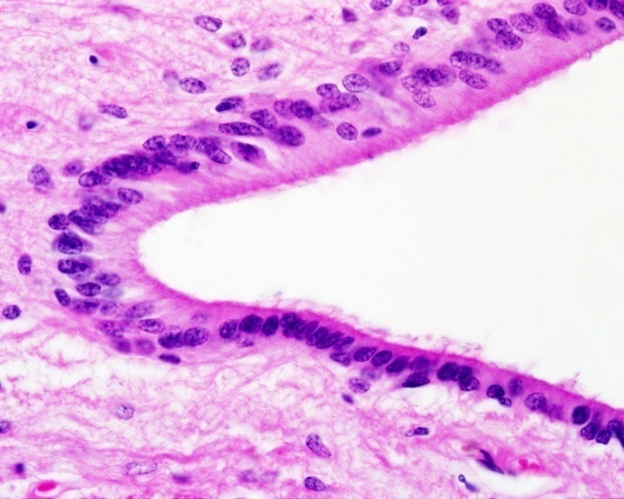
NEUROGLIA
Definition: Are group of cells that act as the supportive tissue of CNS.
Types: 1- Astrocytes 2- Oligodendrocytes 3- Microglia 4- Ependyma
4. Ependyma | 3. Microglia Same as macrophages
Are simple columnar epithelial cells (partially ciliated) lining the brain ventricles and the central canal of spinal cord. | Are spindle-shaped cells with branching processes that rise from each pole of the cell. Are distributed in the grey and white matter of CNS. Are rich in lysosomes. | General information
1. May be formation and circulation of CSF. | 1. Their main function is phagocytosis. | Functions
 |  | Types

Slide 9
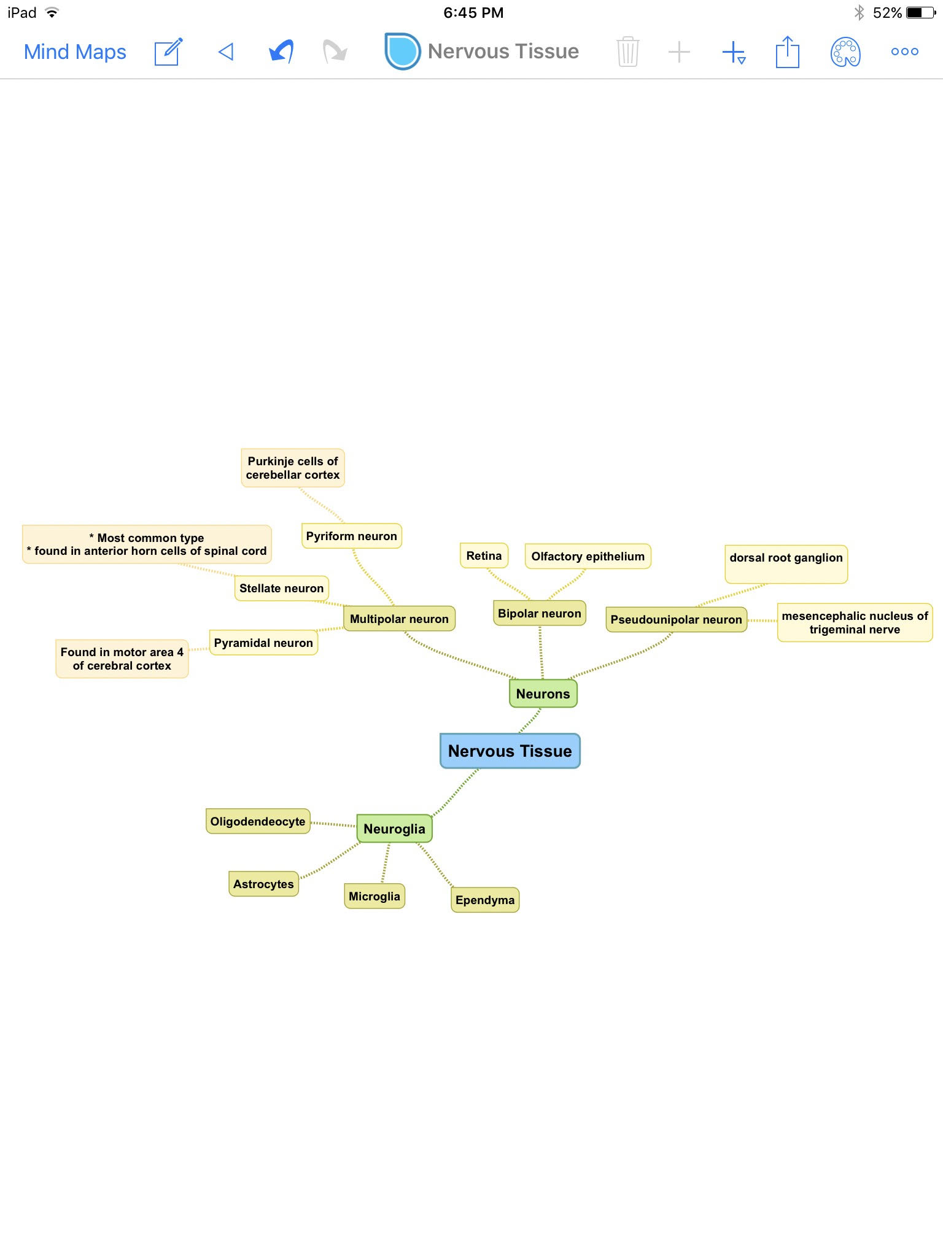
Summary

Slide 10
MCQ’s
5- One of the functions of oligodendrocytes cells?
A. Forming BBB
B. Nutritive
C. Phagocytosis
D. Formation of myelin sheath
6- The type of epithelium in the Ependymal cells is?
A. Simple squamous non ciliated
B. Simple columnar partially ciliated
C. Simple cuboidal
D. Pseudostratified
7- Mesencephalic nucleus of trigeminal nerve and dorsal root ganglion are examples of example of?
A. Unipolar neuron
B. Bipolar neuron
C. Spindle shaped neuron
D. Multipolar neuron
8- "Pyramidal neurons" are a type of multipolar neurons that are found in?
A. Cerebellum cortex
B. Brain steam
C. Cerebral cortex
D. All above
9- Which one of the following is considered
as the commonest type of neuron?
A. stellate neuron
B. Pyramidal neuron
C. Pyriform neuron
D. Bipolar neuron
1- Which of the following contain Nissl Bodies?
A. Dendrites and axon
B. Dendrites and cell body
C. Cell body and axon
D. Only axon
2- Types of nerve fibers that are found inside the CNS are?
A. Myelinated with neurilemmal sheath
B. Unmyelinated with neurilemmal sheath
C. Myelinated and unmyelinated without neurilemmal sheath
D. Non of above
3- Which type of astrocyte is found in the grey matter of the CNS?
A. Fibrous astrocytes
B. Protoplasmic astrocytes
C. Microglia
D. Oligodendrocytes
4- The supportive cells that form gliosis for repairing injuries in the CNS are?
A. Astrocytes
B. Oligodendrocytes
C. Microglia
D. Ependyma
1-B
2-C
3-B
4-A
5- D
6- B
7- A
8- C
9-A

Slide 11
Thank you & good luck
- Histology team
Done by:
Allulu Alsulayhim
Amal AlGarni
Do’aa Walid
Shahad AlAnzan
We’am Babaier
Team leaders:
Rana Barasain
Faisal Alrabaii
للاقتراحات أو الشكاوي:
https://goo.gl/forms/fg6hLipifAzVspuj1
Please if you need anything or even further explanation contact us on:
HistologyTeam436@gmail.com
@histology436

