Slide 1
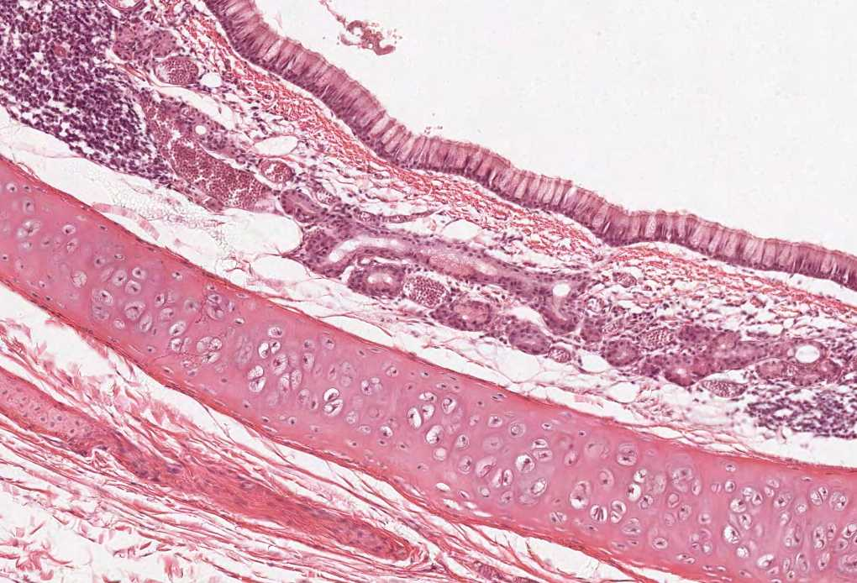
Histology of the Eye
Color index:
Slides.. Important ..Notes ..Extra..

Slide 2
Objectives :
By the end of this lecture, the student should be able to describe:
The general structure of the eye.
The microscopic structure of :
Cornea.
Retina.
Limbus.

Slide 3
EYE BULB
Three coats (3 Tunics) | Components | Notes
1- Fibrous tunic: | A- Cornea B- Sclera | Outermost and tough coat
2- Vascular tunic: | A- Choroid B- Ciliary body C- Iris. | - The middle coat. - Also called uveal coat.
3- Neural tunic: | A- Retina | Innermost and nervous coat

Slide 4
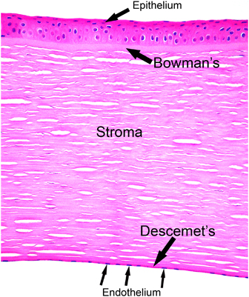
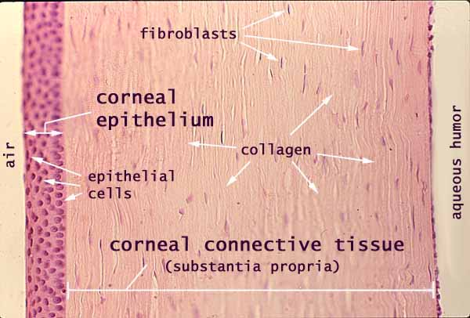
Fibrous tunic: CORNEA مهم
Cornea : | It is the transparent, avascular and highly innervated anterior portion of the fibrous coat. (Represent the anterior 1/6 of the outer fibrous coat of eye blub) (It takes its nutrients from limbus via diffusion )
Composed of 5 distinct layers: | 1. Corneal epithelium. 2. Bowman’s membrane. 3. Stroma. 4. Descemet’s membrane. 5. Corneal endothelium.
1- Corneal epithelium: | Non-keratinized Stratified squamous epithelium. (it is anterior) Contains numerous free nerve endings.
2- Bowman’s membrane: | It is a homogenous non-cellular layer containing type I collagen fibrils. (posterior to the epithelium)
3- Stroma: | It is the thickest layer (about 90%). It is composed of parallel lamellae of dense collagenous C.T. Each lamella is composed mainly of parallel type I collagen fibers with long fibroblasts.
4- Descemet’s membrane: | It is a thick basement membrane. (Anterior to the endothelium)
5- Corneal endothelium: | It is simple squamous epithelium. (posterior) Functions: 1- Formation of Descemet’s membrane. 2- Keeping the stroma relatively dehydrated (sod. pump → water withdrawal from the stroma).

Slide 5
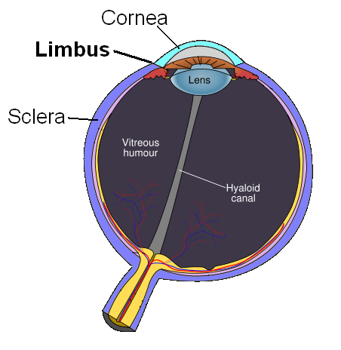
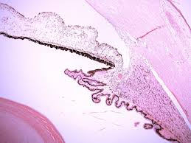
LIMBUS مهم (CORNEO SCLERAL JUNCTION)
- It is the transition region between the cornea and sclera.
- It is about 1.5 mm width.
- It is highly vascular. It gives nutrients to cornea.
- It contains:
1- Trabecular meshwork (small windows): Endothelium-lined spaces.
It leads to canal of Schlemm. (Also called spaces of Fontana)
2- Canal of Schlemm: It drains the aqueous humor into the venous system.
The canal mimics blood capillaries.
(If there is any obstruction in the pathway of aqueous humor it will lead to glaucoma)
Cornea
Canal of Schlemm
Iris
Sclera
Ciliary
body

Slide 6
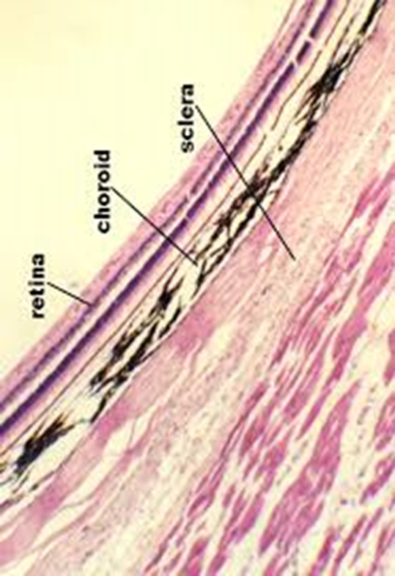
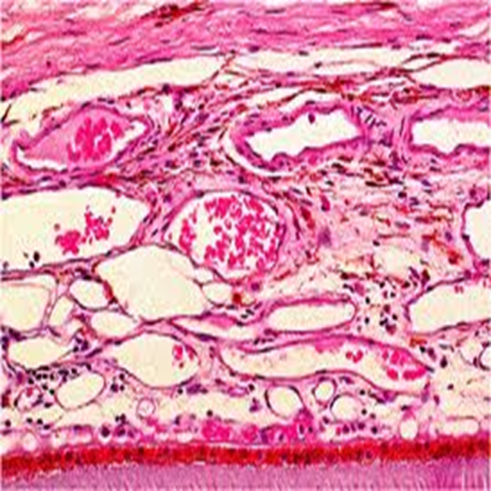
Fibrous tunic: Sclera
It covers the posterior 5/6 of the fibrous tunic.
Sclera Proper: consists of interlacing bundles of type I collagen (dense collagenous C.T., irregular type).
Melanocytes are located in the deeper regions.
Vascular tunic: Choroid
is the vascular, pigmented posterior to cornea portion of the middle vascular tunic.
Structure:
It is composed mainly of loose C.T. with melanocytes. Loose CT is always rich in blood vessels
It is separated from the retina by its Bruch’s membrane.
Bruche’s membraine

Slide 7
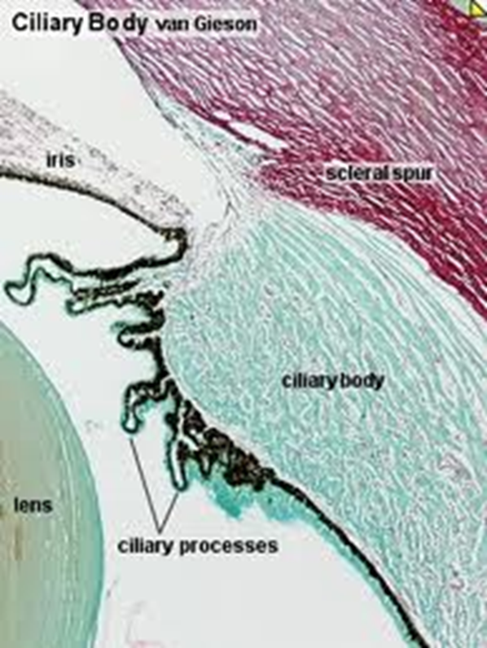
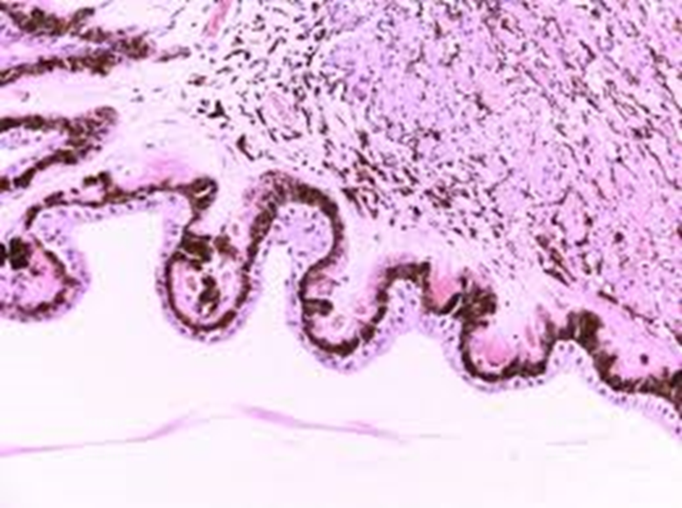
Vascular tunic: Ciliary body
It is the anterior continuation of the choroid.
It surrounds the lens.
Structure:
It is formed of loose vascular and pigmented C.T. that contains 3 bundles of smooth muscle cells (ciliary muscle).
Its inner surface is lined by pars ciliaris retinae
(2 rows of columnar cells; outer pigmented and inner non- pigmented layers) .
Its inner surface is highly folded forming the ciliary processes.
Ciliary processes (smooth muscles)
Processes project from the inner surface of the anterior 1/3 of the ciliary body towards the lens.
Are covered by pars ciliaris retinae (2 rows of columnar cells).
They give attachment to the lens suspensory ligaments (zonule fibers).
ciliary process is what controls curvature of the lens but it is not directly attached to it.
Posterior chamber
Anterior
chamber

Slide 8
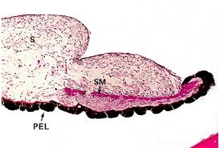
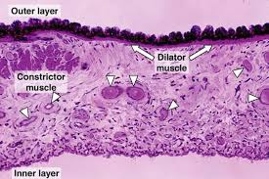
IRIS
1- Anterior border layer | Incomplete layer of fibroblasts and melanocytes. Most of it are cones sells
2- Stroma | Poorly vascularized C.T. with fibroblasts and melanocytes.
3- Vessel layer More prominent layer | Well-vascularized loose C.T. Centrally, it contains circularly arranged smooth muscle fibers (sphincter pupillae muscle).
4- Dilator pupillae muscle layer Arranged in sunrays shape | Contains radially arranged myoepithelial cells. So the iris constricts and dilates the pupil.
5- Posterior surface layer (pigmented epithelium layer) | It is composed of 2 rows of pigmented epithelial cells (pars iridis retinae). They are the continuation of pars ciliaris retinae.

Slide 9
RETINA مهم
Layers | Features | Function
1-Pigmented epithelium | Cuboidal to columnar cells (single layer). Short column Apical microvilli. Increase surface area and act as phagocyte Abundance of melanin granules. | Absorb light. Phagocytosis of membranous discs from tips of rods. (When rods are stimulated, they rupture) Esterification of Vitamin A (in SER).
2-Rods and cones layer. | Are photoreceptor cells. Each has: 1. Dendrite formed of: - Outer segment (OS): contains membranous discs containing rhodopsin (in rods) and iodopsin (in cones). - Connecting Stalk: with modified cilium. - Inner segment (IS). 2. Cell body. 3. Axon: synapses with dendrite of bipolar neuron of inner nuclear layer. | Rods are receptors for dim light ( low intensity light). Cones are receptors for bright light and color vision (red, green & blue).
3-Outer limiting membrane. | A region of zonulae adherents junctions between Muller cells and the photoreceptors.
4-Outer nuclear layer: | Contains nuclei of the rods & cones.
5-Outer plexiform layer: | Contains axodendritic synapses between the photoreceptor cells and dendrites of bipolar and horizontal cells.
6-Inner nuclear layer: | Contains the nuclei of: 1- Bipolar neurons. 2- Horizontal neurons. 3- Amacrine neurons (unipolar neurons): 4- Neuroglial cells (Muller cells) that extend between the vitreous body and the inner segments of rods and cones.
7-Inner plexiform layer: | Contains axodendritic synapses between axons of bipolar neurons and dendrites of ganglion cells and amacrine cells.
8-Ganglion cell layer: | Contains cell bodies of large multipolar neurons of the ganglion cells.
9-Optic nerve fiber layer: | Contains unmyelinated axons of the ganglion cells. N.B. These axons become myelinated as the nerve pierces the sclera.
10-The inner limiting membrane: | It is formed by the basal laminae of the Muller cells.
light
Cones > Color > Large > Bright Light
The axons of rods and cones synapse with dendrites of inner nuclear layer.
The inner nuclear layer cell synapse with each other and with ganglion cell layer.

Slide 10
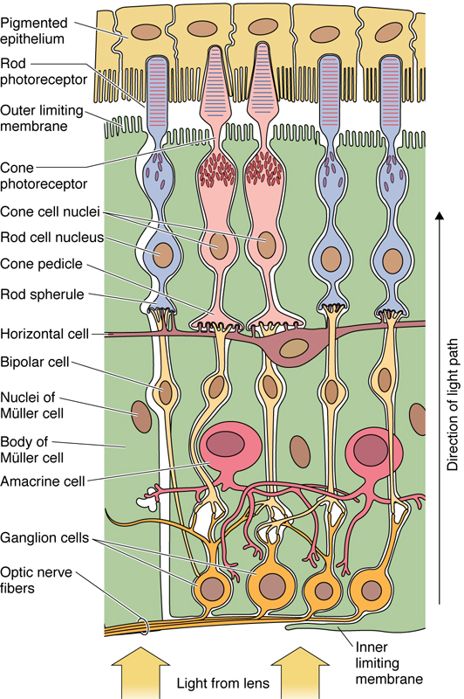
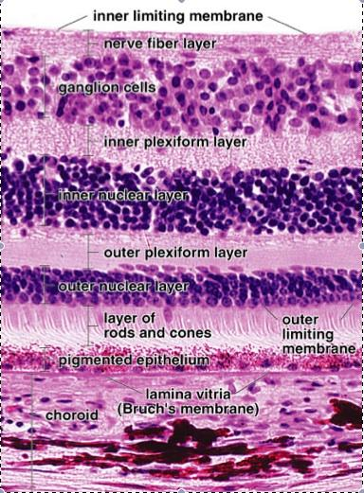
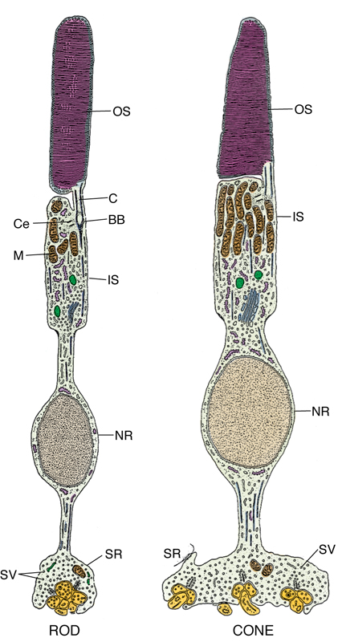
RETINA (main structure)
Last layer is receptors and first is optic nerve axons
different layers of the retina

Slide 11
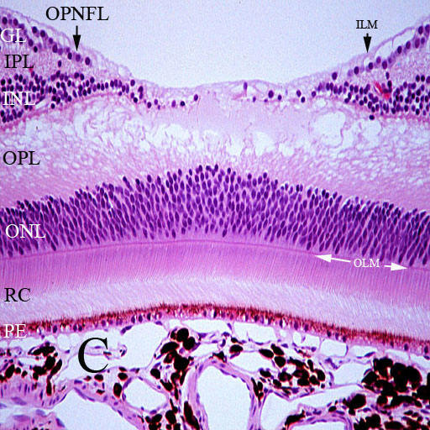
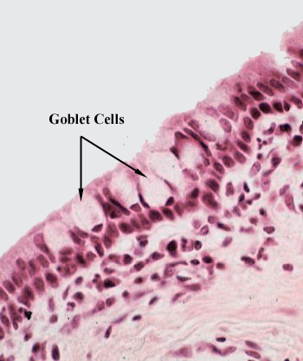
RETINA مهم
CONJUCTIVA
Fovea centralis:
Types of cells in the retina:
Definition | L.M. Picture
It is the transparent mucous membrane lining the inner surfaces of the eyelids (palpebral conjunctiva) and reflecting onto the sclera of the anterior surface of the eye (bulbar conjunctiva). | 1- Epithelium: Stratified columnar epithelium with numerous goblet cells.
 | 2- Lamina propria: Loose C.T.
It lies in the center of macula lutea.
Cones are highly concentrated in the fovea.
It is responsible for visual acuity.
1- Pigmented epithelium.
2- Nerve cells:
- Photoreceptor cells (rods & cones).
- Bipolar neurons.
- Ganglion cells.
- Association neurons:
i. Horizontal cells.
ii. Amacrine cells.
3- Neuroglial cells:
- Muller’s cells.
- Astrocytes. scattered
Less thickness depression called macula lutea near the optic nerve

Slide 13
MCQ’s
1-which one of the following structures keep the stroma of cornea relatively dehydrated?
A-Corneal epithelium
B-Bowman’s membrane
C-Corneal endothelium
D-Descemet’s membrane
2-Canal of schlemm is found in which of the following ?
A-Retina
B-limbus (Corneoscleral junction)
C-sclera
D-Choroid
3- which of the following as the function of the pigmented epithelial cells found in retina ?
A- Absorb light
B- Phagocytosing of tips of the rode to regenerate
C- Esterification of Vit A
D- All above
4- which of the following sites contain the highest concentration of cones?
A- Optic disk
B- Fovea centralis
C- Conjunctiva
D- All above
5-The sclera consist of lose collagenous C.T regular type
A-true
B-false
6-The choroid is separated from the retina by
A-Bowman’s membrane
B-Canal of schelmm
C-optic dick
D-Bruch’s membrane
7-Which layers have the nuclei of rods and cons?
A-Rod and Cons layer
B-inner nuclear layer
C-Outer nuclear layer
D-Ganglion cell layer
8-Goblet cells found are in?
A-conjunctiva
B-Retina
C-Choroid
D-limbus
1-C
2-B
3-D
4-B
5-B
6-D
7-C
8-A

Slide 14
Thank you & good luck
- Histology team
Done by:
Ahmed Badahdah
Mutasem Alhasani
Omar Turkistani
Nawaf Aldarweesh
Mohammed Khojah
Team leaders:
Rana Barasain
Faisal Alrabaii
References:
Females’ and Males’ slides.
Doctors’ notes

