Slide 1
LECTURE: Microbiology of Middle Ear Infections
Editing File
Important
Doctor’s notes
Extra explanation
Only F or only M
"لا حول ولا قوة إلا بالله العلي العظيم" وتقال هذه الجملة إذا داهم الإنسان أمر عظيم لا يستطيعه ، أو يصعب عليه القيام به .

Slide 2
OBJECTIVES:
Upon completion of the lecture , students should be able to:
Define middle ear infection
Know the classification of otitis media (OM).
Know the epidemiology of OM
Know the pathogenesis & risk factors of OM.
List the clinical features of OM.
Know the diagnostic approaches of OM.
Know the management of OM.
Recall common complications of OM.

Slide 3
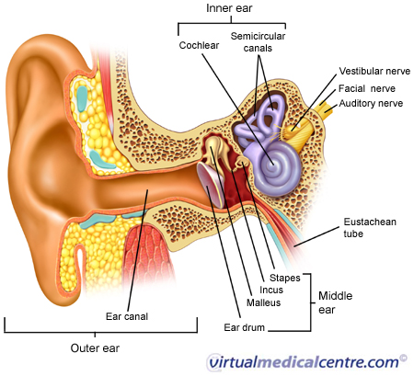
Definitions:
Middle ear is the area between the tympanic membrane and the inner ear including the Eustachian tube.
Otitis media (OM): is inflammation of the middle ear.
Anatomy of the Middle Ear:
OM-Classification:
Acute OM
Chronic OM
Secretory ( Serous) OM

Slide 4
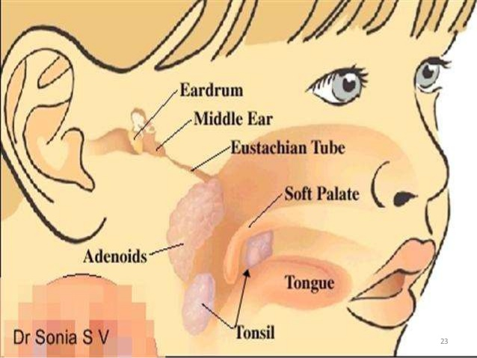
OM - Epidemiology
Most common in infants 6 to 18 months of age (2/3 of cases)* . Improves with age, why ?
The Eustachian Tube which vents the middle ear to the nasopharynx is horizontal in infants, difficult to drain naturally, its surface is cartilage ,and the lymphatic tissue lining is an extension of adenoidal tissue from the back of the nose.**
Often preceded by viral upper respiratory infection (URTI).
Accompanied by viral upper respiratory infection (URTI).
Extra picture
*The baby is protected on his first 6 months because of the IgG he got from his mother
**connected to the back of the nose including tonsils

Slide 5
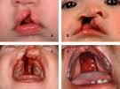
OM-Pathogenesis and Risk Factors:
How the otitis media is developed ?
URTI or allergic condition cause edema or inflammation of the tube.
In normal situation the Functions of the tube *eustachain tube* ( ventilation, protection and clearance ) when they are disturbed they may lead to OM.
During this process the Oxygen lost leading to negative pressure
Pathogens enter from nasopharynx into the middle ear.
Colonization and infection result.
OM- Other risk factors
Anatomic abnormalities
Medical conditions such as Cleft palate ,obstruction due to adenoid or nasogastric tube* or malignancy, immune dysfunction.
Exposure to pathogens from day care.
Exposure to smoking. Some studies relieve that the smoker mothers or fathers they may cause OM to their child, the smoking may initiate allergic and inflammatory prosseces
*nasogastric tube: a tube passed into the stomach via the nose for nutritional support or aspiration of stomach contents

Slide 6
EXTRA SLIDE
هذي بعض الخصائص المهمة للباكتيريا المذكورة فيه هذه المحاضرة - FOR THE NEXT SLIDE
Garm +ve | Gram -ve
Streptococcus pneumonia : Cocci in chains Alpha hemolytic Catalase -ve | Haemophilus influenzae : Cocci Requires X and V factors for growth
Group B streptococcus ( strepto agalactiae): Cocci in chains beta hemolytic Catalase -ve | Moraxella catarrhalis : Diplococcus Oxidase +ve
Streprococcus pyogens (group A): Cocci in chains Alpha hemolytic Catalase -ve | Proteus: Bacilli Oxidase –ve Urase +ve
Staph aureus : Cocci in clusters Catalase +ve Coagulase +ve | Pseudomonas aeruginosa: Bacilli Oxidase +ve

Slide 7
OM-Microbiology-Bacterial Causes:
The majority of OM is bacterial causes and it’s more serious
Acute OM | < 3months of age | -S.pneumoniae,(40%) -group B Streptococcus maternal colonization during labor ` -H.influenzae (non typable)** -Gram negative bacteria including P.aeruginosa
 | > 3 months of age | -S.Pneumoniae -H.influenzae -others eg. S.pyogenes, Moraxella catarrhalis, S.aureus
Chronic OM | Mixed flora in 40% of cases, P.aeruginosa , H.influenzae, S.aureus, Proteus species, K.pneumoniae, Moraxella catarrhalis, anaerobic bacteria.
Serous OM | Same as chronic OM, but most of the effusions are sterile (no bacteria culture) Few acute inflammatory cells
The most common
most common
And E.coli
The most common
Usually is mixed infection with more than one type of organism
(Most common in children less than and older than 3 months)
If you could not find Pseudomonas Aeruginosa, then Anaerobes would probably be the cause.
OM-Viral causes:
RSV( Respiratory Synsechial Virus) -74%
Rhinovirus
Parainfluenza virus
Influenza virus
**H.Influenzae have different types which are typable and non typable.The typable are (type A,B,C,D and E) which cause serious infection, the type B is the most pathogenic type which cause a serious infection such as mengenitis, septicemia and pneumoniae. But the most cases of OM in children is non typable which mean they don not belong to these types A,B,C,D and E

Slide 8
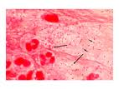
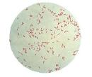
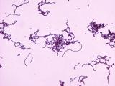
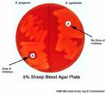
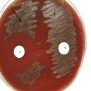
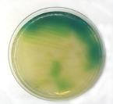
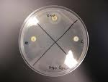
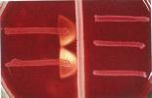
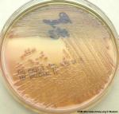
Microbiology of OM
Gram positive diplococci
and pus cell
Streptococcus pneumonia
Gram negative diplococci
and pus cell
Moraxella catarrhalis
Gram positive staphylococcus
Gram negative bacilli
H./Influenzae non-typable
This a plate with optochin disc, which the resistance for viridance
This test is to cofirm H.influenzae which requires X and V factors.

Slide 9
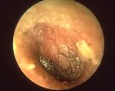
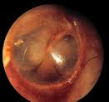
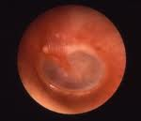
Clinical presentation:
For :Acute, chronic and serous
1- Acute OM
Mostly Bacterial ,often a complication of viral URTI. Pain often severe and continuous in bacteria causes.
First 1-2 days: | -Fever (39 C), irritability, earache , muffled nose which Filled with secretion. -Bulging tympanic membrane ,poor mobility and obstruction by fluid or inflammatory cells on otoscopic examination. Irritability which mean he is crying all the time and sleepless.
3-8 days: | Pus and ear exudative discharge released spontaneously then pain and fever begin to decrease. تخف حرارة الطفل والأعراض الثانية والأم تعتقد إن طفلها صار أحسن، بس لما يصحى الصباح تلقى مخدة طفلها كلها مويه وخراجات من الأذن
2-4 weeks : | Healing phase, discharge dies up and hearing becomes normal.
Images of acute OM:
We can see bulging tympanic membrane and exudative discharge

Slide 10
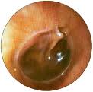
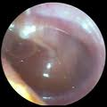
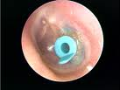
Clinical presentation:
For :Acute, chronic and serous
2- Serous OM (OM with effusion):
Collection of fluid within the middle ear as a result of negative pressure produced by altered Eustachian tube function. Represent a form of chronic OM or allergy-related inflammation. Over weeks to months, middle ear fluid become very thick and glue like( glue ear) Tends to be chronic , with non –purulent secretions. Cause conductive hearing impairment. Cause hearing deficit.
Images of serous OM:
Pediatric doctors when they examine the child they use a small tube to help them to decrease the ear secretions

Slide 11
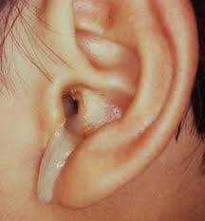
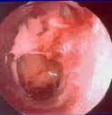
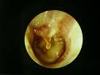
Clinical presentation:
For :Acute, chronic and serous
3- Chronic OM*
Usually result from unresolved acute infection due to inadequate treatment or host factors that perpetuate the inflammatory process. Involves perforation of tympanic membrane and active bacterial infection for long period. Pus may drain to the outside (otorrhea). Result in destruction of middle ear structures and significant risk of permanent hearing loss.
Risk factors such as obstruction, malignancy or cleft plate
Images of chronic OM:
*If they will not complete the course of antibiotic, that’s may lead to chronic OM.

Slide 12
Diagnostic approaches of OM
Clinical examination
Tympanometry ( detect the presence of fluid)
Gram stain and culture of aspirated fluid to determine the etiologic agents.
If there is discharge we have to do the culture of the fluid
Management of OM
Acute OM requires antimicrobial therapy & careful follow up.
Antimicrobial* usually empirical depending on the most likely bacterial pathogens, usually to cover S.pneumonia and H.influenzae.
Drainage of exudate may be required.
Chronic or serous OM need complex management, possibly surgical.
*Such as 3rd generation of cephalosporin such as Ceftriaxone for S.pneumonia Or 2nd generation of cephalosporin such as Cefuroxime​ which cover both S.pneumonia and H.influenzae
Amoxicillin and calvulanic acid combination in resistant infection. ( Augmentin)

Slide 13
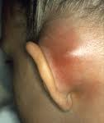
Complications:
Extracranial | Intracranial
Hearing loss Tympanic membrane perforation Mastoiditis * Cholestatoma ** Labyrinthitis others | Meningitis ( most dangerous complication) Extradural abscess Subdural empyema *** Brain abscess others
*Mastoiditis : Inflammation of the mastoid process.
**Cholestatoma : An abnormal skin growth in the middle ear behind the eardrum.
***Subdural empyema: Collection of pus between the dura mater and the underlying arachnoid mater.

Slide 14
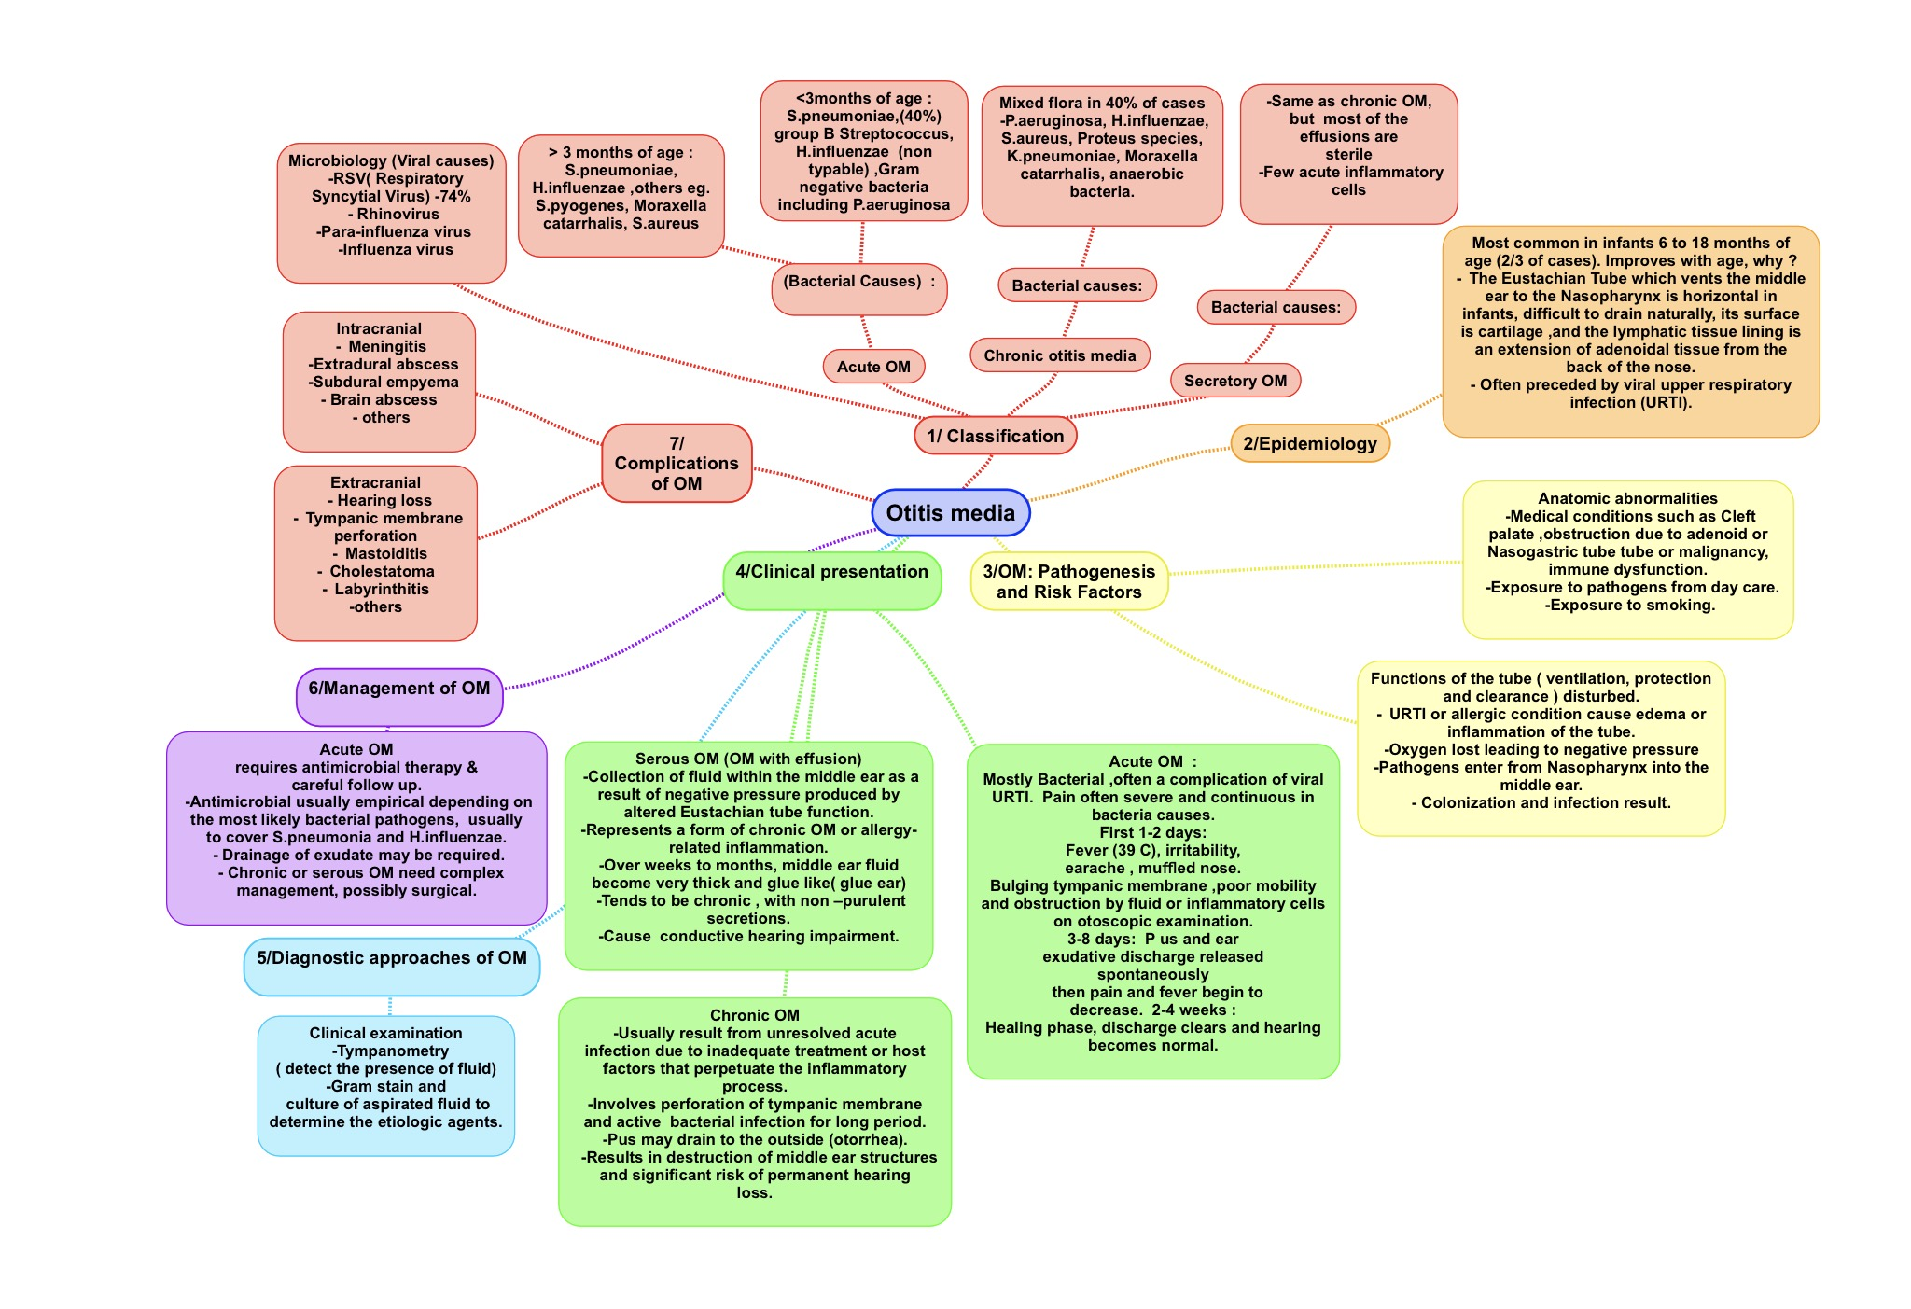
SUMMARY:

Slide 15
QUIZ:
1/ function of eustachian tube is :
A. Ventilation.
B. Protection.
C. Clearance.
D. All of the above
Answer: D
2/ the most common infection for acute OM less than three months organism is:
A. Streptococcus pneumonia.
B. Group B streptococcus
C. H. Influenza
D. Gram negative bacteria
Answer: A
4/ collection of fluid within he middle ear as a result of negative pressure produced by altered eustachian tube function is :
A. Acute OM
B. Chronic OM
C. Serous OM
D. None of the above
Answer: C
5/A result from unresolved acute infection due to inadequate treatment or host factors that perpeuate the inflammatory process:
A. Acute OM .
B. Serous OM
C. Chronic OM
D. Non of the above
Answer: C
6/The diagnostic approach of OM :
A. Tympanometry
B. Gram stain
C. Culture of aspired fluid
D. All of the above
Answer: D
3/ the most common infection for chronic for OM is :
A. S. Aureus .
B. Proteus species
C. Moraxella catarrhalis
D. P.aeruginosa
Answer: D
7/management of OM:
A. Antimicrobial therapy.
B. Drainage of exudate.
C. Surgery.
D. All of the above .
Answer: D

Slide 16
THANK YOU FOR CHECKING OUR WORK, BEST OF LUCK!
Hamad Alkhudhairy
Shrooq Alsomali
Rawan Alqahtani
Hayfaa Alshaalan
Jawaher Alkhayyal
Reem Alshthri
Reema Alshayie
Doctors slides

