Slide 1
LECTURE: Microbiology of Acute Pyogenic Meningitis
Editing File
Important
Doctor’s notes
Extra explanation
Only F or only M
"لا حول ولا قوة إلا بالله العلي العظيم" وتقال هذه الجملة إذا داهم الإنسان أمر عظيم لا يستطيعه ، أو يصعب عليه القيام به .

Slide 2
OBJECTIVES:
Upon completion of the lecture , students should be able to:
Define and know important facts about acute pyogenic meningitis.
Know the epidemiology of acute pyogenic meningitis.
Know the etiologic agents according to the age and common serotypes of the main causative pathogens
Know the clinical presentation of acute meningitis
Identify the microbiology of common causative agents including the morphology, pathogenesis ,identification and complications.
Know the approaches to the clinical diagnosis of acute meningitis case with emphasis on lab diagnosis and comparison between normal and abnormal CSF analysis.
Know the management of acute meningitis case with emphasis on rapid diagnosis and selection of empirical antimicrobial therapy for the common pathogens.
Know the prevention using vaccination and prophylaxis against common pathogens.

Slide 3
Definition:
Causes According to the Age
Pyogenic meningitis is an inflammation of the meninges affecting Pia, Arachnoid and subarachnoid space.
Acute in onset suddenly
serious infection, associated with marked inflammatory exudation.
Usually caused by bacterial infections.
May be preceded by URTI.
Can be fatal if untreated.
Age Group | Common Causative Agents
Newborns | Group B Streptococcus, E.coli (and other gram negative bacilli ) , Listeria monocytogenes,
Infants / Children (1 month – adulthood) | Strep.pneuomiae, N.meningitidis, H.influenzae
Adults | Strep.pneumoniae, N.meningitidis
Special circumstances Trauma | Staph.aureus (sugery) ,Staph.epidermidis (shunt) , Step.pneumoniae (base of skull fracture) , anaerobes, P.aeruginosa
0-1 month
Young people, Elderly, Pregnant lady
Common Etiologic Agents:
Three main capsulated bacterial species:
Neisseria meningitidis
Sterptococcus pneumoniae (most serious)
Hemophilus influenzae (mild & only in children)

Slide 4
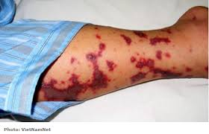
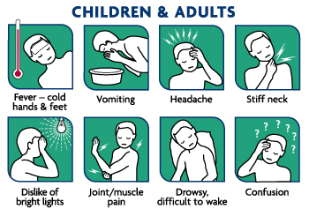
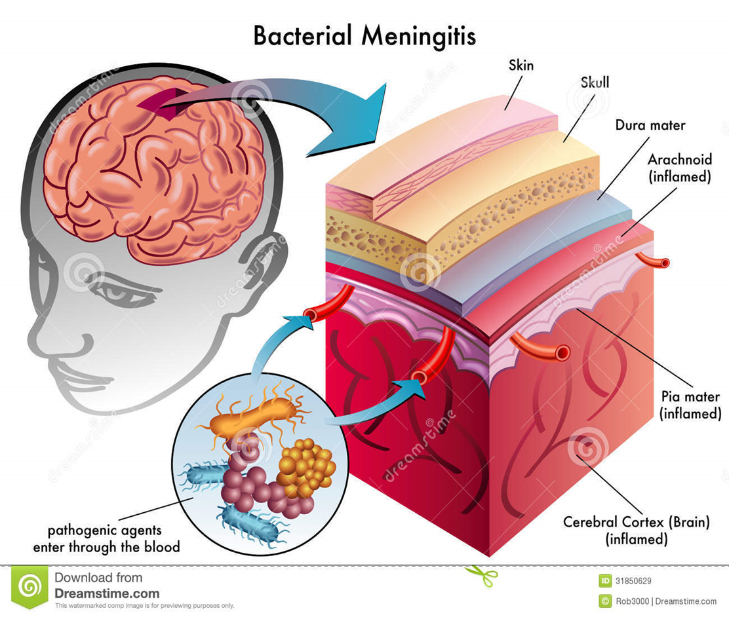
Meningitis- Epidemiology :
There are 1.2 million cases annually worldwide.
135,000 deaths.
Bacterial meningitis is 1 of the top 10 infections causes death worldwide.
Half of the survivals suffer neurological damage, and /or permanent side effects.
Signs/Symptoms of Acute Meningitis
Most Common | In infants they don’t show with neck stiffness like adult, they come with unspecific symptoms like: | Advanced Cases | Advanced disease
fever Headache severe Stiff neck Nausea & vomiting Sensitivity to light Confusion | Inactivity Irritability Vomiting Poor feeding | bruises under skin & spread rapidly | Brain damage Coma Death
*Very important, it will come in the exam as a case
*Q: a boy 2 months old, he has hyperthermia ….etc , In this case the first thing we have to do is? Lumbar puncture.

Slide 5
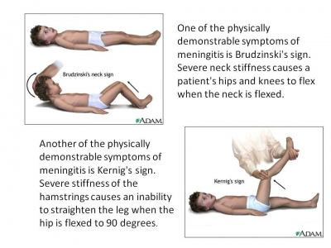
Kerning's sign is positive when the thigh is flexed at the hip and knee at 90 degree angles, and subsequent extension in the knee is painful (leading to resistance)
(Brudzinski's neck sign) is the appearance of involuntary lifting of the legs when lifting a patient's head off the examining couch, with the patient lying supine

Slide 6
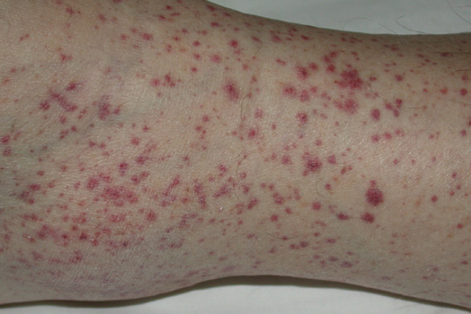
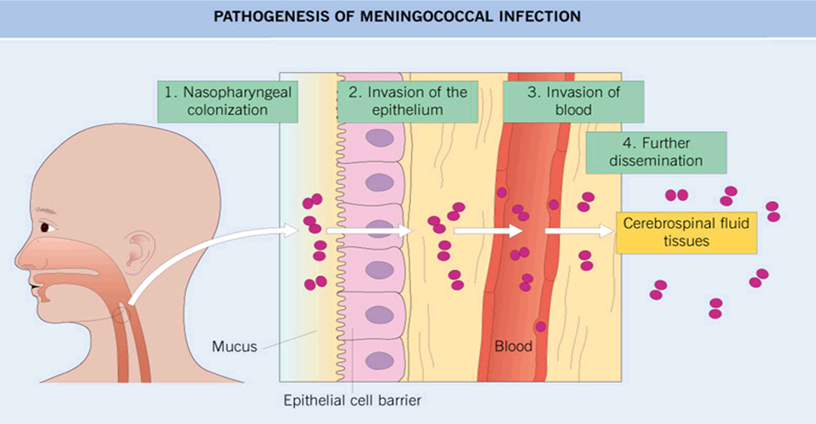
Pathogenisis :
Microorganisms colonize the nasopharynx or the birth canal Septicemia Organisms cross the BBB Cause widespread endothelial damage Activation of coagulation Thrombosis and platelets aggregation Bleeding : Skin rash and adrenal hemorrhage
Purpuric (inside the skin)
Nasopharynx or birth canal
blood
brain
-

Slide 7
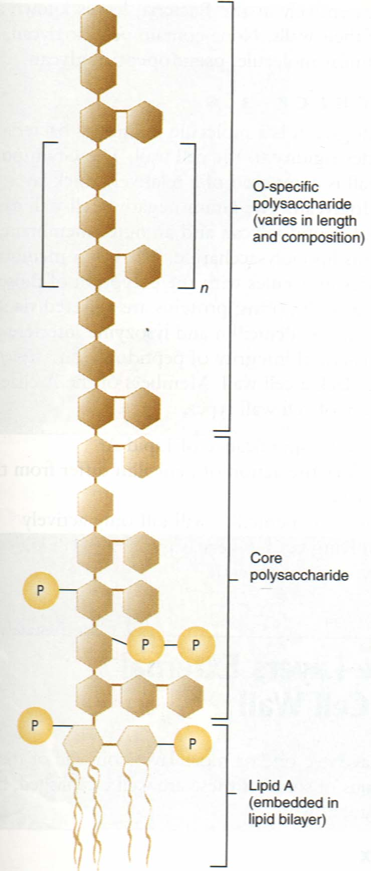
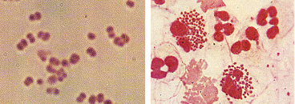
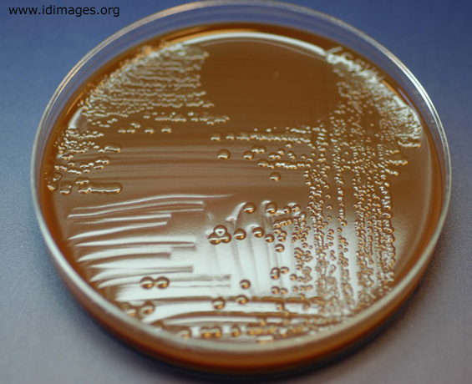
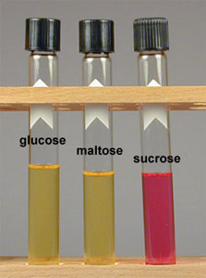
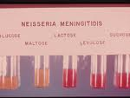
Neisseria Meningitides
General info. | Gram negative Diplococci – Present as normal flora of nasopharynx n 10% of people
Transmission | By inhalation of aerousal droplets and close contact
Prevalence | Common in children below 6 years
Risk Factors | Susceptible individuals ( with no antibodies)
Serotypes * | B,C,Y,W135 cause isolated ,sporadic small epidemics in close population. Serotype A has an epidemic potential in sub-saharan Africa (meningitis belt).
Pathogenisis | Carriers stimulate antibody production In some individuals , the bacterial pili attach to the nasopharungeal microvilli →invasion → bacteremia →endotoxin Lipopolysaccharide (LPS) produced → meninges. In case of carriers it stimulates antibody production its capsule resists phagocytosis
Prognosis | 11-20 % of recovered patients suffer permanent hearing loss, mental retardation. 10-14% of cases are fatal
Not vaccinated or they have a problem in their immune system.
Tests used to identify it:
1- chocolate agar (the best to diagnose bacteremia)
2- gram negative diplococci
3- sugar fermentation: glucose and maltose fermentive
*Very important you should know it, and it should be named as “serogroup” + (based on the difference of polysaccharide)
.

Slide 8
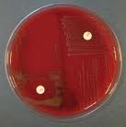
Streptoccous pneumoniae
General info. | Gram positive Diplococci
Risk Factors | May develop after trauma to the skull None vaccinated patients (infection rate decreased due to vaccination)
Pathogenisis | May follow a Pneumococcal pneumonia, or any other site infected with the organism. Pneumolysin toxin decreases inflammatory immune response and leads to severe infection. Capsule is polysaccharide polymer.
Prognosis | High mortality rate more than 30% with treatment ( due to invasive disease) Recovered patients develop learning disabilities.
Worse than N.meningitidis
Tests used to identify it:
1- a hemolytic blood agar
2- gram positive diplococci
3- optochin sensitivity no growness

Slide 9
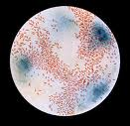
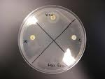
Haemophilus Influenzae
General info. | Small gram negative coccobacilli​ in the nasopharynx normal flora Has a polysaccharide capsule, other species have no capsule. Need blood for optimal growth, Hematin (factor X) and NAD ( factor V). Major cause of LRTI. Occasionally invade deeper tissues and cause bacteremia Bacteremia → CNS ,bones or other organs. Infection rate decreases since the routine use of Hib vaccine .(hemophilus influenzae type B)
Serotypes | Has many serotypes (from A to F). H.Influenzae type b has a capsule ,a polymer of polyribosyl-ribitolphosphate(RPR) ,cause acute life threatening invasive infections
Prognosis | 3-6% mortality rate. 1/3 of survivals have significant neurological sequelae.
Very important im MCQ’s
Have complications ( Deafness )
Tests used to identify it:
1- gram negative coccobacilli
2- satellite test

Slide 10
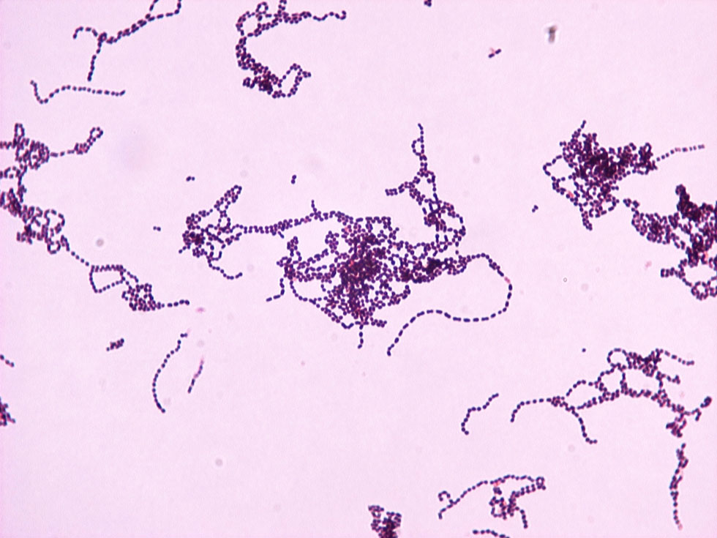
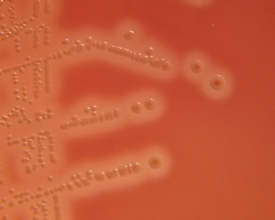
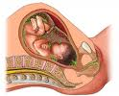
Group B Streptococcus
General info. | Gram positive cocci in chains , Catalase –ve , Resident Bacteria in GIT and vagina (10-30%)
Risk factors | premature rupture of membrane prematurity, low infant innate immunity
Pathogenesis | Gain access to the amniotic fluid during delivery → Colonize the newborn as it passes the birth canal → Cause sepsis and meningitis in the first few days of life or after 4 weeks.
If we discovered Group B in pregnant lady after swapping the vagina we give the baby prophylaxis because if the baby was born while the mother had Group B streptococcus or UTI this will cause an early ( they will comeback to the hospital after 1-2 weeks ) or late infection to the baby. Early infection( from the mother) usually have sepsis or pneumonia while the late infection (from the people surrounding the baby) might develop meningitis.
Tests used to identify it:
1- b hemolytic blood agar.
2- gram positive cocci in chains)

Slide 11
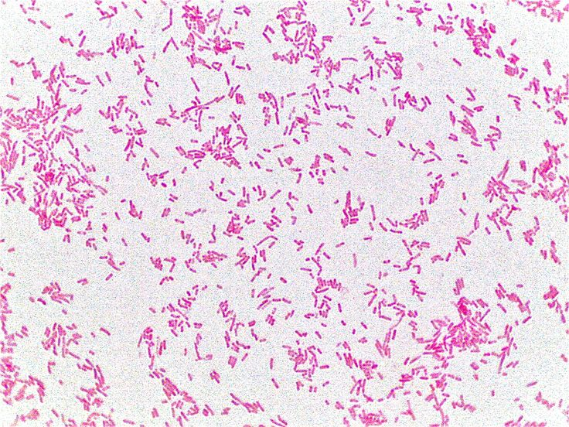
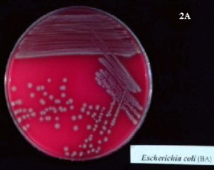
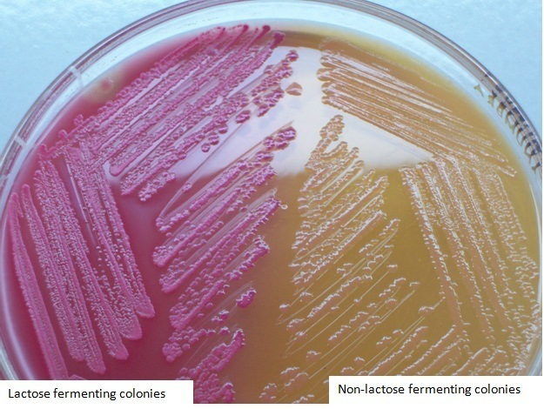
Escherichia Coli
General info. | Gram negative bacilli , Catalase +ve ​, Oxidase +ve ​ , Lactose Fermenter Similar to Group B Streptococcus Most common cause of neonatal meningitis
Pathogenesis | Vaginal Escherichia Coli colonize the infant via a rupture of the amniotic membrane or during birth. Failure of preterm maternal IgM to cross the placenta, leading to a special susceptibility of the newborn to infections. K1 sialic acid capsule​ of some strains invade the brain microvascular endothelial cells.
Tests used to identify it:
1- b hemolytic blood agar
2- gram negative bacilli. 3- lactose fermentation

Slide 12
Listeria Monocytogenes
General info. | Gram positive rods (diphtheroids like) , ​Catalase +ve Human intestinal colonization (2-12%) Causes meningitis in newborns and immunosuppressed patients
Pathogenesis | Widespread among animals in nature including those associated with certain foods (cheese and meet) Spread to fetus following hematogenous spread in the mother, or from the birth canal. Has tropism to the CNS.
Elderly, pregnant lady, children
Diagnosis of Meningitis
Clinically ( symptoms , signs , history ) Specimen : CSF acquired through lumbar puncture and blood specimen for culture CSF : Analysis of cells. protein. glucose . Chloride Culture and antimicrobial susceptibility testing.

Slide 13
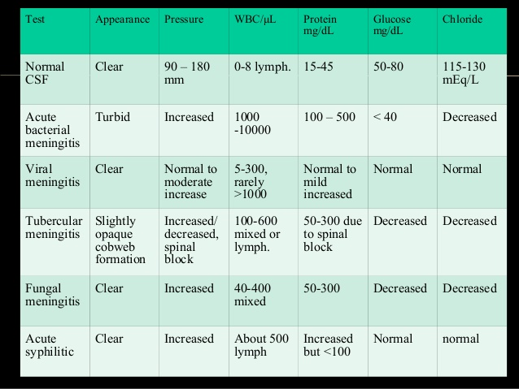
Only in female’s slides
Only in male’s slides
Don’t memorize the numbers.
Only in female’s slides
CSF Findings
Increased protein level due to presence of inflammatory substance, dead organism, protein and WBC. Reduced glucose level ( Normally it is 2/3 of serum glucose level). Increased local white cell count (polymorphonuclear leukocytes.)

Slide 14
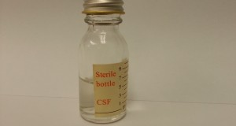
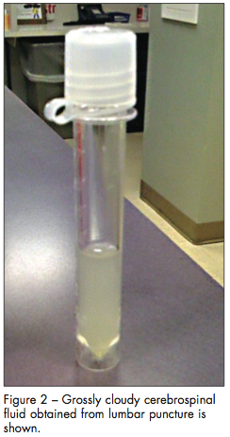
CNS parameters
Normal CSF | Pyogenic meningitis
Adults WBC =0-5 /cmm3, PMN= 0 %, glucose= > 60 % of blood, protein =< 30 mg/dl chloride = 115-130 mmol/l | WBC= 5 - 5000/cmm3 = 1000-5000/cmm3 (range 100-10000) PMN= > 60% Glucose = < 45 % of blood Protein= >60 mg/dl Chloride= 110 mmol/l
Neonates term : WBC =0-32 /cmm3, PMN=>60 %, glucose = >60 % of blood, protein= 20-170 mg/dl Preterm: WBC=0-29/cmm3, PMN= <60 %, glucose = >60 % of blood, protein= 60-150 mg/dl
Traumatic LP (not important)
True WBCs in CSF = Actual WBC in CSF - WBC in blood x RBC in CSF
_______________________
RBC in blood

Slide 15
Management
Urgent , A MEDICAL EMERGENCY Antibiotics after taking specimens for lab diagnosis Parenteral administration
Children & Adults: | Ceftriaxone (or Cefotaxime) + Vancomycin (cover the main 3 pathogens) .
Neonates : | Ampicillin + Gentamicin or Cefotaxime Modify treatment after lab results ( as needed).
Duration : | 10-14 days ( or more ) according to the medical condition.
Prevention: | Vaccination | Prophylactic antimicrobial agent for contacts (Hib & N.meningitidis)
Immediately start with antibiotics.

Slide 16
SUMMARY:
Pyogenic meningitis is an inflammation of the meninges affecting Pia, Arachnoid and subarachnoid space. In newborns : Group B Streptococcus , Escherichia Coli , Listeria Monocytogenes In infants : Streptococcus Pneumoniae , Neisseria Meningitidis , Haemophilus Influenzae In adults : Streptococcus Pneumoniae , Neisseria Meningitidis Neisseria Meningitidis Gram negative diplococci Streptococcus Pneumoniae Gram positive diplococci​ Group B Streptococcus Gram positive cocci in chains Haemophilus Influenzae Small gram negative coccobacilli​ Escherichia Coli Gram negative bacilli Listeria Monocytogenes Gram positive rods CSF analysis : high protein , low glucose , increased WBC , Polymorphonuclear cells (Neutrophils). URGENT, A MEDICAL EMERGENCY. Parenterally:​ Ceftriaxone (or Cefotaxime) + Vancomycin For neonates : Ampicillin + Gentamicin (or Cefotaxime).

Slide 17
QUIZ:
1.A 6-week neonate presented with fever and loss of appetite. LP has revealed the following: presence of cocci gram positive organism in chain. Which one of the following is the most likely causative organism:
a. Group B Streptococcus b. E.coli c. Listeria d. Streptococcus Pneumoniae .
2.For the previous scenario, what is the most appropriate antibiotic:
a. Gentamicin + Ampicillin
b. Gentamicin + Vancomycin
c. Ceftrixone + Vancomycin
d. Amoxacillin + Ceftrixone
3. A 24-years old presented to the ER with neck stiffness and fever. From the history he performed his pilgrimage “HAJJ” by illegal way. LP confirmed that he had meningitis with the result of gram negative diplococci. Which one of the following is the most likely causative organism. :
a. H.infleunzae
b. Streptococcus pnemoniae
c. Nesseria meningitidis d. Lesteria
4.From the previous scenario. What is the most appropriate antibiotic:
a.Gentamicin + Ceftrixone
b. Gentamicin + Vancomycin
c. Ceftrixone + Vancomycin
d. Amoxacillin + Ceftrixone
Answers : 1-A 2-A 3-C 4-C

Slide 18
THANK YOU FOR CHECKING OUR WORK, BEST OF LUCK!
Hamad Alkhudhairy
Yousef aljebrin
Majed alzain
Ibrahim aldeeri
Shrooq Alsomali
Sara Alshamrani
Ghaida Alsaeed
Doctors slides

