Slide 1
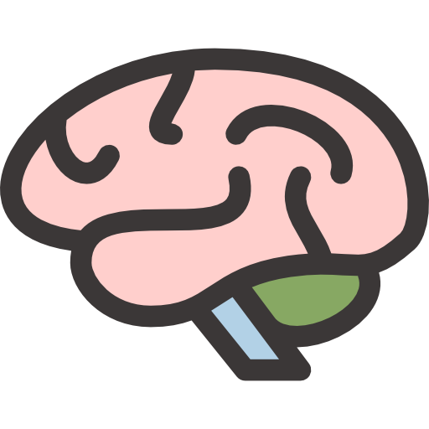
LECTURE: Cerebral TB and other chronic
Cerebral bacterial infection
Editing File
Important
Doctor’s notes
Extra explanation
Only F or only M
"لا حول ولا قوة إلا بالله العلي العظيم" وتقال هذه الجملة إذا داهم الإنسان أمر عظيم لا يستطيعه ، أو يصعب عليه القيام به .

Slide 2
OBJECTIVES:
Upon completion of the lecture , students should be able to:
Etiology
Identification
Clinical presentation
Diagnostic approaches
Treatment Of chronic cerebral and meningitic infections.

Slide 3
Symptoms and signs of chronic cerebral and meningetic infection: over long period or can be recurrent
SYMPTOM: | SIGN:
Chronic headache | +/-Papilloedema (TB infects base of the skull so it causes papilloedema)
Neck or back pain | Brudzinski or Kerning 'positive sign of meningeal irritation
Change in personality | Altered mental status, memory loss, etc
Facial weakness | Seventh nerve palsy
Double vision ,visual loss | 3,4,6 th,Nerve palsy
Arm and leg weakness | Ataxia
clumsiness | Hydrocephalus
They are similar to symptoms of a brain tumor.

Slide 4
Microbiological Causes Of Chronic Cerebral Infection And Meningitis:
Bacteria: (most sever) Most Important. | Common in saudi : | Brucella-Brucellosis , TB-Tuberculosis
 | Partially treated acute meningitis: | Neisseria Meningitidis , Streptococcus Pneumoniae , Haemophilus influenzae.
 | Others: | Syphilis by Treponema Pallidum, Leptospirosis by L. Ictero haemorrhagica, Lyme Disease by Borrelia burgdorferi - Lyme Disease (not common in Saudi Arabia), Nocardiosis by Nocardia Asteroids e.g. N. Asteroids, Cerebral abscess can also same – preferred as chronic infection.
Fungal: | Cryptococcus neoformans ( Aids patients), Candida species (in Saudi Arabia species mainly Candida albicans in immunocompromised patients) , Aspergillus species ( cancer patients + very common) , Histoplasma capsulatum.
Parasitic: | Toxoplasma gonodii (most common , from kittens ) , Trypanosoiasis (caused by Trypanosoma brucei gambiense , Trypanosoma brucei rhodesiense , Trypanosoma cruzi Acanthamoeba spp (Rare causes).
Virus: (less sever) | Some virus can some present as chronic meningitis these include: Mumps , Herpes simplex , HIV.
fungal infection doesn’t come to normal person, usually has underlying disease.
Nocardia is a pyogen which causes brain abscess
Syphilis used to be uncommon, but when HIV arised, with it came back syphilis.
Notes:
1- النص المضلل بالأصفر: فضلا إضافة النص الناقص من سلايد الدكتور رقم 6 وهو
Trypanosoiasis: caused by
Trypanosoma brucei gambiense and Trypanosoma brucei rhodesiense
Trypanosoma cruzi

Slide 5
The most important causes of chronic bacterial cerebral and menigetic infection in Saudi Arabia are :
Tuberculosis
Brucellosis
They should differentiated on the basis of:
Clinical History
Occupations
Clinical symptoms
Cerebrospinal fluid findings
Clinical signs in other organism

Slide 6
Brucellosis:
Etiology | Brucella Species | Gram -ve Coccobacilli | Brucella Melitensis is the most common in Saudi Arabia
Transmission | Contact with domestic animals or consumption of raw milk and dairy products ( camels )
Presentation | ● It usually presents with Pyrexia (fever) of unknown organism of intermittent nature. ● The fever is accompanied by night sweating, however, in between the attacks of fever the patient is not very ill. ● Because the symptoms are not specific and flu-like, untreated Brucilla can invade the CNS, causing chronic cerebral infection and meningitis.
Laboratory | CSF culture and Serology.
Treatment | Two of the following 3 drugs ● Tetracycline ● Rifampicin ● Cotrimoxazole Rifampicin and Cotrimoxazole are preferred as they have good penetration power in the BBB.

Slide 7
Tuberculosis
Etiology: | Mycobacterium Species (Resist Staining) Mycobacterium tuberculosis which infected 1\3 the human race
Presentation: | The patient usually presents with fever of long duration You will never have TB without fever. Symptoms of cough, and coughing blood (Haemoptysis) when the chest is affected. It can present as meningitis or cerebral infection with chronic neurological symptoms and signs. Parenchymal CNS involvement can occur in the form of tuberculoma or, more rarely, abscess. Spinal meningitis,radiculomyelitis, spondylitis, or spinal cord infraction pott’s spine and pott’s paraplegia
Classification
Intracranial | spinal
Tuberculous meningitis (TBM). TBM with Miliary Tuberculosis. Tuberculous Encephalopathy and Vasculopathy. Single or multiple space-occupying lesions (Tuberculoma). Tuberculoma with Miliary Tuberculosis. Tuberculous abscess | Pott’sspine. Pott’sparaplegia. TuberculousArachnoiditis (myeloradiculopathy). Non-osseousspinaltuberculoma. Spinal meningitis.

Slide 8
Chronic cerebral and meningeal infection can produce:-
Neurological disability and, may be Fatal if not treated They usually have Slow insidious onset with progression of signs and symptoms over a period of weeks* They differ from those of acute infection which have Rapid on set of symptoms and signs They are usually diagnosed ,if the neurological syndrome exists for > 4 weeks
*which is a good thing because it gives more time to diagnose

Slide 9
Diagnosis of chronic cerebral and meningeal infections
History for Brucellosis and Tuberculosis
Clinical examination
Imaging by x- ray or MRI or ultrasound
Laboratory findings
As in acute pyogenic infections, in chronic cerebral and meningeal infections the following CSF finding will be as follows:
CSF Findings
Increased CSF pressure indicating increased intra cranial pressure. Increased protein level due to presence of inflammatory substance, dead organism, protein and WBC. Reduced glucose level ( Normally it is 2/3 of serum glucose level). Increased local white cell count but in chronic infection the differential shows lymphocytosis while in acute infections there is increased % of polymorphonuclear leukocytes. Gram stain can sometimes show the causative organism. Z-N Stain (Ziehl-Neelsen stain) can show AFB (acid-fast bacilli) of T.B while modified Z-N can show Nocardia
Notes:
1- النص موجود في سلايد الدكاترة ولم تتم إضافته

Slide 10
Diagnosis
Clinical | CSF | Imaging
Fever and headache for >14 days. Vomiting. Altered sensorium or focal neurological deficit. Mantoux test (Tuberculin skin test) occupying lesions (Tuberculoma). Tuberculoma with Miliary Tuberculosis. Tuberculous abscess | Microscopy: Z.N. Stain. Culture: on L.J. or Fluid Medium. PCR. Pleocytosis : >20 cells, >60% lymphocytes. Increased proteins : >100 mg/dl. Low sugar: <60%. Malignant cells: should be -ve. (because tb formation a granuloma which a mass so it be confuse with tumor) | Exudates in basal cisterns or in sylvian fissure hydrocephalus. Infarcts (basal ganglionic). Gyral enhancement. If it is meningitis, we would find vascular enhancement Tuberculoma formation.
Treatment:
For the first 2 months: Rifampicin + Isoniazid (INH) + Ethambutol + Pyrazinamide Then, for 4-6 months: Rifampicin + Isoniazid (INH)

Slide 11
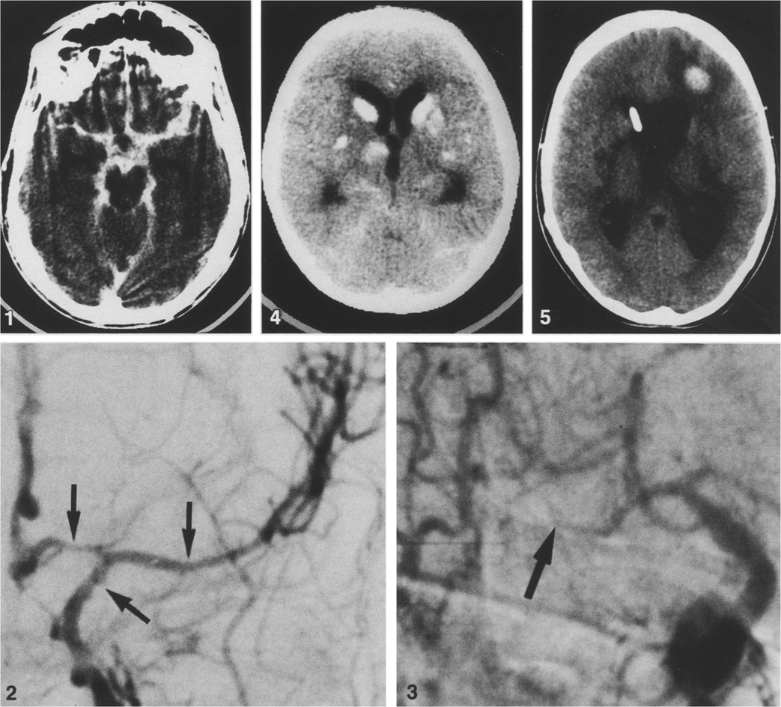
Extra
intense enhancement of the basal subarachnoid
cisterns in acute/subacute TB meningitis

Slide 12
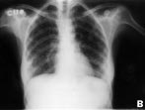
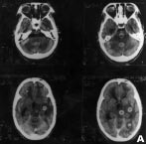
Case report: disseminated tuberculosis
A 30-year-old woman presented with headache, vomiting and fever (104°F), and feeling disoriented and inattentive for 6 days duration. She was conscious, had lateral rectus palsy along with bilateral papilledema¹. Left plantar was extended. Neck rigidity and Kernig’s sign were present. Other systemic and general examinations were normal. All hematological and serum biochemical parameters, including liver function tests, were normal. Chest X-ray showed miliary² shadows in both lungs (figure1). CSF revealed elevated opening pressure, proteins 248 mg/dl, sugar 34 mg/dl (corresponding blood sugar was 98 mg/dl); 204 cells/ml, 15% polymorph, the rest was lymphocytes (85%). CT of the head showed multiple small enhancing lesions in brain parenchyma (figure2). The patient was given antituberculous treatment and corticosteroids³. She showed significant improvement in all her symptoms after 15 days.
1
2
¹This means that there is increased intracranial pressure. Possible diagnosis of Acute Pyogenic Meningitis.
²Miliary indicates a hematogenous spread, you will notice small spots in the lungs.
³When you give steroids to a patient and he/she gets better, this proves the involvement of the immune system as a cause of disease. TB uses the immune system to cause a disease, so to obtain a better result in treatment the anti TB
is given with the steroids.

Slide 13
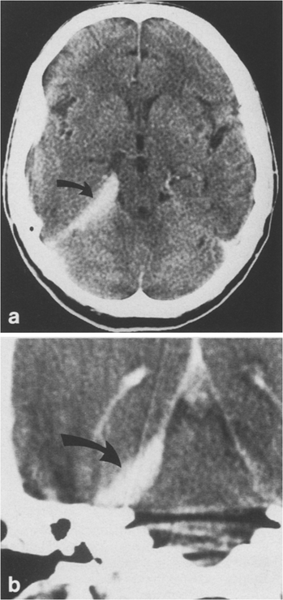
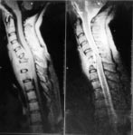
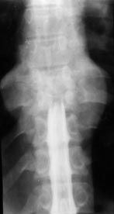
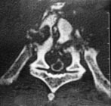
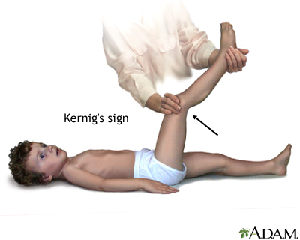
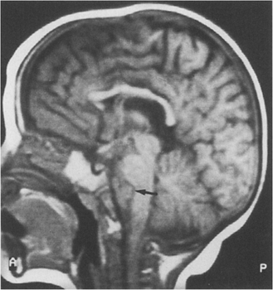
EXTRA
A lumbar myelogram showing spinal block at the level of T9 vertebra, a paraspinal abscess producing spinal block, paraspinal abscess compressing the spinal cord.
A sign indicating the presence of meningitis (inflammation of the meninges covering the brain and spinal cord). The test for Kernig sign is done by having the person lie flat on the back, flex the thigh so that it is at a right angle to the trunk, and completely extend the leg at the knee joint.
CT demonstrating Tuberculoma

Slide 14
Laboratory Findings:
This is mainly related to the laboratory examination of cerebrospinal fluid including:-
Collect of 2-5 ml of CSF and checking for the pressure
Biochemical investigation for :
Total protein
Glucose level in comparison to the serum glucose level
Microscopy:
Presence of organism
Total white cell count
Differential count mainly for:-
Polymorphic
Lymphocytes

Slide 15
Laboratory diagnosis of cerebral and meningetic Tuberculosis and Brucellosis
Mantoux test, Tuberculin skin test(TST)
Chest x-ray for primary focus
CSF microscopy for AFB
CSF culture an solid medium L.J or fluid medium.
PCR or other molecular biopsy test for presence of bacterial element (it is fast but sometimes gives false negative)
Culture of CSF for Brucella
Serology for Brucella
Combination of these finding with clinical history and examination finding :
VDRL and other serological causes for syphilis
Wet preparation of CSF for fungal and parasite
India ink for Cryptococcus neoforman
Culture for CSF for Brucella,T.B Mycobacterium tuberculosis, Leplospira other Bacteria

Slide 16
SUMMARY:
TB and Brucellosis are the most common cause for chronic cerebral infections. Brain is involved so sensory and motor symptoms will appear . Its important to take a good clinical history to differentiate between TB and Brucellosis. Brucellosis is gram (-) bacteria coccobacilli , transmission from Contact with domestic animals or consumption of raw milk and dairy products ( camels and gouts ). Treatment of brucellosis is combination of two antibiotics usually Rifampicin and Cotrimoxazole . TB Mycobacterium Species (Resist Staining) so we use Z-N stain . TB patient usually presents with fever of long duration. CSF findings shows high protein , low glucose , high CSF pressure , lymphocytosis .

Slide 17
QUIZ:
1. the commonest parasitic cause of chronic cerebral infarction an meningitis is:
Gambines
b) acanthamoeba
c) toxoplasma gonodii
d) borlaexaust
2. between the attacks of fever the patient isn’t very ill, it indicate which one of the following micro organism:
a) T.B
b) Pneumonia
c) Candida
d) Brucellosis
3. Which of the following drugs is contraindicated when treating a child with brucellosis:
a) Refanpicin
b) Cotrimoxazole
c) Tetracyclin
d) pyrazinamide
4.which one of the following is a major risk factor of T.B in Saudi Arabia:
AIDS
b) diabetes mellitus c) U.R.T.I
d) myocardial infarction
5.which one of the following should be excluded before diagnosing a patient with T.B
a) Pneumonia
b) Angina pectoris
c) Brucellosis
d) L.R.T.I
6. the commonest bacterial cause of chronic cerebral infarction and meningitis is:
a) T.B + brucellosis
b) brucellosis + S.Pneumonia
c) T.B + E. Coli
d) pseudomonas aeruginosa
Answers : 1-C 2-D 3-C 4-B 5-C 6-A

Slide 18
Case:
Khalid , a 35 -year-old male went to see a neurologist in KKHU because of chronic headache. He reported that he has been suffering from unresolved severe headache with fever and night sweats , between fever he doesn't’t feel sick. he told the doctor that he loves drinking camel milk.
Q1) What is your diagnose ?
Ans) Brucellosis
Q2) regarding your diagnose , what is the proper treatment ?
Ans) Rifampicin and Cotrimoxazole .

Slide 19
THANK YOU FOR CHECKING OUR WORK, BEST OF LUCK!
Hamad Alkhudhairy
Talal alhuqayl
Nawaf alkhudhairy
Saud alshenaifi
Abdulmalik alghanam
Meshal aleiadi
Ibrahim fetyani
Shrooq Alsomali
Ohoud Abdullah
Rana Barasain
Doctors slides

