Slide 1
LECTURE: VIRAL INFECTION OF THE CNS
Editing File
Important
Doctor’s notes
Extra explanation
Only F or only M
"لا حول ولا قوة إلا بالله العلي العظيم" وتقال هذه الجملة إذا داهم الإنسان أمر عظيم لا يستطيعه ، أو يصعب عليه القيام به .

Slide 2
OBJECTIVES:
Acute viral infections of the CNS.
Aseptic meningitis , Paralysis &Encephalitis
Enteroviruses & polioviruses.
Herpes simplex virus 1.
Rabies virus.
Arboviruses (West Nile virus).
structure
Epidemiology
Pathogenesis
clinical presentations
Lab diagnosis
Treatment & prevention

Slide 3
Virus neurological diseases:
Three groups of infection
Acute viral infections of the CNS.
Meningitis, paralysis & encephalitis
Chronic virus neurological diseases.
SSPE, PML, C-J disease, tropical spastic paraparesis, HIV dementia.
Neurological diseases precipitated by viral infections.
Reye’s syndrome, Guillian-Barré syndrome.

Slide 4
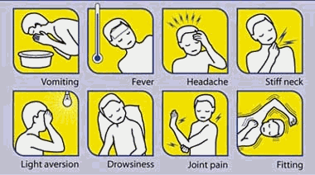
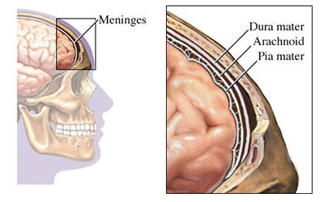
Meningitis:
-It includes the inflammation caused be an infection to the meninges or CSF
Caused by:
Infectious agents:
-bacteria
-viruses
-Fungi
-protozoa
Non-infectious agents.
Symptoms:
Viral meningitis* (we will talk about it in this lecture) | Bacteria meningitis*** (another lecture)
Aseptic meningitis Caused by virus. Less severe Resolves without specific treatment within a week or two** | Septic meningitis Caused by bacteria Quite severe and may result in a) brain damage b) hearing loss c) learning disability It would also causes death!
**spontaneously
*Usually cause by virus and the CSF finding is negative (Aseptic)
***Its an emergency case and need empirical treatment

Slide 5
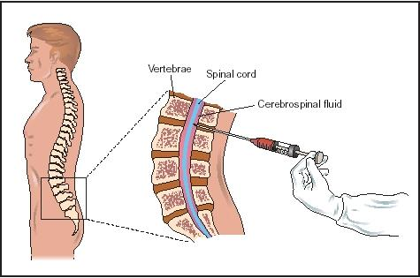
Viral Meningitis (Aseptic meningitis):
Etiological Agents:
Enteroviruses The most common cause of viral meningitis
Other :
Mumps virus .
Arboviruses.
Herpes viruses.
Human Immunodeficiency Virus
Lymphocytic choriomeningitis virus.
Incident has been decreased due to the vaccination
Cerebrospinal fluid (CSF) analysis:
 | Normal | Aseptic meningitis | Septic meningitis
Colour | Clear | Clear | Cloudy
Cells/mm³ | < 5 | increase 100-1000 Lymphocytes | High/v. high 200-20,000 Neutrophils
Glucose mg/dl | 45-85 | Normal | Low<45*
Protein mg/dl | 15-45 | Normal/high 50-100 | High>100
Causes |  | Viruses , others | Bacteria
*consumes by the bacteria

Slide 6
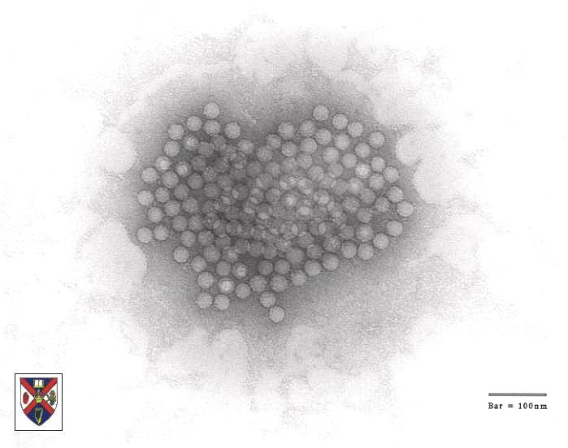
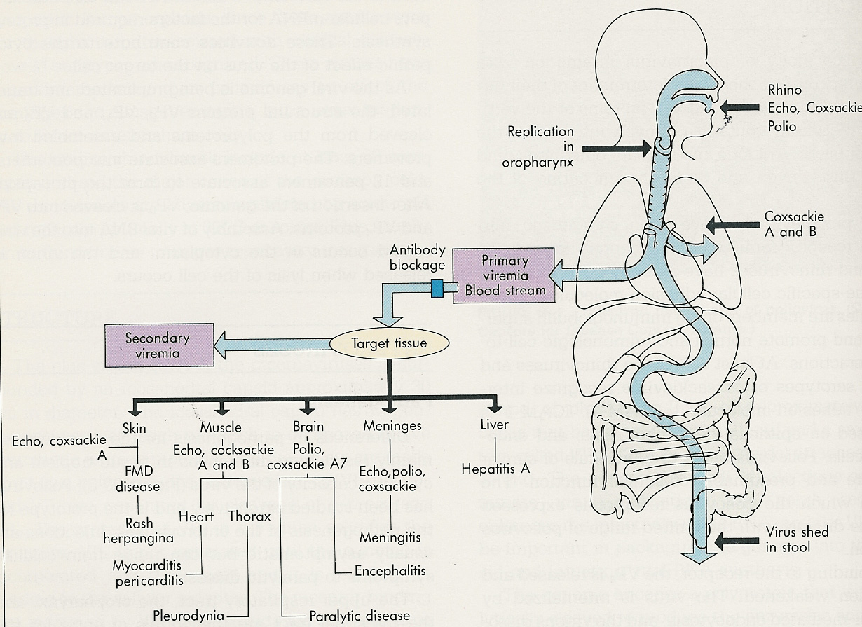
Enteroviruses:
Nonenveloped , icosahedral , ss (+) RNA
Family : | Picornaviridae
Include: | Poliovirus(1, 2&3 types) Coxsackieviruses (A&B) Echoviruses Enteroviruses (68-71)
Epidemiology:
Reservoir: | Human
Spread : | Fecal - oral route (mainly) Inhalation of Infectious aerosols (Crowded, Poor hygiene & Sanitation)
Age : | children > adults
Seasonal distribution*: | summer & fall
Pathogenesis:
HFM
Echo, coxsackie
*Major seasons for enteroviruses infection

Slide 7
Enteroviral infections
Asymptomatic Infections
Diseases:
Neurologic Diseases | Poliovirus Types 1-3 | GP A COX. Types 1-24 | GP B COX. Types 1-6 | Echovirus Types 1-34 | Enterovirus Types 68-71
Aseptic meningitis* | 1-3 | Many | 1-6 | Many | 71
Paralysis** | 1-3 | 7,9 | 2-5 | 2,4,6,9,11,30 | 70,71
Encephalitis*** |  | 2,5-7,9 | 1-5 | 2,6,9,19 | 70,71
NON-Neurologic Diseases:
Respiratory tract infections. Skin and mucosa infections; Cardiac infections Acute hemorrhagic conjunctivitis Others
2-Cardiac and muscular:
Pleurodynia (epidemic myalgia)
Myocarditis, pericarditis
3- Skin and mucosa infections;
Herpangina
Hand-foot-and-mouth disease
Exanthems
3-Acute hemorrhagic conjunctivitis
4-Respiratory tract infections.
5-Others
*Self limiting disease
**flaccid paralysis
***sever

Slide 8
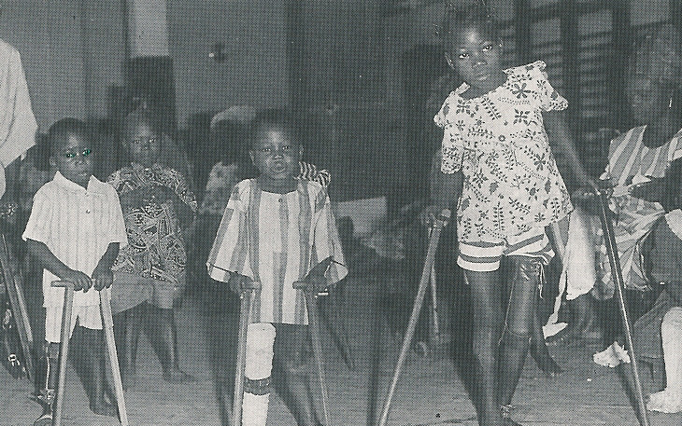
Pathogenesis of polio:
Pathway to CNS by:
Blood
Peripheral nerves
Causing destruction of motor neurons of AHCs
Rarely affects brain stem (bulber poliomyelitis)
شلل الاطفال
Poliovirus Infections:
No illness: | 90-95% | Asymptomatic
Minor Illness*: | 4-8% | Abortive poliomyelitis (No CNS involvement)
Major Illness: | 1-2% | 1- Nonparalytic poliomyelitis (Aseptic meningitis) 2- Paralytic poliomyelitis: (Flaccid paralysis)
*Non-specific signs and symptoms

Slide 9
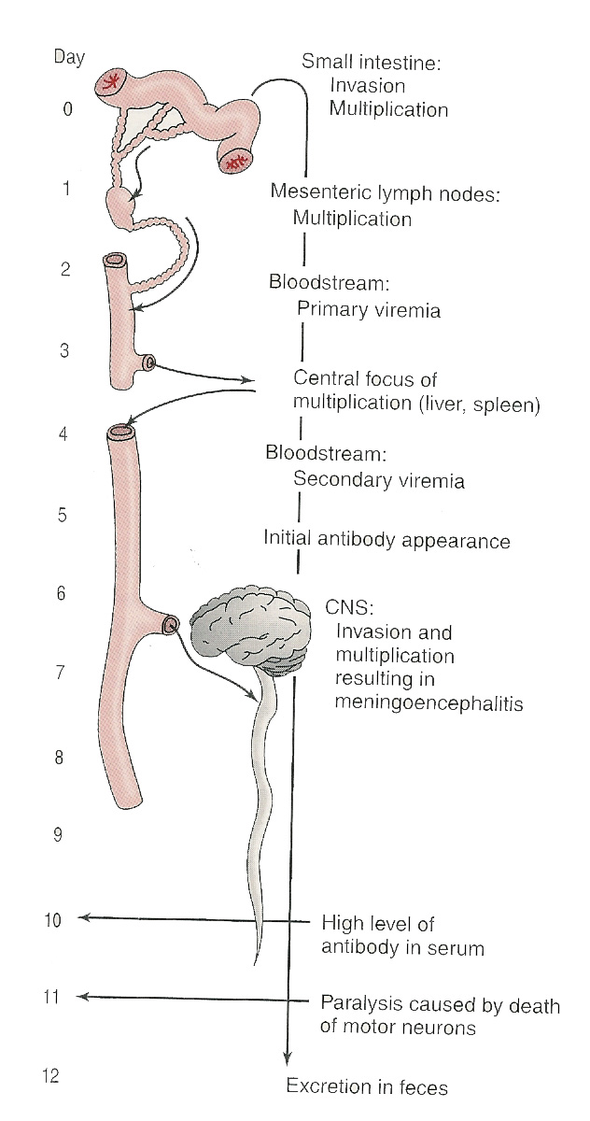
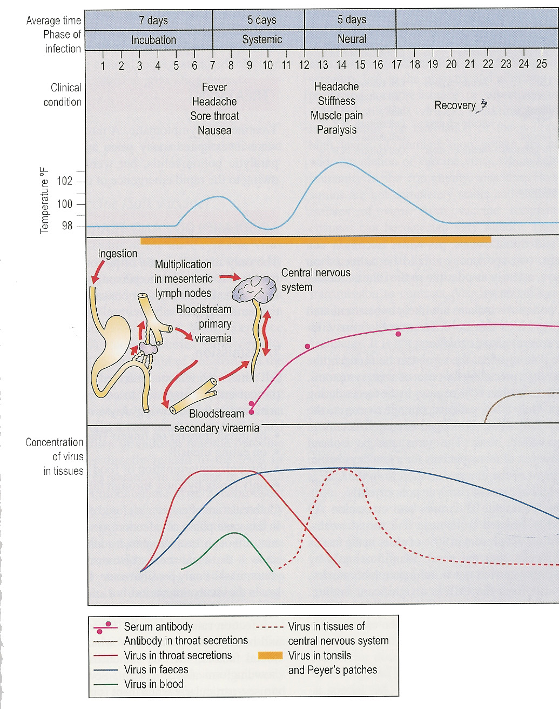
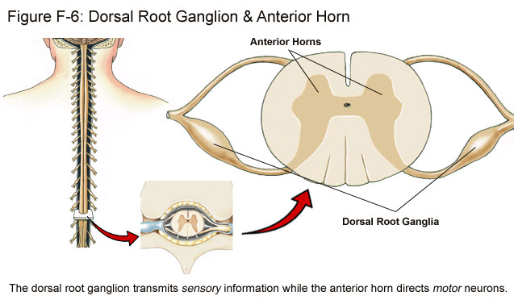
Pathogenesis of polio:
Non-specific symptoms
Immunity: IgA & IgG = Lifelong type-specific immunity

Slide 10
Lab Diagnosis of Enteroviruses
Virus isolation: | Samples: | Stool (best) / Rectal / throat swabs / CSF Inoculate in cell cultures* - in MKC & HDF All EVs grown except some strains of Cox A viruses
 | Observe: | for CPE (cytopathic effect)
 | Identify: | the type by Neutralization Test
 | CSF in aseptic meningitis: | lymphocytosis Glucose level normal to slightly low Protein level normal or slightly high Isolation rate is variable EV(enteroviruses) RNA detected in CSF by RT-PCR
Serology: | (limited value)
Very low the appearance of enteroviruses
The best and gold standard to diagnose
Management
treatment: | No antiviral treatment
Prevention: | Sanitation & Hygienic measures
 | Poliovirus vaccines: | a- Inactivated polio vaccine (IPV) for adult (Salk, Killed) (S/C or IM) b- Live-attenuated polio vaccine (OPV) for children (Sabin, oral)
*Not all of them grow
IPV = injection, OPV = orally
Cytopathic effect (CPE): Any possible change in the appearance of the infected cell (CPE can take several forms) *foundation*

Slide 11
Important Features of Polio Vaccines:
Attribute | Killed (IPV) | Live (OPV)
3 types (trivalent)* | Yes | Yes
Prevents disease | Yes | Yes
Induces humoral IgG | Yes | Yes
Route of administration | Injection | Oral
Induces intestinal IgA | No | Yes
Interrupts transmission | No | Yes
Affords 2º protection by spread to others | No | Yes
Reverts to virulance | No | Yes (rarely)
Causes disease in the immunocompromised | No | Yes
Co-infection with other EVs may impair immunization | No | Yes
Requires refrigeration | No | Yes
Duration of immunity | Shorter | Longer
Against viremia
Notes: 1- immunocompromised and Adult should take the Killed (IPV) type
2- Children take the Live (OPV) type which also oral administration 3- The Live (OPV ) rarely cause paralysis while killed (IPV) not
*Protect against the three types of viruses

Slide 12
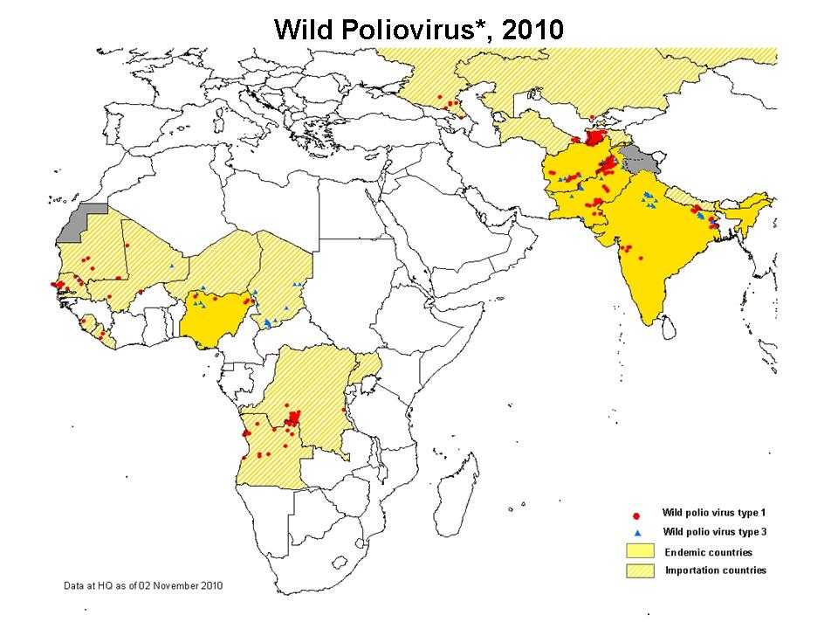
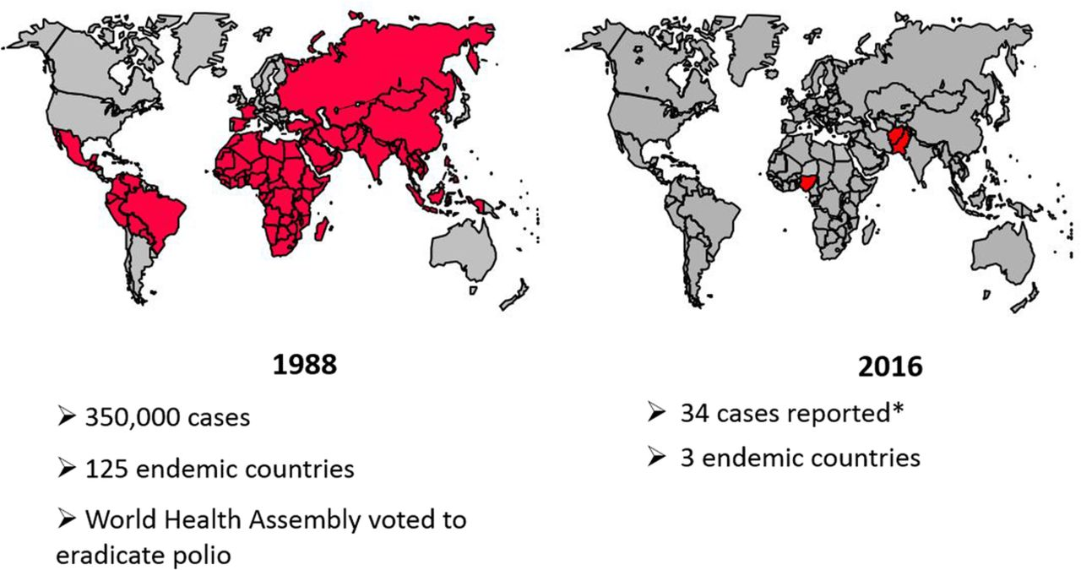
Poliovirus Vaccine:
Adverse reactions ;
local reactions (IPV)
Vaccine -Associated Paralytic Poliomyelitis (OPV) adult , immunocompromised*
4 doses of PV; 2, 4 , 6-18 ms & 4 - 6 yrs
Combination vaccine (Pediarix): contains :IPV, DTaP ,Hib & HB vaccines
At the site of injection
Polio Vaccination of Adults
The Incident has been decreased due to the using of universal vaccination
Indications:
Travelers to polio-endemic countries
HCW
IPV
Take KILLED(IPV) type
Health care worker
*Should take the killed (IPV) type

Slide 13
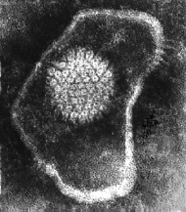
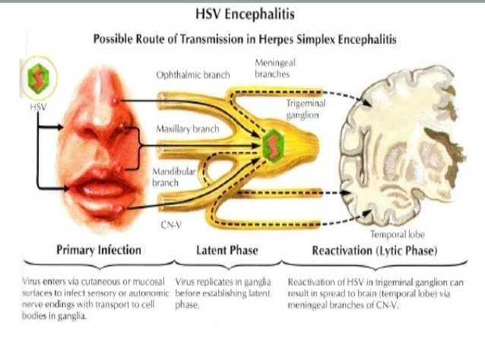
Viral Encephalitis:
Enteroviruses | Herpes viruses. | Rabies virus | Arboviruses | Others
Herpes Simplex Encephalitis:
Caused by:
Herpes simplex virus -1(HSV-1)
dsDNA , Enveloped , Icosahedral Virus
C/F:
Fever ,Headache ,Vomiting ,Seizures & altered mental status.
High mortality rate
Diagnosis:
MRI (magnetic resonance imaging)
CSF: Lymph: high
glucose: normal
Protein: high
detection of HSV-1 DNA by PCR.
Treatment:
Acyclovir.
Type 1
to find the lesion in the temporal lope
this is the only virus (from this group) that can be treated.
-Can transmitted by saliva or direct contact with physclis then travel to the peripheral nerve to the trigeminal ganglia and it will affect the temporal lop ( necrotic lesion )

Slide 14
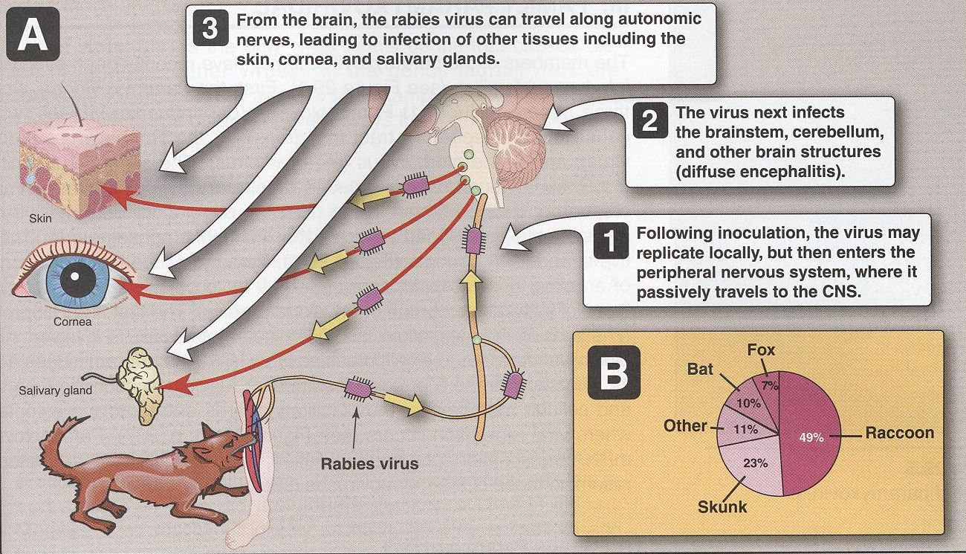
Rabies encephalitis:
s.s (-)RNA genome, Helical nucleocapsid, Enveloped virus.
Family: | Rabies virus :Rhabdoviridae.
Epidemiology;
Reservoir: | a- Major: Raccoons , Foxes, Wolves & bats. | b- Imp: cats & dogs
Transmission: | a- Common route (usually dogs) Bite of a rabid animal | b- Uncommon route Inhalation while in a bat infested cave Corneal transplant
Bullet shaped virus
Pathogenesis:
From animals to human
/ In USA rarely conceder as reservoir for the rabies because they are immunized

Slide 15
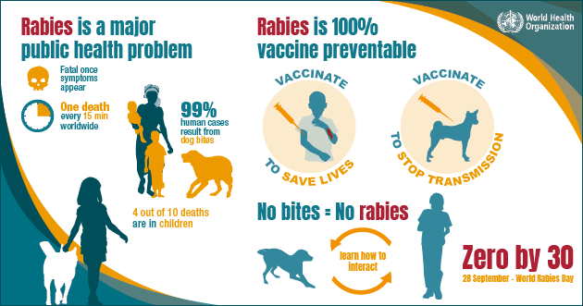
Rabies:
داء الكلب
a fatal acute encephalitis
zoonotic disease .
4 phase :
1-The incubation period: | 1-3 m > longer *
2-The prodromal phase: | Fever, Headache, Malaise, Anorexia, Nausea & Vomiting. Abnormal sensation around the wound.
3-Neurological phase: | A- encephalitis: Nervous , Lacrimation , salivation, Hydrophobia** , Convulsion ,coma & death . | B- Paralytic illness: Ascending , Death , associated with Bat bite.
4- Recovery: | Extremely rare
Non specific illness
Majority of illness
Due to infection of the spinal cord rather than brain
*Variable dependent on many factors including the location of the bite if it’s in head it will be shorter than in leg
**Fear from water due to painful spasm of pharyngeal muscles

Slide 16
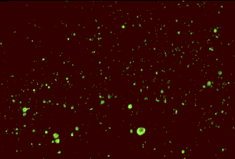
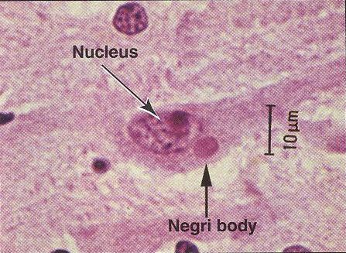
Laboratory Diagnosis:
PCR: | R. RNA in saliva
Rapid virus antigen detection* (IF): | Neck skin biopsy Corneal impressions Brain tissue
Histopathology: | neuronal brain cells intracytoplasmic inclusions (Negri bodies)
Virus cultivation
serology
The most sensitive and specific detection
Back of neck
Rabid brain stained with
Fluorescent anti-rabies antibody
Prevention:
Negri bodies are diagnostic of rabies.
Untreatable but preventable
Control measures against canine rabies include**: | Stray animals control. |  | Vaccination of domestic animals.
Pre-exposure prophylaxis (Vaccine): | Persons at increased risk of rabies e.g. vets, animal handlers etc.
Post-exposure prophylaxis: | Wound treatment | Passive immunization***: human anti-rabies immunoglobulin around the wound & I M. | Passive immunization: human anti-rabies immunoglobulin around the wound & I M. | Active immunization****: Human Diploid Cell Vaccine (HDCV), 5 - 6 doses
Such as people contact with animals
who exposed to the virus
water and antiseptic solution
**Vaccine of animal
***Immediate protection
*appear as a bright fluorescent apple green color when viewed with a fluorescence microscope
****Prolong immunity
/ Passive and active giving at the same time after exposure but different side

Slide 17
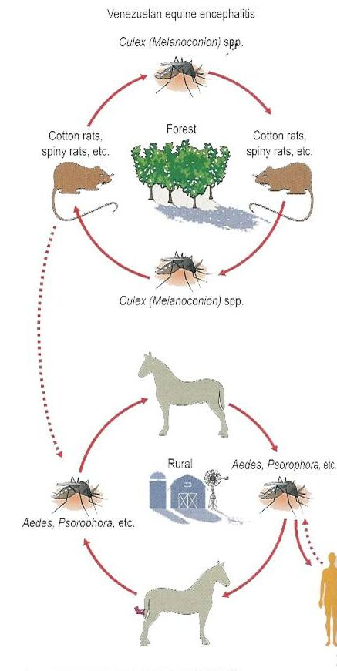
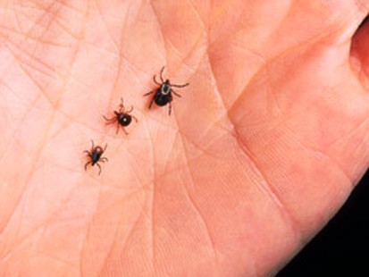
Arthropod –borne Viruses: Arboviruses > 500 Vs
Epidemiology;
Reservoir: | Wild birds & Mammals
Vector: | Mosquito, ticks& Sandfly
Transmission: | bite of infected vector
Infections: | Asymptomatic Infections
Diseases: | 1- Fever, Rash & arthralgia | 2- Hemorrhagic fever ± hepatitis | 3- CNS disease (meningitis & encephalitis)

Slide 18
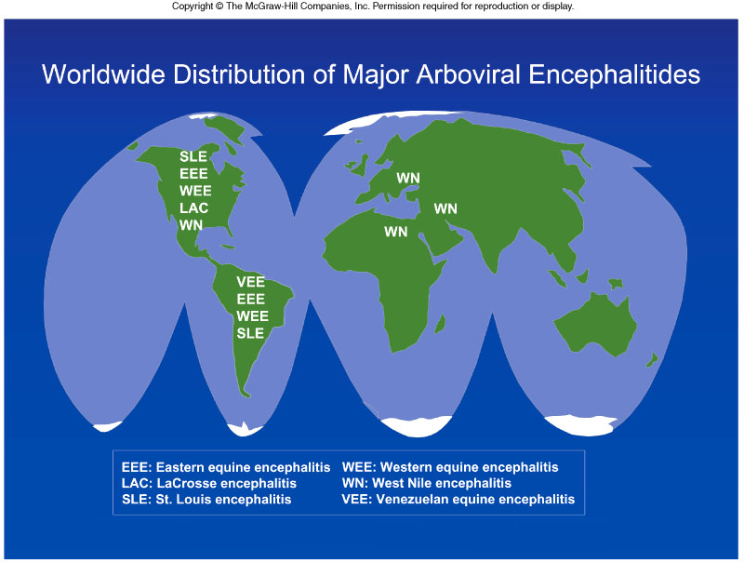
ArboVs associated with CNS disease:
Virus | Vector | Reservoir | Distribution
Eastern equine encephalitis EEEV | Mosquito | Birds | America
Western equine encephalitis WEEV | Mosquito | Birds | America
Venezuelan equine encephalitis VEEV | Mosquito | Rodent | America
Japanese encephalitis V | Mosquito | Birds Pigs | Orient
Murray Valley encephalitis V | Mosquito | Birds | Australia
West Nile V | Mosquito | Birds | Europe, Africa Middle East, Asia, America
Transmitted by

Slide 19
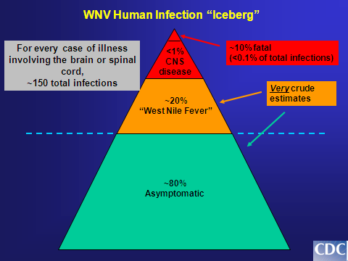
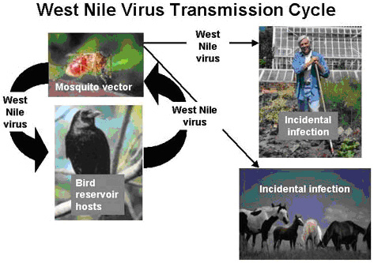
West Nile virus:
spread by infected mosquitoes
Flaviviridae (enveloped +ssRNA)
Febrile illness → meningitis , encephalitis
Laboratory Diagnosis:
Lab methods:
A- Isolation: (Gold standard ) (Reference Lab) | Samples: blood, CSF, Viscera .
 | Cell culture: → CPE → Identify
B- IgM -AB - ELISA, IF: | (most used)
C - Arbovirus RNA: | by RT-PCR
Most sensitive and rapid test
Prevention:
There is no specific treatment
1-Vector Control:
Elimination of vector breading sites
using insecticides
Avoidance contact with vectors ( repellants , net )
2-Vaccines:
Tick-borne encephalitis vaccine
Japanese encephalitis vaccine
There is no vaccine against west Nile encephalitis or meningitis

Slide 20
SUMMARY:
Disease | Causative agent | Route of transmission | symptoms | Lab diagnosis | Management | Vaccine
Polio | Polio virus ssRNA non enveloped | Fecal-oral route or inhalation | Asymptomatic in most, rarely causes aseptic meningitis and flaccid paralysis | Samples: CSF, blood, stool Test: PCR no serology | No antiviral | Adults: Inactivated polio vaccine Children: live-attenuated polio vaccine (gives IG-A immunity)
Viral encephalitis | Herpes dsDNA enveloped | -- | Fever, headache, seizure, high mortality | CSF shows: normal glucose high protein lymphocytosis | Acyclovir | --
Viral encephalitis | Rabies Rhabdovirus ssRNA enveloped | Rabid animal bites (bats and dogs) | Stages: 1.Incubation 2.Prodromal (fever, malaise, etc) 3.Symptoms 4. recovery is rare | PCR for saliva IF for rapid detection Histopathology: negri bodies serology | -- | For animals, prophylaxis, and after bite
West Nile | Arbo virus | Reservoir: birds Vector: mosquito | -- | Isolation of blood, CSF, and saliva IgM AB | -- | Tick borne encephalitis vaccine Japanese encephalitis vaccine

Slide 21
QUIZ:
Patient comes in with fever, headache, nausea, and a stiff neck. You test his CSF and its clear with lymphocytosis. After talking to the patient you discovered that he wasn’t vaccinated as a child, and has recently travelled to India, a very crowded city with poor hygiene. What is the causative agent of his illness?
Herpes
Poliovirus
Neisseria meningitidis
Streptococcus pneumonaie
2. Herpes Simplex is a virus that is ..
dsDNA
ssDNA
ssRNA
3. Which vaccine do you use for children?
Inactivated polio virus
Live attenuated polio virus
4. A vet comes into the ER with fever, headache, malaise, and hydrophobia. Upon further inspection you find that he has viral encephalitis due to a ssRNA virus. What could possibly be the route of transmission?
Rabid animal bite
Fecal-oral
Inhalation
Non of the above
Answers:
B
A
B
A

Slide 22
THANK YOU FOR CHECKING OUR WORK, BEST OF LUCK!
Hamad Alkhudairy
Shrooq Alsomali
Shatha Alghaihb
Rehab Alanazi
Najd Altheeb
Doctors slides
If the plan doesn't work, change the plan but never THE GOAL.

