Slide 1
LECTURE: Fungal Infections of Central Nervous System
Editing File
Important
Doctor’s notes
Extra explanation
Only F or only M
"لا حول ولا قوة إلا بالله العلي العظيم" وتقال هذه الجملة إذا داهم الإنسان أمر عظيم لا يستطيعه ، أو يصعب عليه القيام به .

Slide 2
OBJECTIVES:
To know the main fungi that affect the central nervous system and the clinical settings of such infections.
To acquire the basic knowledge about fungal meningitis and brain abscess: clinical features, etiology, diagnosis, and treatment.
Based on the doctor notes + foundation lectures راح تسهل عليكم المحاضرة :
FUNGI
Yeast : | Moulds or filamentous: | Dimorphic:
It’s a normal flora present in our mouths, GIT… (لكن في حالة ضعفت مناعتنا ممكن تسبب لنا انفكشن) | It present in the environment → inhalation لكن ماتسبب عدوى الا في حالة ضعف المناعة It’s can be : septate or non-septate hypha | Have two forms depending on change in the environmental factors • Yeast : Parasitic form, Tissue form, Cultured at 37° C • Filamentous : Saprophytic form, Cultured at 25 C
 | تنقسم حسب لونها الى قسمين 1-Moniliaceous molds :colorless 2- dematiaceous molds : dark
*بنهاية المحاضرة فيه تشبيهات بسيطة ممكن تساعدكم
Types of fungal infections:
Superficial mycoses Cutaneous mycosis Subcutaneous mycoses
Primary Systemic mycoses
Opportunistic mycoses

Slide 3
Fungal infections of central nervous system (CNS) :
CNS infections are both diagnostic challenge and medical emergency
Delay in diagnosis and initiation of appropriate therapy will lead to high mortality rate or in permanent, severe neurological damage
Fungal infections of the CNS are not common However, they are being increasingly diagnosed
Why? Because of the increase of the number of immunocompromised patients.
Risk factors:
HIV/AIDS | Hereditary immune defects
Diabetes mellitus | Immunosuppressive medications
Solid organs transplantation | Hematopoietic stem cell transplant (HSCT)
Malignancies | Neutropenia
Surgery or trauma | Indwelling catheters (e.g. candidemia → CNS seeding)
Normal flora = Opportunistic
Dimorphic = Primary
Notes:
3

Slide 4
How fungi reach the central nervous system:
Fungi reach the central nervous system by different mechanisms:
Hematogenous spread
Local extension from the paranasal sinuses, the ear, or the orbits.
Traumatic introduction:
Surgical procedures eg. Baby shunt
Head trauma
Injections
lumbar punctures we use it to get CSF
Clinical syndromes
These clinical syndromes can occur either alone or in combination:
1- Meningitis: | 2- Brain abscess:
Sub acute OR Chronic | With or without vascular invasion
Mold | Brain abscess
Yeast | Meningitis
Certain clinical syndromes are specific for certain fungi can give us a clue
Notes:
4

Slide 5
Etiology:
Several fungal agents can cause CNS infections:
Yeast: | Mould: | Dimorphic:
Candida spp | Aspergillus spp | Histoplasma spp
Cryptococcus spp | Zygomycetes | Blastomyces spp
 | Exophiala spp | Coccidioides spp
 | Cladophialophora bantiana | Paracoccidioides spp
 | Rhinocladiella mackinziei
 | and Others
Notes:
5

Slide 6
Cryptococcal meningitis:
AIDS is the leading predisposing factor *
Etiology | Cryptococcus neoformans is the most common etiology Capsulated yeast cells (capsulated) Naturally in Pigeon habitats (soil rich with pigeon dropping)
Acquired by: | Inhalation (not from human to humaun)
Clinical syndromes: | Mainly chronic meningitis
Candidiasis: normal flora
Candida species are the fourth most common cause of hospital acquired blood stream infections
Etiology: | Candida albicans, and other species including C. glabrata, C. tropicalis C. parapsilosis, and C. krusei.
can reach the CNS: | Hematogenously Surgery, Catheters, trauma
Clinical syndromes: | Cerebral abscesses Meningitis ( premature babies)
Pigeon = حمامة
*Cellular immunity is important to be infected by this organism if there is any defect
Notes:
6

Slide 7
CNS Aspergillosis:
Mortality rate is high
Etiology: | Aspergillus fumigatus most cause, but also A. flavus, and A. terrus
Clinical syndrome: | Usually brain abscesses (single or multiple) rarely as meningitis
can reach the CNS: | Spread Hematogenously May also occur via direct spread from the anatomically adjacent sinuses,
Common risk factors include : | Malignancies Transplantation Chemotherapy
-it is inhaled through the respiratory system then goes to CNS through circulation or through paranasal sinuses then to CNS as local extension
-Mostly effect immunocompromised pt. as chemo therapy , transplant surgery , malignancy ( opportunistic infection ) \ -very rare for immune competent
Notes:
7

Slide 8
CNS Zygomycosis (mucoromycosis) عفن الخبز:
The rhinocerebral )it is Mucorales) form is the most frequent presenting clinical syndrome in CNS zygomycosis. Mortality is high (80- 100%) Progression is rapid,
Etiology: | Zygomycetes e.g. Rhizopus, Absidia, Mucor Fast growing fungi ( all of them are Mucorales )
risk factors : | Diabetics with ketoacidosis because it can thrive in high acidic condition, in addition to other risk factors
The clinical manifestations of the rhinocerebral form start as sinusitis, rapidly progress and involve the orbit, eye and optic nerve and extend to the brain could be inhaled Facial edema, pain, necrosis, loss of vision, black discharge Angiotropism due to blood vessel invasion; As angio-invasion is very frequent
To improve the outcome: | Rapid diagnosis Control the underlying disease Early surgical debridement Appropriate antifungal therapy
-General term of opportunistic fungal infection caused by a class called : zygomycetes ( has two order 1-Mucorales 2-Entomophthorales.)
-like Aspergillosis in the mode of transmission , start in the respiratory system then through heamatogenous to CNS
-rhinocerebral has the tendency to invase blood vessel (important) usually the area involved has thrombosis , necrosis , infarction lastly will become plaque scar
Notes:
8

Slide 9
Pheohyphomycosis:
Fungal infections caused by dematiaceous fungi darkly colored due to melanin pigment
Neurotropic fungi
CNS infections: Usually brain abscess, and chronic
Reported in immunocompetent hosts not immunocompromised
Etiology:
Rhinocladiella mackenziei ( Mainly reported from Middle East)
Cladophialophora,
Exophiala , many others
Other Infections:
Histoplasmosis by Histoplasma capsulatum
Blastomycosis: Blastomyces dermatitidis
Coccidiodomycosis: Coccidioides immitis
Paracoccidiodomycosis: Paracoccidioides brasiliensis
Histoplasmosis / Blastomycosis / Coccidiodomycosis / Paracoccidiodomycosis
Caused by primary pathogens
Sub acute or chronic Meningitis (common), and brain abscess
Following a primary infection, mainly respiratory mainly by inhalation then through blood goes to skin , bone , CNS
-Primary systemic infection = affecting the normal person / -Neurotropic = likely invading CNS / -immunocompetent = normal person
Notes:
9

Slide 10
Diagnosis:
Clinical features (history, risk factors, etc): | Not Specific (Past surgery is important in history )
Neuro-imaging: radiological finding | Good value in diagnosis and therapy monitoring
Lab Investigations: | CSF examination (cell count, chemistry) Histopathology
Microbiology
Clinical Samples: CSF - Biopsy- Pus, aspirate - Blood (for serology)
Lab Diagnosis:
CSF abnormalities: Not specific for Fungal infections*
Cell count
Glucose level (low) because it is consumed by the organism
Protein level (high) We check color too (bloody , turbid)
4. PCR: the most accurate test
5. Serology: for detection of antigen or antibody
Candida
Aspergillus
Cryptococcus
Histoplasma
Blastomyces
Coccidioides
Paracoccidioides
2. Direct Microscopy:
Fungal stains: Giemsa, GMS, PAS, India ink (mostly for Cryptococcus neoformans for the presence of polysaccharide capsule )
3. Culture:
Fungal media: SDA**, BHI***, other media if needed.
*because pyogenic bacteria can be the same findings in CSF
**SDA (Sabouraud dextrose agar)
***BHI (brain & heart infusion agar
Notes:
10

Slide 11
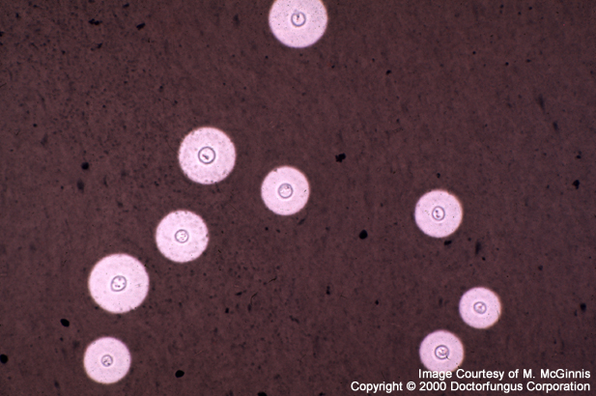
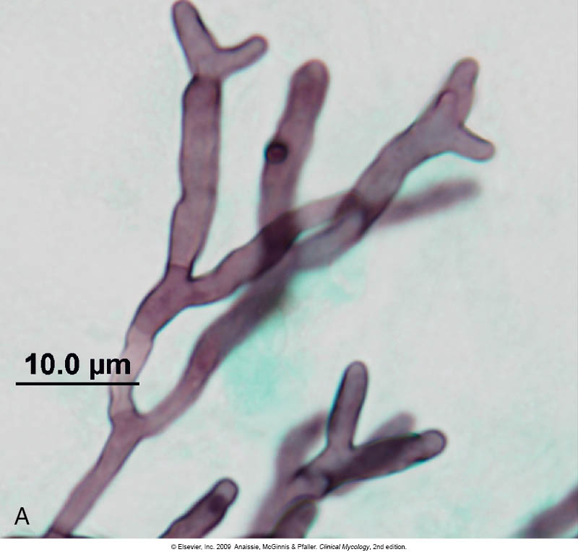
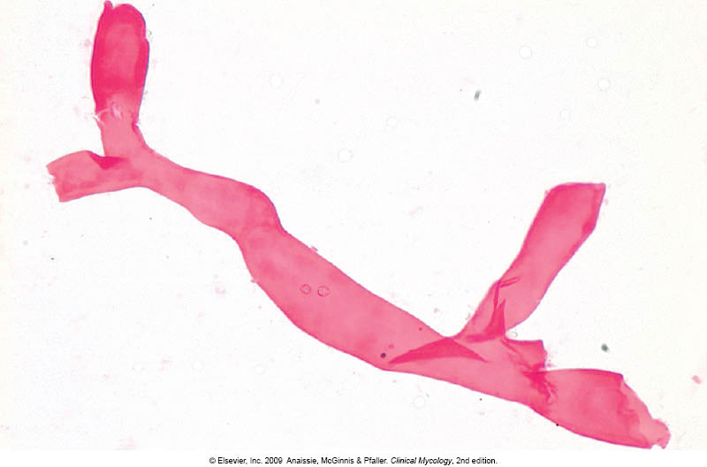
Lab. Diagnosis:
Serology* | Culture | Direct microscopy | CNS infection
Cryptococcal Ag (capsule) Latex agglutination | Yeast | Yeast cells Capsulated (india ink) | Cryptococcal meningitis
Manann Ag (cell wall) | Yeast | Yeast cells and pseudohyphae | Candidiasis
Galactomannan Ag | Hyaline mould | Septate branching hyphae | Aspergillosis
No serology available | Hyaline mould Fast growing | Broad non-septate hyphae | Zygomycosis
β-D- Glucan | Dematiaceous mould | Brown septate hyphae | Pheohyphomycosis
A
A
B
B
C
D
C
*Serology: β-D- Glucan
For diagnosis of invasive fungal infections except cryptococcosis and zygomycosis
D
Ag = antigen
Notes:
11

Slide 12
Management:
1. Control of the underlying disease
2. Reduce immunosuppresion, restore immunity if possible
3. Start antifungal therapy promptly: Polyenes/ Azoles/ Echinocandins
4. Consider surgery in certain situations
5. Key of treatment is early diagnose
Antifungal therapy:
Treatment | CNS fungal infection
Amphotericin B (combination with Flucytosine) | Cryptoccocal meningitis
Caspofungin, Fluconazole, Voriconazole, Amphotericin B | CNS Candidiasis (some are resistance to azole )
Voriconazole | CNS Aspergillosis
Amphotericin B | CNS Zygomycosis
-The Target of anti fungal : cell wall , cell membrane or DNA
-Amphotericin B has side effect : renal toxicity
Notes:
12

Slide 13
Mnemonics :
ANTIFUNGAL MNEMONICS:
1- in all the antifungal we use Amphotericin B EXEPT Aspergillosis we use Voriconazole SO:
Aspergillosis - Voriconazole اصبري أجي لس أوريس =
2- Candidiasis - Caspofungin = كسبوا كاندي
LAB DIAGNOS MNEMONICS:
1- Aspergillosis - Septate branching hyphae = فيهم حروف متشابهة
CNS ZYGOMYCOSIS (MUCOROMYCOSIS):
1-Etiology: Zygomycetes e.g. Absidia, Rhizopus, Mucor = عبسي ذا مكر علي وقال ابي رز بس ولما دخلنا البقالة ماخلى شىء
لو وصلتنا تشبيهات زيادة بنحطها بالاديتنق فايل ان شاء الله + شكرا لكل من أرسل لنا

Slide 14
SUMMARY:
Etiology
-Yeast​: ​Candida spp, ​Cryptococcus spp. ​-Mould​: ​Aspergillus spp, ​Zygomycetes. ​-Dimorphic​ :​Histoplasma spp, ​Blastomyces spp, Coccidioides spp, Paracoccidioides spp.
Cryptococcal meningitis | - ​AIDS​ (​HIV​) ​is the leading predisposing factor​. - Acquired by inhalation. - ​Meningitis​. - Etiology: ​Cryptococcus neoformans→ found naturally in pigeon habitats – capsulated yeast cells . - Lab diagnosis​: Microscope (​india ink)​ → ​Capsulated​ . ​Serology​ → ​Cryptococcal Ag​, ​Latex agglutination​. culture→ yeast. - Treatment​: Amphotericin B + Flucytosine.
Candidiasis | ​ - Reach CNS by: Hematogenous spread, ​surgery​, catheters. - Cerebral abscess​ and ​meningitis​. - Etiology is mainly ​C.albicans(normal flora). - Lab diagnosis​​: Microscope → ​psuedohyphae​. ​Serology​: ​Manann Ag​ and ​β-D- Glucan​ (if invasive). Culture: yeast - Treatment​: Caspofungin, Fluconazole, Voriconazole, Amphotericin B.
CNS Aspergillosis | - ​Brain abscesses​. - Risk factors: Malignancy, transplantation, chemotherapy. Spread Hematogenously, or direct spread from adjacent sinuses. - Mortality rate is high​. - Etiology: ​Aspergillus fumigatus, ​A.flavus and​ A.terrus - Lab diagnosis​: ​Microscope​ → ​Septate​ ​branching​ hyphae. ​Culture​ → Hyaline mould. ​Serology​ → ​Galactomannan Ag​, ​β-D- Glucan​ (if invasive). - Treatment​: Voriconazole.
CNS Zygomycosis (​Mucoromycosis​) | -The ​rhinocerebral​ form is the most frequent presenting clinical syndrome in CNS zygomycosis. - Risk factor: ​Diabetic with ketoacidosis​. - Clinical manifestations: Start as ​Sinusitis​ → rapidly progress → involve the orbit → eye → optic nerve → brain. - Symptoms: ​Facial edema​, necrosis, ​loss of vision​, ​black​ discharge, ​angiotropism​. - Mortality rate is high​. - etiology: Zygomycetes e.g. Rhizopus, Absidia. -Lab diagnosis​​: ​Microscope​ → Broad ​non-septate​ hyphae. ​Culture​ → Hyaline mould, ​fast​ ​growing​. No ​serology​ test is available. - Treatment​: Amphotericin B.
Pheohyphomycosis | -Affects ​immunecompetent hosts​. -Caused by ​dematiaceous fungi​ (neurotropic fungi) - Chronic ​brain abscess​. Etiology: ​Rhinocladiella mackenziei→ most common in middle east. - Lab diagnosis​: Microscope → ​Brown septate​ hyphae. Culture → ​Dematiaceoud​ mould. Serology → ​β-D- Glucan​.
Other infections (Histoplasmosis, Blastomycosis, Coccidiodomycosis, Paracoccidiodomycosis) | -Etiology → primary pathogens - Sub-acute or chronic meningitis​(common) and brain abscess . - following a primary ​respiratory​ infection.

Slide 15
SUMMARY:
- Fungal infections of CNS are not common. Associated with ​Meningitis​ (sub-acute or chronic) or ​brain abscess​.
- Risk factors:
HIV​, hematopoietic stem cell transplant, DM, Indwelling catheters, Solid organs transplantation, Malignancies, Neutropenia,
Hereditary immune defects, Immunosuppressive medications, Surgery or trauma.
-Mechanisms to reach CNS :
Hematogenous spread, Traumatic introduction (e.g. lumbar punctures), Local extension from the paranasal sinuses, the ear, or the orbits.
Diagnosis: Clinical features (history, risk factors, etc),Neuro-imaging, Lab Investigations
Lab Investigations ( CSF examination (cell count, chemistry), Histopathology, Microbiology)
CSF abnormalities | Direct microscopy | Culture | Serology | PCR
Not specific​ for fungal infection. | Fungal stains: Giemsa, GMS, PAS, India ink (Cryptococcus neoformans) | Fungal media: SDA, BHI | To detect the antigens

Slide 16
QUIZ:
1/A 54-year-old man developed a slowly worsening headache followed by gradual, progressive weakness in his right arm. A brain scan revealed a cerebral lesion. At surgery an abscess surrounded by granulomatous material was found. Sections of the tissue and subsequent culture showed darkly pigmented septate hyphae indicating phaeohyphomycosis. This infection may be caused by which species below?
(A) Aspergillus
(B) Cladophialophora
(C) Coccidioides
(D) Malassezia
Answer: B
2/A patient was diagnosed with cerebral abscess. the serology test showed mannan AG. What are we going to see under the microscope?
(A)pseudohyphae
(B) non- septate hyphae
(C) septate hyphae
(D) brown septate hyphae
Answer: A
3/What is the best antifungal treatment for a patient with cytococcal meningitis?
(A) Amphotercin
(B) comination of amphotercin and flucytocin
(C) flucytocin
(D)comination of amphotercin and voriconazole
Answer: B
4/A patient was diagnosed with chronic brain abscess. The culturing of the organism showed Dematiceoud mould. What is the most likely causing organism?
(A) Rhinocladiella Mackenzie
(B) cryptococcus neoformans
(C) C.albicans
(D) Aspergillus fumigatus
Answer: A
5/ A 52 years old male presented to the hospital with cryptococcal meningitis, history was taking and it showed that he had HIV. How did the fungus reach the CNS?
(A) hematogenously
(B) by inhalation
(C) infection from the ear
(D) infection from the paranasal sinuses
Answer: B

Slide 17
THANK YOU FOR CHECKING OUR WORK, BEST OF LUCK!
Hamad Alkhudhairy
Shrooq Alsomali
Shoag Alahmari
Alaa Alaqeel
Doctors slides

