Slide 1
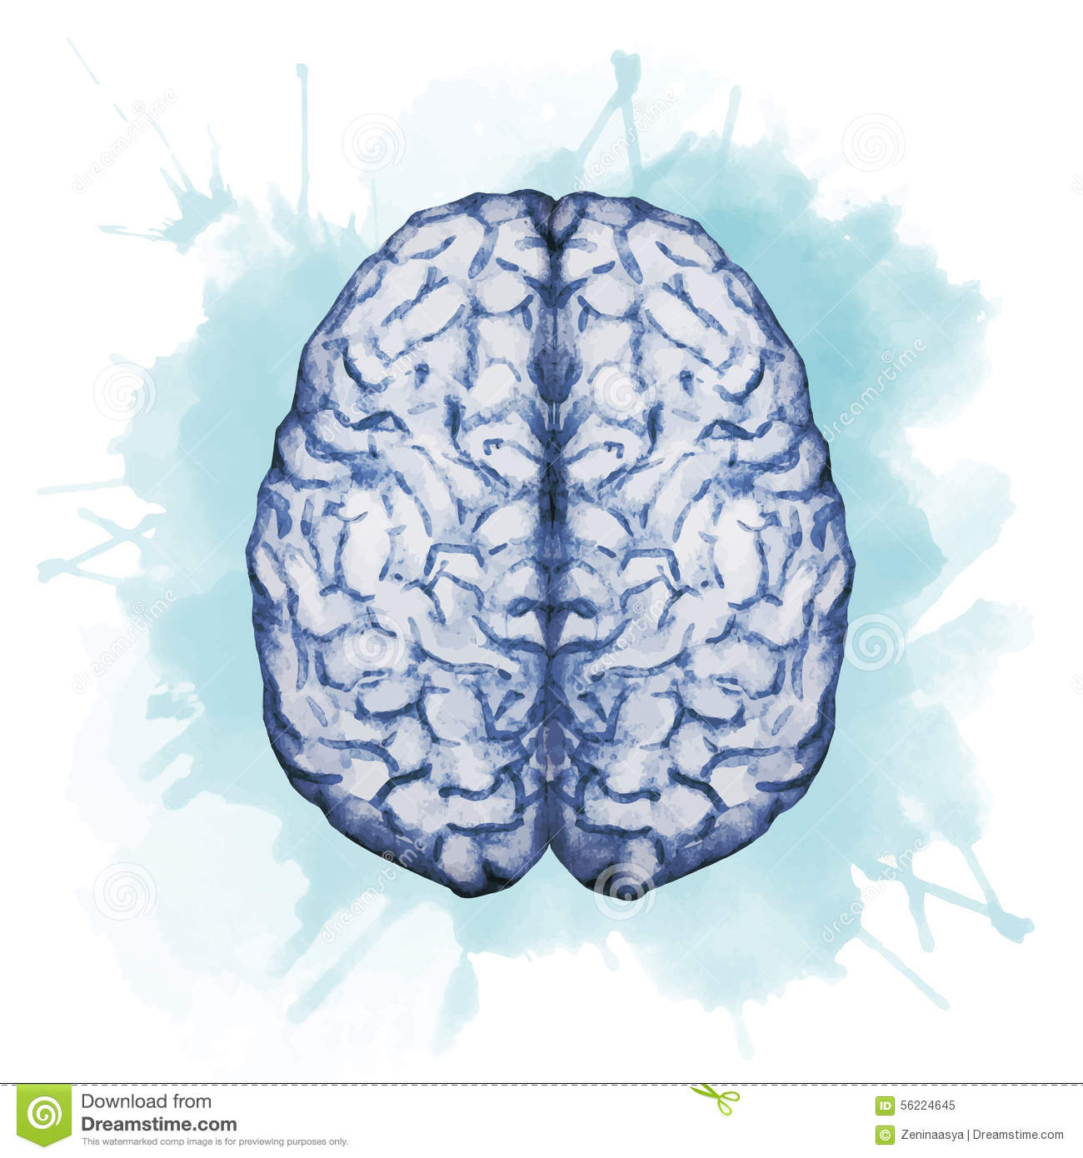
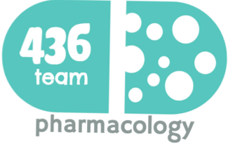
Pharmacology of drugs acting on the eye
Objectives:
Outline common routes of administration of drugs to the eye
Discuss the pharmacokinetics of drugs applied topically to the eye
Classify drugs used for treatment of disorders of the eye
Elaborate on autonomic, anti-inflammatory drugs & drugs used for glaucoma
Hint on ocular toxicity of some drugs
color index:
extra information and further explanation
important
doctors notes
Drugs names
Mnemonics
Check out the mnemonics file :
https://docs.google.com/presentation/d/1Z0Vf9oEOJSXo4JIA0mTCk5jB-OU9LP5TFCwz8iBgNac/edit?usp=sharing
Kindly check the editing file before studying this document
https://docs.google.com/presentation/d/1_-g1vol4eBWPet5xVCkuTGFvvnhFF3PJmU0tWtEEw_o/edit?usp=sharing

Slide 2
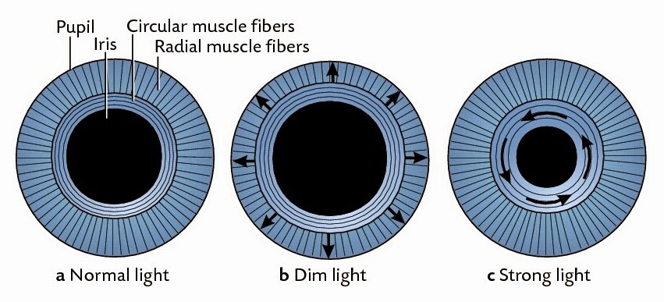
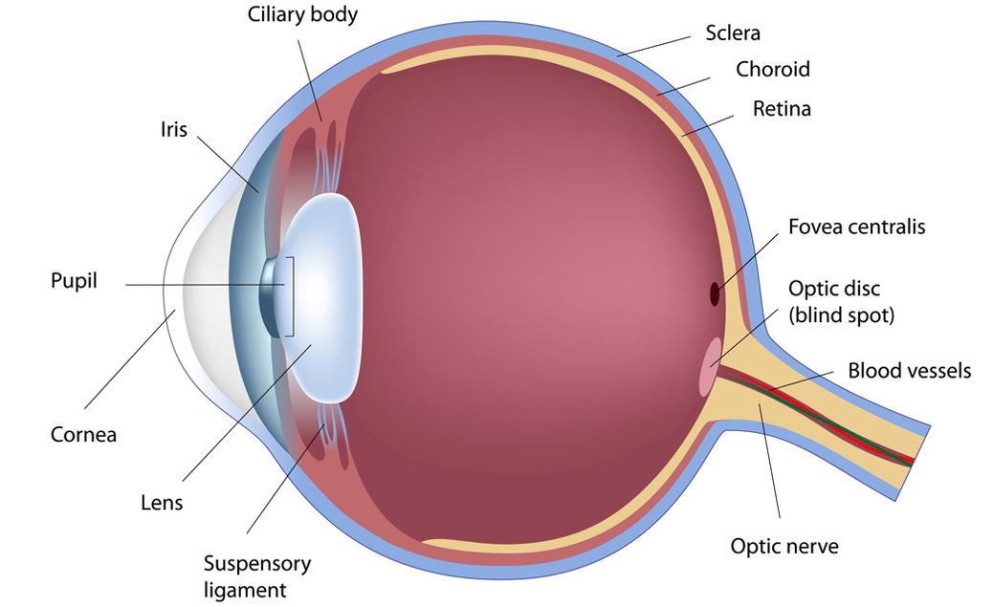
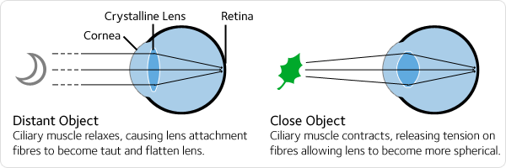
To understand !
Accommodation for light intensity
Anatomy
Mydriasis
Miosis
Accommodation for near/far vision:
Eye accommodation
2:05 min
Overview
Drugs can be delivered to ocular tissue as
Locally (Topically)
Systemically
Orally
IV
Eye drops
Ointments
Injections
Periocular injection.
Intraocular injection.
Locally :
Advantages:
Convenient, Economic, Relatively safe.
Disadvantages:
Compliance, Corneal & conjunctival toxicity.

Slide 3
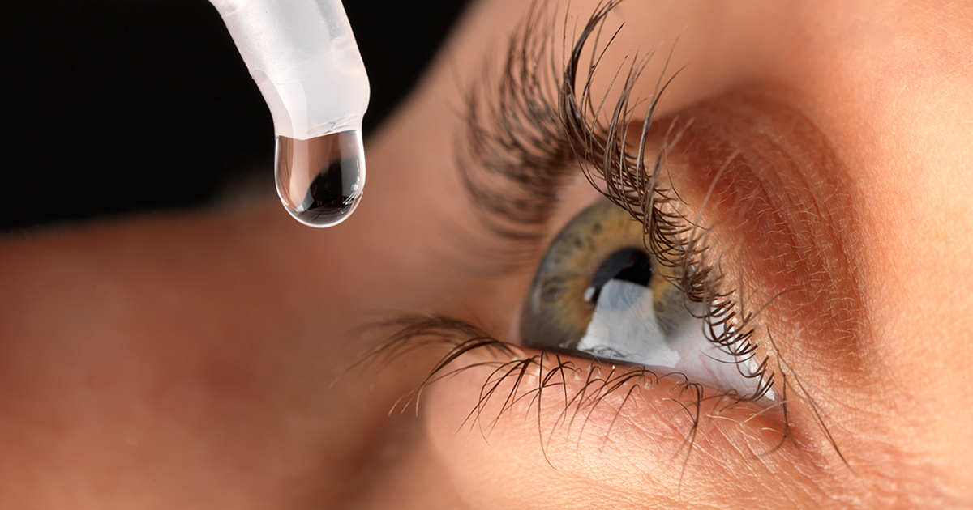
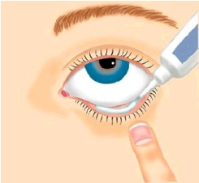
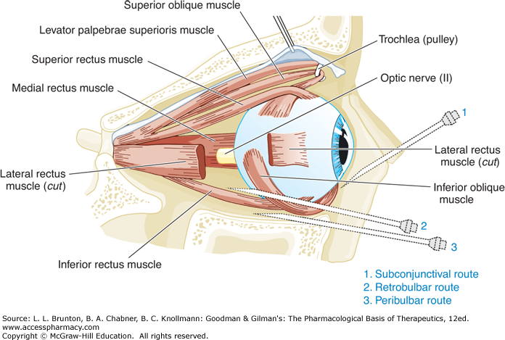
1-Locally: Eye drops, ointments, injections.
 | Eye drops | Ointments
Definition | Eye drops are saline containing drops “liquid” Most common route of administration. One drop = 50 μl / 4 hours (usually) | Ointment is a smooth oily preparation, As a rule of thumb, an ointment base is more occlusive and will drive the medication into the skin more rapidly than a solution or cream base.
Advantages | Convenient, costs less, applied frequently. | Increases the contact time of ocular medication to ocular surface →providing better effect.
Disadvantages | The contact time between the drug and the eye is low due to fast removal by tears → Thus has to be used several times. One of the problems of eye drops is poor compliant of the patient. | The drug has to be highly lipid soluble to have the maximum effect as ointment. t’s a Greasy substance so the contact time between the medication and the tissue is longer
Eye injections
Techniques | intra-ocular injections For anterior segment surgery, infections & retinitis | 1- Intra-cameral: “inside anterior or posterior chamber of the eye” | E.g. • Intra-cameral acetylcholine or lidocaine during cataract surgery. | ADRs
 |  | 2- Intra-vitreal "inside the eye" | E.g. Intravitreal antibiotics in cases of endophthalmitis (an inflammation of the internal coats of the eye) Intravitreal steroid in macular edema (the build-up of fluid in the macula, an area in the center of the retina.) | -Retinal toxicity. -Intraocular toxicity. - Corneal toxicity.
 | Peri-ocular injections | 1-Subconjunctival Sub= under
 |  | 2- Retro-bulbar “behind the eyeball” Retro= behind
 |  | 3- Peri-bulbar “above and below the orbit” Peri=around
 |  | 4-subtenon
 |  | Advantages: They reach behind the iris-lens diaphragm better than topical applications. Drugs penetration is generally weaker for low lipid-soluble drugs, however injections can bypass the conjunctival and corneal epithelium which is good for drugs with low lipid solubility (e.g. penicillins) Steroid and local anesthetics can be applied this way. Used for infection of anterior segment and inflammation of uvea. Disadvantages: Local toxicity, tissue injury, globe perforation, optic nerve damage.
تذكرنا بكلمة كاميرا
شركة لايكا وكانون للكاميرات
(Leica = acetylcholine)
(Canon = lidocaine)
نربطها بكلمة vital
The Antibiotic and steroid can save our vitality

Slide 4
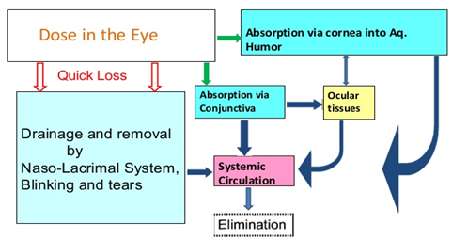
Pharmacokinetics of topical (local) drugs
Absorption Is determined by: | Drug residence time→ the time drug remains in cul-de-sac, tear. It can be prolonged by plugging tear ducts or changing the formulation. Metabolism → esterases Elimination → by nasolacrimal drainage or binding to tear protein. Diffusion → across cornea & conjunctiva.
Distribution | After corneal absorption the drug accumulates in the aqueous humor, intraocular structures or systemically distributed. * Melanin binding prolongs the effect of α -agonists in patients with dark pigmented iris.
Metabolism | Significant biotransformation takes place in the eye. Esterases activate pro-drugs, e.g.: Dipivefrin → (adrenaline) Latanoprost →( PGF2α)
(Dipivefrin = adrenaline )
(dipivefrin = Adrenaline)أو ممكن نقول أبي أدرنالين
2-Systemically: Oral, IV
Oral or IV | - Factors influencing systemic drug penetration into ocular tissue: lipid solubility of the drug: More penetration with high lipid solubility Protein binding: (bound drug) :Not Free to distribute all over the body, It localized in the blood More effect with low protein binding (inverse proportion) Eye inflammation: More penetration with ocular inflammation.
To understand !
Eye |  | Parasympathetic N.S. | Sympathetic N.S.
Iris | radial muscle | No effect | Contraction (Mydriasis) (α1)
 | circular muscle | Contraction (miosis) (M3) | No effect
Ciliary muscle |  | Contraction (M3) (accommodation for near vision) | Relaxation (β2)
Lens |  | Thick, more convex | Thin, more flat
Conjunctival blood vessels |  | Conjunctival Vasodilatation and congestion of blood vessels | Conjunctival Vasoconstriction (α1) and decongestion of blood vessels
Accommodation |  | near vision | far vision
Suspensory ligaments |  | relaxation | contraction
هذا بيتك الثاني ارتاح
*Ciliary muscle is the opposite of the suspensory ligament

Slide 5
Overview
Ocular drugs
Autonomic drugs
Antiglaucoma Drugs
Anti-inflammatory drugs
Chemotherapeutics
Local anesthetics
Ocular lubricants
Miotics
Steroids
NSAIDs
Antibacterial
Antifungal
Antiviral
Mydriatics
Cycloplegics
Drugs acting on
parasympathetic system
sympathetic system
Cholinergic agonists
Cholinergic (muscarinic) antagonists
Adrenergic agonists
Beta blocker
Non-selective agonists
Selective α1 agonists
Selective α2 agonists
Selective β1
Non-selective
Non-selective
Direct agonists
Indirect agonists (anticholinesterases)
Reversible
Irreversible
Natural Alkaloids
Synthetic atropine substituses

Slide 6
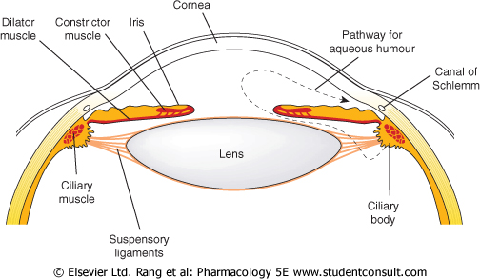
Drugs acting on parasympathetic system:
cholinergic agonists, cholinergic antagonists
Cholinergic agonists
Drug | Direct agonists |  |  | Indirect agonists (anticholinesterases)
 | Acetycholine M receptor Methacholine M+N receptor Carbachol |  | Pilocarpine M receptor | Reversible Bind for short time with Ach esterase then leave it | Irreversible
 |  |  |  | Physostigmine Demecarium | Echothiophate Isoflurophate
Indications | Specific uses : | 1-Induction of miosis in surgery 2- Open angle glaucoma *Acetylcholine has very short duration of action so no medical application for it . | Open angle glaucoma Why not for closed as well ? Closed angle glaucoma is an emergency case which required surgery | Specific uses: 1- Glaucoma 2- Accommodative esotropia
 | General uses: 1- Glaucoma (open & closed angle). 2- Counteract action of mydriatics. after funduscopic examination 3- To break iris-lens adhesions. Sequences of mydriatics drugs followed by miotics drugs (Contraction followed by relaxation) 4- In accommodative esotropia (ecothiophate). الحول 5- in lice infestation of lashes (physostigmine)
0Mech. Of action | 2 contractions : 1- Constriction of the pupillary Circular muscle (sphincter muscle) (miosis) drugs causes constriction are Preferred in treatment of glaucoma 2-Contraction of the ciliary muscle (accommodation for near vision) Decrease in intraocular pressure ↓ IOP. increases aqueous outflow through the trabecular meshwork into canal of Schlemm** Increased lacrimation Conjunctival Vasodilatation may Lead to congestion in eye
ADRs | - Diminished vision (myopia). - Headache
من كثرة الكرب (Carb) صار شخص اكول (achol)
Ecothiophate = Esotropia
**The aqueous humor is secreted by the epithelium of ciliary body.
Produced by a combination of active transport of ions and ultrafiltration of interstitial fluid.
The fluid flows over the surface of the lens, out through the pupil into the anterior chamber. Flows through the trabecular meshwork into Schlemm’s canal by ciliary muscle contraction. and is collected in the scleral veins.
As a result of miosis of the iris muscle which pulled away from the canal of Schliemann so the angle of filtration will increase

Slide 7
Drugs acting on parasympathetic system:
cholinergic agonists, cholinergic antagonists
 | Cholinergic (muscarinic) antagonists
Drug | Natural alkaloids | Synthetic atropine substitutes
 | 1- Atropine Not used because it has very long duration of action 2- Scopolamine (Hyoscine) | 1- Homatropine 2- Tropicamide 3- Cyclopentolate
Duration | Long duration of action 1- Atropine: 7-10 days 2- Scopolamine (Hyoscine) : 3-7 days | Short duration of action 1- Homatropine: 1-3 days 2- Tropicamide: 6 hours Widely used 3- Cyclopentolate: 24 hours
Mech.of action | 2 Relaxations: 1- Passive* mydriasis →due to relaxation of circular muscles. 2- Cycloplegia (loss of near accommodation) →due to relaxation of ciliary muscle. (This effect is due to blocking of paraS only!) - Increased IOP → glaucoma. (especially angle closure glaucoma) - Decreased lacrimal secretion →sandy eye. - Loss of light reflex.
Indications | 1- To prevent adhesion in uveitis & iritis. (because they are doing mydriasis) 2- Funduscopic examination of the eye. 3- Measurement of refractive error. (problem with focusing of light on the retina due to the shape of the eye)
Contra-indications | Glaucoma (angle closure glaucoma) →Because there is no miosis →which makes the filtration C.I easier > IOP may rise dangerously → acute attack of eye pain.
أي مرض بالعين يسبب كربة وهم للشخص
Eye drop are coming
It to late to treat the glaucoma
Ocular actions of drugs acting on sympathetic system
Contraction of dilator (radial) Pupillae (Active mydriasis) → α1
mean the iris go to the back.
Relaxation of ciliary muscles (accommodation for far vision) β2** = reduce filtration angle.
Increase in intraocular pressure IOP
Lacrimation α1
Vasoconstriction of conjunctival blood vessels α1 . (used as decongestion drug)
α & β receptors in the blood vessels of the ciliary processes help in regulation of aqueous humour formation
*Active vs. passive mydriasis: • Atropine (anticholinergic): Blocking muscarinic receptors→ relaxing circular muscles
→ Passive Mydriasis • Sympathetic stimulation: activation of α receptors in radial muscles → contraction
→Active mydriasis
** in the sympathetic system, activation of α receptors leads to smooth muscle contraction, and activation of β2 receptors leads to smooth muscle relaxation

Slide 8
Drugs acting on sympathetic nervous system
Adrenergic agonists
Drug | Non-selective agonists (α1 , α2 , β1 , β2 ) | Selective α1 agonists | Selective α2 agonists
 | 1- Epinephrine 2- Dipivefrin (pro-drug of epinephrine) | Phenylephrine | Apraclonidine (eye drop)
Mechanism of action | - Increase uveoscleral outflow of aqueous humor. | - Active Mydriasis (without cycloplegia). because their effect is on the radial muscle, not the ciliary muscle which is innervated by parasympathetic *no loss of accommodation | Decrease production of aqueous humor. Increaseuveoscleral outflow of aqueous humor. Inhibits sympathetic working.
Route of administration | Used locally as eye drops. |  | Eye drops
Indications | Open angle glaucoma. | 1- Funduscopic examination of the eye. 2- To prevent adhesion in uveitis & iritis. 3- Decongestant in minor allergic hyperemia of eye. | 1- Open angle glaucoma treatment 2- Prophylaxis against IOP spiking after glaucoma laser procedures.
ADRs | 1- Headache. 2- Arrhythmia. 3- Increased blood pressure. | 1- May cause significant increase in blood pressure. 2- Rebound congestion. 3- Precipitation of acute angle-closure glaucoma in patients with narrow angles. | 1- Headache. 2- Bradycardia. 3- Hypotension.
Contra- indications | In patients with narrow angles (low drainage) as they may precipitate closed angle glaucoma. (α1 effect) →because it is doing mydriasis.
Dipivefrin = Epinephrine
تذكرنا بمعجزة عيسى (إبراء الأكمة)

Slide 9
Drugs acting on sympathetic nervous system
Adrenergic agonists: Beta blockers
Drug | Non-selective | Selective β1 Non-selective (cardio-selective)
 | 1- Timolol 2- Carteolol | Betaxolol
Mech. Of action | Act on ciliary body to decrease production of aqueous humor. Blocking of β2 > blocking the relaxation effect on the ciliary muscle.
Rout of admin. | Given topically as eye drops
Indications | Can be used in patients with hypertension & ischemic heart disease. Used in treatment of open angle glaucoma. β-adrenergic blocker timolol, are effective in treating chronic glaucoma but are not used for emergency lowering of intraocular Indications pressure.
ADRs | Ocular irritation.
Contra- indications | 1- In asthma patients. (because the effect of β2 > bronchospasm) 2- Patients with CVS disorders. (because the effect of β1 on the heart)
Notes | Β blockers are the most popular & effective treatment of open angle glaucoma AFTER prostaglandins .
لووول (lol)باب البيت (beta) طلع مقفل ( blockers) !
جاء وقت قطرة العين
بيتك من جماله كسر عين العدو
الجزر مفيد للعين
Timolol = long time

Slide 10
Summary: Autonomic Nerve supply of the Eye
Ocular actions
Parasympathetic N.S. |  | Sympathetic N.S.
Cholinergic agonists | Cholinergic (muscarinic) antagonists
* These 2 are opposite to each other |  | Contraction of dilator (radial) Pupillae (Active mydriasis) → α1 Relaxation of ciliary muscles (accommodation for far vision) →β2
2 contractions : 1- Constriction of the pupillary Circular muscle (sphincter muscle) (miosis) drugs causes constriction are Preferred in treatment of glaucoma 2-Contraction of the ciliary muscle (accommodation for near vision). | 2 relaxations: 1- Passive *mydriasis →due to relaxation of circular muscles. 2- Cycloplegia (loss of near accommodation) →due to relaxation of ciliary muscle.
Decrease in intraocular pressure ↓ IOP. | Increased IOP → glaucoma. (especially angle closure glaucoma) | Increase in intraocular pressure IOP
increases aqueous outflow |  | α & β receptors in the blood vessels of the ciliary processes help in regulation of aqueous humour formation
Increased lacrimation | Decreased lacrimal secretion →sandy eye. | Lacrimation α1
Conjunctival Vasodilatation may Lead to congestion in eye | Loss of light reflex. | Vasoconstriction of conjunctival blood vessels α1 (used as decongestion drug)
Watch it from 4:30
Treatment of open angle glaucoma (chronic)
How glaucoma occurs ? 1- open : angle of filtration is open (canal of Schlemm ) but the problem is increasing in the production of aqueous humor.
2- closed angle glaucoma :here the angle of filtration is narrow by mydriatic drugs need surgery to treat it.
The main goal is to decrease IOP by:
أدري (Adrenergic) إن فيه دجاج بروست (Prostaglandins) برا ( Parasympathomimetics) عشان كذا تبي تصرفني بسرعة (increase ouflow)
اني سيارة (Carbonic anhydrase inhibitors) ؟ قدام بيتك (Beta blockers) فيه ألف وحدة ووحدة (Alpha(1+1=2))
Decreasing production of aqueous humor:
Beta blockers.
Increasing outflow of aqueous humor:
Prostaglandins.
Alpha-2 agonists.
Carbonic anhydrase inhibitors.
Adrenergic agonists, nonspecific.
Parasympathomimetics.
Prostaglandins and Beta blockers are the most popular

Slide 11
Carbonic anhydrase inhibitors & prostaglandin analogues
Drug | Carbonic anhydrase inhibitors E.g. acetazolamide (oral) dorzolamide (topical) preferred | Prostaglandin analogues E.g. latanoprost, travoprost
Mech. of action | Decrease production of aqueous humor by blocking carbonic anhydrase enzyme required for production of bicarbonate ions → (transported to posterior chamber, carrying osmotic water flow). | Increase uveoscleral aqueous outflow. Latanoprost is preferred due to lesser adverse effects. They have replaced beta blockers They are used topically as eye drops & once a day.
Indi-cation | open angle glaucoma
ADRs | Myopia (Nearsightedness), malaise, anorexia, GI upset, headache. Metabolic acidosis, renal stone. | Pigmentation of the iris (heterochromia iridis) Intraocular inflammation. Macular edema.
Contra- indication | Sulfa allergy because they are sulfa derivatives. Pregnancy Digitalis users.
جربت دجاج البروست (Prost) مرة وحدة بحياتي (once a day)
Ops! I can not see any Cars =(carbonic anhydrase) because I have Myopia
I rise up with Big broast= (iris) (Pigmentation) (Prostaglanin)
Closed Angle Glaucoma (acute)
Development of angle closure glaucoma and its reversal by miotics:
1
Mydriasis occurs in an eye with narrow iridocorneal angle, and the iris makes contact with the lens blocking passage of the aqueous from the posterior to the anterior chamber.
Possibly builds up behind the iris which bulges forward and closes the iridocorneal angle thus blocking aqueous outflow.
Miotic makes the iris thin and pushes it away from the lens removing the pupillary block and restoring aqueous drainage.
2
3

Slide 12
Treatment of narrow closed angle glaucoma (acute):
- Acute, painful increases of intraocular pressure due to occlusion of the outflow drainage pathway.
- The only way to treat it is Surgery, but before surgery we give him treatment to decrease IOP.
- Emergency situation that require treatment before surgery (Iridectomy).
The use of drugs is limited to :
Oral
Topical cholinomimetics
Osmotic agents
Acetazolamide
e.g.: pilocarpine
hypertonic solutions of ( Mannitol, Glycerol).
Analgesics
pethidine or morphine (for pain)
Systemic Osmotic agents (Dehydrating agents)
Mech. of action | Can rapidly ↓ IOP by ↓ vitreous volume. Glycerol 50% syrup, orally (cause nausea, hyperglycemia). Mannitol 20% IV (cause fluid overload and not used in heart failure). Dehydrate vitreous body which reduce IOP prior to anterior surgical procedures IV infusion of hypertonic solution (mannitolol,Glycerol)
Indi- cations | Used only in acute situations to temporarily reduce high IOP until more definitive treatments can be rendered. (prior to anterior surgical procedure)
ADRs | Diuresis, circulatory overload, pulmonary edema Heart failure Central nervous system effects such as seizure, and cerebral hemorrhage.

Slide 13
Anti-inflamatory Drugs
Drug | Corticosteroids |  | NSAIDs
 | Topical | Systemic | 1- Ketorolac 2- Diclofenac 3- Flurbiprofen
 | 1- Prednisolone 2- Dexamethasone 3- Hydrocortisone | 1- Prednisolone 2- Cortisone
Mech. of action | - Inhibition of arachidonic acid release from MOA phospholipids by inhibiting phosphlipase A2 |  | - COX (cyclo-oxygenase) inhibitors
Indications | 1- Anterior uveitis. 2- Severe allergic conjunctivitis. 3- Scleritis. 4- Prevention and suppression of corneal graft rejection. 5-postoperatively | 2- Posterior uveitis. 1- Optic neuritis. | 1- Ketorolac: Cystoid macular edema occurring after cataract surgery. 2- Diclofenac: Postoperative inflammation, mild allergic conjunctivitis, mild uveitis. 3- Flurbiprofen: Preoperatively to prevent miosis during cataract surgery. * Because they inhibit prostaglandins which produce miosis without action of cholinergic.
ADRs | - Glaucoma, cataract, mydriasis (especially if it is used for a long time) - Skin atrophy. - Secondary infection. - Delayed wound healing. (healing is slow because it is an immune suppression) |  | Stinging (irritation) Sterile corneal melt & perforation.

Slide 14
Toxicity : Drugs causing corneal deposits
Amiodarone Chloroquine | 1- Pigmented deposits of cornea. 2- Optic neuropathy (mild decreased vision + visual field defects) 3- Retinopathy.
Digitalis | 1- Ocular disturbances 2- Chromatopsia (objects appear yellow, overdosing can cause ocular disturbances) (FACT: Van gogh used to take digitalis)
Phenothizines | 3- Brown pigmentary deposits in the cornea, conjunctiva & eyelid.
Steroids | 1- Cataract formation 2- Increase IOP 3- Glaucoma (long term use)
Ethambutol (TB Medication) | 1- Optic neuropathy Characterized by gradual Progressive central scotomas and vision loss.
Sildenafil | 1- Causes a bluish haze 2- Light sensitivity It Inhibits PDE5 in the corpus cavernosum to achieve penile erection It also mildly inhibits PDE6 which controls the level of cyclic GMP in the retina→ seeing a bluish haze & causing light sensitivity
الملكة أمي تلبس تاج ومصابة بالعمى
نقرأ اسم الدرق ( كأنو ذا زيتي لونه) زيتي مو بعيد عن بني)
إثم بتول سبب لها العمى
تذكرنا بسلايدز الدكاترة دايم لونها أزرق

Slide 15
قادة فريق علم الأدوية :
لين التميمي & عبدالرحمن ذكري
الشكر موصول لأعضاء الفريق المتميزين :
ريم الشثري
رنا باراسين
جواهر الخيال
شذا الغيهب
روان سعد القحطاني
آمال الشيبي
References :
1- 436 doctors slides
2- Team 435
3-Pharmacology (Lippincotts Illustrated Reviews Series), 5th edition.
pharma436@outlook.com
Your feedback:
https://docs.google.com/forms/d/1sxDqHtpP3bUaOhQmYw96IE7mX-DlrklT5dlZUA2teSI/edit
@pharma436

