Slide 1
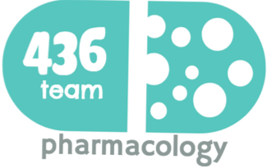
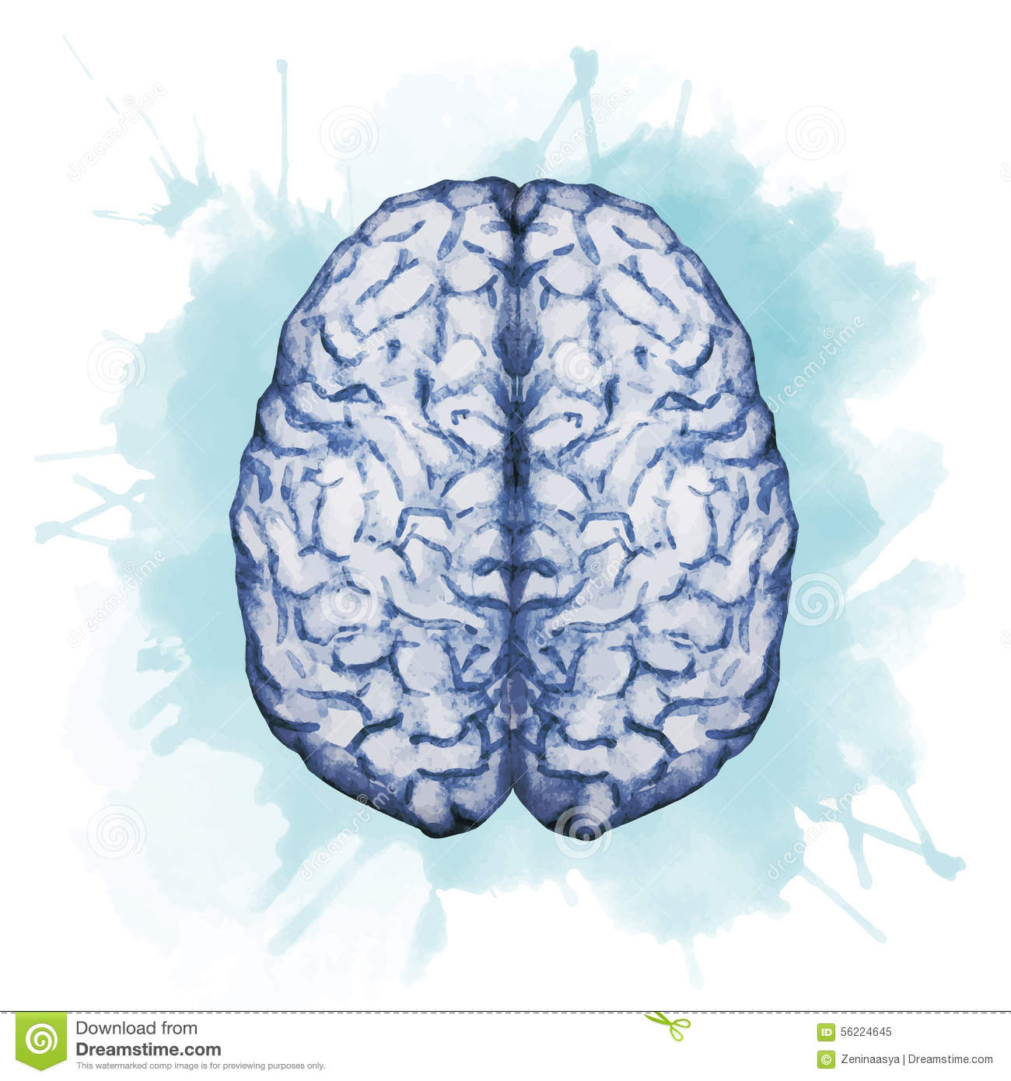
Drugs Used In Meningitis
Objectives:
Describe briefly common types of meningitis.
List the name of antibiotics used for treatment of meningitis
Describe the principles of treatment.
Describe the mechanism of action & adverse effects of the individual drugs.
color index:
extra information and further explanation
important
doctors notes
Drugs names
Mnemonics
Check out the mnemonics file :
https://docs.google.com/presentation/d/1Z0Vf9oEOJSXo4JIA0mTCk5jB-OU9LP5TFCwz8iBgNac/edit?usp=sharing
Kindly check the editing file before studying this document
https://docs.google.com/presentation/d/1_-g1vol4eBWPet5xVCkuTGFvvnhFF3PJmU0tWtEEw_o/edit?usp=sharing

Slide 2
Introduction
Meningitis
It is an inflammation of the protective membranes covering the brain and the spinal cord (meninges).
Causes
Infectious |  |  | Non-Infectious
1.Viruses. (common). 2.Bacteria. (common). 3.Fungal. |  |  | e.g. malignant meningitis (spread of cancer to meninges)
Bacterial Meningitis
Causes of Bacterial Meningitis
Route of transmission:
The bacteria are carried by humans in the nose and throat and spread by close contact such as coughing and/or sneezing, kissing, sharing eating utensils. The pathogens spread from the respiratory (main rout of transmission) tract to the blood stream (septicemia) and to the nervous system and cause bacterial meningitis. Contaminated food specially in immunocompromised patients and pregnant women
Symptoms of Bacterial meningitis
Treatment principles
Emergency hospitalization | Antibiotics: the most important characteristic of the selected antibiotic is to cross BBB(lipophilic drug ) BUT inflammation of the meninges (meningitis) causes changes in the permeability so sometimes we can use hydrophilic drugs(polar) e.g.: aminoglycosides Antibiotics Selected must penetrate adequately into the CSF Remember penetration is easier because of the inflammation. Regimen chosen must have potent activity against known or suspected pathogens & exert a bactericidal effect. (Empiric) mostly broad spectrum. |  |  |  | Measures for treatment of complications.
Prevention better than cure !
A) Haemophilus influenza type B (Hib) bacterium, a leading cause of bacterial meningitis in children. So there is a New Hib vaccines — available as part of the routine childhood immunization schedule have greatly reduced cases of this type of meningitis. |  | B) Pneumococcal polysaccharide vaccine (PPSV) for older children and adults (protects against meningitis caused by S.pneumonia) |  | C) Meningococcal conjugate vaccine ,people going to Hajj. (protects against meningitis caused by N. meningitides)
Is a serious, life threatening disease. Without treatment, bacterial meningitis can cause serious consequences
Cognitive deficits.
Deafness. (loss of hearing)
Hydrocephalus.
paralysis.
stroke, seizures, sepsis, and even death.
Neisseria meningitidis. (gram -ve)
Streptococcus pneumoniae. Most common cause (gram +ve)
Haemophilus influenzae. (gram -ve) ,Vaccine is available.
Pseudomonas aeruginosa→(gram -ve),(very resistant organism)
Staphylococcus aureus. (Gram +ve)
Listeria Monocytogenes.
Mycobacterium tuberculosis→
(tuberculous meningitis).
High fever.
Severe headache.
Stiff neck.
These 3 are meningitis triad
Vomiting.
Nausea.
Seizure
Irritability
Sensitivity to bright light (photophobia) it is an alarm to meningitis
Confusion.
a rash of purple discoloration.
Because meningitis can be deadly we start empiric therapy (Treatment without exact diagnosis) Immediately. antibiotics are given to a person before the specific microorganism causing an infection is known. Empiric therapy may be changed after the culture sensitivity reports are available. Antibiotic selected must reach the meninges in a adequate quantities.

Slide 3
Antibiotics for treatment of Bacterial Meningitis
Mechanism: Inhibitors of cell wall synthesis (B-Lactams)
Penicillins Penams | Cephalosporins Cephems | Carbapenems
As you see here, that all β-lactam antibiotics share the β-lactam ring, but they differ by the compounds bound to it.
Note the site where the Lactamase enzyme acting on. It called (beta-Lactam)ase, because it acts on beta-lactam ring and destruct it. β-lactamase production is the most common mechanism by which the resistance to penicillin developed. →That’s why it is better to combine β- lactamase inhibitors with penincillins (e.g. Amoxicillin + Clavulanic acid) - The penicillins are susceptible to bacterial metabolism and inactivation by amidases and lactamases at the points shown in the figure.
Note the beta-lactam chemical structure of Carpenems, there is stereochemical configuration in the lactam ring that imparts resistance to most common β lactamases.
How does the resistance developed with the penicillins & other beta-lactam antibiotic? Resistance to penicillins and other β-lactams is due to one of four general mechanisms:
(1) inactivation of antibiotic by β-lactamase
(2) modification of target PBPs (structure in the cytoplasmic mem of the bacteria)
(3) impaired penetration of drug to target PBPs,
(4) efflux. Beta-lactamase production is the most common mechanism of resistance

Slide 4
Penicillins
Spectrum | Narrow Spectrum | Extended or wide (active against gram +ve and –ve)
Drug | Penicillin G (benzyl penicillin) natural penicillin | Aminopenicillins synthetic penicillin
 |  | Amoxicillin | Ampicillin
MOA | Inhibit bacterial cell wall synthesis by inhibiting the peptidoglycan layer of bacterial cell wall (bactericidal)
Pharmacokinetics | Poor oral absorption destroyed by gastric acidity. Given IV never orally because it can’t cope with gastric acidity Short acting (4-6 hrs.) → the half-life of penicillin G can be increased to 10 hours in the presence of renal dysfunction. Probenecid inhibits the secretion of penicillins by competing for active tubular secretion via the organic acid transporter and, thus, can increase blood levels β- lactamase sensitive(penicillinase sensitive)= they are susceptible to hydrolysis by β-lactamases Half- life 30-60 min. | Broad spectrum of activity than penicillin G They are acid stable (effective orally) Can also be given parenterally (I.V or I.M) Amoxicillin is better absorbed from the gut and not affected by food. Ampicillin is better to take it on empty stomach because of food drug interaction Not active against pseudomonas aeruginosa → because Pseudomonas aeruginosa has restrictive porins (proteins inserted in the lipopolysaccharide layer), making this organism intrinsically resistant to many antimicrobial agents
β -lactamase | - | Inactivated by β-lactamase enzyme. (now a days combination with B-lactamase inhibitors are available e.g. 1- Amoxicillin + Clavulanic acid = Augmentin (given orally). 2- Ampicillin + salbactum = Unasyn. (Injection). This combination is intended to: Prevent enzymatic hydrolysis by β-lactamase. Extend antimicrobial activity.
ADRs | - Hypersensitivity (anaphylactic reaction) → make sure that patient doesn’t have allergy from the beta-lavtam antibiotics before giving him the treatment. Mild→ such as skin rash ,release of histamine and hypotension or sever →anaphylactic reaction Antibiotic-associated diarrhea (only if taken orally) → the normal flora dies → Super infection mainly by clostridium difficile in colon. Nephritis (with high doses). → beta lactam antibiotics (such as penicillin's) excreted mainly by kidney. Super-infections or secondary infections (candidiasis, oral thrush). oral thrush happen especially in children after long term broad spectrum antibiotic course(normal flora died) and it is a fungal infection High dose in renal failure (seizure). → high toxicity caused by renal failure → may cause seizure.
Extra | Ampicillin (with or without the addition of gentamicin) is the drug of choice for the gram-positive bacillus Listeria monocytogenes.

Slide 5
Drugs | Cephalosporins (3rd generation) | Carbapenems
 | Ceftazidime + Ceftriaxone | Imipenem
MOA | Inhibits bacterial cell wall synthesis (Bactericidal)
Pharmacokinetics | Both of them are given by intravenous infusion. | Not absorbed orally (because it is NOT lipophylic instead it is hydrophilic BUT can cross BBB) given by I.V. Penetrates body tissues and fluids including CSF. Excreted primarily by the kidney. Doses must be reduced in renal failure. Short Half- life about 1 hr. Inactivated by dehydropeptidase in renal tubules to a nephrotoxic metabolites, so it is given with a dehydropeptidase inhibitor Cilastatin for clinical use it given by combination of (Imipenem/cilastatin). Meropenem is one of carbapenems but doesn’t cause renal toxicity s
Bacterial spectrum | Highly effective against Gm –ve bacilli. Anaerobic microbes Ceftazidime → against pseudomonas aeruginosa. Highly resistant to β- lactamases→ Ceftriaxone and cefotaxime are approved for treatment of meningitis. Used for treatment of bacterial meningitis caused by(gram –ve organisms) pneumococci, meningococci, and Haemophilus influenzae. | Has a wide spectrum of activity (aerobic & anaerobic gram negative and gram positive bacteria, including pseudomonads). Resistant to most β-lactamases.
ADRs | Allergy if the patient is allergic to penicillin he will be allergic to Cephalosporins. Thrombophlebitis at site of injection. Renal toxicity. Super-infection. GIT Upset & diarrhea. (not characteristic) | Nausea, vomiting, diarrhea. Skin rash and reaction at the site of infusion. High doses may cause seizure in patients with renal failure. Patients allergic to Penicillins may be allergic to Carbapenems.

Slide 6
Drug | Other inhibitor of cell wall synthesis | AMINOGLYCOSIDES
 | Vancomycin | Gentamicin
MOA | Inhibits bacterial cell wall synthesis (Bactericidal) it is not beta lactam | Inhibit protein synthesis (30s subunit) (Bactericidal)
Pharmacokinetics | Poorly absorbed orally. Used orally only to treat GIT infections caused by clostridium difficile e.g. pseudomembranous colitis because it will stay in GIT and wont move anywhere else and excreted in feces. Given intravenously for the treatment of meningitis. | Not absorbed orally Given by injection I.V
Indications | Used against Methicillin resistant S. aureus (MRSA). Used when the patient is allergic or resistant to penicillin's. because it is against the same type of bacteria which is gram +ve
ADRs | Ototoxicity rare, but the administration with another ototoxic or nephrotoxic drug, such as an aminoglycoside, increases the risk of these toxicities. Nephrotoxicity Phlebitis (inflammation of a vein) at site of injection. Histamine release Causes Red man (red neck) syndrome →not IgA mediated reaction. →you might administered anti-histamine to prevent histamine effects such as diphenhydramine. Hypotension (minimized if injected slowly over 60 minutes) usually infusion of the drug takes 20 min. and this is the cause of hypotension. | Ototoxicity Nephrotoxicity (direct related to serum concentration). Neuromuscular blockade (in very high dose). Contraindicated in patient with myasthenia gravis.
Spectrum | Active only against Gram +ve bacteria (narrow spectrum) With the exception of Flavobacterium. | Antibacterial spectrum. Bacterial exclusive for aerobic G-bacteria.
Combinations | Used in combination with 3rd generation Cephalosporins for treatment of meningitis caused by penicillin resistant pneumococci.
 | May be combined with Ampicillin or Ceftazidime as an initial therapy (empiric therapy) of meningitis in infant, elderly and immunocompromised patients. Ceftazidime is better than Ciftriaxone in child.
Note | S. pneumoniae is the main cause of community acquired pneumonia and meningitis in children and the elderly and immunocompromised patients
Remember: all antibiotics affects the protein synthesis are considered as bacteriostatic EXCEPT aminoglycosides are bactericidal.

Slide 7
قادة فريق علم الأدوية :
لين التميمي & عبدالرحمن ذكري
الشكر موصول لأعضاء الفريق المتميزين :
مؤيد اليوسف
فارس النفيسة
عبدالكريم العتيبي
مؤيد احمد
سعد القحطاني
روان سعد القحطاني
References :
1- 436 doctors slides
2-435 team work
pharma436@outlook.com
Your feedback:
https://docs.google.com/forms/d/1sxDqHtpP3bUaOhQmYw96IE7mX-DlrklT5dlZUA2teSI/edit
@pharma436

