Slide 1
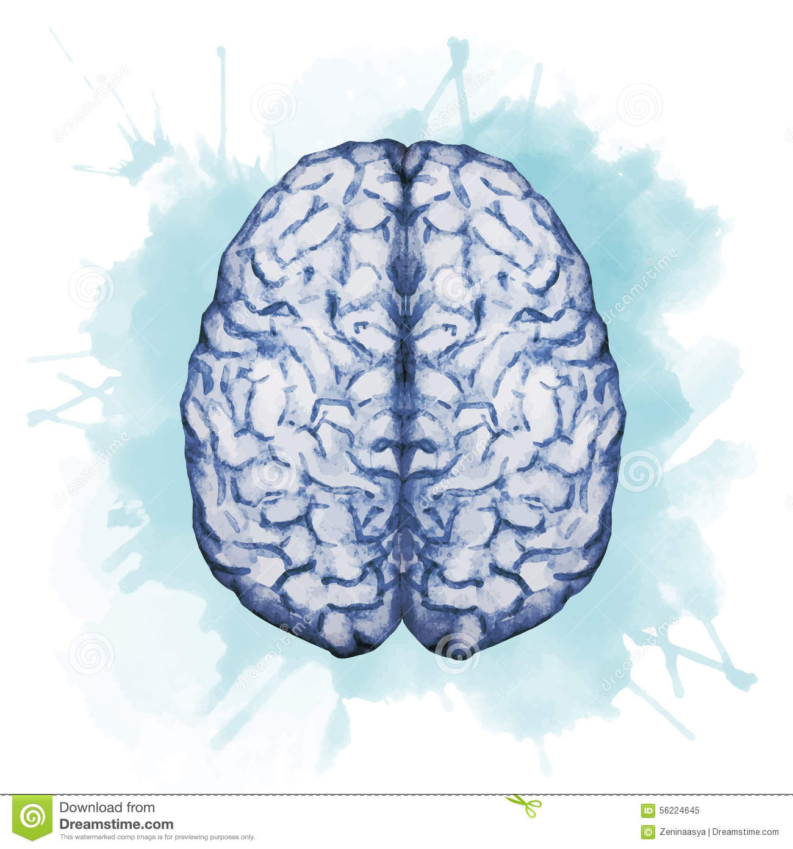
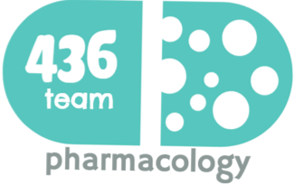
Drugs used in epilepsy 1&2
(this file include 2 lectures)
Objectives:
Describe types of epilepsy and List the antiepileptic drugs
Describe briefly the mechanism of action of and rationale of use of antiepileptic drugs.
Enumerate the clinical uses of each drug
Describe the adverse effects of each antiepileptic
Describe treatment of status epilepticus
color index:
extra information and further explanation
important
doctors notes
Drugs names
Mnemonics
Check out the mnemonics file :
https://docs.google.com/presentation/d/1Z0Vf9oEOJSXo4JIA0mTCk5jB-OU9LP5TFCwz8iBgNac/edit?usp=sharing
Kindly check the editing file before studying this document
https://docs.google.com/presentation/d/1_-g1vol4eBWPet5xVCkuTGFvvnhFF3PJmU0tWtEEw_o/edit?usp=sharing

Slide 2
Introduction
Epilepsy
Definition: Epilepsy is a chronic medical condition characterized by 2 or more unprovoked (done for no good reason) seizures(within 6-12 months). It is a syndrome Not a disease.
What is the difference between syndrome and disease
syndrome | disease
Is a set of medical signs and symptoms that occur together and suggest the presence of a certain disease or an increased chance of developing the disease | Is the actual diagnosed impairment of health or a condition of abnormal functioning
What is the difference between seizure & epileptic syndrome
Seizures | Epilepsy
Abnormal movements or behavior due to unusual electrical activity in the brain, are a symptom of epilepsy. | A group of related disorders characterized by a tendency for recurrent seizures.
Etiology of seizures
Congenital defects, head injuries, trauma, hypoxia. Infection (bacteria or virus) e.g. meningitis, brain abscess, viral encephalitis. the abscess stimulate near by tissue=seizure Concussion, depressed skull and fractures. Causes pressure on the brain Brain tumors (including tuberculoma), vascular occlusion and stroke. Drug withdrawal (always withdrawal symptoms are the opposite of the drug effect), e.g. CNS depressants, alcohol or drug abuse or drug overdose e.g. penicillin. And tricyclic antidepressant A poison, like lead. Fever in children (febrile convulsion).when the kids have fever because of unmyelinated nerves=febrile convulsion. It is not dangerous and treated with cold water (increase the temperate of the water gradually to avoid vasoconstriction of the skin) Hypoglycemia. PKU Phenylketonuria is a rare inherited disorder that causes an amino acid called phenylalanine to build up in body caused by absent or virtually absent phenylalanine hydroxylase (PAH) enzyme activity Phenylalanine tyrosine Photo epilepsy is a type of epilepsy, in which all, or almost all, seizures are triggered by flashing or flickering light.
Triggers the following increase the risk of the attacks not the cause behind it
Fatigue, Stress, Sleep deprivation (Sleeplessness),Poor nutrition & Alcoholism. Triggers can cause an episode even under medication and the patient should avoid them.
Phenylalanine hydroxylase
*Any function of CNS is balanced by neurotransmitters (excitation (glutamate aspartate) and inhibition(GABA))
*the balance between them allow normal neurotransmission in the brain
*epilepsy is due to increase in excitation and decrease in inhibition

Slide 3
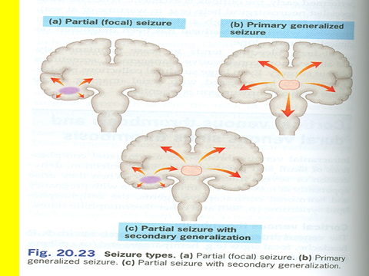
Classification of epilepsy
A-Partial (focal) Arise in one cerebral hemisphere | B-Primary Generalized Both hemispheres + loss of consciousness *very important which of the following antiepileptic drugs used for this type? They are interconnected sometimes | secondary generalization
[1] Simple: consciousness is retained. [2] Complex (psychomotor): Altered consciousness. Most common. | Tonic-clonic (Grand mal): Stiffness (15-30 sec) followed by violent contractions & relaxation (1-2 minute). | Begins as partial (simple or complex) and progress into generalized seizure (tonic-clonic seizure).
 | Tonic: Muscle stiffness .
 | Clonic: Spasms of contraction & relaxation
 | Atonic (loss of tone): Patients legs give under him & drop down.
 | Myoclonic: Jerking movement of the body
 | Absence(Petit mal): Brief loss of consciousness with minor muscle twitches eye blinking (no fall down). frequently during the day up to 30 times especially In children. Drugs which block T calcium channels are only capable to treat absence seizure
 | Status epilepticus: (*very very important) it is a life threating condition(Dangerous): Re-occuring tonic-clonic seizure(3o min or more). when a seizure lasts too long or when seizures occur close together and the person doesn't recover between seizures (Emergency situation). The patient will die because of cardiorespiratory failure
1-Drugs
2-Ketogenic diet
3-Surgery
4-Vagal nerve stimulation
Self reading
-The ketogenic diet is a high-fat, adequate protein, low carbohydrate diet that in medicine is used primarily to treat difficult-to-control (refractory) epilepsy in children.
- When fat is the primary source of calories, ketones are formed.
- It is an alternative for patients who have been refractory to multiple drugs.
- Who are sensitive to the many adverse effects of anti epileptic drugs.
It is an expensive procedure Not very effective
Increase parasympathetic activity
Treatment of Epilepsy
General rules for treatment of epilepsy
* Epilepsy is usually controlled but not cured with medication.
* Up to 80% of patients can expect partial or complete control of seizures with appropriate treatment. 20% are refractory, we need to try different drugs with them
* Antiepileptic drugs are indicated when there is two or more seizures occurred in short interval (6 m -1y)
* An initial therapeutic aim is to use only one drug (monotherapy) to prevent more side effect and if the patient not controlled we can combine 2 or refer to surgery.
* Drugs are usually administered orally except in status epilepsy (IV).
* Monitoring plasma drug level is useful. Most of the used drugs in these cases have a minimal therapeutic index so, we need to monitor the plasma to prevent toxicity especially in carbamazepine
* Triggering factors can affect seizure control by drugs.
* Sudden withdrawal of drugs should be avoided. Tell the patient to do not stop taking the medication to avoid stronger relapse of the seizure

Slide 4
considered Withdrawal
Seizure–free period of 2-5 years or longer.
Normal IQ.
Normal EEG (Electroencephalography (EEG) is an electrophysiological monitoring method to record electrical activity of the brain) prior to withdrawal.
No juvenile myoclonic epilepsy. Sever type begin in young age
Relapse rate when antiepileptic's are withdrawn is 20-40%. (20% in young patients and 40% in elderly)
Mechanism of Anti-Epileptic Drugs:
Antiepileptic drugs inhibit depolarization of neurons by following mechanisms:
Inhibition of excitatory neurotransmission (Glutamate).
Enhancement of inhibitory neurotransmission (GABA). Main inhibitory neurotransmitter in the brain
Blockage of voltage-gated positive current (Na⁺) (Ca²⁺).
Increase outward positive current (K⁺).
*mechanism of action and side effects are very important in this lecture
.
First-generation
Second-generation
Phenytoin
Carbamazepine
Valproate
Wide spectrum
Ethosuximide
Absent seizure
Phenobarbital and Primidone
Benzodiazepines (e.g. Clonazepam, lorazepam and diazepam
Lamotrigine
Topiramate
Levetiracetam
Gabapentin
Felbamate
Zonisamide
Vigabatrin
Classification of antiepileptic drugs
Phenytone and carbazepine have the same MAO
The most important are just the first 2
The rest of the group have many side effects so just know the names
Given intravenously and inhibit GABA
Difference between 1st and 2nd generation: the 1st generation do have effect on microsomal enzymes and most of the 2nd generation drugs don’t have this effect.

Slide 5
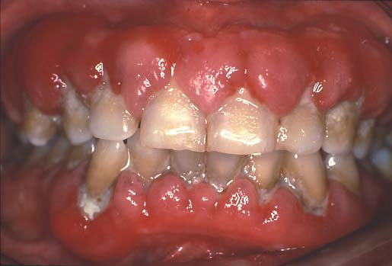
Anti-Epileptic Drugs 1st Generation
Drug | Phenytoin (the oldest one) | Fosphenytoin (Parenteral form of phenytoin) | Carbamazepine
Mech. of action | *important Blockade of Na⁺ & Ca²⁺ influx into neuronal axon. Inhibit the release of excitatory transmitters. Potentiate the action of GABA.
Pharmacokinetics | Given orally, well absorbed from GIT. Also available as capsules, IV and IM →called (fosphenytoin) Enzyme inducer. (increase its metabolism → the duration of action decreases)drug-drug interaction Metabolized by the liver to inactive metabolites. Half life approximately 20 hr. Excreted in urine. | Parenteral form of phenytoin. Prodrug. Rapidly converted into Phenytoin in the body. Advantages over Phenytoin: More Rapid IV administration. (Suitable in ER use) May be IM administered. Lower local tissue and cardiac toxicity. Less pain and phlebitis (inflammation of the vein ) at injection site. | Available as capsule or syrup orally only. can not be used in Status epilepticus *very important Well absorbed. Strong enzyme inducer. (including its own metabolism). Needs Plasma level monitoring Metabolized by the liver to active & inactive metabolites. o T1\2=18-35 hr. Excreted in urine.
Indications | Partial and generalized tonic-clonic seizures. Not in absence seizure. In status epilepticus as IV SLOW infusion of Phenytoin to prevent cardiac side effects but we can use Fosphenytoin as RAPID IV infusion. |  | Drug of choice in partial seizures. *very important Tonic-clonic seizures (1ry & 2ry generalized)grand mal Not in absence seizures. →because it may cause an increase in seizures. Other uses: Bipolar depression. Trigeminal neuralgia
ADRs | Nausea or vomiting. Neurological like headache, vertigo, ataxia, diplopia and nystagmus. Sedation. Gum (gingival) hyperplasia. (very important side effect) Hirsutism. (abnormal hair growth) Acne. Folic acid deficiency (megaloblastic anemia=large red blood cells). Vitamin D deficiency →(osteomalcia). Teratogenic effects. (very common side effect and prohibited during pregnancy ) |  | GIT upset. Hypersensitivity reactions. Drowziness , ataxia, headache & diplopia. Hyponatremia and water intoxication *very important (anti-diuretic effect, and thus it should not be given to children or old patients) Teratogenicity. (prohibited during pregnancy)

Slide 6
Anti-Epileptic Drugs 1st Generation
Drug | Sodium Valproate | Ethosuximide
Mech. of action | Blocks activated Na⁺ channels. Enhances GABA synthesis & reduces degradation. Suppress glutamate action. Blocks T-type Ca²⁺ channels. (that’s why it can be used for absence seizures) | Selectively Inhibits T- type Ca2+ channels in thalamo-cortical neurons. which of the following used for absence seizure ? *very important The best is Ethosuximide because it is selective Then sodium Valproate (choose this if the first one is not in the choices)
P.K | Broad spectrum antiepileptic. Available as capsules, Syrup and I.V. can be used in status epilepticus Metabolized by the liver into inactive form. Enzyme inhibitor. T1\2= 12-16 hr. Excreted in urine. | Absorption is complete. Syrup & capsule forms (to be easily taken for children) Not bound to plasma proteins or tissues. Metabolized in liver. T1\2 = 52-56 hr. 10-20% of a dose is excreted unchanged the urine.
Indications | It is effective for all forms of epilepsy: → wide broad spectrum Generalized Tonic-Clonic seizures (1^{ry} or 2^{ry} ). Absence seizures. Complex partial seizures Myoclonic Atonic Photosensitive epilepsy. | Absence seizures. (mainly given to children)
 | Other uses
 | Bipolar disorder and mania. (as a mood stabilizer) Prophylaxis of migraine. Lennox-Gastaut syndrome. The Lennox-Gastaut syndrome (LGS) is a type of epilepsy with multiple different types of seizures& affect children, particularly tonic (stiffening) and atonic (drop) seizures. Intellectual development is usually, but not always, impaired. (not very important but you should read it)
ADRs | GIT (nausea, vomiting, heart burn) Weight gain (↑appetite). Transient hair loss, with re-growth of curly hair. Thrombocytopenia (not used with aspirin or Coumadin) Transient increase in liver enzymes &Hepatotoxicity (we do periodic assessment) Teratogenicity (neural tube defect) *very important (prohibited during pregnancy) It happen in the brain or spinal cord Like spina bifida OR anencephaly | Gastric distress: Nausea. Vomiting. Drowsiness, fatigue, hiccups, headaches. It is not teratogenic because of that it is given to children
Extra

Slide 7
Anti-Epileptic Drugs 2^{ed} Generation
Drug | Topiramate | Lamotrigine
Action/Mech. of action | Blocks sodium channels (membrane stabilization). potentiates the inhibitory effect of GABA. | Blockade of Na+ channels. Inhibits excitatory amino acid release (glutamate & aspartate).
P.K | Well absorbed orally (80 %). Food has no effect on absorption. Has no effect on microsomal enzymes (most important difference from the first generation) 9-17 % protein bound (minimal). Mostly excreted unchanged in urine. Plasma t½ 18-24 hr. | Available as oral tablets. Well absorbed from GIT. Metabolized primarily by glucuronidation. Does not induce or inhibit CP-450 isozymes (most important difference from the first generation and that’s why it has no Drug-Drugs interactions). T1\2= approximately 24 hr.
Indications | Can be used alone for partial, generalized Tonic-Clonic, and absence seizures. don’t confuse stick to Ethosuximide (specific ) and sodium Valproate (wide spectrum) for absence seizure Lennox-Gastaut syndrome ( or lamotrigine, or valproate ). | As add-on therapy or as monotherapy in partial seizures. And generalized tonic-clonic seizure Lennox-Gastaut syndrome. Bipolar depression
ADRs | Psychological or cognitive dysfunction. Weight loss (can be desirable side effect). Sedation. Dizziness. Fatigue. Urolithiasis. Paresthesias (abnormal sensation). Teratogenecity (in animal but not in human). | Influenza-like symptoms. Skin rashes (may progress to Steven-Johnson syndrome). Stevens-Johnson syndrome is a rare, serious disorder of your skin and mucous membranes. It's usually a reaction to a medication or an infection. Often, it begins with flu-like symptoms, followed by a painful red or purplish rash that spreads and blisters Somnolence (drowsiness). Blurred vision. Diplopia. Ataxia (can be teratogenic).
*very important
*very important

Slide 8
Type of seizure
Type of seizure & choice among drugs
Treated by:
1-carbamzepine.
2-phenytoin.
3-valproate.(wide spectrum)
4-lamotrigine.
Treated by:
Valproate or Carbamazepine or Phenytoin or Lamotrigine
Partial seizures
Generalized seizures
Treated by:
Valproate, Clonazepam
Treated by:
Valproate, Ethosuximide
Atonic
Tonic-Clonic
(grand mal)
Myoclonic
Absence
Treated by:
Valproate
Drugs used for treatment of Status Epilepticus
What is status epilepticus ?
Most seizures last from few seconds to few minutes. When seizures follow one another without recovery of consciousness, it is called “status epilepticus”. It has a high mortality rate. Death is from cardiorespiratory failure. Usually the patient have history of grand mal epilepsy
Antiepileptic's used in status epilepticus
Intravenous injection of:
We use all drugs except ethosuximide and carbamzepine because they are given orally
Lorazepam
Diazepam
(Drug of choice)
Sodium Valproate
Phenytoin
Fosphenytoin
Phenobarbital
Lorazepam has a shorter pharmacokinetic half-life but stays in the brain longer than diazepam.

Slide 9
Pregnancy & antiepileptic's
Seizure is very harmful for pregnant woman. She may loss consciousness
NO antiepileptic drug is safe in pregnancy. Not even 2ed generation
Monotherapy usually better than drug combination.
Valproate & phenytoin are contraindicated during pregnancy.
Patient has to continue therapy
Summary
Epilepsy is classified into partial or generalized according to the site of lesion.
The exact mechanism of action of antiepileptics is not known.
Phenytoin is mainly used for treatment of generalized tonic-clonic seizures .
Carbamazepine is mainly used for treatment of partial seizures
Sodium valproate is a broad spectrum antiepileptic drug.
Lamotrigine & levetiracetam are used as monotherapy or adjunctive therapy in refractory cases.
Lorazepam , diazepam , phenytoin are used intravenously for treatment of status epilepticus.

Slide 10
Summary done by : Jawaher Abanumy
Generation | Drug | M.O.A |  |  |  |  | Types of seizure
 |  | Block Ca++ & Na+ influx | Block T-type Ca++ channels | Inhibit release of excitatory transmitter (glutamate) | Potentiate action of GABA | Increase outward positive k+ current | Partial | Generalized |  |  |  | Status Epilepticus
 |  |  |  |  |  |  |  | Tonic-clonic (grand mal) | Atonic | Myoclonic | Absence (petit mal)
1st | Phenytoin | ✔ |  | ✔ | ✔ |  | ✔ | ✔ |  |  | x | ✔
 | Fosphenytoin | ✔ |  | ✔ | ✔ |  | ✔ | ✔ |  |  | x | ✔
 | Carbamazepine | ✔ |  | ✔ | ✔ |  | ✔✔ | ✔ |  |  | x
 | Valproate | ✔ | ✔ | ✔ | ✔ |  | ✔ | ✔ | ✔ | ✔ | ✔ | ✔
 | Ethosuximide |  | ✔ |  |  |  |  |  |  |  | ✔✔
2nd | Topiramate | ✔ |  |  | ✔ |  | ✔ | ✔ |  |  | ✔
 | Lamotrigine | ✔ |  | ✔ |  |  | ✔ | ✔
Benzodiazepines |  |  |  |  |  |  |  |  |  | Clonazepam |  | Lorazepam & Diazepam

Slide 11
Summary done by : Jawaher Abanumy
Drug | ADRs
Phenytoin | Gum hyperplasia, hirsutism, acne, folic acid deficiency (megaloblastic anemia), vit D deficiency (osteomalacia)
Fosphenytoin | Gum hyperplasia, hirsutism, acne, folic acid deficiency (megaloblastic anemia), vit D deficiency (osteomalacia)
Carbamazepine | Hyponatremia, water intoxication, hypersensitivity, teratogenicity
Valproate | Hepatotoxicity, teratogenicity (neural tube defect), thrombocytopenia.
Ethosuximide | nausea, vomiting, fatigue, headache
Topiramate | Weight loss, sedation, urolithiasis, teratogenicity
Lamotrigine | Influenza-like symptoms, skin rash (Steven-Johnson syndrome), diplopia

Slide 12
قادة فريق علم الأدوية :
لين التميمي & عبدالرحمن ذكري
الشكر موصول لأعضاء الفريق المتميزين :
مؤيد اليوسف
فارس النفيسة
عبدالكريم العتيبي
مؤيد احمد
سعد القحطاني
طراد الوكيل
أنوار العجمي
ندى الصومالي
روان سعد القحطاني
References :
1- 436 doctors slides
2- 435 team work
pharma436@outlook.com
Your feedback:
@pharma436
https://docs.google.com/forms/d/1sxDqHtpP3bUaOhQmYw96IE7mX-DlrklT5dlZUA2teSI/edit

