Slide 1
Drugs used in headache and migraine
Objectives:
Differentiate between types of headache regarding their symptoms, signs and pathophysiology.
Recognize drugs used to prevent migraine.
Identify drugs used to rescue and abort migraine.
Elaborate on the pharmacokinetics, dynamic and toxic profile of some of these drugs.
color index:
extra information and further explanation
important
doctors notes
Drugs names
Mnemonics
Check out the mnemonics file :
https://docs.google.com/presentation/d/1Z0Vf9oEOJSXo4JIA0mTCk5jB-OU9LP5TFCwz8iBgNac/edit?usp=sharing
Kindly check the editing file before studying this document
https://docs.google.com/presentation/d/1_-g1vol4eBWPet5xVCkuTGFvvnhFF3PJmU0tWtEEw_o/edit?usp=sharing

Slide 2
تم بحمد الله
كل الشكر و التقدير لكل من ساهم في إنجاز هذا العمل
أعضاء فريق علم الأدوية المتميزين الذين كانوا خير عونٍ و سندْ
كتب الله أجرهم و نفعهم بما علمهم و زادهم علماً
فيصل العباد
عبدالرحمن العريفي
فؤاد بهجت
عبدالرحمن الجريان
طلال العنزي
عبدالوهاب الشهراني
عبدالكريم الحربي
مؤيد اليوسف
خالد شراحيلي
سعد الرشود
فارس النفيسة
عبدالكريم العتيبي
مؤيد أحمد
سعد القحطاني
عبدالرحمن الراشد
محمد خوجه
عبدالعزيز الجاسر
عمر تركستاني
معتز الطخيس
خالد العيسى
إبراهيم فتياني
حاتم النداح
طراد الوكيل
عبدالعزيز رضوان
روان سعد القحطاني
شذا الغيهب
لينا الوكيل
اللولو سعد الصليهم
غادة المزوع
جومانا القحطاني
ريم الشثري
رنا باراسين
سمر القحطاني
آمال الشيبي
أنوار العجمي
جواهر الخيال
ريما سلطان العتيبي
سارة الشمراني
شهد السويدان
ندى الصومالي
هيفاء بن طالب
دانيا خالد سجا
دعاء عبدالفتاح
قادة فريق علم الأدوية :
لين التميمي & عبدالرحمن ذكري

Slide 3
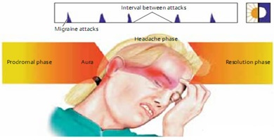
Introduction
Headache
It is Pain anywhere in the region of the head or neck. It is caused by disturbance of the Pain -Sensitive Structures around the brain and it is divided into: Within the cranium (blood vessels, meninges, cranial nerves). Outside the cranium (muscles, nerves , arteries ,veins, subcutaneous tissues ,eyes, ears and other tissues).
Migraine
Recurrent attacks of throbbing headache (pulsating ), mostly Unilateral and some times on both sides. Lasting from > 2 up to 72 hours + Preceded (or accompanied) by AURA. Pain is usually on one side of head with facial and neck pain and nausea and vomiting. It’s called Curtain like effect over one eye.
AURA
It is seeing flashes of light, blind spots or feeling tingling in arm. Perceptual disturbance of motor < sensory nature It is the Best time to give the drugs and it develops mostly 20 minutes before the attack of migraine starts. Visual: Photophobia (↑ sensitivity to light) Auditory: Phonophobia (↑ sensitivity to sound) Olfactory unpleasant smell. Sensory; abnormal sensation of at face, extremities. Develops over 5-20 min. & last fewer than 60 min.
Types of migraine
1-common (without aura 80%) |  | 2-classic (with aura 20%)
Phases of migraine (self reading!)
Prodrom Phase | a change in mood or behavior (irritability, neck stifness) that starts hours or days before headache. It is experienced by 60% of migraineurs.
Aura Phase | Sensory > motor symptoms starts 5-20 min before the migraine attack. It is experienced by 20% of migraineurs.
Headache Phase | moderate to severe pain  with activity + anorexia, vomiting Intolerance to light, sounds, odors Blurry vision ,Blocked nose ,Pale face Sensations of heat or coldness ,Sweating ,Tenderness of the scalp
Postdrom Phase | still not normal, either; More likely fatigued → irritability ,impaired concentration ,scalp tenderness ,mood changes ,GIT symptoms. (self-limiting so if you didn’t treat it will go away anyway after 2 to 72 hours depending on the severity).
Migraine triggers
Diet | Aged cheese (contains tyramine → constrict blood vessels → hypertension), Alcohol, Chocolate, Caffeine, Hot dogs, Avocado, Fermented or pickled foods, Yeast or protein extracts, Aspartame.
Therapy | Antibiotics, Antihypertensive, H2 blockers, Vasodilators, Oral contraceptives (negative feedback when body feel that estrogen levels are elevated).
disease | (e.g. hypertension, epilepsy and depression).
Hormonal changes | Menstrual migraine (Most common) Because estrogen is neuroprotective & its declining during menstrual cycle.
Stress, climate and life style

Slide 4
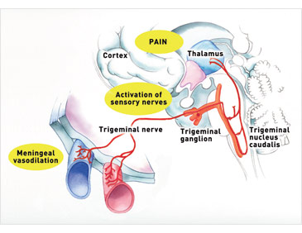
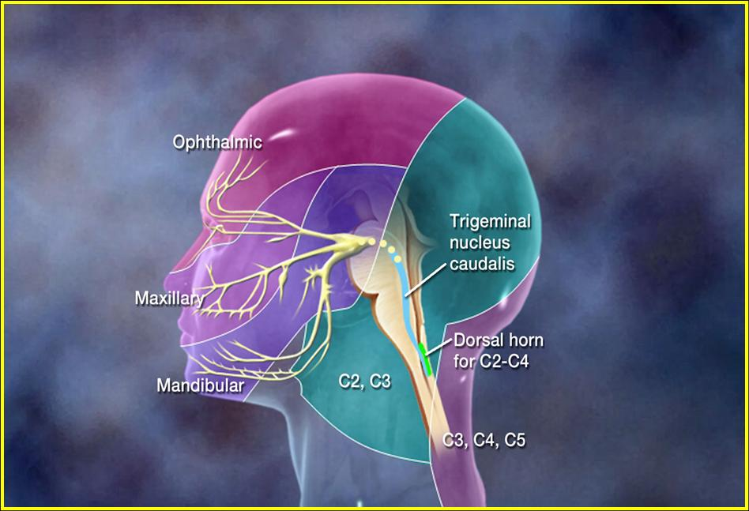
Migraine Causal Theories
Vascular, Cortical Spreading Depression, Neurovascular theory, Mediators [ Serotonin ], Dopaminergic Hypersensitivity. We will discuses only 2 of them :
Vascular theory: Triggers → Intracranial vasoconstriction → migraine aura → focal (local)ischemia → ↑ mediators (damaging inflammatory mediators) → rebound vasodilatation (cause of throbbing pain) → ↑ permeability & leak → inflammatory reaction → activates perivascular nociceptive nerves (pain mediators) → migraine headache → It throbs as blood flow at these sensitive area with each heart beat.
Triggers → Release K / glutamates (too much excitation) → Creates a slowly well-defined depolarizing wave → depolarize adjacent tissues → propagating at a rate of 2-6 mm/min → vasoconstriction → migraine aura → activate trigemino-vascular complex → vasodilation → migraine headache
Stimulation of the trigeminal nerve causes the release of vasoactive peptides (substance P, Neurokinine A and Calcitonine G are the most released peptides in pain) this is responsible for the head pain, as well as the facial and neck pain, experienced during migraine.
The vascular theory: MG is a direct result of general vasoconstriction/vasodilatation of the small-innervated arteries that supply brain
The extracranial arteries, which supply scalp and periosteum of the skull and intracranial arteries located inside the skull and supply brain tissue, are linked via reflex pathways.
Tension in the posterior cervical muscles developed as a result of trauma and physical or emotional stress triggers vasoconstriction of extracranial arteries that supply the scalp. The vasoconstriction of extracranial arteries via reflex pathways triggers vasoconstriction of intracranial arteries that supply the brain. This vasoconstriction corresponds with the aura stage of MG.
As soon as the blood supply to the brain is even slightly compromised, the body will do whatever it takes to maintain normal blood perfusion through the brain. Thus, as a reflex reaction to vasoconstriction in the intracranial brain arteries, the parenchymal arteries (i.e., arteries that enter the brain tissue) dilate.
This dilation causes an exit of liquid into the surrounding brain tissue and even mild local swelling, which triggers an increase of the intracranial pressure. At this point, the MG attack begins.

Slide 5
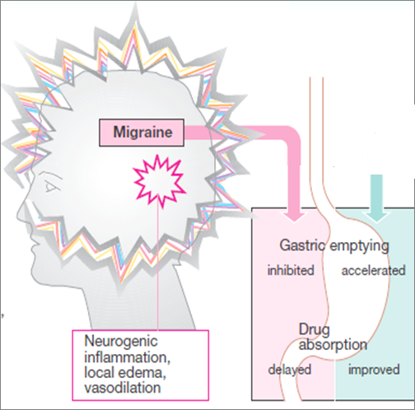
Treatment strategy
Prevent recurrence Prophylactic | Acute attack (Controls attack)
↓ Recurrence frequency, severity, duration & / or disability. ↑Responsive to abortive therapy (drugs stops migraine ) | ABORTIVE therapy (severe-disabling) Treat the cause | RESCUE therapy (mild to moderate) Treat Symptoms
 | - They specifically target pathways of migraine by ↓ meningeal dilatation & ↓ neural activation via 5HT1 agonism (serotonin constrict blood vessels) i.e. Stopping headache as it is evolving. - Abortive medications effective if taken early, just before the pain starts (before vasodilatation), losing effectiveness once the attack has begin (may prevent further attacks only) So they must be rapidly acting | Non-specifically target individual symptoms. i.e. Alleviating Pain, emesis and associated symptoms
N.B. Full effect of therapy needs several weeks to manifest & should continue for 6 months & can be repeated
ACUTE ATTACK (RESCUE THERAPY)
Drug | Analgesics | Mech. of action | NSAIDs: Acetaminophen (=paracetamol) it is stronger than the others. If we combine acetaminophen with: Caffeine (Panadol extra) this will cause wakefulness. 1st generation Anti-Histamine this will cause sedation and it’s good in migraine. Aspirin (weaker). Ibuprofen, Naproxen → Drug of choice for mild to moderate attack with no nausea & vomiting.
 |  |  | Opioid like drugs : μ agonist e.g.: tramadol Central Strong analgesic used in severe attack of migraine and is causes tolerance.
 | Anti-emetics (prevent nausea and vomiting) |  | Dopamine Antagonists | A- Domperidone Drug of choice to avoid sedation and sleeping (not sedative). Gastro-prokinetic effect (gastric empting) (increase gastric motility Increase absorption of drug & reduce vomiting) → ↑ Absorption & bioavailability of abortive therapy.
 |  |  |  | B- Phenothiazines (Promethazine): it is dopamine antagonist & Has a sedative effect.
 |  |  | 5HT3 antagonists: Ondanseteron, Granisetron (the best drugs for vomiting ): For severe nausea and vomiting.
 |  |  | H1 antagonist: Meclizine, diphenhydramine: Has anti-histaminic +sedative + Anti-cholinergic effect. → Safe for pregnancy.

Slide 6
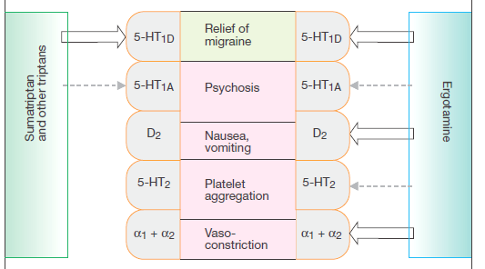
ACUTE ATTACK (ABORTIVE THERPY)
5HT₁
AGONISTS
PARTIAL AGONISTS
TRIPTANS
Selective for serotonin
ERGOTS
non-selective for serotonin
Ergotamine from ergots group affect many receptor so it is not selective
Sumatriptan from triptans group affect ONLY serotonin receptors so it is selective (better)
Prevent recurrence
Anti-epileptics | Anti-depressants | Anti- hypertensives
Block Na⁺ channel & augment GABA at GABA-A receptors Topiramate, Valproic (very low dose) | TCA; amitryptylin and nortryptyline. Why TCA? Because they have 5- HT & H1 actions, which are good for migraine | Β-blockers; propranolol Ca²⁺ Channel Blockers Propranolol is commonly used in prophylaxis of migraine attack.

Slide 7
ACUTE ATTACK (ABORTIVE THERPY)
1- Ergots
Drug | Ergotamine tartarate (rare clinical use due to sever adverse effects) (restricted use) | Dihydroergotamine (DHE) (preferred in clinical setting)
Mech. of action | Product of Claviceps purpurea which is a fungus growing on rye/grains Non-Selective. Partial Agonism at 5HT1 (5HT-1D/1B found in cerebereal And menigeal vessels) receptors. → ↓ release of vasodilating peptides ↓ excessive firing of nerve endings At blood vessels → ↓ vasodilation & stretching of the pain endings Mechanism. Partial agonist effect on α-adrenoceptors → vasoconstriction.
pharmacokinetics | Oral absorption (as Cafergot =ergotamine + caffeine) is Incomplete (erratic) + slow → low bioavailability. Can be taken sublingually, rectal suppository, inhaler. T1/2 nearly 2 hours, ergotamine produces vasoconstriction → 24 hours or longer due to high and long tissue binding ability. Ergotamine tartrate (Reserve drug) Has significant side effects, and may worsen the nausea and vomiting associated with migraine. Because it acts on DA | Nasal spray & inhaler & injectable forms (good to use if patient is vomiting) Given parenterally, and eliminated more rapidly than ergotamine, presumably due to its rapid hepatic clearance and has less adverse effects. Better than Ergotamine tartarate because of the P.K characteristics. has an efficacy similar to that of sumatriptan, but nausea is a common adverse effect.
Indications | They are only used to abort the attacks. Given if the patient can’t tolerate pain and not responsive for other medications . Dihydroergotamine can be given for severe, recurrent attacks not responding to other drugs. Their use is restricted to patients with frequent, moderate attack or infrequent but severe attacks.
ADRs | • GIT upset. • Feeling of cold and numbness of limbs, tingling (because of vasoconstriction). • Anginal pain due to coronary spasm, and disturbed cardiac rhythm (tachycardia or bradycardia). • Prolong use → rebound headache due to vasodilatation followed by vasoconstriction. • Prolong use and high dose → paraesthesia (tingling or burning sensation).
Contraindications | Pregnancy; fetal distress and miscarriage (ergot is uterine stimulant and vasoconstrictor). Peripheral and coronary vascular diseases Because of the vasoconstriction effect. Hypertension Because of the vasoconstriction effect. Liver and kidney diseases. Prophylaxis of migraine. In concurrent use (=same time ) with triptans (at least 6 hours from last dose of triptans or 24 hours from stopping ergotamine and β-blockers)

Slide 8
ACUTE ATTACK (ABORTIVE THERPY) cont.
2-Triptanes
Selective Agonist at 5-HT1 (5-HT1D/1B) receptors→ better than ergots. Similar to ergotamine except that triptans are more selective as serotonergic agonist. No α1, α2, β –adrenergic, dopamine or muscarinic receptors.
Drug | Sumatriptan Super fast | Zolmitriptan | Naratriptan
 | oral, nasal spray, and injectable | nasal spray, and injectable | Oral preparations
MOA | Same as ergot’s MAO Triptans inhibit the release of vasoactive peptides, promote vasoconstriction, and block pain pathways in the brainstem . Triptans inhibit transmission in the trigeminal nucleus caudalis.
pharmacokinetics | - Oral Bioavailability→ low - Subcutaneous → 97%, peaks after 2 min & T1/2 nearly 2 hours (fast action with SC, subcutaneous, good for patient with vomiting) | - Oral bioavailability 40%, peaks after 2 hrs & T1/2 nearly 3 hours. | -Oral bioavailability 70%, peaks after 2 hrs & T1/2 nearly 6 hours (slower onset, less side effects)
Indications | • To abort attacks in patients with frequent, moderate or infrequent but severe attacks. • In cluster headache generalized headache including head and neck. • Sumatriptan → first-line therapy for acute severe migraine attacks.
ADRs | Most of ADRs are the same as with ergot but triptans are better tolerated. Mild pain and burning sensation at the site of injection. Vasospasm, Ischemic heart; Angina and Arrhythmias. Zolmitriptan causes Chest & neck tightness, Coronary vasospasm and Somnolence.
Contraindications | Peripheral vasospastic diseases. Uncontrolled hypertension. Coronary artery disease. History of ischemia. Cerebrovascular disorders. In concurrent use with ergots or others inducing vasospasm. In concurrent use with MAOIs, lithium, SSRIs, → (5HT increased to toxic level). Renal or hepatic impairment. Because these drugs also increase serotonin and norepinephrine and it will cause sever vasoconstriction and arrhythmia or even death

Slide 9
Deciding whether better with a triyptan or with DHE
Patients
migraines a
day or less
Triptans (they give rapid relief of pain)
pregnant
women
Paracetamol or intranasal Sumitriptan and or
Diphenhydramin, Meclizine are safe.
DHE is often the optimal choice because it has longer t_{1/2}
headache episodes lasting 2 or 3 days at a time
Factors when Choosing a Triptans:
remember : always start with analgesic and Never use Ergotamine tartarate.
T 1\2 (h) Reduce pain and prevent recurrence for longer time | T-max (h) Give rapped effect | Medication
10 | 1 | DHE
2 | 0.25 | Sumatriptan SQ
2-3 | 1-1.5 | Rizatriptan
3 | 2.5 | Zolmitriptan
6 | 2-3 | Naratriptan
4 | 2.8 | Eletriptan
26 | 2-3 | Frovatriptan
2
1
3
2
3
1
Advantages of fast T-max: fast release of pain.
Advantages of longer T1/2: less doses needed.
Differences in the time to peak blood concentration T _{max} , equates with faster relief of pain.
Differences in t ½ → a clinical effect in terms of recurrence of headache.
The form of drug preparation could influence the choice, Injectable Sumatriptan reaches T _{max} the fastest followed by DHE nasal spray and Rizatriptan.
For extremely fast relief within 15 min. injectable Sumatriptan is the only choice.
If expected re-dosing is needed and/or recurrence of headache → Naratriptan, frovatriptan, have slower onset, fewer side effects,
and a lower recurrence rate.
Menstraul migraine: Frovatriptan (longer T 1\2 = 26hrs) 2.5 mg twice
per day beginning two days before the anticipated onset of menstrual migraine and continuing for six days.

Slide 10
قادة فريق علم الأدوية :
لين التميمي & عبدالرحمن ذكري
الشكر موصول لأعضاء الفريق المتميزين :
عبدالعزيز رضوان
فيصل العباد
عبدالرحمن الجريان
طلال العنزي
عبدالوهاب الشهراني
عبدالكريم الحربي
دانيا خالد سجا
روان سعد القحطاني
References :
1- 436 doctors slides
2- 435 team work
3-Pharmacology (Lippincotts Illustrated Reviews Series), 5th edition.
pharma436@outlook.com
Your feedback:
@pharma436
https://docs.google.com/forms/d/1sxDqHtpP3bUaOhQmYw96IE7mX-DlrklT5dlZUA2teSI/edit

