Slide 1
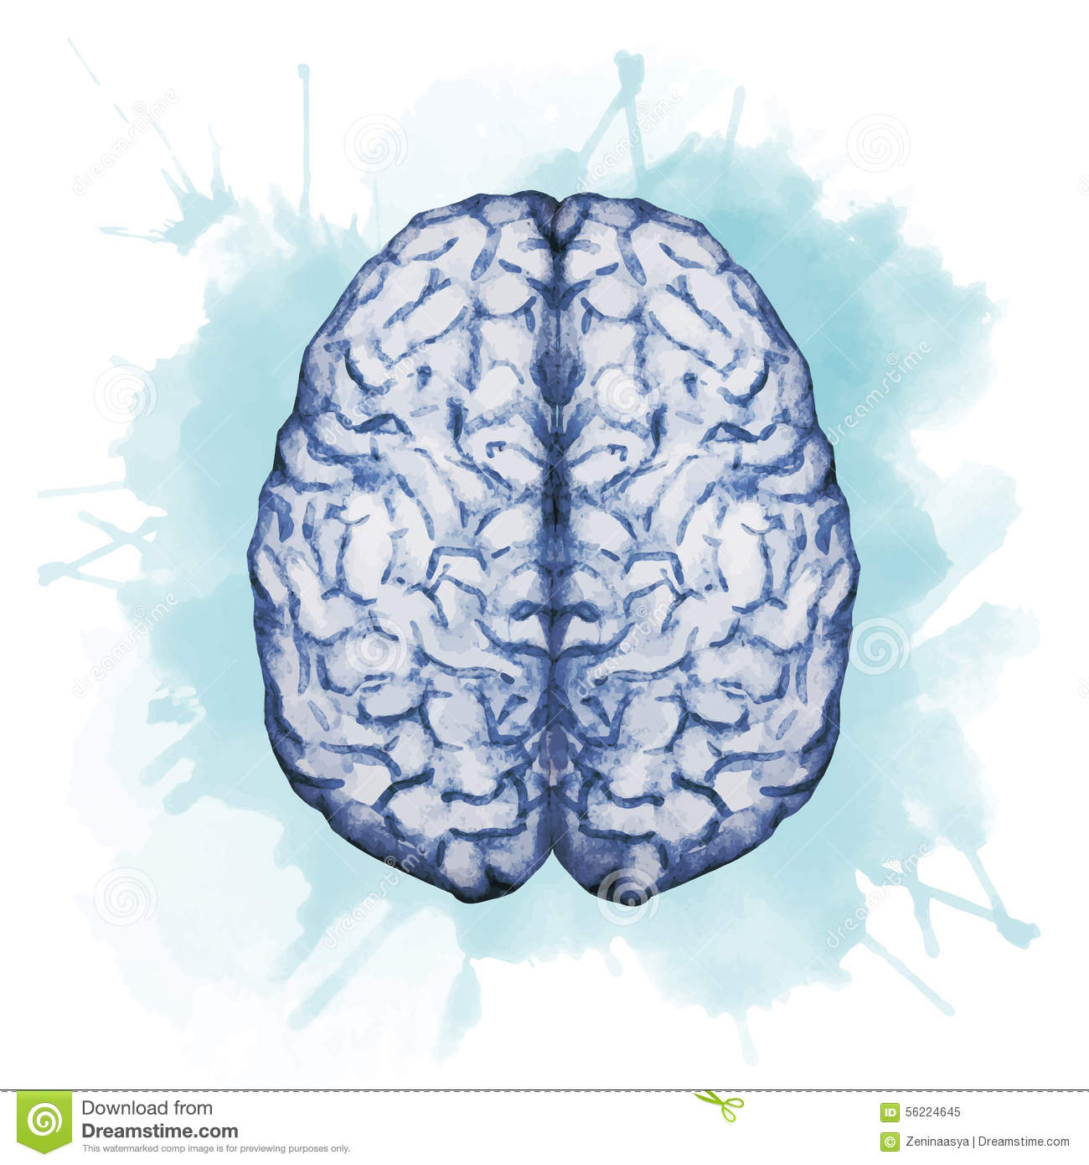
Medication affecting the balance system
Objectives:
Recognize causes and symptoms of balance disorders.
Identify the transmitters involved in vestibular transmission.
Segregate classes of drugs used in the management protocols to control or prevent vertigo.
Identify drugs that can precipitate vertigo.
Color Index:
extra information and further explanation
important
doctors notes
Drugs names
Mnemonics
Check out the mnemonics file :
https://docs.google.com/presentation/d/1Z0Vf9oEOJSXo4JIA0mTCk5jB-OU9LP5TFCwz8iBgNac/edit?usp=sharing
Kindly check the editing file before studying this document
https://docs.google.com/presentation/d/1_-g1vol4eBWPet5xVCkuTGFvvnhFF3PJmU0tWtEEw_o/edit?usp=sharing

Slide 2
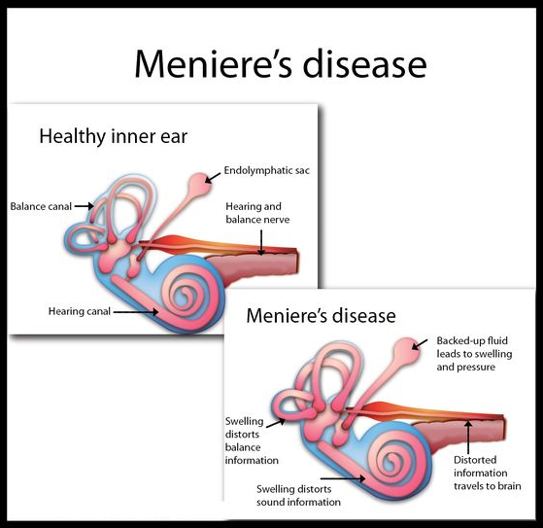
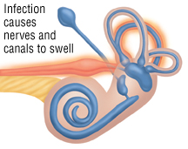
Introduction
The overall incidence of dizziness, vertigo, and imbalance is 5-10%.
It reaches 40% in patients older than 40 years.
Accounts for 3% of total visits to emergency department.
The incidence of falling due to imbalance is 25% in subjects older than 65 years.
1% of falls results in hip fracture.
Roughly 50% of fractured hips will not function normally.
To understand !
Vertigo Vs Dizziness
Dizziness | Vertigo
General term used to express subjective patient complaints related to changes in sensation , movement, perception, or consciousness. Lighted headedness: is feeling as if you might faint. Dizziness is more general than Vertigo because dizziness is false sensation of movement, perception, consciousness, sensation. While Vertigo is false sensation or illusion of movement. There are two types of Vertigo: Objective vertigo describes when the person has the sensation that stationary objects in the environment are moving. Subjective vertigo refers to when the person feels as if they are moving. | A type of dizziness that creates the sense that you or your environment is SPINNING. - BALANCE DISORDER (the individual will feel unsteady when standing or walking)
 | Symptoms
 | Confusion or disorientation. Falling or feeling as if one is going to fall. Nausea or vomiting. Sweating. Nystagmus (Abnormal eye movement).
Confusion: felling not clear about something or don’t have clear thinking about something.
Disorientation: is the loss of sense of direction, position.
Balance disorders
Benign paroxysmal positional vertigo. (BPPV) | A change in head position causes a sudden sensation of spinning. Paroxysmal means sudden and it’s the most common balance disorder.
Acute labyrinthitis | Inflammation of the balance apparatus of the inner ear, probably caused by a viral infection. Why would that happen? Because of the deposition ofcalcium crystals in one of the semicircular canals.
Meniere's disease (Explained in the Picture above) | Disorder of the inner ear (Affects inner ear fluid homeostasis) in cases Meniere’s disease > swelling and increase fluid inside the cochlea. This causes repeated episodes of dizziness, usually with ringing in the ear result in progressive low-frequency hearing loss & balance disorder.

Slide 3
Drugs inducing vertigo
Vestibular toxins
Mixed ototoxins
Overview
Drugs Affecting Balance
Drugs treat vertigo
Specific treatment
(if the cause is known)
Symptomatic treatment
Prophylactic treatment
Involves targeting the underlying cause of the Vertigo (e.g ear infection)
Antibiotics
Involves controlling the acute symptoms and autonomic complaints (e.g., vertigo and vomiting)
Vestibular suppressants
Antiemetics
used to control vomiting & nausea
Reduce the intensity of vertigo and nystagmus evoked by a vestibular imbalance.
1- Antihistamines.
Dimenhydrinate
2- Phenothiazines.
prochlorperazine
3- Dopamine antagonists.
Metoclopramide
domperidone
1- Anti-cholinergics
hyoscine
2-Benzodiazepines.
Lorazepam
Clonzepam
Diazepam
3- Betahistine
Aims to reduce the recurrence of specific vertiginous conditions.
1- Diuretics : Except Loop diuretics¹. e.g Furosemide (Loss of Na & H2O →↓ H2O in the endolymph)
2- Corticosteroids²
3- L- type Ca & K Channel Blockers³& antihistamine
Cinnarizine
Verapamile
1- Because they are ototoxic → ↑ incidence of vertigo.
2- To ↓ inflammation.
3- ↑ Vasodilatation.

Slide 4
Vestibular suppressants
Drug | Anticholinergics | Benzodiazepines | Betahistine
 | Hyoscine it is known as (scopolamine) | Lorazepam Clonzepam Diazepam
Action/Mech. of action | 1-inhibit firing in vestibular nucleus neurons. 2-Reduce the velocity of vestibular nystagmus - Acts by interfering with the transmission of nerve impulses by ACh in the parasympathetic nervous system (specifically the vomiting center) | Minimize anxiety (antianxiety drugs) and panic associated with vertigo and sleep inducer. Why we give it to the patient? Because patient with vertigo will be panic and anxious. by binding adjacent to GABAA receptors →enhance the effects of GABA by increasing GABA affinity for the GABA receptor → open Cl ion channel →hyperpolarize cell membrane. | It is a structural analog (derivative of) of histamine with: 1- Weak histamine H1 receptor agonist By stimulating H1 receptors located on Blood Vessels in the inner ear→ local vasodilation and ↑ permeability helps to reverse the underlying problem of endolymphatic hydrops. (accumulation of endolymph)→ Reduce pressure in endolymph thus reducing edema in the inner ear. 2- More potent histamine H3 receptor antagonist properties By blocking H3 receptors in presynaptic nerve end → prevent reuptake of Histamine by H3 Receptor ↑ the local concentration of histamine in the inner ear → ↑ direct H1-agonist activity. - increases the level of serotonin in the brainstem → ↓ the activity of vestibular nuclei.
P.K |  |  | Tablet or oral solution Rapidly and completely absorbed. (lipid soluble) t½= 3-4 h. Excreted in urine within 24h. Low protein binding.
Indi- cations | Management of vertigo, sedation & motion sickness | In small dosages useful for the management of acute vertigo. | Meniere’s Disease (more discussed in slide 6)
ADRs | Blurred vision and sand eyes. Dry mouth. Sedation. Urinary retention. Constipation. | - Dependence (addiction) - impaired memory - increased risk of falling (not given to patients with chronic vertigo because it inhibits the coordination of skeletal muscle) | Headache Nausea GIT side effects. Hypersensitivity reaction. (H1 Receptor is found in smooth muscles of GIT ↑ contractility by the effect of histamine)
C.I |  |  | Pheochromocytoma (tumor of adrenal gland) because the tumor release high amount of Catecholamine. Bronchial asthma. Because Histamine cause bronchoconstriction. History of peptic ulcer. Hypersensitive patients.
In the past, histamine was used to diagnose Pheochromocytoma, if the patient is suspected to have the tumor, the physician will inject S.C histamine, test is positive if the patients BP increased.

Slide 5
Anti-emetics
Drug | Anti-histamines | Phenothiazines | Dopamine antagonists
 | Diminhydrinate (first generation) | Prochlorperazine (the most popular ) | Metoclopramide+ domperidone.
Action/Mech. of action | Block H1 receptors in CRTZ.(chemoreceptor trigger zone ) the vomiting center in the brain Sedative effects. Weak anticholinergic effects. ↓ Excitability in the labyrinth & blocking conduction in vestibular-cerebellar pathways. | Blocks dopamine receptors (D2) at CRTZ. .(chemoreceptor trigger zone ) NT of CRTZ is Dopamine. Antipsychotic , some sedation + antiemetic. Some vestibular suppressant action | block DOPAMINE D2 receptors in the CRTZ of the medulla, resulting in potent central antinausea & antiemetic action Has some sedative action. Has potent gastroprokinetic effect. Which enhances gastrointestinal motility by increasing the frequency of contractions in the small intestine or making them stronger, but without disrupting their rhythm.
Indications | Vertigo. Nausea and vomiting associated with Motion sickness. | One of the best anti-emetics in vertigo.
ADRs | Sedation. Dizziness. Anticholinergic side effects. |  | Restlessness or drowsiness. Extrapyramidal manifestations (on prolonged use.) such as in Parkinson disease. (this drug produces parkinsonism like symptoms including tremor and muscle rigidity.
Contraindications | Glaucoma. Because it has anti-cholinergic effect that may increase pressure inside the eye. (anticholinergic effect which increase IOP) Prostatic enlargement. (Anticholinergic causes urinary retention by relaxing the urethral smooth muscle) Parkinsonism.

Slide 6
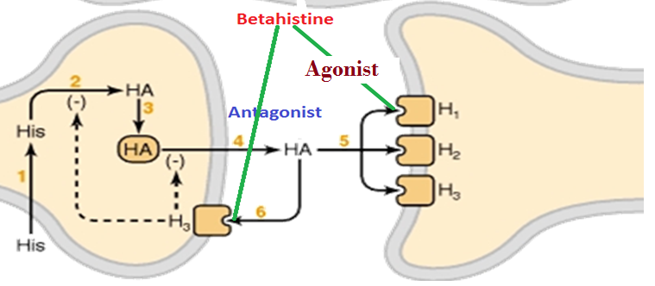
Ca²⁺ channel blockers (Prophylactic)
Drug | Cinnarizine
Action/Mech. of action | Selective K+ channel blocker. Selective Ca2+ channel blocker (vascular smooth muscle relaxation). Anti-Histamine, Anti-Serotonin, Anti-Dopamine ,vasodilation. As physiological condition, ↑ hydrostatic pressure on hair cells activates K+ currents. Cinnarizine inhibits K+ currents lead to: 1- lessen vertigo. 2- motion induced nausea by dampening the over-reactivity of the vestibular hair cells. - It promotes cerebral blood flow (by the effect of ↓ viscosity) to Improve memory especially in elderly.
P.K | Orally in tablet form. Rapidly absorbed Low oral bioavailability due to hepatic first pass metabolism If administered IV in lipid emulsion, it has better bioavailability.
Indi- cations | Nausea and vomiting associated with motion sickness Vertigo Meniere’s disease.
ADRs | Sweating. Headache. Drowsiness. Muscle rigidity and tremor due to D2 blocking effect.
Contra- indications | Parkinsonism because they suffer from shortage of dopamine (anti-dopamine action). Car drivers because of anti-histaminic effect sedation and cause drowsiness
Clinical indications Of Betahistine
Study results: (focus on red )
Betahistine is indicated for treatment of Ménière's syndrome
Efficacy and safety of betahistine treatment in patients with Meniere’s disease: primary results of a long term, multicentre, double blind, randomised, placebo controlled, dose defining trialBEMED trial) BMJ 2016; 352
94% of ENT surgeons in Britain prescribe betahistine for Meniere’ disease, while in USA they think it is no better than a placebo
Current evidence is limited as to whether betahistine prevents vertigo attacks caused by Meniere’s disease, compared with placebo reactions.
Betahistine mechanism of action

Slide 7
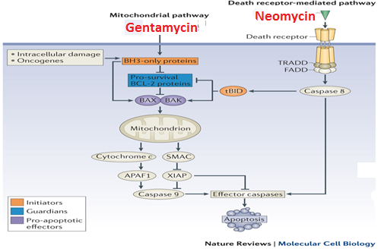
Drugs inducing vertigo
Drugs producing damaging effects on structure or function of labyrinthine hair cells & / their neuronal connections.
A- Vestibular toxins | affect the balance | Alter function | 1- Drugs altering fluid & electrolyte balance. E.g. (loop Diuretics) cause changes in fluid of the vestibule which affect the balance.
 |  |  | 2- Drugs altering (Inhibit) vestibular firing (neuronal depressants) E.g: (Anticonvulsants, Antidepressants, Sedative hypnotics Alcohol, Cocaine) Cocaine is a local anesthetic , they’re neural suppressants drugs cause changes in the function of the vestibular system.
B- Mixed ototoxins | affect hearing & balance | Alter structure | Aminoglycoside antibiotics: we use them with bacterial infections. - Gentamycin - Neomycin - Kanamycin - Streptomycin. | GentaMycin: | NEomycin:
 |  |  |  | Induce apoptosis(cell destruction and death) by evoking free radicals → Mitochondrial Pathway. | Induce apoptosis by activating caspases → DEath Receptor Pathway. So it’s alter the structure.
 |  | Alter function | - Quinine, Chloroquine , quinidine Anti-malarial drugs. - Nitrogen mustard Anti-cancer drug. Loop diuretics. NSAIDs e.g. aspirin. Tobacco. |  | - How functional derangement is induced by these drugs? ↓ Local blood flow → biochemical changes → ↓ electrochemical transduction → ↓ firing of impulse N.B. Functional damage recover after stopping the drugs, but Structural damage doesn’t recover.

Slide 8
قادة فريق علم الأدوية :
لين التميمي & عبدالرحمن ذكري
الشكر موصول لأعضاء الفريق المتميزين :
مؤيد اليوسف
فارس النفيسة
عبدالكريم العتيبي
مؤيد احمد
سعد القحطاني
عبدالعزيز العنقري
روان سعد القحطاني
سمر القحطاني
References :
1- 436 doctors slides
2-435 team work
pharma436@outlook.com
Your feedback:
https://docs.google.com/forms/d/1sxDqHtpP3bUaOhQmYw96IE7mX-DlrklT5dlZUA2teSI/edit
@pharma436

