Slide 1
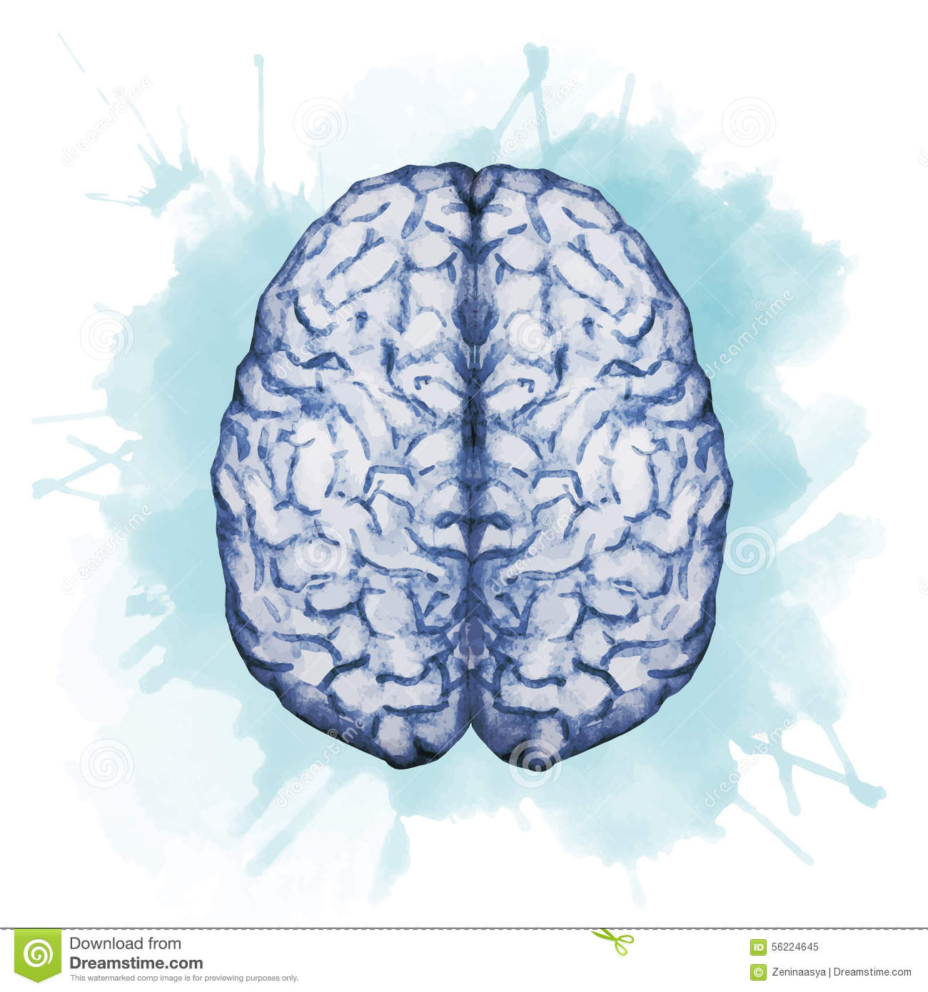
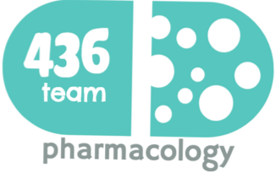
Pharmacology of central neurotransmitter
Objectives:
To understand the role of neurotransmitters in the etiology and treatment of CNS diseases.
To define neurotransmitters.
To understand neuronal circuits system for neurotransmitters.
To compare the location, receptor subtypes, effect of release, and general physiological and pharmacological roles of the neurotransmitter systems and the dysregulation of their level .
Basic classes of neurotransmitters: Cholinergic (Ach),Biogenic amines (norepinephrine, epinephrine, dopamine, glutamate, and serotonin) , Inhibitory amino acids (GABA, glycine) , Opioid peptides.
color index:
extra information and further explanation
important
doctors notes
Drugs names
Mnemonics
Check out the mnemonics file :
https://docs.google.com/presentation/d/1Z0Vf9oEOJSXo4JIA0mTCk5jB-OU9LP5TFCwz8iBgNac/edit?usp=sharing
Kindly check the editing file before studying this document
https://docs.google.com/presentation/d/1_-g1vol4eBWPet5xVCkuTGFvvnhFF3PJmU0tWtEEw_o/edit?usp=sharing

Slide 2
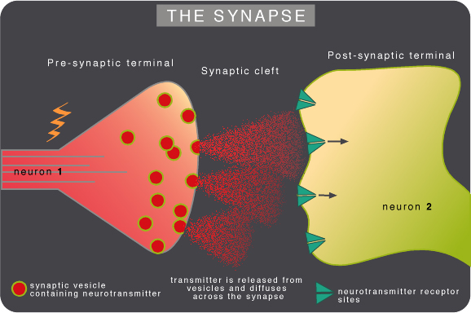
Introduction
What are Neurotransmitters?
Endogenous chemicals or chemical messengers that transmit signals from a neuron to a target cell across a synapse.
They’re packed into synaptic vesicles under the membrane in the axon terminal, on the presynaptic side.
They are released into & diffuse across the synaptic cleft to bind to a specific receptors on the postsynaptic side.
The neurotransmitter-receptor interaction must be terminated quickly to allow rapid, repeated activation of receptors. One of the following can happen to neurotransmitters that have interacted with receptors:
1- They can be quickly pumped back into the presynaptic nerve terminals by active, ATP- dependent processes (reuptake). Neurotransmitters taken up by the nerve terminals are repackaged in vesicles for reuse. 2- They can be destroyed by enzymes near the receptors. One way to treat depression :
MAO enzyme responsible for degradation of serotonin and dopamine if you inhibit this enzyme serotonin and dopamine levels will go high that will lead to antidepressant effect.
3- They can diffuse into the surrounding area and be removed. .
A membrane action potential arriving at the terminal opens axonal Ca channels; Ca inflow releases neurotransmitter molecules from many vesicles by fusing the vesicle membranes to the nerve terminal membrane. Membrane fusion generates an opening through which the molecules are expelled into the synaptic cleft via exocytosis.
Examples of neurotransmitters
Amino acids
Monoamines & other biogenic amines
Peptides
Others
Somatostatin:
a peptide hormone that regulates the endocrine system
Dopamine (DA)
Glutamate (Glu)
Acetylcholine (Ach)
gamma aminobutryic acid (GABA)
Norepinephrine (NE)
Serotonin
(5-HT) for treatment depression
Lippincott’s corner
Although over fifty signal molecules in the nervous system have been identified, six signal compounds, including norepinephrine (and the closely related epinephrine), acetylcholine, dopamine, serotonin, histamine, and γ-aminobutyric acid (GABA), are most commonly involved in the actions of therapeutically useful drugs. Each of these chemical signals binds to a specific family of receptors. Acetylcholine and nor- epinephrine are the primary chemical signals in the ANS, whereas a wide variety of neurotransmitters function in the CNS.

Slide 3
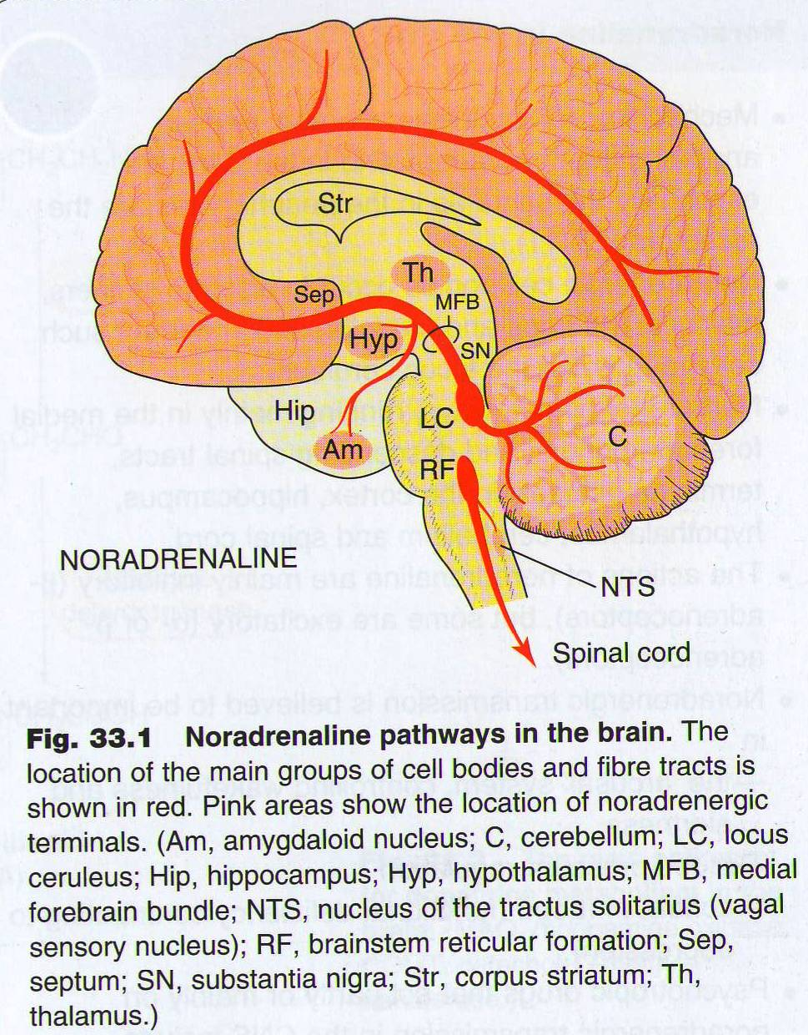
Central Neurotransmitter
Neuropsychopharmacological science seeks to:
Understand how drugs can affect the CNS selectively to relieve pain, improve attention, induce sleep, reduce appetite, suppress disordered movements .... etc.
To provide the means to develop appropriate drugs to correct pathophysiological events in the abnormal CNS.
Importance of understanding neurotransmitters
Doctor note :
Diseases related to ↑ or ↓ neurotransmitters : e.g.
schizophrenia ↑ dopamine which we will give medication to close the receptor
depression we give medication to elevate NE and E .
To understand the etiology of diseases.
To suggest the best drugs to be used.
To understand the other clinical uses of any particular drug
1- Norepinephrine (NE)
Pathway :
Also called noradrenaline, belongs to catecholamines, the direct precursor of NE is dopamine
The CNS effects of NE are manifested in alertness, arousal , and readiness for action.
A variety of medically important drugs work by altering the actions of NE e.g., for treatment of CV problems
(vasoconstriction,↑ BP)and some of psychiatric conditions
(e.g. depression)
So, used in treatment of depression patients.
Fight and flight.
Mood disorders and NE:
*Very important
Treatment
Affective disorders
↑NE
Mania*
↓NE
Depression
Drugs that ↑NE
Drugs that ↓NE
* Mania is characterized by: enthusiasm, rapid thought and speech patterns, extreme self-confidence, and impaired judgment. الهوس

Slide 4
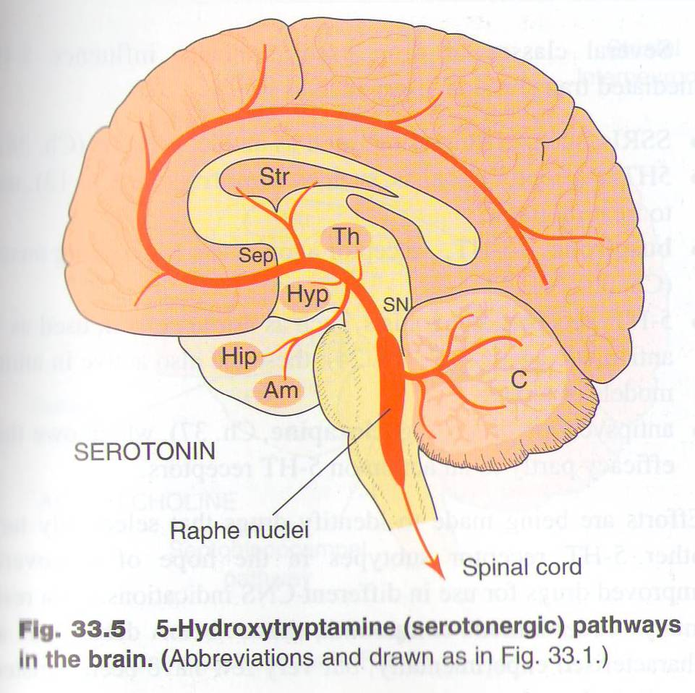
2- Serotonin (5-HT)
Pathway:
extra
Facts:
Primarily found in the CNS , GIT, platelets.
3
serotonin is responsible for feeling of well-being & happiness.
E.g.: dark chocolate contain large amount of serotonin that’s why it bring happiness
4
It plays an important role : in regulation of Mood, sleep, appetite and pain perception. and some cognitive functions, including memory and learning. (memory and learning mostly with acetylcholine but serotonin may have a little role here)
1
5
2
5-hydroxytryptamine (5-HT) is a monoamine.
Modulation of serotonin at synapses is a major action of several classes of antidepressants e.g. selective serotonin re-uptake inhibitors (SSRIs).(will lead to ↑ serotonin in post synaptic)
Diseases that are influenced by changes in serotonin brain content:
*Very important
Vomiting→because its receptors are found in GIT & vomiting center of the medulla. (5-HT3) give Serotonin antagonism
Obsessive compulsive disorders*OCD
Social phobia
(e.g.: talking in front of people)
Depression →low serotonin
Schizophrenia →dopamine & Ach
Generalized anxiety
All the time, unknown reason
*الوسواس القهري : مثال الهوس بالنظافة بشكل مبالغ فيه و خارج عن الإرادة

Slide 5
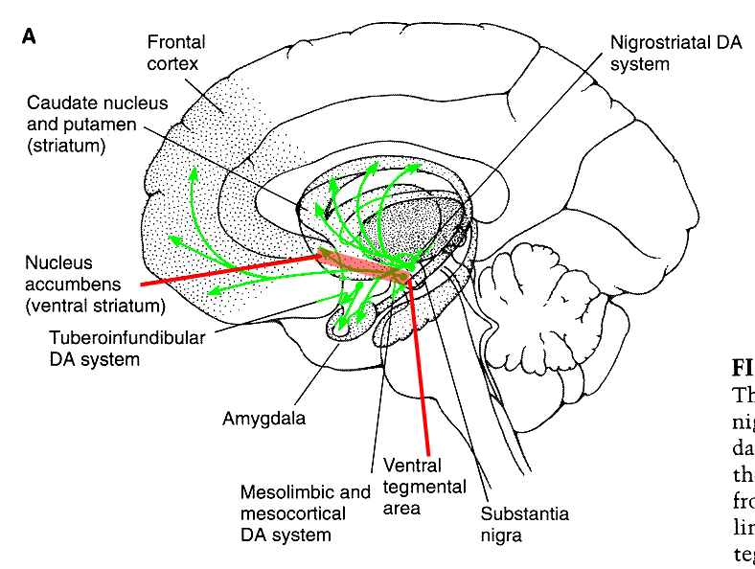
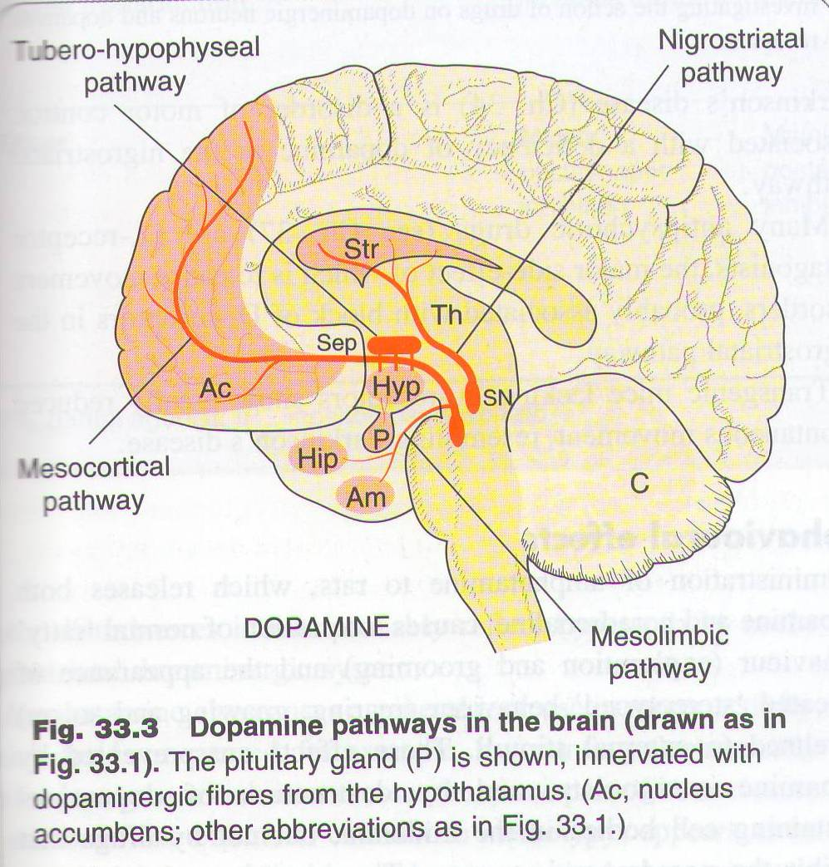
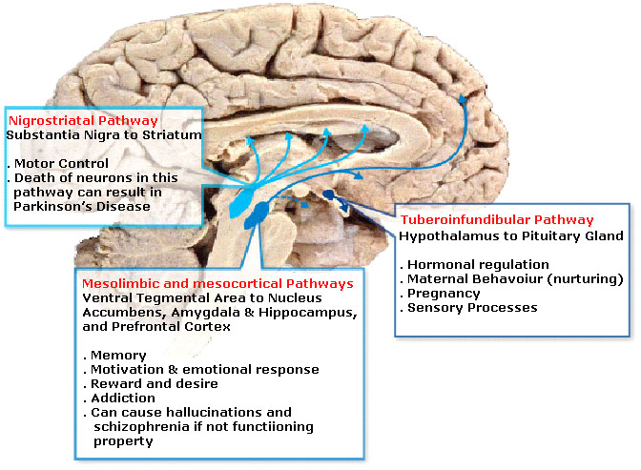
3- Dopamine
↑Dopamine = ↓ Ach
Pathway:
Controls
movements
of dopamine
Over activity
produces
delusions
Effects on dopaminergic synapses:
extra
Dopamine has 4 pathway to synapse in :-
Blockade of postsynaptic dopamine receptors
1- In chemoreceptor trigger zone (CTZ)
↓
Antiemetic effect (low dose)
2- In mesolimbic system
(reward pathway)
↓
Ameliorate schizophrenia (psychiatric effect)
(↑dopamin → schizophrenia)
3-In tuberoinfundibular pathway (hypothalamus – ant.- pituitary)
↓
↑Release of prolactin→hyperprolactinemia (endocrinal effect)
4- In nigrostriatal system (basal ganglia)
↓
Predispose to parkinsonism symptoms (neurologic)
The same pharmacodynamics action may have distinct psychiatric ”neurologic” and endocrine effects.
Diseases that are influenced by dopamine level:
Caused by ↑Dopamine
Treatment: Drugs that ↓Dopamine
Parkinson’s disease
↓Dopamine= ↑ Ach
Drug addiction
(NE,dopamin,5-HT)
Depression
↓ Dopamine
Treatment: Drugs that ↑Dopamine
Schizophrenia
Attention deficit hyperactivity disorder*
ADHD
فرط الحركة *

Slide 6
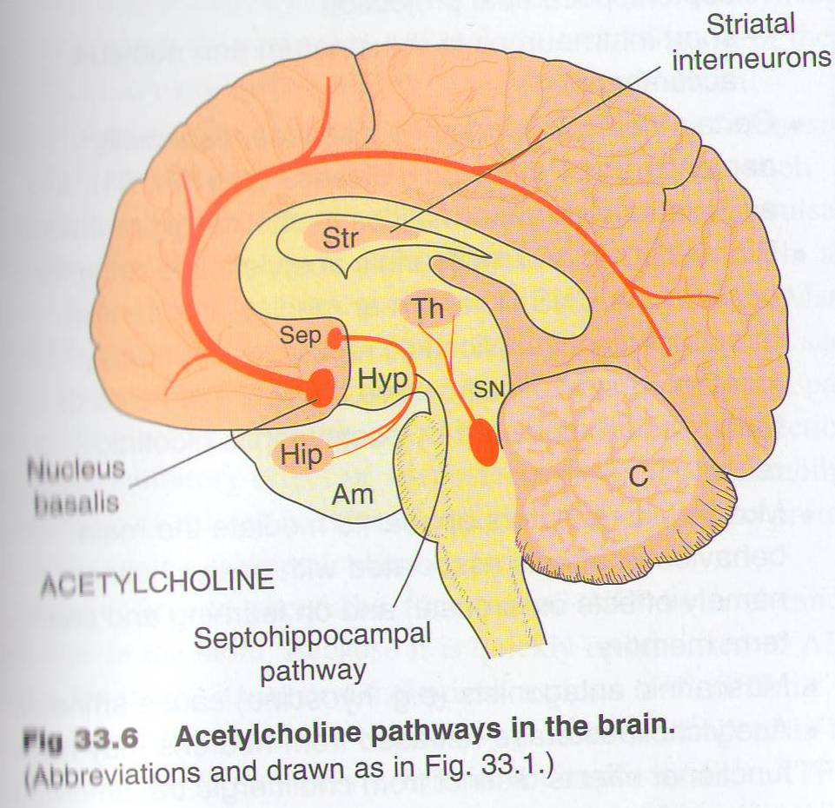
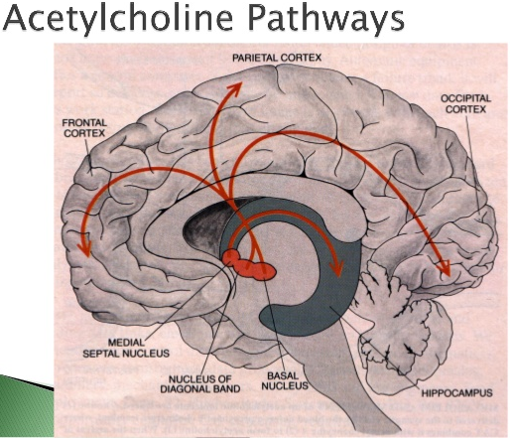
4-Acetylcholine
Pathway:
There are two constellations of cholinergic neurons:
The basal forebrain constellation is located in the telencephalon, medial and ventral to the basal ganglia. It includes the basal nucleus of Meynert (nucleus basalis), which provides cholinergic innervation to the entire neocortex, amygdala (Am), hippocampus (Hip), and thalamus (Th). The medial septal nuclei (Sep) provide cholinergic innervation to the cerebral cortex, hippocampus (Hip), and amygdala (Am).
The second constellation includes cholinergic neurons located in the dorsolateral tegmentum of the pons that project to the basal ganglia, thalamus, hypothalamus, medullary reticular formation, and deep cerebellar nuclei.
Pathway:
*First two points are not important(physiology)
Acetylcholine is the first neurotransmitter discovered
Inside the brain Ach functions as a neuro- modulator—a chemical that alters the way other brain structures process information rather than a chemical used to transmit information from point to point
Ach is both excitatory (as in skeletal muscles) and inhibitory (as in heart muscle->bradycardia) neurotransmitter
Role of Acetylcholine in the CNS :
*Very important
Extra:
Ach is thought to be involved in cognitive functions such as :
Memory
Arousal
Attention
CNS diseases linked to ACH derangement:
*Very important
Ach=Alzheimer’s
Damage to cholinergic receptors ( muscarinic) is associated with memory deficits as in Alzheimer's disease. (↓Ach)
Muscarinic antagonists as hyoscine cause amnesia (Cholinomimetics are used as therapy of Alzheimer ).
Increased brain level of Ach predispose to Parkinson's disease (anticholinergic drugs are used as therapy).
Schizophrenia may be due to imbalance between Ach & dopamine brain levels.
Depression may be a manifestation of a central cholinergic predominance.
Just a theory,
not important
point.

Slide 7
5-Glutamic acid + GABA
Glutamic acid | Gamma amino butyric acid “GABA”
It’s an excitatory neurotransmitter. An increase in its level predispose to epilepsy. | GABA is the main inhibitory neurotransmitter in the brain. Present throughout the brain; there is very little in peripheral tissues.
Potential therapeutic effect of glutamate antagonists | Pathophysiological role of GABA
Reduction of brain damage following : strokes & head injury Treatment of epilepsy Drug dependence Schizophrenia | Decrease GABA brain content is associated with : Epilepsy which is an over activity so that’s why we use GABA which inhibit the excess secretion of neurotransmitter. Anxiety Convulsions Insomnia Benzodiazepine (diazepam) enhances GABA function and used in treatment of above diseases. (it give sedate affect)
*Glycine is the main inhibitory neurotransmitter in the spinal cord.
Very important!!!
Conclusion
Without understanding the involvement of neurotransmitters in the etiology of CNS diseases, doctors could not select the proper drug for any particular disease.
Glutamate:
Glutamate is an important neurotransmitter in the brain it’s a precursor to GABA and its very abundant in quantity.
But an increase in glutamate levels in the brain can lead to multiple brain damages and injuries epilepsy being one of them, due to its excitatory functions (over exciting neurons). Due to that we use glutamate antagonists to help decrease levels of glutamate and treat such cases.
مفيد و وجوده مهم بس الشي اذا زاد عن حده يتقلب ضده لذلك يبدأ يأذي الخلايا
GABA:
GABA on the other hand is inhibitory in function meaning it regulates neuronal activity, if neurons are over exited they will cause disease like anxiety, stress , insomnia etc.
So a decrease in GABA levels will cause these diseases.
يعني هو زي الأم اللي تهدي اطفالها اذا راحت انهبلوا

Slide 8
Summary
Trans- mitter | Function | Diseases that are influenced
Acetylcholine | Ach is thought to be involved in cognitive functions such as : Memory Arousal Attention | Damage to cholinergic receptors ( muscarinic) is associated with memory deficits as in Alzheimer's disease. Muscarinic antagonists as hyoscine cause amnesia (Cholinomimetics are used as therapy of Alzheimer ). Increased brain level of Ach predispose to Parkinson's disease (anticholinergic drugs are used as therapy) Schizophrenia may be due to imbalance between Ach & dopamine brain levels. Depression may be a manifestation of a central cholinergic predominance.
dopamine |  | Parkinson’s disease Schizophrenia Drug addiction Depression Attention deficit hyperactivity disorder*
Norepinephrine | also called noradrenaline , belongs to catecholamines, the direct precursor of NE is dopamine The CNS effects of NE are manifested in alertness, arousal , and readiness for action. A variety of medically important drugs work by altering the actions of NE e.g., for treatment of CV problems and some of psychiatric conditions. | Mania high NE Depression low NE
Serotonin (5- hydroxy-tryptamine) | 5-hydroxytryptamine (5-HT) is a monoamine Primarily found in the CNS, GIT, platelets. It is a popular thought that serotonin is responsible for feeling of well-being & happiness. It plays an important role : in regulation of Mood, sleep, appetite and pain perception. and some cognitive functions, including memory and learning. Modulation of serotonin at synapses is a major action of several classes of antidepressants eg selective serotonin re-uptake inhibitors (SSRIs). | Vomiting Generalized anxiety Obsessive compulsive disorders Depression Social phobia Schizophrenia
GABA | GABA is the main inhibitory neurotransmitter in the brain Present throughout the brain; there is very little in peripheral tissues | Decrease GABA brain content is associated with Epilepsy , Anxiety , Convulsions , Insomnia Benzodiazepine (diazepam) enhances GABA function and used in treatment of above diseases
Glutamate | is an An increase in its level predispose to epilepsy excitatory neurotransmitter | Reduction of brain damage following : strokes & head injury Treatment of epilepsy Drug dependence Schizophrenia

Slide 9
To understand !
Trans-mitter | Anatomic distribution | Receptor subtype | Receptor mechanism
Acetylcholine | Cell bodies at all levels, short and long axons | M1: blocked by pirenzepine and atropine | Excitatory : decrease K conductance & increase IP3 & DAG
 |  | M2: blocked by atropine | Inhibitory : increase K conductance & decrease cAMP
 | Motoneurons – renshew cells synapse | Nicotinic, N | Excitatory: increase cation conductance
dopamine | Cell bodies at all levels, short, medium and long axons | D1: blocked by phenothiazine | Inhibitory: increase cAMP
 |  | D2: blocked by phenothiazine & haloperidol | Inhibitory (presynaptic ): decrease ca conductance - Inhibitory (postsynaptic) : increase K conductance, decrease cAMP
Norepinephrine | Cell bodies in pons and brainstem project to all levels. | Alpha1: blocked by prazosin | Excitatory : decrease K conductance & increase IP3 & DAG
 |  | Alpha2: activated by clonidine | Inhibitory (presynaptic ): decrease ca conductance - Inhibitory (postsynaptic) : increase K conductance, decrease cAMP
 |  | Beta1 : blocked by propranolol | Excitatory : decrease K conductance & increase cAMP
 |  | Beta2 :blocked by propranolol | Inhibitory: increase in electrogenic sodium pumps & increase cAMP
Serotonin (5- hydroxy-tryptamine) | Cell bodies in pons and midbrain project to all levels. | 5-HT1A: buspirone is a partial agonist | Inhibitory: increase K conductance, decrease cAMP
 |  | 5-HT2A: blocked by clozapine , resperidone & olanzapine | Excitatory : decrease K conductance & increase IP3 & DAG
 |  | 5-HT3: blocked by ondansetron | Excitatory: increase cation conductance
 |  | 5-HT4 | Excitatory : decrease K conductance
Self reading

Slide 10
To understand !
Self reading
Trans- mitter | Anatomic distribution | Receptor subtype | Receptor mechanism
GABA | Supraspinal interneurons: spinal interneurons involved in presynaptic inhibition | GABAa: facilitated by benzodiazepine and zolpidem | Inhibitory: increase CL conductance
 |  | GABAb: activated by baclofen | - Inhibitory (presynaptic): decrease ca conductance - Inhibitory (postsynaptic) : increase K conductance
Glutamate | Relay neurons at all levels | -Four subtypes: NMDA subtype blocked by phencyclidine. - Metabotropic subtype. | - Excitatory: increase Ca or cation conductance - inhibitory (presynaptic ): decrease ca conductance & decrease cAMP -Excitatory (postsynaptic): decrease K conductance & increase IP3 & DAG
Glycine | Interneurons in spinal cord and brain stem | Single subtype: blocked by strychnine | Inhibitory: increase CL conductance
opioid peptide | Cell body at all levels | Three major subtypes: mu, delta & kappa. | Inhibitory (presynaptic ): decrease ca conductance & decrease cAMP
 |  |  | Inhibitory (postsynaptic) : increase K conductance & decrease cAMP

Slide 11
قادة فريق علم الأدوية :
لين التميمي & عبدالرحمن ذكري
الشكر موصول لأعضاء الفريق المتميزين :
لينا الوكيل
شهد السويدان
ريم الشثري
جواهر الخيال
شذا الغيهب
امال الشيبي
ريما العتيبي
ساره الشمراني
روان سعد القحطاني
References :
1- 436 doctors slides
2-435 team work
3-Pharmacology (Lippincotts Illustrated Reviews Series), 5th edition.
pharma436@outlook.com
Your feedback:
https://docs.google.com/forms/d/e/1FAIpQLSc57qjDXLPcQLYftI27W91gCKD2RgH0OzQDdDxsiLYmH9DKtw/viewform
@pharma436

