Slide 1
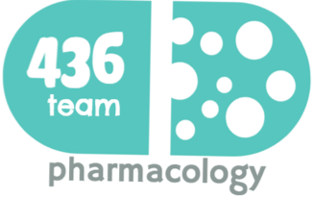
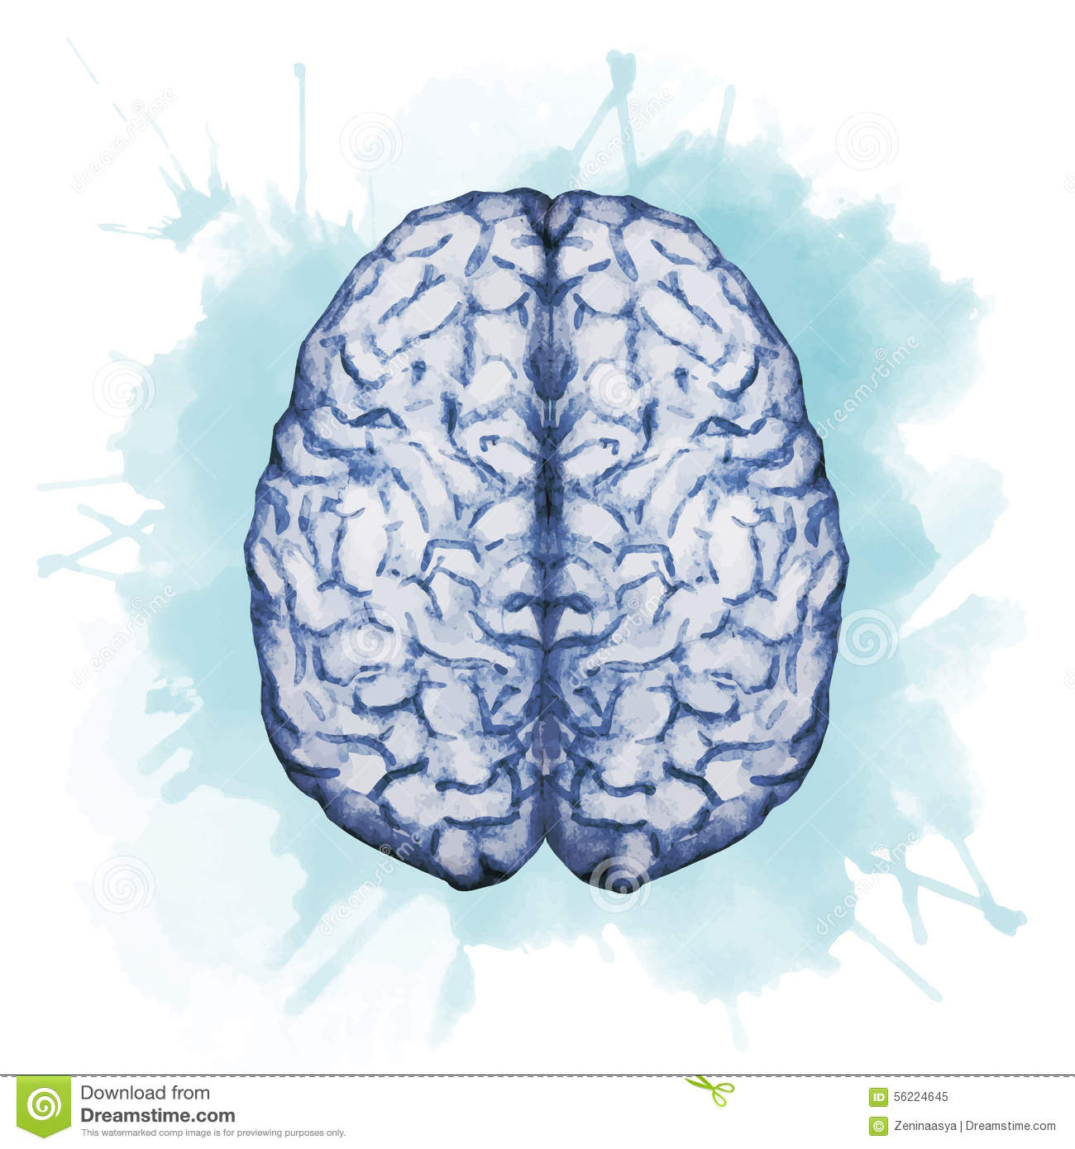
Alcohol and the brain
Objectives:
Describe the pharmacological actions of alcohol
Describe the pharmacokinetic profile of alcohol
Describe the development of intoxication symptoms of alcohol
Describe how alcohol affects various neurotransmitters in the brain.
Identify various toxicity of alcohols at different organs level
Describe the addictive nature of alcohol and its mechanism
Identify alcohol withdrawal symptoms and their management.
Identify clinically relevant drug interactions with alcohol
Hazards of alcohol in pregnancy
Color index:
extra information and further explanation
important
doctors notes
Drugs names
Mnemonics
Check out the mnemonics file :
https://docs.google.com/presentation/d/1Z0Vf9oEOJSXo4JIA0mTCk5jB-OU9LP5TFCwz8iBgNac/edit?usp=sharing
Kindly check the editing file before studying this document
https://docs.google.com/presentation/d/1_-g1vol4eBWPet5xVCkuTGFvvnhFF3PJmU0tWtEEw_o/edit?usp=sharing

Slide 2
Ethyl Alcohol (ethanol)
It is the most commonly abused drug in the world
Pharmacokinetics | Small lipophilic (lipid soluble) molecule→ readily crosses all biological membranes. Rapidly & completely absorbed from GIT. Has high volume of distribution (distributed to all body tissues). →Volume of distribution = Total body water (0.5-0.7 L/kg). “multi compartment distribution” (plasma + ESF + ICF) Crosses placenta (can easily reach the fetus) and excreted in milk.
Metabolism (in gastric mucosa and liver) | Oxidation of ethanol to acetaldehyde via alcohol dehydrogenase (major) or 2-CYT-p450 (minor)(CYP-2E1). Oxidation of Acetaldehyde is converted to acetate via aldehyde dehydrogenase. which also reduces NAD+ to NADH. Acetate ultimately is converted to CO2 + water. At low ethanol concentration → minor metabolism by MEOS(microsomal ethanol-oxidizing system) mainly cyt-p450 (CYP2E1). →Upon continuous (chronic) alcohol use, this enzyme is stimulated and contribute significantly to alcohol metabolism & tolerance. Acute alcohol consumption inhibits CYP450 especially 2E1 (liver enzyme)→ ↓ metabolism of other drugs taken concurrently as (warfarin, phenytoin). Chronic alcohol consumption induces liver microsomal enzyme CYP450 2E1, which leads to significant increases in ethanol metabolism (Tolerance) & metabolism of other drugs as warfarin (Drug interactions). The microsomal enzymes will take the upper hand in metabolism of alcohol in this case.
Alcohol metabolism (major pathway)
Alcohol Metabolism; 90-98% metabolized in liver Depends on cytosolic enzyme (alcohol dehydrogenase)
Oxidation reaction
Acetaldehyde in more toxic than ethanol
Alcohol dehydrogenase
CH3CH2OH (Ethanol)
CH3CHO(Acetaldehyde)
NAD⁺ NADH
NAD⁺
NADH
Aldehyde (acetaldehyde) dehydrogenase
mitochondrial enzyme
Co2+water
CH3COOH( Acetic Acid(

Slide 3
Hepatic cellular processing of (minor pathway)
Depends on the microsomal enzymes
CH3CH2OH (ethanol)
cytosol
Alcohol dehydrogenase
ER
(Endoplasmic
Reticulum)
O₂
NADPH
NADP⁺
CYP450
NAD⁺
NADH
The same effect of alcohol dehydrogenase,
Convert alcohol acetaldehyde
Acetaldehyde
*If NAD+ is low in the body, the body will be destroyed by the huge amount of free radicals.
Mitochondrion
NAD^{+*}
NADH
Aldehyde dehydrogenase
Acetate
Extrahepatic tissue
Prolonged alcohol intake (even if low conc.)
Chronic alcohol abuse
Induction of liver enzymes
Tolerance is developed
Up regulation of microsomal enzymes
Addiction (psychological and physiological symptoms)
Minor pathway start function
Low conc. alcohol intake
Hepatic ethanol metabolism
Alcohol
Alcohol dehydrogenase
Acetaldehyde
NAD+
NADH
NAD+
Alcohol dehydrogenase
NADH
Acetyl CoA
Acetate
Citric Acid Cycle
Energy
Fatty Acid synthesis
Fatty liver

Slide 4
Genetic variation of alcohol metabolism
Aldehyde Dehydrogenase polymorphism
Asian populations (including Chinese, Japanese, Taiwanese, Korean) have genetic variation in aldehyde dehydrogenase resulting in a variant allele ALDH2*2.
Genetic variation of alcohol metabolism →Which means that acetaldehyde can NOT be converted to acetate due to aldehyde dehydrogenase deficiency.
They metabolized alcohol at slower rate than other populations.
Can develop “Acute acetaldehyde toxicity” after alcohol intake →it has a beneficial effect →This Strongly protect against alcohol-use disorders and prevent them from becoming alcoholic.
*Polymorphism is the existence of one gene in different forms.
Acute acetaldehyde toxicity after alcohol intake characterized by:
Nausea
Vomiting
Dizziness
Vasodilation
Headache
Facial flushing
Explanation : The Asian people will have accumulation of acetaldehyde
So when they get another drink of alcohol more acetaldehyde will be formed so the following characters will start to appear (nausea , vomiting, …) .
And that’s one way to treat alcoholism people to let them stop drinking (will be discussed later)

Slide 5
Alcohol (Ethyl alcohol *ethanol*)
Excretion | Excreted unchanged in urine (2-8%). Excreted unchanged via lungs (basis for breath alcohol test). (used as driving test ) Rate of elimination is zero-order kinetic (not concentration-dependent) i.e. rate of (amount of) elimination is the same at low and high concentration.
Mechanism of action | Acute alcohol | CNS depressant. Enhancement the effect of GABA (inhibitory Neurotransmitter) causing CNS depression. Inhibition of glutamate action (excitatory Neurotransmitter) causing disruption in memory, consciousness and alertness.
 | Chronic alcohol | Up-regulation* of NMDA receptors and voltage sensitive Ca channels leading to alcohol tolerance and withdrawal symptoms includes tremor, exaggerated response and seizures. Chronic means low doses in prolonged time.
Acute actions of Alcohol | Mild to moderate amount | On CNS: Relieves anxiety and euphoria(feeling of well-being). In higher doses: Nystagmus, slurred speech, impaired judgment and ataxia. A little bit higher dose: Sedation, hypnosis and loss of consciousness.
 |  | On CVS: Myocardial contractility depression. Vasodilatation due to: Vasomotor center depression. Direct smooth muscle relaxation caused by Acetaldehyde.
 | Sever amounts | Severe CNS depression. Nausea, vomiting and aspiration of vomitus. Respiratory depression and acidosis. CVS depression. Volume depletion. Hypotension. Hypothermia. coma and death.
Chronic actions of alcohol | Tolerance, dependence, addiction and behavioral changes. Liver: Hepatic cirrhosis and liver failure. CVS: hypertension(regarding epithelial cells damage), myocardial infarction. CNS: cerebral degeneration, and peripheral neuropathy. Wernicke encephalopathy or Korsakoff psychosis may occur . (explained later in slide 8) GIT: irritation, inflammation, bleeding and nutritional deficiencies. Endocrine system: gynecomastia (Enlarged breasts in men) and testicular atrophy. hematology: hematological disorders, neoplasia.
*↑ NMDA receptors amount →they become more sensitive →begin to be tolerance and if the drinker didn’t ↑ the dose →withdrawal symptoms will start to appear

Slide 6
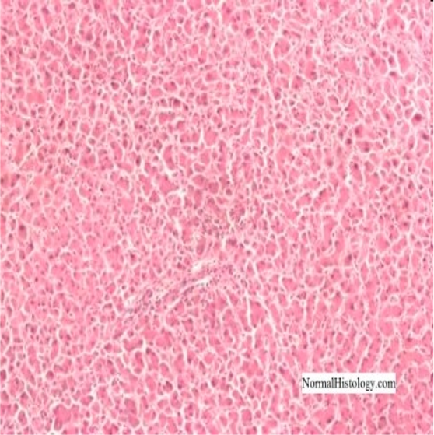
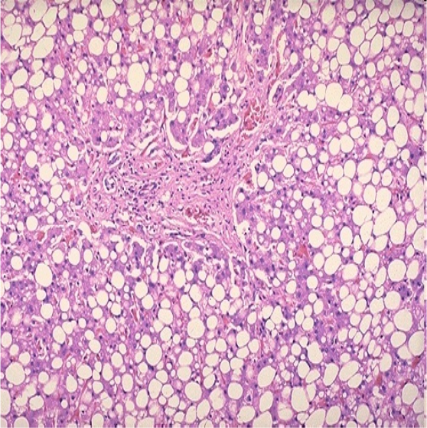
Complications Of Chronic Alcohol Use (Alcoholism)
Organ/ system | Complications
Liver | The most common complications includes: Reduction in gluconeogenesis. → Hypoglacemia Alcoholic Fatty liver/ Alcohol steatosis. Reduction of gluconeogenesis →accumulation of Acetyl co A →energy production from alcohol rather than from fat →accumulation of fat →(fatty liver) Hepatitis. jaundice, Ascites, bleeding, encephalopathy.(liver metabolism not going properly →accumulation ammonia → enter brain →encephalopathy) Hepatic cirrhosis: jaundice, ascites, bleeding and encephalopathy. Irreversible liver failure. Acetate converted to other product Acetyl co A “other than CO2+ H2O”. In over drinking → depletion of NAD will be in reduced form →all enzymes depend on NAD will not work →That lead to accumulation of Acetyl co A →converted into fatty acid→ deposition in liver →first step injury happen in liver on drinking alcohol. Hypoglycemia and ketoacidosis due to impaired hepatic gluconeogenesis and excessive lipolytic factors especially increased cortisol and growth hormone. Acetaldehyde is more toxic than alcohol →causing inflammation and fat cell proliferation Alcoholic Liver Disease: Normal Liver Steatosis (infiltration of liver cells with fat) Steatohepatitis ( inflammation of the liver with concurrent fat accumulation in liver) Cirrhosis (a chronic disease of the liver marked by degeneration of cells, inflammation, and fibrous thickening of tissue) Fatty liver →inflammation→ hepatitis→ fibrosis “liver not functioning” →cirrhosis
GIT | Gastritis, hemorrhagic esophagitis, ulcer diseases and pancreatitis due to direct toxic action on epithelium. Diarrhea.. Deficiency of vitamins. →decrease the absorption in the intestine →due to diarrhea Exacerbates nutritional deficiencies. Weight loss and malnutrition. (due to malabsorption) In heavy drinkers: increased risk of oral and esophageal cancer
CVS | Chronic alcohol abuse can lead to cardiomyopathy including: Cardiac hypertrophy. Congestive heart failure. Arrhythmias due to K⁺ and Mg²⁺ depletion as well as enhanced release of catecholamine. Hypertension due to increased calcium and sympathetic activity also by producing substances that attack the vascular epithelial cells. Alcohol is the most common cause of reversible hypertension.
Healthy liver Liver in chronic alcoholics Normal liver Fatty liver

Slide 7
Organ/ system | Complications
Hematology | Iron deficiency anemia (microcytic anemia) due to inadequate dietary intake and GIT blood loss. Megaloblastic anemia due to folate deficiency, malnutrition and impaired folate absorption. Hemolytic anemia. (Destruction of red blood cells) Bone marrow suppression. Thrombocytopenia (suppressing platelet formation and prolong bleeding time). Impaired production of vitamin-K dependent clotting factors leading to prolonged prothrombin time. (Vit K is an important precursor to clot if there were deficiency thrombocytopenia will happen )
Endocrine | Hypogonadism | In women | ovarian dysfunction, amenorrhea (abnormal absence of menstruation) , anovulation, hyperprolactinemia (high prolactin) associated with low estrogen →infertility.
 |  | In men | Gynecomastia, decreased muscle and bone mass, testicular atrophy and sexual impotence due to inhibition of luteinizing hormone (LH), decreased in testosterone, estradiol and progesterone.
 | Hypoglycemia & ketoacidosis | due to impaired hepatic gluconeogenesis & excessive lipolytic factors, especially increased cortisol and growth hormone. Ketoacidosis can be seen in 2 condition if the glucose is : Low : alcoholism patient (fatty liver) High : diabetic patient
CNS | Tolerance. Physiological and psychological dependence. Physiological dependence: Changes in physiological action according to the substance the patient’s addicted to it. Psychological dependence: No changes in the physiology but the person just want to show off. Addiction: dopamine, serotonin and opioids are involved Neurological disturbances. Wernicke-Korsakoff syndrome. Vitamins deficiency→ A,D,B”B1”→ Wernicke encephalopathy or Korsakoff psychosis may occur

Slide 8
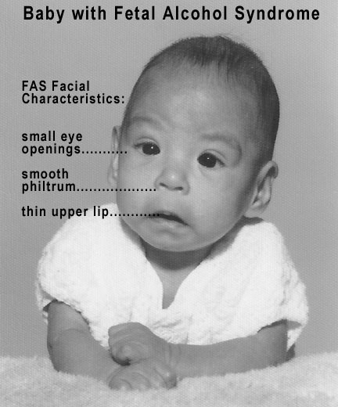
Chronic Alcoholism Associated Syndromes
Fetal alcohol syndrome(FAS) | are a group of conditions that can occur in a person whose mother drank alcohol during pregnancy. Problems may include an abnormal appearance, short height, low body weight, small head size, poor coordination, low intelligence, behavior problems, and problems with hearing or seeing. Irreversible syndrome Ethanol rapidly crosses placenta and it’s prohibited in all pregnancy trimesters. Prenatal exposure to alcohol causes: Intrauterine growth retardation (reduction in body weight) due to hypoxia. Congenital malformation (Teratogenic effects) such as: Microcephaly. (small brain) Impaired facial development. Congenital heart defects. Physical and mental retardation.
Wernicke-Korsakoff syndrome | It is a combined manifestation of 2 disorders:
 | Wernicke's encephalopathy characterized by: ocular disturbances unsteady gait changes in mental state as confusion, delirium(هذيان) , ataxia | Korsakoff's psychosis: Impaired memory especially in elderly. Cognitive and behavioral dysfunction.
 | Cause: thiamine (vitamin B1) deficiency (rarely seen with absence of alcoholism) due to: inadequate nutritional intake. decreased uptake of thiamine from GIT. decreased liver thiamine stores.
 | Treated by: thiamine + dextrose-containing IV fluids. (because of dehydration).
Alcoholism Tolerance | Chronic consumption of alcohol leads to tolerance That develops due to:
 | Metabolic tolerance (pharmacokinetic) | Due to induction (increase) of liver microsomal enzymes (e.g. CYP450) in chronic use.
 | Functional tolerance (Pharmaco-dynamic) | Changes in CNS sensitivity of receptors to dopamine and GABA mainly.

Slide 9
Alcoholism withdrawal symptoms | There symptoms result from high sympathetic activity & upregulation of the receptors Autonomic hyperactivity & craving for alcohol Vomiting, thirst Profuse sweating, severe tachycardia Vasodilatation, fever Delirium, tremors, anxiety, agitation, insomnia (CNS effects and need to be controlled) transient visual/ auditory illusions, violent behavior, hallucinations. Grand mal seizures (after 7-48 hours of alcohol cessation) Due to super-sensitivity of glutamate receptors & hypo-activity of GABA receptors are possibly involved.
Management of alcoholism withdrawal | Substituting alcohol with a long-acting sedative hypnotic drug (depressant drug) then tapering the dose
 | Benzodiazepines | as (Chlordiazepoxide, diazepam) →long acting drug. Or lorazepam that is preferable (shorter duration of action)
 |  | Dose of benzodiazepines should be carefully adjusted To provide Efficacy: (IV/ po) &Manage withdrawal symptoms & prevent irritability, insomnia, agitation & seizures. & avoid excessive dose that causes respiratory depression & hypotension.
 | Fluoxetine | Serotonin reuptake inhibitor (anti-depressant drug). Affect dopamine levels.
 | Clonidine & Propranolol | Clonidine is a2 agonist inhibits the action of exaggerated sympathetic activity.
 | Acamprosate | a weak NMDA receptor antagonist & GABA activator, reduce psychic craving (reduce risk of relapse)
To prevent alcohol relapse
Alcohol and drug interactions | Acute alcohol use (large dose) | causes inhibition of liver microsomal enzyme, decreases metabolism of some drugs and increases their toxicities e.g. bleeding with warfarin
 | Chronic alcoholuse(continuous dose) | induces liver microsomal enzymes and increases metabolism of drugs such as warfarin, propranolol and etc
 | other | Acetaminophen + alcohol (chronic use)= risk of hepatotoxicity. →due to increased production of free radical metabolite of acetaminophen→High metabolism of high doses of acetaminophen →high free radicals (result from metabolismby microsomal enzymes) →hepatotoxicity NSAIDs + alcohol: Increase in the risk of developing a major GI bleeding or an ulcer. Because NSAIDs may causes ulcer and bleeding, so the combination increases the risk of ulcer & bleeding Narcotic drugs (codeine and methahdone) + alcohol= risk of respiratory and CNS depression Alcohol suppresses gluconeogenesis, which may increase risk for hypoglycemia in diabetic patients.
Disulfiram therapy: 250 mg daily
.
Inhibits hepatic aldehyde dehydrogenase
.
increase blood level of acetaldehyde
Acetaldehyde produces extreme discomfort, vomiting, diarrhea, flushing, hotness, cyanosis, tachycardia, dyspnea, palpitations & headache
.
Disulfiram induced symptoms render alcoholics afraid from drinking alcohol

Slide 10
قادة فريق علم الأدوية :
لين التميمي & عبدالرحمن ذكري
الشكر موصول لأعضاء الفريق المتميزين :
عبدالرحمن الراشد
عمر تركستاني
معتز الطخيس
خالد العيسى
إبراهيم فتياني
لينا الوكيل
روان سعد القحطاني
References :
1- 436 doctors slides
2-435 teamwork
pharma436@outlook.com
Your feedback:
https://docs.google.com/forms/d/e/1FAIpQLSc57qjDXLPcQLYftI27W91gCKD2RgH0OzQDdDxsiLYmH9DKtw/viewform
@pharma436

