Slide 1

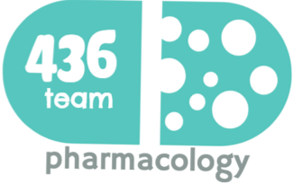
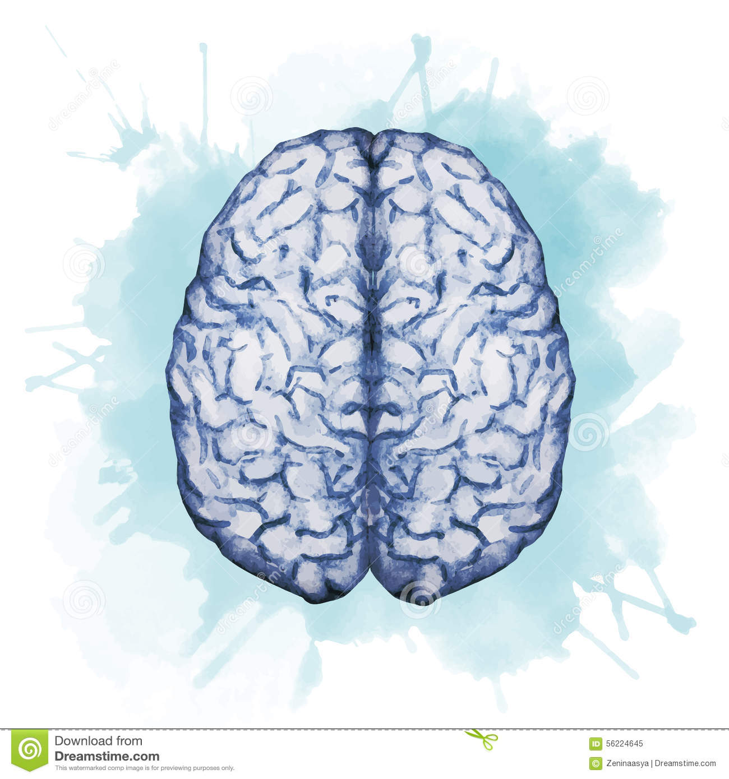


Drugs used in Parkinsonism
Objectives:
Recognize the symptoms and pathophysiology of parkinsonism.
Understand the pharmacology of drugs used for treatment of parkinsonism.
Define pharmacokinetics, pharmacodynamics and side effects of different drugs used for the treatment of parkinsonism.
color index:
extra information and further explanation
important
doctors notes
Drugs names
Mnemonics
Check out the mnemonics file :
https://docs.google.com/presentation/d/1Z0Vf9oEOJSXo4JIA0mTCk5jB-OU9LP5TFCwz8iBgNac/edit?usp=sharing
Kindly check the editing file before studying this document
https://docs.google.com/presentation/d/1_-g1vol4eBWPet5xVCkuTGFvvnhFF3PJmU0tWtEEw_o/edit?usp=sharing

Slide 2
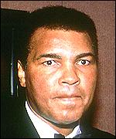
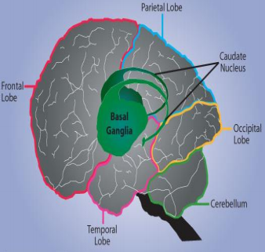
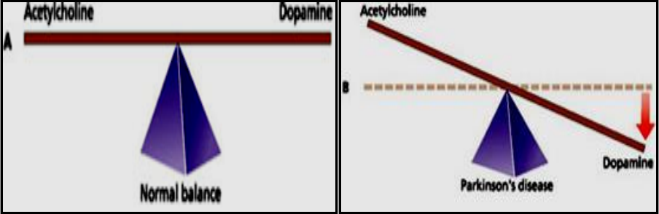
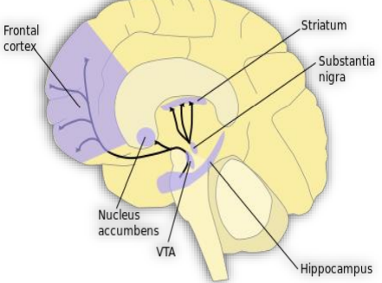
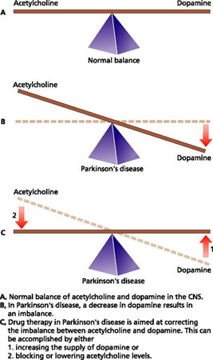

To understand!
Parkinson’s Disease |  | Pathophysiology
A progressive neurodegenerative diseases disorder that occurs mainly in the elderly and can lead to disability unless effective treatment is provided. |  | This movement disorder occurs mainly due to ↓dopamine/↑acetylcholine imbalance in basal ganglia (caudate nucleus, substantia nigra & corpus striatum) that is involved in motor control.
Dopamine Pathway |  | In Parkinson’s disease
1- Reward pathway | 2-Motor pathway | Predominance of Ach + Deficiency of dopamine
DA is manufactured in nerve cell bodies located within the ventral tegmental area (VTA) and is released in the nucleus accumbens and the prefrontal cortex. | Cell bodies in the substantia nigra that manufacture and release dopamine into the striatum.
Causes |  | Characters
It is idiopathic disease but some causes may be: Genetic. Toxins used to induce models of Parkinson disease from animals (MPTP = methyl phenyl tetrahydropyridine). Head trauma. Cerebral anoxia. (hypoxia) Oxidative stress increase production of free radicals due to e.g. environmental pollution, nicotine and sulfa medication Drug-induced Parkinson's disease e.g. antipsychotics (as haloperidol) and Dopamine antagonists (as metoclopramide (antiemetic). |  | Simplified by the acronym “ TRAP ”: Tremors at rest. Rigidity of muscles. Akinesia or Bradykinesia (no movement or slowness in initiating and carrying out voluntary movements). Postural and gait abnormalities. Anxiety or depression.
Treatment approach More discussed in page 3
Or
Drugs to block cholinergic activity
Main approach Drugs to increase dopaminergic activity

Slide 3
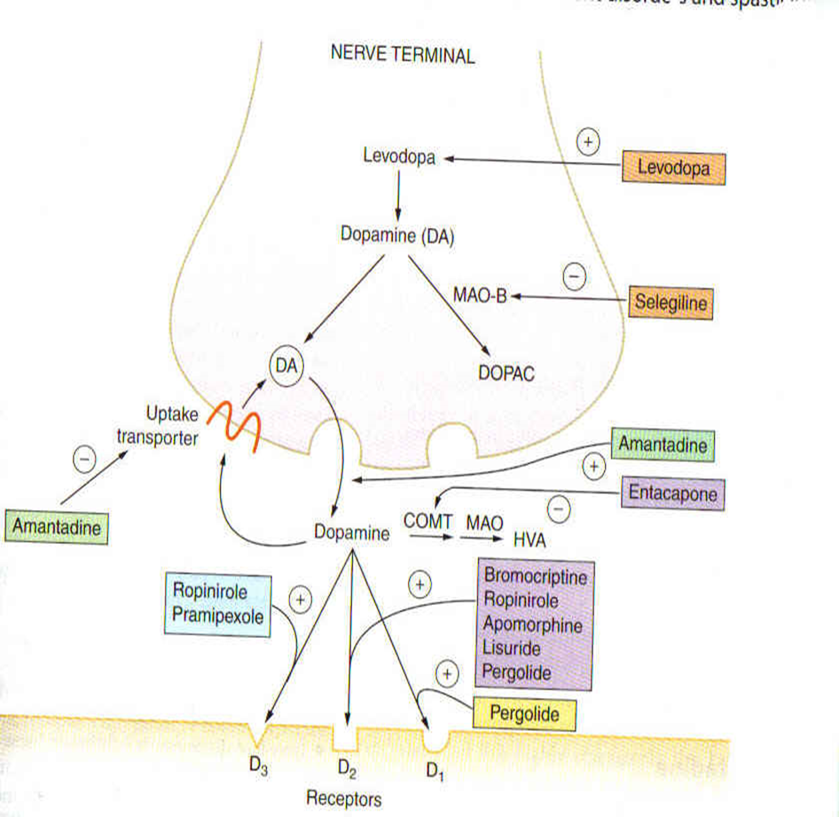
Drug Treatment
Drugs to increase dopaminergic activity.
Increase central DA synthesis
(DA precursors): L-dopa+
carbidopa
DA releaser: amantadine
COMT inhibitors: entacapone
e.g. Nitecapone
MAO-B inhibitors*:
selegiline
Minor approach
Drugs to block cholinergic activity
Muscarinic antagonists:
Benztropine,
Trihexy-phenidyl
DA receptor agonists
Inhibition of DA metabolism
Main approach
Ergot derivatives:
bromocriptine, pergolide
Non ergot derivatives:
pramipexole
Drugs that mimic the effects of D2&D3 receptor
*the non-selective MAO inhibitors (A&B) are used as antidepressants and they produce many ADRs.
Patients with Parkinson have deficiency of DA, to treat them we can’t give only DA. Why? Dopamine is a polar can not cross the blood brain barrier → can not produce action
Also, Dopamine metabolized by COMT and MAO
*L-dopa have catechol nucleus so, we prescribe it with one of the DA metabolism inhibitors to prolong the action
Overview on the treatment of Parkinson's disease
treatment of parkinson’s disease
Mild cases
Main cases
Adjuncts to levodopa
Other useful drugs
selegiline, amantadine or anticholinergics
Levodopa and carbidopa
Other medications
Dopamine agonist →Bromocriptine
MAO-B inhibitors →Selegiline
Enhance dopamine release →Amantadine
Muscarinic receptor antagonist →Benztropine and trihexyphenidyl
COMT inhibitors entacapaone
Benzo is from benzene so it is lipid soluble → cross BBB.
It is a minor treatment if the patient can’t take dopamine → give him anti-muscarinic drugs.

Slide 4
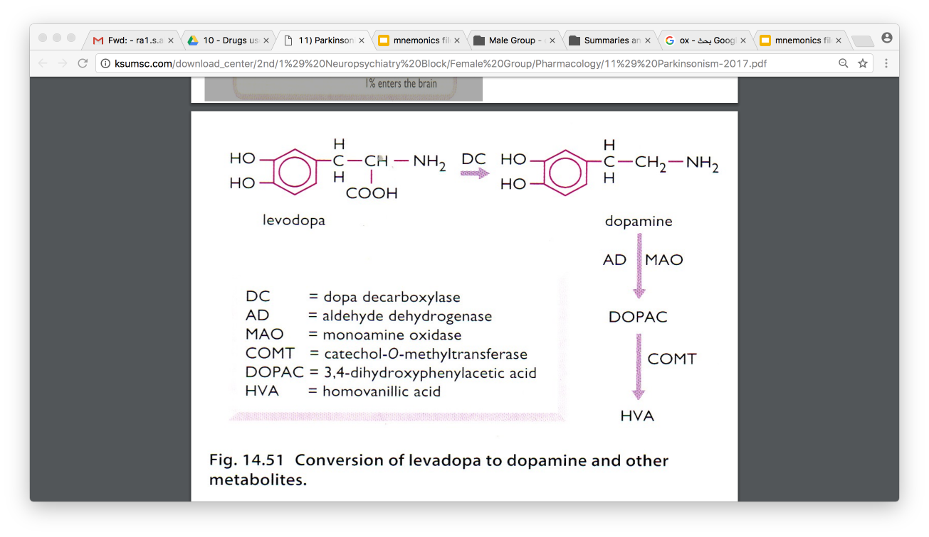
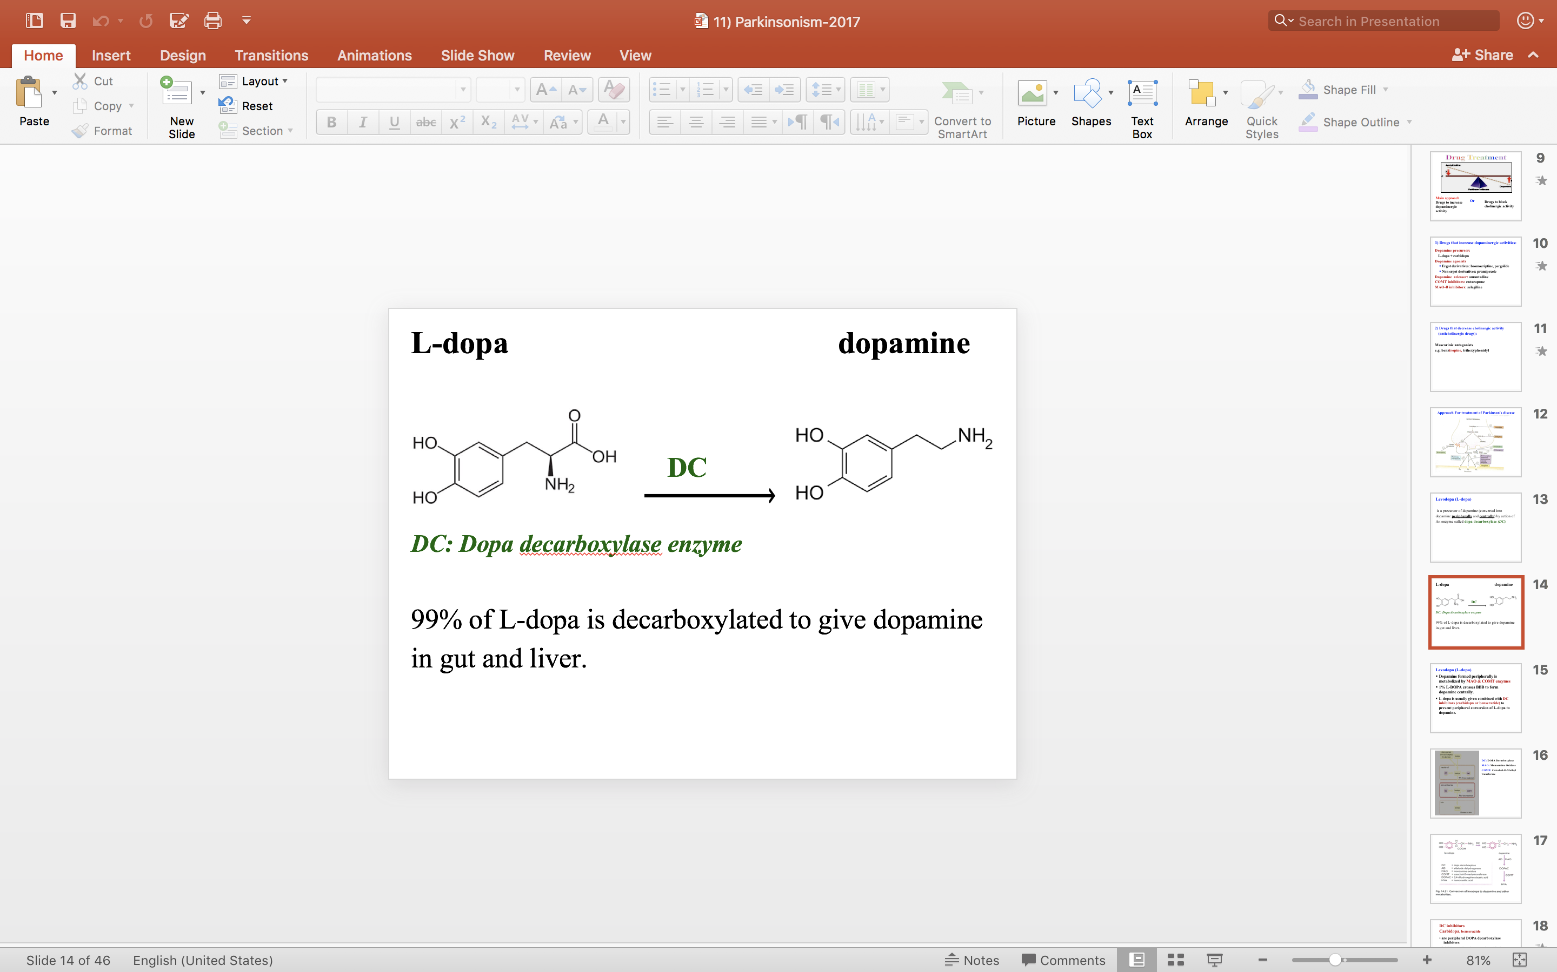
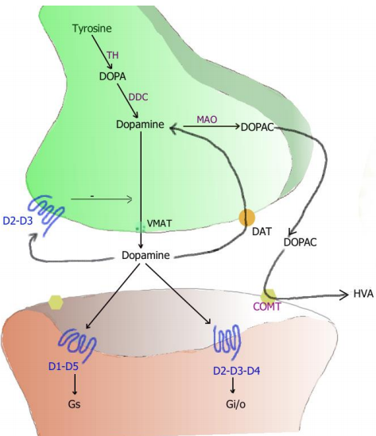
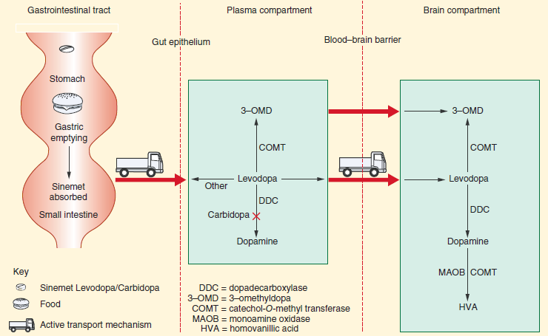
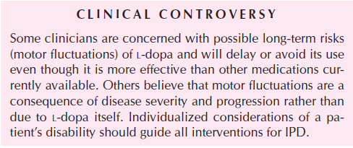
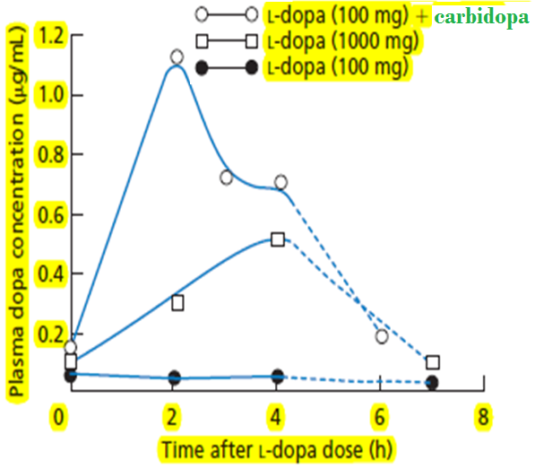
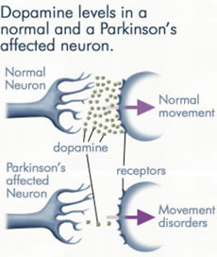
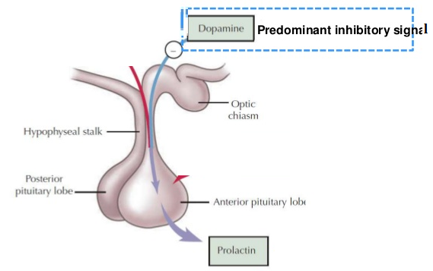
Dopamine processing in a synapse:
DC: DOPA Decarboxylase
MAO: Monoamine Oxidase
COMT: Catechol-O-Methyl transferase
*L-dopa is an amino acid
( derivative from tyrosine)contain COOH and NH2
* Dopa decarboxylase enzyme convert L-dopa to dopamine by removal of COOH
Better understanding !

Slide 5
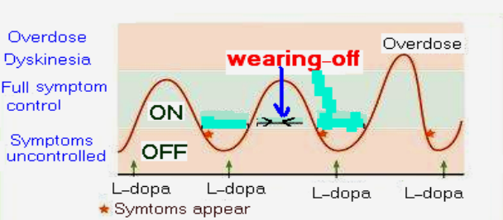
Drugs that increase dopaminergic activities (DA precursors)
Drug | Levodopa (L-dopa)
Pharmacokinetic | It is a precursor of dopamine. L-dopa is a replacement therapy, it’s not prevent the progression of the disease. Pathway of L-dopa: Is converted into dopamine via dopa decarboxylase (DC) peripherally and centrally. Dopamine formed peripherally is metabolized by MAO & COMT enzymes. 99% L-dopa is decarboxylated to give dopamine in gut and liver by decarboxylase enzyme. peripherally 1% crosses BBB to form dopamine centrally. Given orally (should be taken on empty stomach )especially without proteins). Absorbed from the small intestine and taken up to CNS by active transport system. → so if we take a protein meal → uptake process done by competition process between the amino acids & L-dopa. High protein meal interferes with its absorption and transport into CNS. Short duration of action (t½ = 2 hs) → (fluctuation of plasma concentration).
Limitation | Limitation of L-DOPA treatment (effective only for the first 4-5 years) Dyskinesia (involuntary movements occurs in 40 to 90% of patients) → due to fluctuating plasma levels of levodopa. (not constant concentration) The dyskinesia can be reduced by lowering the dosage; however, the symptoms of parkinsonism may then reappear. Wearing-off effect (duration of “on” states becomes shorter) (decrease in L-dopa effect) How can we improve wearing-off effect? By combining it with MAO inhibitors to decrease the frequency of administration and prolong the action potential. On-off phenomenon* (On= improved mobility & Off=Akinesia or hypomobility) because of short T_{1/2.} Wearing off effect and on-off phenomena occur due to → progression of the disease and the loss of striatal dopamine nerve terminals.
P.D | Dopamine acts on dopaminergic receptors D1-D5 (G-protein linked receptors) D1, D5 →Excitatory. - D2, D3, D4 →Inhibitory.
*Sudden transition from normal kinetic activity to dyskinetic activity.
في المستطيل الأخضر =
drug in the therapeutic range = on phenomenon
فوق المستطيل الأخضر = تركيزه عالي في الدم
تحت المستطيل الأخضر= يقل التركيز = off phenomenon
Dyskinesia and response fluctuations with L-DOPA
prescription | L-dopa is usually combined with carbidopa or benserazide (DC inhibitor). →Why? → because Carbidopa is a peripheral dopa decarboxylase inhibitor →inhibit GIT & other peripheral conversion of L-dopa to dopamine. → It acts only peripherally because it does not cross BBB → ↑ T1\2 → Why only peripherally? Benefit of L-dopa + carbidopa combination: -Lowers the effective levodopa dose. -Increase availability of L-dopa to CNS. -Reduce side effects of L-dopa.
Because when it acts also centrally, we won’t take the benefit because L-dopa will not degraded to produce dopamine + it is polar so can’t cross BBB

Slide 6
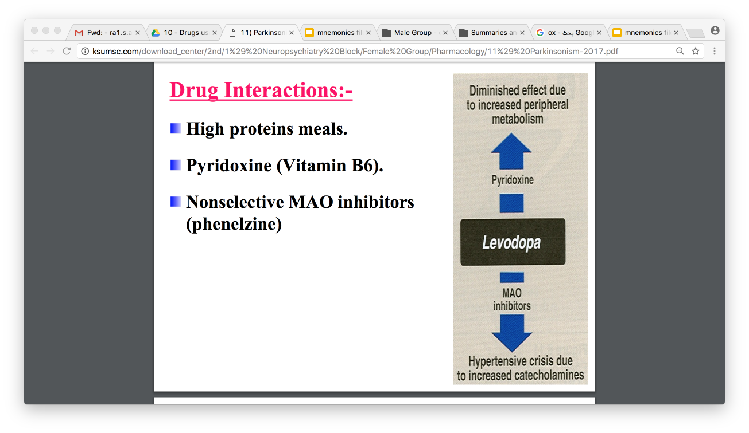
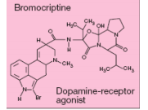
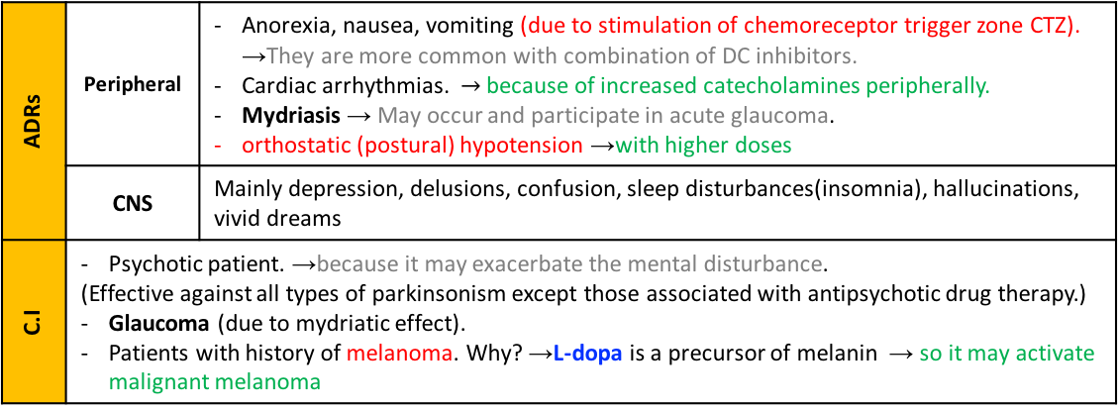
Drugs that increase dopaminergic activities (DA precursors)
Drug | Levodopa (L-dopa) cont.
Indications / Uses | The most efficacious therapy. → 1 st line treatment. The best results of levodopa are obtained in the first few years of treatment. L-dopa ameliorates all signs of parkinsonism particularly bradykinesia & rigidity but does not cure the disease. Should not be used in parkinsonism associated with antipsychotic drug therapy.
Drug interaction | High proteins meals. (compensate on the same receptors ) Pyridoxine (Vitamin B6). → ↓ effect of L-dopa due to ↑ peripheral metabolism by Vit.B6. Adrenomimetic aminees Nonselective MAO inhibitors (phenelzine, tranylcypromine). → Hypersensitivity crisis due to ↑ catecholamines, MAO inhibitors are 3 types A (metabolize catechol amines: 5-TH + NE ) & B (metabolize DA)& non-selective
ADRs | Peripheral | Anorexia, nausea, vomiting (due to stimulation of chemoreceptor trigger zone CTZ). →They are more common with combination of DC inhibitors. Cardiac arrhythmias. $→$because of increased catecholamines peripherally. Mydriasis → May occur and participate in acute glaucoma. orthostatic (postural) hypotension →with higher doses
 | CNS | Mainly depression, delusions, confusion, sleep disturbances(insomnia), hallucinations, vivid dreams
C.I | Psychotic patient. →because it may exacerbate the mental disturbance. (Effective against all types of parkinsonism except those associated with antipsychotic drug therapy.) Glaucoma (due to mydriatic effect). Patients with history of melanoma. Why? →L-dopa is a precursor of melanin → so it may activate malignant melanoma
Dopamine Receptor Agonists
Overview:
.
Have longer duration of action than L-dopa (less likely to cause dyskinesias than levodopa) but more likely to cause psychotic side effects
They are divided into ergot derivatives and non ergot depending on the density .
Ergot derivatives: bromocriptine, pergolide
Non ergot derivatives: pramipexole, ropinirole
Clinical use:
As monotherapy, the dopamine agonists are less effective than levodopa. Thus can only be used as initial therapy for early stages of the disease, and it has longer duration of action.
In advanced stages, dopamine agonists are used as an adjunct to levodopa, they may contribute to clinical improvement and reduce levodopa dosage needs.
Lippincott: Dopamine agonists may delay the need to use levodopa therapy in early Parkinson disease and may decrease the dose of levodopa in advanced Parkinson disease.

Slide 7
Dopamine Receptor Agonists
Drug | Ergot derivatives: e.g:Bromocriptine, pergolide | Non ergot derivatives:
 | Bromocriptine | Pramipexole
Mech. of action | D2 agonist, and a partial D1-antagonist T½ = 6-8 h. Longer than Levodopa (t½ =2 h) But L-dopa more effective. | D3 agonist Used alone as initial therapy or in combination with Ldopa.
Route of admin. | Orally Absorbed to a variable extent from the GIT ; peak plasma levels are reached within 1–2 hours after an oral dose. Excreted in the bile and feces. | Orally Rapidly absorbed, reaching peak plasma concentrations in approximately 2 hours, excreted largely unchanged in the urine excreted unchanged in urine. Renal insufficiency may necessitate dosage adjustment
Indications | Used for the treatment of: 1. Parkinson’s disease 2. Hyperprolactinemia (galactorrhea) Galactorrhea is a condition of elevated serum prolactin.which induces infertility in women. Secretion of prolactin is under inhibitory control by dopamine. 3. Infertility in women. | Has the advantage of being free radicals scavenger. For example, cimetidine, which inhibits renal tubular secretion of organic bases, increases the halflife of pramipexole by 40%
ADRs | Similar to L-dopa: Nausea, vomiting, postural hypotension Cardiac arrythmias Confusion, hallucinations, delusions Dyskinesias (less prominent). Somnolence
Contraindications | • Psychosis • Peripheral vascular disease (only ergot derivatives, which cause severe vasoconstriction and may cause gangrene with high dosage) • Recent myocardial infarction. Active peptic ulceration (with Bromocriptine)

Slide 8
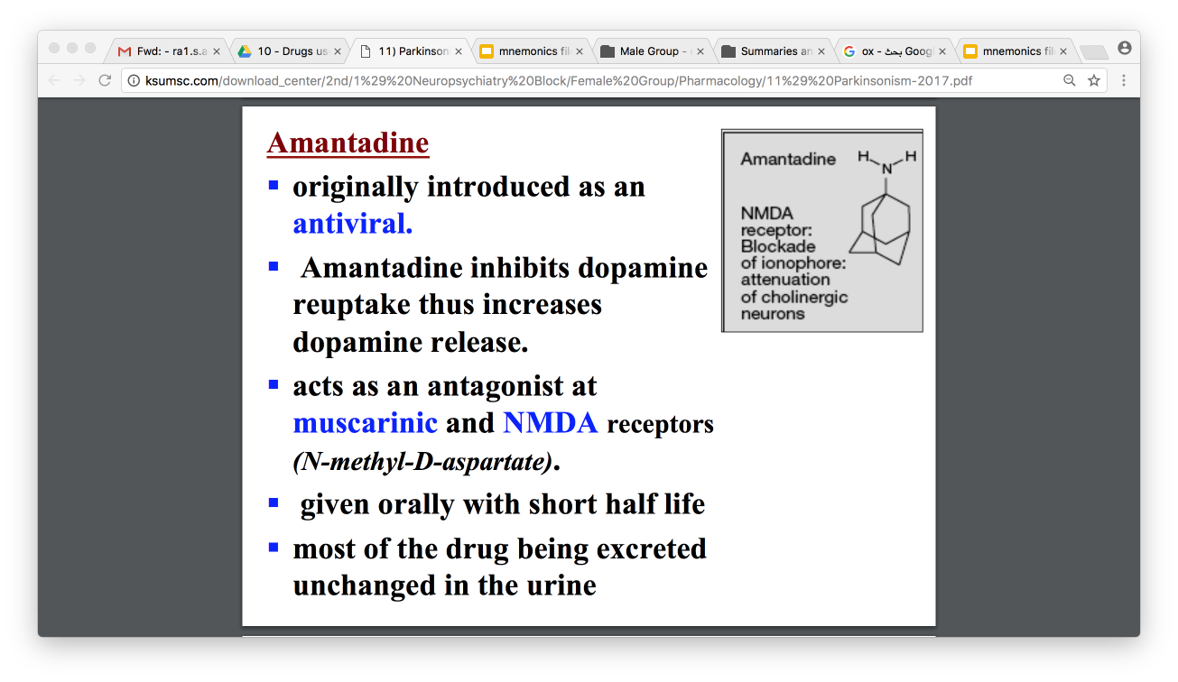
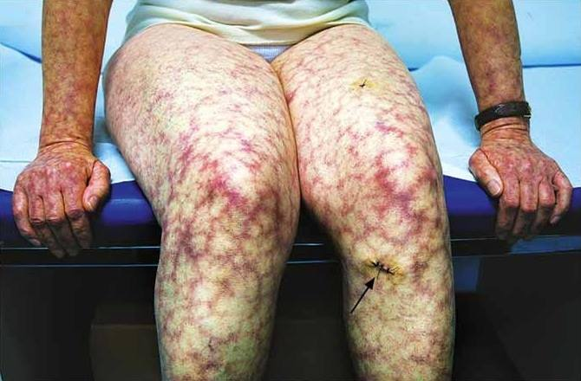
Amantadine
action | - originally introduced as an antiviral. Anti-parkinsonism. 1. inhibits the reuptake of DA→ Increases dopamine release 2. Acts as an antagonist at muscarinic receptors 3. Antagonist at NMDA receptors (N-methyl-D-aspartate) (glutamate receptors)
Route of admin. | - Given orally with short half life = 2-4 h - Most of the drug is excreted unchanged in the urine
Efficacy | - Less efficacious than L-dopa (Modest effectiveness) - Tolerance (decrease of response) develops to its therapeutic effect after 6-8 months. (tolerance is after 3-5 years for levodopa) - Its benefits last only for short period and only used for L-dopa resistance. (which is caused by variation in response among patients) - Amantadine and the anticholinergics may exert additive effects on mental functioning. (A muscarinic receptor antagonist effect and atropine like effect)
Uses | - Useful in the early stages of parkinsonism or as an adjunct to levodopa therapy.
C.I | -Anticholinergics. -In patients with a history of seizures or heart failure
ADRs | Nausea, anxiety, insomnia, confusion, hallucinations (dopamine like side effects). • Dry mouth, urinary retention , constipation (anticholinergic effects). • Restlessness and hallucinations (NMDA antagonist). → NMDA is a type of glutamate receptors & glutamate is an excitatory neurotransmitter, antagonizing it will thus cause restlessness and hallucinations. • Ankle edema, and livedo reticularis*.(rare) *Discoloration of skin due to accumulation Of blood inside veins.
Notes | Lippincott: It was accidentally discovered that the antiviral drug amantadine [a-MAN-ta-deen], which is effective in the treatment of influenza has an antiparkinsonism action. - Amantadine has several effects on a number of neurotransmitters implicated in causing parkinsonism, including increasing the release of dopamine, blockading cholinergic receptors, and inhibiting the N-methyl-D-aspartate (NMDA) type of glutamate receptors. - The drug may cause restlessness, agitation, confusion, and hallucinations, and, at high doses, it may induce acute toxic psychosis. Orthostatic hypotension, urinary retention, peripheral edema, and dry mouth also may occur. Amantadine is less efficacious than levodopa, and tolerance develops more readily. However, amantadine has fewer side effects. The drug has little effect on tremor, but it is more effective than the anticholinergics against rigidity and bradykinesia.
Amantadine is contraindicated with heart failure patients because it causes fluid retention.

Slide 9
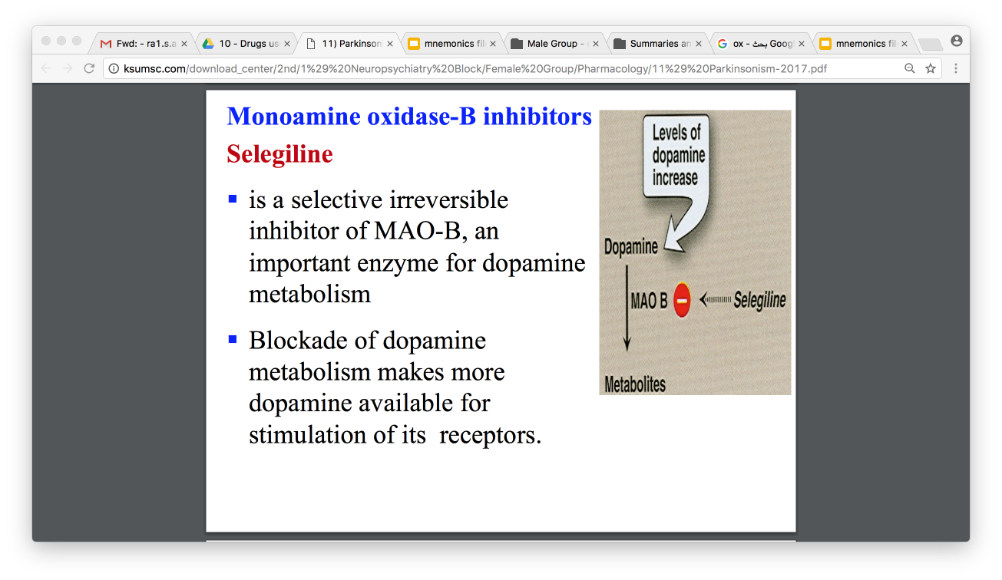
Monoamine oxidase-B (MAO-B) inhibitors
Drug | Selegiline
Mech. of action | It is a selective irreversible inhibitor of MAO-B, an important enzyme for dopamine metabolism. * MAO-A →metabolize NE, 5-HT, DA The blockade of dopamine metabolism makes more dopamine available for stimulation Mech. of its receptors. Selegiline may have neuroprotective effects due to: - Metabolized to desmethylselegiline, which is anti-apoptotic. Has anti-oxidant activity against toxic free radicals produced during dopamine Metabolism so it slows the progression of the disease
Indications | Adjunctive to levodopa/carbidopa in later-stage parkinsonism to: Reduce the required dose of levodopa. As monotherapy may be effective in newly diagnosed patients - Delay the onset of dyskinesia and motor fluctuations that usually accompany long-term treatment with levodopa.(the main goal is to prolong the effect of L-dopa without increase the dose and within the therapeutic range and that happens when we combine L-dopa with MAO & COMT inhibitors )
ADRs | At high doses: - It may inhibit MAO-A →(hypertensive crises) →as a result, do not prescribe selegiline with drugs that increase the level of catecholamines. - May ↑the adverse effects of levodopa. - May cause insomnia when taking later during the day.
Contra-indications | Co-administered with: Meperidine Tricyclic antidepressants. Selective serotonin reuptake inhibitors (may cause hyperpyrexia, agitation, delirium, coma).due to increase in catecholamine →Serotonin toxicity. Food restriction “low tyramine diet” is required. →increase release of E & NE →sever elevation in BP (cheese effect)(cheese and banana are rich in tyramine which increase noradrenaline. So, taking this type of food with MAO B inhibitor (which indirectly increase noradrenaline) will increase the catecholamine level epically noradrenaline and causes hypertension )
Only in girl
slides !
COMT(Catechol-O-Methyl transferase) Inhibitors
Drug | Entacapone | Tolecapone
Action/Mech. of action | - Acts peripherally to inhibit COMT enzyme required for L-dopa degradation. Usually given in combination with L-dopa and carbidopa to diminish peripheral metabolism of L-dopa. Can’t cross BBB | - Peripheral and central COMT inhibitor - More lipid soluble than entacapone. - More penetration into CNS. - Tole = Total = Central & peripheral
Indications | Used as adjuvant to L-dopa + carbidopa to: - Decrease fluctuations - Improve response - Prolong the ON-TIME
ADRs | L-dopa side effects
 | Orange discoloration of urine. | -
Not all patients respond to anti-cholinergic drugs

Slide 10
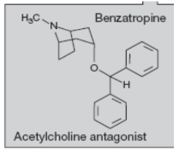
Anticholinergic Drugs
Drug
Action/Mech. of action
Indications
ADRs
C.I
Benztropine | Trihexphenidyl
Central muscarinic antagonist. (Efficacy is due to blockade of muscarinic receptors in the striatum) - It has modest anti-parkinsonian action.
- Improve tremor & rigidity. (but have little effect on bradykinesia. - Provide benefit in drug-induced parkinsonism (due to antipsychotics). - Used during early stage of the disease - Used as an adjunct to levodopa therapy.
- Cycloplegia Mydriasis Dry mouth Urinary retention Constipation | At high doses: - Confusion - Delirium Hallucinations May cause withdrawal symptoms in pts receiving large dose
- Prostatic hypertrophy - Glaucoma - Intestinal obstruction (due to constipation)
Summary
In mild cases, selegiline, amantadine or anticholinergics can be used.
Levodopa and carbidopa is the main treatment
All other medications are adjuncts to levodopa therapy
Other useful drugs include bromocriptine (dopamine agonist), selegiline (monoamine oxidase-B inhibitor), amantadine (enhances dopamine release) and benztropine (muscarinic receptor antagonist), that is used for parkinsonism caused by antipsychotic drugs.

Slide 11

قادة فريق علم الأدوية :
لين التميمي & عبدالرحمن ذكري
الشكر موصول لأعضاء الفريق المتميزين :
روان سعد القحطاني
غادة المزروع
رنا باراسين
لينا الوكيل
سمر القحطاني
References :
1- 436 doctors slides
2- 435 team’s work
3-Pharmacology (Lippincotts Illustrated Reviews Series), 5th edition.
pharma436@outlook.com
Your feedback:
https://docs.google.com/forms/d/e/1FAIpQLSc57qjDXLPcQLYftI27W91gCKD2RgH0OzQDdDxsiLYmH9DKtw/viewform
@pharma436

