Slide 1


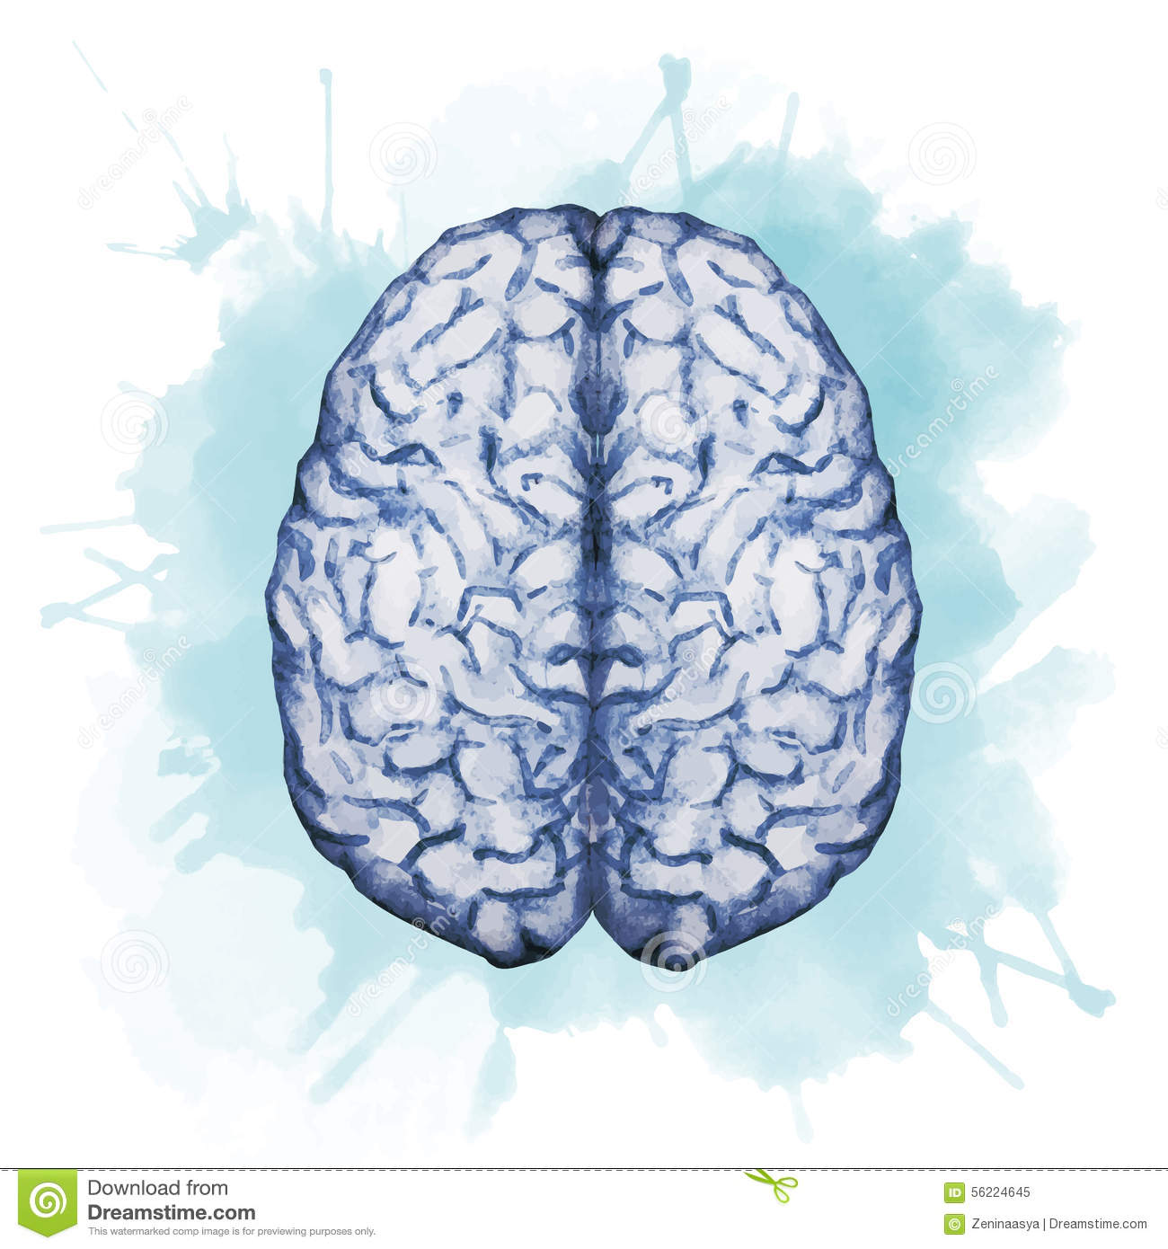


Drugs used in management of pain
Objectives:
Revise how pain is perceived and modulated, emphasizing on neurotransmitters, receptors, channels involved
Classify drugs used in management of pain
Expand on pharmacology of opiates, patterns of classification, mechanism of action , indications, ADR,…etc. detailing on morphine as an example & its synthetic derivatives.
Hints on the properties & clinical uses of morphine antagonists.
Compare in brief actions and indications of other opiate agonists and antagonists.
color index:
extra information and further explanation
important
doctors notes
Drugs names
Mnemonics
Check out the mnemonics file :
https://docs.google.com/presentation/d/1Z0Vf9oEOJSXo4JIA0mTCk5jB-OU9LP5TFCwz8iBgNac/edit?usp=sharing
Kindly check the editing file before studying this document
https://docs.google.com/presentation/d/1_-g1vol4eBWPet5xVCkuTGFvvnhFF3PJmU0tWtEEw_o/edit?usp=sharing

Slide 2
Overview
Drugs used in management of pain
NSAIDs
Adjuvant drugs
Opioids
• 1st class of drugs used.
• work at the site of tissue (act peripherally)
• so decreasing opioid-related side effects.
• Neither cause tolerance or dependence.
• Has a ceiling effect to analgesia.
NSAIDS are anti inflammatory therefore they prevent formation of the chemical mediators associated with nociceptor activation
modify the perception of pain and remove the concomitants of pain such as anxiety, fear, depression.
They don’t really stop the pain rather they work on managing it via controlling symptoms
Primarily indicated for clinical conditions other than pain
Antiepileptics
Antidepressants
neuroleptic
anxiolytics
Receptors (g protein coupled r)
classification according to
1.Mu (µ).
2. Kappa (ĸ)
3. Delta (δ)
4. ORL-1.
their source
agonistic/antagonistic action
their specificity of action on receptors
1. Natural → Morphine,Codeine
2. Semisynthetic → Heroin
3. Synthetic → Pethidine, Methadone
Agonists Morphine, Codeine, Pethidine, Methadone
Mixed agonist\antagonist Pentazocine
Pure antagonist Nalaxone, Naltraxone
µ receptor. agonists → Morphine, codeine, heroin
agonist at k receptor. & antagonist at µ receptor. → Pentazocine

Slide 3
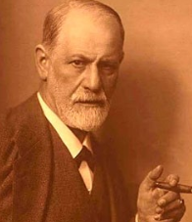
To understand !
A case of overdose:
Sigmund Freud, the father of psychoanalysis. His cancer of the jaw was causing him increasingly severe PAIN & agony. He begged his friend and doctor, Max Schur to relieve him. His doctor administered increasing doses of MORPHINE that resulted in Freud's death on 23 September 1939.
What effect of morphine caused the death of Sigmund Freud? Euthenasia
What is pain?
-The 5th vital sign suggests that assessment of pain should be as automatic as taking a client’s BP and pulse
-Is an unpleasant sensory and emotional experience associated with actual and potential tissue damage, or described in terms of such damage
Why should we treat pain?
Pain is a miserable experience.
Pain is the most common reason patient seek medical advice.
Impairs the patient functional ability & psychological well being.
Pain increases :
- sympathetic output.
- Increases myocardial oxygen demand.
- Increases BP, HR.
Pain limits mobility.
Increases risk for DVT (Deep vein thrombosis) and PE (Pulmonary embolism)
May cause myocardial infraction.
Drugs used in management of pain:
We use Adjuvant drugs and NSAIDs in order to relieve.
Adjuvant drugs
May modify the perception of pain (by ↓ AP) and remove the concomitants of pain such as anxiety, fear, depression.
Opioids
Opium is derived from the juice of the opium poppy, Papaver somniferum
NSAIDs
Generally the first class of drugs used for controlling pain.
e.g. Anxiolytics, Neuroleptics, Antidepressants, Antiepileptics. Used in sever + chronic pains
The natural products include morphine, codeine, papaverine and thebaine
Opiates are drugs derived from opium and semisynthetic and synthetic derivatives
Opioids are natural, semi- synthetic, or synthetic compounds that produce morphine-like effects.
Uses: Their primary use is to relieve intense pain, whether that pain results from surgery, injury, or chronic disease.
Work at site of tissue injury to prevent the formation of the nociceptive mediators As histamine and prostaglandin.
Can decrease opioid use by ~30% therefore decreasing opioid-related side effects.
They neither cause tolerance or dependence
Has a ceiling effect to analgesia. They have a limit then if the pain increase than this limit NSAID produce No effect to relief the pain even if we increase the dose.
Primarily indicated for clinical conditions other than pain. They’re indicated for anxiety-epilepsy-depression.
Opioids refer to opiates and Endogenous opioid peptides, e.g. β− Endorphins, enkephalins & dynorphins.
Useful in neuropathic pain

Slide 4
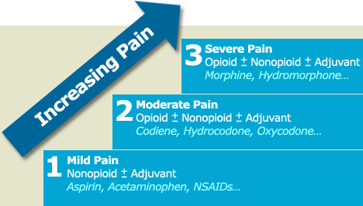
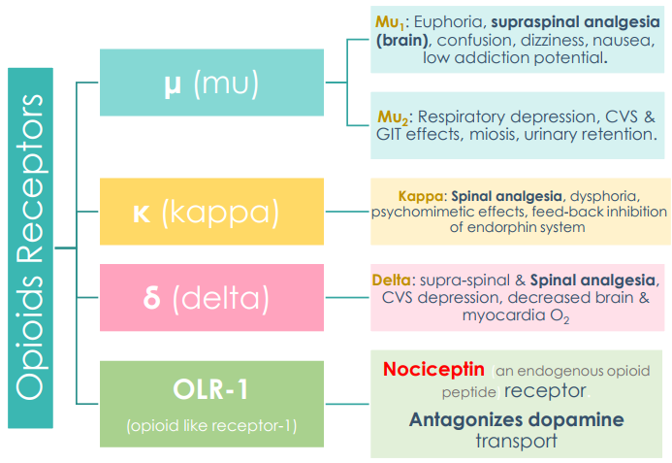
Opioids
WHO Pain Ladder:
Why do we use more than 1 drug? →Combination of drugs lowers the ADRs
If the combination failed because of increasing in the severity of the pain then we add strong Opioid.
Side effects
Analgesia
كل شيء له ثمن، فإذا أبغى أقضي أو أقلل الألم راح أضطر أزود الأدوية وجرعاتها فبالتالي زدت معها الآثار الجانبية
If these drugs failed to control pain then we have to add mild or weak Opioid.
What’s the advantages and disadvantages for this combination?
Advantages: NSAIDs, they’re not addictive and they aren’t cause tolerance.
Disadvantages: they can only relieve mild to moderate pain they can’t relieve severe pain e.g. pain of trauma – pain of cancer.
Opioids exert their pharmacological receptors through 4 types of receptors: These receptor mainly found in the CNS and less in peripheral
435team
All of the 4 receptors are typical G-protein coupled receptors.
Anatomical distribution in brain, spinal cord, & the periphery.
Classification :
A- According to their source:
1- Natural: Morphine Codeine | 2- Semi-synthetic: Heroin → (Diacetylmorphine, synthesized form morphine) |  | 3- Synthetic: Pethidine, Methadone.
B- According to their specificity of action on receptors:
Morphine, codeine, heroin→ µ -receptor agonists |  | Pentazocine → agonist at k –receptors → antagonist at µ-receptors
C- According to agonistic/antagonistic actions:
1- Agonists; Morphine, Codeine, Pethidine, Methadone | 2- Mixed agonists /antagonists; Pentazocine |  | 3- Pure antagonist; Nalaxone, Naltraxone

Slide 5
Opioids
Drug | morphine
Mech. of action | Binding to presynaptic opioid receptors coupled to Gi (inhibitory G protein) →↓ AC (adenylate cyclase) & cAMP →↓ N-type voltage-gated Ca2+ channels (inhibit influx of Ca2+,→ reduce release of neurotransmitter) →↓ excitatory transmitter. Binding to postsynaptic receptors → opening of K channels. (↑postsynaptic K+ efflux (hyperpolarization) →↓ neuronal excitability. Decrease release of neurotransmitter from presynaptic and decrease the neuronal activity of post synaptic leading decrease in action potential signals of pain.
Pharmacodynamics Actions | Analgesia [in acute & chronic pain] more effective on visceral & skeletal pain. Euphoria & sedation. → relieves anxiety of patient. → that’s why they may addict it. Respiratory depression → by reduction of the sensitivity of respiratory center neurons to carbon di- oxide. Main cause of death in addicted people Depression of cough reflexes → treatment of non-reproductive cough. Dry cough. Nausea & vomiting → ↑ excitation CRTZ . Pin point pupil (miosis) →Diagnostic feature of opioid addiction. How? It excites the EWN →enhance parasympathetic effect →constrict pupil. Releases histamine from mast cells →causing: hypotension, bronchoconstriction, itching of skin →contraindicated w\ asthmatic pts. Effects on GIT:- • ↑in tone of contraction , ↓motility of intestine →severe constipation →In GIT reduces motility (peristalsis) by reducing release of Ach →used to treat diarrhea. • ↑biliary tract pressure and biliary colic due to contraction of the gallbladder and constriction of the biliary sphincter→ contraindicated in biliary colic. increase the intra-biliary pressure so for this reason we can’t use it for gallbladder colic. - Depress renal functions
Tolerance | Tolerance occurs when the person takes a higher dose of the drug to achieve the same level of response achieved initially Occurs rapidly with opioids (e.g. morphine 12–24 hours) Develops to(reduce) respiratory depression, analgesia, euphoria and sedation. No tolerance for miosis so it’s good indicator for addict people.
Dependence | Dependence develops when the neurons adapt to the repeated drug exposure and only function normally in the presence of the drug Physical dependence (abstinence)→withdrawal manifestations develop upon stoppage. Or giving opioids antagonist. Lasts for a few days (8-10 days) in form of ↑body ache, insomnia, diarrhea, goose flesh, lacrimation. Psychological dependence lasting for months / years →craving. This is very difficult to treat. Dependence developed mainly with morphine.
Pharmacokinetics | T 1⁄2 is 2-3 h It is slowly and erratically absorbed orally (bioavailability 10-40%) → Given SC, IM, or IV injection. Metabolized by conjugation with glucuronic acid It goes to the intestine (undergo recycling) then it goes back to the blood circulation. Undergoes enterohepatic recycling → Crosses BBB. Crosses Placenta →Infants born of addicted mothers show physical dependence on opiates and exhibit withdrawal symptoms if opioids are not administered if the mother got addictive to morphine, the newborn baby will also be addictive to morphine.
This is the vomiting center in the brain.(Stimulate vomiting).

Slide 6
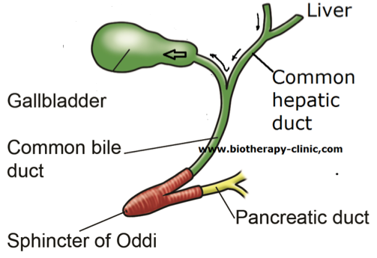
Opioids con.
Drug | morphine
Clinical Indications | Pain Control : cancer pain, severe burns, trauma, Severe visceral pain (not renalcolics (because it constricts the ureter) /biliary colics, acute pancreatitis because the gall bladder & pancreas has similar sphincter constricted by morphine) Myocardial Ischemia and Acute Pulmonary Edema Relief : distress : e.g. heart failure (non painful conditions) Pre- anesthetic medication
Adverse Effects | Constipation Respiratory Depression Itching Nausea /Vomiting Constricted Pupil Sedation (CRINCS) | Contraindications | Head Injury dilation in cranial blood vessels > intra-cranial Pressure >bleeding Bronchial asthma or Impaired Pulmonary Function Biliary colic →it increase the pressure of biliary tract. Elderly : more sensitive due to →↓ Metabolism, lean body mass& Renal function Pancreatic pain Pts take MAOIs (Monoamine oxidase inhibitors) →bc depressant actions of morphine are enhanced Infants, neonates, or during child birth→ decrease conjugating capacity → accumulate→ respiratory depression
*morphine release histamine, so it can cause bronchoconstriction and centrally depresses respiration.
Better understanding
Mechanism of action (opioids)
Pharmacological action of morphine

Slide 7
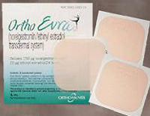
Opioids
Opioid drugs:
Drug | Codeine
Characteristics | µ Agonist Dependence less than morphine
Indication | Used in mild & moderate pain (systemic) Dry cough Diarrhea
Opioid Agonists:
Drug | TRAMADOL | PETHIDINE (meperidine) | FENTANYL
Mechanism of action | Synthetic, μ agonist. less potent than Morphine. →so it is weak Analgesic. inhibits NE and 5HT (serotonin) reuptake. | Synthetic, more effective k (kappa) agonist. | Synthetic, μ agonist, more potent than Pethidine and Morphine
 |  | Pharmacodynamics
 |  | - Less analgesic, constipating, depressant on fetal respiration than morphine. - No cough suppressant effect. - Does not cause pinpoint pupils but, rather, causes the pupils to dilate because of an anticholinergic action.
P.K | Can be given orally →more oral bioavailability | ____ | Highly lipophilic. Short Duration.
Indications | Mild to moderate acute and chronic visceral pain. During labor→ because it does not inhibit respiration. | As in Morphine but not in cough and diarrhea. Better →preanaethetic medication. Used in obstetric analgesia (no decrease in respiration) Used in severe visceral pain; renal and biliary colics (smooth muscles relaxant). - Used for acute pain. Pethidine is metabolized by dealkylation for this reason it doesn’t accumulate in the body of the fetus so, it won’t cause respiratory depression in the fetus. Has atropine-like action (smooth muscle relaxant) so we can use it with biliary colic and pancreatitis. | Analgesic supplement during anesthesia (IV or intrathecal = injection into the spinal canal). Induce and maintain anesthesia in poor-risk pts (stabilizing heart) Used in combination with Droperidol as NEUROLEPTANALGESIA. - In cancer pain and severe postoperative pain; (transdermal patch changed every 72 hrs)
ADRs | - Seizures (not use with epileptics) - Nausea - Dry mouth - Dizziness - Sedation - Less ADRs on respiratory and CVS | Tremors, convulsions is due to the serotonin in the brain, hyperthermia, hypotension. Blurred vision, dry mouth, urine retention (atropine-like effects) Tolerance and addiction. | - Respiratory depression (most serious) - CV effects are less. So it is good for pts with heart problems. - Bradycardia may still occur
لصقه تخدر كل الجسم و يتم تغييرها كل ٣ أيام

Slide 8
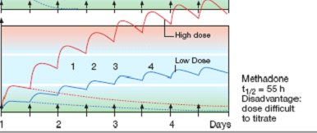
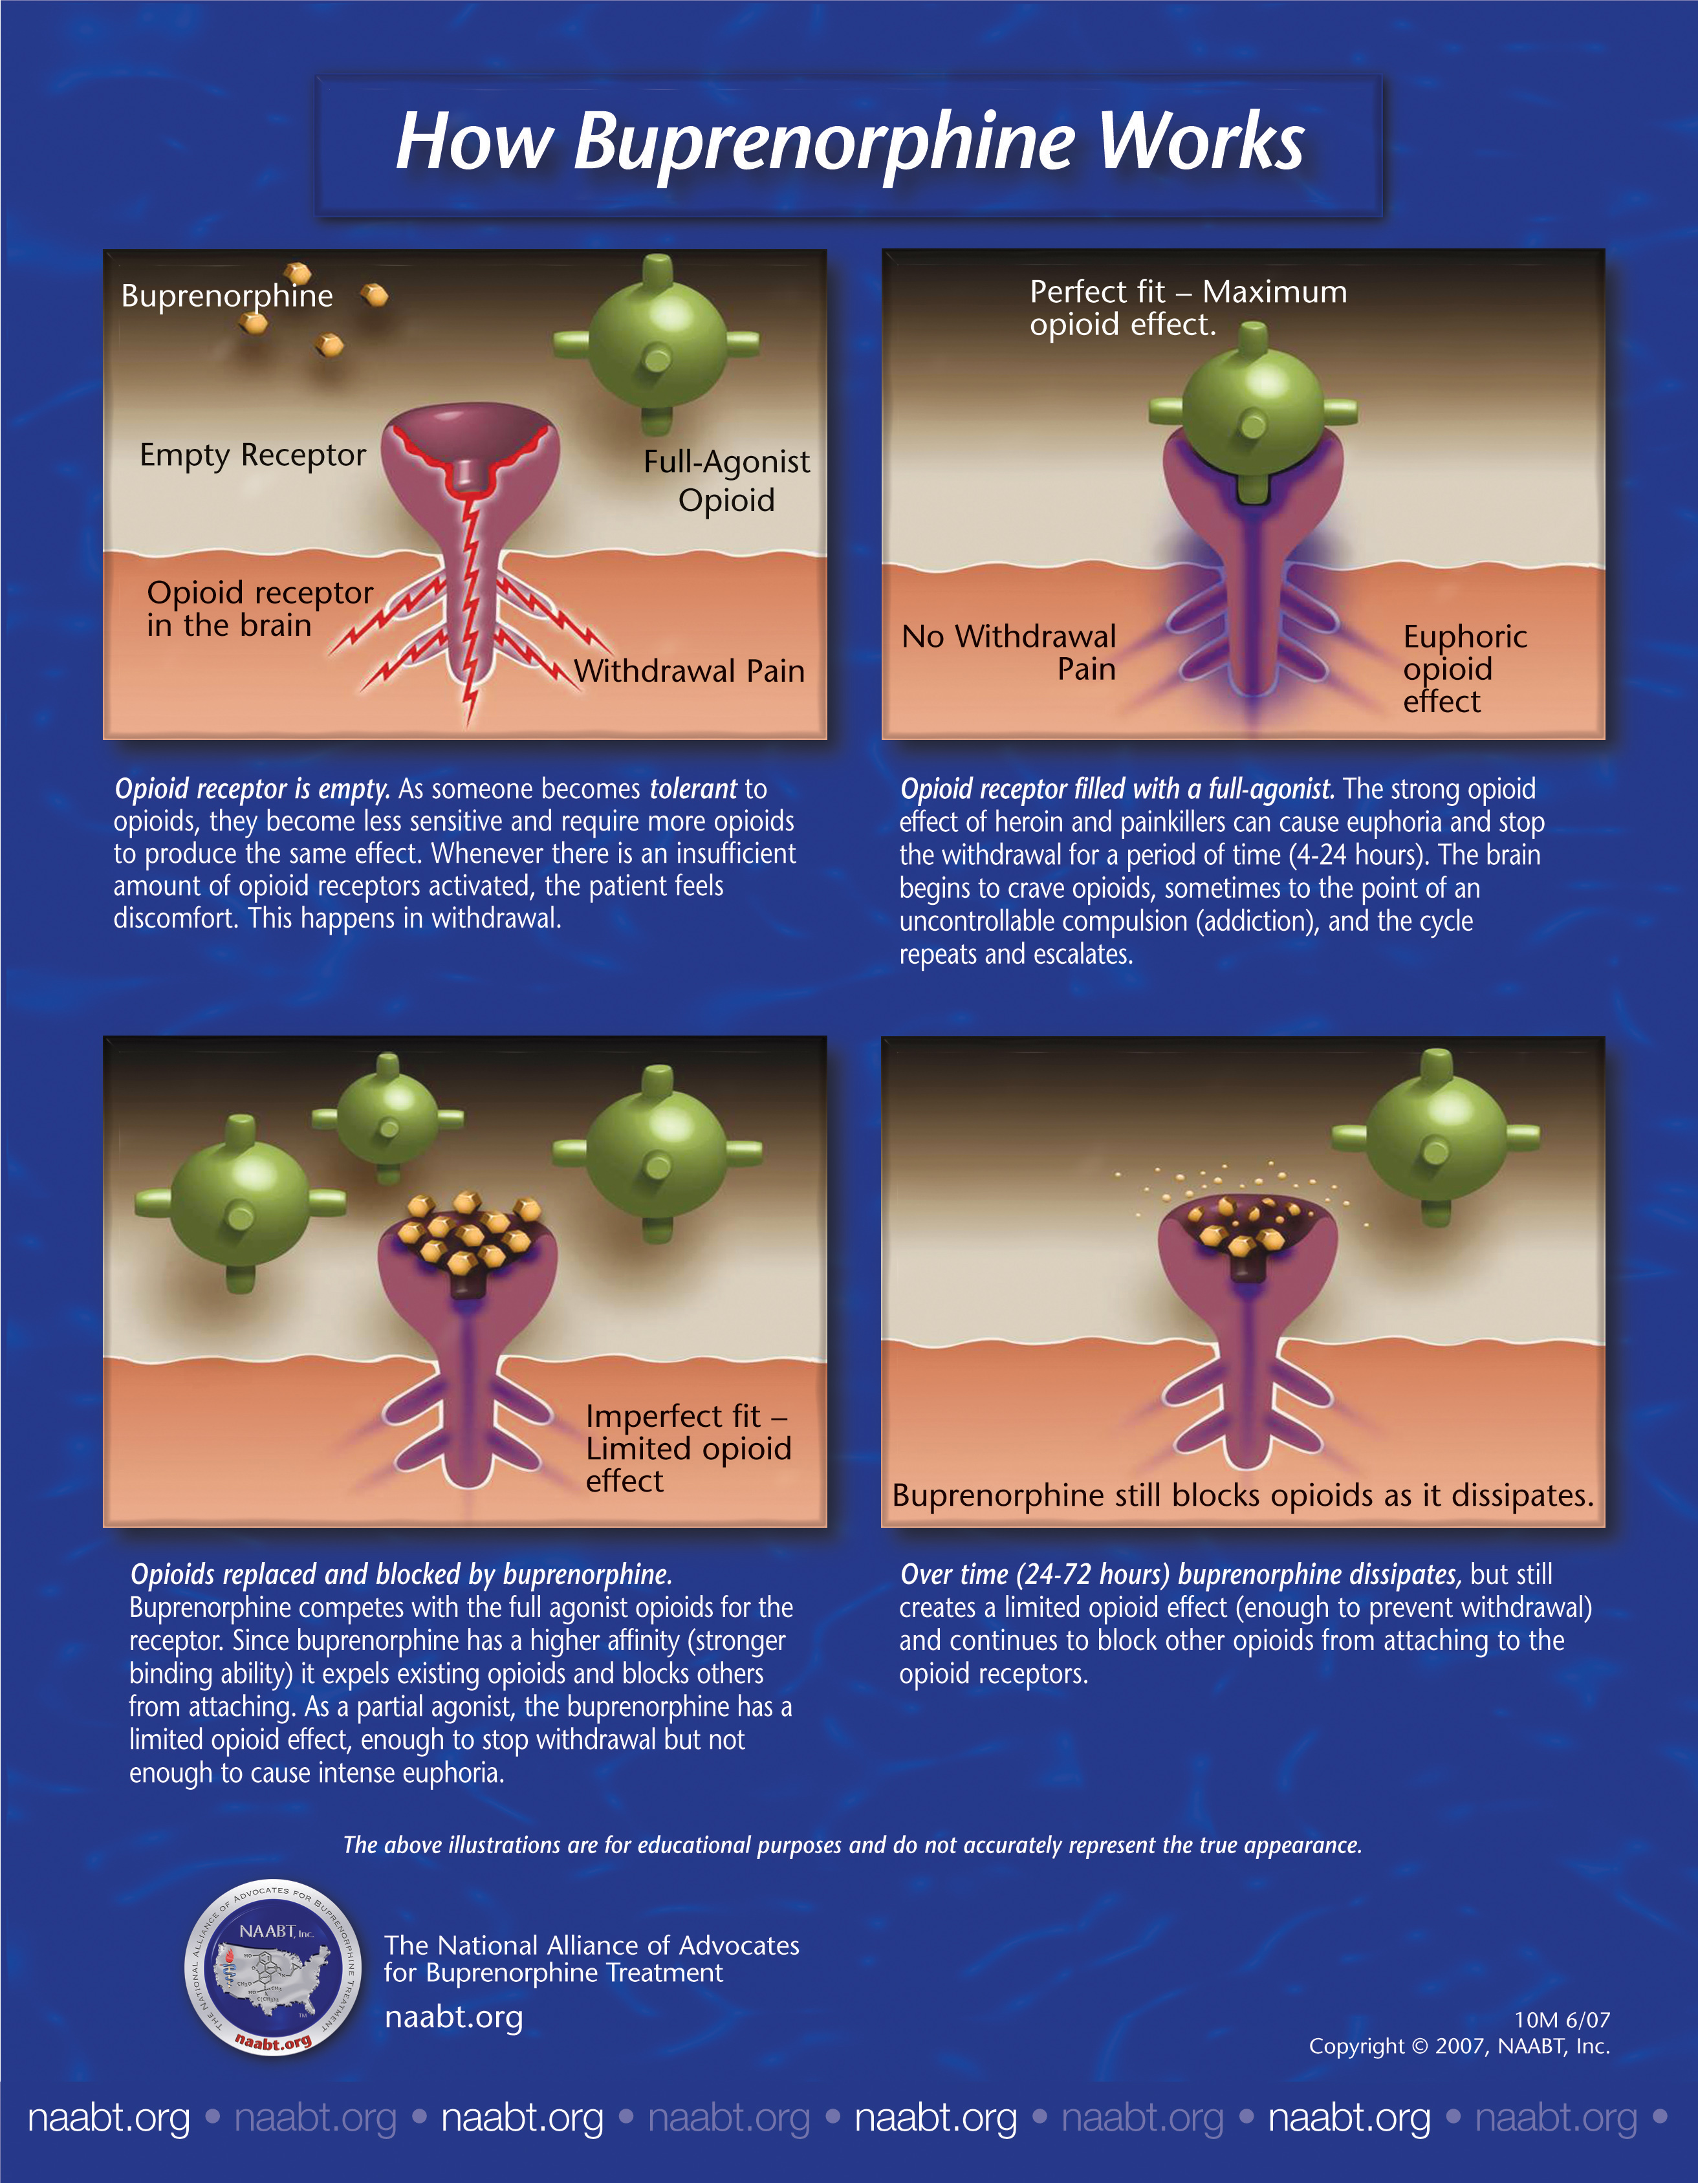
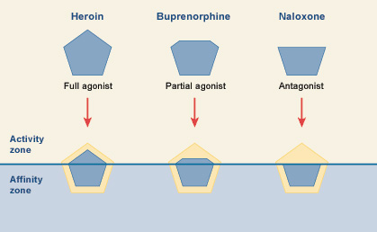
Opioids
Drug | Opioid agonists | Opioid Antagonists
 | METHADONE | NALOXONE | NALTREXONE
Action/Mech. of action | - Weaker synthetic μ agonist. - antagonist of the N-methyl- D- aspartate (NMDA) receptor. | - Pure opioid antagonist - Competitive antagonist to μ, κ, and δ. | Very similar to Naloxone
P.D | In non-addicts, it causes tolerance and dependence but not as severe as that of Morphine. | ___ | ___
P.K | T1/2 = 55 hrs | Effects lasts only for 2-4 hrs. | Longer duration of action. T1/2 = 10hrs
Indications | Used to treat and control opioid withdrawal (in people who have become addicted to opiates such as heroin) neurogenic pain →NMDA antagonist. | Used to treat and reverse respiratory depression caused by opioid overdose. Reverse the effect of analgesia on the respiration of the new born baby. Precipitates withdrawal syndrome in addicts.
 |  | OPIOID ANTAGONISTS
 | With addiction of opioid: With methadone:
Use for overdose of morphine (antidote)
It is better to be pure either Agonist or Antagonist
Morphine
Nalorphine
Naloxone
An ADDICT
After 72 hours
methadone

Slide 9
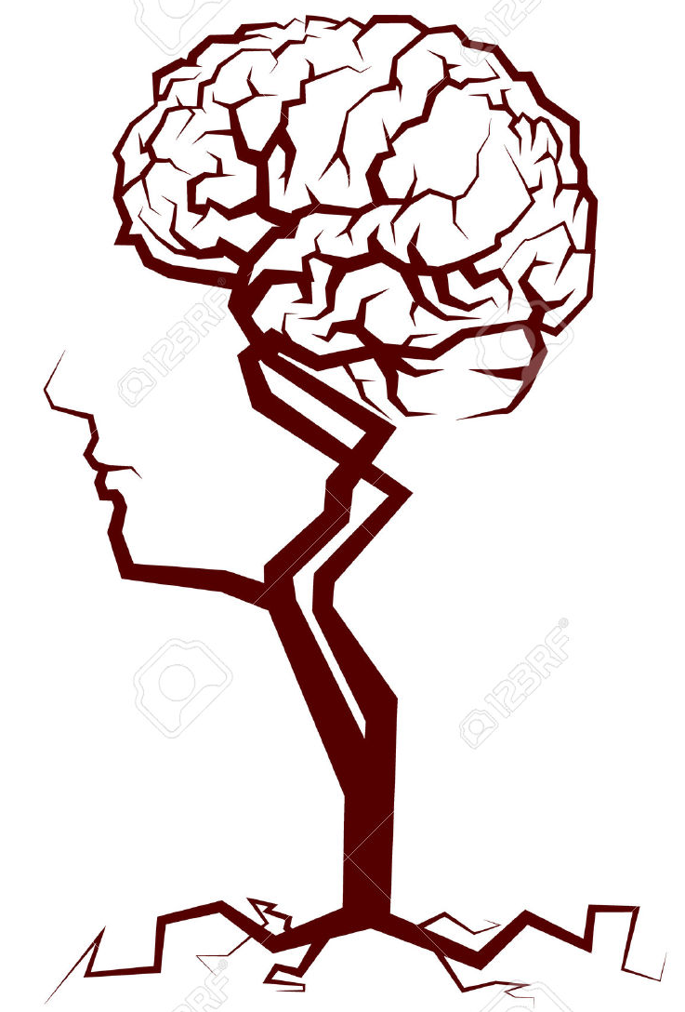
قادة فريق علم الأدوية :
لين التميمي & عبدالرحمن ذكري
الشكر موصول لأعضاء الفريق المتميزين :
غادة المزروع
ريم الشثري
ساره الشمراني
شذا الغيهب
سمر القحطاني
ريما العتيبي
روان سعد القحطاني
References :
1- 436 doctors slides
2- 435 team’s work
pharma436@outlook.com
Your feedback:
https://docs.google.com/forms/d/1sxDqHtpP3bUaOhQmYw96IE7mX-DlrklT5dlZUA2teSI/edit
@pharma436

