Slide 1
Drugs used in schizophrenia
Objectives:
List the classification of antipsychotic drugs used in schizophrenia.
Describe briefly the mechanism of antipsychotic action of these drugs.
Describe the pharmacological actions of antipsychotic drugs.
Relate between pharmacological actions & adverse effects of antipsychotic drugs.
Enumerate the clinical uses of antipsychotic drugs.
Describe the advantages of atypical antipsychotic drugs over typical drugs.
color index:
extra information and further explanation
important
doctors notes
Drugs names
Mnemonics
Check out the mnemonics file :
https://docs.google.com/presentation/d/1Z0Vf9oEOJSXo4JIA0mTCk5jB-OU9LP5TFCwz8iBgNac/edit?usp=sharing
Kindly check the editing file before studying this document
https://docs.google.com/presentation/d/1_-g1vol4eBWPet5xVCkuTGFvvnhFF3PJmU0tWtEEw_o/edit?usp=sharing

Slide 2
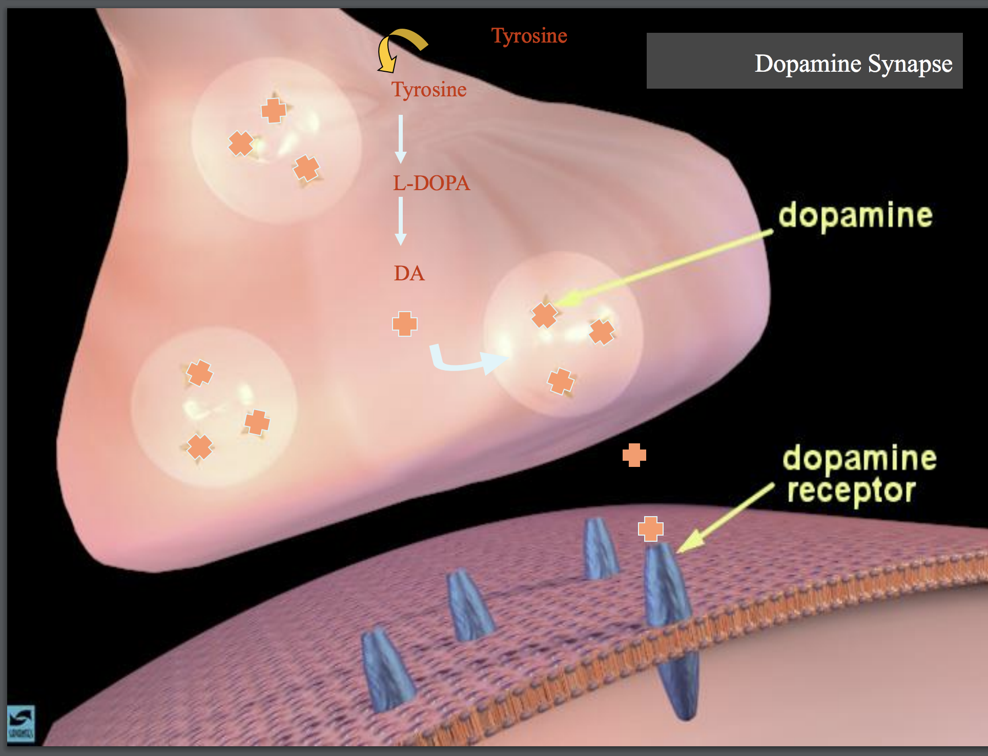
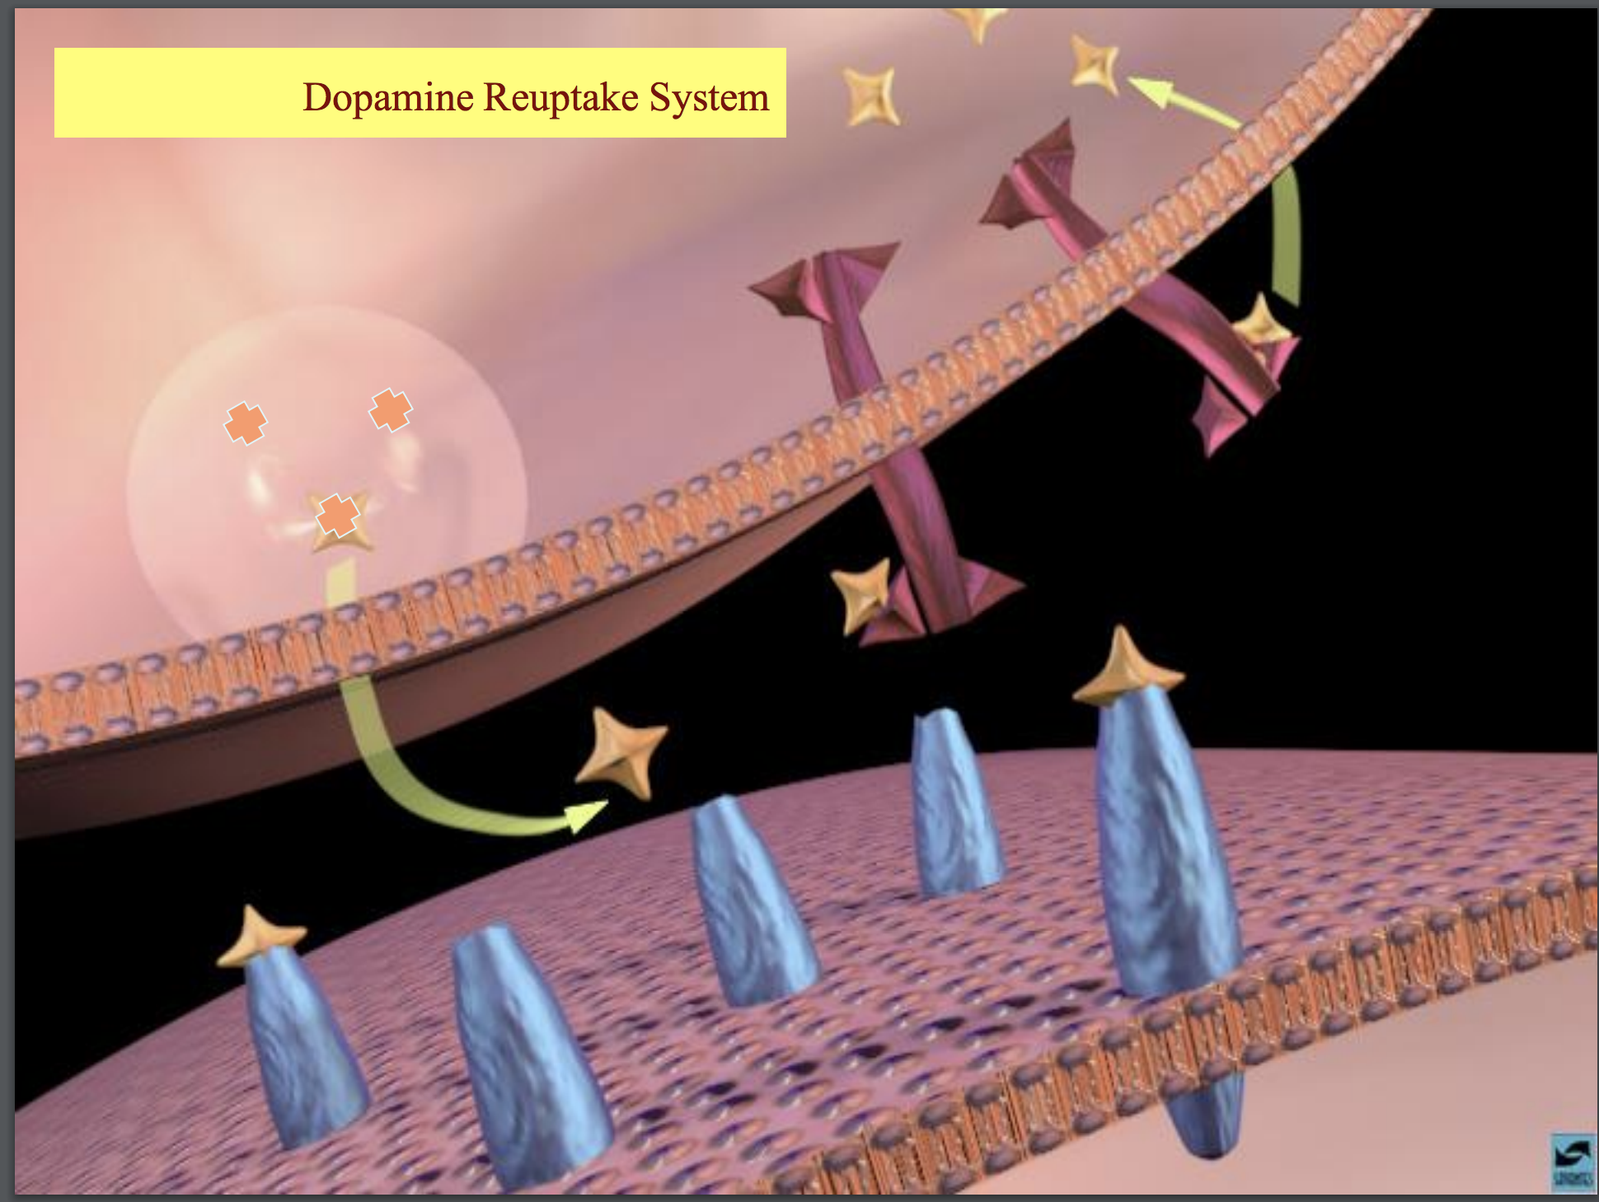
Introduction
Psychoses :
Schizophrenia affect thoughts
Affective Psychoses affects mood
Mania.
Depression
Manic-depressive illness (bipolar affective disorder).
Schizophrenia
It is a thought disorder characterized by divorcement from reality in mind of patient. it may involve hallucinations, delusions , intense suspicion, paranoia (felling of persecution or control by external forces).
Positive Symptoms | Negative Symptoms (FAMILY MEMBERS notice these changes not the patient )
Hallucinations. Delusions. Paranoia. | Social withdrawal. Anhedonia (absence of pleasure). Emotional blunting.
Dopamine System
Dopaminergic pathways in the brain :
Schizophrenia drugs affect all the pathways
1- Mesolimbic-mesocortical pathway schizophrenia drugs have therapeutic effect on these pathways
2- Nigrostriatal pathway
behavior
co-ordination of voluntary movements
3- Tuberoinfundibular pathway
4- Medullary-periventricular pathway
endocrine effects
(metabolic effects)
Most of schizophrenia drugs side effects comes from blocking D2 receptors in pathways other than Mesolimbic-mesocortical . If we avoid blocking D2 so, we avoid these side effects
DOPAMINE RECEPTORS :
There are at least five subtypes of receptors:
D 1, D 2, D 3, D 4, D 5
D2 is the classical dopamine receptor

Slide 3
Antipsychotic drugs
What are they ?
are group of drugs used in the treatment of schizophrenia.
-Old name (neuroleptic drugs)
Classification:
Drugs used in schizophrenia are classified according to chemical structures Into
Typical | Atypical
discovered first, non selective, many side effects, rarely used nowadays. | more selective, less side effects, 1st line treatment for schizophrenia.
Better!
Classification of antipsychotic drugs
Typical Antipsychotic Drugs →affect D2 mainly Except Cariprazine on D3 → treat the +ve symptoms.
Phenothiazine derivatives Its chemical structure similarto TCAs →similar ADRs | Such as: Chlorpromazine(Protype very old),Thioridazine
Butyrophenones | Such as: Haloperidol
Thioxanthene | Such as: Thiothixene
Atypical Antipsychotic Drugs better than typical →Affect both DA & 5-HT receptors →treat +ve & -ve symptmos.
Dibenzodiazepines | Such as: Clozapine
Benzisoxazoles | Such as: Risperidone
Thienobenzodiazepines | Such as: Olanzapine
Dibenzothiazepines | Such as: Quetiapine
Benzisothiazoles | Such as: Ziprasidone
piperazine/piperidine derivatives | Such as: Cariprazine (approved in 2015 by the FDA)
The pharmacological action of antipsychotic drugs result from
Blocking dopamine receptors at different areas in the brain.
Blocking muscarinic receptors
Blocking α-adrenergic receptors
Blocking H1 receptors
Advantages of Atypical drugs | Adverse effects on CNS
They block both dopaminergic & serotonergic receptors. They are effective in refractory cases of schizophrenia. They produce few extrapyramidal effects. | They are due to blocking dopamine receptors at areas other than mesolimbic area (extrapyramidal effects).

Slide 4
Pharmacological actions of typical & atypical anti-psychoses
Before starting the pharmacological actions we need to be familiar with these concepts:
Psychomotor slowing: involves a slowing-down of thought and a reduction of
physical movements in an individual.
Psychotic disorder: abnormal thinking and perceptions.
Agitation: a state of anxiety or nervous excitement.
Tardive dyskinesia: a neurological disorder characterized by involuntary movements of the face and jaw.
Galactorrhea: excessive or inappropriate production of milk.
Amenorrhea: an abnormal absence of menstruation.
Gynecomastia: enlargement of a man's breasts, usually due to hormone imbalance or hormone therapy.
Impotence: inability to develop or maintain an erection of the penis during sexual activity in humans.
Pruritus: severe itching of the skin.
CNS
Antipsychotic effect | Its effect: | (it’s the main use). It takes from 10 days to 3 weeks to start its action Produce emotional quieting and psychomotor slowing. Decreasing hallucinations, delusions and agitation.
 | Mechanism: | blockage of dopamine receptors in the mesolimbic system. →treat +ve symptoms. *Atypical drugs exert their antipsychotic action through blocking serotonergic (5HT2) and dopaminergic receptors→. treat –ve symptoms also.
Extrapyramidal symptoms | Its effect: | EXTRAPYRAMDAL = PARKINSOMISM LIKE EFFECT. - Abnormal involuntary movements such as tremors, parkinsonism, and tardive dyskinesia.
 | Mechanism: | blockage of dopamine receptors in the nigrostriatum.
Endocrine effects | Its effect: | Galactorrhea Amenorrhea cause false +ve pregnancy test Gynecomastia & impotence.
 | Mechanism: | prevent dopamine from inhibiting prolactin release from pituitary gland and that will lead to hyperprolactinemia.
Metabolic effect: | Its effect: | changes in eating behavior and weight gain.
 | Mechanism: | blockage of dopamine receptors in the medullary- periventricular pathway.
Antiemetic effect: | Its effect: | Effective against drug and disease- induced vomiting. (not-motion sickness)
 | Mechanism: | blockage of dopamine receptors in the CTZ of the medulla. The chemoreceptor trigger zone (CTZ) is an area of the medulla oblongata that receives inputs from blood-borne drugs or hormones, and communicates with other structures in the vomiting center to initiate vomiting.
female
For male

Slide 5
Pharmacological actions Cont.
ANS
Anticholinergic effects | Its effect: | Blurred vision Dry mouth Urinary retention Constipation
 | Mechanism: | blockage of muscarinic receptors.
Antiadrenergic effects | Its effect: | Postural hypotension Impotence failure of ejaculation.
 | Mechanism: | blockage of alpha1-adrenergic receptors. NOTE: Non of the atypical group causes antiadrenergic effect.
Other
Temperature regulation:
May cause lowering of body temp. Mechanism: heat loss as a result of vasodilation due to alpha1-blocking or central effect.
ECG changes:
prolongation of QT interval, abnormal configuration ST segment and T wave. c.I : in cardiac patients
Antihistaminic effect :
sedation due to H1 receptor blockage.
Quinidine-like action:
Increasing action potential duration as well as prolonged QT interval. It causes arrhythmia
*very important
Beneficial effect
*very important
*very important
*very important
Anti-arrhythmic drug
*very important

Slide 6
Adverse effects
Unwanted pharmacological effects
CNS
1- Sedation, drowsiness, fatigue →haloperidol (typical), Risperidone (atypical)
2- Extrapyramidal symptoms: →Some occurring early (Parkinson’s syndrome) ,other late occurring
B) Neuroleptic Malignant Syndrome | A) Tardive Dyskinesia (IRREVERSIBLE MANIFSTATION if we don’t stop the drug )
Rare but life threatening →Symptoms are muscle rigidity and high fever (clinically similar to anaesthetic malignant hyperthermia). The stress leukocytosis and high fever associated with this syndrome may wrongly suggest an infection.). | (from Latin tardus, slow or late coming) It is a disorder of involuntary movements (choreoathetoid movements of lips, tongue, face, jaws, and limbs ) Choreoathetosis: combination of chorea (irregular migrating contractions) and athetosis (twisting)
Due to prolong use
Has a genetic element
ANS
2- Antiadrenergic Effects : | 1- Anticholinergic Effects :
Postural hypotension. Impotence Failure of ejaculation. Chlopromazine (typical) Thioridazine (typical) | Blurred vision. Dry mouth. Urinary retention. Constipation→ Such as with: Chlorpromazine (typical), Clozapine (atypical)
يجمع كل الاعراض الجانبية المعروفة
Gynecomastia
Endocrine Effects:
Gynecomastia
Amenorrhoea
Miscellaneous Effects:
Obstrucive jaundice
Granular deposits in cornea
Retinal deposits
( Only thioridazine)
Weight gain
Mostly Atypical
Clozapine
Agranulocytosis( life threating) - About 1-2% - Usually happen after 6-18 weeks - Weekly WBC is mandatory - Seizures *Agranulocytosis, also known as agranulosis or granulopenia, is an acute condition involving a severe and dangerous leukopenia (lowered white blood cell count)
*very important

Slide 7
Therapeutic Uses
NON-PSYCHIATRIC | PSYCHIATRIC
Nausea and vomiting (prochlorperazine and benzquinamide) Only used as antiemetics Pruritis (Itching because of anti-histamine effect) Preoperative sedation ( rare use ) | Schizophrenia ( primary indication) Acute mania Manic-depressive illness ( bipolar affective disorder ) during the manic phase Atypical Bipolar affective disorder is characterized by periods of deep, prolonged, and profound depression that alternate with periods of an excessively elevated or irritable mood known as mania.
Pharmacokinetics:
• Incompletely absorbed.
• Highly lipid soluble.( So it can cross BBB)
• Highly bound to plasma proteins.
• Undergo extensive first-pass hepatic metabolism.
• Excretion by the kidney
Atypical Antipsychotics
What are they ?
- 2nd Generation antipsychotics
- Now considered as First line treatments for schizophrenia
- Little or no extrapyramidal side effects
- Effective in treatment of resistant schizophrenia.
- Are effective on both positive & negative symptoms.
- Block both dopaminergic & serotonergic receptors.
Clinical uses :
- Refractory cases of schizophrenia.
- To reduce the risk of recurrent suicidal behavior in patients with
schizophrenia.

Slide 8
Atypical Antipsychotics
*very important
Remember it’s Atypical
Drug | Risperidone | Ziprasidone | Clozapine | Olanzapine | Quetiapine | Cariprazine
Mech. of action | Blocks D2 & 5HT2 receptors. | Blocks D2 & 5HT2 receptors | Blocks both D4 & 5HT2 receptors. | Blocks D1 - D4 & 5HT2 receptors. | Blocks D1 -D2 & 5HT2 receptors | approved in 2015 by the FDA - has higher affinity at D3 receptor
Indications |  | Drug interactions: - Should not be used with any drug that prolongs the QT interval. Activity decreased by carbamazepine (inducer of CYP3A4) Activity increased by ketoconazole (antifungal) (inhibitor of CYP3A4) |  |  |  | has a positive impact on the cognitive symptoms of schizophrenia
ADRs | - Postural hypotension - QT prolongation - Weight gain | - Drowsiness, Akathisia (cant keep still) ,Headache ,Dizziness, Weight gain. | Agranulocytosis - Seizures - Myocarditis - Excessive salivation (during sleep) | - Weight gain - -Sedation Flatulence, increased salivation & thirst. - Postural hypotension. | Sedation Hypotension Sluggishness Dry mouth - Increased appetite (weight gain) - Abdominal pain - Constipation
Contra- indications | Patients with long QT interval. | It increases mortality in elderly patients with dementia-related psychosis. | it contraindicated in patient with epilepsy

Slide 9
Summary
Drugs used in schizophrenia are classified according to chemical structures.
The advantages of atypical drugs include :
They block both dopaminergic & serotonergic drugs.
They are effective in refractory cases of schizophrenia
They produce few extrapyramidal effects
The pharmacological actions of antipsychotic drugs result from :
Blocking dopamine receptors at different areas in the brain.
Blocking muscarinic receptors
Blocking α-adrenergic receptors
Blocking H1 receptors
Adverse effects on CNS are due to blocking dopamine receptors at areas other than mesolimbic area
Blockade of H1, muscarinic & α- adrenergic receptors.
The main clinical use is in schizophrenia
Examples of atypical drugs includes : Clozapine Risperidone Olanzapine Quetiapine Ziprasidone
The synapse and synaptic neurotransmission
Describe the synapse and the process of chemical neurotransmission. Indicate how vesicles containing a neurotransmitter, such as dopamine (the stars), move toward the presynaptic membrane as an electrical impulse arrives at the terminal. Describe the process of dopamine release (show how the vesicles fuse with the presynaptic membrane). Once inside the synaptic cleft, the dopamine can bind to specific proteins called dopamine receptors (in blue) on the membrane of a neighboring neuron. Introduce the idea that occupation of receptors by neurotransmitters causes various actions in the cell; activation or inhibition of enzymes, entry or exit of certain ions. State that you will describe how this happens in a few moments
Dopamine binding to receptors and uptake pumps in the nucleus accumbens
Explain that cocaine concentrates in areas of the brain that are rich in dopamine synapses. Review dopamine transmission in the nucleus accumbens. Point to dopamine in the synapse and to dopamine bound to dopamine receptors and to uptake pumps on the terminal.

Slide 10
قادة فريق علم الأدوية :
لين التميمي & عبدالرحمن ذكري
الشكر موصول لأعضاء الفريق المتميزين :
فيصل العباد
عبدالرحمن الجريان
طلال العنزي
عبدالوهاب الشهراني
عبدالكريم الحربي
روان سعد القحطاني
ندى الصومالي
References :
1- 436 doctors slides
2-435 team work
pharma436@outlook.com
Your feedback:
https://docs.google.com/forms/d/1sxDqHtpP3bUaOhQmYw96IE7mX-DlrklT5dlZUA2teSI/edit
@pharma436

