Slide 1
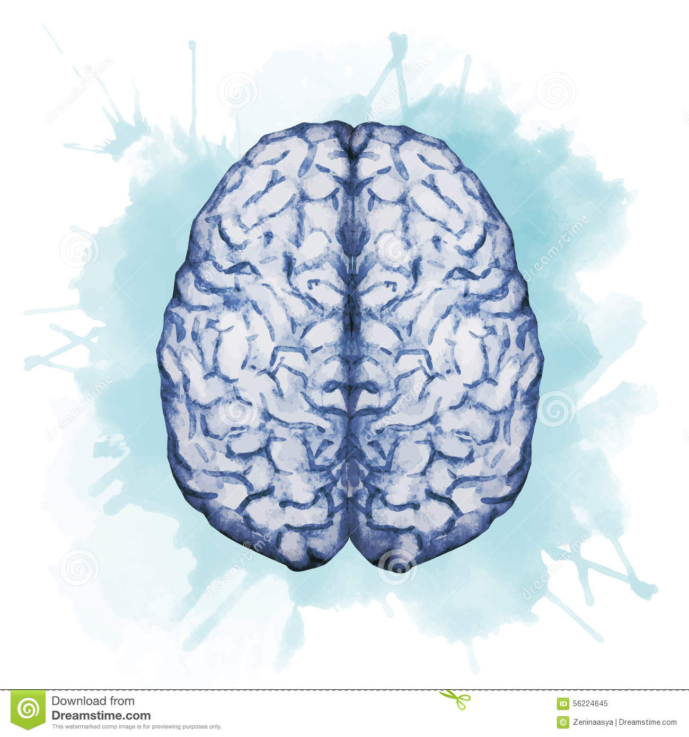
Drugs used in anxiety & panic disorder
Objectives:
Define different types of anxiety disorders
Classify types of drugs used for treatment of anxiety
Recognize the different characteristics of anti anxiety drugs
Identify the specific clinical applications of each class of anti-anxiety drugs.
Know side effects of different classes of anti-anxiety drugs.
color index:
extra information and further explanation
important
doctors notes
Drugs names
Mnemonics
Check out the mnemonics file :
https://docs.google.com/presentation/d/1Z0Vf9oEOJSXo4JIA0mTCk5jB-OU9LP5TFCwz8iBgNac/edit?usp=sharing
Kindly check the editing file before studying this document
https://docs.google.com/presentation/d/1_-g1vol4eBWPet5xVCkuTGFvvnhFF3PJmU0tWtEEw_o/edit?usp=sharing

Slide 2
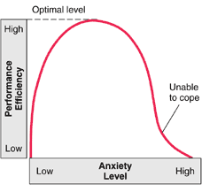
Introduction
Anxiety Physical and emotional distress which interferes with normal life
Emotional or psychological symptom | Physical or somatic symptoms
Feeling tense Trouble concentrating Irrational (without reason) & excessive fear and worry Irritability Restlessness. | Sympathetic symptoms: Sweating Tachycardia Shortness of breath Stomach upset Frequent urination or diarrhea Sleep disturbances (Insomnia) Fatigue (feeling intense)
+ attitude
- attitude
Dr.hanan explanation :
Anxiety low → performance low (carelessness)
↑ Anxiety → ↑performance ( e.g: afraid fro be fired they work more → + attitude )
Moderate anxiety → highest performance
After that the more anxiety people won’t coped with there life ↓ performance (inverse relation ) (most patient come for this → - attitude )
Physical or somatic symptoms
Types of anxiety
Generalized anxiety disorder (GAD) The most common type | Post-traumatic stress disorder (PTSD)
Patients are usually and constantly worried about every thing, health, money, work with no apparent reason. | An anxiety disorder that affects people who have experienced a severe emotional trauma, such as rape or dramatic car accident, or even war.
Phobias | Obsessive-compulsive disorder (OCD)
An intense, uncontrolled fear of a specific situation such as open spaces (they’ll stay in home) & heights. | An anxiety disorder in which people cannot prevent themselves from unwanted thoughts or behaviors that seem impossible to stop e.g. washing their hands. These thought interrupted them from work and their life
Panic Disorder
Sudden, intense and acute attacks of anxiety in certain situations. Panic attacks cannot be predicted. Remarked fear and sometimes it’s sever and may lead to uncontrolled urination (Autonomic effect)
Treatment of anxiety
Benzodiazepines
(BDZ)
Psychotherapy (cognitive behavioral therapy) (talk to someone)
Anxiolytics
(Anti anxiety agent )
5HT reuptake inhibitors
5HT_{1A} agonists
Antidepressants
Beta-adrenergic blockers
Overview of anxiety treatment
Antianxiety drugs :
There are drugs that can relieve anxiety without interfering with mental or physical function
Initial therapy

Slide 3
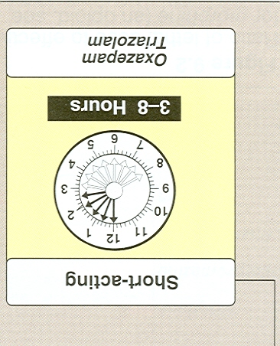
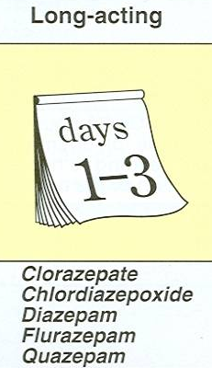
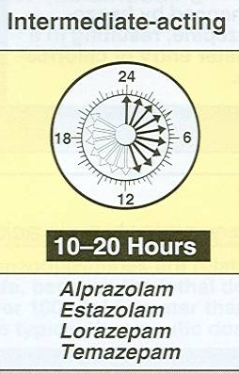
SUMMARY
Classes of anxiolytics | Uses | Adverse effects
Benzodiazepines | Generalized anxiety disorders, OCD, phobia, panic attack. | Ataxia, confusion, dependence, tolerance, withdrawal symptoms.
SSRIs (fluoxetine) | Generalized anxiety disorders, Obsessive-compulsive disorder, phobia, panic attack. | Sexual dysfunction, atropine like actions.
Tricyclic Antidepressants (doxepin, imipramine) | Anxiety with depression & panic attacks. | Weight gain, sexual dysfunction, atropine like actions, arrythmia.
5HT1A agonists (buspirone) | Mild anxiety(only) Not effective in panic attack. | Minimal adverse effects.
Beta adrenergic blockers (propranolol, atenolol) | Phobia (social Phobia). | Hypotension.
In severe case
2nd line treatment
1st line treatment
In Mild
case
Control the somatic symptoms
Benzodiazepines
Suffix “zolam” or “zepam”
classifications according to duration of action
Short acting
(3-8hrs) TO
(Average 4h)
intermediate
(10-20hrs (a day) “late”
Long acting
(24-72hrs)
Triazolam
Oxazepam
Lorazepam (antiepileptic)
Alprazolam
Temazepam
Estazolam
Diazepam
Chlordiazepoxide
Flurazepam
Clorazepate
Quazepam

Slide 4
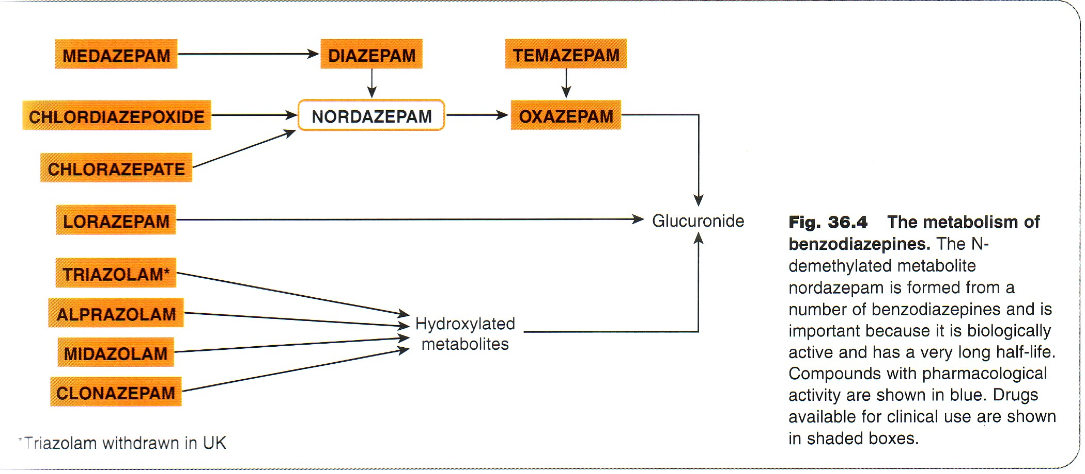
Benzodiazepines
explanation :
Big form of benzodiazepines metabolize in the liver and transfer into intermediate metabolize called Nordazepam which also has CNS depressant and then it will transfer to another metabolize which is called Oxazepam (short duration action) which enter glucuronide conjugation to be easily execrated in urine.
Glucuronic acid is a phase 2 (phase 1 : oxidation , reduction , hydrolysis ) studied in foundation block ☺
So we won’t give the elderly patient long duration drugs due to :
1- They have low metabolize function + increasing in age will decrease phase 1 enzyme function so → they will have what’s called : CNS super sensitivity = respond more than young patient to drugs
2- Accumulation of the diazepam will cause → sever CNS depression eg : delirium (patient can open the house door and go out without consciousness)
Lorazepam go directly to phase 2 → that’s why it is preferred in elderly patient + it is an intermediate in action

Slide 5
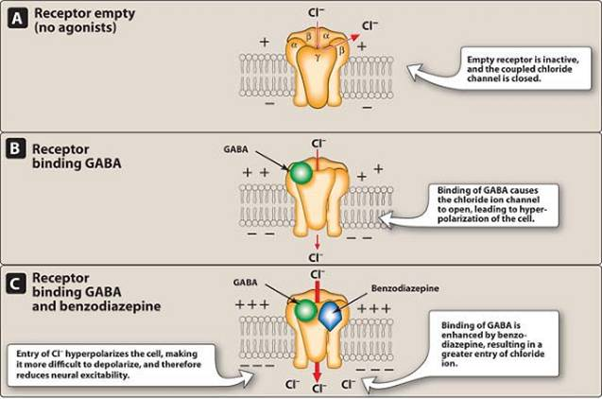
Benzodiazepines
mech. Of action
P.K | Lipid soluble • widely distributed. Well absorbed orally. • Can be given parenterally Chlordiazepoxide - Diazepam (IV only NOT IM) (IM : lead to erratic absorption (not very well absorbed) but if it’s the only way you can do it ) • •cross placental barrier (Fetal depression). •excreted in milk (neonatal depression). •Bezodiazepines is metabolized in liver to another active metabolites → Nordazepam again it works as CNS depression that’s why Bezodiazepines have long duration of action, and this mechanism called → cumulative effect & it’s excreted in urine.
Pharmacological Action | CNS depressants: (depend on the dose) Anxiolytic action and Sedation (1\3 of the dose): Hypnotic action. = sleeping pills (total dose) Anterograde amnesia .temporary impairment of memory (more increase) Respiratory & CVS depression (over dose) Depression of cognitive and psychomotor function (#driving or workers in factory → give them short acting) Some have skeletal muscle relaxing effect (diazepam)by increasing presynaptic inhibition in the spinal cord • Some have anticonvulsant effect e.g. clonazepam, diazepam, lorazepam.(antiepileptic) Therapeutic doses have minimal depressant effects on: cardiovascular system & respiratory system.
1) Benzodiazepines binds to BZ receptor in the brain
2) enhance GABA action on brain GABA (γ-aminobutyric acid): is an inhibitory neurotransmitter
3) chloride channels opening leading to increase CL⁻⁻ influx to the cell (hyperpolarization)
4) more difficult(for the stimulant) to depolarizes which will lead to
→ reduction of neural excitability.
Pharmacology Recall (page 78-79):
Benzodiazepines bind to specific receptors that are separated from but adjacent to the 𝐺𝐴𝐵𝐴𝐴 receptor, they potentiate the binding of GABA to its own receptor. The binding of GABA to its own receptor results in increased 𝑪𝒍−conduction (they’re connected see the picture), cell membrane hyperpolarization, & decreased initiation of action potentials.
Remember benzodiazepines do not bind to GABA receptors, they bind adjacent to them.

Slide 6
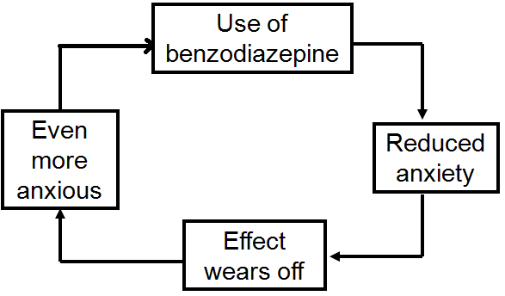
Benzodiazepines
Therapeutic uses | 1. Anxiety disorders: Short term relief of severe anxiety, General anxiety disorder, OCD (Obsessive- Compulsive Disorder) , Panic disorder with depression Alprazolam (antidepressant + anxiolytic effect) • Benzodiazepines are fast acting typically bringing relief within (30mins – hour). 2. Sleep disorders (Insomnia): Triazolam, Lorazepam, Flurazepam. (Triazolam not used as sleeping pills anymore due to short action) They tend to decrease the latency to sleep onset and increase Stage II of NREM sleep. 3. Treatment of epilepsy: Diazepam – Lorazepam. (given in emergency as IV) 4. In anesthesia: • Pre-anesthetic medication (diazepam). Before surgery • Induction & maintenance of anesthesia (Midazolam, IV) 5. Alcohol withdrawal syndrome: (diazepam)
ADRs | • Cognitive impairment. • Ataxia (motor incoordination) with ↑ dose • Impairment of driving ability. • Anterograde amnesia. • Hangover: (excess sedation,drowsiness, confusion) • Tolerance and dependence. • Psychological & physical dependence with continuous use. • Risk of withdrawal symptoms: Rebound (exaggerated) insomnia, anorexia, anxiety,agitation, tremors & convulsion). • Respiratory & cardiovascular depression in large doses only (toxic effects).
Drug | Flumazenil (Benzodiazepine antagonist)
P.K | Given by injection, has short plasma half life so repeated dosing is required because it is also an antidepressant
P.D | - Selective Benzodiazepine receptor antagonist. - Bind competitively to GABA receptor → displacing benzodiazepine
uses | 1- Used in benzodiazepines overdose (antidote) 2- can precipitate withdrawal symptoms in benzodiazepines addicts Patient whose addicted to sleeping pills suddenly you stop it from it → withdrawal symptoms will happen
precaution | Should be used with precaution: Pregnant women or breast-feeding Dose reduction is recommended in : liver disease , old people
Drug interactions
Drugs | Examples
CNS depressants e.g. alcohol & antihistaminics (1st generation→ cross BBB→ sedation) | effect of benzodiazepines (Additive effect) (synergic affect)
Cytochrome P450 inhibitors e.g. cimetidine & erythromycin | t_{1⁄2} of benzodiazepines by inhibition of metabolism
CYT P450 inducers phenytoin & rifampicin | t_{1/2} of benzodiazepines (almost all epileptic drugs are inducers)

Slide 7
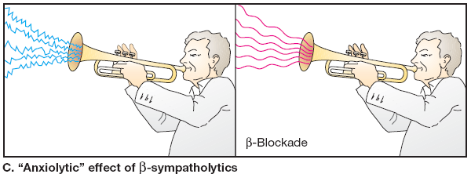
class | 5HT_{1A} agonists ( 5-hydroxytryptamine) | SSRIs | Tricyclic Antidepressants | Beta Blockers
Drug | Buspirone | Fluoxetine | Doxepin , Imipramine , Desipramine | Propranolol (non selective), Atenolol
Action/Mech. of action | Acts as a partial agonist at brain 5HT_{1A} receptors, presynaptic inhibiting 5HT release. Weak dopamine D2 action , but not antipsychotic Rapidly absorbed orally Slow onset of action (delayed effect) T½ : (2 – 4 h). Undergoes extensive hepatic metabolism, some of the metabolites are active Its clearance is reduced by liver dysfunction Adaptive changes after chronic treatment , reduction in 5HT2 receptors in cortex | (SSRIs) : Selective serotonin reuptake inhibitors by blocking uptake of 5-HT Given orally has long half life | act by reducing uptake of 5HT & NA Delayed onset of action (weeks). | ↓ by blocking peripheral sympathetic system ↓ Reduce somatic (not psychological) symptoms of anxiety.
Indication | Used As anxiolytic in (mild) generalized anxiety disorders cause : It’s only anxiolytic No hypnotic effect. No muscle relaxant effect. No anticonvulsant action. No alcohol additive effect. Doesn’t impair memory and coordination. (can use in elderly patients) Does not affect driving skills. Minimal risk of dependence. No withdrawal symptoms. No potentiation of other CNS depressants Minimal psychomotor & Cognitive dysfunctions | First line of treatment for most anxiety disorders (Panic disorder, OCD, GAD, PTSD, phobia) because they are : 1- well tolerated, 2- low risk for dependency and abuse 3- low potential for overdose. (CVS& respiration depression) | Used for anxiety especially associated with depression Effective for panic attacks | Decrease BP & slow heart rate → so Used in performance or social anxiety. Are less effective for other forms of anxiety
ADRs + Contraindication | Slow onset of action (delayed effect) GIT upset, dizziness, drowsiness Not effective in severe anxiety/panic disorders Drug Interactions with CYT P450 inducers and inhibitors Increase blood pressure in people taking MAOI. Should be used with precaution : Pregnant women or breast-feeding. People over 65 (old people) Dose reduction is recommended in liver disease & old people | -Delayed onset of action (weeks). -Nausea, diarrhea , GIT upset -Weight gain or loss Fluoxetine cause weight Loss. -Sexual dysfunction -Dry mouth -Sleep disturbance or insomnia -Seizures | -Atropine like actions : (dry mouth-blurred vision, urinary retention Tachycardia) -α-blocking activity (Postural hypotension) -Sexual dysfunction -Weight gain | Should be used with caution in asthma, cardiac failure, peripheral vascular disorders
DRUG interaction
Buspirone | CYP450 3A4 Inhibitors : (verapamil, diltiazem Ca+2 blocker) | ↑ buspirone level.
 | CYP450 3A4 Inducers : (Rifampin) | Causes 10 fold ↓ buspirone level.

Slide 8
قادة فريق علم الأدوية :
لين التميمي & عبدالرحمن ذكري
الشكر موصول لأعضاء الفريق المتميزين :
شذا الغيهب
هيفاء بن طالب
لينا الوكيل
سمر القحطاني
آمال الشيبي
روان سعد القحطاني
References :
1- 436 doctors slides
2-435 team work
3-Pharmacology (Lippincotts Illustrated Reviews Series), 5th edition.
pharma436@outlook.com
Your feedback:
https://docs.google.com/forms/d/1sxDqHtpP3bUaOhQmYw96IE7mX-DlrklT5dlZUA2teSI/edit
@pharma436

