Slide 1
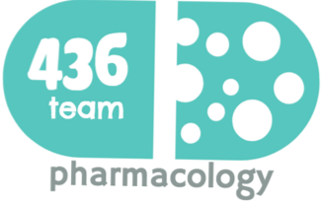
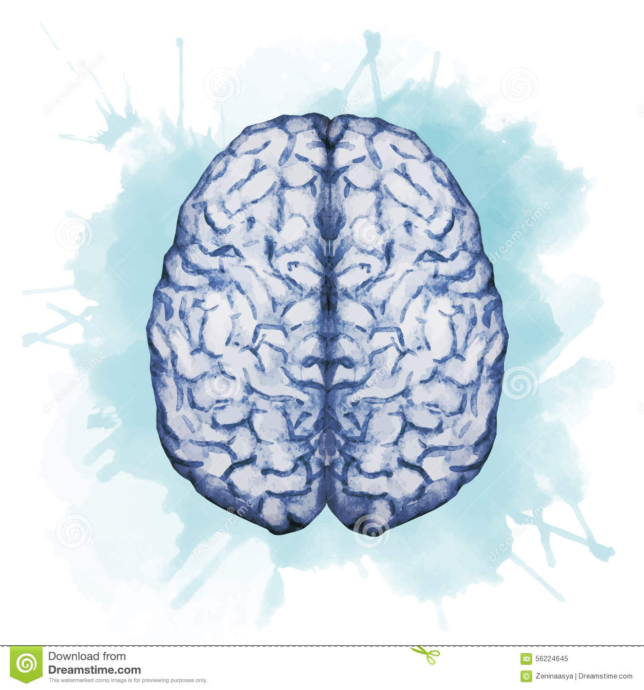
Drugs used in Depression Old &new
(this file include 2 lectures)
Objectives:
Realize neurotransmitter defects in different types of depression.
Elaborate on how antidepressants generally act.
Classify the existing antidepressant into elder (TCAs & MAO Is) and newer groups (SSRIs, SNRIs, NRIs, NAASs, NDRIs, SARIs).
Expand on pharmacology of each group; setting examples, discussing pharmacodynamics potentials, pharmacokinetic differences, varied indications, contraindications and side effects.
Enumerate augmenter drugs used in depression
color index:
extra information and further explanation
important
doctors notes
Drugs names
Mnemonics
Check out the mnemonics file :
https://docs.google.com/presentation/d/1Z0Vf9oEOJSXo4JIA0mTCk5jB-OU9LP5TFCwz8iBgNac/edit?usp=sharing
Kindly check the editing file before studying this document
https://docs.google.com/presentation/d/1_-g1vol4eBWPet5xVCkuTGFvvnhFF3PJmU0tWtEEw_o/edit?usp=sharing

Slide 2
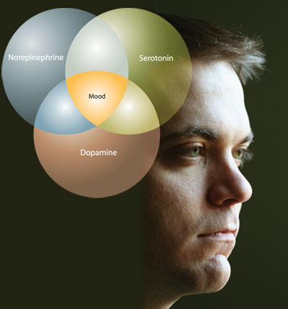
Introduction
Depression
- Depression is a very common psychiatric disorder that is related to the Mood ( affective disorder) - Disorders of mood like: depression and mania are associated with changes in mood, it causes symptoms that affect feelings. . Clinical depression: the symptoms comes every day for two weeks at least, and here we need the treatment. - Disorders of mood rather than disturbance in thought or cognitions.
Incidence:
- Depression is a chronic and recurrent illness that can affect at least 20% of the population at some period in their lifetime. Estimated: 35-40 million Americans will suffer from major Depressive Illness . costing 15-35 billion dollars/ year.
Symptoms of depression:
Symptoms of depressive illness are highly recognizable, both to those affected and to those closest to them, once they are told what to look for. Here is a checklist of symptoms of Depressive illness: If most of these symptoms last for two weeks or more, the person probably has Depressive illness.
Symptoms of mania:
causes mood swings creating periods with the following symptoms: *a high energy level with Decreased need for sleep. *Unwarranted or exaggerated belief in one's own ability. *Extreme irritability. *Rapid unpredictable emotional changes. *Impulsive, thoughtless activity, with a high risk of damaging consequences (i.e., stock speculations, sudden love affairs, etc.).
Pathophysiology:
Neurotransmitter Imbalances & Dysregulation creates a state of deficiency in monoamines creates a state of deficiency in monoamines such as NTs (serotonin (5-HT), Dopamine, NE)
*Loss of energy and interest
* Diminished ability to enjoy oneself
*Decreased or increased sleeping or appetite
*Difficulty in concentrating
*indecisiveness, slowed thinking
*Exaggerated feelings of sadness, hopelessness, or anxiety.
*Feelings of worthlessness
*recurring thoughts about death and suicide
Classification of depression
Classification
According to severity of symptoms:
According to type:
Other forms of depression:
1. Mild depression
self-limiting
2. Moderate depression difficulties at home and work
3. Severe depression serious, associated with suicidal thoughts in this case we need to make sure that the patient takes his medications
- in which depression alternates with mania.
- It is mainly hereditary and appears in early adult life
- mood swings are always in the same direction (depression)
- about 75% of cases are non-familial
- accompanied by symptoms of anxiety and agitation
-Associated with stressful life events.
25% familial unrelated to external stresses(endogenous depression)
1.Psychotic depression caused by genetic factors
2.Postpartum depression such as pregnant women
3.Atypical depression
1- Bipolar depression (manic-depressive):
2- Unipolar depression (major depression):
Not distinguished clearly

Slide 3
To understand
Which leads to disturbed neuronal signal processing
which in a long run leads to alterations in the structure of the neuronal networks
These structural changes are believed to be one of the main reasons for depression
One main cause of depression is the reduction in the concentration of certain neurotransmitters in the brain, such as serotonin and dopamine
Extra
.
Biochemical Theory of Affective Disorders.
Affective disorders→ ↓serotonin
↑NE
Mania*
↓NE
Depression
Drugs that ↑NE
Drugs that ↓NE
Important to understand !
Treatment
methyldopa :Anti-hypertensive drug α2 agonist drug, so it will stop the release of NE and other NTs that lead to depression.
What is the evidence to support this theory ?
Amphetamine (called students drug). causes mania while reserpine and methyldopa produce Depression (these drugs depletes NE and dopamine storage)
Reserpine inhibits NA and 5-HT storage,
Methyldopa inhibits NA synthesis
5-HT deficiency
Decreased level of NE
Dopamine
may cause the sleep problems, irritability and anxiety associated with depression
regulates mood, alertness, arousal, appetite, reward & drives, may contribute to the fatigue and depressed mood of the illness
is important for pleasure, sex & psychomotor activity
Reduced in depression
- What are the features of drugs that should be used for Rx of Depression?
- Simply to increase the levels of these amines.

Slide 4
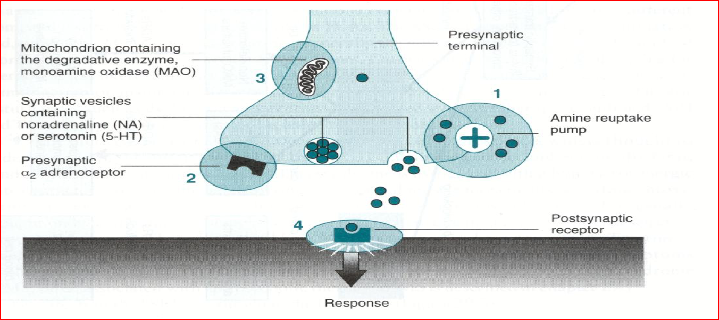
Antidepressants
Antidepressants do not act immediately (show clinical effects after 3 weeks) indicating that secondary adaptive changes must occur before the benefit is gained
The most consistent adaptive change seen with antidepressant drugs is the downregulation of beta-, alpa-2 and 5-HT2 receptors.
These receptor mediate negative feedback on monoamine release in the brain.
Desensitization (down-regulation) of β-adrenoceptors (decrease c-AMP ) is very important and is related to clinical response.
Sites of action of anti depressants:
1- Monoamine (NE or/ and 5-HT) re-uptake pump inhibitors
2- Blockade of pre-synaptic a₂ receptors
3- Inhibition of MAO enzyme
Old drugs have one action
New drugs have more than one action and less side effects
Very very very useful video explains each class with their mechanism of action. watch from (1:40)
Classification :
Classification of antidepressants based on site of action:
Drugs that block the reuptake of NE and 5- HT and this will trigger the nerve to synthesis more NE&5-HT
Drugs that Inhibit MonoAmino Oxidase
Drugs that selectively block 5-Ht reuptake(SSRIs)
Drugs that Block Presynaptic α2 adrenoceptors
e.g. Most tricyclics (old Antidepressants)
MAOIs, Phenelzine, Tranylcypraine, Moclobemide)
(old Antidepressants)
Fluoxetine, Paroxetine,
Sertraline, Citalopram (New Antidepressants)
(e.g.: Mirtazapine, Mianserin).
*Mechanism of action very important

Slide 5
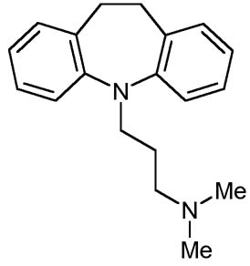
Antidepressants Available in the Market (Worldwide)
Class | Drugs
Tricyclics (TCAs) and Tetracyclics | Imipramine, Amoxapine, Maprotiline, Nortriptyline, Trimipramine, Clomipramine, Protriptyline, Desipramine, Amitriptylin , Doxepin
Selective Serotonin Reuptake Inhibitors (SSRIs) | Fluoxetine, Fluvoxamine, Citalopram, Sertraline, Paroxetine, Escitralopram
Monoamine Oxidase Inhibitors (MAOIs) | Tranylcypramine, Phenelzine, Moclobemide
Serotonin And Noradrenaline and Reuptake Inhibitors (SNRIs) | Venlafaxine, Duloxetine
Serotonin-2 Antagonist and Reuptake Inhibitors (SARIs) | Nefazodone , Trazodone
Noradrenergic and Specific Serotonergic Antidepressant (NaSSAs) | Mirtazapine
Serotonin Reuptake Enhancer | Tianeptine
Noradrenaline Reuptake Inhibitor (NRI) | Reboxetine
Norepinephrine and Dopamine Reuptake Inhibitor (NDRI) | Bupropion
Old Anti-depressant
Old antidepressants
TRICYCLIC ANTIDEPRESSANTS* (TCAs)
the oldest one
TETRACYCLIC ANTIDEPRESSANTS
Imipramine
Desipramine
Clomipramine
Amitriptyline
Nortriptyline
Doxepin
Trimipramine
Maprotiline
Amoxapine
What is the common mechanism of TCAs&MAOIs on NTs?
Increasing monoamines.
Monoamine: serotnin&dopamine.
and they’re endogenous products, synthesized in your body.
You have to know the classification of each drug (tricyclic or tetracyclic)
Transformation BY Demethylation
From active form to other active form
*TCAs have characteristic three-ring nucleus
Note: depression also comes in mild forms that do not require treatment with antidepressants. Treatment is only required to suffer from severe forms of depression mentioned above.

Slide 6
Old Anti-depressant
Drug | Tricyclics (TCAs)
 | Imipramine, Nortriptyline, Trimipramine, Clomipramine, Protriptyline, Desipramine, Amitriptyline ( and Tetracyclic drugs: Amoxapine, Maprotiline)
Mech. of action | All tricyclics block reuptake pumps for both 5HT (serotonin) and NE (norepinephrine) in nerve terminals by competing for binding site of the transport protein, so ↑ conc. of NE & serotonin in the synaptic cleft & at the receptor site. Clomipramine, Imipramine, Amitriptyline have more potency for inhibition of 5HT uptake pump. Nortriptyline, Desipramine have more potency for inhibition of NE uptake pump. TCAs also block serotonergic, alpha1-adrenergic, histaminic, and muscarinic receptors.
Pharmacological action | 1- Elevate mood 2- Improve mental alertness 3- Increase physical activity Note:The antidepressant effect may develop after several weeks of continued treatment ( 2-3 weeks) not immediately after taking the medications 4- In non-depressed patients →They cause sedation, confusion & motor incoordination.
P.K | Peak levels: 2-6 hours. They are "lipophilic“in nature as well as any drug affect the brain (well absorbed from the GIT and readily cross the blood brain barrier to penetrate the CNS). Elimination: hepatic oxidation. They are metabolized in the liver by demethylation (Imipramine to Desipramine, Amitriptyline to Nortriptyline) and by hydroxylation into metabolites that retain the biological activity of the parent compounds. →This affects the T1\2 by increasing it.
Indications | Endogenous (Major) Depression →moderate to severe. Panic attack /acute episode of anxiety. Imipramine is used for treatment of nocturnal enuresis (bed wetting) but it is not congenital issue in children and geriatric patients →it constricts internal urethral sphincter (anti-muscarinic effect). Muscarinic effect = urinary retention. Generalized Anxiety Disorder (GAD). Obsessive Compulsive Disorder (OCD) Attention Deficit Hyperkinetic Disorder (ADHD). Chronic neuropathic pains or unexplained body pains. →e.g. pain involved in diabetic patients, or any pain affecting the nerves
ADRs | TCAs block: α1 adrenergic receptors, H1 histamines receptors , M1 cholinergic receptors So it effects the memory , 5HT2 receptors. Anti-cholinergic: Dry mouth (dental problem; xerostomia), blurred vision, constipation & urine retention, aggravation of glaucoma. Atropine like action Anti-histaminic: Sedation, confusion. →H1 receptor effects. Anti-adrenergic: Postural hypotension, arrhythmias, conduction defects. Weight gain, sexual dysfunction & impotence. →old group causing sexual dysfunction. Lower seizure threshold. We don’t use it with patients have already seizure TCAs have narrow therapeutic index: toxicity can develop; excitement, delirium , convulsions, respiratory depression, coma, atropine-like effects, cardiac arrhythmias, sudden death. TADs (TCAs) are highly protein bound and have a large volume of distribution →Therefore hemodialysis is not effective for treatment of TCA toxicity. We prefer to give selective drugs because toxicity is dangerous

Slide 7
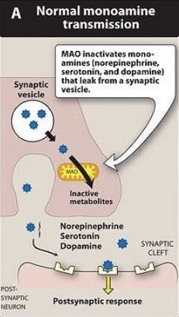
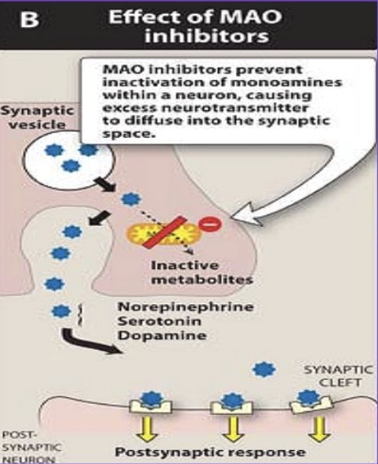
Old Anti-depressant
Drug | Tricyclics (TCAs) Cont.
Drug interaction | TCA are strongly bound to plasma protein, therefore their effect can be potentiated by drugs that compete for their plasma protein binding site (Aspirin and Phenylbutazone). increase their effect. TCAs are metabolized by liver microsomal enzymes, therefore their effect can be reduced by inducers of liver microsomal enzymes (Barbiturates) decreased effect of TCA, or potentiated by inhibitors of liver microsomal enzymes (Oral contraceptives, Antipsychotics, and SSRIs) increased effect of TCA . TCAs (inhibitors of monoamine reuptake) should not be given with MAOIs (monoamine oxidase inhibitors, which are inhibitors of monoamine degradation) →cause hypertensive crisis. Because the both increase NE -> lead to hypertension Additive to anti-psychotics and anti-parkinsonism (which have anticholinergic effect) → increase anti-cholinergic effects.
C.I مره مهم | TCAs should not be used in patients with Glaucoma or with enlarged prostate because of their atropine-like action. Because of anticholinergic effects TCAs (given alone) are contraindicated in manic-depressive illness (Bipolar disease), because they tend to "switch" the depressed patient to the "manic" phase, therefore, they should be combined with "lithium salts". Give 2 together Seizure disorders →because they decrease its threshold. Cardiovascular (IHD “ischemic heart disease” and arrhythmias)
Monoamine oxidase
MAO is a mitochondrial enzyme found in nearly
all tissues, and they exist in two forms: MAO-A: responsible for NE, 5-HT
catabolism. It also metabolizes
tyramine of ingested food.
MAO-B: is more selective for
dopamine metabolism .
They play role in Parkinson’s disease.
Monoamine oxidase inhibitors (MAOIs)
Monoamine oxidase inhibitors (MAOIs)
non-selective
(MAO-A & MAO-B)
selective
phenelzine
(irreversible, long acting))
tranylcypromine (reversible)
moclobemide (MAO-A)
selegiline (MAO-B)
→ The effect of irreversible MAOIs persists for a period of 2-3 weeks after stopping treatment, time needed by the body to synthesize new enzyme.
The best drug in it is group for depression, because it is selective & reversible
→ (antidepressant action, Short acting)
→ (used in the treatment of Parkinsonism)

Slide 8
Monoamine oxidase inhibitors (MAOIs)
Drug | Phenelzine | Tranylcypromine | Moclobemide | Selegiline
Type | Non- selective mostly in labs not for patients |  | Selective and Reversible. * better !
 | Irreversible (phenelzine) long acting ( 2-3 weeks) Non-selective = act on MAO A & B |  | Act on MAO-A Anti depressant action. Short acting | Act on MAO-B - Used in the treatment of Parkinsonism. *better !
Clinical uses | Only used for refractory cases and in atypical depression where phobia and anxiety are prominent symptoms., and have a limited uses because: ADRs food and drug interactions low antidepressant efficacy
ADRs | Anti-muscarinic effects , Postural hypotension, Sedation, sleep disturbance, Weight gain
 | Specific ADRs for (Phenelzine) Sexual dysfunction Hepatotoxicity |  | the side effects is stronger than TCAs.
Drugs interactions | 1- Pethidine pain killer: MAOIs interact with the opioid receptor agonist (pethidine) which may cause severe hyperpyrexia, restlessness, coma, hypotension. The mechanism still unclear – but it is likely that an abnormal pethidine metabolite is produced because of inhibition of normal demethylation pathway. 2- Levodopa for parkinsonism: Precursor of dopamine can interact with MAOIs leading to hypertensive crisis. 3- Amphetamine and Ephedrine with allergic conditions: Indirectly acting sympathomimetic can interact with MAOIs causing the liberation of accumulated monoamines (NE) in neuronal terminals leading to hypertensive crisis 4- TCAs: (inhibitors of monoamine reuptake) can interact with MAOIs (inhibitors of monoamine degradation) leading to accumulation of monoamines (NE) which will cause hypertensive crisis. 5- MAOIs & SSRIs: Serotonin syndrome. (give 1-2 weeks gap before initiating SSRIs)
=Low benefit/risk ratio.
Type | Drug | Sedation | Anti- cholinergic | Hypotension
Non-selective irreversible | Isocarboxazid | + | ++ | +
 | Phenelzine | + | ++ | +
 | Tranylcypromine | - | + | +
Selective reversible | Moclobemide | - | - | -
Very important : Moclobemide is selective + reversible
With less side effects
Cheese Reaction
This occurs when Tyramine rich foods (Old cheese, Concentrated yeast products, Pickled or smoked fish, Red beans, Red Wine, Chicken liver, Sausages) are taken with MAOIs.
- Tyramine in food is normally degraded in the in the gut by MAO-A.
- Since the enzyme is inhibited by MAOIs, tyramine from ingested food is absorbed, and
then taken up into adrenergic neurons where it is converted into octopamine - a false transmitter which causes massive release of (NE) and may result in hypertensive crisis, severe hypertension, severe headache and fatal intracranial hemorrhage.
➢ Important Note: Moclobemide has No cheese reaction occurs with its use →It can be displaced from MAO-A by tyramine, and this mitigates the risk of food interactions . And this is a unique thing for it !

Slide 9
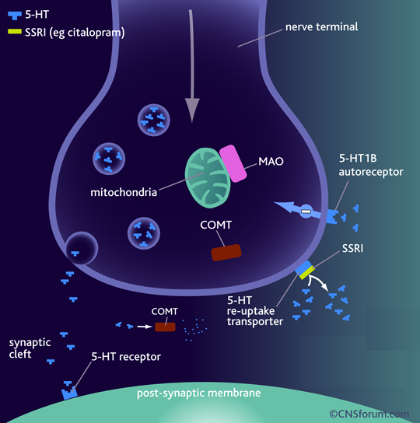
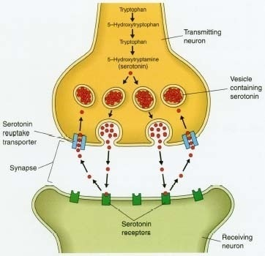
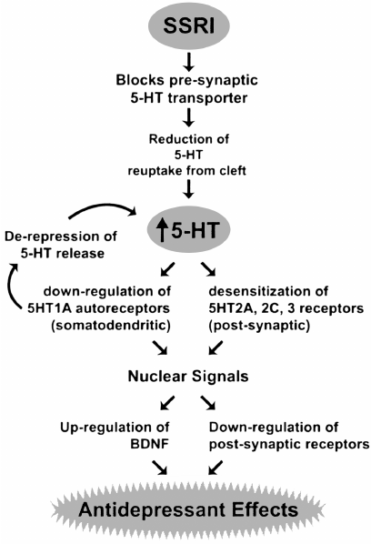
New Anti-depressant
There are 6 new groups in the New generation of anti-depressants:
Selective Serotonin Reuptake Inhibitors (SSRIs)
NE Selective Reuptake Inhibitors (NRIs)
Serotonin and Noradrenaline Reuptake Inhibitors (SNRIs)
Norepinephrine and Dopamine Reuptake Inhibitor (NDRI)
Noradrenergic and specific Serotonergic Antidepressant (NaSSA)
Serotonin-2A Antagonist and serotonin Reuptake Inhibitors (SARI)
As we can see here it became more selective
1. Selective Serotonin Reuptake Inhibitors (SSRIs)
The SSRIs are currently the most widely utilized class of antidepressants in clinical practice.
They act within the brain to increase the level of serotonin (5-HT) in the synaptic gap by inhibiting its re-uptake.
SSRIs are described as 'selective' because they affect only the reuptake pumps responsible for serotonin.
Mechanism of action of SSRIs :
They’re much better than TCAs.
The serotonin transporter (SERT) is a monoamine transporter protein
This is a membrane protein that transports serotonin from synaptic spaces into presynaptic neurons.
Selective serotonin reuptake inhibitors (SSRI) and other antidepressants bind to SERT transporter and block
The result is an increased availability of serotonin (5-HT) in the synaptic space
They have No effect on NET (norepinipherine transporter) and they do not block mAch, H, or a1 Adrenoceptor → so no antimuscarinic nor sedative effects Except Paroxetine →has sedative & anti-muscarinic effects. less side effects from old grp BC of selectivity
Extra
They are nearly of comparable efficacy but of preferential response in each individual (the response differ from one to anther)

Slide 10
Selective Serotonin Reuptake Inhibitors (SSRIs)
drug | Fluoxetine | Fluvoxamine | Citalopram | Escitalopram | Sertraline | Paroxetine
Advantages | The Most commonly prescribed antidepressants Lacks cardiovascular and anticholinergic side effects compared to TCA (tricyclic antidepressants) In contrast to MAOI (monoamine oxidase inhibitors), they do not cause ‘cheese’ reaction Safer (low risk of overdose) Acute toxicity is less than that of MAOI or TCA
Pharmacokinetic | T1/2: Too long (3-11 days): Fluoxetine (Prozac) *very important and unique Moderate length (~24hr): Sertraline, Paroxetine, Citalopram. Metabolized by P450 then conjugation. They are enzyme inhibitors Weak inhibitors →Sertraline, Citalopram →↓ interaction Strong inhibitors →Fluoxetine, Paroxetine →↓metabolism of TCAs, neuroleptics, some antiarrhythmic, β-blockers.
 | Fluoxetine differs from others members of this class in: 1- It has a longer t1/2 (50hrs). 2- Available as sustained release preparations once weekly. 3- Metabolite norfluoxetine = potent as parent drug t1/2 10 days.
Uses | Same as for TCA, in addition effective in the following conditions Depression Anxiety Disorder. Post traumatic stress disorder. Premenstrual dysphoric disorder. Attention Deficit Hyperkinetic Disorder (ADHD). Eating disorders- bulimia nervosa (fluoxetine), Anorexia nervosa (they are opposite but the drug is for the psychological causes). *very important Treatment of premature ejaculation (via stim. of 5-HT2A).. *very important
ADRs | GIT symptoms: Nausea & vomiting (due to 5-HT3 stim.) and diarrhea. → because of increased serotonergic activity in the gut. Changes in appetite (5-HT3) → weight loss Sleep disturbances: Drowsiness with Fluvoxamine. Serotonin plays a major role in sleep. Anxiety & Tremors. (if combined with other antidepressants). Because of excess amount of serotonin. Sexual dysfunction: Loss of libido , delayed ejaculation (stim of 5-HT2A). useful for treatment of premature ejaculation. (because of increased serotonergic tone at the level of the spinal cord and above) serotonin = sexual dysfunction. Discontinuation syndrome: Symptoms are headache ,malaise & flu-like symptoms, agitation , irritability & nervousness tell the patient to never stop taking the medication
Drug interaction | SSRIs are potent inhibitors of liver microsomal enzymes. So they should not be used in combination with TCAs because they can inhibit their metabolism increasing their toxicity. They're shouldn’t used in combination with MAOIs because of the risk of life-threatening "serotonin syndrome" (tremors, hyperthermia, cardiovascular collapse and death). Both drugs require a "washout" period of 6 weeks before the administration of the other. for the CNS to be free off it

Slide 11
Side effects of SSRIs
Only in boys’ sllides
Drug | Cardiotoxicity | Nausea | Anti-cholinergic | Sedation
Citalopram | ? | ++ | _ | _
Fluoxetine | _ | ++ | _ | _
Fluvoxamine | _ | +++ | _ | +
Paroxetine | _ | ++ | + | +
Sertraline | _ | ++ | _ | _
Remember
Have mentioned in previous slide
Fluoxetine differs from others members of this class in: 1- It has a longer t1/2 (50hrs). 2- Available as sustained release preparations once weekly.
3- Its metabolite norfluoxetine = potent as parent drug t1/2 =10 days.
2. Noradrenergic and specific Serotonergic Antidepressant (NaSSA)
Noradrenergic and specific Serotonergic Antidepressant (NaSSA)
Drug | Mirtazapine * very important
Action/Mech. of action | α2 receptor antagonist it increase sympathetic outflow because it do negative feedback Increase NE and 5HT levels Blocks 5HT2A, 5HT3 and thus reduces side effects of anxiety, and sexual dysfunction Blocking 5HT2C, and H1 receptors.
Indications | Preferred in cancer patients because: it’s so important to know these points and compare it with other drugs. 1. Improves appetite 2- ↓ nausea & vomiting ( 5-HT₃ blocking) 3- ↑ body weight (appetite stimulant) 4- Sedation (potent antihistaminic) 5- Less sexual dysfunction (5-HT₂ blocking) 6- Has no anti-muscarinic effect 7- anti-depressant effect Because of these reasons we use it for cancer patients
ADRs | Sedation (H1 blocking effect) weight gain (5-HT2C blocking effect)
Notes | Mirtazapine acts as an antagonist at central pre-synaptic alpha(2)-receptors, inhibiting negative feedback to the presynaptic nerve and causing an increase in NE release. Blockade of heteroreceptors, alpha(2)-receptors contained in serotenergic neurons, enhances the release of 5-HT, increasing the interactions between 5-HT and 5-HT1 receptors and contributing to the anxiolytic effects of mirtazapine. Mirtazapine also acts as a weak antagonist at 5-HT1 receptors and as a potent antagonist at 5-HT2 (particularly subtypes 2A and 2C) and 5-HT3 receptors. Blockade of these receptors may explain the lower incidence of adverse effects such as anxiety, insomnia, and nausea. Mirtazapine also exhibits significant antagonism at H1-receptors, resulting in sedation. Mirtazapine has no effects on the reuptake of either NE or 5-HT and has only minimal activity at dopaminergic and muscarinic receptors

Slide 12
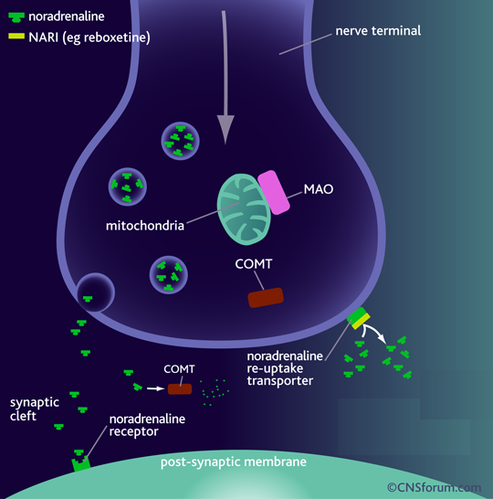
Other types of new anti-depressant
3-Serotonin-2A Antagonist and Reuptake Inhibitors
4-Serotonin and NE Reuptake Inhibitors
5-NE and Dopamine Reuptake Inhibitors not serotonin
6-NE selective Reuptake Inhibitors
Selective Blockage of 5HT to Reduce Depression
Trazodone, Nefazodone (important)
Selective Blockage of 5HT and NE
Venlafaxine
NE and DA Reuptake Inhibitor, With No Direct Action on 5HT
Bupropion (important)
Block only NET
Reboxetine
Antidepressants drugs (new group) cont
Drug | Serotonin-2A Antagonist and serotonin Reuptake Inhibitors (SARI) | NE Selective Reuptake Inhibitors (NRIs)
 | Trazodone, Nefazodone (Serotonin modulators) * very important | Reboxetine (important)
Action/Mech. of action | Blocks 5HT uptake selectively but in a less potent manner than tricyclics. This reduces depression. However, they are powerful 5HT2A antagonists, blockade of 5HT2A receptors stimulates 5HT1A receptors, which may help reduce depression. 5HT2A antagonism also reduces the risk of sexual dysfunction, anxiety, sedation which is normally associated with SSRIs. | Block only NET (norepinephrine transporter) No affinity for 5HT, DA, ADR, H, mAch receptors So, has positive effects on the concentration and motivation in particular. effects of NE.
uses | - | Safe to combine with SSRIs Clinical depression
ADRs | sexual dysfunction,anixity ,sedation Any thing decrease serotonin causes sexual dysfunction | Minimal side effects only related to activation of ADR system as : Tremor Tachycardia urinary hesitancy Hypertension
Notes | Nefazodone: Structurally related to trazodone but has less sedative effect and does not block α- adrenoceptors however; like most SSRI inhibit P450 3A4 isoenzyme.
Reboxetine →

Slide 13
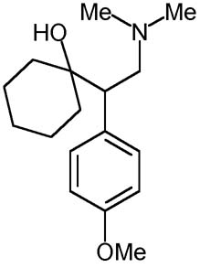
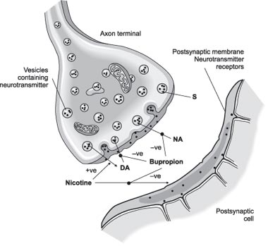
Antidepressants drugs (new group) cont
Drug
Action/Mech. of action
uses
ADRs
Notes
Serotonin and Noradrenaline Reuptake Inhibitors (SNRIs) | Norepinephrine and Dopamine Reuptake Inhibitor (NDRI)
Venlafaxine (effexor) | Bupropion *very important
Selective 5HT and NE uptake blockers combines the action of SSRI and NRI. But without α1, M1 cholinergic or H receptor blocking properties. | Is unique in possessing significant potency as NE and dopamine reuptake inhibitor, with no direct action on 5HT.
It is used primarily for the treatment of depression, generalized anxiety disorder, and social anxiety disorder in adults. Venlafaxine is first and most commonly used SNRI. (more tolerable) | Treatment of major depression and bipolar depression Can be used for smoking cessation (because of DA release) As it reduces the severity of nicotine craving & withdrawal symptoms
- | Seizures; it decrease threshold of neuronal firing (increases the stimulating NT, Similar toTCAs)
Desvenlafaxine is a metabolite of Venlafaxine (Similar to TCAs, but they have better tolerability.) | Advantages: No sexual dysfunction (because no 5-HT blocking effect) → given in young (combination with SSRIs to avoid sexual dysfunction) No weight gait [ No 5HT effect ] No orthostatic hypotension.
Venlafaxine →
Bupropion selectively inhibits the neuronal reuptake of dopamine, norepinephrine, and serotonin; actions on dopaminergic systems are more significant than imipramine or amitriptyline whereas the blockade of norepinephrine and serotonin reuptake at the neuronal membrane is weaker for bupropion than for tricyclic antidepressants. The increase in norepinephrine may attenuate nicotine withdrawal symptoms and the increase in dopamine at neuronal sites may reduce nicotine cravings and the urge to smoke. Bupropion exhibits moderate anticholinergic effects
Bupropion →
Side effects of atypical antidepressants
Drug | Toxicity | Sedation | Hypotension | Anticholinergic effects
Mirtazepine | - | ++ | _ | +
Nefazodone | - | + | + | -
Trazodone | + | +++ | +++ | -
Venlafaxine | + | ++ | + | +

Slide 14
Clinical Uses of Antidepressants
Be smart focus on red!
Endogenous Depression : SSRIs (first Choice), New generation and Tricyclics can be used
Panic Disorders ( Imipramine or SSRIs)
Obsessive Compulsive Disorders (SSRIs or Clomipramine)
and Chronic pain (Amitriptyline)
Anorexia nervosa and Bulemia (SSRIs ) → Fluoxetine
Schizo-Affective Disorders (Amoxapine or SSRI + Haloperidol) name of these 2 drugs are important
Premature ejaculation (SSRI)
Anxiety disorders (Amitriptyline)
Migraine and Anxiety & IBS irritable bowl syndrome (Amitriptyline)
Nocturnal Enuresis in children e.g. Imipramine (strong anti-cholinergic effect) name of this drug is important
Neuropathic Pain (Dual NE and 5-HT reuptake Blocker)

Slide 15
قادة فريق علم الأدوية :
لين التميمي & عبدالرحمن ذكري
الشكر موصول لأعضاء الفريق المتميزين :
اللولو سعد الصليهم
روان سعد القحطاني
هيفاء بن طالب
شهد السويدان
ريما العتيبي
أنوار العجمي
سمر القحطاني
آمال الشيبي
جومانا القحطاني
References :
1- 436 doctors slides
2-435 team work
3-Pharmacology (Lippincotts Illustrated Reviews Series), 5th edition
pharma436@outlook.com
Your feedback:
https://docs.google.com/forms/d/1sxDqHtpP3bUaOhQmYw96IE7mX-DlrklT5dlZUA2teSI/edit
@pharma436

