Slide 1
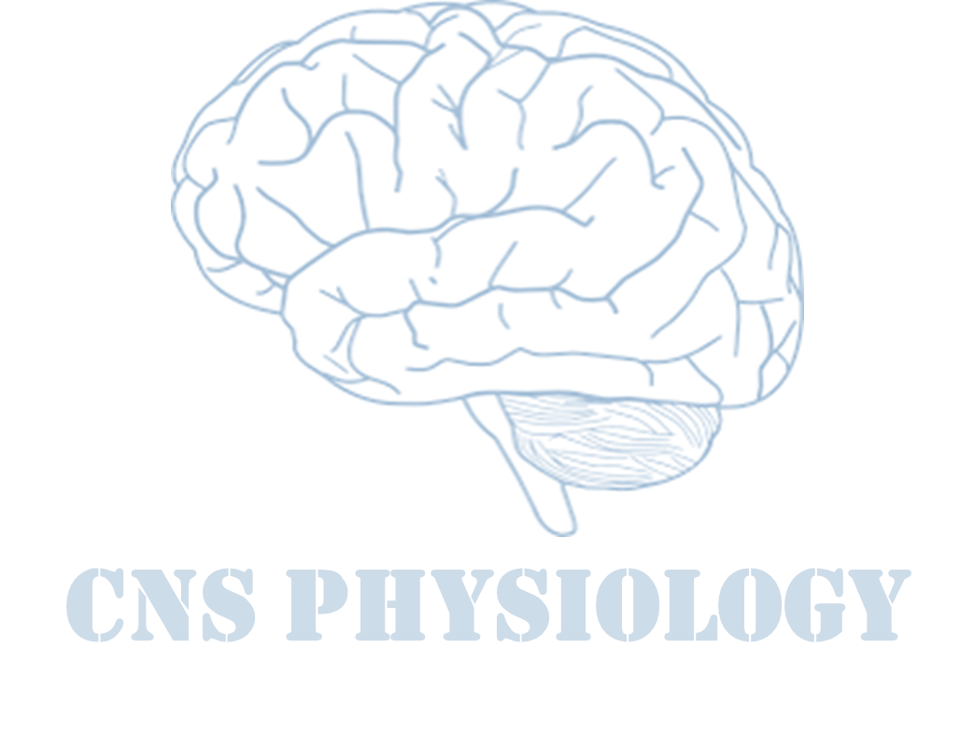
Text.
Important
Formulas
Numbers
Doctor notes
Extra notes and explanation
Lecture No.1
« وإن الملائكة لتضع أجنحتها لطالب العلم رضاً بما يصنع »

Slide 2
Physiology of Synapses &Receptors
Objectives:
Define a synapse and describe the structure and function of chemical and electrical synapses.
Define what neurotransmitters are, and how they are released and act on their receptors, and
how they are removed.
Differentiate between ionotropic receptors and metabotropic receptors
Differentiate between postsynaptic and presynaptic inhibition, and between excitatory and
inhibitory postsynaptic potentials (EPSPs and IPSPs).
Describe properties of synapses and explain the nature of temporal and spatial summation.
Appreciate that effectiveness of neurotransmitters can be modified by drugs and diseases.

Slide 3
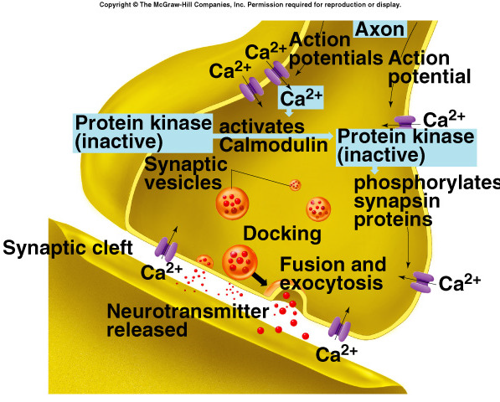
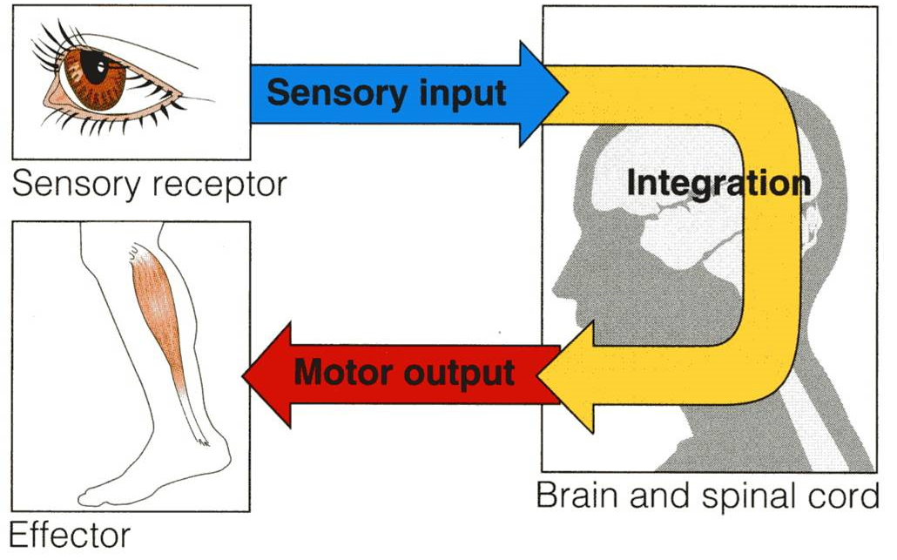
ONLY IN MALES’ SLIDES
How brain functions?
Synaptic transmission, neurotransmitters
Collection of sensory input.
Central Integration.
Motor output.
Information is transmitted in the central nervous system mainly in the form of nerve action potentials, called nerve impulses, through a succession of neurons, one after another.
Propagation of AP in the axon
will result in the opening of
voltage-gated Ca channels
Calcium activates
calmodulin → calmodulin
activates protein kinase
PK exposes syntaxin
and Synaptobrevin
causing the vesicle to
become “sticky”→
vesicles fuse in docking
site and NTs are releases.
syntaxin and synaptobrevin are proteins found in the membranes of synaptic vesicles. They play a role in vesicle fusion to the “ docking “ site.

Slide 4
Synapse
Structure ​of chemical
synapses
What is it?
It is a junction​ where the axon or some other portion of one cell (pre​synaptic cell)Terminates on the dendrites, soma, or axon of another neuron (post ​synaptic cell).
The CNS contains more​ than
100 billion neurons.
The brain has 86 billion neurons.
Some CNS neurons receive 20,000 synapses.
Synaptic input is converted to a nerve impulse (ap) at the axon hillock​.
The output signal (AP) travels by way of a single axon leaving the neuron.
The synapse is present in the CNS. And the Junction is present outside it.
The brain only uses glucose for Energy.
Unlike muscles that can sustain no blood supply for 2 hours, the brain can only last a few seconds before serious damage is inflicted.
1. Synaptic knob (presynaptic terminal):
It has synaptic vesicles (neurotransmitter vesicles).
2. Synaptic cleft (gap): ​
The space between the axon terminal and sarcolemma
where neurotransmitters release into.
It has a width of 200-­300 angstroms.
3. Postsynaptic membrane:
It has receptors for neurotransmitters or ion channels.
Damage in Wernicke's area that is located on the union of parietal and occipital lobe will result in loss of comprehension. E.g. when asked about their name, patients will reply with something unrelated like “the weather is cold”
ONLY IN FEMALES’ SLIDES
ONLY IN FEMALES’ SLIDES

Slide 5
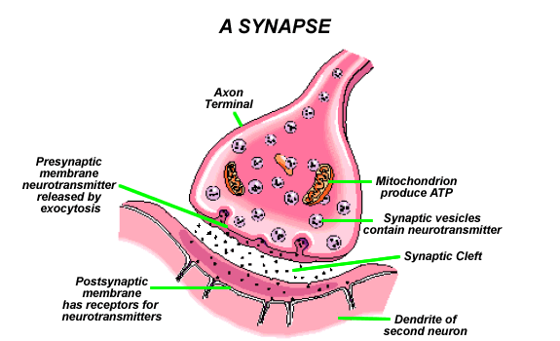
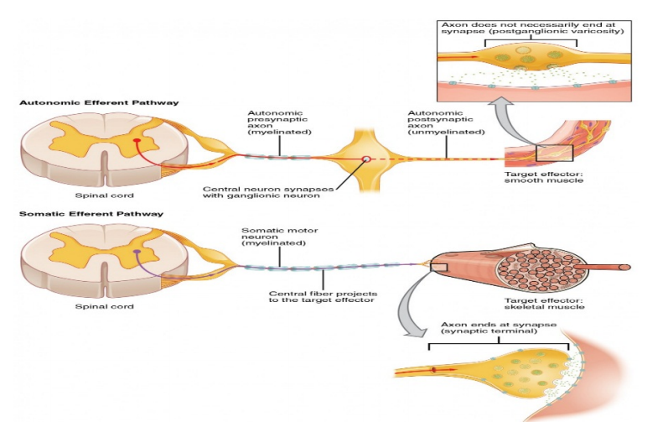
Synapse
ONLY IN MALES’ SLIDES
ONLY IN FEMALES’ SLIDES
A synapse is the connection between a neuron and a second cell.
In the CNS, this other cell is also a neuron.
In the PNS, the other cell may be either a neuron or an effector cell e.g. gland or muscle.
Examples of Junctions outside the CNS
Neuromuscular junction
Contact between: autonomic neurons and smooth, cardiac muscles and any other effector cells.

Slide 6
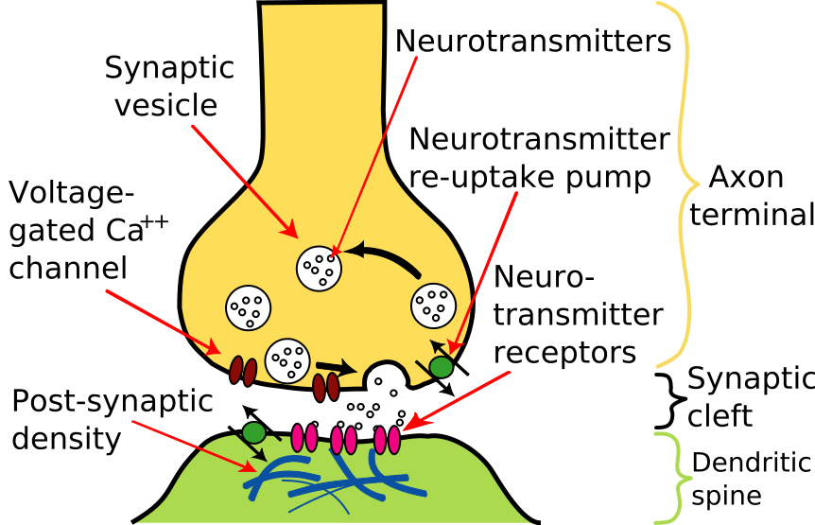
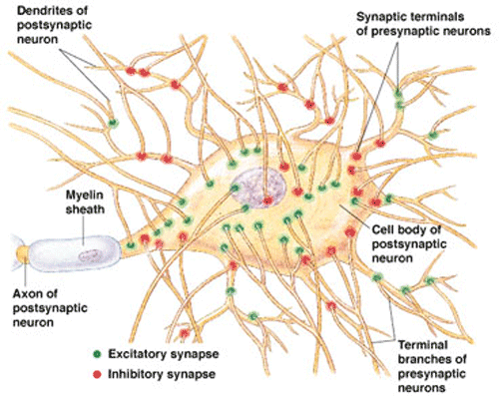
Synapse
ONLY IN FEMALES’ SLIDES
Structure ​of
chemical synapses

Slide 7
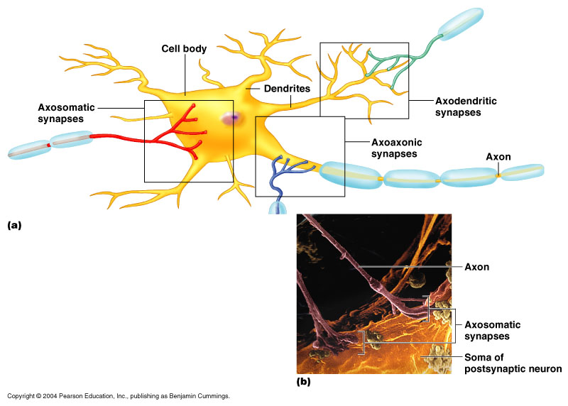
Functional anatomy: Types of synapses
Types of synapses
Anatomical types
Functional types
Axodendiritic
Axosomatic
Other types
Chemical synapses
Electrical synapses
conjoint synapses

Slide 8
Anatomical types
Types of synapses
Anatomical types
Functional types
Synapses between the axon of one neuron and the dendrite of another neuron.
Axodendiritic
Chemical synapses
Axosomatic
synapses between the axon of one neuron and the soma of another neuron.
Electrical synapses
Other types
axoaxonic: axon to axon.
conjoint synapses
dendrodendritic: dendrite to dendrite.
dendrosomatic: dendrites to soma.

Slide 9
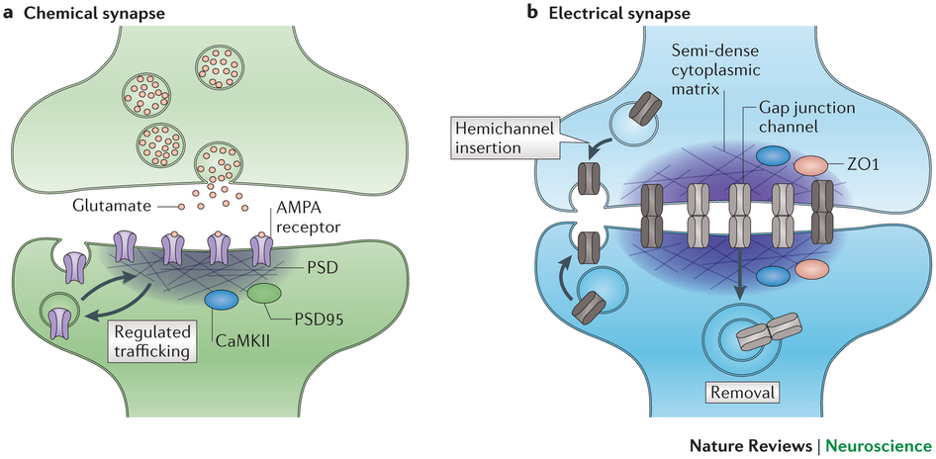
Functional types
Functional types
Chemical synapses | Electrical synapses | conjoint synapses
Via Neurotransmitters. | Ion exchange via Gap Junctions. | Both electrical and chemical.
20-­30 nm. | 2-­4 nm.
One-­direction transmission. الإتجاه واحد، لأن النيوروترانسمتر لازم يرتبط بالمستقبل، والمستقبل يكون في البوست سينابتك فقط. | Bi-­direction transmission. بإتجاهين، لأن الأيونات لا تتطلب مستقبل.
Almost all ​synapses in the CNS. (Most common type) | less​ common than Chemical synapses, and are very rare​ in the brain. | Example: ​neurons in the ​lateral vestibular nucleus
A neuron secretes a chemical substance called neurotransmitter at the synapse to act on the next neuron (by binding to a specific receptor enabling an electrical signal “postsynaptic potential or action potential”) to excite it, inhibit or modify its sensitivity. | membrane of the pre­ and postsynaptic neurons come close together. Gap junctions form. low membrane borders, which allows direct ​passage of ions and small ​molecules. Correspond to gap junctions found in other cell types if present, they are Important in the CNS in: Mental attention. Emotions & Memory​. Arousal​ from sleep.
ONLY IN MALES’ SLIDES
ONLY IN MALES’ SLIDES
ONLY IN MALES’ SLIDES
ONLY IN FEMALES’ SLIDES
ONLY IN FEMALES’ SLIDES

Slide 10
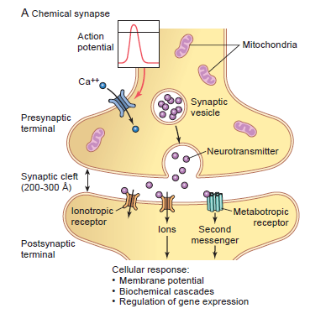
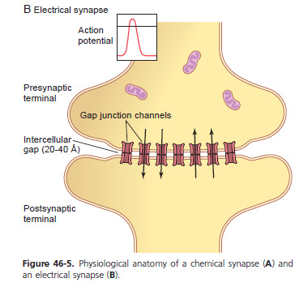
Cont.
ONLY IN MALES’ SLIDES
Functional types
Chemical synapses | Electrical synapses
Terminal bouton is separated from postsynaptic cell by synaptic cleft. NTs are released from synaptic vesicles. Vesicles fuse with axon membrane and NT released by exocytosis. Amount of NTs released depends upon frequency of AP. | Impulses can be regenerated without interruption in adjacent cells. Gap junctions: Adjacent cells electrically coupled through a channel. Each gap junction is composed of 12 connexin proteins.
 | The bidirectional transmission of electrical synapses permits them to help coordinate the activities of large groups of interconnected neurons. Promotes synchronous firing of a group of interconnected neurons. For example in: Mental attention. Emotions and Memory Arousal from sleep
 | Examples: Smooth and cardiac muscles, brain, and glial cells.
In the Electrical synapses there is a direct contact between pre synaptic and post synaptic.
No delay occurs in Electrical synapses ( unlike chemical synapses).
As you see in the picture, the space between pre synapse and post synapse in the chemical is larger than electrical.

Slide 11
Recall
Recall what you studied in MSK block about neurotransmitters:
1
2
3
Arrival of AP in the presynaptic.
Lead to opening of ca₂ channels and releasing of ca₂ through vessels.
Increase ca₂ concentration in presynaptic which will lead to the transmission to the postsynaptic.
5
4
Will reach to the threshold.
Neurotransmitters will lead to the change of electrical grave in CM.

Slide 12
Synaptic Vesicle
Extra
Synaptic vesicular membrane
An abundant organelle with a diameter of 40 nm.
Can accommodate only a limited ​number of neurotransmitters.
Each vesicle contain only one type​ of neurotransmitters.
Different vesicles containing different NTs are often found in a single synaptic knob.
There are over 100 Neurotransmitter.
Synaptotagmin ​
and SNAREs ​are proteins
involved in the vesicle
fusion.
Synaptotagmin ​(protein on the vesicle involved in vesicle
fusion) helps the vesicle to bind to the terminal membrane
without Ca.
When Ca binds to synaptotagmin it starts the interaction with SNARE proteins ​(on the presynaptic membrane)
causing exocytosis.
Exocytosis ​occurs only in vesicles close​ to the terminal membrane.

Slide 13
Mechanism of a synaptic transmission
ONLY IN MALES’ SLIDES
ONLY IN FEMALES’ SLIDES
NT release is rapid because many vesicles form fusion-complexes at “docking site.”
AP travels down axon to bouton.
VG Ca²⁺ channels open.
Ca²⁺ enters bouton down concentration gradient.
Inward diffusion triggers rapid fusion of synaptic vesicles and release of NTs.
Ca²⁺ activates calmodulin, which activates protein kinase.
Protein kinase aid in the fusion of synaptic vesicles.
NTs are released and diffuse across synaptic cleft.
NT (ligand) binds to specific receptor proteins in postsynaptic cell membrane.
NT effects are produced
AP
NT release
Inhibition or excitation of the postsynaptic membrane
Binding to post synaptic receptors
depending on the type of the neurotransmitter
i.e. excitatory or inhibitory))

Slide 14
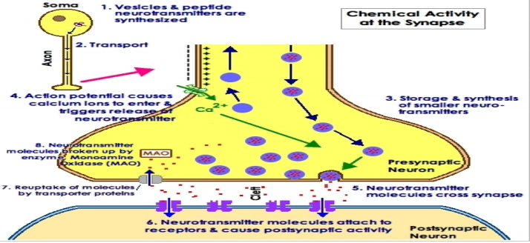
Fate of neurotransmitter
After a transmitter substance is released at a synapse, it must be removed by either:
Diffusion out of synaptic cleft into surrounding fluid.
Enzymatic destruction: ​e.g.​ ​Ach esterase for Ach.
Active transport (reuptake) ​back into presynaptic terminal itself . e.g. Norepinephrine.

Slide 15
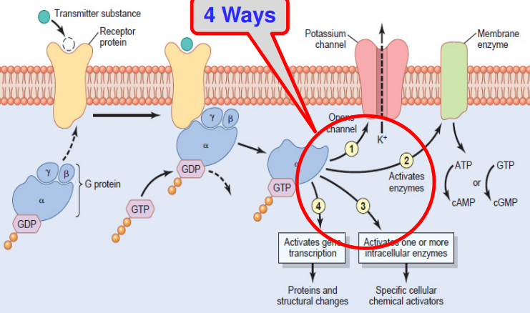
Postsynaptic receptors ​
ONLY IN MALES’ SLIDES
Transmitter Substance acts on the Postsynaptic Neuron via “Receptor Proteins”.
Have binding & intracellular component.
1. By gating ion channels directly and allowing passage of specified types of ions through the membrane (ionotropic receptors)
“Second Messenger” System in the Postsynaptic Neuron acts in 4 Ways:
Receptor activation acts in one of two ways:
2. By activating a “second messenger” that is not an ion channel but a molecule that protrudes into the cell cytoplasm and activates one or more substances inside the postsynaptic neuron (metabotropic receptors)

Slide 16
Cont.
ONLY IN FEMALES’ SLIDES
Components of postsynaptic
Receptors ​
Binding site
Ionophore
That face the cleft to bind the neurotransmitter.
​ ​It passes all the way through the membrane to interior.
2nd messenger system
Ion channels
2nd messenger system in the postsynaptic membrane ​­metabotropic (​slow​) receptors.
­This mechanism is important where ​prolonged​ ​postsynaptic changes are needed to stays for days, months, years (memory).​ ​
­Effects: ​intracellular enzymes activation, gene transcription, etc.
Next slide

Slide 17
Ion Channels
ONLY IN FEMALES’ SLIDES
Ion Channels ­ Ionotropic (​fast​).
(also known as ligand­gated ion channels​).
Whether a NT is excitatory or inhibitory depends on the receptor it binds to:
 | Cation channels​ | Anion channels​
Mechanism | Opening of Na⁺ channels → Increase membrane potential in positive​ direction toward threshold level of excitation due to in​flux of (+)charges → (+) neuron. | Opening of Cl­⁻ channels → Decrease membrane potential in negative​ direction away from threshold level due to in​flux of (-­) charges → (-­) neuron
Examples: | Na⁺ (most common)​, K⁺, Ca⁺⁺, … | Cl­⁻ ​channels (mainly).
The action of excitation and inhibition is depending on the charges.
More positive = excitation.
More negative = inhibition.

Slide 18
Functional differences between ionotropic & metabotropic receptors
Extra
IONOTROPIC | METABOTROPIC
Mediate rapid ​PSPs. | Mediate slower PSPs
Duration of PSPs is 10-­30 ms or less | Duration from 100`s ms to minutes or longer.
PSPs (EPSP or IPSP) develop within 1-­2 msec after an AP reaching the presynaptic terminal | This slowness is due to activation of second messengers leading to opening of ion channels
A NT may ​activate both​ ionotropic and metabotropic receptors to produce both fast & slow postsynaptic potentials at the same synapse

Slide 19
Electrical events in postsynaptic neurons ​
ONLY IN FEMALES’ SLIDES
Electrical events in postsynaptic neuron ​
1. Resting membrane potential (RMP) of neuronal soma
2. Excitatory postsynaptic potential (EPSPs)
3. Inhibitory postsynaptic potentials (IPSPs)
Soma of a neuron has a RMP of
about -65 mv which is less negative
than the (-­70 to 90) mv found in
skeletal muscles fibers.
If the voltage is less negative → the
neuron is excitable.
When excitatory ​neurotransmitter binds to its receptor on
post synaptic membrane → partial depolarization​
(increase Na influx​) of post­synaptic cell membrane Immediately under presynaptic ending, i.e. EPSPs.
If this potential rises enough to threshold level → AP will
develop and excite the neuron.
This summation will cause the membrane potential to increase​ from -­65 to -­45 mV. (20 mV difference.)
So the EPSPs = ​+20mV​ makes the membrane reach the firing
level → AP develops at ​axon hillock​.
Synapse on the cell body ​is more effective than other parts of
the neuron.
How?
When an inhibitory​ NT binds to its receptor on post synaptic membrane, it causes hyper​polarization of the
postsynaptic membrane
Increases​ membrane permeability to Cl⁻ ­​ of post synaptic membrane (produced by inhibitory neurotransmitter) →Decrease​ excitability and
membrane potential(more negative). Where the membrane reaches -70 mV​ (5 mV difference of the RMP.)
How EPSPs differs from Action potential?
• Proportionate to the strength of the stimulus.
• Can be summated.
• If large enough to reach firing level à AP is produced.

Slide 20
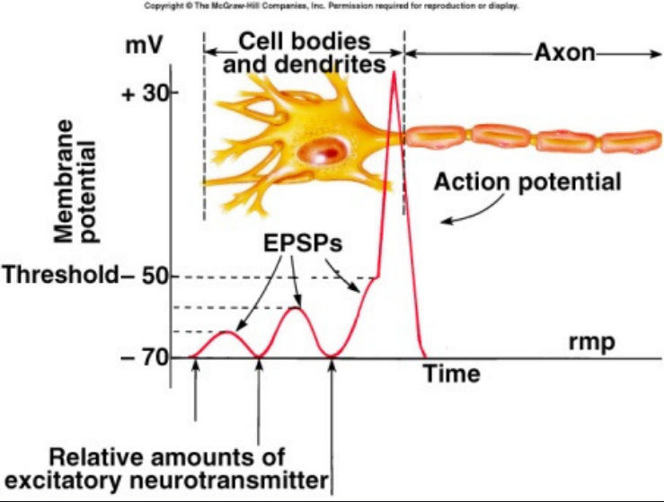
EPSP & IPSP at Chemical Synapses
ONLY IN MALES’ SLIDES
EPSP (excitatory postsynaptic potential):
IPSP (inhibitory postsynaptic potential):
Opening of Na channels to threshold level (Most Common).
2. ↓ conduction through Cl⁻ or K channels, or both.
3. Various changes in the internal metabolism of the postsynaptic neuron to excite or, in some instances, to ↑ excitatory membrane receptors or ↓ inhibitory membrane receptors.
Opening of Cl⁻ ion channels through the postsynaptic neuronal membrane.
2. ↑ in conductance of K ions out of the Neuron.
3. Activation of receptor enzymes that inhibit cellular metabolic functions that ↑ inhibitory membrane receptors or ↓ excitatory membrane receptors.

Slide 21
Synaptic properties
Synaptic properties
1. One­ way conduction
2. Synaptic delay
3. Fatigue (synaptic depression)
Synapses generally permit conduction
of impulses in one way​
i.e. from presynaptic to postsynaptic neuron. “Bell- Magendie law”.
It is the minimum​ time required for transmission across the synapse.
It is 0.5 ms​ for transmission across one synapse.
This time is taken by:
Discharge ​of transmitter substance by presynaptic terminal.
Diffusion ​of transmitter to postsynaptic membrane.
Action of transmitter on its receptor​.
Action of transmitter to increase membrane permeability​
Increased diffusion of Na+ ​to increase postsynaptic potential.
Clinical Importance: is that
we can know number of synapses involved in neuronal pathways by time lag.
It is due to exhaustion ​of neurotransmitter.
How?
If the presynaptic neurons are continuously
Stimulated there may be an exhaustion of the neurotransmitter, (results in) →​ stoppage of
Synaptic transmission.
In the pre synaptic membrane all of the neurotransmitters used from continuous stimulation will result in the arrival of ap but it won't propagate.
Synaptic fatigue is a protective phenomena.
ONLY IN MALES’ SLIDES

Slide 22
Cont. Fatigue (synaptic depression)
ONLY IN MALES’ SLIDES
The cause of this sudden cessation of reverberation is fatigue of synaptic junctions in the circuit. Fatigue beyond a certain critical level lowers the stimulation of the next neuron in the circuit below threshold level so that the circuit feedback is suddenly broken.
Synaptic fatigue short-term (synaptic depression), is an activity dependent form of short term synaptic plasticity that results in the temporary inability of neurons to fire and therefore transmit an
input signal.
Almost these exact patterns of output signals are recorded from the
motor nerves exciting a muscle involved in a flexor reflex after pain
stimulation of the foot.

Slide 23
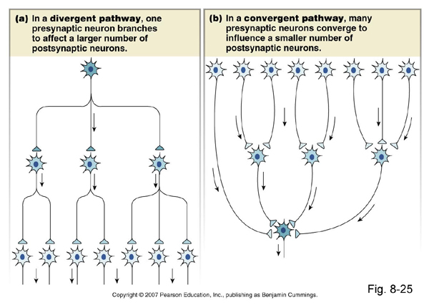
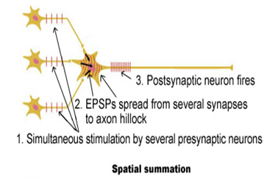
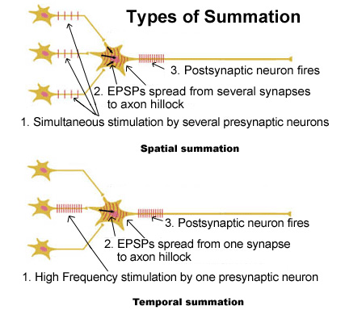
Cont.
Synaptic properties
4. Convergence & Divergence
5. SYNAPTIC INHIBITION
6. Summation
Next slide.
Convergence
D​ivergence
Spatial
Temporal
When many presynaptic neurons Converge on anysingle postsynaptic neuron
Axons of presynaptic neurons d​evide into
many branches that diverge ​to end on many postsynaptic neurons
Eliciting an action potential in a neuron with input from multiple presynaptic cells.
When the frequency of stimulation increased from the same presynaptic fiver
ONLY IN FEMALES’ SLIDES
ONLY IN FEMALES’ SLIDES

Slide 24
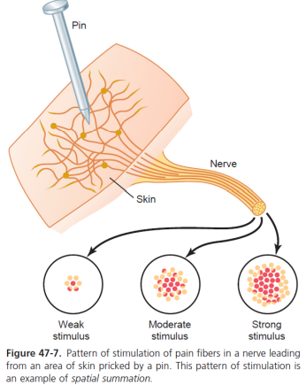
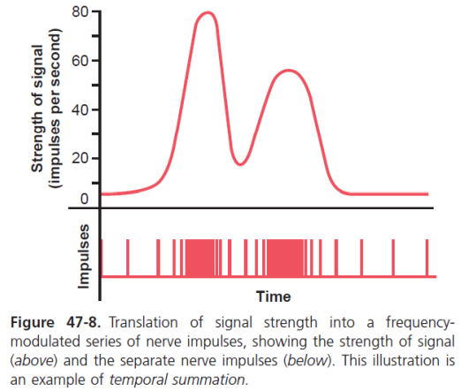
Cont. (Summation)
ONLY IN MALES’ SLIDES
Transmission of signals of different intensity in nerve tracts
Spatial
Temporal
Increasing signal strength is transmitted by using progressively greater numbers of fibers.
Transmitting signals of increasing strength is by increasing the frequency of nerve impulses in each fiber

Slide 25
Synaptic Inhibition
6. Synaptic inhibition
Types | Definition
A. Direct Inhibition (​post​synaptic inhibition)​ مباشر، لا يوجد وسيط أو تدخل. | ­Occurs when: An inhibitory neuron (releasing inhibitory substance) acts on a postsynaptic neuron leading to hyper​polarization due to opening of Cl⁻ [IPSPs] and/or K+ channels. ­ Example: ​Glycine​ at the level of the spinal cord to block pain ​impulses.
B. Indirect Inhibition (​Pre​synaptic inhibition) غير مباشر، تطلَّب تدخل بري سينابتك وبوست سينابتيك. | ­Occurs when​:​ An inhibitory synaptic knob lies directly on the termination of a presynaptic excitatory fiber. The inhibitory synaptic knob release a transmitter which inhibits the release of excitatory transmitter from the presynaptic fiber. ­ Example: ​ ​GABA​ (Pain modification)
C. Reciprocal Inhibition | Inhibition of antagonist activity is initiated in the agonist muscle when agonist is excited. impulses pass directly to the motor neurons supplying the same muscle and via branches to inhibitory interneurons that end on motor neurons of antagonist muscle. When flexing the arm, flexors are activated while extensor muscles are inhibited.
D. Inhibitory Interneuron (​Renshaw cells​) | Negative feedback​ inhibitory interneuron of a spinal motor neuron. Control the strength of contraction. Renshaw cells have the same function as Reciprocal inhibition.
ONLY IN FEMALES’ SLIDES
Dopamine can be excitatory or inhibitory ( depending on the receptor ). However, glycine is always Inhibitory

Slide 26
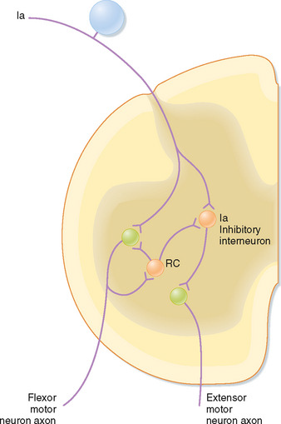
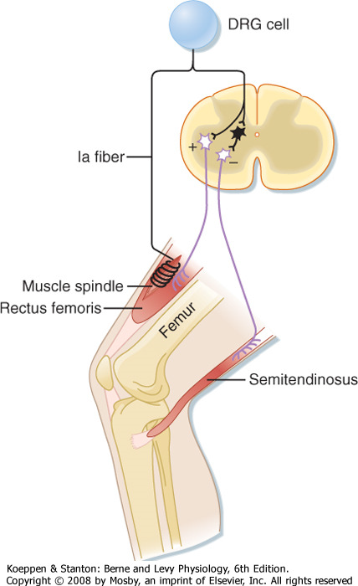
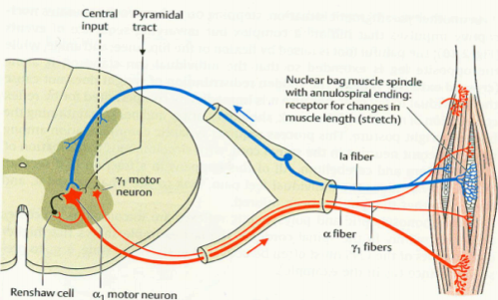
Cont. Synaptic Inhibition: Inhibitory interneuron ( Renshaw cells)
ONLY IN MALES’ SLIDES
ONLY IN FEMALES’ SLIDES

Slide 27
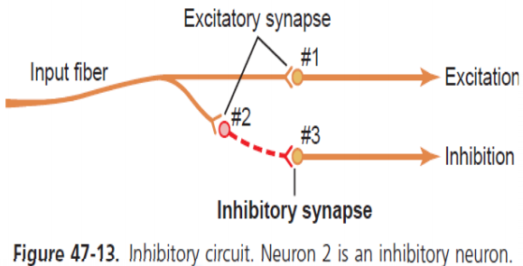
Cont. Synaptic Inhibition: Pre-synaptic inhibition
ONLY IN MALES’ SLIDES
Neuronal Circuit With Both Excitatory and Inhibitory Output Signals.
This type of circuit is characteristic for controlling all antagonistic pairs of muscles, and it is called the reciprocal inhibition circuit.

Slide 28
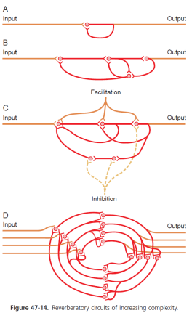
Reverberatory (Oscillatory) Circuit
ONLY IN MALES’ SLIDES
Cause of Signal Prolongation. caused by positive feedback within the neuronal that re-excite the input of the same circuit. Once stimulated, the circuit may discharge repetitively for a long time called long term potentiation
The simplest Fig A, involves single neuron.
Fig B shows additional neurons in the feedback circuit, which causes a longer delay between initial discharge and the feedback signal.
Fig C shows a more complex system in which both facilitatory and inhibitory fibers impinge on the reverberating circuit.
Fig D shows reverberating pathways with parallel fibers.

Slide 29
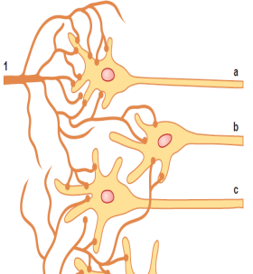
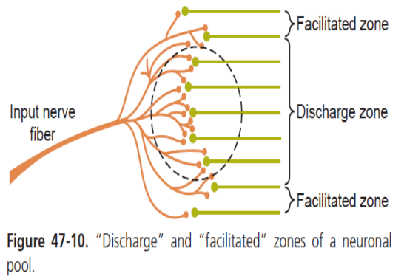
Zones of neuronal pool
ONLY IN MALES’ SLIDES
The neuronal area stimulated by each incoming nerve fiber is called its stimulatory field. Large numbers of the terminals from each input fiber lie on the nearest neuron in its “field,” & fewer terminals lie on the neurons farther away.
Discharge zone of the incoming fiber, also called the excited zone (a with suprathreshold stimulus).
To each side, the neurons are facilitated but not excited, and these areas are called the facilitated zone, also •called the subthreshold zone or subliminal zone. (b & c not enough to cause excitation).

Slide 30
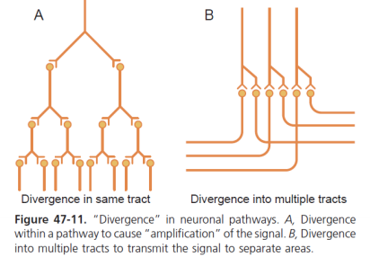
Divergence.
ONLY IN MALES’ SLIDES
In divergence weak signals entering a neuronal pool are amplified. Two major types
Amplifying type
Divergence into multiple tracts
Eg: corticospinal pathway
Eg: dorsal columns: of the spinal cord takes two courses in the lower part of the brain: 1. into the cerebellum.
2. on through the lower regions of the brain to the thalamus and cerebral cortex.

Slide 31
Convergence.
ONLY IN MALES’ SLIDES
Convergence means signals from multiple inputs uniting to excite a single neuron
Action potentials converging on the neuron from multiple terminals provide enough spatial summation to bring the neuron to the threshold required for discharge.
Convergence can also result from input signals (excitatory or inhibitory) from multiple sources:
the interneurons of the spinal cord receive converging signals from:
peripheral nerve fibers entering the cord.
Propriospinal fibers passing from one segment of the cord to another.
corticospinal fibers from the cerebral cortex.
several other long pathways descending from the brain into the spinal cord.
From interneurons converge on the anterior motor neurons to control muscle function. By summation

Slide 32
Doctor’s notes
Reciprocal Inhibition:
Because the sensory will travel and at the level of the spinal cord, sensory information about the pain that we are experiencing will travel and give information to the motor component for the motor reaction and it will give responses to contract this muscle and to inhibit the antagonist and withdrawal will occur.
Reciprocal antagonists are opposite each other. The type of action with inhibition of the opposite action
It receives collateral information from the motor.
That means when sensory information is received and the muscle gets contracted, the collateral and interneuron will receive the information from the motor through this collateral fibers to be informed about the muscle contraction because it will control the muscle contraction.
مثل لما ننجرح بالإبرة ما نجلس نقرر إذا هو يؤلمنا أو لا، من غير تفكير أو كنترول يصير مباشرة والشعور المؤلم يتوزع على الكثير من السيجمينتس من السباينل كورد عشان تعطينا الكثير من المسل كونتراكشين وانهيبيشن اكشنز.
Inhibitory Interneuron (​Renshaw cells​):
It receives collateral information from the motor.
That means when sensory information is received and the muscle gets contracted., the collateral and interneuron will receive the information from the motor through this collateral fibers to be informed about the muscle contraction because it will control the muscle contraction.
مثل لما يحدث عندنا ألم بسيط وظيفة النتيرنيورونز أنها تمنع زيادة الإنقباض في العضلات.

Slide 33
Factors affecting synaptic transmission
1. Alkalosis:
Increases​ ​neuronal excitability.
Causes cerebral epileptic seizures​ (due to Increased excitability of cerebral neurons).
Example: over breathing ​in a person with epilepsy. The over breathing blows off carbon dioxide and therefore elevates the pH of the blood momentarily.
2. Acidosis:
Depresses​ ​neuronal activity.
pH around 7 “As in severe diabetic or uremic acidosis” usually causes a coma.
3. Hypoxia:
Causes​ Depression​ of neurons.
4. Drugs:
Caffeine found in coffee, tea, strychnine, theophylline and theobromine increases neuronal excitability, by reducing the threshold for excitation of neurons.

Slide 34
Thank you!
اعمل لترسم بسمة، اعمل لتمسح دمعة، اعمل و أنت تعلم أن الله لا يضيع أجر من أحسن عملا.
The Physiology 436 Team:
Team Leaders:
Lulwah Alshiha
Laila Mathkour
Mohammad Alayed
Females Members:
Amal AlQarni
Ghada Almazrou
Males Members:
Qaiss Almuhaideb
Contact us:
References:
Females and Males slides.
Guyton and Hall Textbook of Medical Physiology (Thirteenth Edition.)

