Slide 1
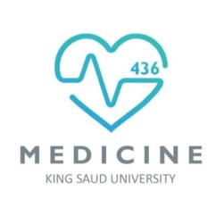

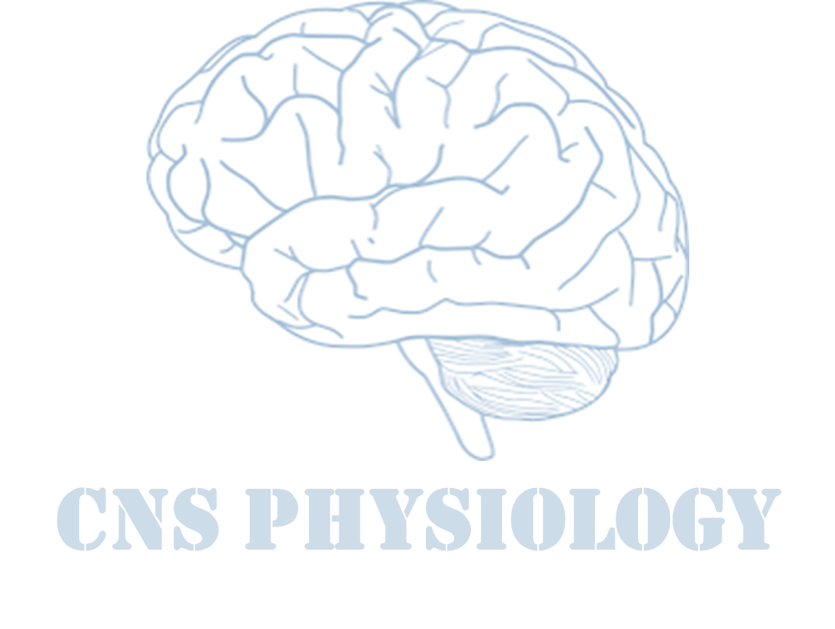

Text
Important
Formulas
Numbers
Doctor notes
Notes and explanation
Lecture No.10
“يرفع الله الذين آمنوا منكم والذين أوتوا العلم درجات”

Slide 2
Accommodation & Pupillary Light Reflex
Objectives:
Describe different components of the eye and function of each and understand the eye protection media.
Describe the refraction of light as it passes through the eye to the retina, identifying the refractive media of the eye.
Describe the refractive error that account for myopia, hypermetropia, presbyopia and astigmatism and their correction by eye glasses or contact lenses.
Know layers of retina, blind spot, and fovea centralis-explain the differing light sensitivities of the fovea, peripheral retina and optic disk.

Slide 3
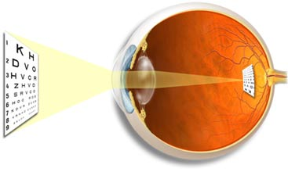
Visual Acuity
Definition:
Degree to which details of objects are perceived.
The degree to which the details and contours of objects are perceived, it is usually defined in terms
of the shortest distance by which two lines can be separated and still be seen as 2 lines.
person can normally distinguish two separate points if their centers lie up to 2 micrometers apart on the retina, which is slightly greater than the width of a foveal cone.
Visual threshold:
Is minimal amount of light that elicit sensation of light.
Snellen’s chart:
Normal acuity = 6/6 = (d/D)
d= distance of Patient / D= distance of normal person = 6/6.
A person of 6/12 has less vision than normal vision (d/D Patient/normal)
ONLY IN MALES’ SLIDES
ONLY IN FEMALES’ SLIDES

Slide 4
Duplicity theory of vision
ONLY IN FEMALES’ SLIDES
Two kinds of vision under different conditions:
Differentiate between cones & rods vision
Photopic vision | Scotopic vision
bright light vision | night vision, dim light vision
Served by cones | Served by rods
High visual acuity = colors & details | Low visual acuity = no colors or details
Low sensitivity to light = needs high visual threshold to be stimulated | Great sensitivity to light = low visual threshold

Slide 5
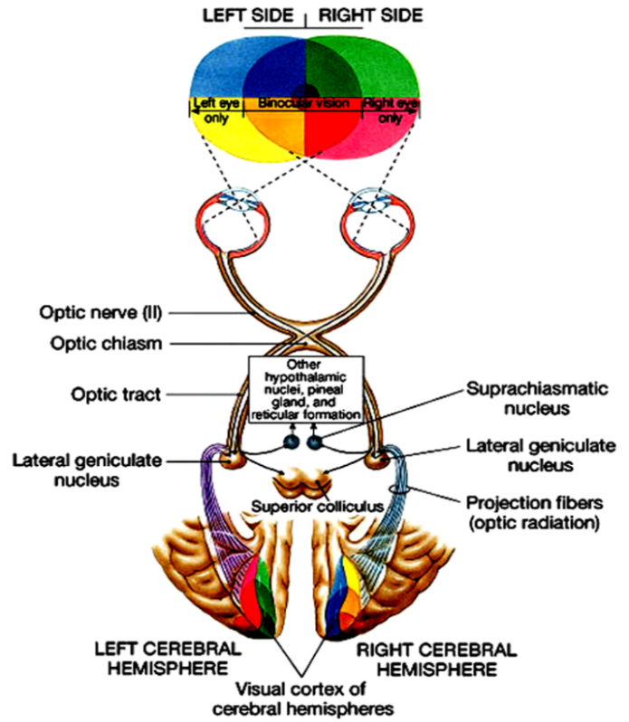
Visual Pathway
ONLY IN MALES’ SLIDES
Visual pathway
2. Optic chiasma
3. Optic tract
1. Optic nerve
4.Lateral geniculate body (nucleus)
5.Optic radiation
6.Visual cortex
Visual Pathway: Pathway from Retina to the Visual Centers in the Brain.
Photoreceptors: Rods and Cones synapse on Bipolar Cells, which in turn, synapse on Ganglion Cells.
Axons of Ganglion Cells constitute the Optic Nerve. These axons converge at the Optic disc, which is also called Blind Spot.
Why? Passing through the Blind Spot → they leave the eye, constituting the Optic Nerve.

Slide 6
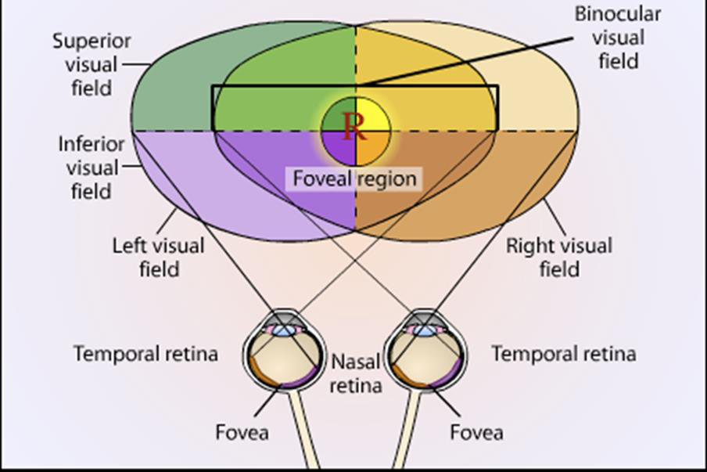
Cont.
ONLY IN MALES’ SLIDES
Optic nerve fibers from the medial (nasal) side of retinae decussate in the Optic Chiasma.
Therefore an Optic Chiasma lesion (e.g. Pituitary Tumor) will cause vision loss from the both lateral halves of the Field of Vision.
Optic nerve fibers from the lateral (temporal) parts of the retinae do not decussate.
Therefore, each optic tract carries fibers from both the temporal side of the ipsilateral retina + nasal side of the contralateral retina.
Therefore, a lesion in optic tract will cause loss of vision from the ipsilateral nasal field of vision + contralateral temporal field of vision.

Slide 7
Visual Pathway
ONLY IN FEMALES’ SLIDES
Cones and rods
Bipolar cells
Ganglion cells
Optic nerve (axons of ganglion cells)
Optic chiasma
Visual cortex (broadmann area 17) in occipital cortex
Optic radiation
Axons of cells from geniculocalcarine tract
Lateral geniculate body in thalamus
Optic tract

Slide 8
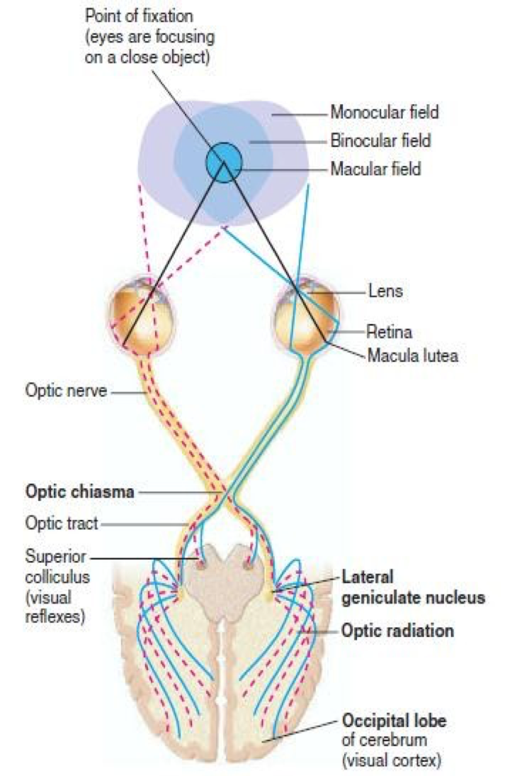
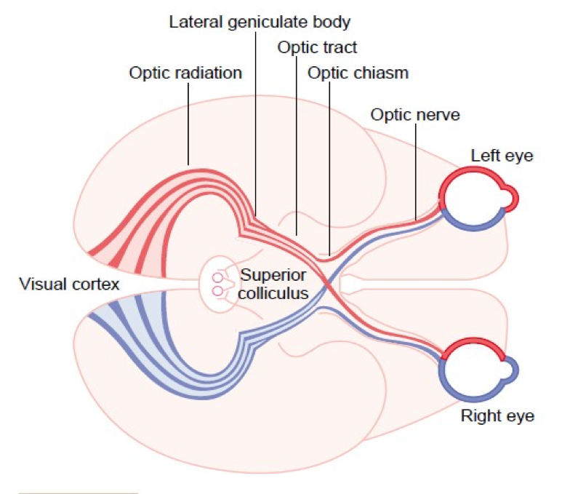
Cont.
ONLY IN FEMALES’ SLIDES
Some ganglion cells axons pass from optic tract to pretectal region of midbrain for pupillary reflexes & eye movement.
Some axons of ganglion cells from optic chiasma pass directly to hypothalamus for circadian rhythm (light-dark cycle) that synchronize various physiologic changes of the body with night and day.
Some axons from lateral geniculate body in thalamus to superior colliculus in midbrain for accommodation. R & its miosis component & to control rapid directional movements of the two eyes.

Slide 9
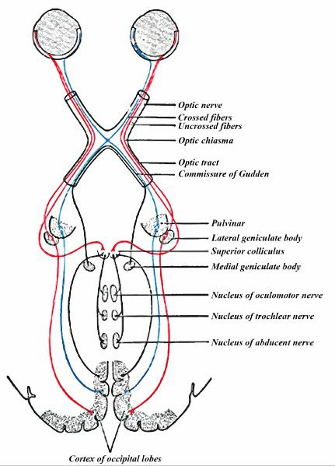
Visual Pathway and Field
ONLY IN FEMALES’ SLIDES
The nasal fibers (medial) cross to opposite side.
The temporal fibers (lateral) do not cross.
Nasal fibers conveys temporal field (outer) of vision.
Temporal fibers conveys nasal field ( inner) of vision.
Optic tract includes:
Lateral fibers of the same side (nasal field (inner) of vision).
Medial fibers of the opposite side i.e. temporal field of other eye (outer).
Left optic tract:
Conveys lateral (temporal) fibers of the left eye + medial (nasal fibers) of the right eye = right half
of visual field of left eye & right half of visual field of right eye, both form right half of visual field
of both eyes.
N.B:
The left optic tract corresponds to the right ½ of the visual field.
The right optic tract corresponds to the left ½ of the visual field.

Slide 10
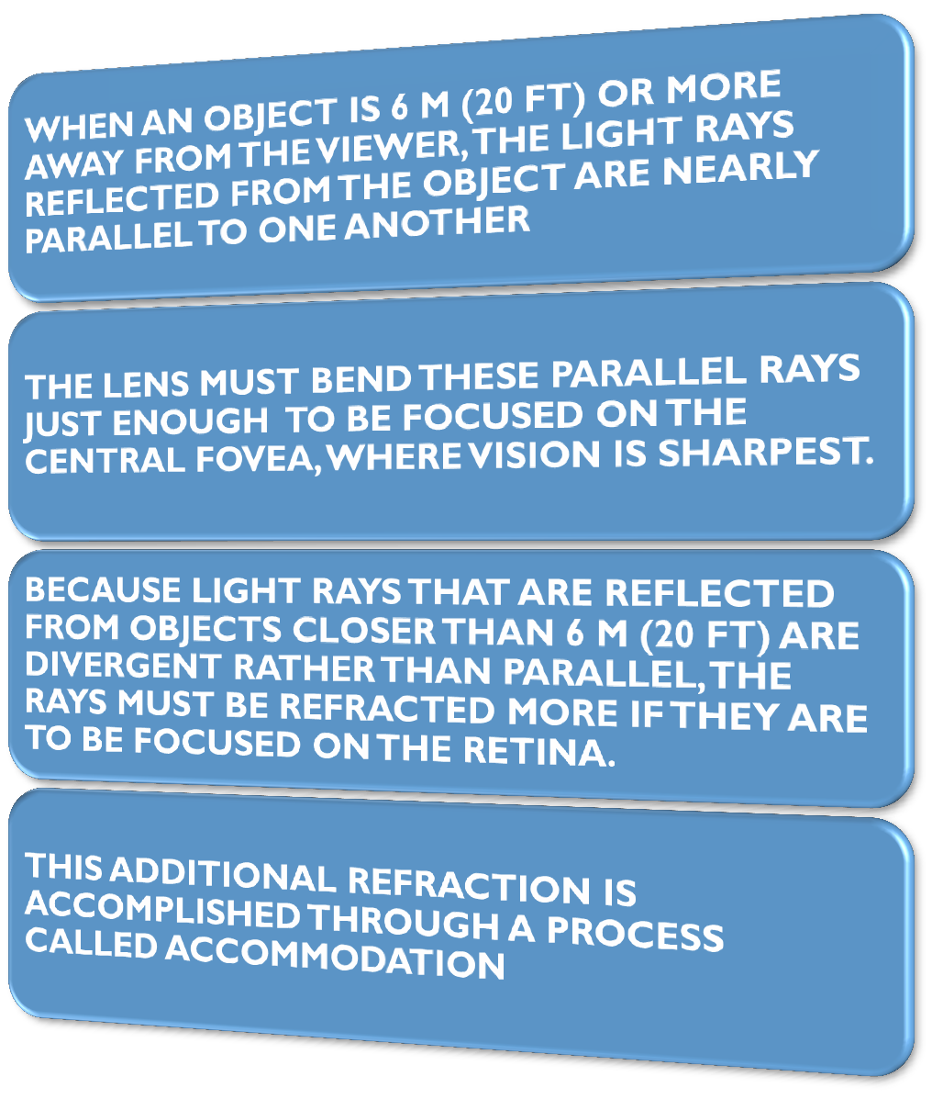
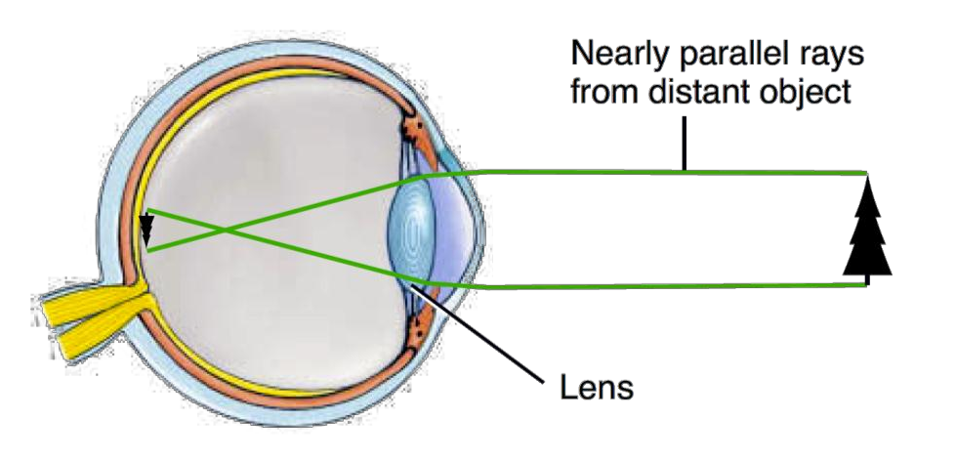
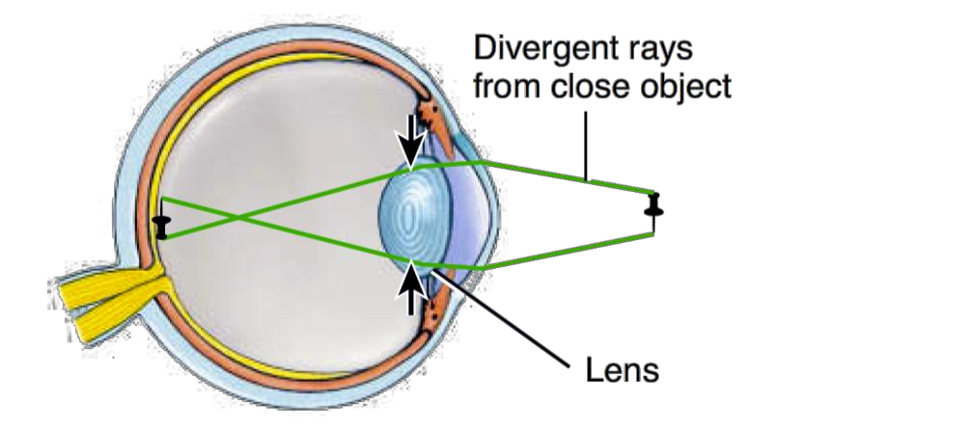
Accommodation (focusing)
ONLY IN FEMALES’ SLIDES

Slide 11
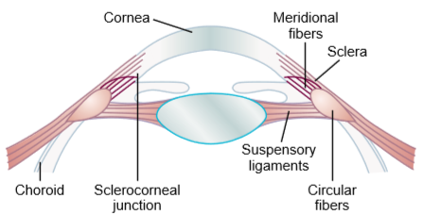
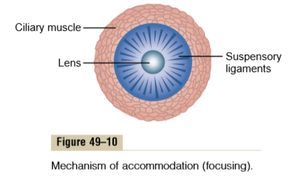
Guyton corner
Mechanism of Accommodation “focusing”
In children, the refractive power of the lens of the eye can be increased voluntarily from 20 diopters to about 34 diopters; this in an “accommodation" of 14 diopters. To do this, the shape of the lens is changed from that of a moderately convex lens to that of a very convex lens. The mechanism is as follows. In a young person, the lens is composed of a strong elastic capsule ﬁlled with viscous, proteinaceous, but transparent ﬂuid. When the lens is in a relaxed state with no tension on its capsule, it assumes an almost spherical shape, owing mainly to the elastic retraction of the lens capsule. However, as shown in Figure 49–10, about 70 suspensory ligaments attach radially around the lens, pulling the lens edges toward the outer circle of the eyeball. These ligaments are constantly tensed by their attachments at the anterior border of the choroid and retina. The tension on the ligaments causes the lens to remain relatively ﬂat under normal conditions of the eye.

Slide 12
Cont.
Mechanism of Accommodation “focusing”
However, also located at the lateral attachments of the lens ligaments to the eyeball is the ciliary muscle, which itself has two separate sets of smooth muscle ﬁbers—meridional ﬁbers and circular ﬁbers. The meridional ﬁbers extend from the peripheral ends of the suspensory ligaments to the corneoscleral junction. When these muscle ﬁbers contract, the peripheral insertions of the lens ligaments are pulled medially toward the edges of the cornea, thereby releasing the ligaments’ tension on the lens. The circular ﬁbers are arranged circularly all the way around the ligament attachments so that when they contract, a sphincter like action occurs, decreasing the diameter of the circle of ligament attachments; this also allows the ligaments to pull less on the lens capsule. Thus, contraction of either set of smooth muscle ﬁbers in the ciliary muscle relaxes the ligaments to the lens capsule, and the lens assumes a more spherical shape, like that of a balloon, because of the natural elasticity of the lens capsule.
Accommodation Is Controlled by Parasympathetic Nerves. The ciliary muscle is controlled almost entirely by parasympathetic nerve signals transmitted to the eye through the third cranial nerve from the third nerve nucleus in the brain stem .

Slide 13
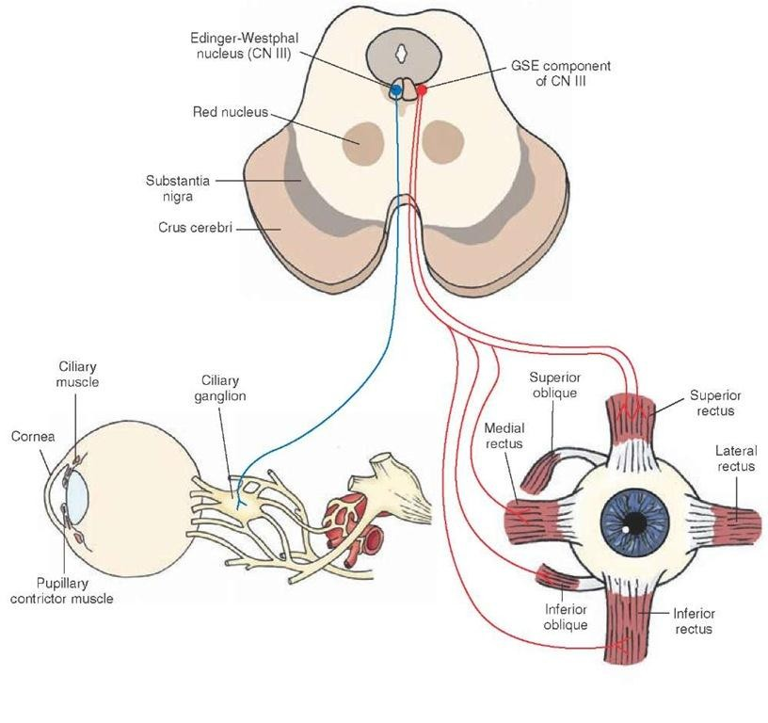
Accommodation
ONLY IN FEMALES’ SLIDES
Is an active process for modification of the refractive power of the eye to view a nearby object by increasing the curvature of lens.
Ciliary muscle has two separate sets of smooth muscle fibers (longitudinal fibers and circular fibers).
Contraction of either set in the ciliary muscle relaxes the ligaments to the lens capsule, and the lens assumes a more spherical shape, because of the natural elasticity of the lens capsule& and increase its refractive power.
The ciliary muscle of accommodation is controlled by parasympathetic nerves transmitted to the eye through oculomotor nerve.

Slide 14
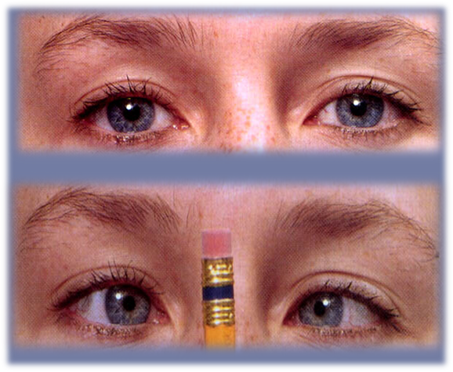
Accommodation
ONLY IN MALES’ SLIDES
Modification of the refractive power of the eye (curvature of the lens) to view a nearby object.
Goal: Clear vision of a nearby object.
1
9
Ciliary muscles Contraction
Far object focused on the retina
1
2
Lens changes
“accommodation “
Changes in the pupil
2
8
Relaxation of the suspensory ligament
Decrease dioptric power of the eye
4
3
The near response
Convergence of the eyes
3
7
Lens more convex
Lens less convex (flat)
4
6
Increase dioptric power of the eye
contraction of the suspensory ligament
5
Near object focused on the retina

Slide 15
Pathway of accommodation
ONLY IN FEMALES’ SLIDES
Light on eye
retina
optic nerve
optic chiasma
optic tract
contraction of iris muscles for miosis of near response
bilateral ciliary muscle contraction
( accommodation. R)
ciliary ganglion to oculomotor nerve
EWN
lateral geniculate body in thalamus & to superior colliculus in midbrain

Slide 16
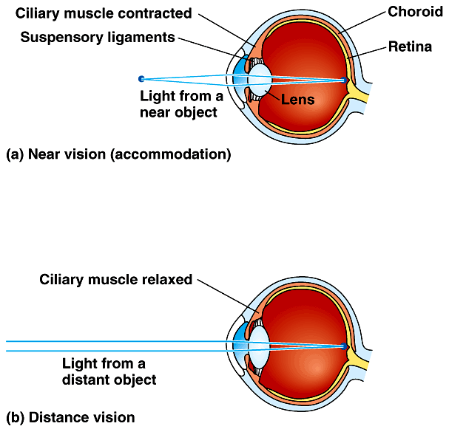
Cont.
ONLY IN FEMALES’ SLIDES
Accommodation is the focusing of light in the retina. We focus by changing the shape of the lens.
Near vision | From near (close) objects parallel rays focus behind retina (if ciliary muscles remain relaxed) = blurred vision. Solution is to increase curvature & refractive power of lens by accommodation to bring focus on retina.
Far vision “At rest” | Ciliary muscles are relaxed + taut (tense) ligaments + flat lens.

Slide 17
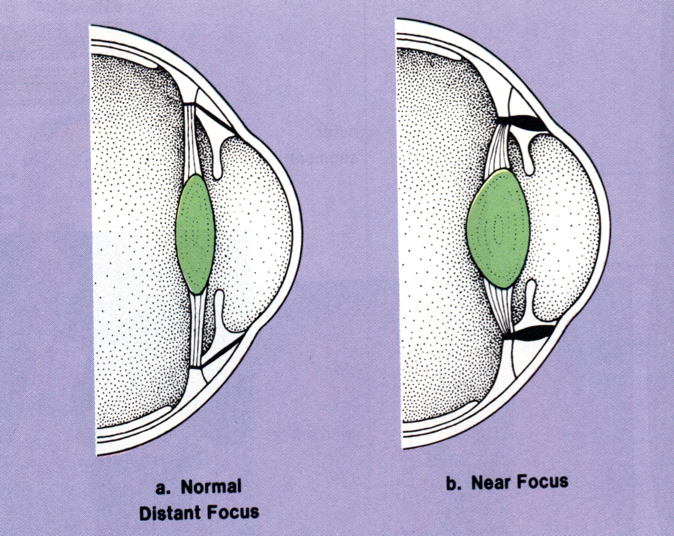
Cont.
ONLY IN MALES’ SLIDES
Distant vision:
Ciliary muscle relaxed suspensory ligaments under tension lens is flattened focus on distant objects.
Accommodation:
Ciliary muscle contracts reduced tension on suspensory ligaments lens becomes round
Focus on near objects.

Slide 18
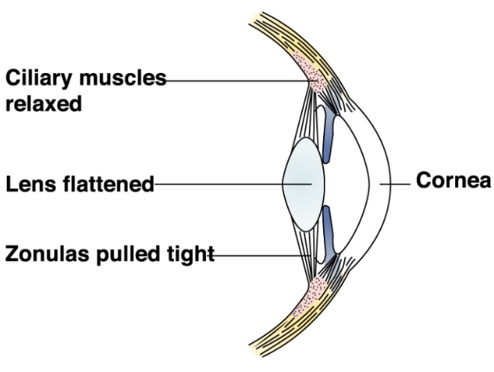
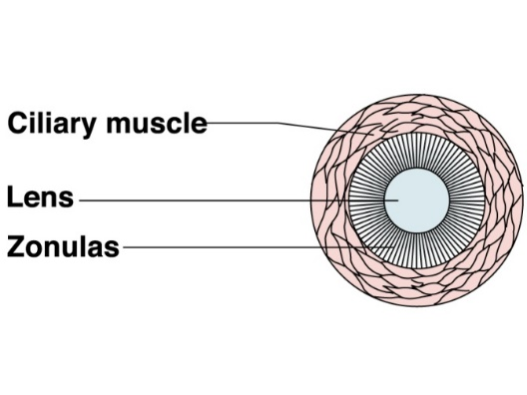
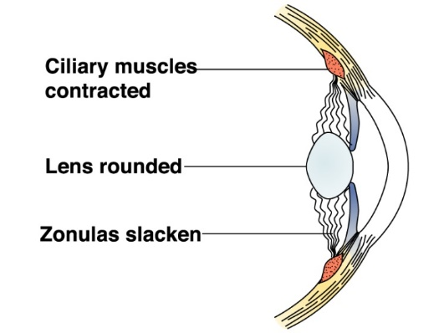
Cont.
ONLY IN MALES’ SLIDES
When the ciliary muscles are relaxed, the zonalus pulls tight and keeps the lens flattened for distant vision.
The elastic lens is attached to the circular ciliary muscles by the zonalus which is made of inelastic fibers.
When the ciliary muscles contract, it releases the tension on the zonalus and the elastic lens returns to a more rounded shape suitable for near vision.

Slide 19
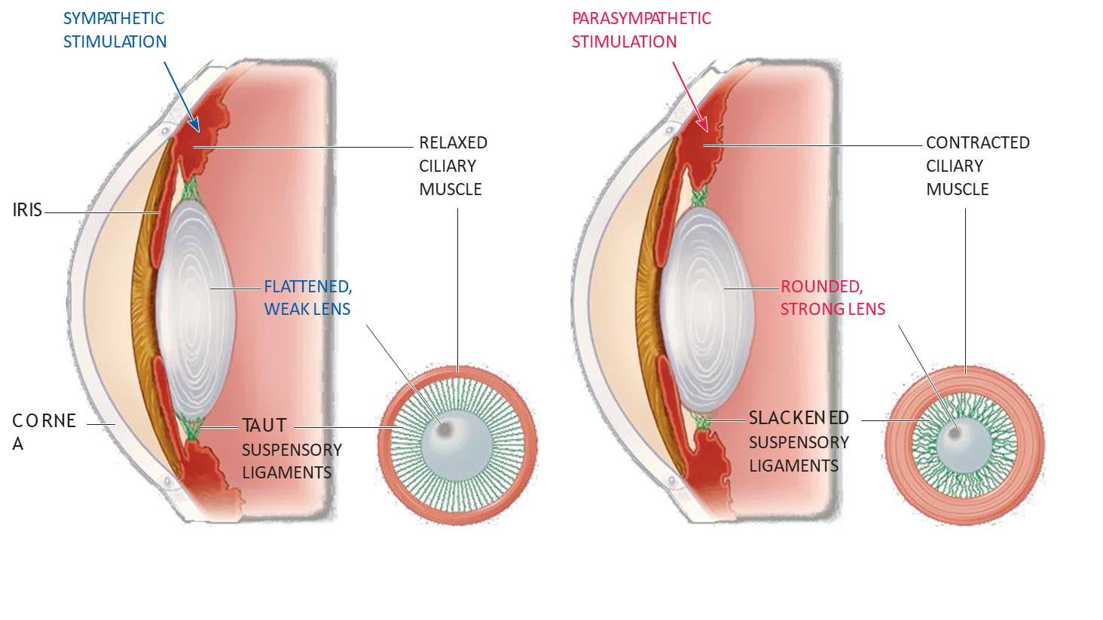
Cont.
ONLY IN FEMALES’ SLIDES
Relaxed | Contracted
the lens is held under tension by the lens ligaments. | If the gaze is directed at a near object, the ciliary muscle contracts.
Because the lens substance is malleable and the lens capsule has considerable elasticity, the lens is pulled into a flattened shape. | This decreases the distance between the edges of the ciliary body and relaxes the lens ligaments, So that the lens springs into a more Convex shape.

Slide 20
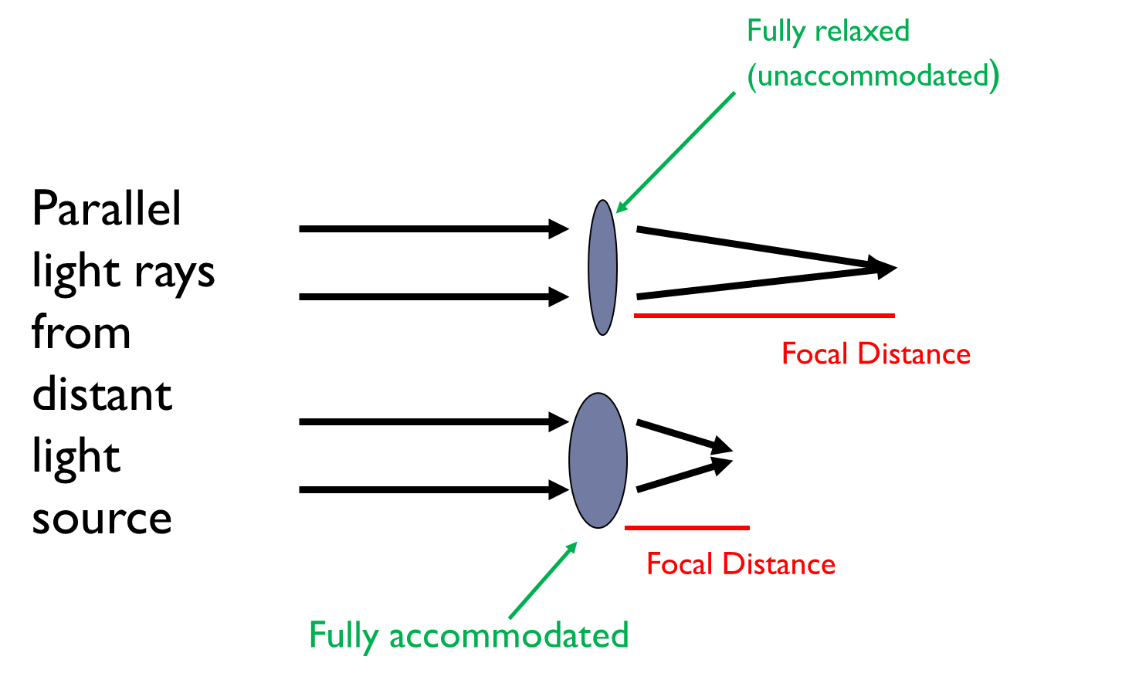
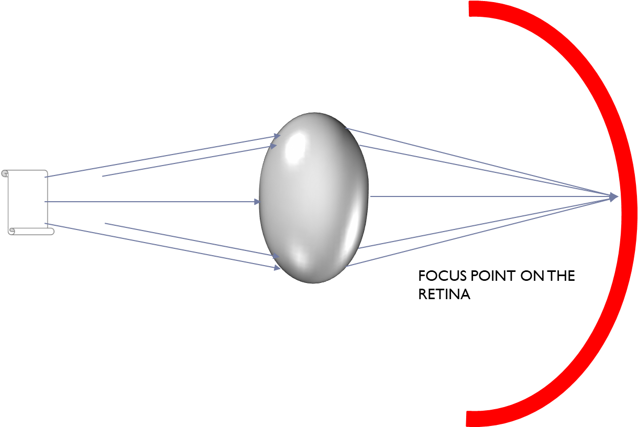
Image focusing
ONLY IN MALES’ SLIDES
Lens accommodation:

Slide 21
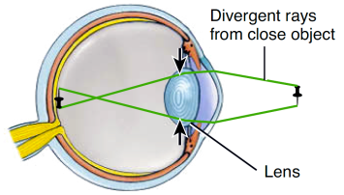
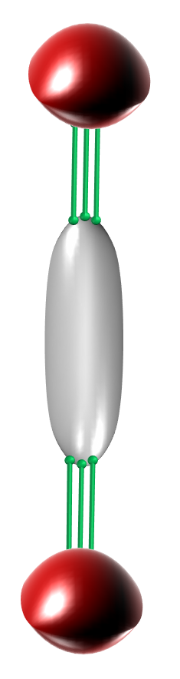
Accommodation to near objects
ONLY IN MALES’ SLIDES
The problem of bringing diverging rays from close objects to a focus on the retina can be solved by increasing the curvature or refractive power of the lens. That is accommodation.
The ciliary muscle contracts
The tension on the suspensory ligaments decreases.
The lens becomes more globular in shape
Accommodation occurs to a closer object being viewed

Slide 22
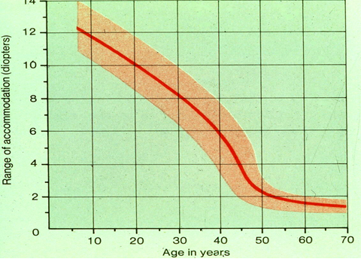
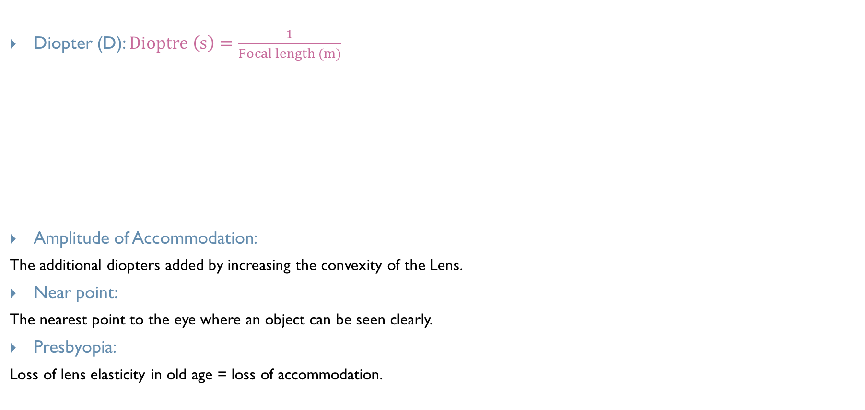
Vision and accommodation
ONLY IN MALES’ SLIDES
Diopter (D): $Dioptre \left(s\right)=\frac{1}{Focal length (m)}$
Amplitude of Accommodation:
The additional diopters added by increasing the convexity of the Lens.
Near point:
The nearest point to the eye where an object can be seen clearly.
Presbyopia:
Loss of lens elasticity in old age = loss of accommodation.
Dioptric power of the eye
Cornea | 40 - 45 D
Lens | 15 - 20 D
Accommodation | +12 D

Slide 23
Near vision
ONLY IN FEMALES’ SLIDES
looking at a close object (near response):
convergence of both visual axis
pupil constriction
Accommodation
Near point:
Nearest point to eye at which object can brought into focus on retina by accommodation.
10 years = 9 cm.
At 60 years = 80-100 cm, due to hardness of lens & loss of accommodation.
Near point and amplitude of accommodation
Age (yrs) | Near point (cm) | Amplitude of Accommodation
10 | 9.0 | 11.0
20 | 10.0 | 10.0
30 | 12.5 | 8.0
40 | 18 | 5.5
60 | 83 | 1.2
70 | 100 | 1.0

Slide 24
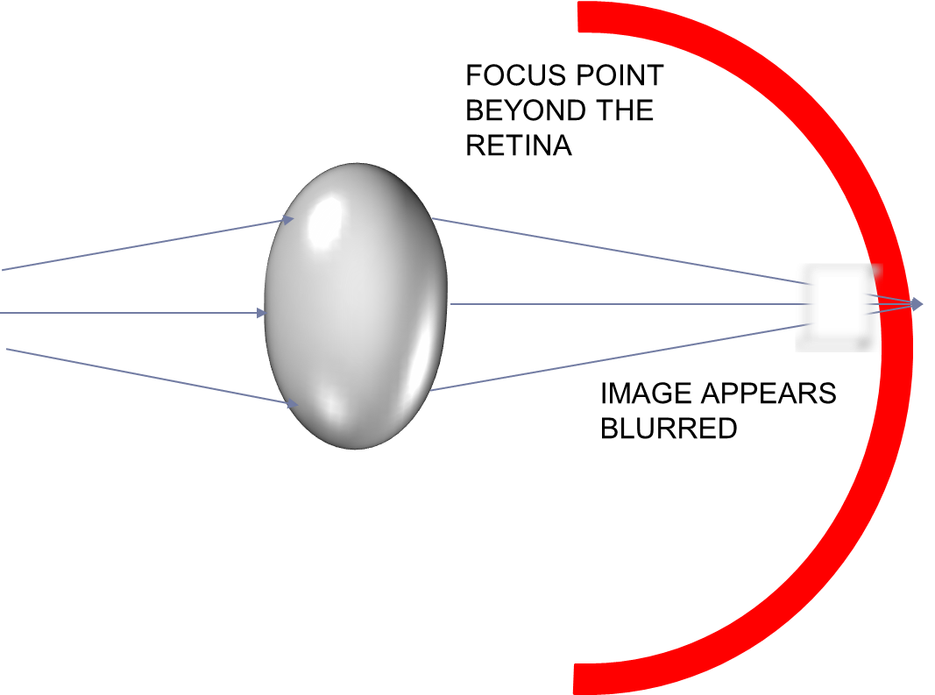
Presbyopia
ONLY IN MALES’ SLIDES
ONLY IN FEMALES’ SLIDES
With age, the lens grows larger and thicker and becomes far less elastic.
The lens can no longer become as spherical as at a younger age.
This results in loss of accommodation due to the decrease in the degree to which the curvature of the lens can be increased.
Lens is hardened and cannot
become more spherical to
refract light from the
closer object.
Presbyopia: (triade):
loss of accommodation & focus behind retina.
loss of lens elasticity.
near point recede.
Correction by biconvex lens.

Slide 25
Argyll robertson pupil (neuro-syphilis)
Normally, the pupil constricts in response to: the accommodation Reflex & the light reflex.
In neuro-syphilis, it constrict in response to: accommodation reflex but not to the light reflex.
In syphilis tabes dorsalis which destroy pretectal nucleus:
Light R is lost & accommodation R remains because lesion is in pretectal nucleus only, away from superior colliculus & fibers of accommodation.
damage of transmission of visual signals from the retinas to the edinger-westphal nucleus, blocking the pupillary reflexes as in alcoholism, encephalitis.
ONLY IN FEMALES’ SLIDES

Slide 26
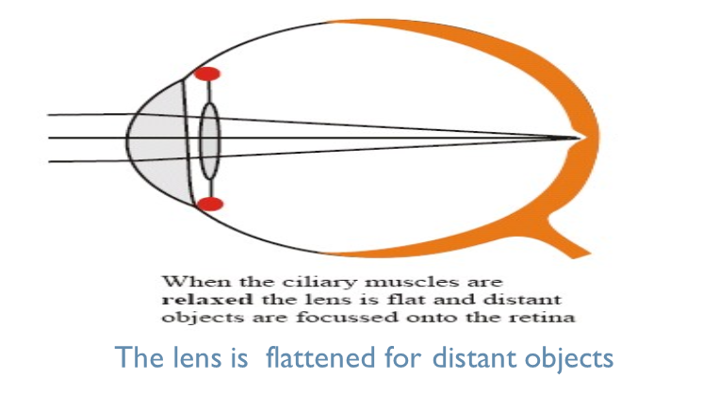
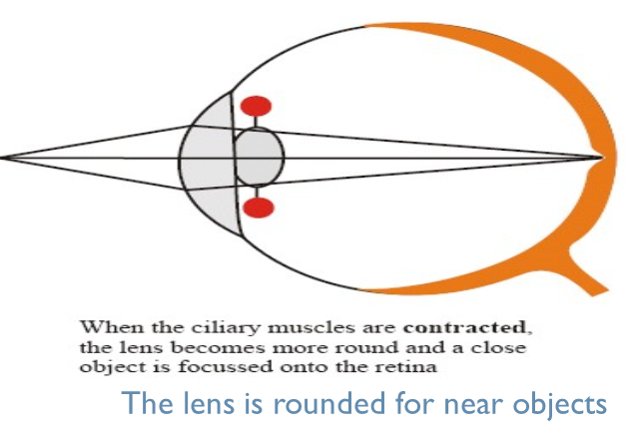
Accommodation reflex
ONLY IN FEMALES’ SLIDES
Focusing at near object: increased anterior surface curvature of lens by ciliary muscles contraction, slack = relaxed ligaments & increased anterior surface curvature of lens. In order to add 12D to refractive power of lens.
both circular & longitudinal cilliary muscles contract to pull cilliary muscle forwards & inwards = cilliary muscles edges come close to each other to increase anterior surface curvature of lens.
Test= sanson purkinje image.

Slide 27
The accommodation reflex
ONLY IN MALES’ SLIDES
Afferent:
Efferent:
Retina
Optic nerve
Optic chiasma
Optic tract
Lateral geniculate body
Visual cortex
Oculomotor nucleus
parasympathetic
Ciliary ganglion
Ciliary muscle
Circular pupillary muscle

Slide 28
Neuroanatomy corner
Accommodation Reflex
When the eyes are directed from a distant to a near object, contraction of the medial recti brings about convergence of the ocular axes; the lens thickens to increase its refractive power by contraction of the ciliary muscle; and the pupils constrict to restrict the light waves to the thickest central part of the lens.
The afferent impulses travel through the optic nerve, the optic chiasma, the optic tract, the lateral geniculate body, and the optic radiation to the visual cortex. The visual cortex is connected to the eye field of the frontal cortex . from here, cortical fibers descend through the internal capsule to the oculomotor nuclei in the midbrain. The oculomotor nerve travels to the medial recti muscles. Some of the descending cortical fibers synapse with the parasympathetic nuclei (edinger-westphal nuclei) of the third cranial nerve on both sides.
Here, the fibers synapse, and the parasympathetic nerves travel through the third cranial nerve to the ciliary ganglion in the orbit. Finally, postganglionic parasympathetic fibers pass through the short ciliary nerves to the ciliary muscle and the constrictor pupillae muscle of the iris.

Slide 29
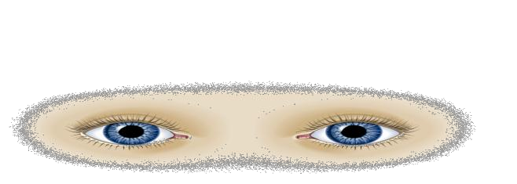
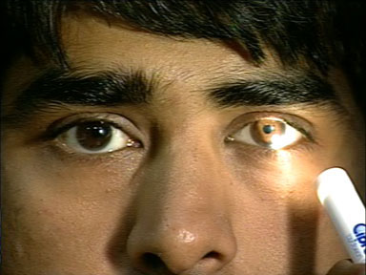
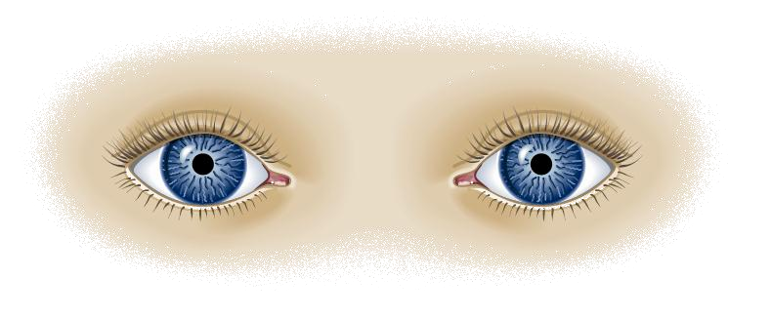
Pupillary light reflex
ONLY IN MALES’ SLIDES
ONLY IN FEMALES’ SLIDES
When an eye (Left) is subject to bright light, a direct light reflex occurs constriction of the pupil as well as a consensual indirect reflex of the other (Right) pupil.
Quantity of light changes X30 fold.
Light on one eye pupil = constriction of this pupil direct & the other pupil indirect or consensual.
Both pupils constrict.

Slide 30
Pathway of Consensual Pupillary Light Reflex (Indirect)
ONLY IN FEMALES’ SLIDES
Light on eye
retina
optic nerve
optic chiasma
optic tract
short ciliary nerve to constrictor pupillae
supply both eyes by oculomotor nerves
both ciliary ganglia
both oculomotor nerve nuclei (EWN)
pass through superior colliculus to end in pretectal nucleus
miosis in both eyes
Conversely in darkness, the reflex becomes inhibited which results in dilation of
the pupil.

Slide 31
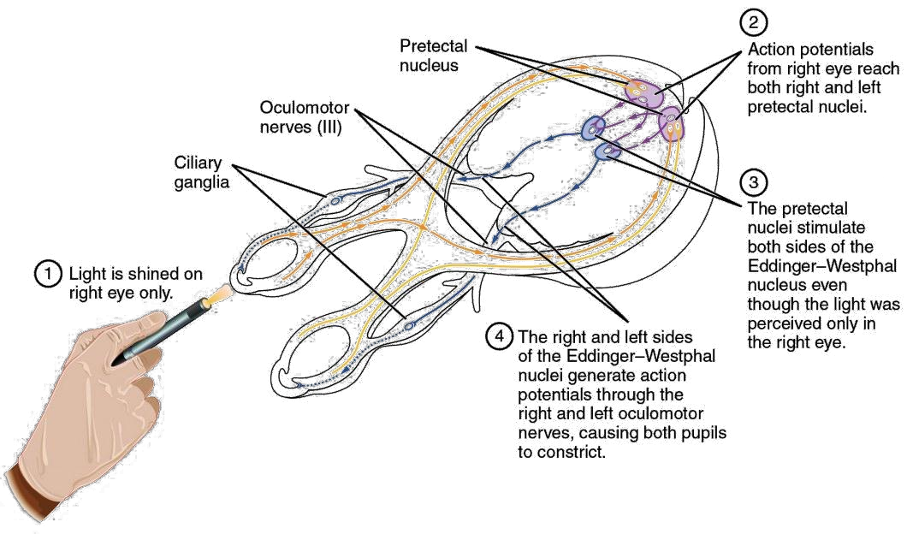
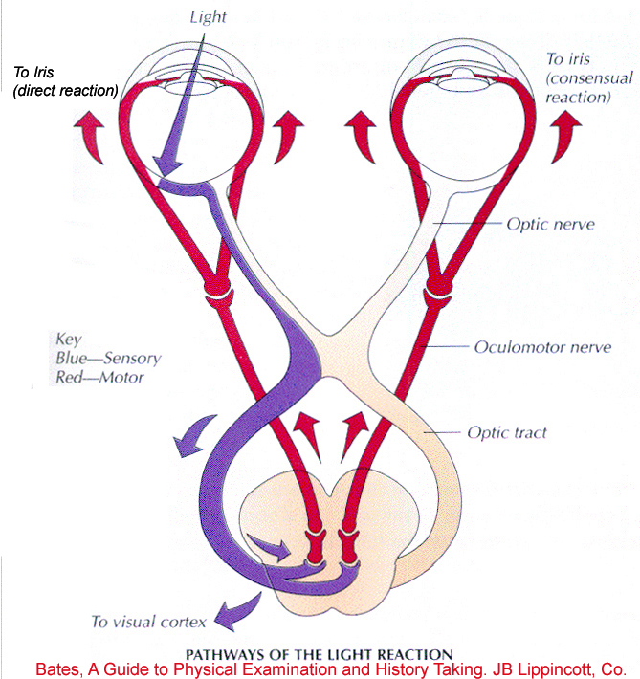
Cont.
ONLY IN MALES’ SLIDES
ONLY IN FEMALES’ SLIDES

Slide 32
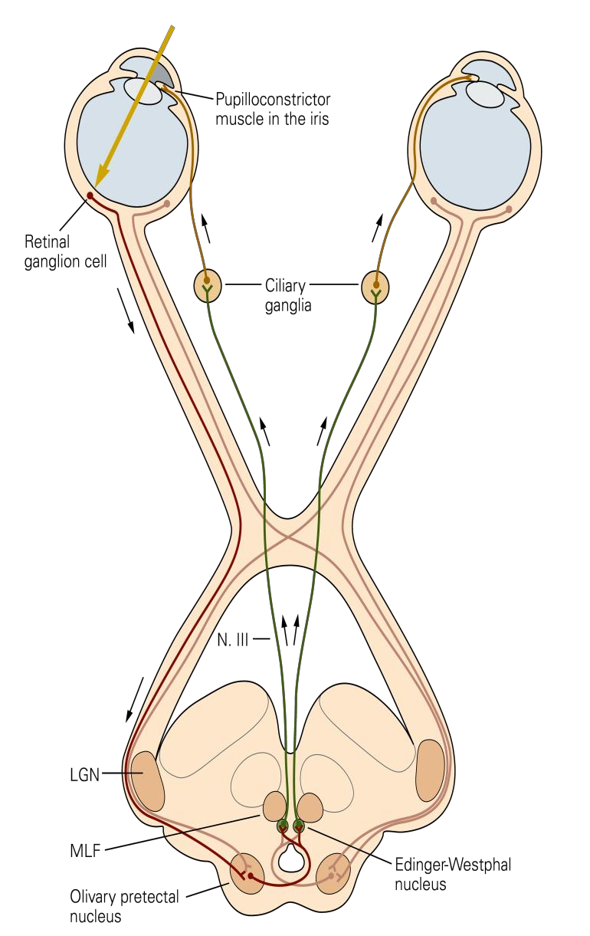
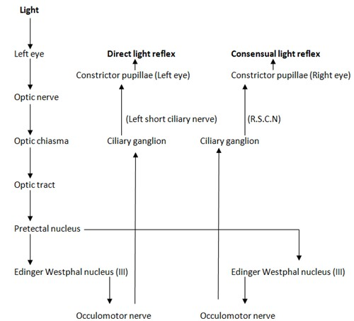
Cont.
ONLY IN FEMALES’ SLIDES

Slide 33
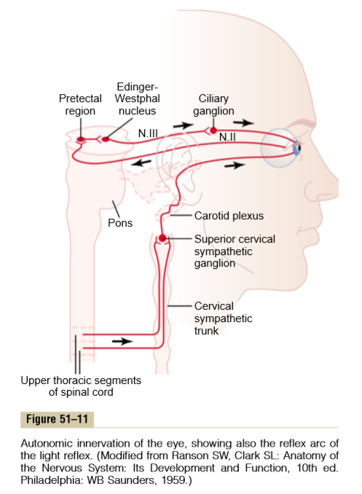
Guyton corner
When light is shone into the eyes, the pupils constrict, a reaction called the pupillary light reﬂex. The neuronal pathway for this reﬂex is demonstrated by the upper two black traces in Figure 51–11. When light impinges on the retina, a few of the resulting impulses pass from the optic nerves to the pretectal nuclei.
Pupillary Light Reﬂex.
From here, secondary impulses pass to the Edinger-Westphal nucleus and, ﬁnally, back through parasympathetic nerves to constrict the sphincter of the iris. Conversely, in darkness, the reﬂex becomes inhibited, which results in dilation of the pupil. The function of the light reﬂex is to help the eye adapt extremely rapidly to changing light conditions. The limits of pupillary diameter are about 1.5 millimeters on the small side and 8 millimeters on the large side.
Therefore, because light brightness on the retina increases with the square of pupillary diameter, the range of light and dark adaptation that can be brought about by the pupillary reﬂex is about 30 to 1—that is, up to as much as 30 times change in the amount of light entering the eye.

Slide 34
Autonomic control of accommodation and pupillary aperture
ONLY IN FEMALES’ SLIDES
Parasympathetic:
Parasympathetic preganglionic fibers in the Edinger- Westphal nucleus to third nerve to the ciliary ganglion.
Then preganglionic fibers synapse with postganglionic parasympathetic neurons, which send in ciliary nerves into the eyeball to:
the ciliary muscle that controls focusing of the eye lens.
the sphincter pupillae of the iris that constricts the pupil.
Sympathetic:
The sympathetic innervation of the eye originates in lateral horn cells of the first thoracic segment of the spinal cord, to sympathetic chain to the superior cervical ganglion, synapse with postganglionic neurons.
sympathetic fibers spread along the surfaces of the carotid artery, to innervate the radial fibers of the iris (which open the pupil).

Slide 35
Lateral geniculate body (LGB)
ONLY IN FEMALES’ SLIDES
Function of LGB:
Acts as a relay station for visual information from optic tract to cortex.
Acts as gate controls signal transmission to visual cortex i.e. control how much signals reach visual cortex.
It has point to point
transmission with high degree of (spatial fidelity).
Color vision & detect shapes & texture.
N.B: It receives gating control signals from two major sources:
Corticofugal fibers returning in a backward direction from the primary visual cortex to the lateral geniculate nucleus.
Reticular areas of the mesencephalon. Both of these are inhibitory and, when stimulated, can turn off transmission through selected portions of the dorsal lateral geniculate nucleus.
Lateral geniculate body LGB (6 layers):
Left LGB (similar to left optic tract) has all layers receive from RIGHT ½ of visual field.
Right LGB (similar to right optic tract) has all layers receive from LEFT ½ of visual field.
ONLY IN FEMALES’ SLIDES

Slide 36
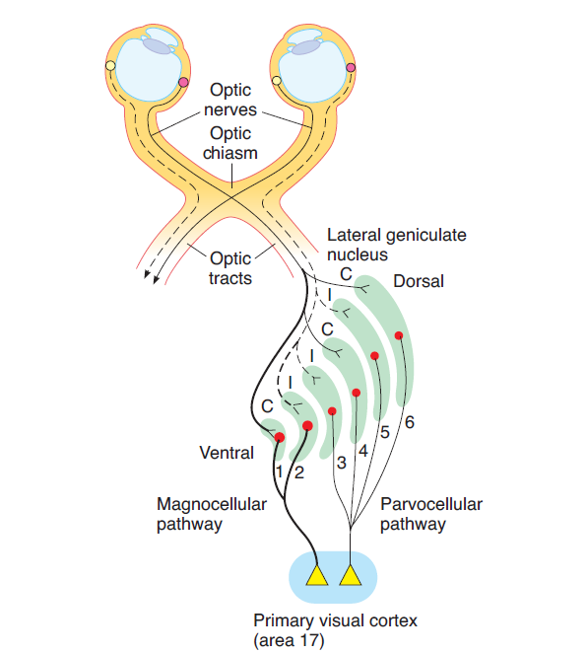
LGB pathways to visual cortex
The magnocellular pathway:
From layers 1 and 2 which have large cells and are called magnocellular., Carries signals for detection of movement, depth, and flicker.
This magnocellular system provides a rapidly conducting pathway to the visual cortex. However, this system is color blind, transmitting only black and white information. (only in female)
The parvocellular pathway:
From layers 3, 4, 5, 6 which have small cells and are called parvocellular, carries signals for color vision, texture, shape, and fine detail.
moderate velocity of conduction. (only in female)

Slide 37
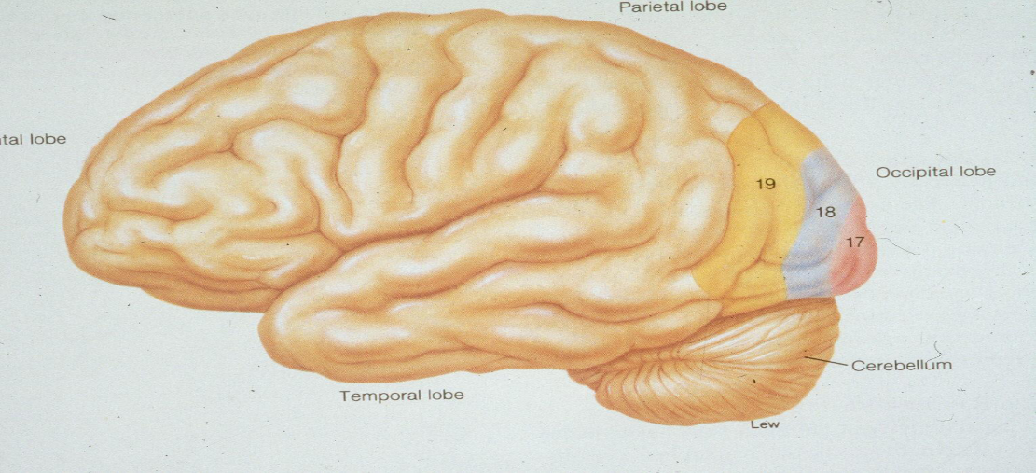
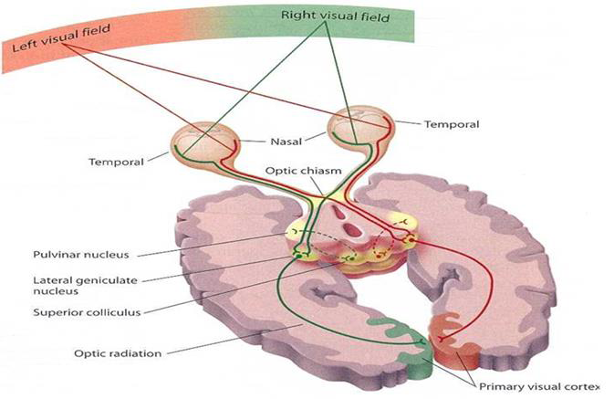
Visual cortex
ONLY IN MALES’ SLIDES
Cortical Visual areas:
Primary (area 17)
Secondary association area, (areas 18, 19)
Primary Visual area (Area 17) :
On medial aspect of each occipital lobe.
Its neurons arranged in the form of columns forming 6
distinct layers.
Fovea has broad presentation.

Slide 38
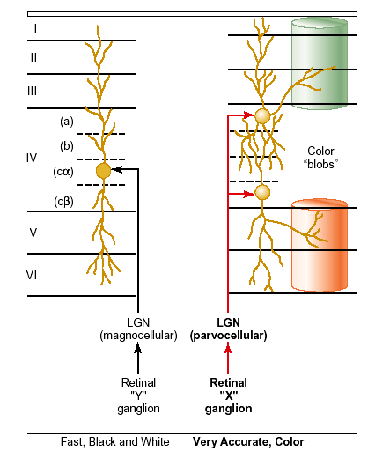
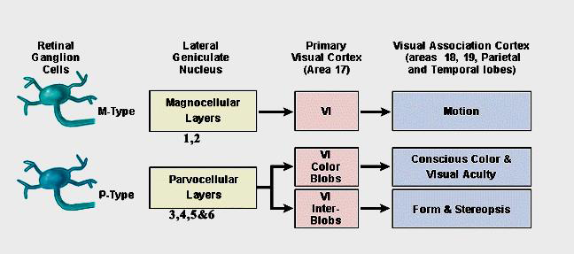
Cont.
ONLY IN MALES’ SLIDES
Role of Area 17: Perception of visible objects without knowing the meaning of these objects.
Secondary Visual Processing: Association Areas (18 &19):
In parietal & temporal lobes.
Interpretation of visual stimuli.
Dealing with complex perception of patterns & forms & responsible for object recognition.
Retinotopic Organization & Processing of visual information:

Slide 39
Three types of retinal ganglion cells and their respective fields
ONLY IN MALES’ SLIDES
In primates a different classification is used:
Parvocellular (P) cells:
  which project to parvocellular layer of LGB, conducting signal of fine details & colors.
Magnocellur(M) cells:
  which project to magnocellular layer of LGB, and they are high sensitive to low contrast stimuli and to rapid movement visual signals.
W cells:
sensitive or detecting directional movement in the field of vision, and they are probably important for much of our rod vision under dark.
X Cells:
Transmission of the Visual Image and Color Vision.
Y Cells:
to Transmit Instantaneous & rapid Changes in the Visual Image , either rapid movement or rapid change in light intensity.

Slide 40
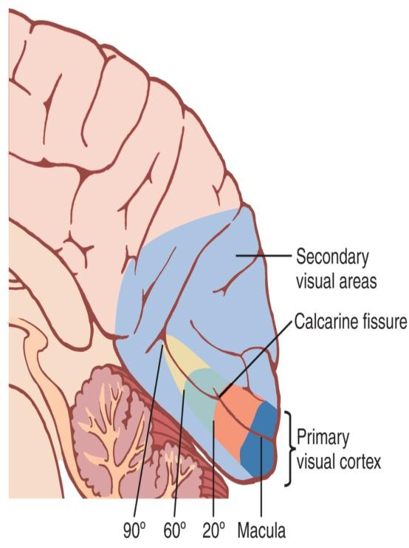
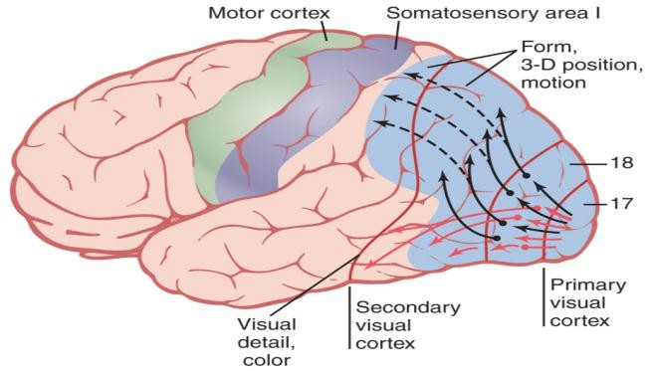
Visual Cortex
ONLY IN FEMALES’ SLIDES
The primary visual cortex has six major layers of cells arranged verticallymeach act as a separate functional unit for processing of information.
The fovea is responsible for the highest degree of visual acuity, so it has larger representation in the primary visual cortex than the most peripheral portions of the retina.
Signals from the retinal fovea transmits its signals terminate near the occipital pole, whereas signals fro the more peripheral retina terminate in concentric h circles anterior to the pole on the medial occipital lobe.
The upper portion of the retina is represented superiorly and the lower portion inferiorly.

Slide 41
Cont.
ONLY IN FEMALES’ SLIDES
1. Primary visual cortex (braodmann area 17):
Perceive sensation of vision (movement + shapes + stereoscopic vision + brightness) & has blobs for color detection.
2. Association visual cortex (area 18 &19) (secondary visual areas ):
Located mainly anterior to the primary visual cortex Function:
interpretation of visual stimuli:
- The fixation mechanism that causes the eyes to “lock” on the object of attention is controlled by secondary visual center.
- When this fixation area is destroyed bilaterally, causes difficulty keeping its eyes directed toward a given fixation point.
Effect of Removing the Primary Visual Cortex:
- Removal of the primary visual cortex causes loss of conscious vision (blindness).
but patient react subconsciously to changes in light intensity, to movement in the visual scene. These reactions include turning
the eyes, turning the head, and avoidance. This vision is believed to be sub served by neuronal pathways that pass from the optic
tracts mainly into the superior colliculi

Slide 42
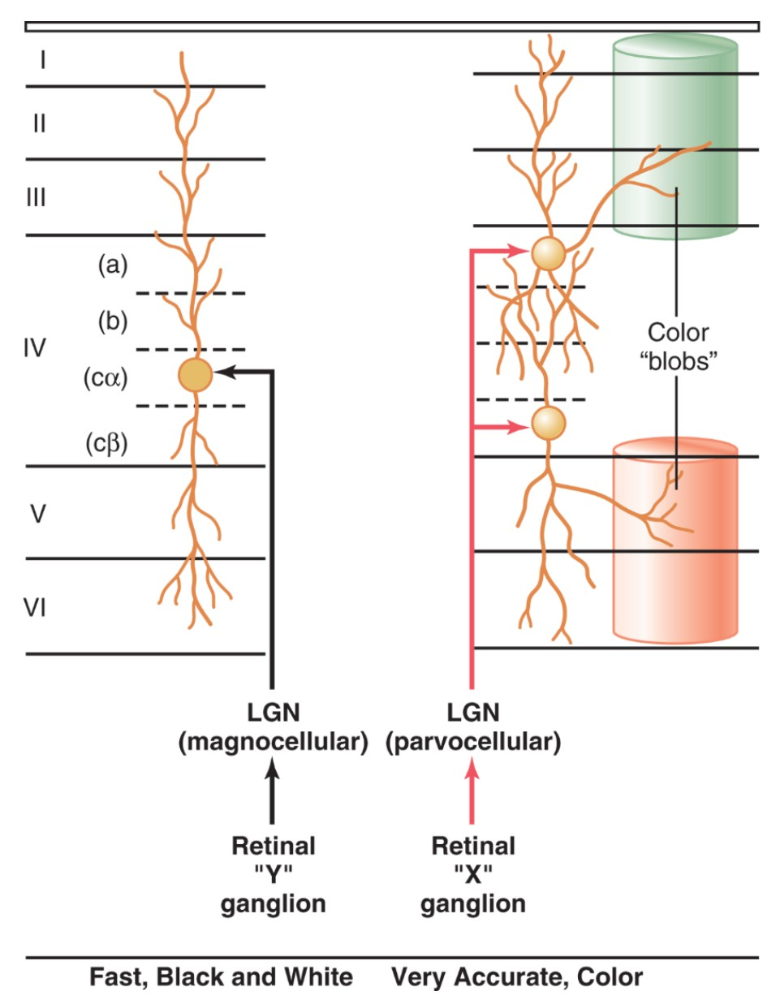
Cont.
ONLY IN FEMALES’ SLIDES
Color blobs: are in the visual cortex. Interspersed among the primary visual columns & among the columns of the secondary visual areas.
Column-like areas called color blobs. Clusters of cells responsible for color detection.
Simple cells detect color contrast details, bars of light, lines, borders and edges.
Complex cells detect line orientation when a line is displaced laterally or vertically in the visual field ( linear movements of a stimulus).

Slide 43
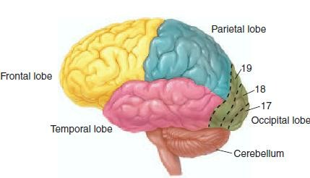
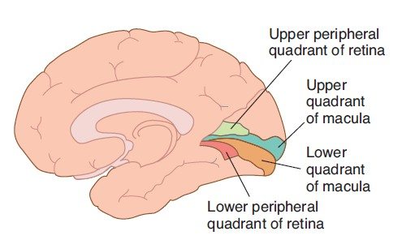
Cont.
ONLY IN FEMALES’ SLIDES
Macular sparing: loss of peripheral vision with intact macular vision.
because the macular representation is separate from that of the peripheral fields and is very large relative to that of the peripheral fields.

Slide 44
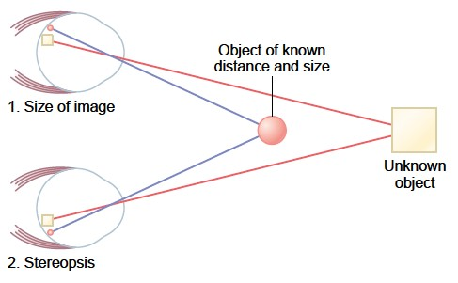
Determination of distance of an object from the eye “depth perception”
A person normally perceives distance by three major means:
1. The sizes of the images of known objects on the retina, the brain calculate from image sizes the distances of objects.
2. The phenomenon of moving parallax:
when the person moves his head to one side or the other, the images of close-by objects move rapidly across the retinas, while the images of distant objects remain almost completely stationary.
3. The phenomenon of stereopsis or binocular vision:
This binocular parallax (or stereopsis) that gives a person
with two eyes far Greater ability to judge distances.
Only in female

Slide 45
Doctors’ notes
Internal carotid compresses the temporal side of optic chiasm on both sides will result in bi-nasal heminopia.
In accommodation, the changes in the pupil is for the sake of decreasing receptive field.
Accommodation will increase the anterior curvature of the lens only and not posterior. WHY? Because of semisolidness of the vitreous humor.

Slide 46






Thank you!
اعمل لترسم بسمة، اعمل لتمسح دمعة، اعمل و أنت تعلم أن الله لا يضيع أجر من أحسن عملا.
The Physiology 436 Team:
Team Leaders:
Lulwah Alshiha
Laila Mathkour
Mohammad Alayed
Females Members:
Lama AlTamimi
Munirah Aldofyan
Zeena Alkaff Ghada Alskait
Males Members:
Basel almeflh
Contact us:
References:
Females’ and Males’ slides.
Guyton and Hall Textbook of Medical Physiology (Thirteenth Edition.)
First Aid Usmle Step 1 ( 2017)

