Slide 1

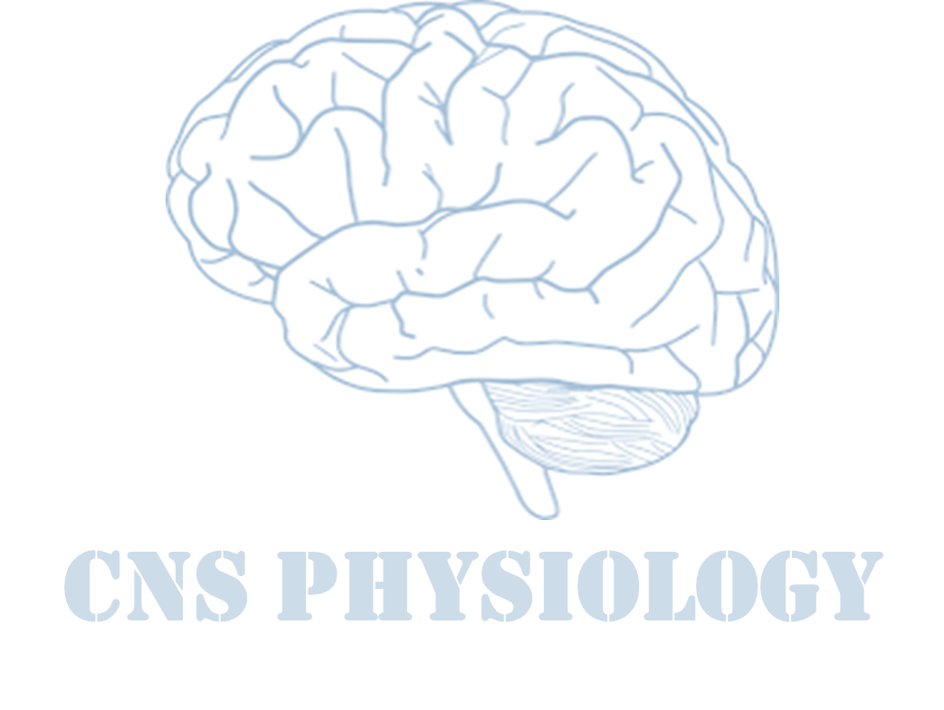
Text
Important
Formulas
Numbers
Doctor notes
Notes and explanation
Lecture No.11
ذو الهمم العالية هم من يراهم الآخرون (أنهم مرهقون أنفسهم )

Slide 2
The Photo transduction in light and dark
Objectives:
Differentiate between rodes & cones concerning distribution and convergence on ganglion cells.
Contrast the phototransduction process for rods and cones in light and dark and the ionic basis of these responses.
List and compare functional properties of scotopic and photopic vision.
To know the visual cycle and rhodopsine regeneration.

Slide 3
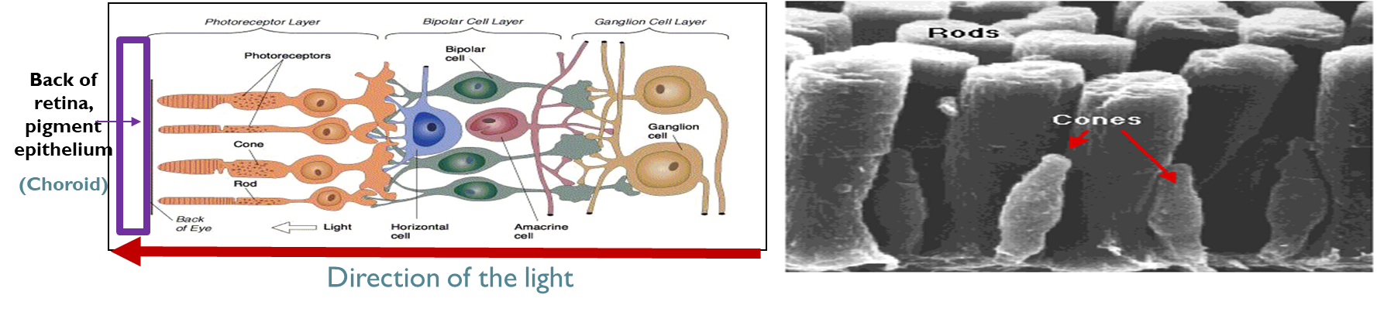
Physiology of vision
Stimulus: Light.
Definition of light: ‘elctromagnetic’ radiation that is capable of exciting the human eye’ + its Extremely fast.
Visible light Spectrum:
Extends from 397 to 723 nm.
Eye functions under two 2 conditions of illumination:
  Bright light (Photopic) vision, By : Cones
  Dim light (Scotopic vision), By : Rods
Duplicity theory of vision

Slide 4
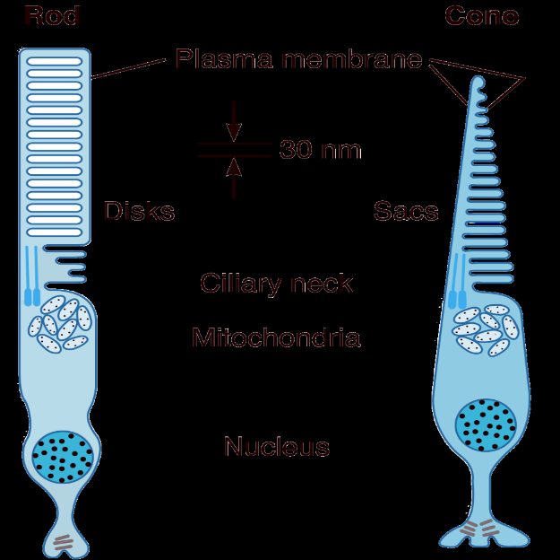
Photoreceptors
Rods
Cones
 |  | Cones | Rods
 |  | 5,000,000 cones | 100,000,000 rods
 |  | Abundant in & Around fovea | Abundant in the periphery of the retina
 |  | Best for bright light conditions / respond to high levels of light intensity (illumination) | Best for low light (dimlight) conditions / respond to levels of light intensity (illumination) below threshold levels for cones so it is more sensitive
 |  | See all colors | Monochromatic/ see black/white and shades of gray
 |  | Good acuity | Poor acuity
The inner and outer segments : Are connected by a ciliary stalk through which the photosensitive compounds travel from the inner segment (where they are manufactured) to the outer segment of the rods and cones (where they are used) | Outer segment: (modified cilia) Has disks full of photosensitive pigment (rhodopsin) react with light to initiate action potential. There are na channels in the outer segment. | Outer segment: Conical Small Contain 3 types of rhodopsin | Outer segment: Big Rode like Contain one type of rhodopsin
 | Inner segment: Full of mitochondria (source of energy for na-k pump). There is na-k pump in inner segment. | Thick in cones
Plasma membrane
Disks
Sacs
Ciliary neck
Mitochandria
Nucleus

Slide 5
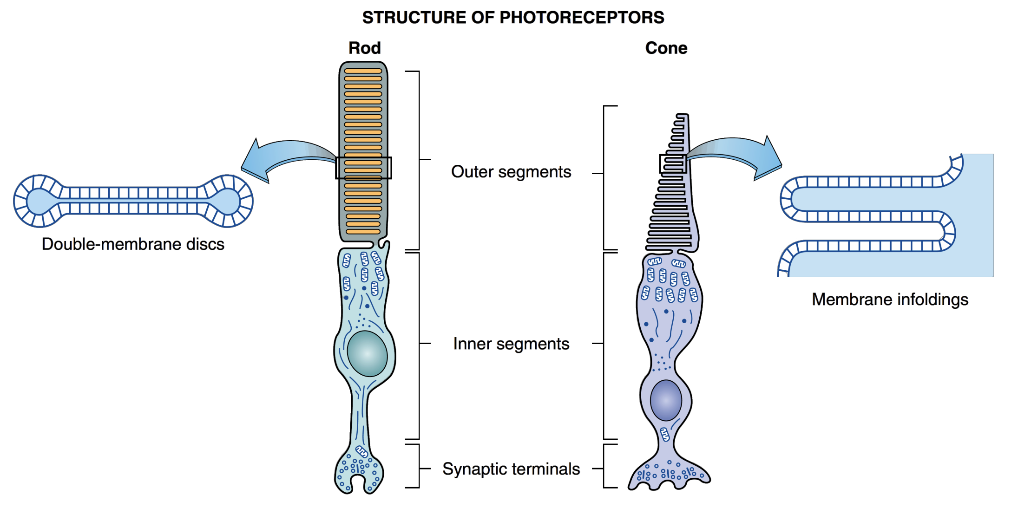
Structure of photoreceptor
ONLY IN FEMALES’ SLIDES
Each rod contains a stack of disk membranes that are flattened membrane-bound intracellular organelles that have detached from the outer membrane.
Disks are free floating
The saccules of the cones are formed by infolding of the membrane of the outer sigment.
The saccules and disks contain the photosensitive compounds that react to light → initiating action potentials in the post synaptic cells

Slide 6
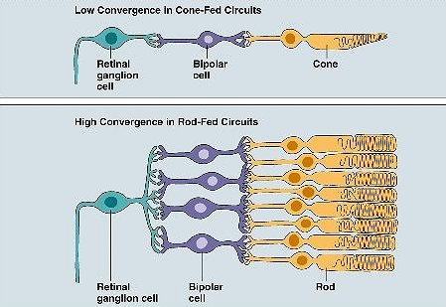
Convergence
Cones Rods
Photoreceptors
Ganglion cells
The receptive field of a
ganglion cell in the retina of the eye is composed of input from all of the photoreceptor which synapse with it
A group of ganglion cells in turn forms the receptive field for a cell in the brain. This process is called convergence
ONLY IN FEMALES’ SLIDES
Cones | Rods
120 million rode& 6 million cone converge on 1.2 million optic nerve fibers , (126 million receptor on 1.2 million nerve fiber ) so convergence is 105 receptor: 1 fiber.
Low convergence in cones :
  each foveal cone synapse with →one bipolar cell →one ganglion cell →single optic nerve fiber
Value of low convergence ;
  increases visual acuity → integrated information from small area of retina
Disadvantage:
  decreases sensitivity to light i.e need high threshold of illumination to stimulate cones.
High convergence of rods:
  several rodes about 300 synapse with one bipolar cell& one ganglion cell
Value of high convergence ;
  decreases visual acuity = integrated information from large area of retina
  increases sensitivity to light i.e so low light threshold stimulate the rods)

Slide 7
Photosensitive compounds
Composition:
  Retinine1 (Aldehyde of vitamin A ): Same in all pigments , from dietary beta-carotene
  Opsin (protein): Different amino acid sequence in different pigments
  Rhodopsin (Rod pigment): Retinine + scotopsin
Cones | Rods
It is rhodopsin (iodopsine) formed of :- Opsin protein + retinal (retinene 1 = aldhyde form of Vit A). There are 3 types of rhodopsin in cones : (photopsine I,II,III ) each respond to a certain wave length of light for color vision. | - Its rhodopsin formed of :- Scotopsin protein(opsin) + retinal (retinene 1 = aldhyde form of Vit A) = visual purple (Rhodopsin of the rods most strongly absorbs green-blue light and, therefore, appears reddish-purple, which is why it is also called "visual purple) -It forms 90% of rods protein ,stored in disks of rods at outer segment. -At dark rhodopsin is in 11-cisretinal form (inactive). -At light sensitive form which increase sensitivity of rods to light.
Rods &cones potentials are graded, local potential (generator potential) propagated as A.P in
ganglion cells
Ganglion cell action potential (all or none A.P) transmitted to optic nerve
ONLY IN FEMALES’ SLIDES

Slide 8
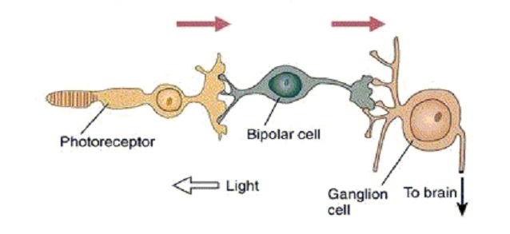
Retinal photoreceptors mechanism
Step 1
Step 2
Step 3
Light
Absorption by photosensitive substances
Structural change in photosensitive substances
Phototransduction
Action potential in the optic nerve
The process of converting light stimuli into electrical signals
Light hits photoreceptors, sends signal to the bipolar cells
Bipolar cells send signal to ganglion cells
Ganglion cells send signal to the brain

Slide 9
Extra to understand the whole mechanism together it is recommended to read then take the drs slide as summary
Step 2
Step 1
the photopigment in rods is rhodopsin.
it exists in the dark as 11-cis retinal, which fits into a binding site within the interior of the opsin portion of rhodopsin .
The plasma membrane of a photoreceptor’s outer segment contains chemically gated Na channels. That respond to an internal second messenger cyclic GMP . binding of cGMP to these Na channels keeps them open
PHOTORECEPTOR ACTIVITY IN THE LIGHT : On exposure to light, the concentration of cGMP is decreased through a series of biochemical steps triggered by photopigment activation .
When 11-cis retinal absorbs light, it changes to the all-trans retinal conformation . This is the only light-dependent step in the entire process of phototransduction. As a result of this change in shape, retinal no longer fits snugly in its binding site in opsin, causing opsin to also change its conformation, which activates the photopigment. Membrane- bound opsin is similar in shape and behavior to G-protein-coupled receptors, except that instead of being activated by binding with an extracellular chemical messenger, photopigments are activated in response to light absorption by retinal.
Rod and cone cells contain a G protein called transducin. the activated photopigment activates transducin, which in turn activates the intracellular enzyme phosphodiesterase. which degrades cGMP, thus the reduction in cGMP permits the chemically gated Na channels to close.this channel closure stops the depolarizing Na leak and causes membrane hyperpolarization. the hyperpolarization, which is the receptor potential, passively spreads from the outer segment to the synaptic terminal of the photoreceptor. Here the potential change leads to closure of the voltage gated Ca2 channels and a subsequent reduction in glutamate release from the synaptic terminal. The hyperpolarizing potential and subsequent decrease in neurotransmitter release are graded according to the intensity of light. e brighter the light is, the greater the hyperpolarizing response and the greater the reduction in glutamate release.
Step 2
Step 1
Step 3
PHOTORECEPTOR ACTIVITY IN THE DARK :
In the absence of light, the concentration of cGMP is high (Light absorption leads to the breakdown of cGMP (explained in the light section)) therefore, the Na channels of a photoreceptor are open in the absence of stimulation, that is, in the dark. the resultant passive inward Na leak, (the so-called dark current,) depolarizes the photoreceptor. the passive spread of this depolarization from the outer segment (where the Na channels are located) to the synaptic terminal (where the photoreceptor’s neurotransmitter is stored) keeps the synaptic terminal’s voltage-gated Ca2 channels open. Calcium entry triggers the release of the neurotransmitter glutamate from the synaptic terminal while in the dark.

Slide 10
Photoreceptor pigments
Activation of rhodopsin:
In the dark: rhodopsin is inactive (in 11 cis-retinal form which needs light for its activation ) , inactive rhodopsin is essential for depolarization
its inactivation keeps Na channels open & Na current occurs
    In the light (Activation of rhodopsin) : retinine1 in the 11-cis configuration All-trans isomer → Metarhodopsin II (Closure of
    Na channels) → metarhodopsin II→ all-trans-retinal by a conformational change (bleaching) and all
    trans-retinal separate from opsin by light and opsin remains alone.
In the dark again: trans-retinal is enzymatically re-converted to the 11-cis-retinal form via an retinal isomerase enzyme.
- Since the scotopsin is present alone (having been removed from the rhodopsin) it immediately will combine with 11-cis-retinal to regenerate new rhodopsin , so : 11cis-Retinal in rods + scotopcin → → rhodopsin regeneration
Light
ONLY IN FEMALES’ SLIDES

Slide 11
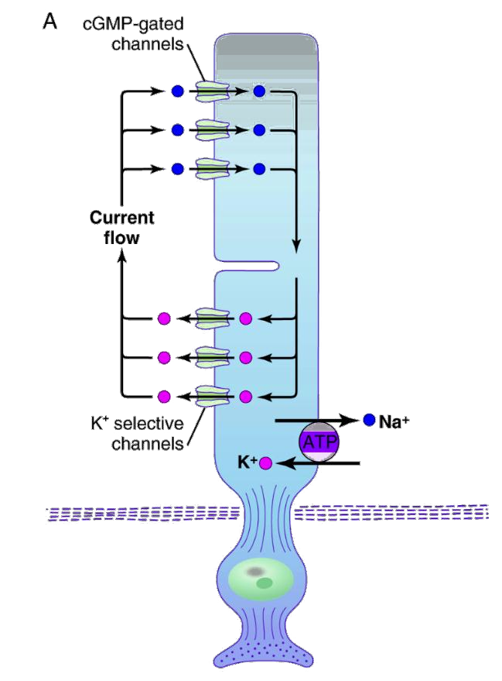
Electrophysiology of vision
( phototransduction)
ONLY IN FEMALES’ SLIDES
Phototransduction :
A-at dark ( scotopic vision, dimlight vision):
Rhodopsin in 11-cisretinal ( inactive form-light sensitive form which increase sensitivity of rods to light)
(5 –GMP) in the c-gmp form c-gmp at c-gmp gated na channels of the outer segment , it bound to proteins at na channel membrane that will keep them open) → opening of na channels at outer segment → allow na influx after its is pumped out from na –K pump of the inner segment→ depolarization. (-40 mvolt , instead of -80 mvolt in most receptors)
Dark current (na current):- at the inner segment na pumped
By na- K pump to outside & re-entered through na channels (at outer segment ) → depolarization flow to synaptic endings → steady increased release of glutamate at synapses with bipolar cells → which get depolarization potential ( off-center bipolar cells)→ depolarize ganglion cells

Slide 12
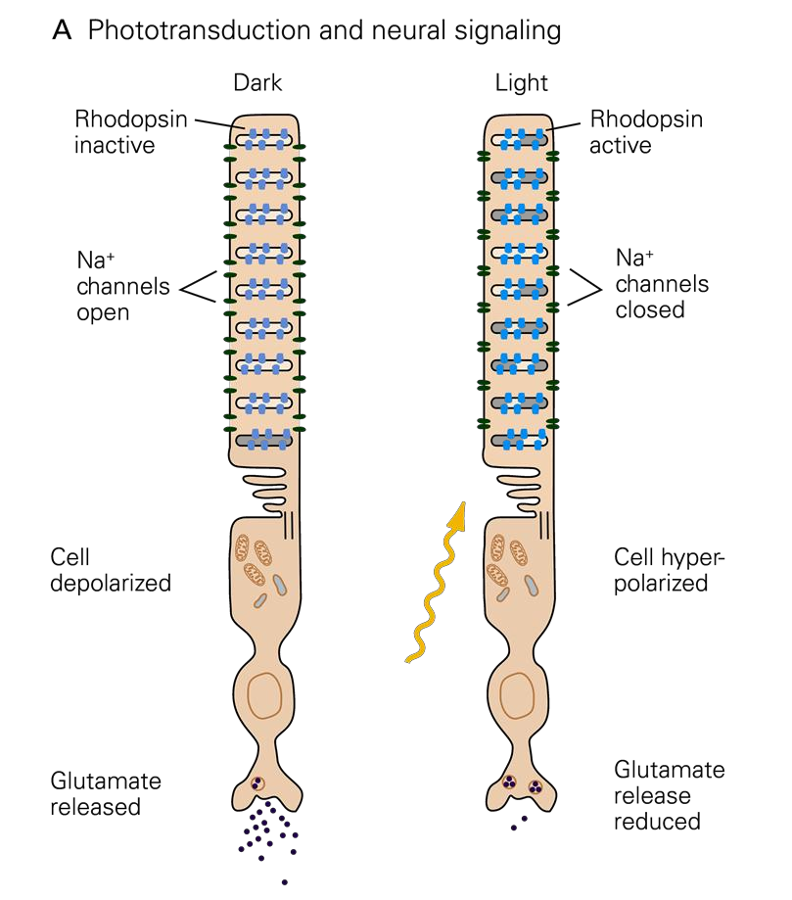
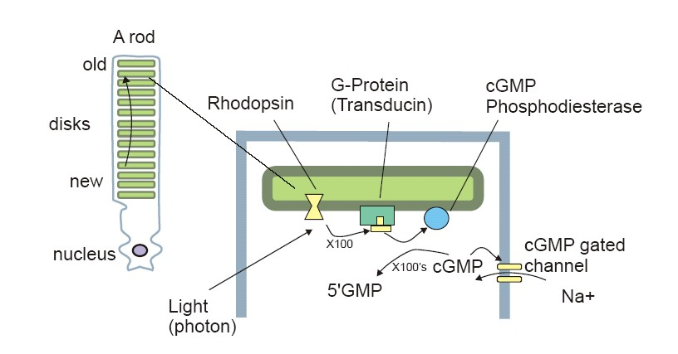
Visual cycle :
B- in the light :
Change in photopigment
Metarhodopsin II
( an active rhodopsin)
Activation of of G–protein (transducin)
Activation of phophodiesterase
Decrease release of synaptic transmitter:
Response in bipolar cells (hyperpolarization) ( off-center bipolar cells get hyperpolarized in -70 ~ -80 millivolts ,this cause decreased release of glutamate
Hyperpolarization of receptor how ? still Na pump from inner segment from inside the rods to outside + despite potassium ion being pumped to the inside of the cell there is a potassium leaking out of the cell through non gated potassium channels in the inner segment of the rods which generate ( -70 ~ -80 millivolts)
Closure of Na channels
conversion of c-GMP to 5- GMP → Decrease IC cyclic GMP
ONLY IN FEMALES’ SLIDES
Generator potential in amakrine cells & ganglion cells (depolarize )
Action potential in optic nerve fibers
NB/
These reactions occur in both rods &cones but in rods occur at low illumination as in dimlight & in cones at high illumination.
- in cones 4 times faster

Slide 13
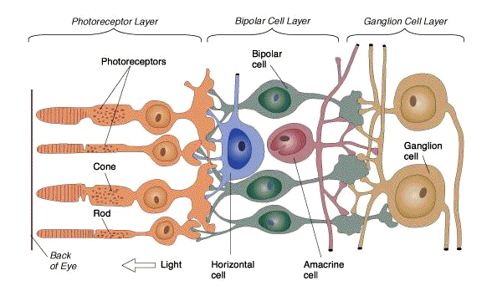
Synaptic mediators in retina:-
Ach
glutamate
dopamine
serotonine
GABA
somatomedin
substance P
enkephalins
glucagons
neurotensin
In dark:-
In light:-
depolarization of rod receptors which depolarize bipolar cell (OFF-center)
glutamate is continuously (steadily) released
generator potential
AP in ganglion cells
hyperpolarization of the receptors
decrease glutamate release
hyperpolarize bipolar cells (OFF-center)gradual depolarize ( on –center cells),depolarize amacrine cell
AP in ganglion cells.
generator potential
Electric recording in Retinal cells:
  Rods & Cones: Hyperpolarization
  Bipolar cells: Hyper- & Depolarization
  Horizental cells: Hyperpolarization
  Amacrine cells: Depolarizing potential
  Ganglion cells: Depolarizing potential

Slide 14
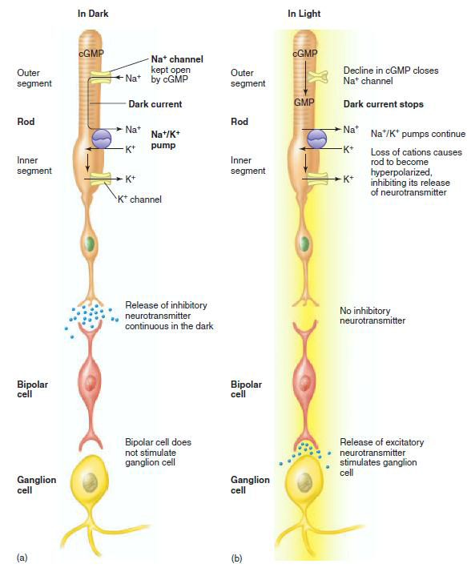
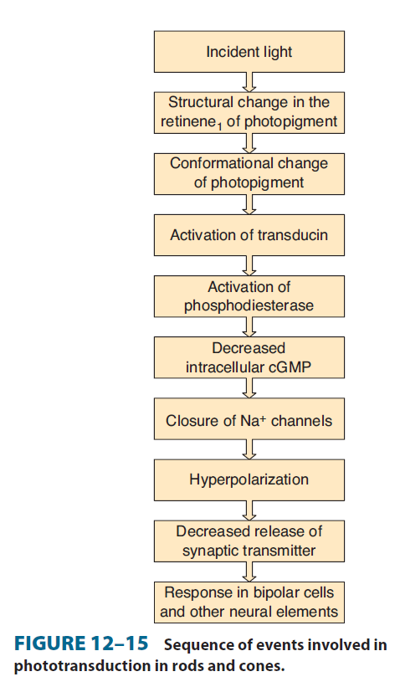
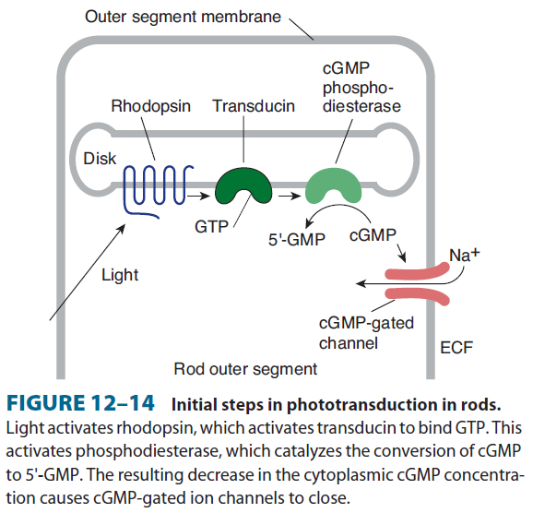
Retinal photoreceptors mechanism (as a summary)

Slide 15
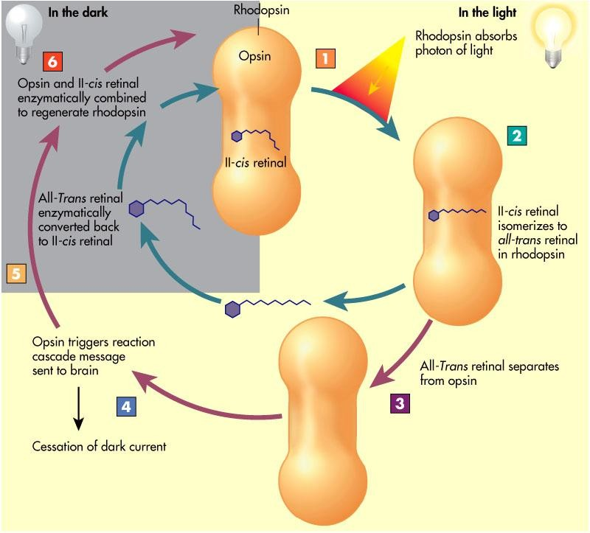
Summary
ONLY IN FEMALES’ SLIDES

Slide 16
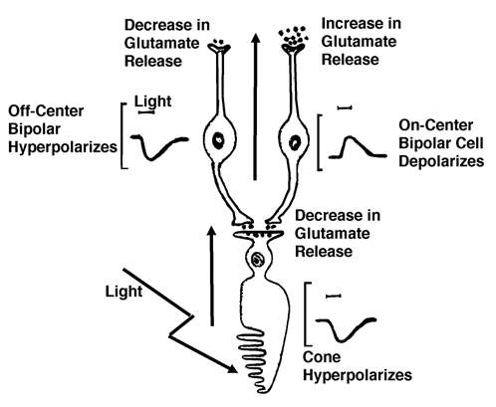
Bipolar cells
We have 10 types of cones bipolar cells & one type of rod bipolar cell
Light: hyperpolarize the receptors>>>> decrease glutamate release at photoreceptor ends>>.
1- depolarize ON- center bipolar cells
2- hyperpolarize OFF-center bipolar cells ( inactive)
Dark: depolarize receptors >>> increase glutamate at photoreceptor ends>>
1-hyperpolarize ON- center bipolar cells
2-depolarize OFF-center bipolar cells
N.B/
ON- center bipolar ( synaptic connection with center photoreceptors= cones , so light depolarize them to see in bright light) | OFF- center bipolar ( synaptic connection with peripheral photoreceptors= rods , so dark depolarize them to see in dark)
All these help to sharpen signal from rods in dark and from cones in light

Slide 17
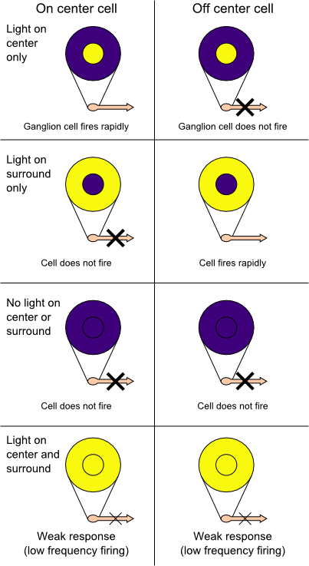
Types of retinal ganglion
ONLY IN FEMALES’ SLIDES
There are two types of retinal ganglion cells :
An on-center cell : is stimulated when the center of its receptive field is exposed to light, and is inhibited when the surround is exposed to light.
Off-center cells : is stimulated by activation of the surround and inhibited by stimulation of the center
Stimulation of on –center cell's : receptive field produces depolarization and an increase in the firing of the ganglion cell, stimulation of the surround produces a hyperpolarization and a decrease in the firing of the cell.
Stimulation of both the center and surround : produces only a mild response (due to mutual inhibition of center and surround).

Slide 18
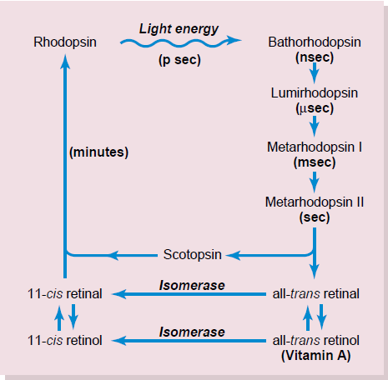
Scotopsin Retinal Visual Cycle
Photochemistry of Color Vision by the Cones
The amount of rhodopsin in the receptors therefore varies inversely with the incident light level.
When there is excess retinal in the retina, it is converted back into vitamin A, thus reducing the amount of light-sensitive pigment in the retina.
Photopsins Retinal Visual Cycle
The cones are about 30 to 300 times less sensitive than rods to light.

Slide 19
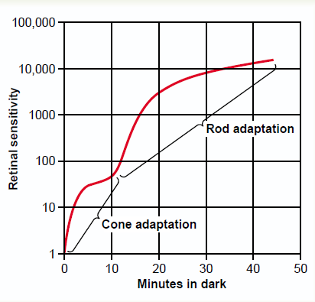
Adaptations
1- Dark adaptation : Increased sensitivity of the photoreceptors when vision shifts from bright to dim light
                Dark adaptation has 2 components:-
                (Reaches max in 20 minutes)
                1- rapid : First 5 minutes …… threshold of cones (only in fovea)
                half of the cone rhodopsin regenerate in only 90 seconds.
                2- less rapid 5 to 20 mins ……. threshold of rods → Sensitivity of rods (in the peripheral) retina
                - sensitivity of rods to light increase , in1min increase10 folds
                - ( rods increase their sensitivity to light by convergence 300:1 ganglion cell , so summation at ganglion cell potential will increase sensitivity to light )
                - What happen in this 20 min ? Regeneration of rhodopsin
NYCTALOPIA:- ( night blindness)
Vitamine A deficiency (main source of retinal of rhodopsin) cause rods
, cones & retinal degeneration & loss of rods
Treatment: R / Intravenous vit A if receptors are well.
Q- Why radiologists & aircraft pilots wear red goggles in bright light?
A- Light wavelength of the red stimulate the cones & stimulates rods to some extent, so red goggles for rods act as dimlight , so with it rods are adapted to darkness & form large amounts of rhodopsin while the person in bright light & when person enter dark places he can see well & not remain 20 minutes.
ONLY IN FEMALES’ SLIDES

Slide 20
Cont.
Three types of retinal ganglion cells and their respective fields
2- Light adaptation:
When light switched on again, the rods are knocked out of action ( they stop sending AP at high levels of light) & cones start to function to adjust & adapt to the level of brightness in 5 min this is called Light adaptation
1-W cells : sensitive for detecting directional movement in the field of vision, and they are probably important for much of our rod vision under dark conditions
2- X Cells : Transmission of the Visual Image and Color → color Vision
3-Y Cells : to Transmit Instantaneous & rapid Changes in the Visual Image , either rapid movement or rapid change in light intensity

Slide 21






Thank you!
اعمل لترسم بسمة، اعمل لتمسح دمعة، اعمل و أنت تعلم أن الله لا يضيع أجر من أحسن عملا.
The Physiology 436 Team:
Team Leaders:
Lulwah Alshiha
Laila Mathkour
Mohammad Alayed
Females Members:
Leena Alwakeel
Aseel Alsulimani
Males Members:
Mohammad almutlaq
Contact us:
References:
Females and Males slides.
Guyton and Hall Textbook of Medical Physiology (Thirteenth Edition.)

