Slide 1
Text
Important
Formulas
Numbers
Doctor notes
Notes and explanation
Lecture 14
Lecture No.12
“ Don’t Stop When You’re Tired, Stop When you’re DONE “

Slide 2
Color vision, light and accommodation reflex
Objectives:
Perform the test for visual acuity using a Snellen's chart, list the common refractive errors and describe how they can be corrected.
Perform the test for near vision using a Jaeger's chart.
Perform the test for Astigmatism using Astigmatism chart and describe how it can be corrected.
Determine one's near point.
Demonstrate one's blind spot.
Explain the mechanisms of accommodation with the help of Purkinje-Sanson images.
Identify one’s color-vision defects using the Ishihara's colored charts.

Slide 3
Color vision
It the ability to discriminate between different colors.
there are 3 primary colors ( ) sensed by cones in fovea & appreciated within photopic vision.
sensation of extraspectral colors as white can be produced by mixing properties of the blue &red & green in different combinations.
Black means absence of light ( not darkness because in dark we do not see black only)
Colors have three attributes hue, intensity, and saturation (degree of freedom from dilution with white).
For any color there is a complementary color that, when properly mixed with it,
produces a sensation of white.
Black is the sensation produced by the absence of light, but it is probably a positive sensation because the blind eye does not “see black;” rather, it “sees nothing.
blue
red
green
yellow
orange
purple
History of color vision:
Newton (1704) used a prism to show that sunlight was composed of light with all colors in the rainbow. He defined it as the spectrum.
ONLY IN MALES’ SLIDES

Slide 4
Color vision theory
Young - Helmholtz theory (The Trichromatic theory) : we have 3 kinds of cones each has a specific photopigment (rhodopsin) & is sensitive to one of the 3 primary colors
 | Blue cone system | Green cone system | Red cone system
The pigment | S pigment ( blue sensation pigment) | M pigment ( green sensation pigment) | L pigment ( red sensation pigment)
Wave length | short wave length ( 440 nm) | middle wave length ( 535 nm senses the green color & less to yellow) | large wave length at or > 535 nm so senses the red & yellow color
Absorbing light at | - | The light absorbed at the green portion | The light absorbed at the red portion
The three primary colors are perceived by three photoreceptor pigments (with broad absorption curves). White light is produced by mixing three colors. each cone system respond to its color at a lower threshold than needed to sense other colors ( red cones respond to red or yellow color at a lower threshold than to green color).

Slide 5
Cone wavelength ranges
ONLY IN FEMALES’ SLIDES
Light absorption by the pigments of three color-receptive cones of human retina.

Slide 6
Cone wavelength ranges
ONLY IN MALES’ SLIDES
Relative absorption
S
M L
Cone pigment three kinds
565
535
440
400
500 600
700
Wavelength (nm)

Slide 7
Sensation of colors
Sensation of any color determined by:
wavelength of light
amount of light absorbed by each type of cones
Frequency of impulses from each cone system to ganglion cells which is determine by waves length of light.
(by the intensity of light)

Slide 8
Color coding
Color vision is coded by:
In ganglion cells:
different responses in ganglion cells that depends upon the wave length of stimulus which determine frequency of impulses in ganglion cells.
In brain:
the color perception in the brain depends on the amount of activity in each of the 3 cone systems as mentioned above.

Slide 9
Color perception
Color perception
White color
Orange color
Yellow color
Blue color
perception of white is due to: equal stimulation of blue & red & green cones.
There is no wave length corresponds to white, white is a combination of all wave
Lengths.
Perception of orange is due to stimulation of :
99% of red cones
42% of green cones
0% of blue cones
so ratio is (99 : 42 : 0)
Boy’s slide: the ratio is 83: 83 : 0
Girl's slide: Perception of yellow is due to stimulation of:
50% of red cones
50% of green cones
0% of blue cones
so ratio is ( 50 : 50 : 0 )
Perception of blue is due to stimulation of:
0% of red cones
0% of green cones
97% of blue cones
so ratio is ( 0 : 0 : 97 )
تدرجات الألوان تحدد بناء على اختلاف نسب الألوان الثلاث الأساسية فمثلاً الأزرق ينتج عندما تتحفز الBlue cones)) بنسبة 97% ولو كان اللون أزرقاً فاتحاً فستكون نسبة التحفيز أقل .

Slide 10
Color perception
ONLY IN FEMALES’ SLIDES
Perception of white light
there is no single wavelength of light corresponding
to white; instead, white is a combination of all the
wavelengths of the spectrum.
as can be seen in this vector diagram – white occupies the
middle of the vector

Slide 11
Color blindness
Definition
Related definitions
Anamoly and Anopia
Red - green blindness
Color blindness is a genetic condition
Weakness or total blindness in detecting a primary color
Trichromats: see the 3 1^{ry} colors (normal or have slight weakness in detecting red or green or blue color).
Dichromats: boy’s slide: (blind to one 1^{ry} color) girl’s slide: ”have only 2 cone pigments systems only so he is completely blind to red or green or blue (so they may have protanopia , deuteranopia, or tritanopia) they get color by mixing only 2 of the primary colors”.
Monochromats: have only one color pigment (system) or loss of all so see only black or grey or have no color perception.
Prot → red
Deuter → green
Trit → blue
Anamoly → weakness
Anopia → Total loss (blindness)
Protanamoly
Protanopia
Deuteranamoly
Trichromats
Deuteranopia
Dichromats
Tritanamoly
Tritanopia
Protanopia (red blindness): no red cones system so person has shortened spectrum wave length
If only weakness in red color vision is called Protanamoly
ONLY IN FEMALES’ SLIDES
Deuteranopia (green blindness): no green cones system so person see only long & short wave length
If only weakness in green color vision is called Deuteranamoly
Tritanopia (blue blindness): no bluecones system
If only weakness in blue color vision is called Tritanamoly

Slide 12
Cont.
Definition
Related definitions
Anamoly and Anopia
Red - green blindness
Color blindness is a genetic condition
Green & red cones see different colors between wave length 525-675 nm & distinguish them.
If either of these cones are absent, the person can not distinguish 4 colors ( red – green – yellow - orange) & he can not distinguish red from green (primary colors) so called ( red – green blindness).
It is x- linked disease transmitted from females to their male sons, never occur in females as they have 2 x chromosomes.
Males have one x & one y chromosome so if this one x chromosome miss the gene for color vision, he will get red-green color blindness (their gene is on x chromosome).
Females show the disease only if both x chromosomes lack the gene.
Females from color blind fathers are carriers transmit the disease to ½ of their sons.
ONLY IN FEMALES’ SLIDES
There is gene for rhodopsin on chromosome (3).
There is gene for blue sensitive S cone pigment on chromosome (7).
There is gene for red & green sensitive cone pigment on x chromosome.
when a single group of color receptive cones is absent
(due to absence of their gene) the person can not see or distinguish some colors from others.

Slide 13
Color blindness
ONLY IN FEMALES’ SLIDES

Slide 14
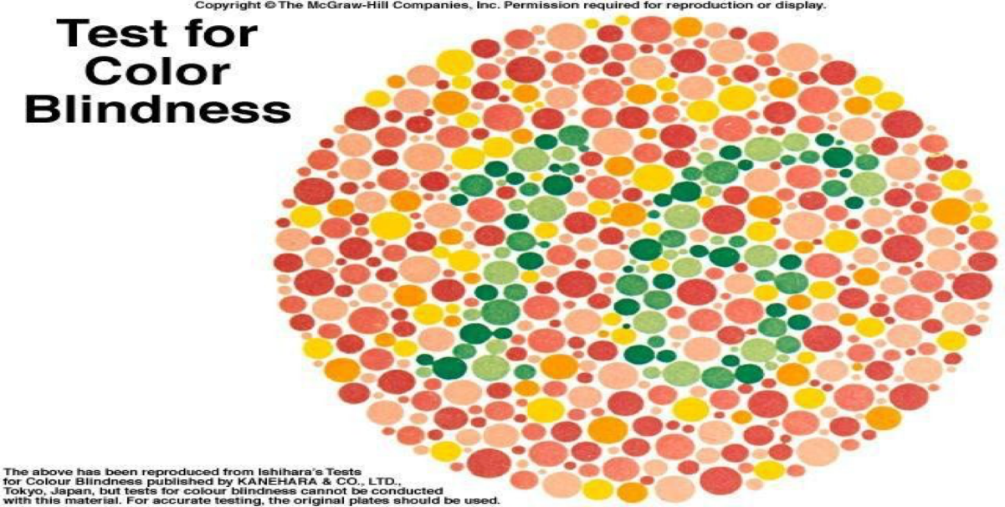
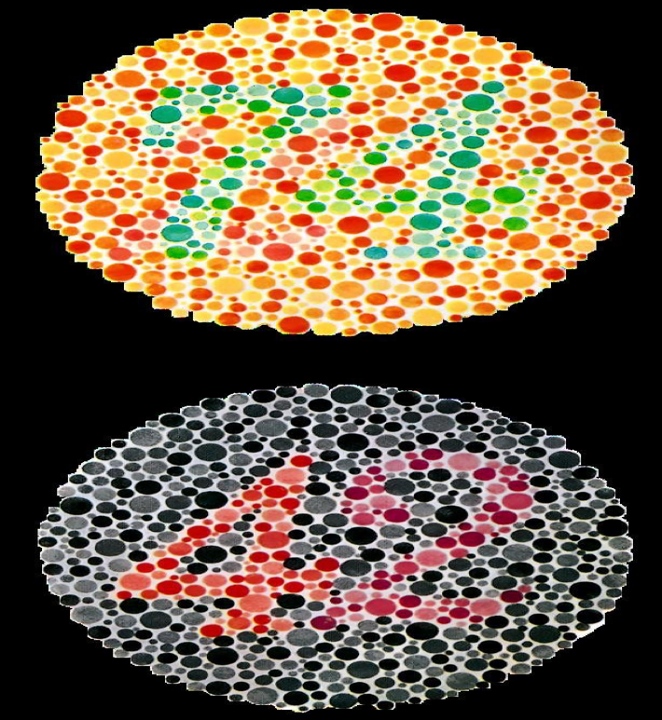
Test for color blindness
Ishihara chart, which are plates contain figures made up of colored spots on background of similarly shaped colored spots.
The figures are intentionally made up of colors that are liable to look the same as the background to an individual who is color blindness.
Some color-blind individuals are unable to distinguish certain colors, whereas other have only a color weakness.

Slide 15
Thank you!
اعمل لترسم بسمة، اعمل لتمسح دمعة، اعمل و أنت تعلم أن الله لا يضيع أجر من أحسن عملا.
The Physiology 436 Team:
Team Leaders:
Lulwah Alshiha
Laila Mathkour
Mohammad Alayed
Females Members:
Allulu Alsulayhim
Shatha Alghaihb
Amal Alshaibi Ghada Alhadlaq
Males Members:
Contact us:
References:
Females and Males slides.
Guyton and Hall Textbook of Medical Physiology (Thirteenth Edition.)

