Slide 1
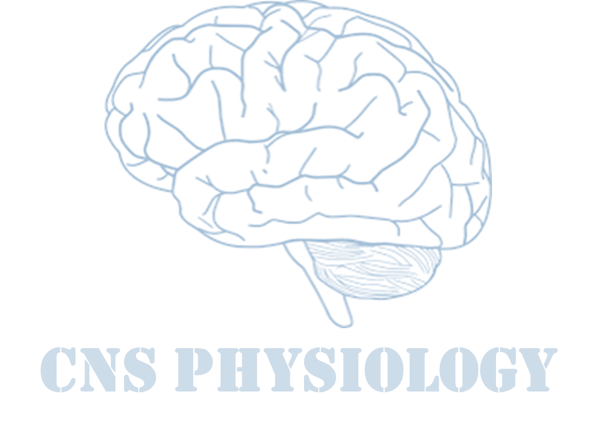
Text
Important
Formulas
Numbers
Doctor notes
Notes and explanation
Lecture No.13
“There Is A Crack In Everything. That’s How The Light Gets In”

Slide 2
Physiology of Taste and Smell
Objectives:
Appreciate the physiology of olfaction.
Describe the olfactory pathway.
Appreciate some pathophysiological conditions related to olfaction as anosmia, parosmia hypo and hyperosmia.

Slide 3
1- SMELL

Slide 4
Special senses
ONLY IN FEMALES’ SLIDES
Extra
He
Vision
Hearing
Smell
Taste
The olfactory (smell) system:
The olfactory system is the least understood sensory system.
It helps us enjoy life (e.G. Perfume, and food).
Smell can be a powerful stimulant of human emotions.
It is also a warning system alerting us to dangerous signals (e.G., Gas leak, spoiled food).
It helps in choosing mates in some mammals (release of pheromones).
Minute quantity of an odorant in the air can elicit a smell sensation.
Methylmercaptan can be smelled when only 25x10⁻¹² g is present in each ml of air.
This substance is mixed with natural gas so that even a small amount of gas leak can be detected.

Slide 5
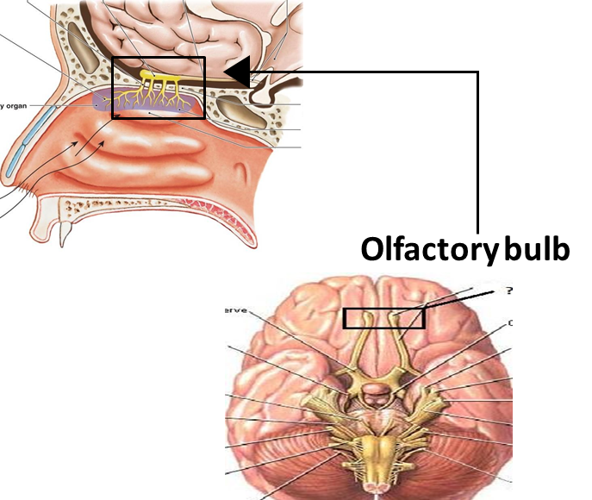
Anatomy of the olfactory system
Anatomy of the olfactory system
Extra Pic
A.Peripheral components
B.Central components
Olfactory receptors:
Located in the olfactory epithelium.
Olfactory nerve fibers:
Located in the olfactory nerve (CN I)
Olfactory bulb:
In the brain
Olfactory tract.
Olfactory cortex:
Deep in the temporal lobe and bas of the frontal lobe (interpretation of olfactory signals).
Olfactory mucus:
in the roof of nasal cavity near the septum.
Contain olfactory receptors (bipolar neurone).
Axons collected in bundles called fila olfactoria.
ONLY IN FEMALES’ SLIDES

Slide 6
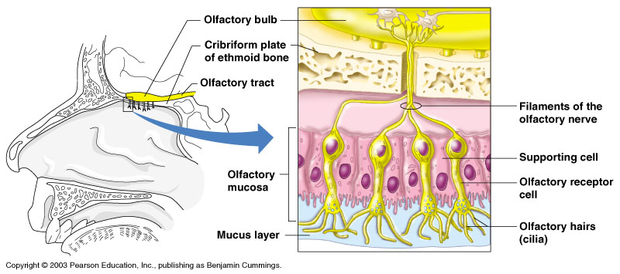
Olfactory epithelium
Physiology of smell
ONLY IN MALES’ SLIDES
Power of perceiving odors is called smell.
Olfactory receptors present in the roof of nasal cavity.
Neurons with long cilia (olfactory hairs).
Chemicals must dissolved in mucus for detection.
Impulses transmitted
via the olfactory nerve.
Interpretation of
smells is made in the
olfactory cortex of the
brain.

Slide 7
Physiology of olfaction
1
Molecules dissolve in mucus layer.
2
Combine with receptors on cilia.
3
Stimulate adenylat cyclase.
4
Increase intracellular camp.
5
Opening of Na channels.
6
Receptors potential.
7
AP in olfactory pathway.
Human can differentiate between 2000-4000 odours.
Adaptation can occur to pleasant and nasty smells due to changes both in receptors and central connections.
The connection between olfactory epithelium and air molecules is easily abolished.

Slide 8
Mechanism of Excitation of the Olfactory Cells Mechanism of Olfactory Cell Stimulation
ONLY IN MALES’ SLIDES
Diffusion of the odorant substance, into the mucus.
Odorant binds and activates the receptor protein, resulting in activation of G-protein complex.
This causes activation of adenyl cyclase in the cell membrane.
This enzyme converts ATP into cAMP (a second messenger).
This causes activation of sodium ion channels resulting in
Na influx.
Depolarization and excitation of the olfactory neuron.
Transmission of nerve impulses into CNS by the olfactory nerve.

Slide 9
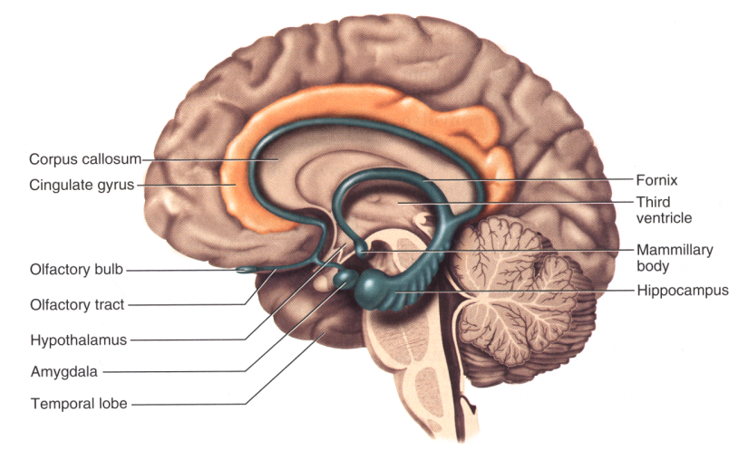
Olfactory pathway
ONLY IN FEMALES’ SLIDES
Fila olfactoria inter olfactory bulb synapse with mitral and tufted cells:
From mitral cells lateral and intermediate stria start end on ipsilateral cortex.
From tufted cells medial strai start then cross the midline & end on granular cells in opposite side (contralateral).
Impulses travel from
olfactory tracts to the limbic system (also involved in emotions and memory).
Impulses are interpreted in olfactory cortex deep in temporal lobe and base of frontal lobe
ONLY IN MALES’ SLIDES

Slide 10
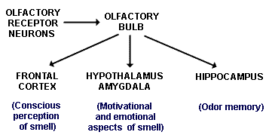
Olfactory pathway
ONLY IN MALES’ SLIDES
Olfactory receptor cell
olfactory nerve
olfactory bulb
Olfactory tract
Medial olfactory area
Lateral olfactory area
Septal nuclei
Orbitofrontal cortex
(newer)
thalamus
Hypothalamus limbic system (primitive parts)
(less old olfactory system)
Limbic system (hippocampus)
(very old olfactory system)
Prepyriform cortex
Pyriform cortex
amygdala

Slide 11
Cont.
Neuronal connections of the olfactory system
ONLY IN MALES’ SLIDES
ONLY IN FEMALES’ SLIDES
First order neuron:
From olfactory epithelium to glomerulus.
Second order neuron:
The olfactory bulb, where the second neurons of the olfactory pathway (mitral and tufted cells) are located.
The axon of these second order neurons pass centrally as the olfactory tract.
Third order neuron:
The prepiriform area (area 28) is considered the primary olfactory cortex which contains the third order neurons.
Impulses travel along the olfactory tracts to the limbic system:
Also involved in emotions and memory.
Impulses are interpreted in olfactory cortex:
Deep in
temporal lobe and base
of frontal lobe.
Extra

Slide 12
Pathophysiology of smell This slide is very important
Anosmia: loss of smell sensation.
Due to damage of olfactory epithelium.
Some brain oberation
genetic
Hyposmia: decreased ability to smell.
Due to Vitamin A deficiency.
Inflamation
age
Dysosmia: distorted identification of smell.
Parosmia (dysosmia):
Alteration in smell sensation
Altered perception of smell in the presence of an odor, usually unpleasant.
Phantosmia: Perception of smell without an odor present.
Agnosia: Inability to classify or contrast odors, although able to detect odors.
Hyperosmia: increase in smell sensation adrenal insufficiency.

Slide 13
2- TASTE
(Gustation)

Slide 14
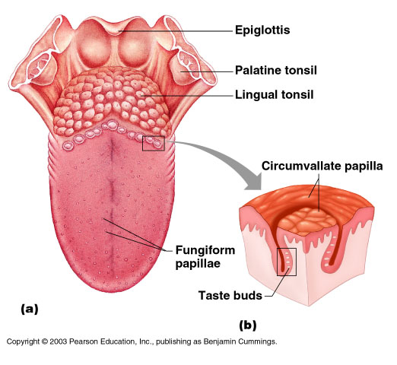
Taste sensations
ONLY IN MALES’ SLIDES
Taste is the sensation produced when a substance in the mouth reacts chemically with taste receptor.
Taste buds are specialized receptors widely scattered throughout the oral cavity.
Tongue
Soft palate
Inner surface of cheeks
A Taste bud is a specialised receptors in
the oral cavity, but mainly on the tongue, some on the palate.
ONLY IN FEMALES’ SLIDES

Slide 15
Cont.
Sweet (sweet receptors respond to sugar, sacchrine, amino acids).
Sour (salt receptors respond to acids -free H ions-).
Bitter (alkaloids, other substances).
Salty (chemical salts (NaCl) m ions . Mental.
Umami (glutamate-“meat (beef) taste of steak”).
We will talk about how the first 4 tastes are transmitted.
Distribution of taste buds on tongue (not uniform):
Sweet - tongue tip
Sour - tongue margins
Bitter - back of tongue
Salty - widely distributed
ONLY IN MALES’ SLIDES
5 established taste
Taste buds on tongue not uniform

Slide 16
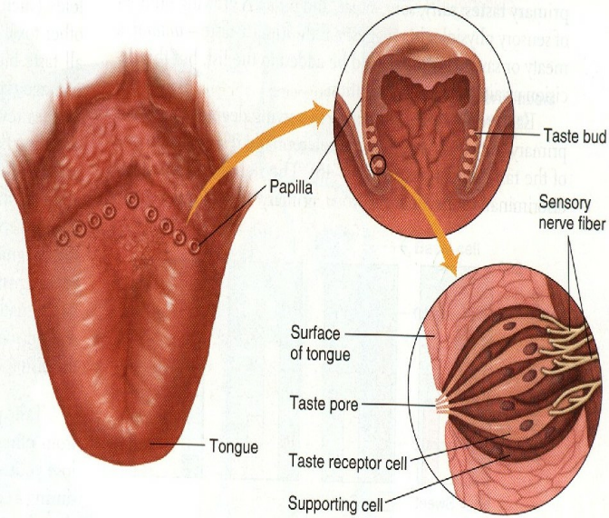
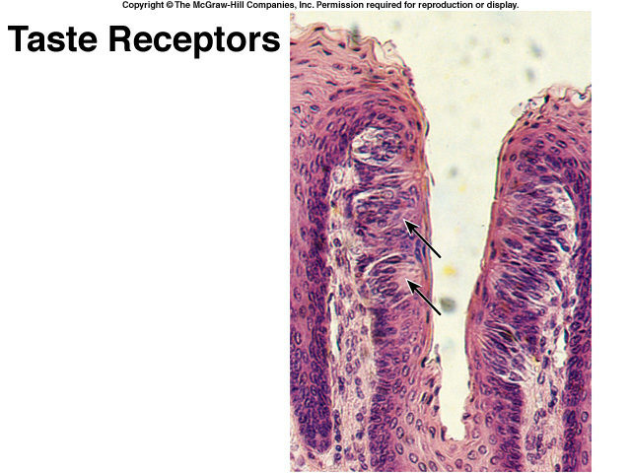
Taste buds
Barrel shaped structures that contain taste receptors.
Types of papillae:
The tongue is covered with 3 types of projections called papillae:
They are found in small protrusions (bumps, projections) called papillae
Foliate papillae
Circumvallate
Fungiform
Filiform
(no taste buds on the mid dorsum of the tongue)
Taste Receptors:
ONLY IN MALES’ SLIDES
Filiform: Sharp - no taste buds
Fungiform: Rounded with taste buds
Circumvallate: Large papillae with taste buds

Slide 17
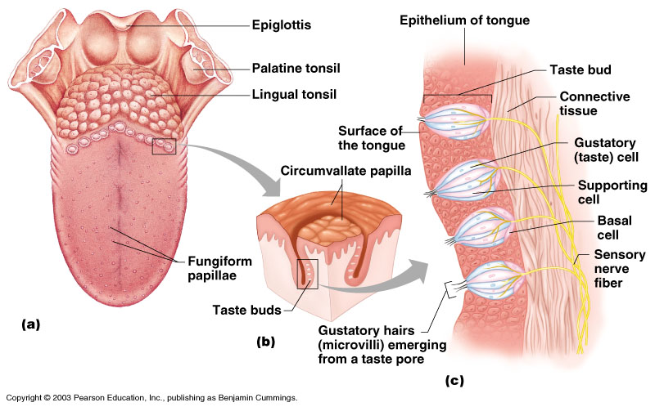
Anatomy of taste buds
Structure of Taste bud:
Gustatory cells with microvilli (gustatory hair).
They are receptors cells with cilia projected through taste pore in between there are supporting cells.
Hairs are stimulated by chemicals dissolved with saliva and transmit impulses to the
brain.
ONLY IN MALES’ SLIDES
Impulses are
carried to the gustatory complex by cranial nerves as taste buds are found in different areas:
Facial nerve
Glossopharyngeal nerve
Vagus nerve
ONLY IN MALES’ SLIDES

Slide 18
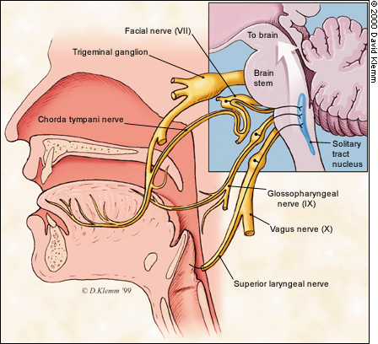
Taste sensation
The taste pathway
Molecules dissolve in the saliva » attached to receptors on cillia of gustatory cells » receptors potential » action potential.
Combination between molecules and receptors are week (since taste can be easily abolished by washing mouth with water).
Taste Pathway
First order neurons:
Taste fibres from the three cranials nerves form tractus solitarius » end in the nucleus of tractus solitarius (medulla).
Second order neurons:
From TS cross the midline to ascend in the medial lemniscus to the thalamus.
Third order neurons:
From thalamus project the cerebral cortex through thalamic radiation

Slide 19
Pathophysiology of taste sensation
Ageusia (complete loss of taste).
Genetic
Dysgeusia (disturbed taste).
Sexual hormonal effect (metallic taste)
Hypergeusia (adrenal insufficiency)
Common cold
inflamation
Hypogeusia: it can be caused by many diseases, and drugs such as penicillamine
Taste sensation can be modified by Meraculin (from Miracle fruit):
When Meraculin is applied to tongue, it makes acids taste sweet.
ONLY IN MALES’ SLIDES
Many diseases can produce hypogeusia.
In addition, drugs such as captopril and penicillamine, which contain sulfhydryl groups, cause temporary loss of taste sensation.

Slide 20
Doctors’ notes
Dr mentioned for taste to be registered by brain, food particules have to dissolve in saliva.
Taste is condensed in the tip, back and periphery of tongue. Mid dorsum has an insignificant amount so it’s dismissable.
Gustatory cells = Taste cells (they’re the same thing).
Dr mentioned he might bring a picture of the tongue and ask which areas of the tongue have a condensation for which taste (for example: tip of tongue → Sweet).
There are 4 main taste sensations (Sweet, sour, bitter, salty) and 1 extra called “Umami” (Umami works on the sour and salty regions, it’s the “Beef taste” receptors).
The Receptor-Molecule bond is weak → taste of something can be washed off from mouth.
يعني لأن الرابطة ضعيفة بين المستقبل و الأكل نفسه لو نغسل فمنا بالموية بس يروح الطعم
For smell to be registered, molecules HAVE TO BE DISSOLVED IN MUCUS.
Adaptation is when a person gets used to a smell so he no longer feels it.
زي مثلا لما واحد يروح سوق السمك، بالبداية الريحة ما تطاق كريهة بعدين بعد ربع ساعه تسوق يصير ما يشمها
Olfactory pathways:
Frontal cortex
Hypothalamus amygdala
Hippocampus
Smell is registered in Area 28 of the brain.

Slide 21
Thank you!
اعمل لترسم بسمة، اعمل لتمسح دمعة، اعمل و أنت تعلم أن الله لا يضيع أجر من أحسن عملا.
The Physiology 436 Team:
Team Leaders:
Lulwah Alshiha
Laila Mathkour
Mohammad Alayed
Females Members:
Reema Alotaibi
Rana Barasain
Shrooq Alsomali
Amal Alqarni
Najd AlTheeb
Males Members:
Abdullah Alsaeed
Contact us:
References:
Girls’ and boys’ slides.
Guyton and Hall Textbook of Medical Physiology (Thirteenth Edition.)

