Slide 1
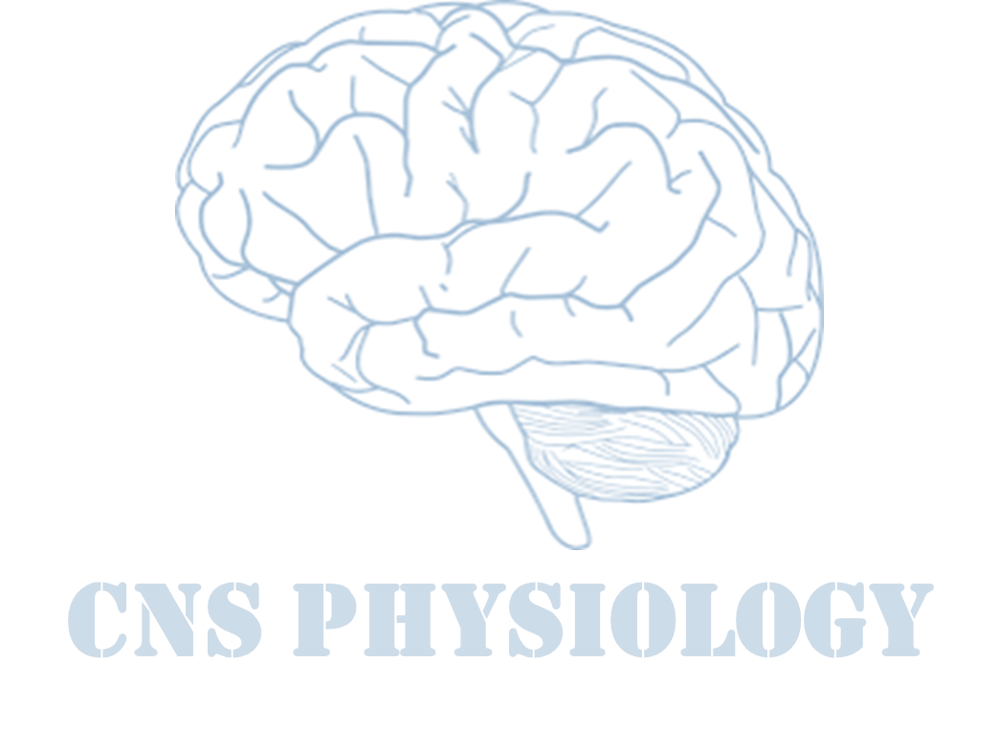
Text
Important
Formulas
Numbers
Doctor notes
Notes and explanation
Lecture No.14
“Only Those Who Dare To Fail Greatly Can Ever Achieve Greatly”

Slide 2
Physiology of Proprioception in Balance
Objectives:
Identify the major sensory receptors & pathways.
Describe the components, processes and functions of the sensory pathways.
Appreciate the dorsal column system in conscious proprioception (anatomy and functions).
Describe the spinocerebellar tract pathway in unconscious proprioception from muscles, tendons, and joints.
Defferentiate between sensory and motor ataxia.

Slide 3
Organization of the Nervous System (introduction)
ONLY IN FEMALES’ SLIDES
The brain
Central Nervous System (the center of integration and control)
Two big initial divisions:
The spinal cord
31 Spinal nerves: carry info to and from the spinal cord.
Peripheral Nervous System (the nervous system outside of the brain and spinal cord)
12 Cranial nerves: carry info to and from the brain.

Slide 4
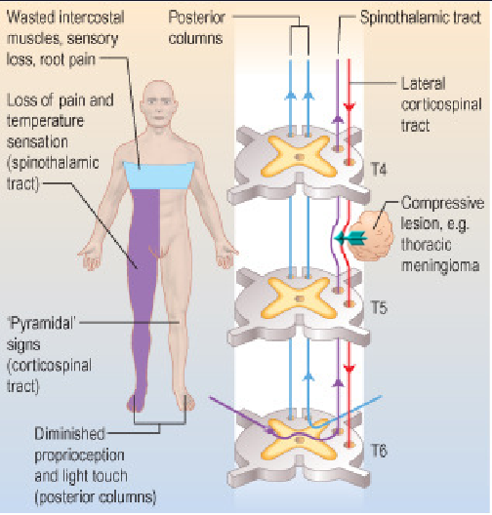
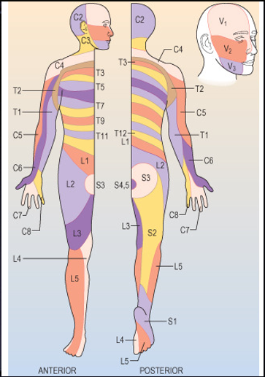
Dermatomes
Dermatome is an area on skin supplied by a single spinal nerve.

Slide 5
What is Proprioception ?
ONLY IN MALES’ SLIDES
ONLY IN FEMALES’ SLIDES
Proprioception stems from the latin word proprius which means "one's own“ or "individual“.
It is the sense of one`s own body position.
It is also called proprioceptive / position sense.
It is the awareness of body position and of movements of body parts.
Strength of effort being employed in movements.
It can be divided into:
Static proprioception: conscious perception of the orientation of the different parts of the body with respect to one another.
Dynamic proprioception: rate of movement sense (also called kinesthesia).
Encapsulated Nerve Endings.
Monitor stretch in locomotory organs.
types of proprioceptors:
Exteroception: By which one perceives the outside world.
Interoception: By which one perceives pain, hunger, and the movement of internal organs.
ONLY IN MALES’ SLIDES

Slide 6
Cont.
Exrta
Proprioception informs us about:
The location of a body part in relation to other parts.
The rate of movement of a body part when it is moving.
The degree to which our muscle are being contracted or stretched.
The amount of tension created in our tendons.
The head orientation in relation to the ground and in response to movement.
Proprioceptive information is carried from periphery to the CNS by proprioceptors and other somatic receptors.

Slide 7
Types of Proprioceptors This slide is important
Muscle spindles also detect the degree of strength on the muscles and rate of change of movement.
Golgi tendon is stimulated when there is overstretch : a stretch that may tear the muscle or separate it from it's tendon.
Proprioceptors include the muscle spindles, Golgi tendon organs, and joint receptors.
These provide a sense of body position and allow fine control of skeletal movements.
Muscle spindles:
Detect how much a muscle is stretched.
Imbedded in the perimysium between muscle fascicles.
Golgi tendon organs:
Located near the muscle-tendon junction.
Detect tension of a muscle on its tendon.
Provide information about the strength of contraction & tension.
Joint Kinesthetic receptors:
Are mechanoreceptors + sensory (nerve endings) in the joint capsules, they
detect angle and movement of the joints.
N.B: Cutaneous & deep receptors also contribute to proprioception

Slide 8
Cont.
ONLY IN MALES’ SLIDES
There are two types: These are main ascending sensory pathways for proprioception.
Types of Proprioception
Conscious proprioception | Unconscious proprioception
It reaches the level of sensory cerebral cortex (cerebrum) via the dorsal column tract. | is communicated to the cerebellum primarily via: The dorsal spino-cerebellar tract (dSCT). The ventral spino-cerebellar tract (vSCT).

Slide 9
Sensory receptors types
ONLY IN MALES’ SLIDES
Mechanoreceptors: which detect mechanical compression or stretching of the receptor or of tissues adjacent to the receptor, ex: proprioceptors.
Thermoreceptors: which detect changes in temperature, some receptors detecting cold and others warmth.
Nociceptors (pain receptors): which detect damage occurring in the tissues, whether physical damage or chemical damage, ex: free nerve endings.
Electromagnetic receptors: which detect light on the retina of the eye, ex: rods and cones.
Chemoreceptors: which detect taste in the mouth, smell in the nose, oxygen level in the arterial blood, osmolality of the body fluids, carbon dioxide concentration, and perhaps other factors that make up the chemistry of the body, ex: chemo R in carotid bodies

Slide 10
Classification of sensory receptors
Classification of Sensory Receptors
ALL this smart art is extra
B-Based on their adequate stimulus
A-Based on their location
(Sherrington 1906)
concerned with the external environment
-Found on the the surface of the body
-Monitor changes in the external environment
Mechanoreceptors
Thermoreceptors (cold & heat)
Chemoreceptors (ex: taste receptors)
Photoreceptors
(in the retina).
Nociceptors
(pain receptors)
Exteroceptors
concerned with the internal environment (visceral)
Interoceptors
ONLY IN FEMALES’ SLIDES
concerned with one`s own body position
-Are those relating to the physical state of the body, including joint position, and sate of tendons and muscles.
Sensory receptors classified according to:
Location
Type of stimulus detected
Structure
Proprioceptors

Slide 11
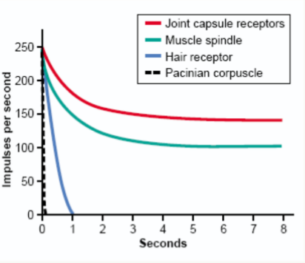
Cont.
ONLY IN MALES’ SLIDES
Extra
Adaptation of receptors:
When a continuous sensory stimulus is applied, the receptor responds at a high impulse rate at first and then at a progressively slower rate until finally the rate of action potentials decreases to very few or often to none at all.
Based on their speed of adaptation
Slowly adapting (SA)
Rabidly adapting (RA)
Fire as long as the stimulus is there (tonic receptors).
Nociceptors and proprioceptors show no or very little adaptation.
Fire upon stimulus and cease firing when the stimulus remains constant (phasic receptors).
Getting used to the bad smell in a room.
Being aware of a ring or a watch only when putting them on or taking them off (onset and offset).

Slide 12
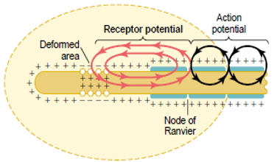
Cont. Adaptation of receptors
ONLY IN MALES’ SLIDES
Rapid adapting or phasicreceptors.
Ex: meissner’s corpuscles(touch), pacinian corpuscles(vibration)
Slowly adapting or tonic receptors.
Ex: ruffini’s (pressure ,skin stretch ) krause’s end bulbs, and merkel’s disks.
Non adapting receptors.
Ex: free nerve endings for pain sensation.
Mechanisms by which receptors adapt:
First, the pacinian corpuscle is a viscoelastic structure so that after stimulation within few hundredths of a second, the fluid within the corpuscle redistributes, so that the receptor potential is no longer elicited.
The second mechanism of adaptation of the pacinian corpuscle, but a much slower one, results from accommodation , which occurs in the nerve fiber itself. This probably results from progressive “inactivation” of the sodium channels in the nerve fiber membrane.
Receptor potential of the pacinian corpuscle:
For joint position and vibration sensation (Also Ruffini’s endings).
The receptor potential produced by compression induces a local circuit of current flow that spreads along nerve fiber.
The frequency of repetitive action potentials transmitted from sensory receptors increases approximately in proportion to the increase in receptor potential.
The Explanation of this picture next slide.

Slide 13
Doctors’ explanation
when deformed area is compressed it cause a receptor potential if this receptor potential is enough it causes action potential.
receptor potential is localized graded and
doesn't spread.
AP: it's either yes or no ( not graded ) and
spreads.
If you want to stimulate them in a
continuous state you increase the strength
of stimulus.
Pain receptors don't adapt and
proprioceptors also.

Slide 14
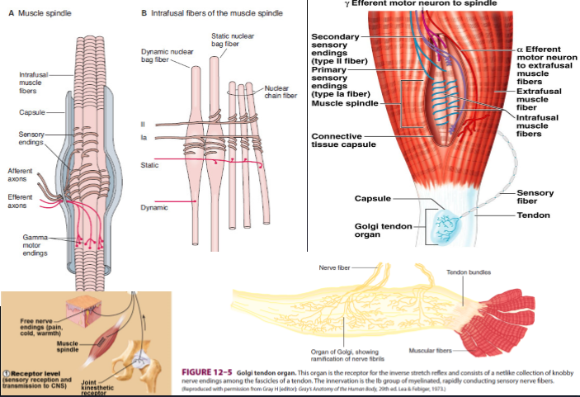
Structure of proprioception
ONLY IN MALES’ SLIDES
Structures concerned with proprioception:
Proprioceptors (spatial orientation, four inputs).
Brain Stem (Cortico, Rubro, Vestibulo, Reticulo, Olivo, Tectospinal).
vestibular system (apparatus, nuclei).
Ascending Tracts.
Visual system.
Cerebellum (flocculonodular lobe → dynamic equilibrium, Uvula → Static equilibrium).
Cerebral cortex (primary cortical center for equilibrium located in the parietal lobe deep in the sylvian fissure).
Conscious perception will be perceived by cortex so impulses passes through brain stem.
Reticulo: you must be awake to perceive the perception.
Olivo: because it's connected to cerebellum.
When all equilibrium contributers are damaged the person still can stand and maintain balance because of visual clues if this person closes his eyes he falls.
Uvula responsible for static equilibrium and flocculonodular for dynamic.

Slide 15
Muscle Spindles & Golgi Tendon Organs
The doctor was explaining this
Muscle spindles:
They detect changes in the length of muscle.
They convey length information to the CNS via group I and II afferent neurons.
This information is important for determining the position of body part.
Golgi tendon organs
They detect changes in muscle tension.

Slide 16
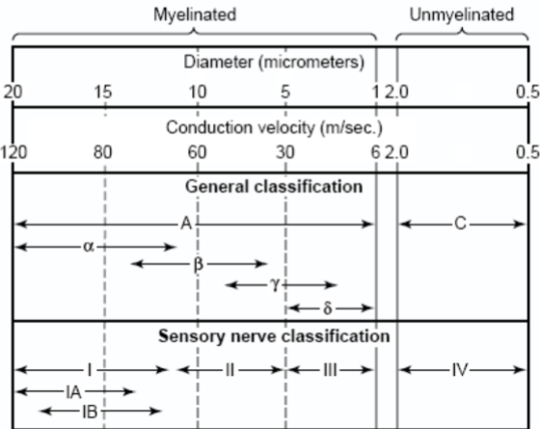
Classification of nerve fibers
ONLY IN FEMALES’ SLIDES
An Overview of Sensory Pathways and the Somatic Nervous System.
Neural pathways:
Afferent pathways: Sensory information coming from the
sensory receptors through peripheral nerves to the spinal
cord and to the brain .
Efferent pathways: Motor commands coming from the brain
and spinal cord, through peripheral nerves to effecter organs .

Slide 17
Encapsulated
Unencapsulated nerve endings
Encapsulated Nerve Endings:
Consist of one or more end fibers of sensory neurons.
Enclosed in connective tissue.
Include four main types:
Meissner’s corpuscles
Pacinian corpuscles
Ruffini’s corpuscles
Proprioceptors

Slide 18
Cont. Encapsulated nerve endings This slide is important

Slide 19
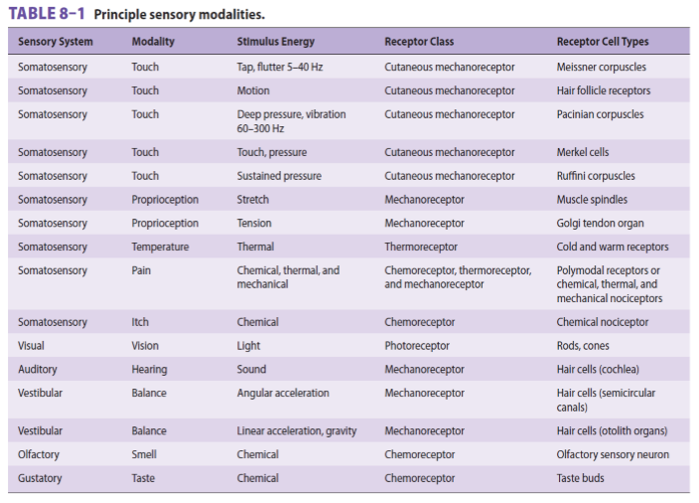
Sensory modalities
ONLY IN MALES’ SLIDES

Slide 20
Reflex arc
ONLY IN MALES’ SLIDES
Stimulus
Receptor
Afferent
Center
Efferent
Effector
Effect
Stretch reflex
Inverse stretch reflex
Muscle stretch
Muscle spindle
Afferent 1a
Over stretch
Golgi organ tendon
Afferent 1b
Extrafusal fibers
Efferent α motor
Spinal cord (center)
Efferent α Motor
Inhibitory interneuron
Spinal cord (center)
Muscle contraction
Reciprocal inhibition of antagonist
Extrafusal fibers
Muscle relaxation
Reciprocal inhibition of antagonist

Slide 21
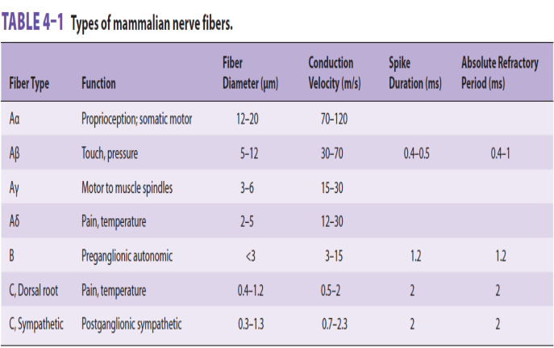
Types of mammalian fibres
ONLY IN MALES’ SLIDES

Slide 22
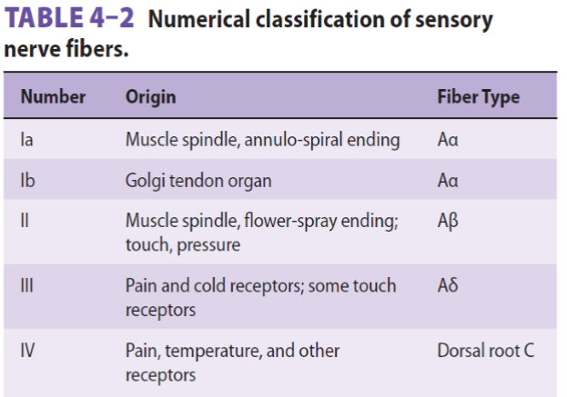
Classification of sensory nerve fibres
ONLY IN MALES’ SLIDES

Slide 23
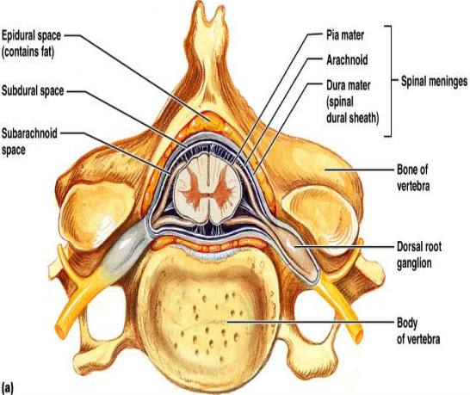
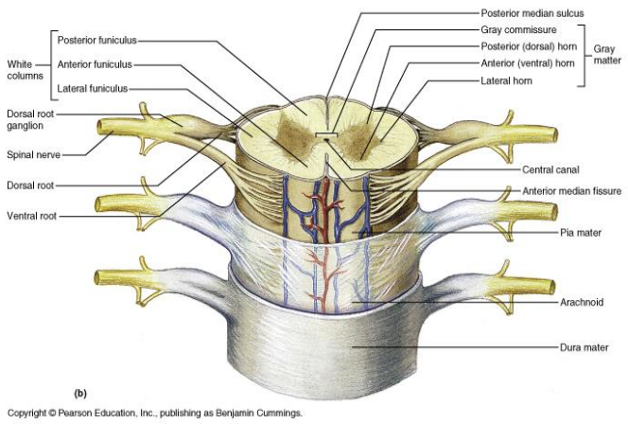
Spinal cord tracts
Sensory information from receptors throughout most of the body is relayed to the brain by
means of ascending tracts of fibers that conduct impulses up the spinal cord.
When the brain directs motor activities, these directions are in the form of nerve impulses that
travel down the spinal cord in descending tracts of fibers.
Spinal cord tracts
Ascending tracts (sensory)
Descending tracts (motor)
A Cross-section view of spinal cord- wider laterllay than anteroposteriorly. In the middle on the dorsal side is a shallow groove called the posterior median sulcus and on the ventral side is the anterior median fissure (deeper).
center consist of gray matter shaped like a butterfly and there is an opening at the center.
Spinal cord is protected by three layers of meninges. The only difference from the brain is that the dural matter does not attach to bone. The dural matter is surrounded externally by a layer of cushioning fat called epidural space.
ONLY IN FEMALES’ SLIDES

Slide 24
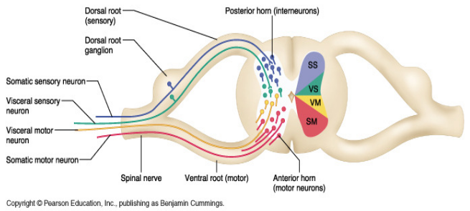
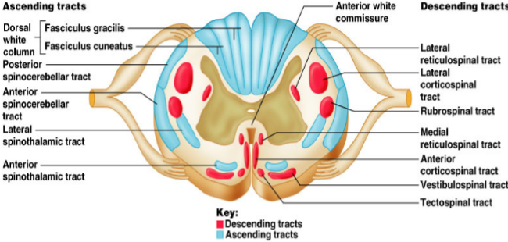
Organization of spinal cord
Grey matter: organization
White matter in the spinal cord
Dorsal half – sensory roots and ganglia.
Ventral half – motor roots.
Dorsal and ventral roots fuse laterally to form spinal nerves.
Four zones are evident within the gray matter –somatic sensory (SS), visceral sensory (VS), visceral motor (VM), and somatic motor (SM).
Fibers run in three directions, ascending, descending and transversely.
Divided into three funiculi (columns), posterior, lateral and anterior.
Each funiculus contains several fiber tracks.
Fiber tract names reveal their origin and destination.
Fiber tracts are composed of axons with similar functions.

Slide 25
Ascending sensory tracts
There are several ascending sensory systems.
Dorsal column system & Anterolateral system.
Each system carries different types of sensations or modalities proprioception, pain, temperature, fine touch, crude touch, vibration.
Sensory systems allow us to detect, analyze and respond to our environment .
Ascending pathways carry information from sensory receptors to the brain.
Conscious: reach cerebral cortex.
Unconscious: do not reach cerebral cortex.
Sensations from body reach the opposite side of the brain.
Stereognsis the mental perception of depth or three dimensionality by the senses, usually in reference to the ability to perceive the form of solid objects by touch.
Conscious feeling always relayed to cerebral cortex so if only cerebellar tracts are intact you won't feel any thing.
Sensory pathways: 3 neurons:
1st: enters spinal cord from periphery.
2nd: crosses over (decussates), ascends in spinal cord to thalamus.
3rd: projects to somatosensory cortex.
Spinal tracts:
These are known as sensory and motor pathways consisting of multineuron pathways connecting the CNS to the PNS. At some point most pathways crossover (decussate),
Ascending (sensory) Pathways :
Dorsal column pathway: carries signal of fine touch, pressure, vibration , stereognosis and concious proprioception, ascends up dorsal white column in fasciculus gracilis or cutaneatus to medulla oblongata to the thalamus to primary somatosensory cortex (post central gyrus).
Posterior and anterior spinocerebellar pathways: carry subsconcious proprioception. Dorsal gray horn to lateral column to medulla oblongata to pons to cerebellum.
Spinothalamic pathway: carries signals of pain, temperature, deep pressure, and course touch. From psterior gray horn decussate into lateral and anterior funiculi up to the thalamus to primary somatosensory cortex (postcentral gyrus).

Slide 26
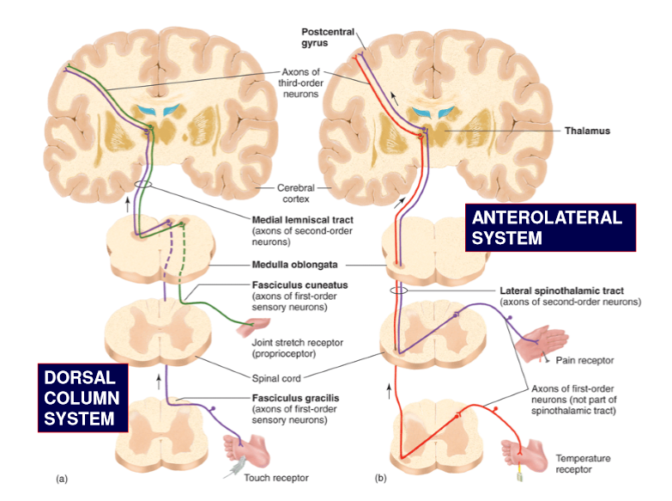
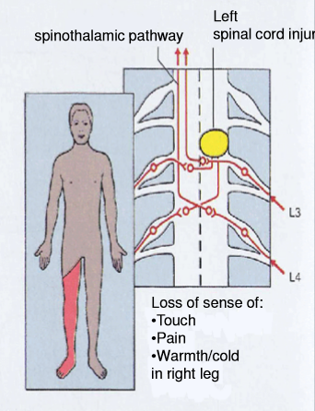
Cont. Anterolateral system
ONLY IN MALES’ SLIDES
Ventral and lateral spinothalamic tracts.
Pain.
Thermal sensations, (warmth & cold).
Crude touch and pressure sensations capable only of crude localizing ability on the surface of the body.
Tickle and itch sensations.
Sexual sensations.
Spinothalamic lesion

Slide 27
Dorsal column–medial lemniscal system
Touch sensations requiring a high degree of localization of the stimulus.
Touch sensations requiring transmission of fine gradations of intensity.
Carries fine touch, tow point discrimination, pressure, vibration and conscious
proprioception signals.
Phasic sensations like vibratory sensations.
Sensations that signal movement against skin.
Joints Position sensations (Proprioception).
Pressure sensations requiring fine degrees of judgment of intensity.
Strereognosis.
Fine Touch
Pressure
Vibration
Position
Movement
3rd neuron
Projects to somatosensory cortex.
Fact conducting A α/β-fiber neurons
2nd neuron
Crosses over in medulla, ascends to thalamus.
1st neuron
Enters spinal cord through dorsal root, ascends to medulla (brain stem).

Slide 28
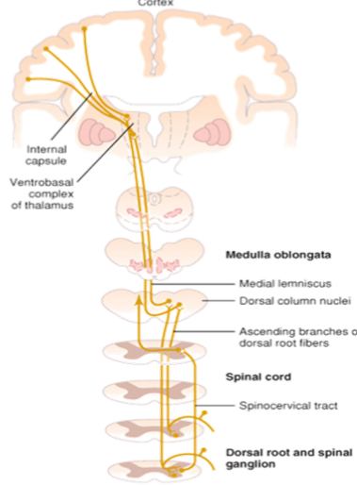
Proprioception from head
ONLY IN MALES’ SLIDES
In this pathway through the brain stem, each medial lemniscus is joined by additional fibers from the sensory nuclei of the trigeminal nerve, these fibers subserve the same sensory functions for the head that the dorsal column fibers subserve for the body.

Slide 29
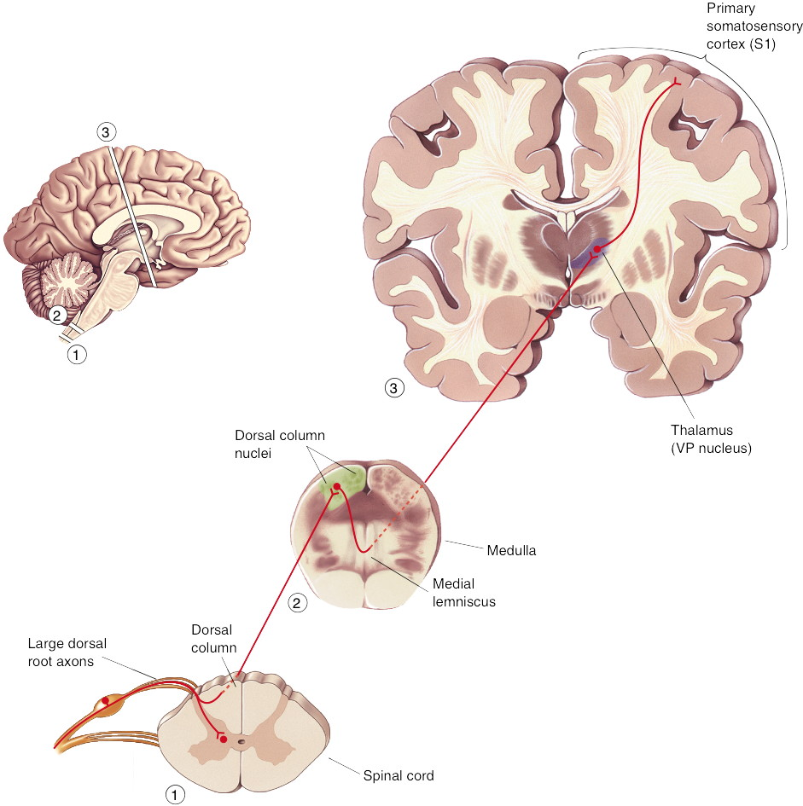
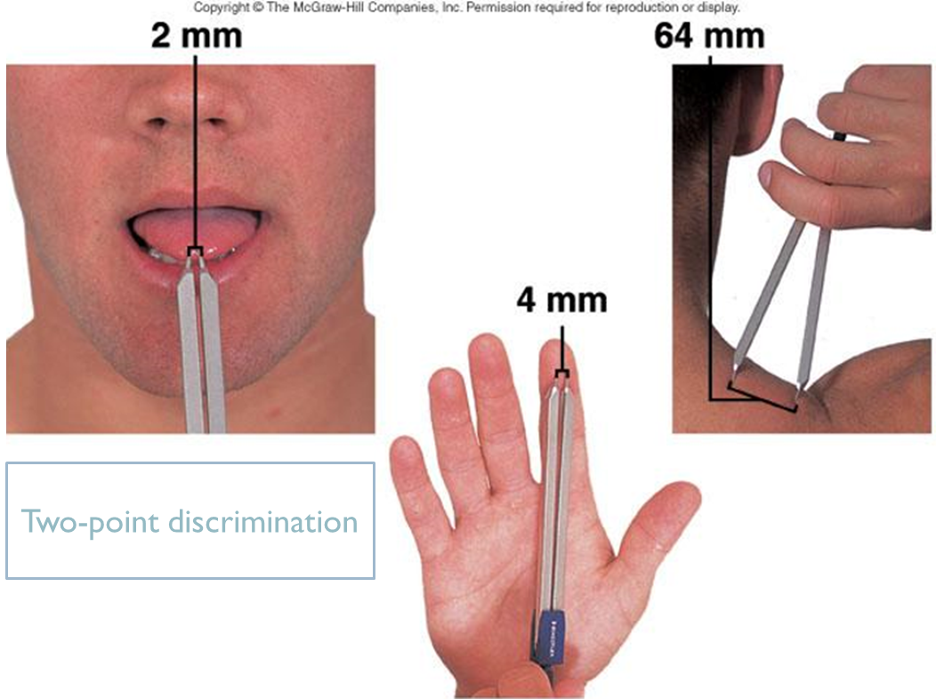
Dorsal column pathway
ONLY IN FEMALES’ SLIDES
Two point discrimination: is the ability to detect a small distance between two objects in contact with the skin.
In the face and the hands the sense of two point discrimination is better than other areas of the body why is that? Its because of two reasons: 1.there are more sensory receptors in our face and hands.
2. the lips face and tongue are represented by larger areas in the somatic cortex

Slide 30
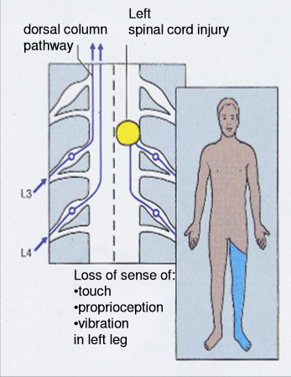
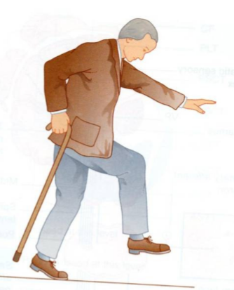
Dorsal column damage
Sensory ataxia.
Patient staggers; cannot perceive position or movement of legs.
Visual clues help movement.
In spinothalamic lesion decussation in spinal cord so lesion may be manifested contralaterlly.
Control of rate (slow or fast) range(distance ) force and direction of movement is lost duo to loss of perception in sensory ataxia.
If eyes closed they fall.
The damage here (picture) will be on the same side
because it is at the level of the spinal cord, if the
damage was above the medulla it would be on the
opposite (contralateral) side.
Positive romberg test the test depends on the
integrity of proprioception from the joints of the legs.

Slide 31
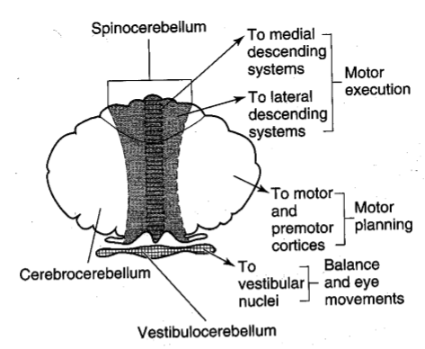
Role of cerebellum in proprioception
ONLY IN MALES’ SLIDES
Functional division of cerebellum
Vestibulocerebellum (flocculonodular lobe)
Spinocerebellum
(vermis + intermediate zone)
Cerebrocerebellum
In association with the brain stem and spinal cord control equilibrium and postural movements.
During performance of rapid motions specially with changes in direction controlling balance between agonist and antagonist muscle contractions of the spine, hips, and shoulders during rapid changes in body positions as required by the vestibular apparatus.
Feedback control of distal limb movements by way of the intermediate cerebellar cortex and the interposed nucleus.
Feedback information from the peripheral parts of the body, especially from the distal proprioceptors of the limbs, telling the cerebellum what actual movements result.
Function of the large lateral zone of the cerebellar hemisphere to plan, sequence, and time complex movements.

Slide 32
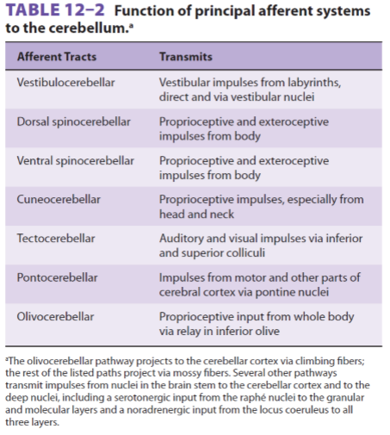
Function of afferent system to the cerebellum
ONLY IN MALES’ SLIDES
Sustained movement is touch.
Rapid repetitive movement is considered vibration.
Pressure is deep touch.

Slide 33
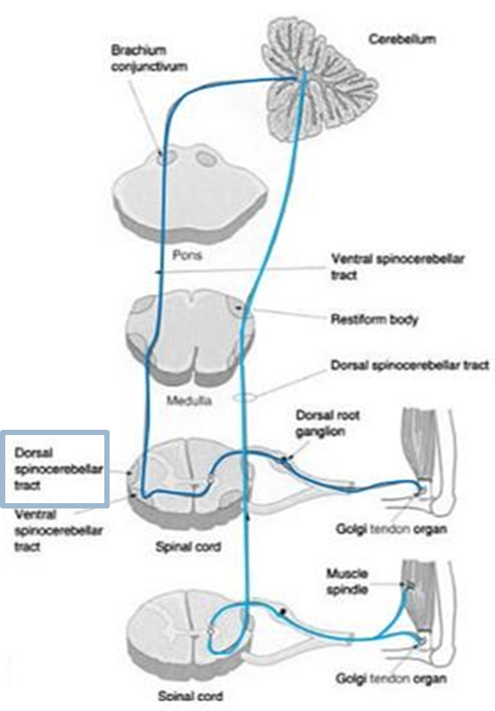
The dorsal & ventral spinocerebellar tracts
Extra
They carry subconscious proprioception signals.
Receptors in muscles and joints.
Spinocerebellar tract damage leads to cerebellar ataxia.
Function of dSCT, informs the cerebellum about:
Muscle length and contraction.
Degree of tension on tendons.
Position of body parts & their movement Forces acting on the body surfaces.
1st neuron:
Enters spinal cord through dorsal root.
2nd neuron:
Ascends to cerebellum.
3rd neuron:
Ascends to cortex.

Slide 34
Ataxia and gait disturbances
Ataxia: inability to coordinate voluntary muscular movements that is due to nerve damage (CNS or PNS) and not due to muscle weakness (called also incoordination).
Types of Ataxia
Sensory ataxia
Motor ataxia
Failure of proprioceptive information to the CNS. May be due to disorders of spinal cord or peripheral nerves.
Can be compensated for by visual inputs.
PNS lesions
(Ex: polyneuropathy) injury to sensory receptors and afferent neurons.
Cause ataxia because there is loss of the sense of joint position proprioception. Broad-based, high-stepping, stamping gait develops.
This ataxia is made worse by removal of additional sensory input (e.g. vision)
Ataxia is made worse in the dark or no vision. First described in sensory ataxia of tabes dorsalis, this is the basis of Romberg's test.
Romberg's test. Ask the patient to close the eyes while standing with feet together.
The affected patient becomes unstable (Romerg`s test).

Slide 35
Cont.
Motor ataxia: caused by cerebellar disorders.
Features of cerebellar ataxia:
Intact sensory receptors and afferent pathways.
Integration of proprioception is faulty.
Midline cerebellar lesions cause truncal ataxia.
Lateral cerebellar lesions cause limb ataxia.
Thalamic infarcts may cause contra lateral ataxia with sensory loss.
Clumsy movements.
Incoordination of the limbs (intention tremor).
Reeling gait (wide-based, unsteadiness, and irregularity of steps, often with a tendency to fall to one or other side, forward or backward).
Alcoholic intoxication produces similar effects.
How can we differentiate between cerebellar or dorsal column ataxia? If it was cerebellar or motor ataxia the imbalance would be there whether the patient closed his eyes or had them opened if it was in the dorsal coloumn or a sensory ataxia the patient will loose balance when his eyes are closed (positive romberg test).
Motor ataxia = cerebellar ataxia.
Control of rate (slow or fast) range(distance ) force and direction of movement is lost duo to loss of motor control.

Slide 36
Brown-séquard syndrome
ONLY IN MALES’ SLIDES
Is an incomplete spinal cord lesion.
Hemisection injury often in cervical region.
May be caused by trauma, tumor, multiple sclerosis.
Ipsilateral loss
Contralateral Loss
Fine touch, Vibration, Proprioception (injury to dorsal Column).
Leg ataxia (injury to dorsal spinocerebellar tract).
Spastic paresis below lesion (lateral corticospinal).
Patients also suffer from ipsilateral upper motor neuron paralysis (see lecture of Upper motor lesion).
Flaccid paralysis (Ventral horn destruction).
Dermatomal anesthesia (Dorsal horn destruction).
Loss of pain and temp (injury of lateral spinothalamic tract).
Loss of crude touch and pressure (ventral spinothalamic).
Minor contralateral muscle weakness (Ventral corticospinal tract).
Leg ataxia (injury to V. spinocerebellar).

Slide 37
Thank you!
اعمل لترسم بسمة، اعمل لتمسح دمعة، اعمل و أنت تعلم أن الله لا يضيع أجر من أحسن عملا.
The Physiology 436 Team:
Team Leaders:
Lulwah Alshiha
Laila Mathkour
Mohammad Alayed
Females Members:
Ghada Alskait
Aseel Alsulimani
Males Members:
Ali Alsubaie
Abdullah Alsaeed
Contact us:
References:
Females’ and Males’ slides.
Guyton and Hall Textbook of Medical Physiology (Thirteenth Edition.)

