Slide 1
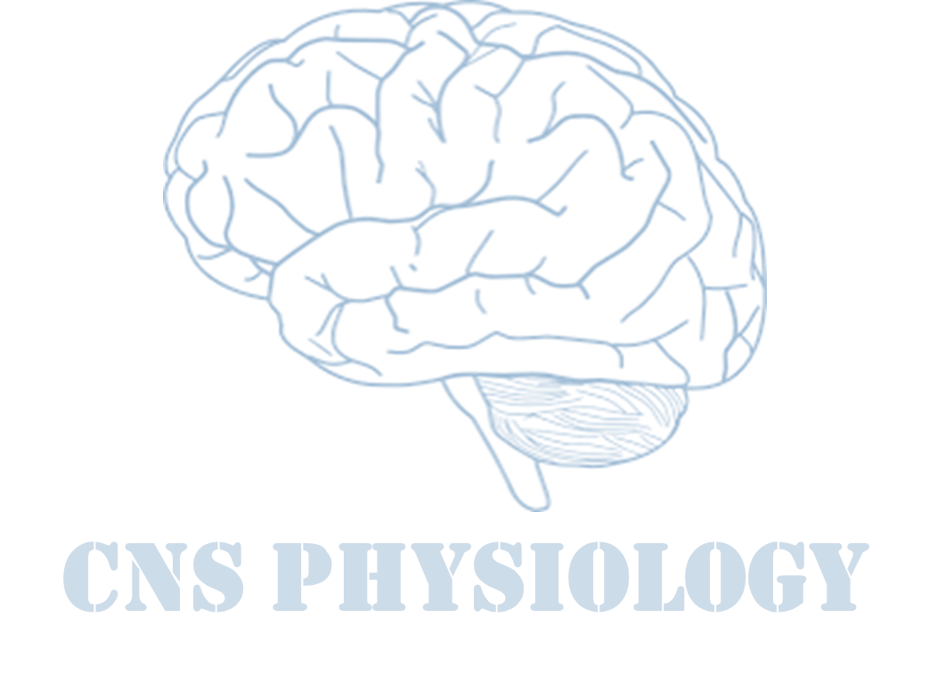
Text
Important
Formulas
Numbers
Doctor notes
Notes and explanation
Lecture No.15
“Life Is Like Riding A Bicycle. To Keep Your Balance, You Must Keep Moving”

Slide 2
Physiology of the inner ear balance
Objectives:
Understand the sensory apparatus of the inner ear that helps the body maintain its postural equilibrium.
The mechanism of the vestibular system for coordinating the position of the head and the movement of the eyes.
The function of semicircular canals (rotational movements, angular acceleration).
The function of the utricle and saccule within the vestibule (respond to changes in the position of the head with respect to gravity (linear acceleration).
The connection between the vestibular system and other structure (eye, cerebellum, brain stem).

Slide 3
Control of equilibrium
Equilibrium: Reflexes maintain body position at rest & movement through receptors of postural reflexes:
1. Proprioceptive system (Cutaneous sensations).
2. Visual (retinal) system.
3. Vestibular system (Non auditory
membranous labyrinth¹).
4. Cutaneous sensation.
Cooperating with vestibular system
wich is present in the semicircular
canals in the inner ear.
¹: the explanation in the next slide.

Slide 4
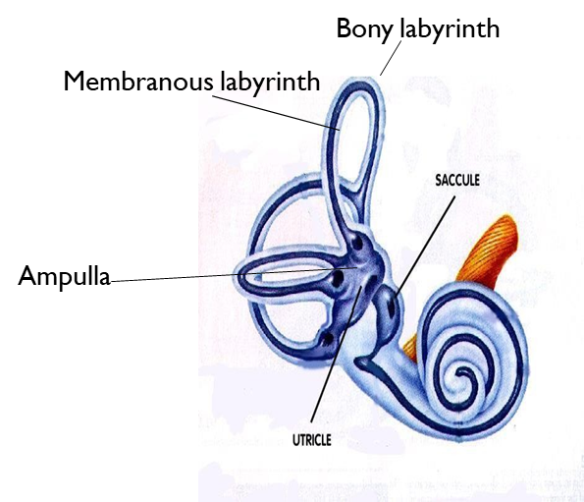
Labyrinth
Ampulla or crista ampullaris: are the dilations at the end of the semicircular canals and they affect the balance.
The dilations connect the semicircular canals to the cochlea utricle and saccule: contain the vestibular apparatus (maculla).
Labyrinth
Bony labyrinth
bony cochlea, vestibule & 3 bony semicircular canals.
Enclose the membranous labyrinth.
Auditory (cochlea for hearing).
Non-auditory for equilibrium (Vestibular apparatus). composed of two parts:
Vestibule: (Utricle and Saccule).
Semicircular canals “SCC”.
Membranous labyrinth
Membranous labyrinth has sensory receptors for hearing and equilibrium
Vestibular apparatus is responsible for equilibrium

Slide 5
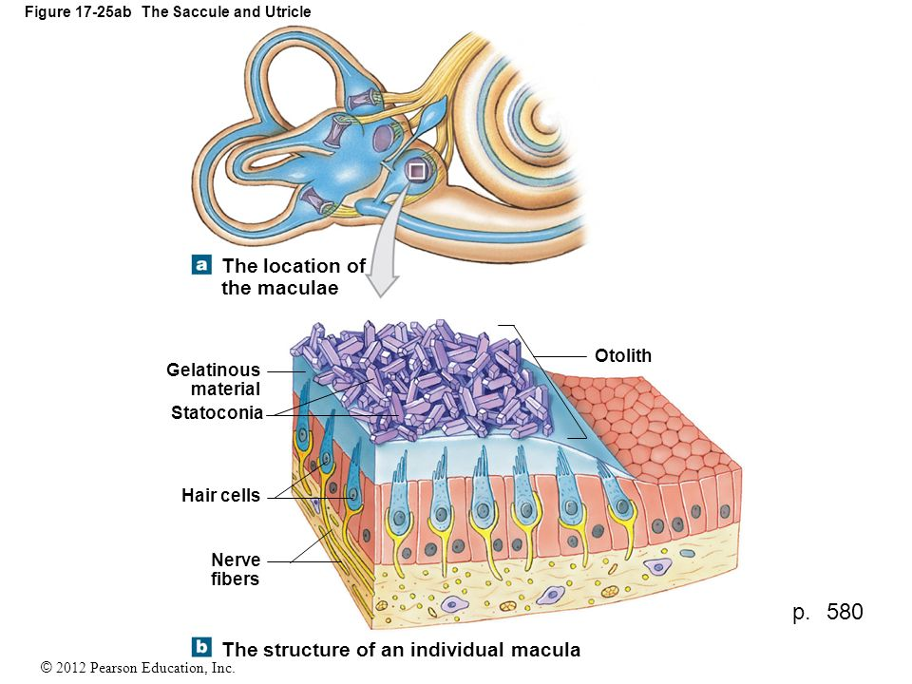
Macula (otolith organs) of utricle and saccule
Hair cell synapse with endings of the vestibular nerve.
Hair cell has 30-150 (stereocilia) & one large cilium called (kinocilium).
Both connected with thin filamentous attachments.
All cilium membrane has positive potassium channels.
Otolithes (statoconia) of calcium carbonate suspended
in gelatinous material.
Macula of utricle is IN horizontal plane if the head is
vertical, so cilia point upwards.
Stimulated when the head bends forward & backward & laterally.
Macula of utricule place horizontally so the hair cell pointed upward.
Macula of saccule place in lateral wall and vertically so the hair cell
pointed laterally.
Extra picture
Stereocilia then comes the gelatinous material then the Ca carbonate.
Gelatinous material is to exaggerate the movement and its stronger with the otoconia on the top of it.

Slide 6
Hair cells
ONLY IN MALES’ SLIDES
Hair cells
Hair cells in utricle | Hair cells in saccule
Person in upright position: (head vertical) Macula in horizontal plane. Hairs pointing upwards. Hair cells signal head movements in any direction ➞ inform the brain of orientation of head in space. | Person in upright position: (head vertical) Macula in vertical plane. Hairs pointing laterally. Hair cells operate when one is lying down.
Head bent forward >> stereocilia bent toward kinocilum >> action potential of vestibular branch of 8th carinal nerve >> feel disturbance of equilibrium.

Slide 7
Cont.
ONLY IN FEMALES’ SLIDES
Macula of:
Utricles detect balance in horizontal direction.
Saccule detect balance in horizontal and vertical direction.
هذه المعلومة تنافي المعلومة المذكورة في السلايد السابق، عند الرجوع للمصدر ( قايتون وقانون ) وجدنا اختلاف أيضا لهذا لم نعتمدهما.
حسب رد د. سلطان ( Block chairman) نعتمد المعلومة المذكورة في السلايد السابق.
وسنوافيكم في حال استحدث تغيير...

Slide 8
Mechanism of Action
At rest there’s equal discharge from all hair cells because the pressure above it from the otoconia is the same on gelatinous material and stereocilia.
Direction of stereocilia to the vestibular nerve determines if its excitation or inhibition.
Bending of stereocilia towards kinocilium ➞ depolarization + ca entry + neurotransmitter release ➞ increase rate of impulses to 8th nerve fibers.
Bending of stereocilia away from kinocilium ➞ hyperpolarization ➞ decrease rate of impulses to 8th nerve fibers.
Stereocilia shift to toward kinocilium>> open k channel >> depolarization occurs(vice versa).
Stereocilia shift away from kinocilium>> close k channel >> hyperpolarzition.
ONLY IN MALES’ SLIDES

Slide 9
Functions of macula (mainly utricle)
Functions of macula
Orientation of head in space & maintenance of static equilibrium
Detection of linear acceleration
In erect upright position (vertical position)
Bending the head to one side
Linear acceleration
At deceleration
RT & LT utricle impulses balance each other.
No sensation of male equilibrium.
Statoconia crystals of hair cells fall to that side by their weight ➞ pull stereocilia to move towards kinocilium ➞ depolarization (stimulation).
Stereocilia of the other side moves away from kinocilium ➞ hyperpolarization (inhibition).
As at running & standing in a bus.
At beginning of movement statoconia lag behind movement by its inertia ➞ fall backwards ➞ cilia moves backward ➞ person feels he is falling backwards ➞ try to correct this by leaning forwards to shift statoconia & cilia anteriorly.
(Runner try to stop) ➞ statoconia move forwards by its momentum ➞ person feels falling anteriorly.

Slide 10
Examples
تخيل أنك راكب باص وتحرك فجأة في البداية راح تميل للأمام وذلك بسبب:
Statoconia goes back >> feeling you are falling backward and you try to correct by leaning forward.
في حالة التوقف فجأة او تقليل السرعة:
Statocnia goes forward >> feeling you are falling forward and you try to correct by leaning backward.
The area at the back will be stimulated more than the area in the front.
Hair cells are sensing differences of pressure applied by gelatinous material and otoconia transmitted to the hair cells give us different discharge, intensity, going of the information about our position in reference to the surroundings and maintain our equilibrium and balance with the visual pathway and proprioception.
Macula inside the utricle will sense the movement in horizontal position. Saccule will sense vertical and horizontal. Semicircular canals will sense angular accelation.

Slide 11
Semicircular canals
Horizontal (lateral).
Anterior.
Posterior.
Perpendicular to each other filled with endolymph dilated end called
ampulla crista ampularis (as macula) cilia embedded in a gelatinous mass
called cupula, (Sense the change in position).
Detect angular changes.

Slide 12
Mode of action and functions
during rest : equal discharge from SCC on both.
Detect & maintain posture during head rotation in any direction (angular acceleration) rotation.
If we move the fluid will move in the opposite direction:
١- لأنه بطيء.
٢- لانه ماتحرك، حنا اللي تحركنا.

Slide 13
Doctors’ explnation
The movement of fluid in the opposite direction. We move from left to right and the fluid move from right to left.
This movement and the positioning of kinocilium and stereocilia will cause the movement of stereocilia towards the kinocilium, stimulate the same side.
If stereocilia move away from kinocilium it will cause inhibition.
The net result is excitation and inhibition which will go to the vestibular nerve, nucleus, the connection of the vestibular nucleus to the eye (CN 3, 4 and 6) in addition to the signals coming from the visual cues so it will maintain our stability and it will control the right eye movement according to our body movement.

Slide 14
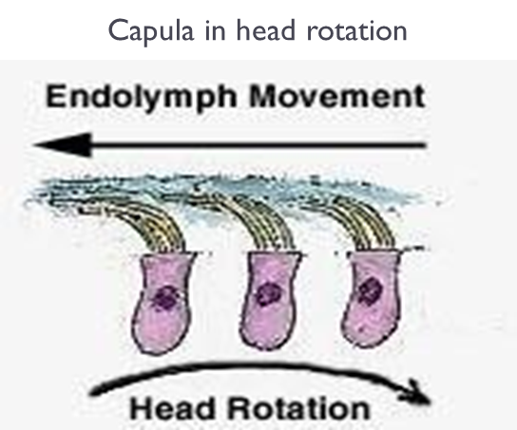
Rotation from left to right in horizontal plane
Endolymph ➞ opposite direction by inertia from right to left ➞ the cilia of right side bent by endolymph towards the kinocilium ➞ towards the utricle➞ depolarization ➞ impulses from right side increase.
Impulses from left side decrease as cilia bent away from kinocilium ➞ sensation of rotation to right.
Toward = depolarization = increase.
Away = hyperpolarization = decrease.

Slide 15
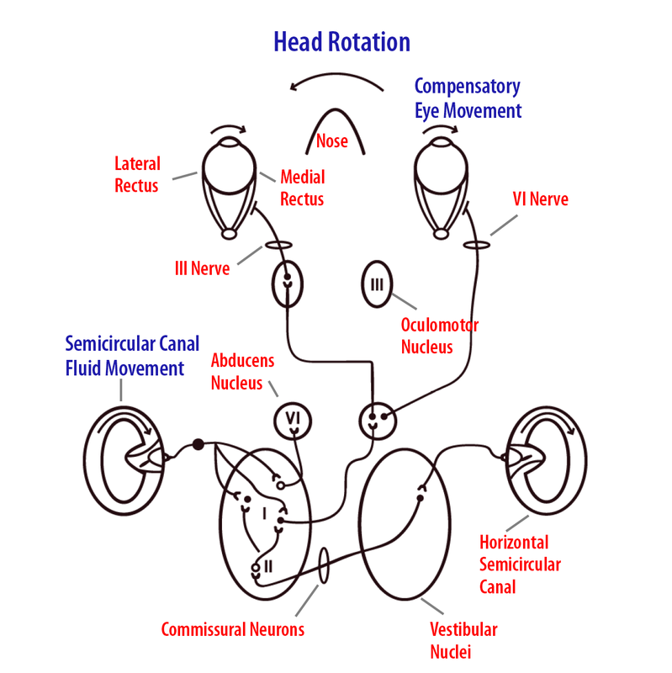
Cont.
Extra

Slide 16
Vestibular function
ONLY IN MALES’ SLIDES
Predictive function of SCC in the maintenance of equilibrium: i.e Predict ahead of time that mal-equilibrium is going to occur. How? Send impulses to CNS for corrective measures before the start of the fall.

Slide 17
Vestibular pathway
1. Neural connection
The vestibular nuclei on either sides of the brain stem send signal to:
Cerebellum.
Nuclei of cranial nerves III, IV, and VI.
Reticular formation.
Spinal cord (vestibulospinal tracts).
Thalamus.
Effects of stimulation of S.C.C (rotation)
Vertigo: this false sensation of counter-rotation at end of rotation.
Nystagmus (Because our eyes are moving in response to the signals coming from the vestibular apparatus The fluid is still moving inside the vestibular apparatus, our eyes which are connected to the vestibular nucleus (still having positive signals).
Bradycardia.
Hypotension.
Increased muscle tone on same side of rotation to support the body & decreased muscle tone on the opposite side.

Slide 18
Thank you!
اعمل لترسم بسمة، اعمل لتمسح دمعة، اعمل و أنت تعلم أن الله لا يضيع أجر من أحسن عملا.
The Physiology 436 Team:
Team Leaders:
Lulwah Alshiha
Laila Mathkour
Mohammad Alayed
Females Members:
Hayfaa Alshaalan
Males Members:
Fahad Alfayez
Talal alenezi
Ali Alsubaie
Contact us:
References:
Females’ and Males slides’.
Guyton and Hall Textbook of Medical Physiology (Thirteenth Edition.)

