Slide 1
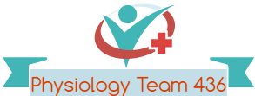
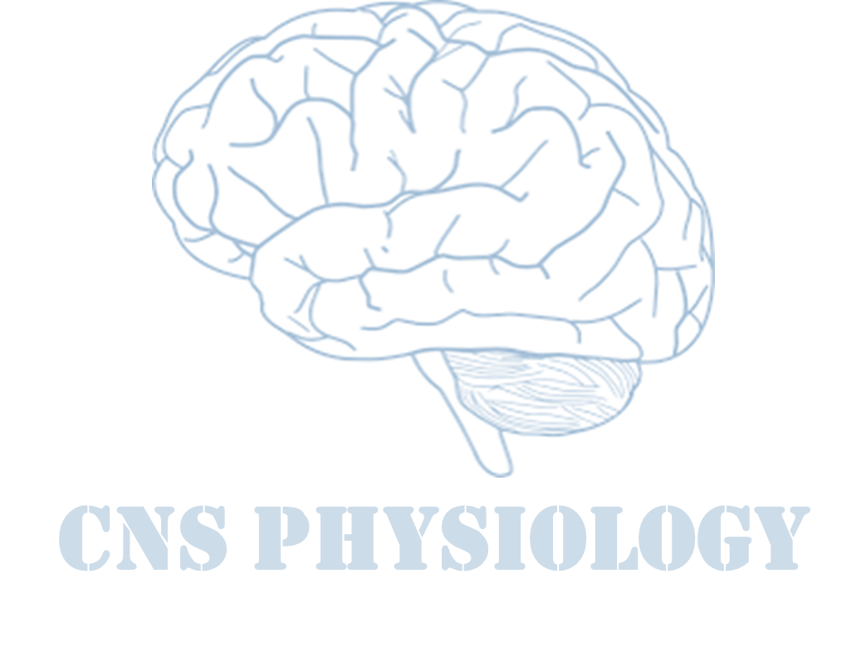
Text
Important
Formulas
Numbers
Doctor notes
Notes and explanation
Lecture No.16
“Believe In Your Dreams. They Were Given To You For A Reason”

Slide 2
Physiology of postural reflexes
Objectives:
Postural reflexes are needed to keep the body in a proper position while standing, moving. When body posture is suddenly altered it is corrected by Sevier reflexes. These reflexes are operating at spinal cord, medulla, mid-brain and cortical levels. To make the reflex movements smooth cerebellum, basal ganglia and vestibular apparatus are needed. Students are required to know posture-regulating parts of CNS.

Slide 3
What is posture?
ONLY IN MALES’ SLIDES
ONLY IN FEMALES’ SLIDES
Posture is the attitude taken by the body in any particular situation like standing posture, sitting posture, etc.. Even during movement, there is a continuously changing posture.
The basis of posture is the ability to keep certain group of muscles in sustained contraction for long periods. Variation in the degree of contraction and tone in different groups of muscle decides the posture of the individual.
It is maintenance of upright position against gravity (center of body is needed to be between the legs) it needs anti-garvity muscles (Extensor muscles).
Up-right posture need postural reflexes.
Posture depends on muscle tone (stretch reflex) ( basic postural reflex).
The main pathways concerned with posture are:
Medial tracts: control proximal limbs & axial muscles for posture & gross movements.
Lateral pathways: as corticospinal-rubrospinal control distal limbs.

Slide 4
Postural reflex
ONLY IN MALES’ SLIDES
These reflexes resist displacement of the body caused by gravity or acceleratory forces, and they have the following functions:
Studied over animals by cutting the centers above the tested area.
1. Maintenance of the upright posture of the body.
2. Restoration of the body posture if disturbed.
3. Providing a suitable postural background for performance of voluntary movements.

Slide 5
Cont.
postural reflex depends on the following receptors
vestibular apparatus receptors
visual (vision) & auditory (hearing) receptors
Proprioceptors of muscles, tendons, ligaments & joints
Maculae (utricle & saccule) & SCC cristae.
Macula for linear acceleration and orientation of head in space.
SCC Cristae for angular acceleration.
Vision can compensate for loss of auditory, vestibular & proprioception (tabes dorsalis +ve rombergism).
If pt with sensory ataxia stands with eyes closed, he/she falls down*.
+ve Rombergs sign when the posture maintenance is fully vision dependent
زي اللي عندهم نيوروسيفيلس لما يسكر عيونه ما يقدر يحافظ على توازنه ويطيح
Neck Proprioceptors
Detect head position in relation to trunk
ONLY IN FEMALES’ SLIDES
ONLY IN FEMALES’ SLIDES
Body Proprioceptors
Proprioceptors of anti-gravity muscles
Pressure receptors
As in sole of feet initiate positive supporting reaction (magnet reflex)
* Loss of balance when the he standing patient close their eyes is interpreted as a positive romberg's test (sensory ataxia).

Slide 6
Cont.
Postural reflexes
1- Static reflexes (at rest) (statotonic) Maintain posture at rest |  |  | 2- Phasic reflexes “center in C.C” (with motion) (statokinetic reflex) Maintain posture during motion
Spinal Reflexes (Explained in the next slides) | Medullary Reflexes (Explained in the next slides) | Righting Reflexes Center: In the midbrain (Explained in the next slides) | A- Hopping Reaction when animal is pushed laterally reflex hopping to keep limbs in position to support body. The receptors are in muscle spindles.
N.B: spinal receptors can be studied in spinal animal with cut at neck between the S.C & brain stem so all S.C is intact. |  |  | B- Placing Reaction blind folded animal suspended in air & moved towards a supporting surface, the feet will be placed firmly on the supporting surface (receptors are touch receptors & proprioceptors in soles of feet)
CC = Cerebral Cortex

Slide 7
Cont.
مثلاً لما شخص يمشي يرفع رجل ويوقف على رجل وهكذا، الرجل اللي واقف عليها
positive reaction or magnet reflex ( local static(
والرجل المرفوعة
Negative supporting receptor (segmental)
Spinal Reflexes “Center in Spinal Cord”
Studied in spinal animals; with cut between spinal cord and brain stem¹
1- Local Static Reflexes (in 1 limb) | 2- Segmental Static Reflexes (in 2 limbs)
i. Positive supporting reaction (magnet reflex) Receptors are proprioceptors of flexors(contraction of both flexors & extensors) (protective reflex). When you stand on one feet (contraction of both flexors & extensors AT THE SAME TIME .. Against reciprocal innervation. ii. Stretch Reflexes (static): This is the most important local static reflex which controls the tone in those extensor muscles which keep the body upright (antigravity muscles). | Mediated by one segment of the spinal cord as: Crossed extensor reflex. Negative supporting receptor. It refers to disappearance of positive supporting reaction. It is initiated by stretch of the extensor muscles. Which release +ve supporting reaction ( receptors are proprioceptors of extensors of the released limb).
ONLY IN MALES’ SLIDES
ONLY IN FEMALES’ SLIDES
In the tested animal we make sure that the reflex is done by spinal cord by cutting all the centers above
1: To abolish the effects of the higher level structures in order to study the “spinal reflexes” only

Slide 8
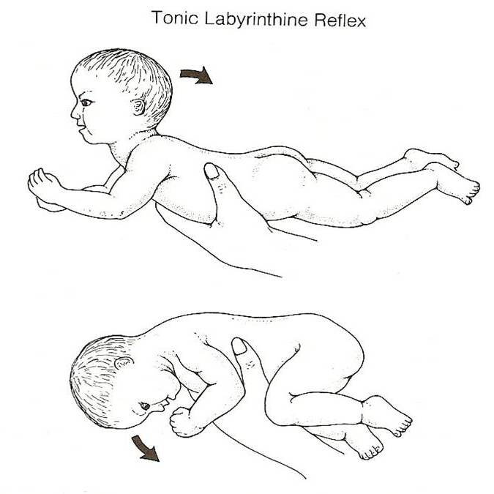
Postural Reflex
Labyrinthine Static Reflex
00:17
Medullary Reflexes “center in Medulla oblongata”
1- Neck Static Reflexes | 2- Labyrinthine static reflex
Studied in: a decerebrated animal cut above medulla + labyrinth destroyed. | Studied in: decerebrated animal + elimination of neck proprioceptors (labyrinth intact).
Stimulus is: changing head position that (+) neck proprioceptors. | Stimulus is: gravity 1- ventroflexion of head (or prone position) 4 limbs flexion 2- dorsiflexion of head (or supine position) 4 limbs extended( as in decerebration)
Neck Static reflexes: (Movements that stimulate proprioceptors) Ventroflexion of head: Flexion of forelimb (arms) + extension of hind limb (as in decerebration). Dorsiflexion of head: Extension of forelimb (arms) + flexion of hind limb. Turning head to one side: Extension of limbs on that side + flexion of other side. | Receptors are: otolith organs (maculae).
Cancellation of the effect of neck proprioceptors is done through cutting first three cervical nerves.
The difference between the two types is one of them depends on labyrinth with abolishing the effect of neck proprioceptors and vise versa for the other type.
Decerebrate: remove the cerebrum from (a laboratory animal) | Hind limb: A posterior appendage, such as a leg, wing, or flipper.
Forelimb: An anterior appendage, such as a leg, wing, or flipper.

Slide 9
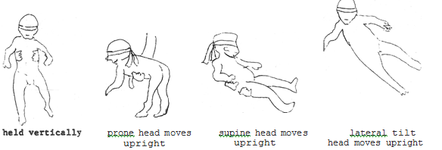
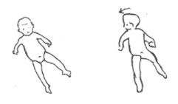
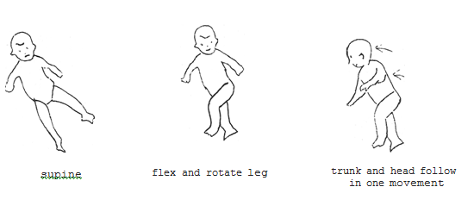
Postural Reflex
Righting reflex
00:34
Righting Reflexes “Center is midbrain except the visual in C.C”
when upright posture is disturbed as in falling down. (When the body goes off balance and falls down, the righting reflexes helps the body to regain the upright position) Studied in a decerebrated animal (cut above midbrain = upper decerebration)
1A- labyrinthine righting reflexes (midbrain): | Definition: cover eyes & animal held in air from pelvis (the body is not in the proper position) As in tilting the head: (+) otolith organs → (+) neck muscles to correct the head level (when head is not in proper site) All static labirynthine reflexes have macula as receptors but in statokinetic reflexes during motion macula act in linear & SCC receptors act in angular acceleration
 | Stimulus: the body is not in the proper position
 | Receptors: otolith organs
 | Response: righting of head
1B- Body on head righting reflexes (midbrain): | Stimulus: pressure on side of body & head is free
 | Receptors: trunk proprieoceptors (body pressure receptors)
 | Response: reflex correction of head
1C- Neck righting reflexes (midbrain) : | Stimulus: stretch of neck muscles (if head is corrected & body still tilted) righting of shoulders & body.
 | Receptors: muscle spindles of neck muscles
 | Response: righting of body
1D- Body on body (midbrain): | Stimulus: Pressure on side of the body and head is fixed
 | Receptors: trunk proprieoceptors (body pressure receptors)
 | Response: reflex correction of body
2- visual righting reflexes (cortical/ cerebral cortex): Studied in animals with intact brain (no decerebration), cutting upper 3 cervical nerves + destruction of the labyrinth | Stimulus: Visual stimulus (visual image can correct position of head & body if position is disturbed)
 | Receptors: eye receptors
studied in mid brain animal with destroyed labyrinth

Slide 10
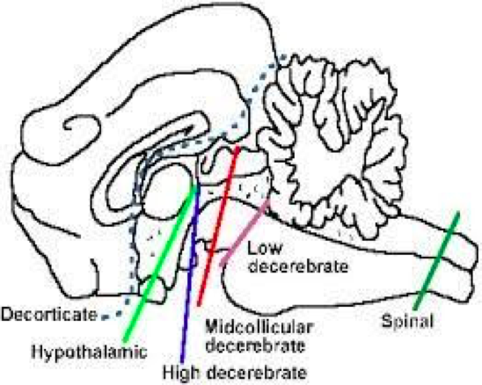
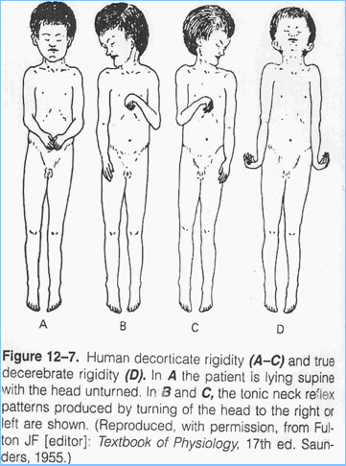
Decerebrate rigidity & decorticate rigidity

Slide 11
Decerebrate Rigidity
Site of lesion: between the superior and inferior colliculi of the midbrain, lesion below Red Nucleus (e.g. mid-collicular lesion).
block normal inhibitory signals from brain & red nucleus in midbrain to tonically active pontile R.F & Vestibular nucleus causing:
ONLY IN FEMALES’ SLIDES
ONLY IN MALES’ SLIDES
Maintained tonic static postural reflexes that support animal against gravity:
a. medullary tonic neck.
b. medullarylabyrinthine R). 2-Absent midbrain righting R 3-Extension of head & 4 limbs extensors ( as in labyrinthine static R).
The jaw may be clenched with the neck hyperextended due to increased extensor tone from vestibulospinal & reticulospinal tracts to extensor motor neurons.
spasticity & rigidity & extension in antigravity muscles.
Extensive extensor posture of all extremities → Rigidity of all 4 limbs.
All limbs extended, arms extended by the sides & rotated internally (outward).
Hallmark → elbows extended.
Head may be arched to the back, it is due to:
Increased general excitability of the motor neuron pool; especially Gamma efferent discharge (due to facilitatory effects of the un inhibited Vestibulospinal Tract).

Slide 12
Cont.
In a decerebrated animal:
damage to level below red nucleus.
Features of decerebrate rigidity:
Hyperextension of all four limbs.
Dorsiflexion (hyperextension) of tail and head.
Extreme hyperextension of the spine (opisthotonus) produces concave configuration of the back.
The animal can be made to stand on four limbs but is easily toppled by slight push.
The jaw may be clenched with the neck hyperextended due to increased extensortone from vestibulospinal & reticulospinal tracts to extensor motor neurons.
Spasticity & rigidity & extension in antigravity muscles.
Reflexes that are lost/absent:
Optical (visual) righting Reflexes.
Reflexes that are retained / still present i.e. reflexes the do not depend primarily on cerebrum:
Maintained tonic static postural reflexes that support animal against gravity (medullary tonic neck & labyrinthine R).
Tonic Labyrinthine reflexes.
Tonic Neck Reflexes.
Other Righting Reflexes.
ONLY IN FEMALES’ SLIDES
Opisthotonus: is a state of severe hyperextension, in which an individual's head, neck and spinal column enter into a complete "bridging" or "arching" position.

Slide 13
Cont.
ONLY IN FEMALES’ SLIDES
Decorticate rigidity more common in human than decerebate rigidity:
lesion in cerebral cortex but brain stem is intact, as what seen in hemiplegic pts after Hge of internal capsule.
Medullary tonic neck & tonic labyrinthine reflexes present.
Righting midbrain reflexes present.
Visual righting, placing & hopping reflexes lost.
it causes extensor rigidity in legs & moderate flexion of arms if head unturned , as supine position (tonic neck reflexes).
Turning the head to one side initiates tonic neck reflexes, ex: turning head to the left = extension of limbs on left side & flexion of right side.
Cause:
Lesions above the red nucleus so rubrospinal are intact together with pontine reticulospinal and the vestibulospinal leads to the characteristic flexion posturing of the upper extremities and extensor posturing of the lower extremities.
Since the corticospinal tract is interrupted, the pontine reticulospinal and the vestibulospinal extend l.L.
Normally suppressor area 4 strip in the anterior edge of precentral gyrus inhibit red nucleus , if this inhibition is lost by decortication ,red nucleus is disinhibited.
Disinhibition of the red nucleus facilitate the rubrospinal tract to flex U.L.
Also there is loss of inhibitory cortical signals (from suppressor area 4 strip in the anterior edge of precentral gyrus) to gamma motor neurons via reticulospinal.

Slide 14
Decorticate Rigidity (actions of the cerebral cortex are removed)
In humans, where true decerebrate rigidity is rare, since the damage to the brain centers involved in it are lethal.
Decorticate rigidity more common in human than decerebate rigidity, due to: Lesion in cerebral cortex, but brain stem is intact. As seen in hemiplegic patients after Hge of internal capsule.
However decorticate rigidity can be caused by bleeding in the internal capsule which causes UMNL (damage to upper motor neurons).
Symptoms & Signs:
Flexion in the upper limbs.
extension in the lower limbs.
extensor rigidity in legs & moderate flexion of arms if head unturned, as supine position (tonic
neck reflexes).
The hands are clenched into fists, and the legs extended and feet turned inward.
Tonic neck reflexes are produced by turning the head to one side, ex: to the left extension of limbs on left side & flexion of RT.
ONLY IN FEMALES’ SLIDES

Slide 15
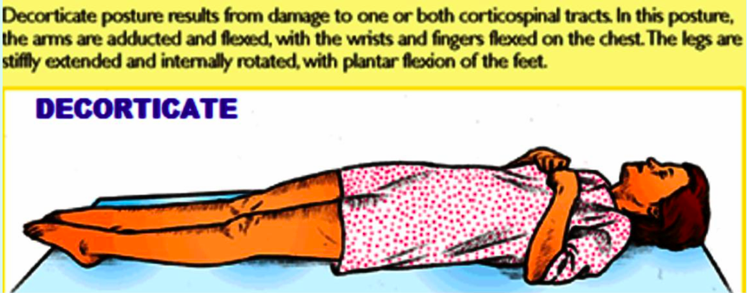
Decorticate Rigidity
ONLY IN MALES’ SLIDES
In a decorticate animal:
Decorticate animal is one in whom the whole cerebral cortex is removed but the basal ganglia and brain stem are left intact.
Characteristic features: moderate rigidity is present.
Cortex inhibit medullary reticulospinal tract. Therefore, removal of cortex results in facilitation of γ motor neuron discharge.
Reflexes that are lost/absent:
Placing reaction, hopping reaction
Visual righting reflex
Reflexes that are retained /still present i.E. Reflexes the do not depend primarily on cerebral cortex:
Tonic labyrinthine reflexes
Tonic neck reflexes
Other righting midbrain reflexes

Slide 16
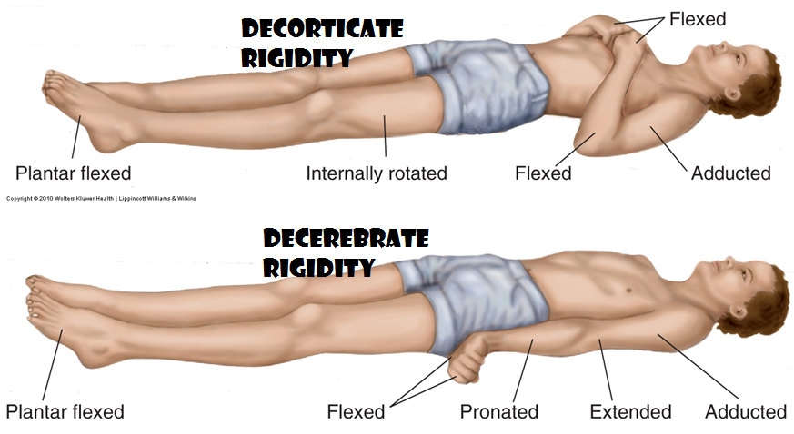
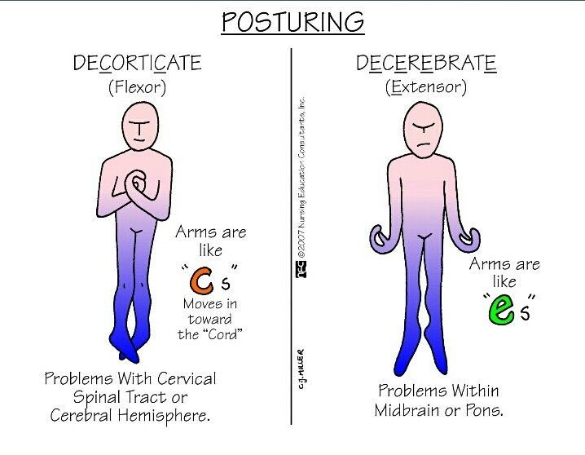
Decerebrate rigidity & decorticate rigidity

Slide 17
Summary of postural reflexes
الجدول هذا هو الي أبغاكم تعرفونه من المحاضرة

Slide 18
Thank you!
اعمل لترسم بسمة، اعمل لتمسح دمعة، اعمل و أنت تعلم أن الله لا يضيع أجر من أحسن عملا.
The Physiology 436 Team:
Team Leaders:
Lulwah Alshiha
Laila Mathkour
Mohammad Alayed
Females Members:
Lama Altamimi
Shahd Alsowaidan
Males Members:
Hassan Alshammari
Mohammad almutlaq
Basel almeflh
Contact us:
References:
Females and Males slides.
Guyton and Hall Textbook of Medical Physiology (Thirteenth Edition.)

