Slide 1


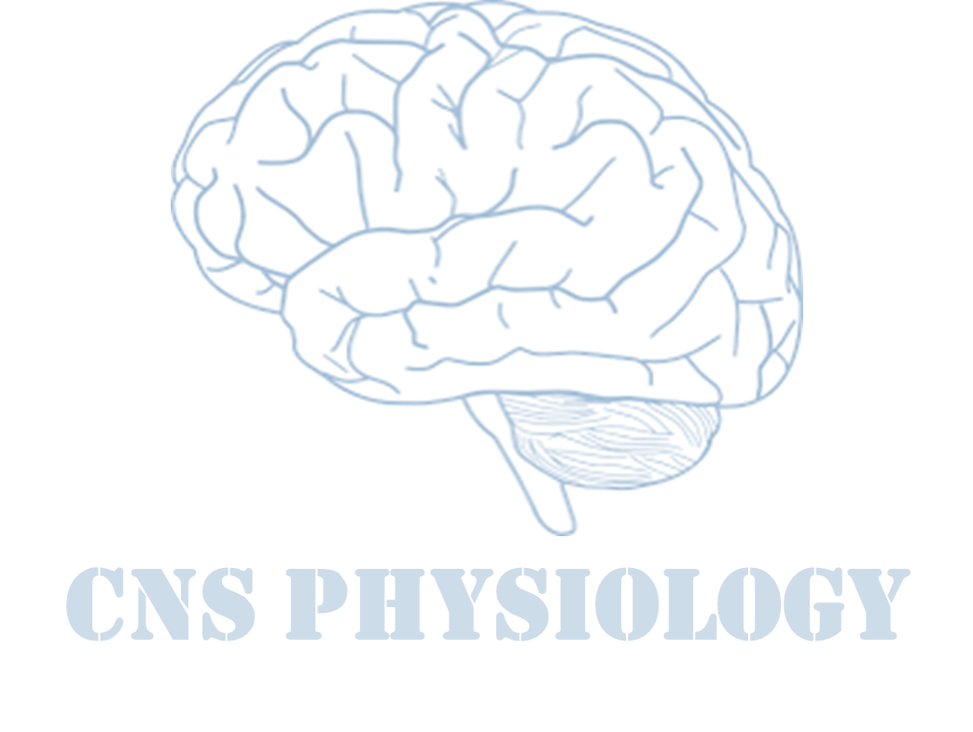

Text
Important
Formulas
Numbers
Doctor notes
Notes and explanation
Lecture No.17
“Keep Moving Forward”
We recommended you to read this lecture from neuroanatomy book. You can find the book on the team drive, page 117-123

Slide 2
Cerebellum (CB)
Objectives:
Describe the functional divisions of the cerebellum; vestibulocerebellum, spinocerebellum and cerebrocerebellum.
Understand cell types / nuclei of the cerebellum.
Understand the functions of cerebellum in regulation of movement, tone and balance.
Define the physiological roles of the cerebellum in regulation of movement.
Understand and Explain the abnormalities associated with cerebellar disease: Cerebellar nystagmus, changes in muscle tone, ataxia, drunken gait, scanning speech, dysmetria (past-pointing), intention tremors, rebound phenomenon and adiadochokinesia.

Slide 3

Cerebellum (CB)
Cerebellum is a highly folded part of the brain, lies underneath the occipital lobe of the cortex.
Occupies a prominent position beside the main sensory and motor systems in the brain stem.
It is connected or attached to the brain stem on each side by three cerebellar peduncles: (1)superior, (2)middle and (3) inferior.
It consists of two connected hemispheres (cerebellar hemispheres connected by vermis).
Each hemisphere controls the same side (ipsilateral) of the body (unlike the cerebral cortex).
Various fibers inter and leave the cerebellum through these peduncles.
Cerebellum is derived from a Latin word means "little brain.“ Cerebellum is the largest part of the hind brain, lies behind the pons and medulla Oblongata.
Shape: Oval shaped, with an approximate weight is 150 gm.
Location: Situated in the posterior cranial fossa.
Anteriorly: 4th ventricle, pons, and medulla oblongata.
Superiorily: Covered by tentorium cerebelli.
Posterio-inferiorly: Squamous occipital.

Slide 4
Cerebellum: the rule of 3
ONLY IN MALES’ SLIDES
3 lobes | Floculonodular lobe Anterior lobe Posterior lobe
3 cortical layers | Molecular layer Purkinje cell layer Granular layer
3 purkinje’s cells afferent paths | Mossy fibers Climbing fibers Aminergic fibers
3 pairs of deep nuclei | Fastigial Interposed(globose & emboliform) Dentate
3 pairs of peduncles | Superior (pri.Output) Middle (pri.Input) Inferior (pri.Input)
3 functional division | Vestibulocerebellum Spinocerebellum Cerebrocerebellum

Slide 5
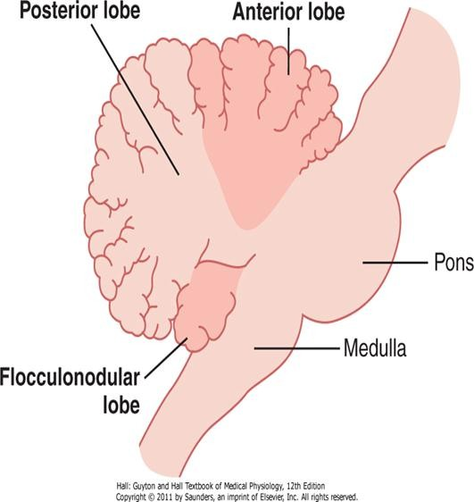
Anatomical lobes of CB
ONLY IN MALES’ SLIDES
Anatomically, the CB is divided into 3 lobes:
The anterior lobe.
The posterior lobe.
The flocculo-nodular lobe.
The anterior and posterior lobes are separated by
the primary fissure.
The posterior and flocculondular lobes are separated by
the posterior fissure.

Slide 6
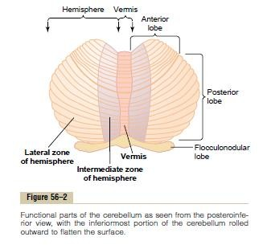
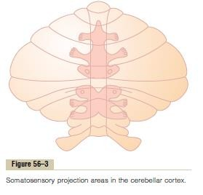
Anatomical & functional divisions of the CB
ONLY IN FEMALES’ SLIDES
The anterior & posterior lobes on each side constitute 2 large cerebellar hemispheres,
which are separated by a narrow band called the vermis.

Slide 7
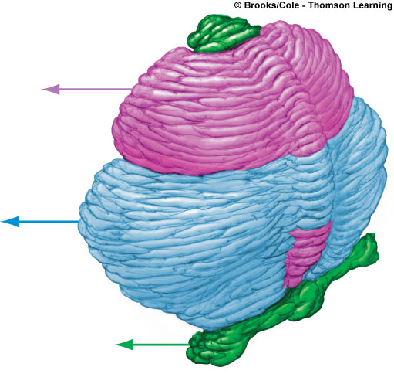

Cont.
ONLY IN MALES’ SLIDES
Primary fissure
Anterior Lobe
It makes the movements smooth and coordinated.
Posterior
Lobe
It interacts with motor cortex in planning & programming of movements.
Flocculo-Nodular
Lobe (FN lobe)
Vestibulocerebellum
Maintenance of balance, control of eye movements.
Folia
Spinocerebellum
Cerebrocerebelum

Slide 8
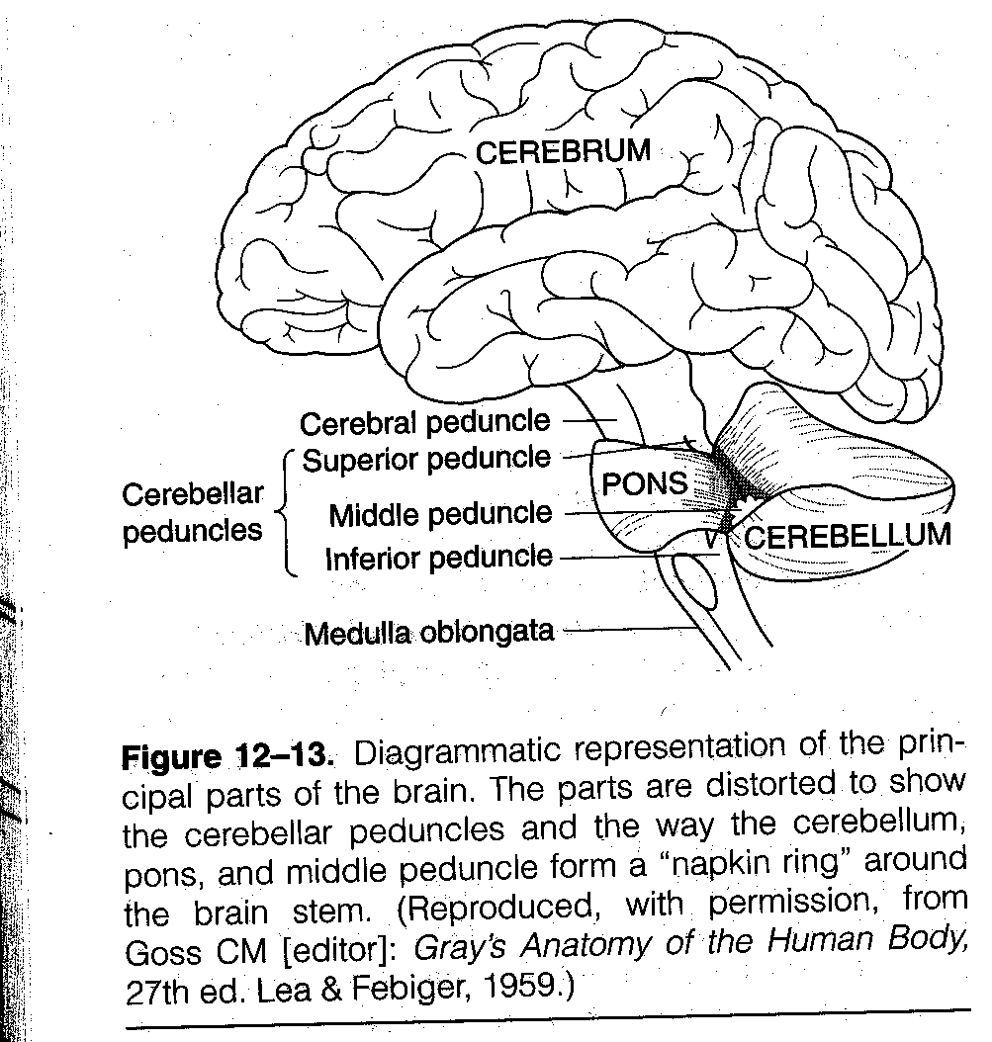
Cerebellar peduncles
Cerebellar peduncles: carry afferents from where?
Inputs to the Cerebellum
from the cerebrum
SuperiorCerebellar Peduncle
Middle Cerebellar Peduncle
Inputs to the Cerebellum
from from the Pons
Inferior Cerebellar
Peduncle
Inputs to the Cerebellum
from the Medulla Oblongata

Slide 9
Principal afferent tracts to the cerebellum
Afferent tracts | Transmits
Vestibulocerebellar | Vestibular impulses from labyrinths, direct & via vestibular nuclei.
Dorsal Spinocerebellar | Prorioceptive & exteroceptive impulses from the body.
Ventral Spinocerebellar | Prorioceptive & exteroceptive impulses from the body.
Cuneocerebellar | Prorioceptive impulses, especially from the head and neck.
Tectocerebellar | Auditory & visual impulses via inferior and superior colliculi.
Pontocerebellar | Impulses from motor and other parts of cerebral cortex via pontine nuclei.
Olivocerebellar | Proprioceptive input from whole body via relay in inferior olive.

Slide 10

Cerebellum layers
The cerebellum has an external cerebellar cortex separated by white matter from the deep cerebellar nuclei as follows:
Cerebellar Cortex | Cerebellar Nuclei
Molecular Layer Purkinje Cell Layer Granular Layer Purkinje cells Basket cells Golgi cells Stellate cells | Dentate Nucleus Globose Nucleus Emboliform Nucleus Fastigial Nuclei Granular cells → Glutamate…Exci Stellate Globose and Emboliform also known as interpositus nucleus.
GABA…Inhabit

Slide 11
Functional divisions of the cerebellum
Functionally speaking , the Cerebellum is divided into 3 parts: Neocerebellum , Spinocerebellum & Vestibulocerebellum.
Function | Outputs | Inputs | Cortex | Nuclei | CerebellumLobe
Muscle tone, posture & coordination of movements | SCP to Red Nucleus, Fastigial to RF | Spinal and brainstem paths | Vermis & Medial portions of Cerebellar hemispheres | Interposed, Fastigial | Paleocerebellum
Planning and executive of voluntary & skilledhand movements | SCP | Corticopontine, pontocerebellar | Lateral portions of Cerebellar Hemisphere | Dentate | Neo- cerebellum
Balance, equilibrium | Vestibular nuclei, RF | Vestibular nuclei | Flocculonodular | Fastigial | Archi cerebellum

Slide 12
Cont.

Slide 13
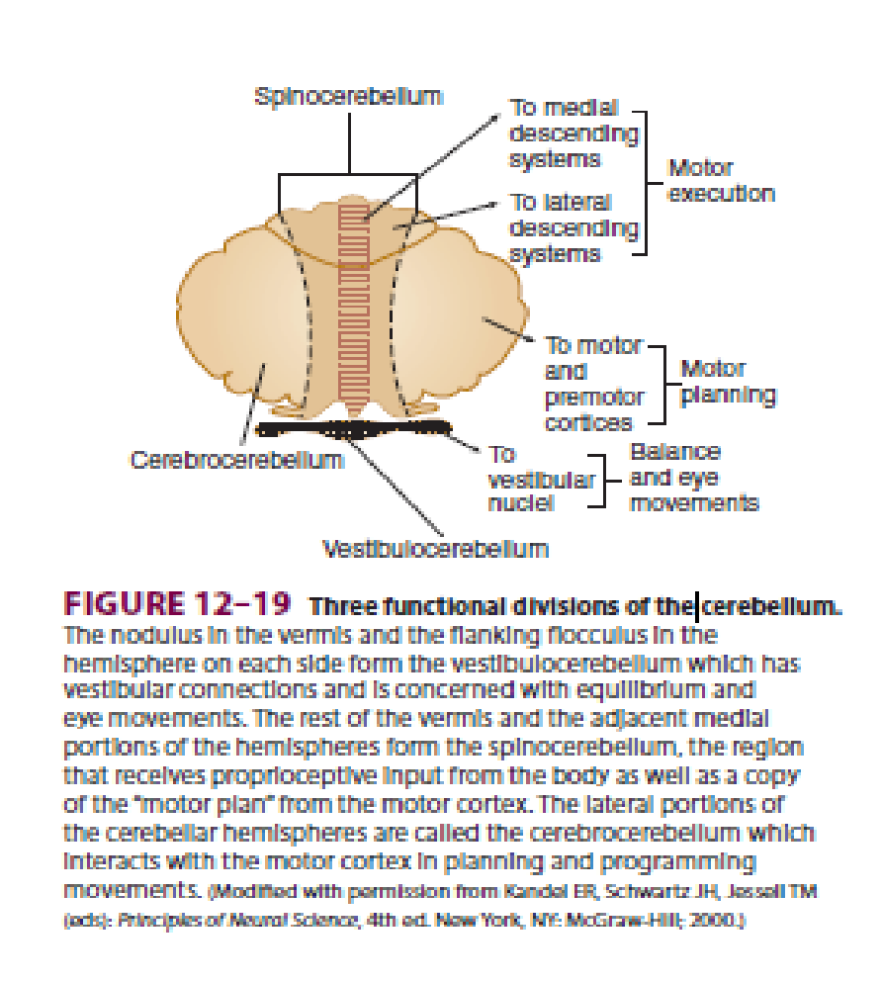
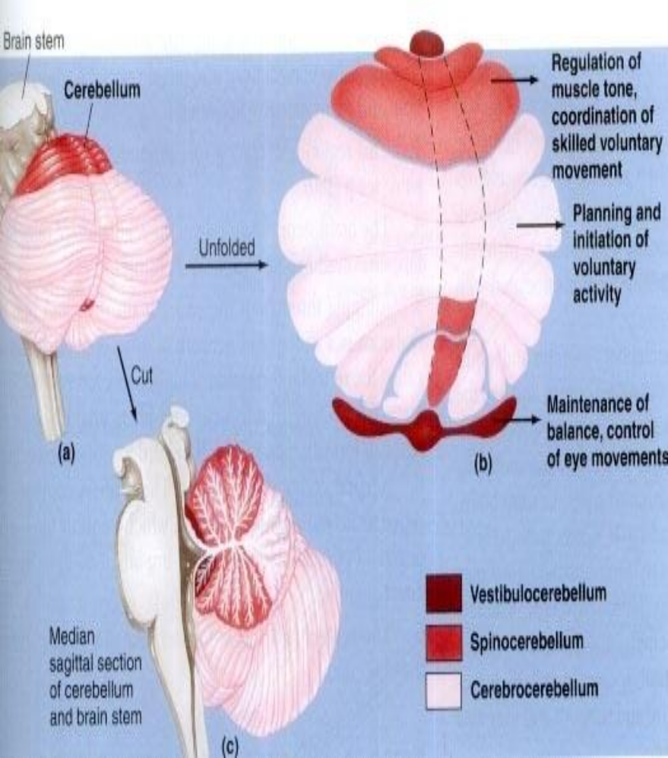
Cont.
ONLY IN FEMALES’ SLIDES
Flocconudoular for equilibrium & vestibular connections
Cerebro-cerebellum (connections with cerebrum) they act together to establish movements and planning.

Slide 14
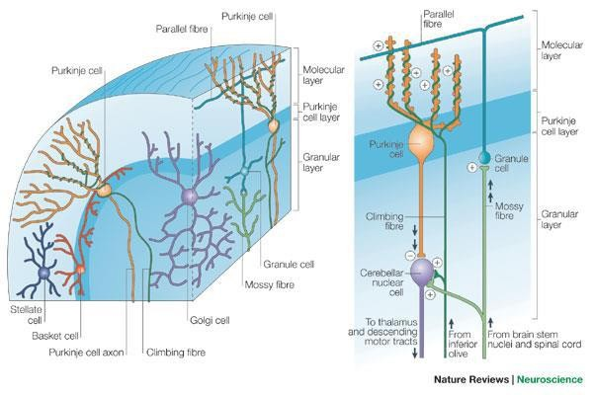
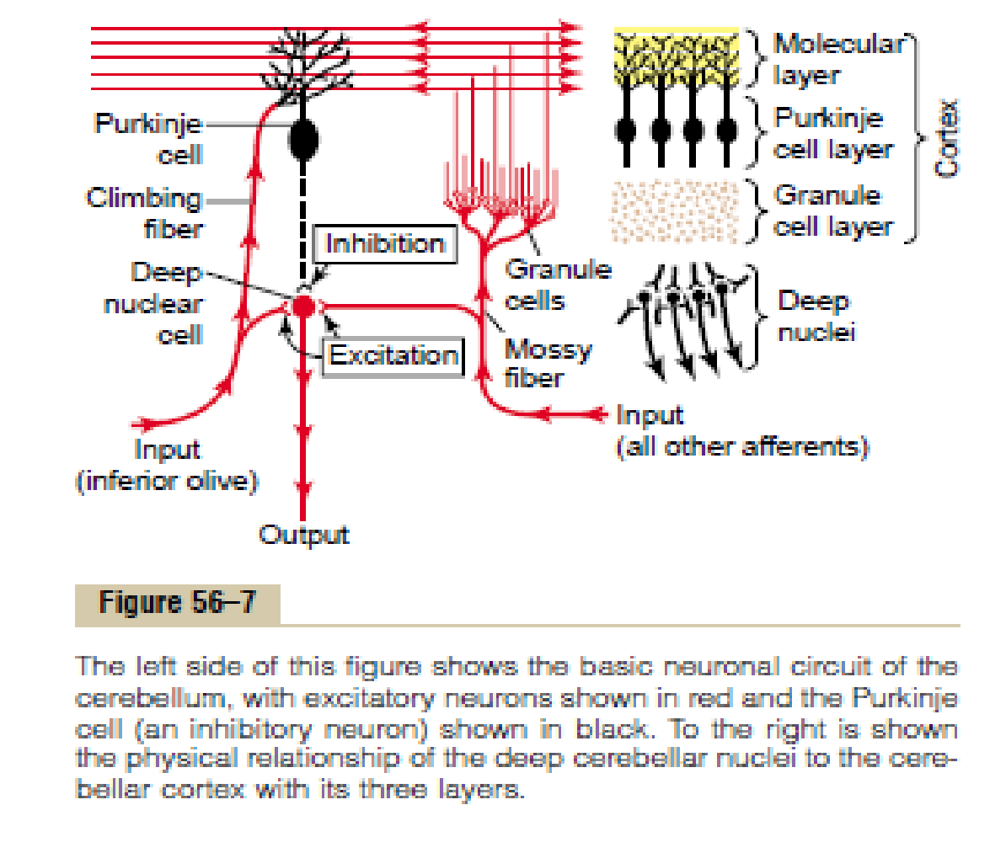
Structure & connections of cerebellum
Purkinje cell.
Granule cell.
Basket cell.
Golgi cell.
Stellate cell.
Climbing fiber.
Mossy fiber.
Parallel fiber.
Inferior olivary nucleus.
Deep cerebellar nuclei.
Affrent
Medulla
Affrent
Impulses arrive to cerebellar cortex & leave it from deep nucli

Slide 15
Cont.
This slide is very important
The CB has an external layer of gray matter( cerebellar cortex), and an inner white matter.
The cortex is deeply infolded, giving a large surface area, and it contains five different cell types:
Golgi, basket, stellate which are inhibitory interneurons ( The over all output 3 inhibit + 1 excites).
The granule cells, which are excitatory.
The purkinje cells which are the output cells, inhibit the deep nuclear cells (DNCs).
The inhibitory neurons in the CB release GABA ( ex: stellate, basket, Golgi, Purkinji cells).
The excitatory neurons release glutamate (ex: granule cells, that also has GABA A receptors) To be inhibited by GABA neurotransmitter.
You have to know which cell is excitatory or inhibitory and what neurotransmitters they release.

Slide 16
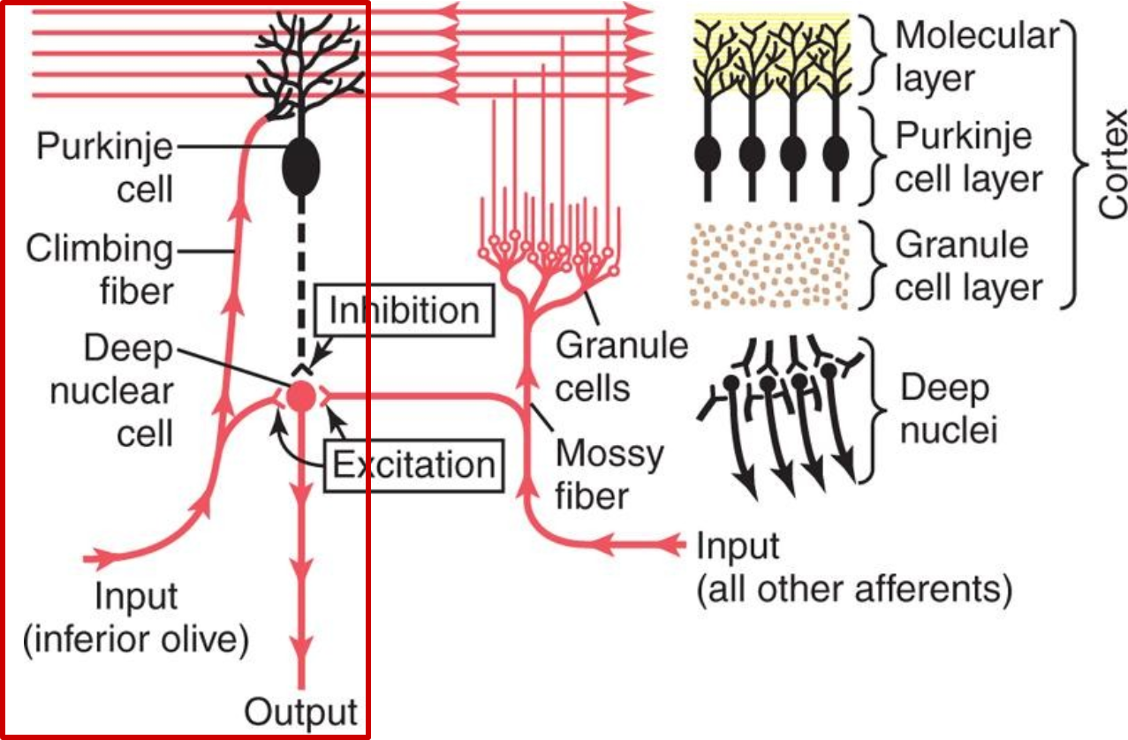
Functional unit of the cerebellar cortex-the purkinje cell and the deep nuclear cell
ONLY IN MALES’ SLIDES
Functional unit
Cerebral cortex
Brainstem
Spinal cord
Red= excitatory
Black =inhibitory

Slide 17
Cont.
The white matter contains 3 deep nuclei:
Dentate.
Fastigial.
Interpositous (formed of globose & emboliform nuclei). emboliform nuclei = 2 united nucli
All afferent fibers relay first at the deep nuclei and the cerebellar cortex, then the latter discharges to the deep nuclei, from which the efferent fibers originate and leave the CB.

Slide 18
Output from deep nuclei
Fastigii
Nucleus
Interpositus
Nucleus
Dentate
Nucleus
Red nucleus
Motor cortex
Reticular formation
Red nucleus
Premotor cortex
Control distal muscle during movement
Control axial muscle during movement
Planning of movement
Its timing and initiation

Slide 19
Cerebellum and voluntary motor control
Cerebral and cerebellar control of voluntary movements, involving especially the intermediate zone of the cerebellum.

Slide 20
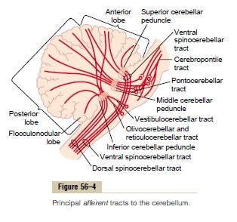
Afferent (input) pathway
The CB receives both sensory and motor information through a rich afferent nerve supply.
This arises from:
Other areas of the brain.
Peripheral receptors.
and enters the CB via the 3 cerebellar peduncles.
1. The climbing fibers:
From the inferior olivary nucleus.
It learns the cerebellum to perform new patterns of movements precisely.
2. The mossy fibers:
From all other afferent fibers that enter the cerebellum + some fibers coming from the inferior olivary nucleus (so they are greater than the climbing fibers).
Help the precise execution of the voluntary movements (concerning their initiation, duration and termination), which occurs by controlling the turn on and turn off output signals from the cerebellum to the muscles.

Slide 21
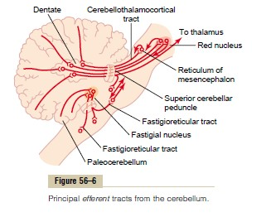
Efferent (out put) fibers
There are 3 main efferent pathways from the 3 parts of the CB:
Are the axons of the 3 deep nuclei.
Leave the CB through the cerebellar peduncles.
Leave the CB through the superior
and inferior peduncles.
ONLY IN FEMALES’ SLIDES

Slide 22
Functions of the cerebellum
The CB is called the silent area, because its stimulation does not give rise to any sensation and cause almost no motor movements.
It is important in the precise execution of rapid muscular movements (Coordinate what is already present).
Damage to the CB cause almost total incoordination of muscular movements, although the muscles are not paralyzed.
The cerebellum is concerned only with subconscious control of motor activity, and its functions as well as the involved part include the following:
A. Control of equilibrium & postural movements
B. Control of the Stretch Reflex
C. Control of voluntary movement by the cerebellum
The function of the vestibulocerebellum.
It receives information from the vestibular apparatus (It will till that the person is moving), then through the fastigial nucleus, it discharges to the brain stem, and through the vestibulospinal and reticulospinal tracts.
It controls equilibrium & postural movements by affecting the activity of the axial muscles (trunk & girdle muscles¹).
The cerebrocerebellum exerts a facilitatory (a little bit hypertonic) effect on the stretch reflex & increases the muscle tone, while the spinocerebellum probably exerts an inhibitory effect.
However, normally the facilitatory effect predominates (so cerebellar diseases often result in hypotonia).
Next slide.
¹ Shoulder gridle, Pelvic gridle

Slide 23
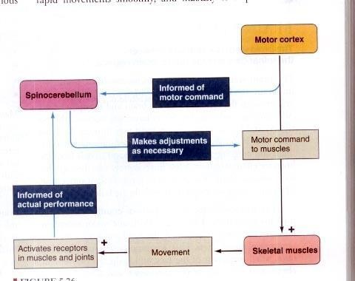
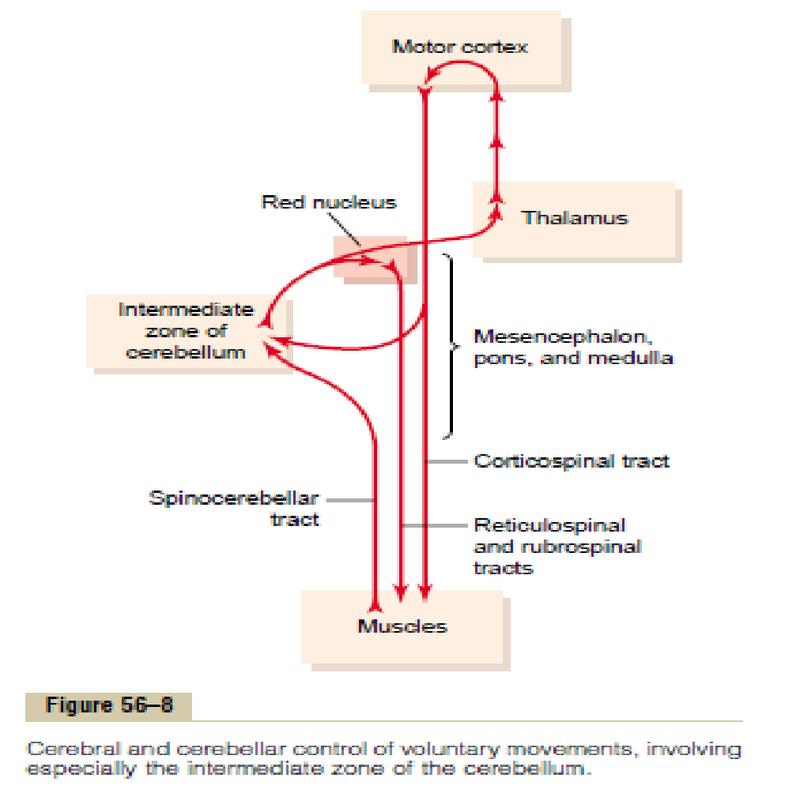
Cont.
A. Control of equilibrium & postural movements
B. Control of the Stretch Reflex
C. Control of voluntary movement by the cerebellum
Observe motor cortex & muscle function & compare it so it adjusts (increase or decrease) the impulses from the motor cortex
A comparetive function

Slide 24
Cont.
Each cerebellar hemisphere is connected by efferent and afferent pathways to the contra lateral cerebral cortex (the cortico – ponto-crebello-dentato- thalamo- cortical circuit).
The cerebellum exerts its effects on the same side of the body:
  The vermis controls muscle movements of the axial body, neck, shoulders and hips.
  The intermediate zones controls muscle contractions in the distal portions of both the upper and lower limbs (especially the hands, fingers, feet and toes).
  The lateral zones help in the planning of sequential movements.
Other functions of cerebellum:
  The CB co-ordinates involuntary postural movements initiated by extra-pyramidal system by acting as a comparator (in the same way as in voluntary movement) and correcting errors so movements do not over shoot.

Slide 25
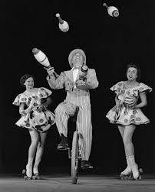
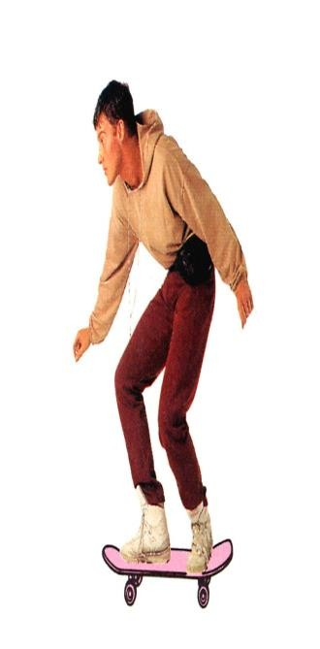
Cont.
ONLY IN FEMALES’ SLIDES
Maintenance of equilibrium (balance, posture, eye movement). To
avoid nystagmus.
2. Coordination of the half Automatic movement of walking and
posture maintenance. ( The movement we don’t think about, like
walking).
3. Adjustment of muscle tone.
4. Motor learning – motor skills (Fine movements, like piano).

Slide 26
Clinical features / tests related to cerebellum
ONLY IN MALES’ SLIDES
Ataxia | Reeling, wide-based gait.
Decomposition of movement | Inability to correctly sequence fine, coordinated acts.
Dysarthria | Inability to articulate words correctly, with slurring. Inappropriate phrasing.
Dysdiadochokinesia | Inability to perform rapid alternating movements.
Dysmetria | Inability to control range of movement.
Hypotonia | Decreased muscle tone.
Nystagmus | Involuntary, rapid oscillation of the eyeballs in a horizontal, vertical, or rotary direction, with the fast component maximal toward the side of the cerebellar lesion.
Scanning speech | Slow enunciation with a tendency to hesitate at the beginning of a word or syllable.
Tremor | Rhythmic, alternating, oscillatory movement of a limb as it approaches a target (intention tremor) or of proximal musculature when fixed posture or weight bearing is attempted (postural tremor).

Slide 27
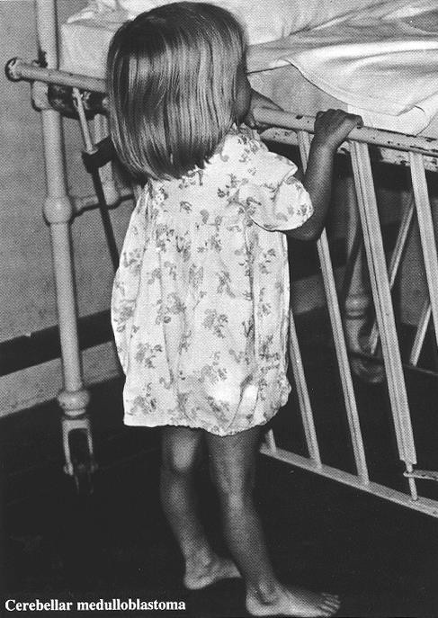
Lesions of the vestibulocerebellum
ONLY IN FEMALES’ SLIDES
Ex: Due to a tumor called medulloblastoma.
Leads to trunk ataxia (Incoordination of movement of the trunk) which is characterized by:
Equilibrium disturbances: the patient sways on standing, cannot maintain the erect posture, needs support, and walks by a staggering or drunken gait and have nystagmus (Remarkable).
Can’t stand erectly (defected vestibulo cerebellar pathway).

Slide 28
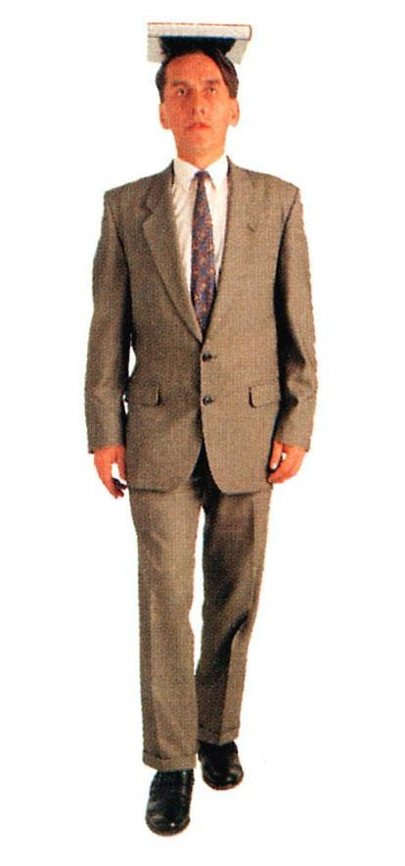
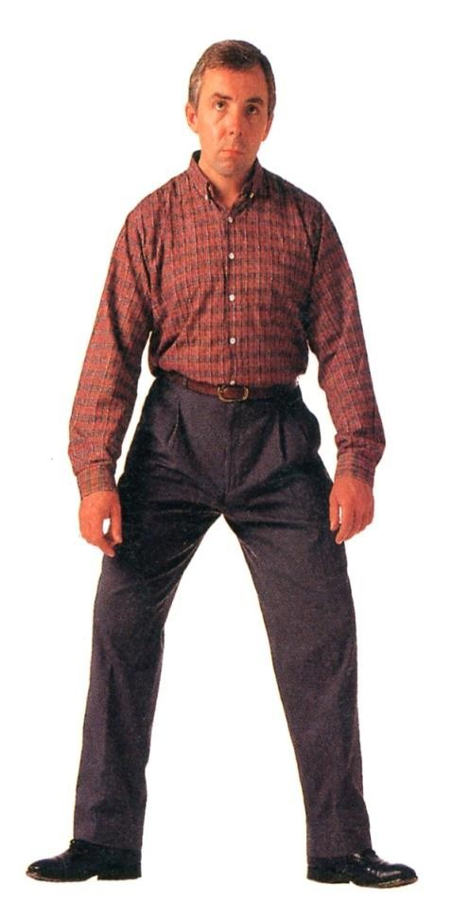
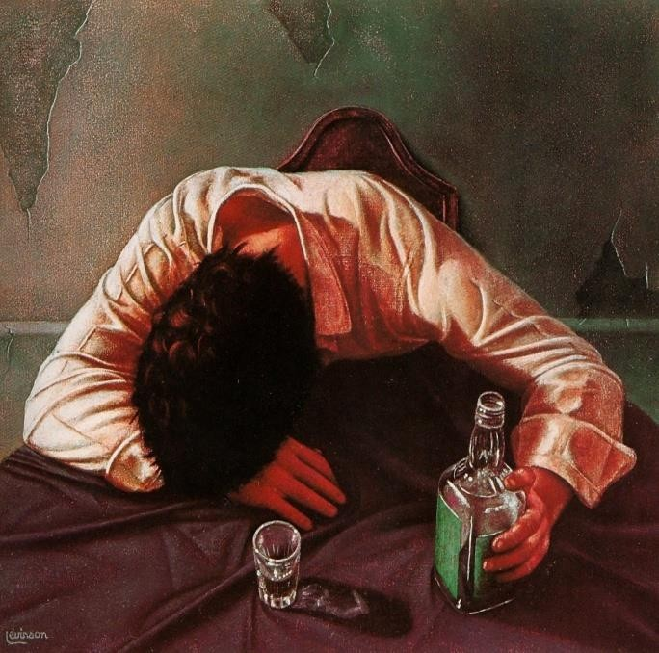
Ataxia
ONLY IN FEMALES’ SLIDES
Posture
Gait – Ataxia Tremor
This is incoordination of voluntary movements.
It is either sensory or motor (or mixed).
Motor ataxia: Is due to defect in the coordination of the voluntary movements.
It commonly occur in lesions of either:
the cerebellum or spinocerebellar tracts.
the labyrinth (vestibular apparatus).
the cortical motor areas.
Manifestation of the neocerebellar syndrome
Hypotonia
Asthenia
Motor ataxia
Due to loss of the facillitatory effect of the CB on the stretch reflex, and it is associated with pendular knee jerk.
Muscle weakness: this is due to difficulty in initiation and maintenance of muscle contraction secondary to loss of the potentiating signals by the mossy fiber circuit.
Incoordination of the voluntary movements, specially the rapid movements (becoming abnormal in rate, range, force and direction).

Slide 29
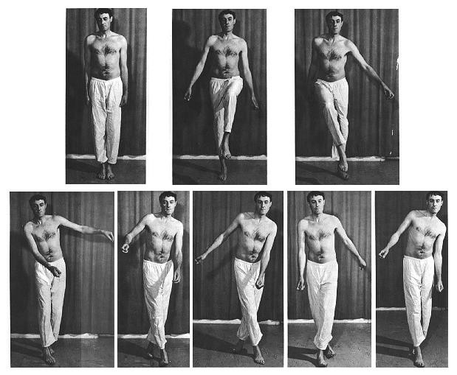
Cerebellar Ataxia
ONLY IN FEMALES’ SLIDES
Cerebellar Ataxia: Ataxia is incoordination of muscle
movement leading to imbalance.
Left cerebellar tumor ataxic gait and position:
Sways to the right in standing position.
Steady on the Right leg.
Unsteady on the left leg.
ataxic gait.
ONLY IN MALES’ SLIDES
Manifestation of Motor Ataxia
Dysmetria
Kinetic (intension, action or terminal) tremors
Inability to control the distance of the motor act, which may either overshoot the intended point (=hypermetria or past pointing) or stop before it.
This an oscillatory movement that appears on performing a voluntary movement (especially at its end) but is absent at rest.
It can be demonstrated by the finger nose test.
It occurs secondary to dysmetria and is due to a series of subconscious correction of the overshoot followed by overshoot of the correcting movements demonstrated by the finger nose test. Its secondry to dysmetria.
He can keep steady on the left side and he may fall on the diseased side.

Slide 30

Cont.
ONLY IN FEMALES’ SLIDES
Cerebellar Syndrome
2:33
Manifestation of Motor Ataxia
Rebound phenomenon
Asynergia
Failure of progression of movements: manifested by
Dysartheria
Nystagmus
Staggering (drunken) gait
This is over shooting of a limb when a resistance to its movement is suddenly removed. (Loss of the braking function of the CB), ( the arm pulling or flexion) test.
This is loss of the harmony between the three groups of muscles involved in performance of voluntary movement the agonists, protagonists (Puts the muscle in a position that facilitates its function). and antagonists.
A- adidokokinesia (dysdiadokokinesia)
Inability to perform alternate (opposite) movements successively at a rapid rate e.G pronation and supination of the forearm or upward and downward movement the hand.
B- decomposition (fragmentation of movements): inability to perform actions involving simultaneous movements at more than one joint.
Dysartheria: this is difficulty in producing clear speech. It is due to incoordination of the speech muscles secondary to loss of the predictive functions of the CB. The syllables may be too long or too short, loud or weak and speech may be also staccato or scanning i.E. Cut off into separate syllables.
This is tremor of the eyeballs that occurs on looking to an object placed at one side of the head. (Mainly in vestibulocerebellar damage).
Nystagmus is a very common feature of multiple sclerosis).
The patient walks unsteady – on a wide base (zigzag-like gait) in a drunken (swaying) manner, and tends to fall on the diseased side. Such gait is more apparent with archicerebellar damage.
Bilateral dysfunction of the cerebellum is caused by alcoholic intoxication, hypothyroidism, inherited
cerebellar degeneration (ataxia), multiple sclerosis or non metastatic disease.
ONLY IN FEMALES’ SLIDES

Slide 31
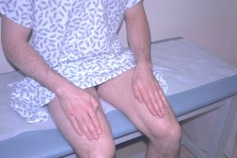
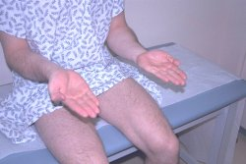
Dysdiadochokinesis
ONLY IN MALES’ SLIDES
Dysdiadochokinesis: rapidly alternating movements.
Dysdiadochokinesis: Inability to perform rapidly alternating movements. Is called dysdiadochokinesia.
It is usually caused by multiple sclerosis in adults and cerebellar tumors in children.
Patients with other movement disorders
(e.g. Parkinson's disease) may have abnormal
rapid alternating movement testing secondary
to akinesia or rigidity, thus creating a false
impression of dysdiadochokinesia.

Slide 32
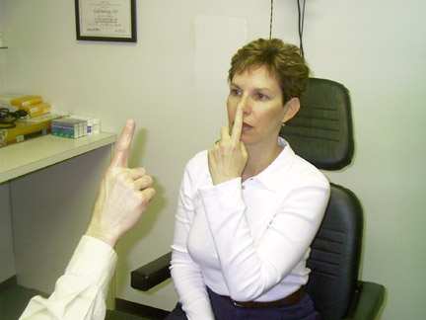
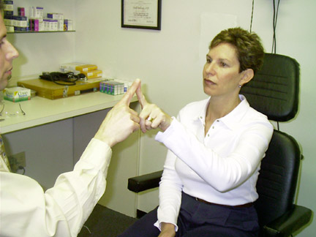
Finger to finger & finger nose test
While the examiner holds his finger at arm's length from the patient. Patient touches her nose and then touches the examiner's finger. After several sequences, the patient is asked to repeat the exercise with her closed eyes.
A patient with a cerebellar disorder tends to miss the target.
To see if there is dysmetria.
Other signs:
Patient is unstable.
Has dysmetria.
Bundler knee jerk.
Can’t do quick supination and pronation.

Slide 33
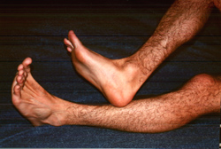
Heel to shin test
ONLY IN MALES’ SLIDES
The heel to shin test is a measure of coordination and may be
abnormal if there is loss of motor strength, proprioception or a
cerebellar lesion.
If motor and sensory systems are intact, an abnormal, asymmetric
heel to shin test is highly suggestive of an ipsilateral cerebellar lesion.

Slide 34
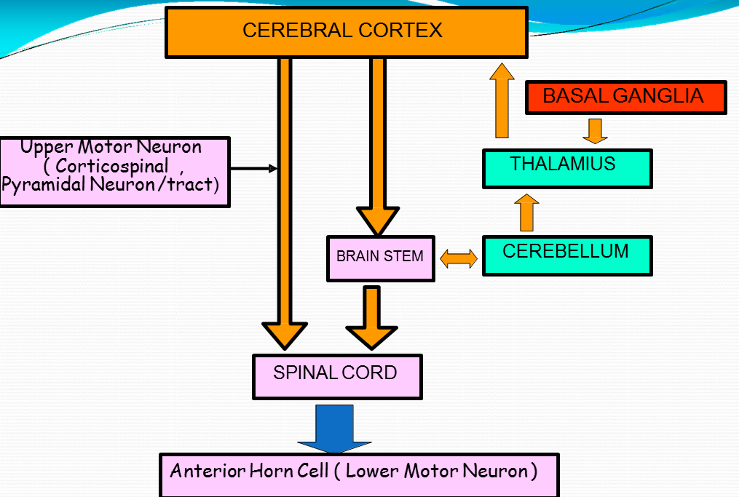
Summary
ONLY IN MALES’ SLIDES

Slide 35
Neuroanatomy corner
Cerebellar lesions cause incoordination of the upper limbs(intention tremor), lower limbs (cerebellar ataxia), speech(dysarthria) and eyes (nystagmus).
Because of the pattern of ipsilateral and decussated path ways that enter and leave the cerebellum, unilateral lesions of the cerebellar hemisphere cause symptoms on the same side of the body. This is in contrast to cerebral lesions (e.g. in the cerebral cortex, internal capsule or basal ganglia),which give rise to contralateral symptoms. A unilateral cerebellar hemispheric lesion causes ipsilateral incoordination o the arm (intention tremor) and of the leg, causing an unsteady gait, in the absence of weakness or sensory loss.
Functional anatomy of the cerebellum
Archicerebellum | Paleocerebellum | Neocerebellum
Corresponds to the flocculonodular lobe and fastigial nucleus. Its principal connections are with the vestibular and reticular nuclei of the brainstem and it is concerned with the maintenance of equilibrium. | Corresponds to the vermis and paravermal area, together with the globose and emboliform nuclei. It receives fibers from the spinocerebellar tracts and projects to the red nucleus of the midbrain. | Corresponds to most of the cerebellar hemisphere and the dentate nucleus. It receives afferents from the pons and projects to the ventral lateral nucleus of the thalamus.
We recommended you to read this lecture from neuroanatomy book. You can find the book on the team drive, page 117-123

Slide 36
Neuroanatomy corner
Lesions of the cerebellum:
  A midline lesion o the cerebellum (such as a tumor) leads to loss o postural control; as a result, it is impossible to stand or sit without toppling over, despite preserved coordination o the limbs them selves.
  Because of the pattern of ipsilateral and decussated pathways that enter and leave the cerebellum, unilateral lesions of the cerebellar hemisphere cause symptoms on the same side of the body. This is in contrast to cerebral lesions (e.g. in the cerebral cortex, internal capsule or basal ganglia), which give rise to contralateral symptoms.
  A unilateral cerebellar hemispheric lesions causes ipsilateral incoordination o the arm (intention tremor) and of the leg, causing an unsteady gait, in the absence of weakness or sensory loss.
  Bilateral dysfunction of the cerebellum, caused by alcoholic intoxication, hypothyroidism , inherited cerebellar degeneration/ataxia, multiple sclerosis or paraneoplastic disease, causes slowness and slurring of speech (dysarthria ), incoordination of both arms and a staggering, wide-based, unsteady gait (cerebellar ataxia ).
  Cerebellar lesions also impair coordination of eye movements. The eyes exhibit a characteristic, in voluntary and rhythmic to-and- fromotion (nystagmus), greatest in amplitude when gaze is directed to the same side as the lesion . Nystagmus is a very common feature of multiple sclerosis. The combination of nystagmus with dysarthria and intention tremor constitutes ‘Charcot’striad ’, which is highly diagnostic o the disease.
We recommended you to read this lecture from neuroanatomy book. You can find the book on the team drive, page 117-123

Slide 37






Thank you!
اعمل لترسم بسمة، اعمل لتمسح دمعة، اعمل و أنت تعلم أن الله لا يضيع أجر من أحسن عملا.
The Physiology 436 Team:
Team Leaders:
Lulwah Alshiha
Laila Mathkour
Mohammad Alayed
Females Members:
Durrah Alhamdi
Safa Al-Osaimi Hanin Bashaikh Rana Barasian
Males Members:
Faisal Alfawaz
Qais Almuhaideb
Contact us:
References:
Females’ and Males’ slides.
Guyton and Hall Textbook of Medical Physiology (Thirteenth Edition.)
Neuroanatomy An Illustrated Colors Text 5th.

