Slide 1
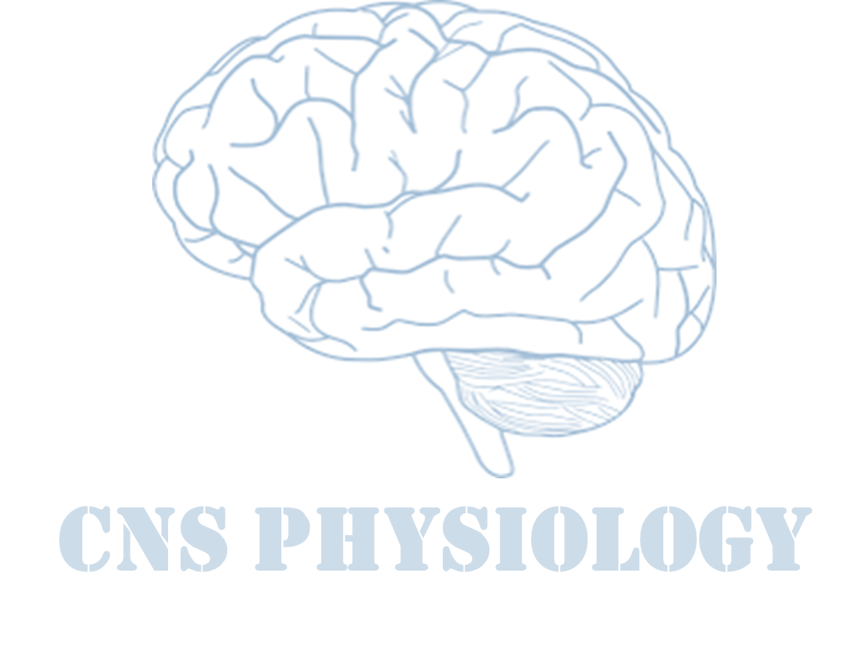
Text.
Important
Formulas
Numbers
Doctor notes
Extra notes and explanation
Lecture No.18
« إنًّ معي ربي سيهدين »

Slide 2
Physiology of consciousness
Objectives:
1- Define consciousness and explain the different states of consciousness .
2- Explain what is meant by the “ Reticular Activating System ”( RAS).
3- Define the location and function of the Bulboreticular Facilitatory Area .
4- Describe how the interaction between the Bulboreticular Facilitatory Area , Thalamus and Cerebral Cortex subserves & sustains consciousness
5- Explain how a medical person can differentiate between a conscious and unconscious person by means of outward behavior as and physical signs .
6- Describe the role of EEG and evoked potentials in differentiating between a conscious person , a sleeping person , a comatose patient and brain dead patient

Slide 3
What is Consciousness?
It has been defined by psychologists as our awareness of ourselves and our environment.
Is the brain state in which a person is being aware of the self and surroundings.
It is a product of electrical activity of the brain.
flat EEG = unconscious.

Slide 4
Level of consciousness
Leve of consciousness
Normal consciousness
Clouded consciousness
Sleep
Coma
State of normal arousal , being fully awake and aware of the self and surroundings.
Arousable لازم يكون
ويقدر يسوي ردة فعل للاشياء اللي حوله
person conscious but mentally confused .
Eg:
- drug or alcohol intoxication
- High fever Associated with malaria or septicemia ,Dementia …etc.
person unconscious in relation to the external world & surroundings but is arousable ( can be aroused ).
person unconscious and not arousable.

Slide 5
Brain structures involved in the conscious state
Reticular formation:
Set of interconnected nuclei that are located throughout the brainstem (Pons, Midbrain, Upper medulla), and the thalamus.
Role in: behavioral arousal and consciousness ( sleep\ awake cycle).
Connect the brainstem to the cerebral cortex.
It consist of 3 parts:
Lateral Reticular Formation.
Paramedian Reticular Formation.
Raphe nuclei (Median RF).
Brain stem Reticular formation
Thalamus
Brain structures involved in the conscious state
Hypothalamus
Wide spread area in the cerebral cortex
Ascending projection pathways

Slide 6
Con. Reticular formation
Brown color refer to (ONLY IN MALES’ SLIDES)
Lateral Reticular Formation | 2. Paramedian Reticular Formation | 3. Raphe nuclei (Median RF)
Has small neurones. Receives information from ascending tracts for touch and pain. Receives vestibular information from median vestibular nerve. Receives auditory information from superior olivary nucleus. Receives Visual information from superior colliculus. Receives Olfactory information via medial forebrain bundle. Paramedian تجمع المعلومات من كل مكان وترسلها لل | Has large cells. Receives signals from lateral reticular formation. Contains: Nucleus ceruleus contains noradrenergic neurones and Dopaminergic (DA) neurones, that projects onto cortex of cerebral hemispheres. Ventral tegmental nucleus contains dopaminergic neurones that project directly onto the cortex. Cholinergic neurones secreted by gigantocellular neurones project onto the thalamus. Noradrenaline: excitatory, play role in rapid eye movement sleep REM. cholinergic: excitatory. Dopamine:(secreted by substantia nigra cells) either inhibitory or excitatory. | In the midline of the reticular formation. Contain serotonergic projections to the brain and spinal cord. Serotonin: inhibitory, Essential role in normal sleep.

Slide 7
Con.

Slide 8
Function of reticular formation:
ONLY IN MALES’ SLIDES
1. Somatic motor control (reticulospinal tracts).
تعطي معلومات للمسل عشان تنقبض بطريقة صحيحة ويكون الشخص
in good position
2. Cardiovascular control.
Thruogh cardiac and vasomotor centers of the medulla oblongata.
3. Pain modulation :
Pain signals from the lower body, RF, cerebral cortex.
Rf is origin of the descending analgesic pathways.
Act in the spinal cord to block the transmission of some pain signals to the brain.
4. Sleep and consciousness:
The reticular formation has projections to the thalamus and cerebral cortex .
It plays a central role in states of consciousness like alertness and sleep.
Injury to the reticular formation can result in irreversible coma.
Reticular formation is called “cerebral cortex switch”
5. Habituation:
This is a process in which the brain learns to ignore repetitive, meaningless stimuli while remaining sensitive to others.
A good example of this is when a person can sleep through loud traffic in a large city, but is awakened promptly due to the sound of an alarm

Slide 9
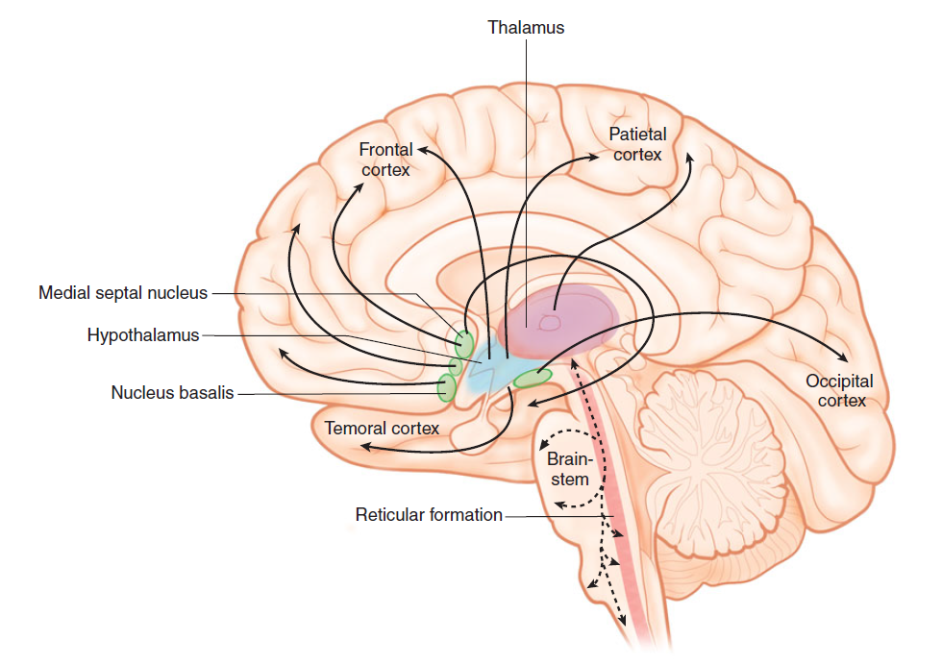
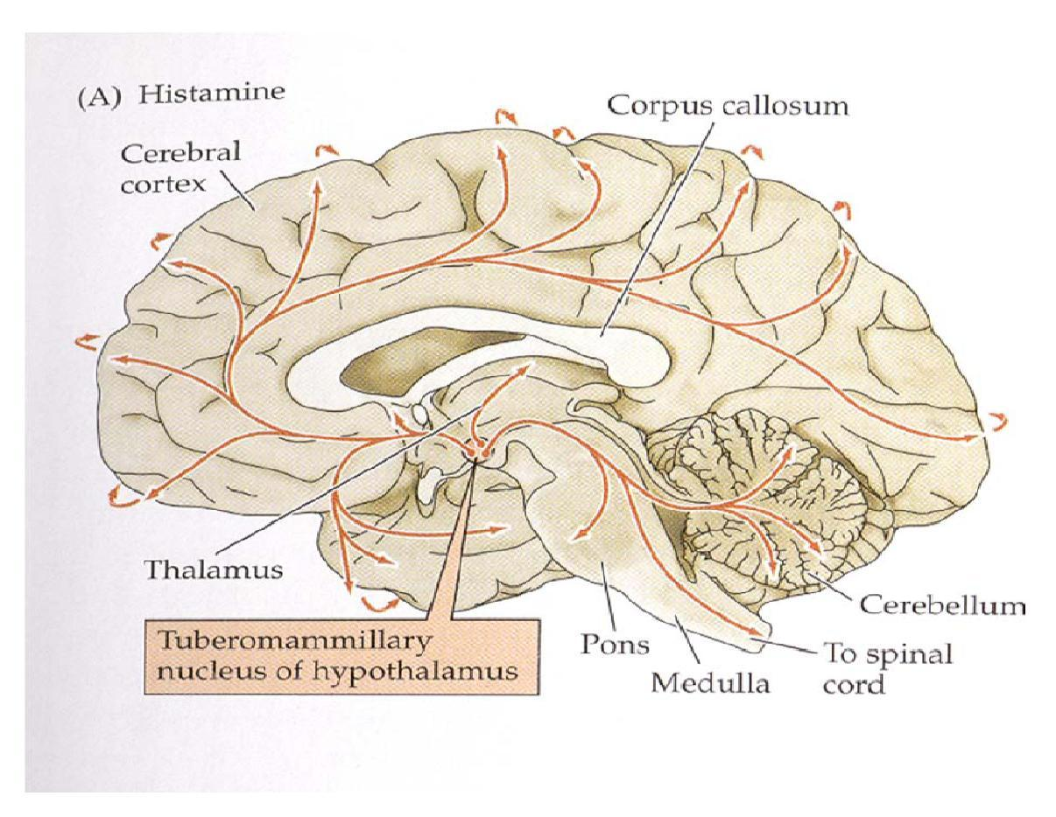
Thalamus
Hypothalamus
Located in the mid-part of the diencephalon.
Cholinergic projections from the thalamus are responsible for:
Activation of the cerebral cortex.
Regulation of flow of information through other thalamic nuclei to the cortex via projections into reticular nuclei.
Tuberomammillary nucleus in the hypothalamus projects to the cortex and is involved in maintaining the awake state.
The only part that excite the cortex by histaminergic neurons.

Slide 10
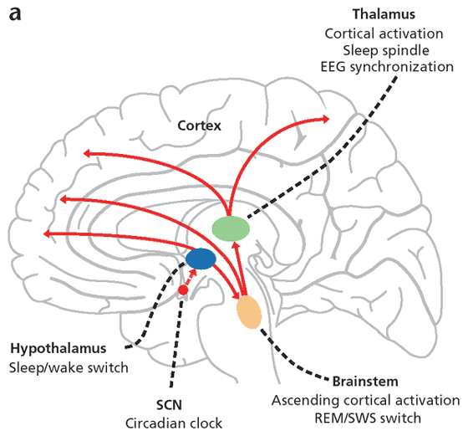
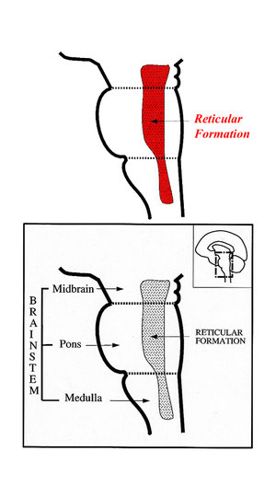
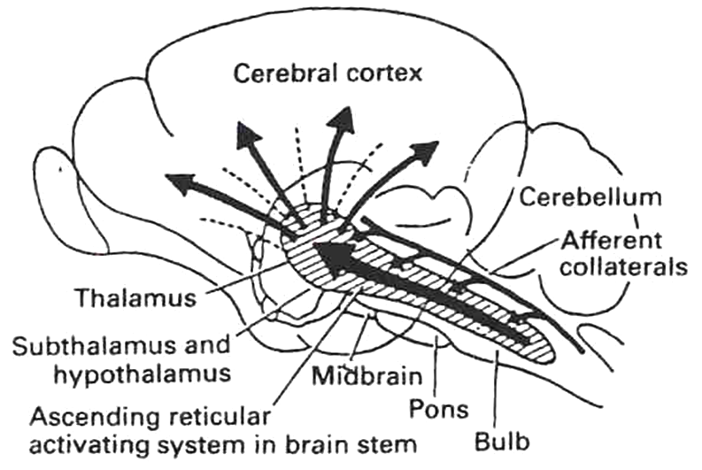
Anatomical components of RAS (reticular activation system)
The RAS is composed of several neuronal circuits connecting the brainstem to the cortex .
Originate in the upper brainstem reticular core and project through synaptic relays in the thalamic nuclei to the cerebral cortex.
As a result, individuals with bilateral lesions of thalamic intralaminar nuclei are lethargic or drowsy.
Pons (uppers & middle) and midbrain are essential for wakefulness.
Lesion in the mid-pons => unconsciousness.

Slide 11
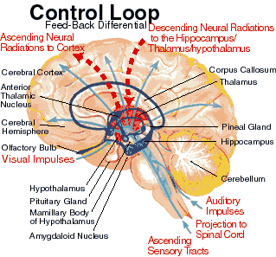
Con.
Bulboreticular Facilitory ( Excitatory ) = Reticular Excitatory Area of the Brain Stem .
Reactivate by Positive feedback from cerebral cortex.
Excitatory area (bulboreticular facilitatory) sends excitatory signals into Thalamus.thalamus excites almost all areas of the cortex.
The Bulboreticular Facilitory ( Excitatory ) Area + Thalamus = Reticular Activating System ( RAS).
The RAS is the system which keeps our cortex awake and conscious.
Excitatory area
Thalamas ومتصلة ب RF جزء من
راح ترسل سقنالز الى
cerebral cortex
consciousفتخلي الشخص
لز زادت ال
Inhibitory area
بتثبط الRAS
ولو كانت sever قد تؤدي لفقد الوعي

Slide 12
Function of RAS:
1. Regulating sleep-wake transitions:
If inhibitory area activity increase > reduce the activity of RAS > less afferent signal to the CC >sleep (only in female).
RAS suppress ascending afferent activity to the CC > sleep (only in male).
2. Attention:
RAS mediate transitions from relaxed wakefulness to of high attention.
There is increased regional blood flow in the midbrain reticular formation (MRF) and thalamic intralaminar nuclei during tasks requiring increased alertness and attention (only in male).
3. RAS and learning:
The RAS is the center of balance for the other systems involved in learning, self-control or inhibition, and motivation.
When functioning normally, it Provides the neural connections for processing and learning of information, and the ability to pay attention to the correct task.
Selective attention (to the correct task).

Slide 13
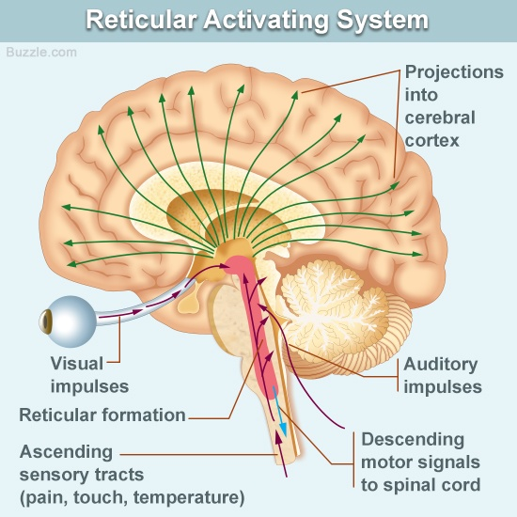
RAS

Slide 14
RAS dysfunction
If RAS is depressed | If the RAS is too excited
An under-aroused cortex. Difficulty in learning. Poor memory. Little self-control. lack of consciousness or even coma. | Over aroused cortex . Hyper-vigilance (sensory sensitivity ). Touching everything. Talking too much. Restless. Hyperactive.

Slide 15
Indices of Level of Consciousness ((تقييم وعي المريض
Appearance & behavior:
Posture (sitting, standing) ,open eyes, facial expression.
Responds to stimuli ( including the examiner’s questions about name , orientation in time & place
Other general qs like who is the president?
Vital signs:
Pulse, BP, respiration, pupils, reflexes, particularly brainstem reflexes, etc.
EEG:
Each of these states (wakefulness, sleep, coma and death ) has specific EEG patterns .
Evoked potentials:
Evoked potentials are of two types: Auditory and Visual.
In cases of brain death .

Slide 16
Electroencephalogram
Alpha waves | Beta waves | Theta waves | Delta waves
Recorded from the parietal &occipital regions | Frontal lobes | Temporal and occipital | From the cerebral cortex
Awake and relaxed+ eyes closed | Produced by visual stimuli and mental activity | -normal (newborn) -in adults indicates severe emotional stress | -in normal sleep (Adults) and in an awake infant -In an awake adult indicates brain damage.
10 to 12 cycles/second. | 13 to 25 cycles per second | 5 to 8 cycles/second | 1 to 5 cycles/second

Slide 17
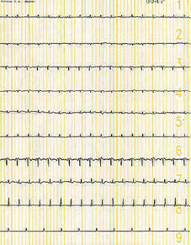
Brain death confirmatory testing with EEG
Normal EEG (at normal magnification)
Brain Death (Flat EEG,at very high magnification)

Slide 18
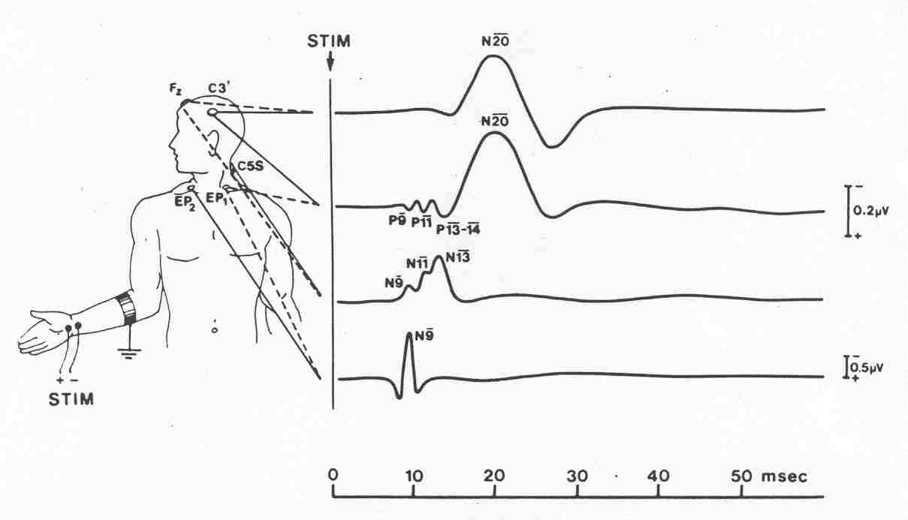
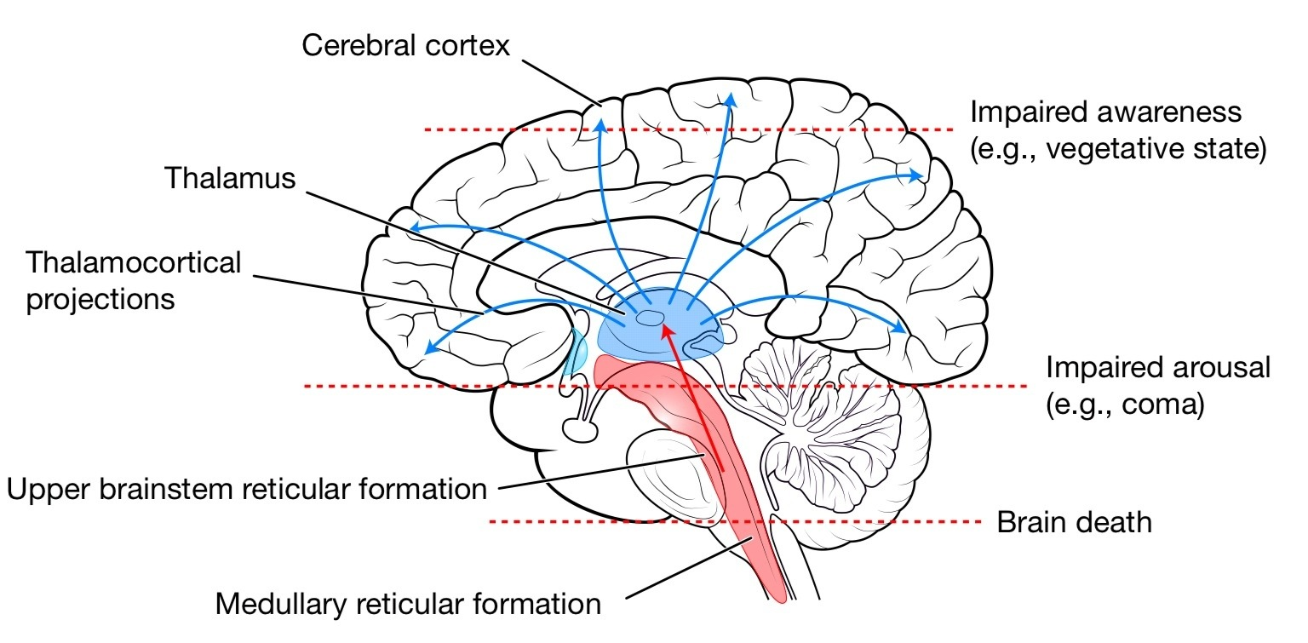
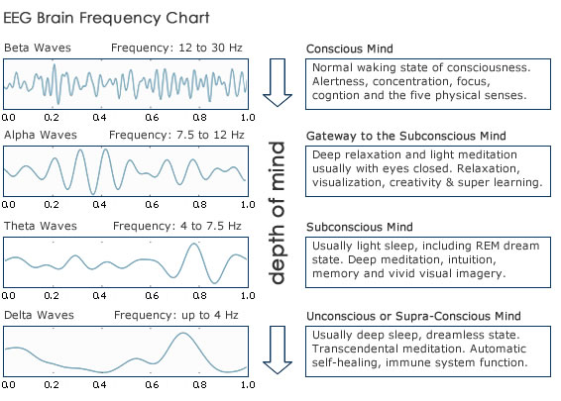
Brain death confirmatory testing with somatosensory evoked potentials
ONLY IN MALES’ SLIDES
Stimulation of a sense organ can evoke a cortical response that can be recorded by scalp electrode over the primary receiving cortical area for that particular sense.
Extra

Slide 19
Thank you!
اعمل لترسم بسمة، اعمل لتمسح دمعة، اعمل و أنت تعلم أن الله لا يضيع أجر من أحسن عملا.
The Physiology 436 Team:
Team Leaders:
Lulwah Alshiha
Laila Mathkour
Mohammad Alayed
Females Members:
Ashwaq Almajed
Rawan Alqahtani
Shrooq alsomali
Males Members:
Abdullatif Alabdullatif
Contact us:
References:
Females and Males slides.
Guyton and Hall Textbook of Medical Physiology (Thirteenth Edition.)

