Slide 1
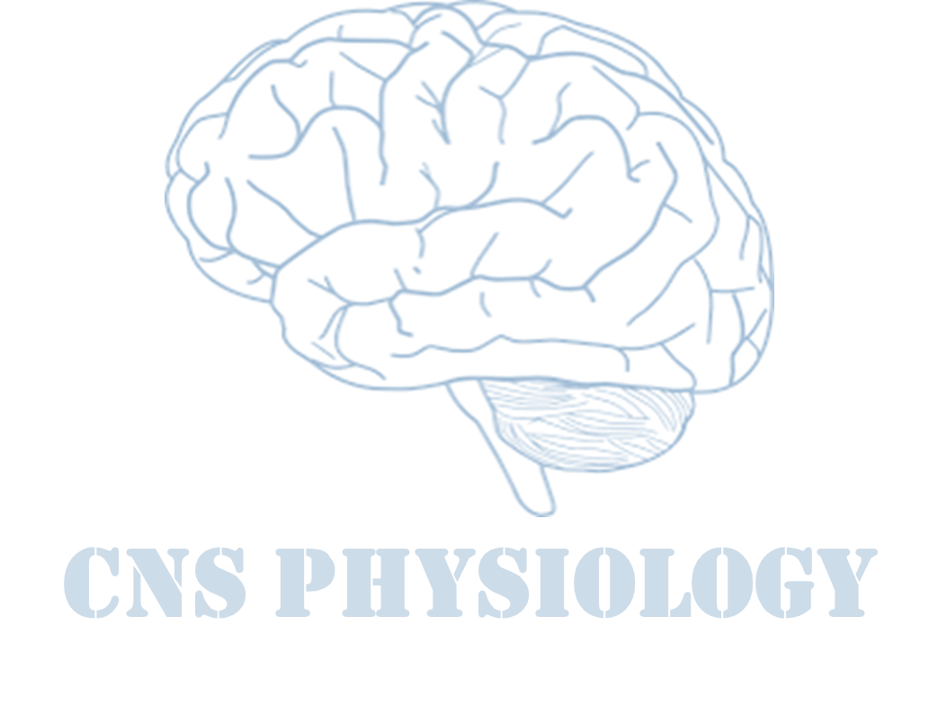
Text
Important
Formulas
Numbers
Doctor notes
Notes and explanation
Lecture No.19
“The One Who Falls And Gets Up Is So Much Stronger Than The One Who Never Fell”

Slide 2
Function of Cerebral hemisphere
Objectives:
1- Students will be able to describe the general structure of the
Cerebrum and Cerebral Cortex.
2- Students will be able to identify the Cerebrum, the Lobes of the Brain, the Cerebral Cortex, and its major regions/divisions.
3- Students will be able to describe the primary functions of the Lobes and the Cortical Regions of the Brain.

Slide 3
Introduction
The cerebrum is the largest part of the brain with two hemisphere, linked by commissural fibres of corpus callosum.
Each cerebral hemisphere contains externally highly convoluted cortex of grey matter and internal mass of white matter or medulla.
The cerebral hemispheres contains motor and sensory areas and the limbic system.
Cerebrum is the largest division of the brain. It is divided into two hemispheres, each of which is divided into four lobes.
ONLY IN MALES’ SLIDES
cerebrum
cerebrum
cerebellum

Slide 4
Phineas Gage
ONLY IN FEMALES’ SLIDES
In 1848 in Vermont, had a 3.5-foot long, 13 lb. metal rod blown into his skull, through his brain, and out of the top of his head. Gage survived. In fact, he never even lost consciousness.
Friends reported a complete change in his personality after the incident. He lost all impulse control.

Slide 5
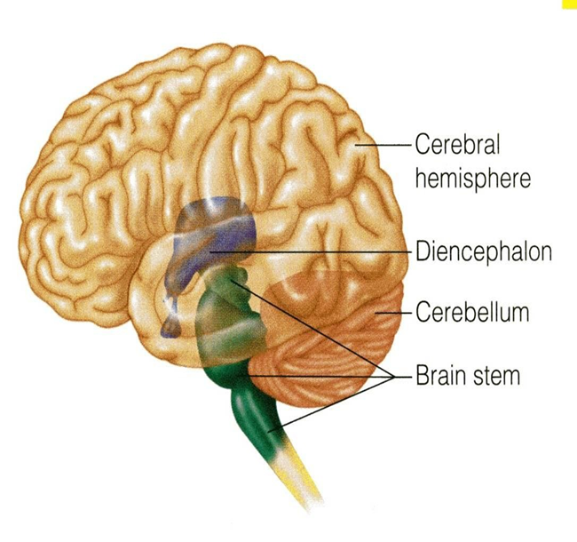
Overview of the brain
ONLY IN FEMALES’ SLIDES
Component of the brain
Cerebellum
Telencephalon
Diencephalon
Brainstem
Basal Ganglia
Cerebrum
Hypothalamus
Thalamus
Medulla
Pons
Midbrain
collection of grey matter situated inside the cerebral hemispheres
contains center for autonomic and endocrine control
mainly a relay
station for sensory pathways in their way to the cerebral cortex

Slide 6
Cont.
ONLY IN FEMALES’ SLIDES
The term “ brainstem ” is actually an anatomic rather than physiologic term, because it is easier , in terms of anatomy, to group “ all CNS structures that hang between the cerebrum and spinal cord “ together. However, in terms of Physiology,the situation is more complicated, because brainstem structures are involved in many diverse & different bodily functions:
Most people ( about 90 %) have the left cerebral hemisphere dominant , and are therefore
right-handed.
The remaining (around 10 % ) of the population usually have their right hemisphere
dominant, and are therefore left-handed.
The frontal lobe of the dominant hemisphere contains Broca’s area (the area for production
of speech).
Therefore, if a right-handed person gets a stroke involving his left cerebral hemisphere , he is likely to have right-sided hemiplegia (paralysis) and aphasia (loss of the power of speech).
Regulation of consciousness wakefulness and sleep
it contain several Cranial Nerve nuclei
Balance ( Vestibular nuclei )
Respiratory , Cardiovascular and Gastrointestinal control

Slide 7
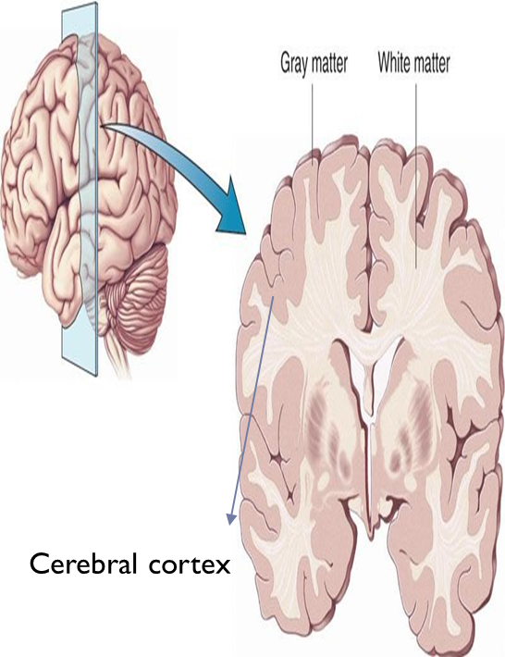
Cerebral cortex
ONLY IN FEMALES’ SLIDES
Cerebral cortex is the outermost layer of gray matter making up the superficial aspect of the cerebrum.
Cerebral features
Gyri | Elevated ridges “winding” around the Brain.
Sulca | Small grooves dividing the gyri
Central sulcus | Divides the frontal lobe From the parietal lobe
Fissures | Deep grooves, generally dividing large regions / lobes of the brain
Longitudinal fissures | Divides the two cerebral hemispheres
Transverse fissure | Separates the cerebrum from the cerebellum
Sylvian/lateral fissure | Divides the temporal lobe from the frontal and parietal lobes

Slide 8
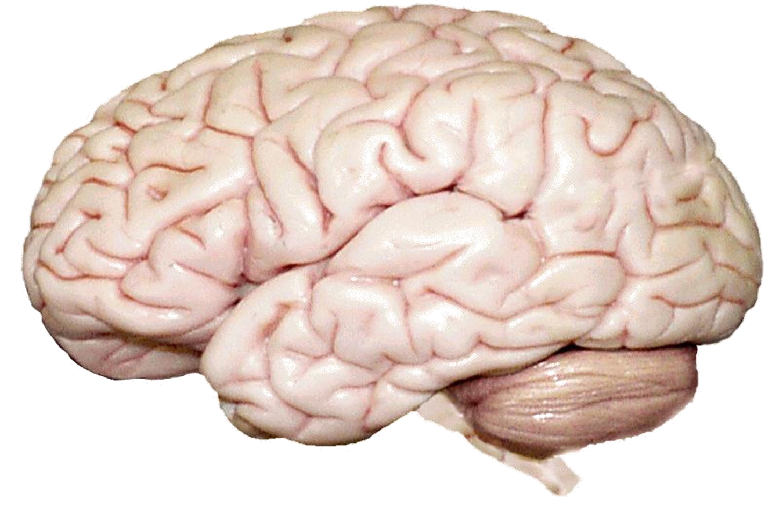
Cont.
ONLY IN FEMALES’ SLIDES
Real sulci
Gyri
"ridge"
Sulci
“groove”
Fissure
“deep groove”
Real sulci
Longitudinal fissure
Real sulci

Slide 9
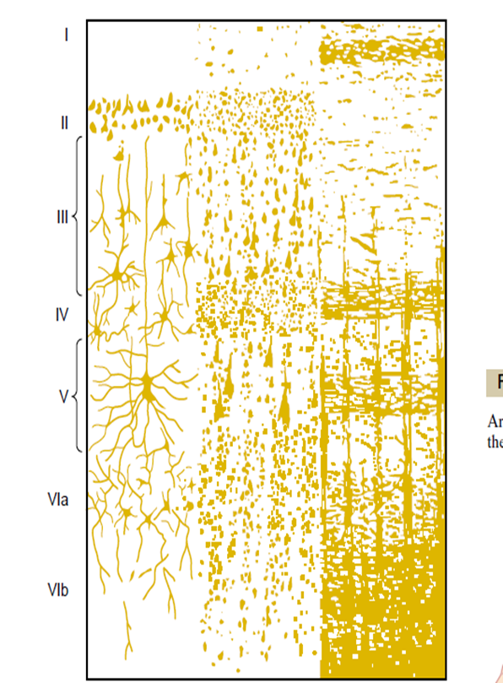
Cerebral cortex layers
ONLY IN MALES’ SLIDES
Microscopically the cortex consist of six layers or lamina parallel to the surface
From outside to inside the layers are:
I-Molecular layer
II-external granular layer
III-layer of pyramidal ells
IV-internal granular layer
V-large pyramid cell layer
VI-Layer of fusiform of polymorphic cells
The incoming sensory signal excites neuronal layer IV first; then the signal spreads toward the surface of the cortex and also toward deeper layers.
Layers I and II & III perform most of intracortical association function.
The neurons in layers II and III making short horizontal connections with adjacent cortical areas.
The neurons in layers V and VI send output signals to brain stem ,spinal cord (V) & thalamus (VI)

Slide 10
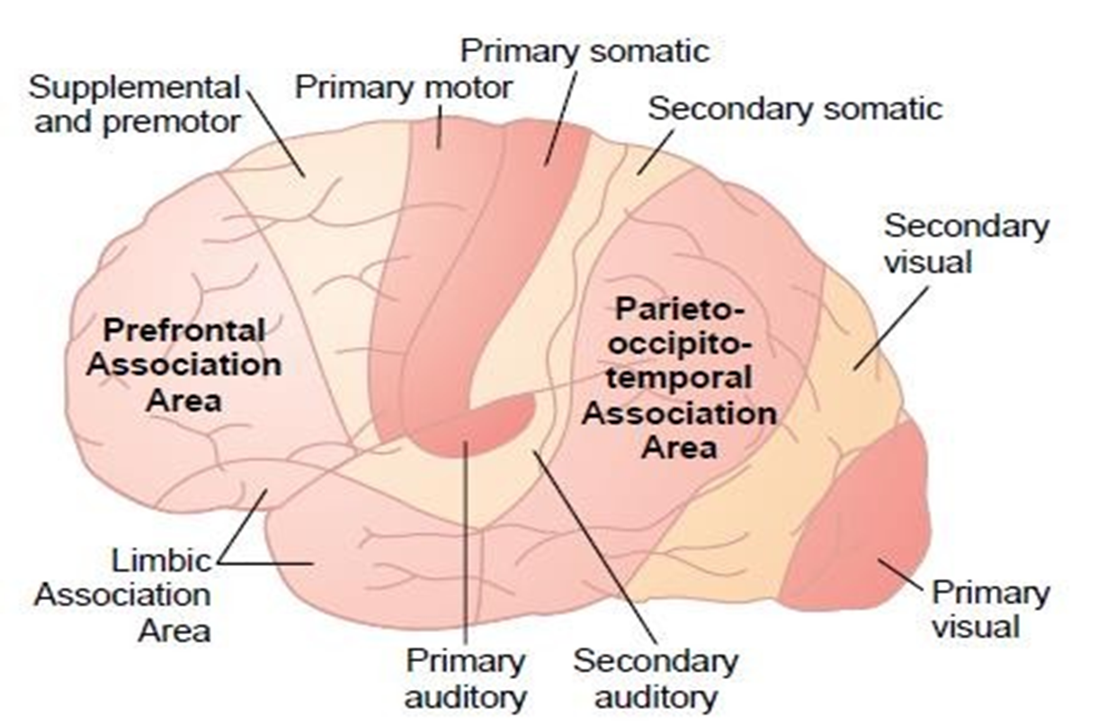
There are three type of functional area of cerebral cortex
ONLY IN MALES’ SLIDES
Secondary areas
The secondary areas make sense out of the signals
Association area
They receive and analyze signals simultaneously from multiple regions of both the motor and sensory cortices as well as from subcortical structures.
primary motor& sensory areas
primary motor areas have direct connections with specific muscles for causing discrete muscle movements.
primary sensory areas detect specific sensation(visual, auditory,somatic) transmitted directly to the brain from peripheral sensory organs.
in the primary areas.
The most important association areas are:
(2) prefrontal association area.
(3) limbic association area.
(1) Parieto-occipitotemporal association area.

Slide 11
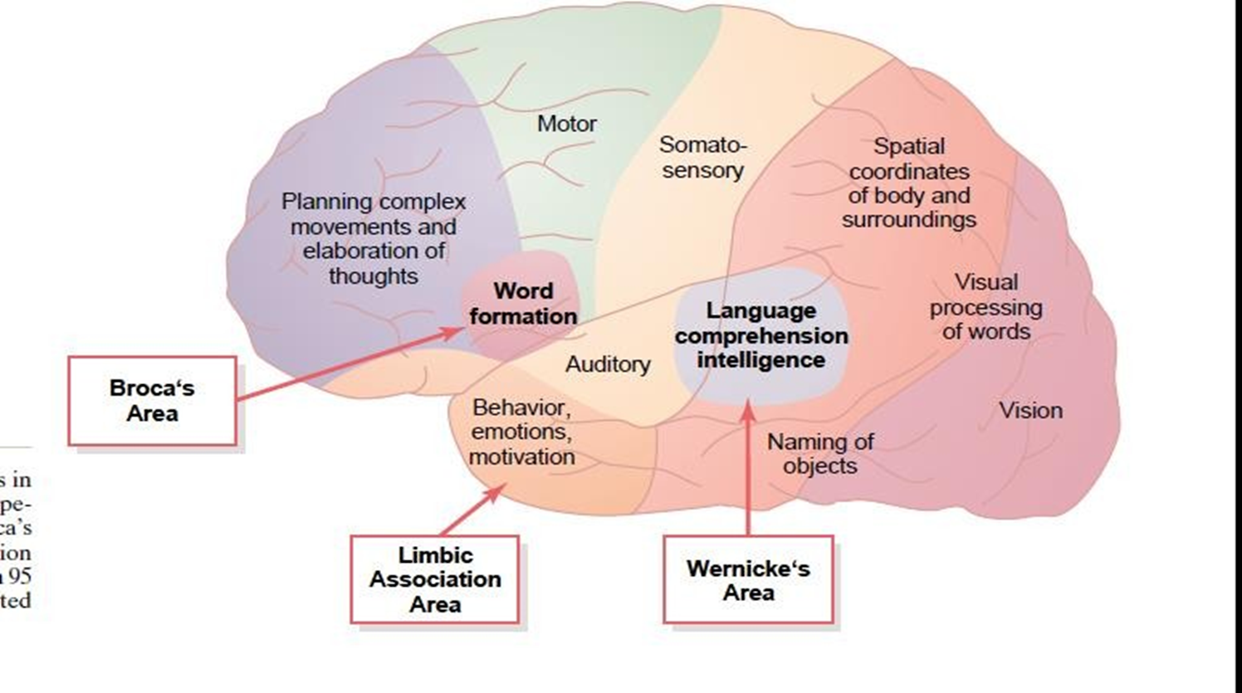
(1) Parieto-occipitotemporal association area
ONLY IN MALES’ SLIDES
Functions:
Analysis of the Spatial Coordinates of the Body.
Language Comprehension.
Initial Processing of Visual Language (Reading).
Area for Naming Objects.
Area | Site | Function
Analysis of the spatial coordinates of the body. | Beginning in the posterior parietal cortex and extending into the superior occipital cortex | Computes the coordinates of the visual , auditory, and body surroundings.
Area for language comprehension | Wernicke's area, lies behind the primary auditory cortex in the posterior part of the superior gyrus of the temporal lobe | Higher intellectual function
Area for initial processing of visual language (reading). | Angular gyrus area | Make meaning out of the visually perceived words (lesion causes dyslexia or word blindess)
Area for naming objects. | Lateral portion of anterior occipital lobe & posterior temporal lobe | Naming objects.

Slide 12
Prefrontal area limbic area
ONLY IN MALES’ SLIDES
Area of faces recognition
Is the anterior pole of frontal lobe. It contributes in the following functions:
Planning of complex pattern of movements.
Production of deep, more abstract and logically sequenced thoughts which enable attainment of goals.
Working memory (ability to tie thoughts together in a logical sequence by comparing many bits of information with appropriate stored knowledge and be able to instantly recall this information for future planning).
المنطقة هذي مسؤولة عن التفكير المعقد وإنشاء خطط وتنبؤات في المخ وإذا ما كانت سليمة قد يفقد المريض الوظيفة هذه
Lesions in this area lead to change in personality and behaviour
Consists of anterior and inner portion of temporal lobe.
It is primarily concerned with emotion, behavior and motivational drive for different tasks most importantly learning.
Lesion of this area may lead to decreased aggression , lack of emotion , hyper sexuality & hyperphagia
Located on the underside of the brain on the medial occipital and temporal lobes.
The occipital portion is contiguous with visual cortex , while the temporal one is closely associated with limbic system.
inability to recognize faces is called “prosopagnosia”.

Slide 13
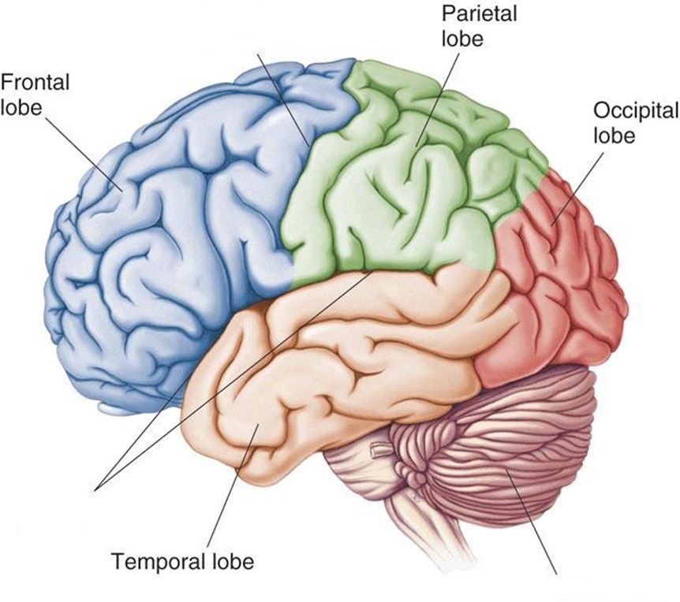
Four lobes of the brain
Frontal
Partial
Temporal
Occipital
* Note: Occasionally, the Insula is considered the fifth lobe. It is located deep to the Temporal Lobe.

Slide 14
Frontal lobe
The Frontal Lobe of the brain is located deep to the Frontal Bone of the skull.
It plays an integral role in the following functions:
Memory Formation
Emotions
Decision Making
Reasoning
Personality
The frontal lobe is Responsible for initiation and execution of voluntary movement .
Also contains Broca’s area of speech in the dominnat hemisphere ( i.e., in the left hemisphere in most people ) .
Lesion can cause:
paralysis on opposite side of the body.
Aphasia: ( loss of ability to speak ) if lesion involves Broca’s area in the dominant hemispare.

Slide 15
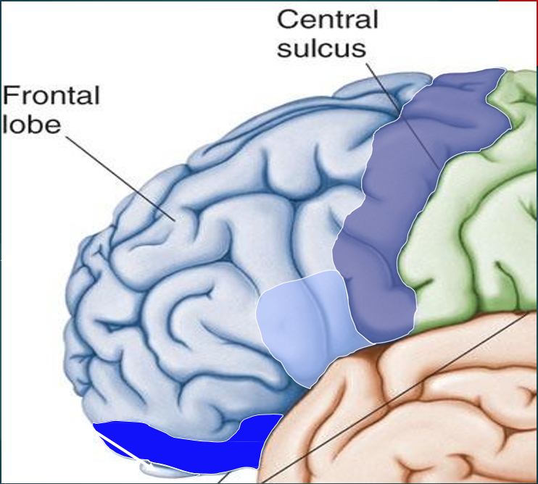
Frontal lobe (cortical region)
3-Orbitofrontal cortex :
Site of frontal lobotomies.
is a neurosurgical operation that involves severing connections in the brain's prefrontal lobe.
Possible Side Effects:
Epilepsy
Poor Emotional Responses
Perseveration (Uncontrolled, repetitive actions, gestures, or words)
Desired Effects:
Diminished Rage
Decreased Aggression
Poor Emotional responses
Primary motor cortex (precentral gyrus ):
Cortical site involved with controlling body movement
2-Brocus area :
plan of motor pattern for expressing of individual words, located on left frontal lobe (males)
Controls facial neurons, speech, and language comprehension.(female)
Located on Left Frontal Lobe.
“Broca’s Aphasia “: Results in the ability to comprehend speech, but the decreased motor ability (or inability) to speak and form words.
4-Olfactory Bulb :
Cranial Nerve I, Responsible for sensation of Smell

Slide 16
Partial lobe
The Parietal Lobe of the brain is located deep to the Parietal Bone of the skull.
Parietal lobe is essential for our feeling of touch, warmth/heat, cold, pain, body position and appreciation of shapes of palpated objects.
When damaged, the person loses the ability to recognize shapes of complex objects by palpation (palpation = examination of objects by touch) & develops Sensory Inattention on opposite side.
It plays a major role in the following functions/actions:
-Senses and integrates sensation(s)
- Spatial awareness and perception (Proprioception - Awareness of body/ body parts in space and in relation to each other)
Partial lobe Contains :
(1) Primary Somatosensory cortex in the post-central gyrus: involve with processing of tactile and proprioceptive information
(2) Sensory Association Cortex, for integration & association of sensory information
ONLY IN FEMALES’ SLIDES

Slide 17
Parietal lobe “cortical regions “
Somatosensory association cortex
Primary gustatory cortex
Site involved with processing of tactile and proprioceptive information.
Assists with the integration and interpretation of sensations relative to body position and orientation in space. May assist with visuo-motor coordination.
Primary site involved with the interpretation of the sensation of Taste.
Primary somatosensory cortex (postcentral gyrus)

Slide 18
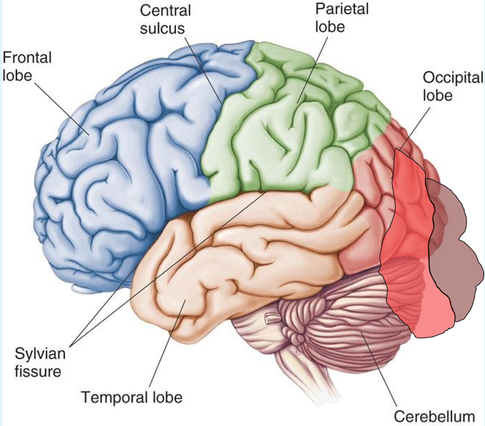
Occipital lobe
The Occipital Lobe of the Brain is located deep to the Occipital Bone of the Skull.
Its primary function is the processing, integration, interpretation, etc. of VISION and visual stimuli.
Primary Visual Cortex This is the primary area of the brain responsible for sight-recognition of size, color, light, motion, dimensions, etc.
Visual Association Area Interprets information acquired through the primary visual cortex.

Slide 19
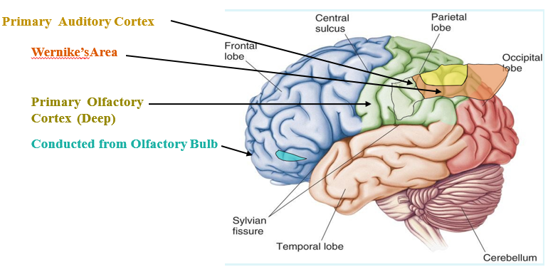
Temporal lobe
The Temporal Lobes are located on the sides of the brain, deep to the Temporal Bones of the skull.
They play an integral role in the following functions:
Hearing.
Organization/Comprehensin of language
Information Retrieval (Memory and Memory Formation)
Temporal lobe cortical regions
Primary auditory cortex
Responsible for hearing
Primary olfactory cortex
Interprets the sense of smell once it reaches the cortex via the olfactory bulbs. (Not visible on the superficial cortex)
Wernicke’s Area
Language comprehension.
Located on the Left Temporal Lobe
The temporal lobe contain centres for hearing , taste , contribute to smell perception and
Essential for memory function .
ONLY IN FEMALES’ SLIDES

Slide 20
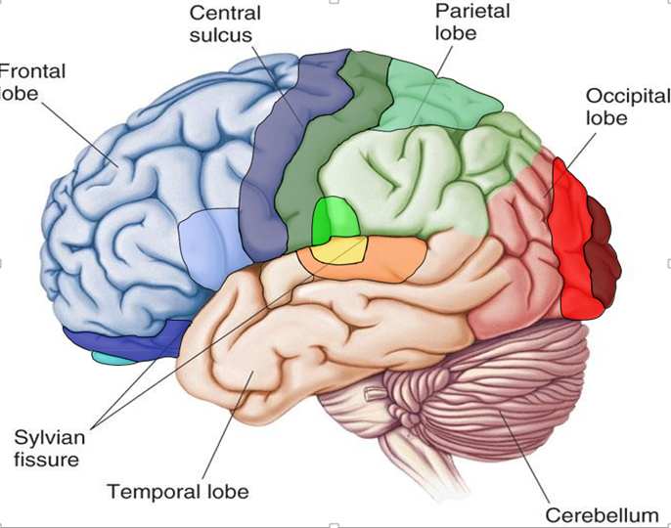
Cont.
Lesion in the temporal lobe cortical regions may lead to:
1. Wernicke’s Aphasia :
Language comprehension is inhibited. Words
and sentences are not clearly understood, and
sentence formation may be inhibited or
non-sensical.
2. Memory impairment:
can be associated with temporal lobe epilepsy.

Slide 21
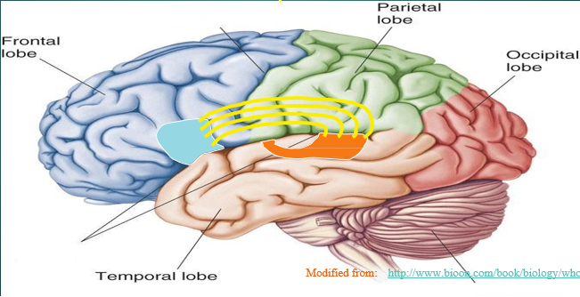
Arcuate fasciculus
ONLY IN FEMALES’ SLIDES
Arcuate Fasciculus:
A white matter tract that connects Broca’s Area and Wernicke’s Area through the Temporal, Parietal and Frontal Lobes. Allows for coordinated, comprehensible speech. Damage results in “ conduction aphasia “
Conduction Aphasia :
Where auditory comprehension and speech articulation are preserved, but people find it difficult to repeat heard speech.

Slide 22
Functional principle of cerebral hemisphere
Each cerebral hemisphere receives sensory information from, and sends motor commands to, the opposite side of body.
The 2 hemispheres have somewhat different functions although their structures are alike.
Correspondence between a specific function and a specific region of cerebral cortex is not precise.
No functional area acts alone; conscious behavior involves the entire cortex.
Higher level :prefrontal cortex
Most complicated region, coordinates info from all other association areas.
Important in intellect, planning, reasoning, mood, abstract ideas, judgement, conscience, and accurately predicting consequences.
Phineas Gage.
ONLY IN FEMALES’ SLIDES

Slide 23
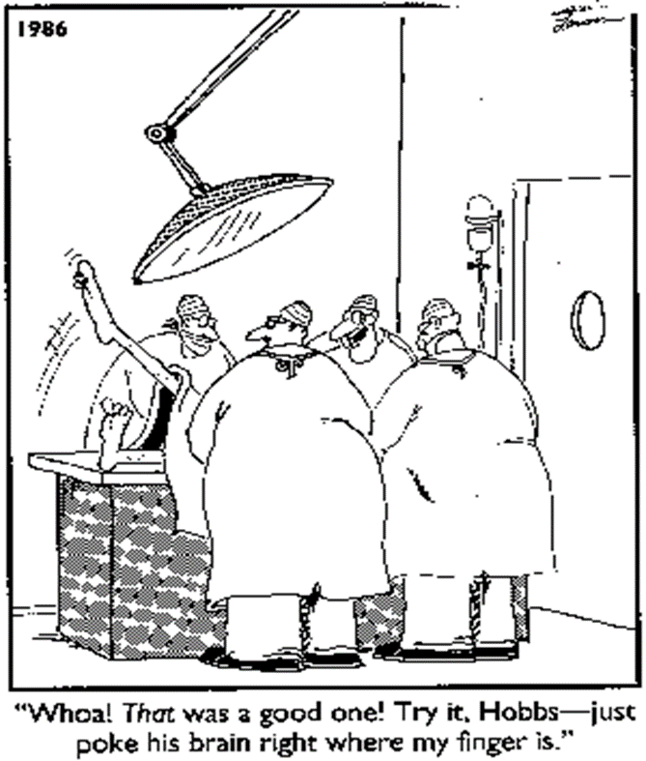
Dominant and non-dominant hemisphere (hemisphere lateralization )
Functional differences between left and right hemispheres
In most people, left hemisphere (dominant hemisphere) controls:
reading, writing, and math, decision-making, logic, speech and language (usually)
Right cerebral hemisphere relates to:
recognition (faces, voice inflections), affect, visual/spatial reasoning, emotion, artistic skills.
Q: Assuming this comical situation was factually
accurate, what Cortical Region of the brain would
these doctors be stimulating?
understanding & interpreting music,
Non verbal visual Experience
Spatial relation between the person & their surroundings
Body language and intonation of peoples voices
ONLY IN FEMALES’ SLIDES
ONLY IN MALES’ SLIDES

Slide 24
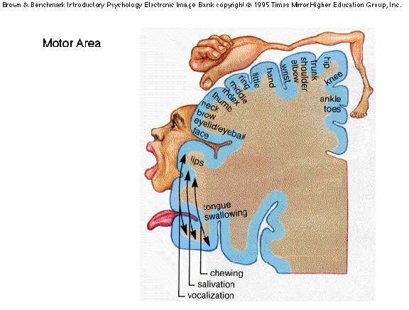
Primary motor cortex
ONLY IN MALES’ SLIDES
This graphic representation of the regions of the primary motor cortex and primary sensory cortex is one example of a Homunculus.

Slide 25
Doctors’ notes
Function of cerebral:
Frontal lobe: personality emotion memory, motor.
Initiation of voluntary movement, speech.
Lesion on frontal lobe eg. Stroke leads to half of body paralysis cant speak aphasia , personality change emotions.
Parietal lobe lesion loss of sensation somatic sensation vibration pain temperature , awareness of body parts proprioception of the opposite side.
Occipital lobe lesion, vision lost, Temporal lesion, hearing lost olfactory lost.
Difficulty comprehensive of speech.
Each cerebral hemisphere receive information from the opposite side.

Slide 26
Thank you!
اعمل لترسم بسمة، اعمل لتمسح دمعة، اعمل و أنت تعلم أن الله لا يضيع أجر من أحسن عملا.
The Physiology 436 Team:
Team Leaders:
Lulwah Alshiha
Laila Mathkour
Mohammad Alayed
Females Members:
Haifa Alwael
Allulu Alsulayhim
Jawaher Alkhayyal
Males Members:
Mohammad almutlaq
Faisal Alfawaz
Contact us:
References:
Females’ and Males’ slides.
Guyton and Hall Textbook of Medical Physiology (Thirteenth Edition.)

