Slide 1
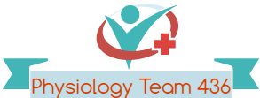
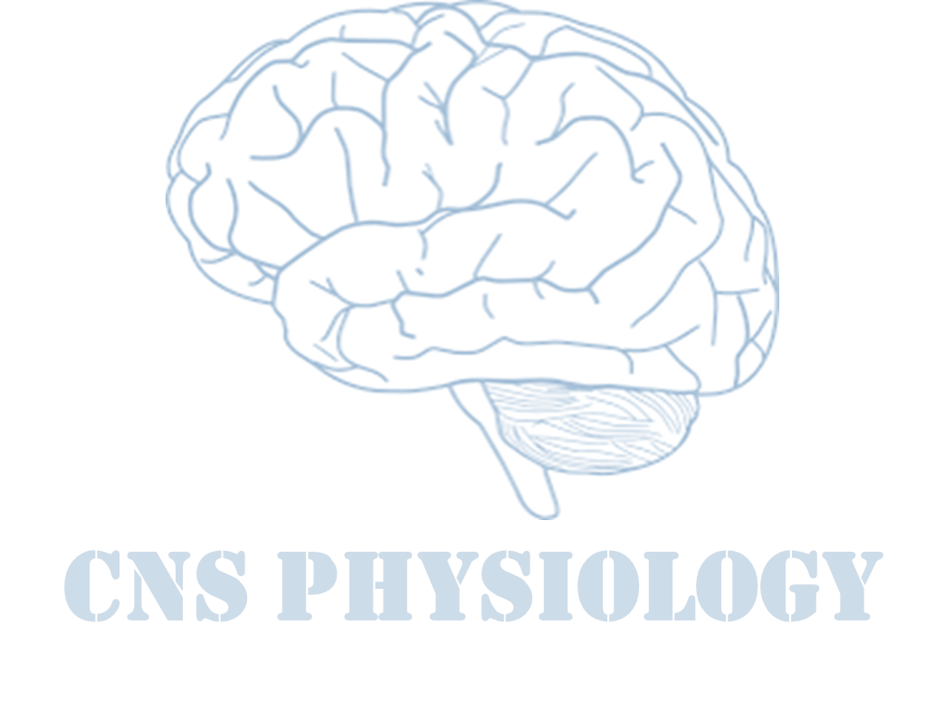
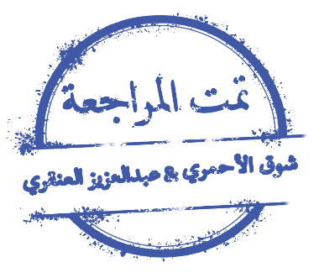
Text
Important
Formulas
Numbers
Doctor notes
Notes and explanation
Lecture No.2
“You Only Fail When You Stop Trying”.

Slide 2
Physiology of the Motor Tract
Objectives:
1- Describe what is upper motor neuron and lower motor neuron.
2- Explain the origin, course (pathway) and functions of the following motor tracts:
Pyramidal tracts:
corticospinal (lateral and ventral) & corticobulbar tracts and their functions.
Extrapyramidal tracts:
1) Rubrospinal tract
2) Vestibulospinal tracts
3) Tectospinal tracts
4) Reticulospinal tract
5) Olivspinal tract

Slide 3
Motor Neurons
Upper and Lower Motor Neurons
They are essential for performance of voluntary movements.
Upper motor neurons (UMN)
Lower motor neurons (LMN)
These are the motor neurons whose cell bodies lie in the higher motor centers (neurons of motor cortex).
Their axons pass to brain stem and spinal cord to activate the cranial (brain stem neurons) and spinal motor nuclei (neurons).
These are the motor neurons of the spinal cord (AHCs) (spinal motor neurons) and brain stem motor nuclei of the cranial nerves (cranial motor neurons) that innervate skeletal muscle directly.

Slide 4
Classification of Descending Motor System
ONLY IN MALES’ SLIDES
The following are the important sets of descending motor tracts, named according to the origin of their cell bodies and their final destination:
Descending Motor Tracts
Pyramidal tract
Extrapyramidal tract
The motor tract which originates from the cerebral cortex and descends to the spinal cord (the corticospinal tract) passes through the pyramids of the medulla.
The rest of the descending motor pathways which do not travel through the medullary pyramids.
1) Corticospinal (pyramidal)
2) Corticobulbar
1) Rubrospinal tract
2) Vestibulospinal tracts
3) Tectospinal tracts
4) Reticulospinal tract
5) Olivspinal tract

Slide 5
Motor Areas
Cells of Origin of Pyramidal tract
30% from:
Motor area 4
(the primary motor area)
( M1)
30% from:
1) Premotor area (motor association area)
2) Supplementary cortex
40% from:
Parietal cortex
(Somatic sensory area 3,1,2)
posterior to the central sulcus.
3% from:
large myelinated fibres, derived from the large, highly excitable pyramidal Betz cells of MI.
Internal capsule
Cerebral Peduncle (midbarain) Pons
Medullary Pyramid
Pyramidal Decussation
Lat. Cross & Vent. Uncross White matter in spinal cord
Ant. Horn of spinal cord through a interconnection
α motor neuron of opposite side
Cells of Origin

Slide 6
Pyramidal Tract Overview
Motor areas
1- Primary Motor Area (M1) (Area 4) | 2- Premotor area (motor association area) | 3- The Supplementary Motor Area
Occupies the precentral gyrus, and Contains large, highly excitable Betz cells. طلبت بيتزا(Betz cells) كبيرة (giant) وكان التوصيل سريع (highly excitable) والبيتزا شكلها مثلث قريب من الهرمي (pyramidal) M1 of one side controls skeletal muscles of the opposite side of the body. Area of representation is proportional with the complexity of function done by the muscle. So, muscles of hands and tongue occupy 50% of this area. | lies in front of the primary motor area & below supplementary motor area. Its stimulation produces complex coordinated movements, such as setting the body in a certain posture to perform a specific task. It works in association with the supplemental motor area, establishing the motor programs necessary for execution of complex movements. | located on the lateral side of the brain in front of area 4 and above the pre-motor area & extends on medial side of the cerebral hemisphere. Concerned with planning and programming motor sequences. Stimulation of this area leads to bilateral grasping movements of both hands simultaneously. This area make motor programs for axial muscles. It provides background adjustment for finer motor control of the arms and the hands by the premotor area and primary motor cortex
ONLY IN MALES’ SLIDES

Slide 7
Motor Areas: Primary Motor Area 4
Excitation of the spinal cord motor control areas by the primary motor cortex and red nucleus:
In the motor cortex:
The neurons of this area arranged in vertical Columns.
Each column has six distinct layers of cells.
The pyramidal cells that give rise to the corticospinal fibers all lie in the fifth layer of cortical surface.
Function of each column of neurons:
Each column of cells functions as a unit, operate as an integrative processing system, using information from multiple inputs to determine the output response from the column.
Each column can function as an amplifying system to stimulate large numbers of pyramidal fibers to the same muscle or to synergistic muscles simultaneously.

Slide 8
Motor areas: premotor area:
ONLY IN MALES’ SLIDES
A few highly specialized motor centers have been found in the premotor areas of the human cerebral cortex:
1- Broca’s area for speech.
(word formation)
2- The frontal eye movements area
3- Head rotation area
4- Hand skills area
Located above Broca’s area in the frontal lobe.
Controls voluntary movements of the eyes towards different objects in the visual field.
Located above the eye movement area in the motor cortex.
Directs the head toward different visual objects.

Slide 9
Motor Areas
ONLY IN MALES’ SLIDES

Slide 10
Motor Areas
ONLY IN FEMALES’ SLIDES

Slide 11
Dynamic & Static Signals are Transmitted by The Pyramidal Neurons
ONLY IN FEMALES’ SLIDES
Each column of cells excites two types of pyramidal cell neurons:
1-The dynamic neurons are excited at a high rate for a short period at the beginning of a contraction, causing the initial rapid development of contraction.
2- The static neurons fire at a much slower rate, but continue firing at this slow rate to maintain the force of contraction as long as the contraction is required.
The neurons of the red nucleus have similar dynamic and static characteristics.
Greater percentage of dynamic neurons is in the red nucleus and a greater percentage of static neurons is in the primary motor cortex.
Column of neurons do processing and strengthen the signal that comes from the motor tract.
Dynamic works at the beginning when we want to initiate, that happens quickly, and the static maintains the movement.
Red nucleus is mostly dynamic.

Slide 12
Corticospinal (Pyramidal) Tract
3% of the pyramidal fibers are large and myelinated, derived from the large ,giant, highly excitable pyramidal Betz cells in motor area 4. These fibers form monosynaptic connections with motor neurons of the spinal cord.
But most of pyramidal fibers are unmyelinated.
The Betz cells fibers transmit nerve impulses to the spinal cord at a velocity of about 70 m/sec, the most rapid rate of transmission of any signals from the brain to the cord.
The axons from Betz cells send short collaterals back to the cortex itself to inhibit adjacent regions of the cortex when the Betz cells discharge, thereby “sharpening” the excitatory signal.
To posterior limb of Internal Capsule
(between caudate and putamen nuclei of the basal ganglia).
Fibers from the cerebral cortex descend in
Corona Radiata
To genu
And the anterior two-third of the posterior limb
To Brain Stem
(Midbrain, pons, Medulla Oblongata)

Slide 13
Corticospinal (Pyramidal) Tract
ONLY IN MALES’ SLIDES
These fibers form monosynaptic connections with motor neurons of the spinal cord.
But most of pyramidal fibers are unmyelinated.
Some fibers cross in brainstem to supply contralateral cranial nerve nuclei constitute the Corticobulbar tract.
In the lower medulla around 80% of the fibres cross to the opposite side, and descend in the lateral column of spinal cord as the Lateral Corticospinal Tract.
They synapse on the contralateral spinal motor neurons, or on interneurons.
These fibers controls and initiates fine discrete skilled movement of fingers and hands.

Slide 14
Corticospinal (Pyramidal) Tract

Slide 15
Corticospinal (Pyramidal) Tract
ONLY IN FEMALES’ SLIDES
Corticobulbar tract
- Terminates on cranial nerve nuclei of opposite side, decussating just before they reach their target nuclei
- The Corticobulbar tract carries
information to motor neurons of the cranial nerve nuclei
In the brain stem midbrain, pons & medulla oblongata
2) Corticospinal tracts (pyramidal)
- Descends through the midbrain and pons, Then in the lower medulla
oblongata the fibers form pyramids so called pyramidal tract
- Divide into:
Lateral Corticospinal tract
Ventral (Anterior) Corticospinal tract
- Corticospinal tract descend to lower medulla oblongata, the fibers collect together تجمعlike pyramid that’s why we call it pyramidal tract.
- The corticobulbar tract ends in opposite side (crosses) on AHC of brain stem (cranial nerve nuclei).
- Bulbar = brain stem that innervate head and neck

Slide 16
ONLY IN MALES’ SLIDES
Corticospinal (pyramidal) Tract: Course and Termination
Fibers of the CBS tract descend from the cerebral cortex
Collect together and descend through the posterior limb of the internal capsule
Through the middle portion of the cerebral peduncles of the midbrain
The fibers are separated by transverse pontine fibres in the pons
In the upper medulla oblongata where they form the pyramids of the medulla
In the lower region of the medulla, most of the fibers cross to the opposite site forming the “medullary decussation”
fibers which do not decussate in medulla (about 20%) descend on
the same side of the spinal cord (ipsilaterally) as the
ventral corticospinal tract
Finally they decussate (cross to the opposite side ) & synapse on the contralateral spinal motor neurons
They control the axial and proximal limbs muscles so it concern with control of posture.
About 80% cross to the opposite side of the spinal cord (contralaterally) and continue as the
lateral corticospinal tract

Slide 17
Lateral and Ventral Corticospinal Tracts
ONLY IN FEMALES’ SLIDES
80%: Lateral Corticospinal tract
20%: Ventral (Anterior) Corticospinal tract
- 80% of fibers cross midline in pyramids.
- Pass laterally in spinal cord white matter.
Remaining 20% corticospinal fibers does not cross midline
- Ends directly ( not via interneurons = monosynaptic connections) on motor neurons (ahcs) of the opposite side.
- Here the lower motor neurons (LMNs) of the corticospinal cord are located.
Cross at level of termination to synapse with interneurons , that synapse with motor neurons (AHCs) of opposite side specially in in the neck or in the upper thoracic region.
N.B: the fibers of the corticospinal tract terminate at different levels in interneurons of the gray matter & some ends at sensory neurons of dorsal horn & a very few terminate directly on the anterior motor neurons that cause muscle contraction.
Pass medially in ventral horn so control axial & proximal limb muscles
NB: So corticospinal tract( ANT& LAT) supply skeletal muscles of the opposite side
Then peripheral motor nerves carry the motor impulses from the anterior horn to the voluntary muscles
Function:
They control the bilateral postural movements by the supplementary motor cortex (which share in origin of these tracts)
Function:
fibers control and initiate fine discrete skilled movements of hands, fingers and toes.
As the fibers pass laterally in spinal cord white matter, so they control distal limb muscles.

Slide 18
Lateral and Ventral Corticospinal Tracts
ONLY IN MALES’ SLIDES
After they form the pyramid, the fibers divide into lateral and anterior.
80%: Lateral corticospinal goes into the opposite side, reaches the AHC directly without interneurons and make monosynaptic connection to the muscle.
20%: Anterior corticospinal goes down without crossing, but they cross at the end in the spinal cord and go into interneurons. (important for posture)

Slide 19
Functions of Lateral and Ventral Corticospinal Tracts
1
Initiation of fine, discrete, skilled voluntary Movements in the contralateral side of the body.
2
The lateral corticospinal tract (main bulk of the tract): controls distal muscles of distal limbs (hand and digits)
3
The ventral corticospinal tracts: control posture of Axial & proximal muscle for balance, climbing, walking
4, 5
Which are concerned with fine skilled movement (e.g painting , writing, picking up a small object)
Effect on stretch reflex:- facilitate muscle tone through gamma motor neurons.
Those fibers originate from parietal lobe are for sensory- motor coordination
Corticobulbar tracts: control face & neck muscles & facilitate their tone, and are involved in facial expression, mastication, swallowing.
6
NB: In the cervical enlargement of the cord where the hands and fingers are represented, large numbers of corticospinal and rubrospinal fibers terminate directly on the anterior motor neurons to activate muscle contraction.

Slide 20
Corticospinal (Pyramidal) Tract
ONLY IN FEMALES’ SLIDES

Slide 21
Removal of the Primary Motor Cortex (Area Pyramidalis)
Removal of the area that contains the giant Betz pyramidal cells (Area Pyramidalis) causes varying degrees of paralysis of the represented muscles.
If the caudate nucleus and adjacent premotor and supplementary motor areas are not damaged, gross postural and limb “fixation” movements can still occur, but there is a loss of voluntary control of discrete movements of the distal segments of the limbs especially of the hands and fingers.
This does not mean that the hand and finger muscles themselves cannot contract (paralysis); rather,
the ability to control the fine movements is gone.
So area pyramidalis is essential for voluntary initiation of finely controlled movements, especially of the hands and fingers
ONLY IN FEMALES’ SLIDES
- If we remove column 5 from motor area 4: there will be no complete paralysis but there is no skilled movement because that area is responsible for initiation of that movement, because we have other areas responsible for that movement like red nucleus.

Slide 22
Effects of Lesions in the Motor Cortex or in the Corticospinal pathway (Stroke)
ONLY IN MALES’ SLIDES
The motor control system can be damaged by the “stroke.
The result is loss of blood supply to the cortex or to the corticospinal tract where it passes through the internal capsule.
Muscle Spasticity Caused by Lesions That Damage Large Areas Adjacent to the Motor Cortex.
The primary motor cortex normally exerts a continual tonic stimulatory effect on the motor neurons of the spinal cord; when this stimulatory effect is removed, hypotonia results.
Most lesions of the motor cortex, especially those caused by a stroke, involve the primary motor cortex & adjacent parts of the brain such as the basal ganglia. In these instances, muscle spasm occurs in the muscles on the opposite side of the body (because the motor pathways cross to the opposite side).

Slide 23
Extrapyramidal Tracts
Descending Motor Tracts
Pyramidal tract
Extrapyramidal tract
The rest of the descending motor pathways which do not travel through the medullary pyramids.
Origin:
Motor area 4, Premotor area 6, Suppressor 4 area
Course:
Corona radiata > Internal capsule > Basal ganglia > Brain stem > Bulbospinal tract
1) Rubrospinal tract
2) Vestibulospinal tracts
3) Tectospinal tracts
4) Reticulospinal tract
5) Olivspinal tract
ONLY IN FEMALES’ SLIDES
Descend to spinal cord as:
Extrapyramidal system
1- Sets the posutral background needed for performance of skilled movements
2- Control of subconscious gross movements

Slide 24
1- Rubrospinal Tract
ONLY IN FEMALES’ SLIDES
ONLY IN MALES’ SLIDES
Red Nucleus in midbrain
Fibers decussate at same level of red nucleus
Red nucleus in midbrain fibers decussate at same level of red nucleus.
It receives afferent connections from:
1- psilateral cortical motor area (corticobulbar pathway)
2- contalateral side of cerebellum.
3- basal ganglia.
Course: Pass down through Pons & Medulla
Termination: Ends in anterior Horn of spinal cord
Course: Descend with the lateral corticospinal tract
Termination: ends In spinal cord tract occupies the lat. white column , & fibers synapse on the contralateral interneuron of spinal cord gray matter or directly on AHCs
Rubrospinal (red nucleus): passes lateral (lateral motor system)works in distal places like fingers
Ends after passing through interneurons OR goes directly to AHC

Slide 25
ONLY IN FEMALES’ SLIDES
Cont.
Red nucleus is located in mesencephalon.
It receives direct fibers from the primary motor cortex through the corticorubral tract & some branching fibers from the corticospinal tract as it passes through the mesencephalon.
These fibers synapse in the lower portion of the red nucleus, the Magnocellular portion.
The rubrospinal tract, which crosses to the opposite side in the lower brain stem into the lateral columns of the spinal cord.
Termination of Rubrospinal fibers: mostly on interneurons of the cord gray matter, along with the corticospinal fibers. But some of the rubrospinal fibers terminate directly on anterior motor neurons.

Slide 26
Functions of Rubrospinal Tract
It is an additional pathway for transmission of cerebral cortical motor commands to the lower motor neurons similar to those of the corticospinal tract. When the corticospinal fibers are destroyed discrete fine control movement can still occur but impaired.
Facilitatory to the alpha and gamma-MNs of the distal flexor muscles, but they are inhibitory to extensor muscles.
Rubrospinal tract lies in the lateral columns of the spinal cord, along with the corticospinal tract, and terminates on the interneurons and motor neurons that control the more distal muscles of the limbs.
Therefore, corticospinal & rubrospinal tracts together are called the lateral system of the cord, in contradistinction to a vestibulo-reticulospinal system which lies mainly medially in the cord and is called the medial motor system of the cord

Slide 27
2- Vestibulospinal Tracts
Origin: From vestibular nucleus.
Fibers originate in vestibular nuclei in pons (which receive inputs from inner ear, vestibular apparatus, and cerebellum)
Course: Axons descend in the ipsilateral ventral white column of spinal cord.
Function:
1- Controls Postural & righting reflexes.
2-Excitatory to ipsilateral spinal motor neurons-that supply axial & postural muscles
3- Control eye movements ( correction consciously by vision, moves eyes to help correction)
ONLY IN FEMALES’ SLIDES
Vestibular Apparatus detects changes in head position, so it sends
fibers to Vestibular Nuclei in Pons + sends fibers to Cerebellum.
Vestibular nuclei tracts are always excitatory to Gamma Efferents (whereas Red nucleus is always inhibitory)
ONLY IN MALES’ SLIDES

Slide 28
Functions of Vestibulospinal Tracts
 | 1- Lateral vestibulospinal tract Function | 2- Medial vestibulospinal Tract Function
Cells of origin | Lateral Vestibular Nucleus. | Medial Vestibular Nucleus
Course | Axons descend in the ipsilateral ventral white column of spinal cord. | - As its axons descend ipsilaterally in the ventral white column of spinal cord, some fibers form part of the Medial Longitudinal Fasciculus. - The medial longitudinal fasciculus (consists of both ascending & descending fibers) link vestibular nuclei to nuclei supplying the extraocular muscles. - End at the cervical segments of the spinal cord
Function | This tract mediates excitatory influences upon extensor motor neurons to maintain posture and righting reflex. | for coordination of head and eye movements

Slide 29
Role of The Vestibular Nuclei to Excite The Antigravity Muscles
ONLY IN FEMALES’ SLIDES
The vestibular nuclei, function in association with the Pontine reticular nuclei to control the antigravity muscles.
The vestibular nuclei transmit excitatory signals to the antigravity muscles by way of the lateral and medial Vestibulospinal tracts.
Without this support of the vestibular nuclei, the pontine reticular system would lose much of its excitation of the axial antigravity muscles.
Vestibulospinal tract: originate from Pons (vestibular nucleus), gets impulses from many places, always excitatory.
Responsible for reflexes and posture and eye movement.
Lateral branch: which excites posture and antigravity muscles.
Medial branch: goes to brain stem, responsible for extra ocular muscle, and also some of the medial goes to lateral to help.

Slide 30
3- Tectospinal Tracts
Origin: from superior colliculi (VISUAL reflex) & inferior colliculi (AUDITORY reflex) of midbrain.
Course: The tract decussates in the dorsal tegmentum.
Then the axons descend in ventral white column of spinal cord.
Termination: Ends on Contralateral cervical motor neurons (contralateral cervical AHCs).
Function: Mediate/facilitate reflex turning of the head and neck in response to visual or Auditory stimuli (responds towards direction of the stimuli).
Tectospinal tract: 2 parts, one for audible reflex one for vision reflex.
ONLY IN MALES’ SLIDES

Slide 31
4- Reticulospinal Tract
ONLY IN MALES’ SLIDES
 | 1- Pontine (medial) reticulospinal tract Function | 2- Medullary (lateral) reticulospinal tract Function
Cells of origin | arises from neurons of the pontine reticular formation” | arises from neurons in the medullary reticular formation”
Course | descends to all levels of the spinal cord | its fibers descend to all levels of the spinal cord
Termination | Terminate mainly on interneurons in the spinal gray matter which excite the medially situated alpha and gamma-MNs innervating the antigravity muscles, that is the muscles of the vertebral column and the extensor muscles of the lower limbs. | synapse with interneurons that inhibit the alpha and gamma-MNs of antigravity and extensor muscles, but they facilitate the alpha-and gamma-MNs of flexor muscles.
Function | Exerts a strong facilitatory effect on the motor neurons of the antigravity and extensor muscles to support the body posture against gravity. | Activate the medullary inhibitory system which can counter-balance the facilitatory effect of the pontine reticular formation on the antigravity muscles.
Reticulospinal tract: reticular formation is the substance inside brainstem (pontine and medullary reticular formation).
Pontine is always excitatory (gets impulse from vestibuospinal which go to gamma) and help in tone and antigravity.
Medullary is inhibitory (gets inhibition from basal ganglia and rubrospinal and corticospinal tracts) and inhibits gamma to decrease pontine effect.

Slide 32
Cont.
ONLY IN FEMALES’ SLIDES
 | 1- Pontine (medial) reticulospinal tract | 2- Medullary (lateral) reticulospinal tract
Cells of origin | pontine reticular formation which has high Excitability & in addition, they receive strong excitatory signals from the vestibular nuclei. | medullary reticular formation
Course | Axons descend in anterior (ventral) white column of spinal cord | Axons descend in lateral white column of spinal cord on both sides -It receive strong input from) it receive strong input from: the corticospinal tract. the rubrospinal tract. Other Motor pathways. These activate the medullary reticular inhibitory system to counterbalance the excitatory signals from the pontine reticular system.
Function | Pontine reticulospinal tract increases gamma efferent activity (excitatory to Axial & antigravity, extensor muscles of the body = increases muscle tone) It causes powerful excitation of antigravity muscles. | Medullary reticulospinal tract, inhibits gamma efferent activity (transmit inhibitory signals to antigravity extensor muscles = decreases muscle tone)
The reticular formation makes up a central core of the brainstem.
It contains sensory & motor neuronal groups.
Pontine and medullary nuclei projects to the AHCs of the spinal cord via Reticulospinal Tract.

Slide 33
5- Olivospinal Tract
Origin: in Inferior Olivary Nucleus of the medulla is found only in the cervical region of the spinal cord. (supply neck of muscles).
Function: is uncertain, but thought to facilitate muscle tone.
Secondary olivocerebellar fibers transmit signals to multiple areas of the cerebellum.
ONLY IN FEMALES’ SLIDES
Olivospinal tract: from olivary nucleus, goes anterior and medial in spinal cord’s white matter, ends in cervical segment because it functions in head and neck, we don’t know what exactly is the function.
These send information to cerebral cortex.

Slide 34
Summary of Motor Tracts

Slide 35
Summary of Motor Tracts
ONLY IN MALES’ SLIDES

Slide 36
Thank you!
اعمل لترسم بسمة، اعمل لتمسح دمعة، اعمل و أنت تعلم أن الله لا يضيع أجر من أحسن عملا.
The Physiology 436 Team:
Team Leaders:
Lulwah Alshiha
Laila Mathkour
Mohammad Alayed
Female Members:
Rana Barasain
Lama AlTamimi
Munirah Aldofyan
Male Members:
Fouad Faathi
Contact us:
References:
Females and Males slides.
Guyton and Hall Textbook of Medical Physiology (Thirteenth Edition.)

