Slide 1
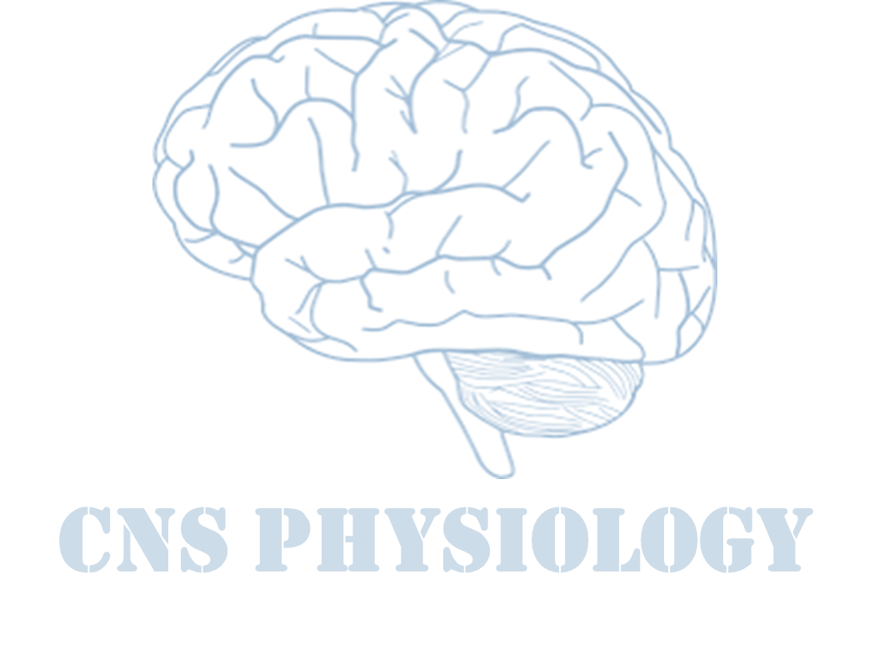
Text
Important
Formulas
Numbers
Doctor notes
Notes and explanation
Lecture No.20
“Worrying Doesn’t Change Anything, But Trusting In God Changes Everything”

Slide 2
AUTOREGULATION OF CEREBRAL BLOOD FLOW
Objectives:
Describe cerebral circulation & circle of Willis.
Explain main arteries that supply blood to brain.
Normal Rate of Cerebral Blood Flow.
Explain auto-regulation of cerebral blood flow.
Explain the factors effecting the cerebral blood flow.
Effects of impaired cerebral blood circulation.

Slide 3
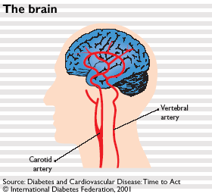
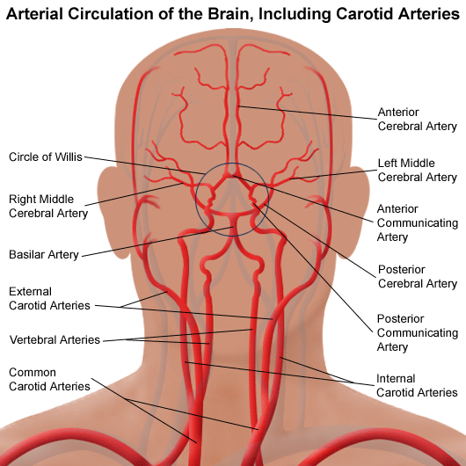
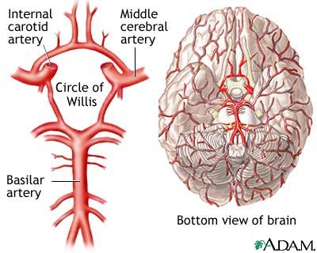
Cerebral circulation
Brain receive its blood supply from four
main arteries:
Two internal carotid arteries.
Two vertebral arteries.
They form the circle of willis: a group of
arteries near the base of the brain which
is called the arterial circle of willis.
ONLY IN MALES’ SLIDES
The clinical consequences of vascular disease in the cerebral circulation is depend upon which vessels or combinations of vessels are involved.
Named after an english physician named thomas willis, who discovered it and then published findings in 1664, on cerebri anatomi (latin “anatomy of the brain”).
The vertebral arteries unite to form Basilar artery.
The basilar artery and carotids arteries form the circle of willis.
Substances injected into one carotid artery distributed almost completely to the cerebral hemisphere on that side. Normally no crossing over occurs probably because the pressure is equal on both sides.

Slide 4
Cont.
ONLY IN FEMALES’ SLIDES
The vertebral arteries unite to form basilar artery.
The basilar artery and the carotids form the circle of willis.
The circle of willis is origin of six large vessels.
The circle of willis is origin of six large vessels:
1. Anterior cerebral artery (left and right).
Anterior communicating artery.
2. Internal carotid artery (left and right).
3. Posterior cerebral artery (left and right).
Posterior communicating artery (left and right).
Basilar artery.
The middle cerebral arteries, supplying the brain, are not considered part of the circle.

Slide 5
Innervation
ONLY IN FEMALES’ SLIDES
Three systems of nerves innervate the cerebral blood vessels
Sympathetic
vasoconstriction
Parasympathetic
Sensory nerves
Postganglionic sympathetic neurons have their bodies in the superior cervical ganglia. During acute hypertension it attenuates increase in CBF.
Cholinergic neuron originate in sphenopalatine ganglia end on large arteries.

Slide 6
Cerebral circulation and blood flow
ONLY IN MALES’ SLIDES
Cerebral blood flow:
Normal rate of cerebral blood flow:
Normal blood flow through the brain of the adult person averages 50 to 65 ml /100 grams of brain tissue /minute.
For entire brain: 750 to 900 ml/min, or 15 per cent of the resting cardiac output.
Physiological consideration:
Brain: 1350 gm, and accounts for 2% of body weight yet requires 20% of resting oxygen consumption.
O2 requirement of brain is 3-3.5 ml/100gm/min.
And in children it goes higher up to 5ml/100/min.
That’s why brain requires higher blood supply 55ml/100gm/min is the rate of blood supply.
Brain has high metabolic rate:
Requires more substrate.
Lack of storage of energy.

Slide 7
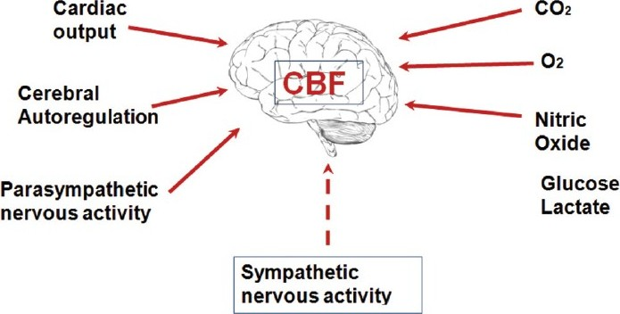
Cerebral blood flow
ONLY IN FEMALES’ SLIDES
Cerebral blood flow is highly related to metabolism of the tissue.
Three metabolic factors have potent effects in controlling the cerebral blood flow:
Carbon dioxide concentration.
Hydrogen ion concentration.
Oxygen concentration.
Neural factors.
Other mediators
CBF is tightly regulated to meet the brain's metabolic demands.
It is important to maintain CBF within narrow limits because too much blood can raise intracranial pressure (ICP) which can compress and damage delicate brain tissue.
Too little blood flow causes ischemia.
Ischemia : results if blood flow to the brain is below 18 to 20 ml / 100 g / minute.
Tissue death : occurs if flow drops below 8 to 10 ml / 100 g / minute.
ONLY IN FEMALES’ SLIDES

Slide 8
cerebral perfusion pressure(CPP)
ONLY IN FEMALES’ SLIDES
ONLY IN MALES’ SLIDES
Cerebral perfusion pressure (CPP):
The net pressure of blood flow to the brain.
CPP can be defined as: CPP = MAP − ICP.
CPP is regulated by two balanced, opposing.
MAP
ICP
CPP
forces
Mean arterial pressure(MAP) is the force that pushes blood into the brain.
ICP force that pushes out.
CPP is normally between 70 - 90 mmHg in an adult human
Pressure > 20 mmHg is abnormal

Slide 9
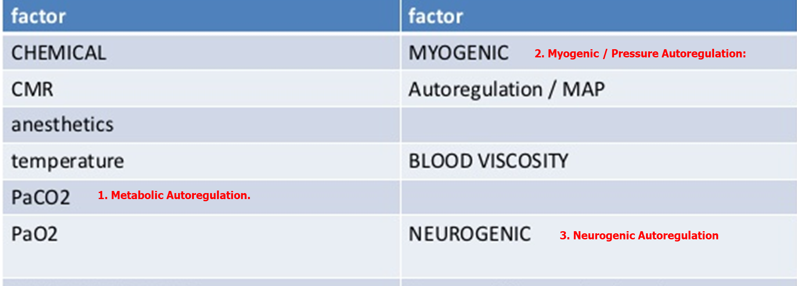
Regulation of cerebral blood flow
ONLY IN MALES’ SLIDES
Factors effecting cerebral blood flow:

Slide 10
Regulation of cerebral blood flow
ONLY IN FEMALES’ SLIDES
Increase cerebral blood flow in response to excess carbon dioxide or excess hydrogen ion concentration.
70% increase in arterial PCO2 approximately doubles the cerebral blood flow. Increase the blood flow by indirect vasodilatation.

Slide 11
Cont.
ONLY IN FEMALES’ SLIDES
Hypoxia & hypercapnia:
Excess carbon dioxide can dilate blood vessels up to 3.5 times their normal size.
Blood vessels also dilate in response to low ph.
When activity in a given region of the brain is heightened, the increase in CO₂ and H⁺ concentrations causes cerebral vasodilatation, and deliver more blood to the area to meet the increased demand.
Hypoxia, or inadequate oxygen, also dilates blood vessels and increases blood flow.
While high levels of oxygen constrict cerebral blood vessels.
Nitric oxide & adenosine are autoregulation mediators.
Neural stimuli:
Under normal conditions sympathetic has little effect, because the blood flow, auto-regulation mechanism can override the nervous effects.
During acute hypertension, sympathetic attenuates increase in CBF.
The sympathetic nervous system normally constricts the large- and intermediate-sized brain arteries enough to prevent the high pressure from reaching the smaller brain blood vessels. This is important in preventing vascular hemorrhages into the brain for preventing the occurrence of “cerebral stroke.”

Slide 12
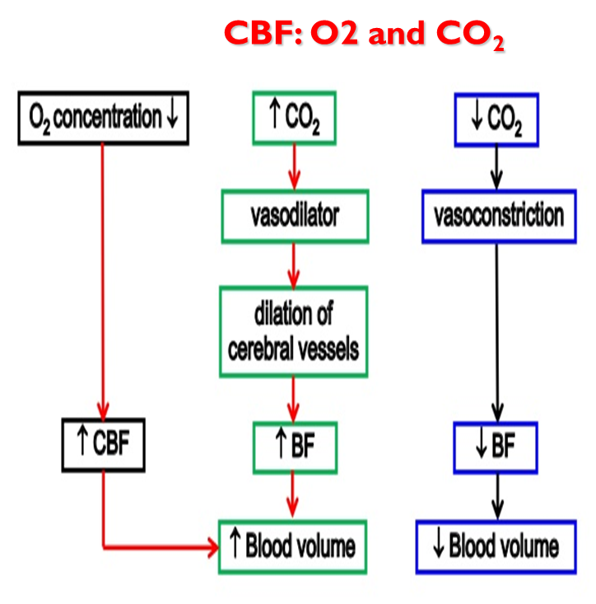
Cont.
Metabolic autoregulation:
Hydrogen ions
Carbon dioxide is increase cerebral blood flow by combining with water in the body fluids to form carbonic acid, with subsequent dissociation of this acid to form hydrogen ions.
The hydrogen ions cause vasodilation of the cerebral vessels.
The dilation directly proportional to the increase in hydrogen ion concentration.
Increases Hydrogen ion concentration, increase CBF.
Such substances include lactic acid, pyruvic acid, and any other acidic material formed during the course of tissue metabolism.

Slide 13
Cont.
Increased hydrogen ion concentration greatly depresses neuronal activity.
It is fortunate that an increase in hydrogen ion concentration also causes an increase in blood flow, which in turn carries hydrogen ions, carbon dioxide, and other acid forming substances away from the brain tissues.
Increasing H ion concertation can lead to coma.
Loss of carbon dioxide removes carbonic acid from the tissues; this, along with removal of other acids, reduces the hydrogen ion concentration back toward normal.
Thus, this mechanism helps maintain a constant hydrogen ion concentration in the cerebral fluids and thereby helps to maintain a normal, constant level of neuronal activity.
Oxygen Deficiency as a Regulator of Cerebral Blood Flow.
The rate of utilization of oxygen by the brain tissue remains within narrow limits - almost exactly 3.5 (± 0.2) ml of oxygen per 100 grams of brain tissue per minute.
If blood flow to the brain insufficient to supply this needed amount of oxygen, the oxygen deficiency mechanism causing vasodilation, returning the brain blood flow and transport of oxygen to the cerebral tissues to normal.

Slide 14
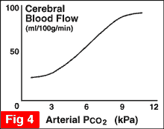
Cont.
Decrease in cerebral tissue PO2 below about 30 mm hg (normal value is 35 to 40 mm hg) immediately begins to increase cerebral blood flow.
Brain function becomes deranged at lower values of po2, especially at po2 levels below 20 mm hg.
Oxygen deficiency is a
regulator of cerebral blood flow except during periods of intense brain activity (at this time co₂& h are more important¹).
Oxygen mechanism for local regulation of cerebral blood flow is important protective response against diminished cerebral neuronal activity and therefore, against derangement of mental capability.
ONLY IN MALES’ SLIDES
Metabolic autoregulation:
ONLY IN FEMALES’ SLIDES
70 % increase in arterial PCO2, approximately doubles the cerebral blood flow.
¹ Because they are secreted in large quantity.

Slide 15
Cont.
ONLY IN MALES’ SLIDES
Myogenic / Pressure Autoregulation:
Arterioles dilate or constrict in response to changes in BP and ICP in order to maintain a constant CBF.
Myogenic theory: The vascular smooth muscles are highly responsive to changes in pressure, a process called myogenic activity, that contributes to auto-regulation of cerebral blood flow.
Vascular smooth muscle within cerebral arterioles contract to stretch response, regulating pressure changes. Autoregulation of CBF completely BP-dependent.
Metabolic Autoregulation:
Arterioles dilate in response to potent chemicals that are by-products of metabolism such as lactic acid, carbon dioxide and pyruvic acid.
CO2 is a potent vasodilator.
Increased CO2 or decreased BP > vasodilation.
Decreased CO2 or increased BP > vasoconstriction.
Increase Carbon dioxide (Hypercapnia) causes cerebral vasodilation.
As the arterial tension of CO2 rises, CBV and CBF increases
When it is decreased vasoconstriction is induced.

Slide 16
Cont.
The brain maintains proper CPP through the process of autoregulation.
Cerebral blood flow is “autoregulated” extremely well between arterial pressure limits of 60 and 140 mm Hg.
ONLY IN FEMALES’ SLIDES
ONLY IN MALES’ SLIDES
The response to lower pressure, is arteriolar dilation in the brain while when blood pressure rises they constrict.
Thus, changes in the body's overall blood pressure do not normally alter cerebral perfusion pressure drastically.
At their most constricted condition, blood vessels create a pressure of 150 mmhg, and at their most dilated the pressure is about 60 mmhg.
Old patients and chronic hypertension patients must normalize there blood pressure to avoid the rapture of small vessels.
Mean arterial pressure can be decreased acutely to as low as 60 mm Hg or increased to as high as 140 mm Hg without significant change in cerebral blood flow.
Hypertension, auto-
regulation of cerebral
blood flow occurs even when
the mean arterial pressure
rises to as high as 160 to 180
mmHg. If arterial pressure
falls below 60 mmHg,
cerebral blood flow become
severely decreased.

Slide 17
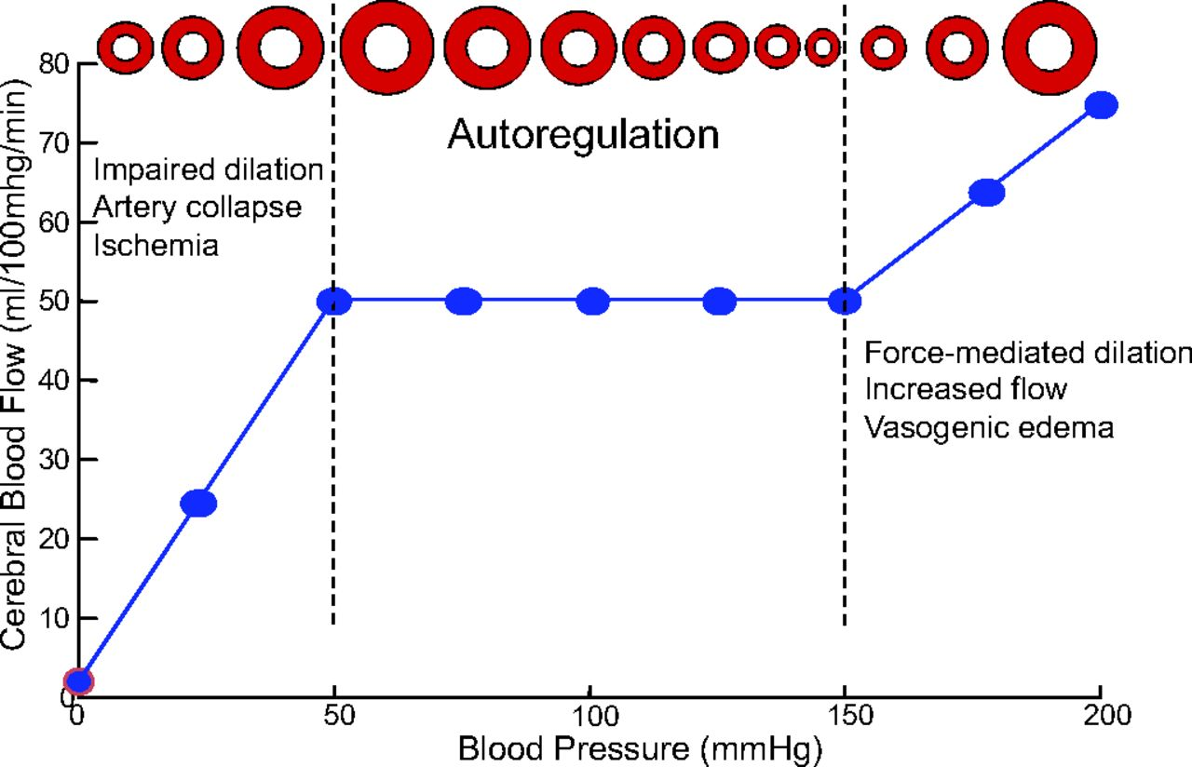
Regulation of cerebral blood flow
ONLY IN MALES’ SLIDES

Slide 18
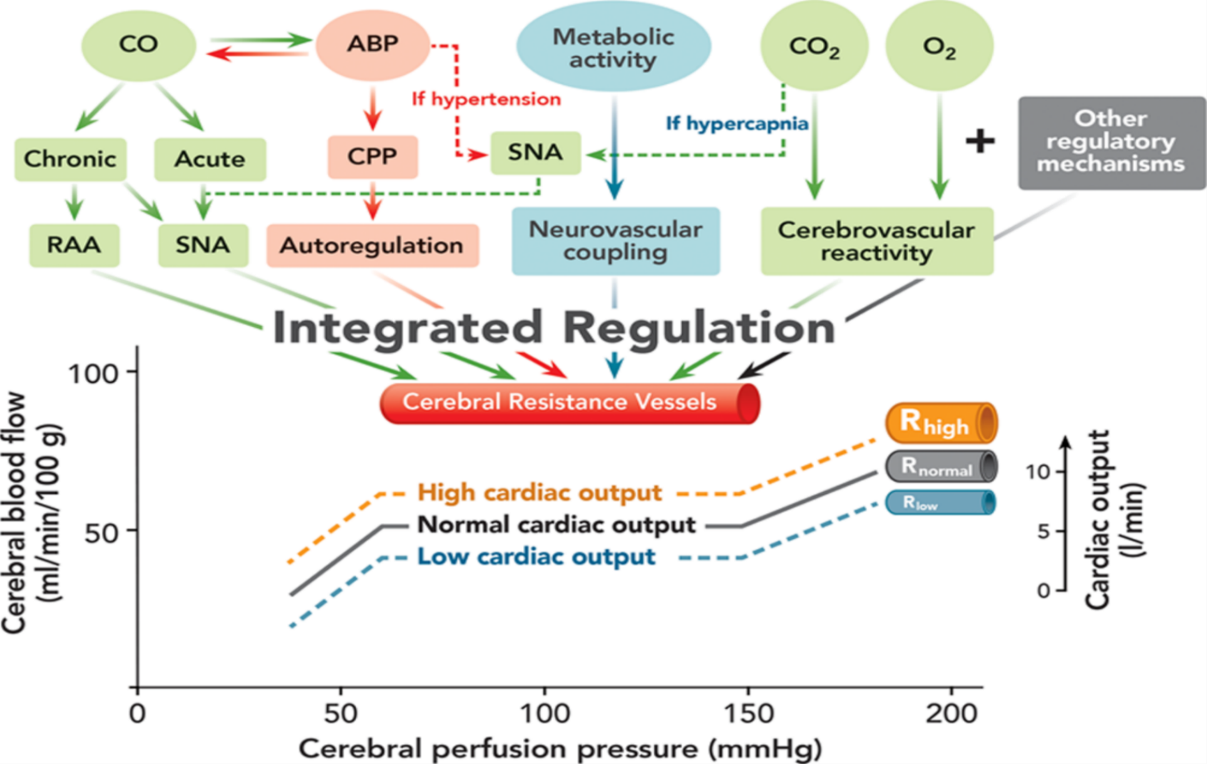
Cont.
ONLY IN MALES’ SLIDES
Cardiac output (CO); Sympathetic nervous activity (SNA); Renin–angiotensin–aldosterone (RAA) system; Arterial blood pressure (ABP); Cerebral perfusion pressure (CPP); Carbon dioxide (CO₂) and oxygen (O₂).
(R) Cerebral resistance vessels at high (R_{high}), normal (R_{norm}), and low (R_{low}).

Slide 19
Cont. Autoregulation
ONLY IN FEMALES’ SLIDES
When pressures are outside the range of 60 to 150 mmHg, the blood vessels' ability to autoregulate pressure through dilation and constriction is lost, and cerebral perfusion is determined by blood pressure alone without autoregulation.
Thus, hypotension can result in severe cerebral ischemia.
Effect of ICP changes on systemic blood pressure:
Cushing reflex: ‘Normally, the ICP [Intracranial Pressure] ranges from 1 to 15 mm Hg (but other sources give ranges like 8 to 18 mm Hg).
If ICP > 33 mmHg over a short period of time, CBF will drop markedly, leading to hypoxia and hypercapnia of vasomotor area causing blood pressure rises.

Slide 20
Role of the sympathetic nervous system in controlling cerebral blood flow
ONLY IN MALES’ SLIDES
Neurogenic Autoregulation:
The cerebral circulatory system has strong sympathetic innervation that passes upward from the Superior cervical sympathetic ganglia in the neck and then into the brain along with the cerebral arteries.
ANS and Neurochemical control has minor role.
Pressure and Metabolic Autoregulation is most important.

Slide 21
Cerebral blood flow
The vascular smooth muscles are highly responsive to changes in pressure, a process called myogenic activity, that contributes to auto-regulation of cerebral blood flow.
The endothelial cells in the brain circulation are also highly specialized and provide a barrier to fluid movement called the blood-brain barrier. When these normal cell processes fail or altered such as in hypertension.
Cerebral circulation
Fainting
Stroke
Temporary loss of consciousness, weakness of muscles, and inability to stand up, caused by sudden loss of blood flow to the brain & changes in blood pressure.
Fainting is a relatively common symptom caused by a various factors relating to changes in blood pressure.
The American Heart Association reported that fainting is responsible for 3% of all visits to emergency units and 6% of all admissions to hospitals.
Stroke occurs when the blood supply to a part of the brain is blocked resulting in the death of an area.
If a large vessel is blocked the outcome may be rapidly fatal or may lead to very severe disability.
If smaller blood vessels are blocked the outcome is less severe and recovery may be good.
ONLY IN MALES’ SLIDES
ONLY IN MALES’ SLIDES
ONLY IN MALES’ SLIDES
The most common
types of disability are the loss of functions of one side of the body and speech problems.

Slide 22
Stroke
ONLY IN FEMALES’ SLIDES
If the middle cerebral artery is blocked on the left side of the brain, the person is likely to become:
Almost totally demented because of lost function in wernicke’s speech comprehension area in the left cerebral hemisphere.
Unable to speak words because of loss of broca’s motor area for word formation.
In addition, loss of function of neural motor control areas of the left hemisphere can create spastic paralysis of most muscles on the opposite side of the body.
Blockage of a posterior cerebral artery will cause infarction of the occipital pole on the same side, which causes loss of vision as (hemianopsia).
strokes that involve the blood supply to the midbrain can block nerve conduction in major pathways between the brain and spinal cord, causing both sensory and motor abnormalities.

Slide 23
Cont.
ONLY IN MALES’ SLIDES
Stroke
Ischemic
Hemorrhage
Thrombus formation or embolism.
Vasospasm (ET-1?) associated with subarachnoid hemorrhage.
Ruptured aneurism.
Vascular weakening due to chronic hypertension.

Slide 24
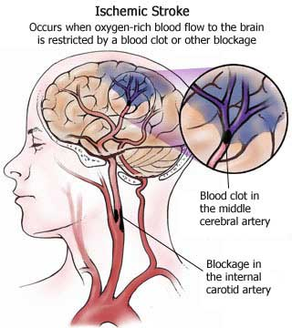
Types of stroke
Types of stroke
Dementia
Transient ischemic attack
Extra
Thrombotic
Hemorrhagic
Embolic
This may result from repeated episodes of small strokes which produce progressive damage to the brain over a period of time.
The main clinical feature of dementia is a gradual loss of memory and intellectual capacity.
Loss of motor function in the limbs and incontinence can also occur.
When blood supply to a part of the brain is temporarily interrupted without producing permanent damage.
Recovery may occurs within 24 hours.
Usually result from small blood clots or clumps from plaques of atheroma which get carried into the blood circulation producing transient blockages.
Occasionally these clots may get carried from the heart or arteries leading to the brain (e.g. carotid arteries), rather than from within the cerebral circulation itself.
Stroke due to the blockage of an artery leading to or in the brain by a blood clot.
Stroke due to bleeding from a ruptured blood vessel, usually a consequence of hypertension.
Stroke due to the formation of a blood clot in a vessel away from the brain.
The clot is carried in the bloodstream until it lodges in an artery leading to or in the brain.
The thrombotic and hemorrhagic forms are common
ONLY IN MALES’ SLIDES

Slide 25
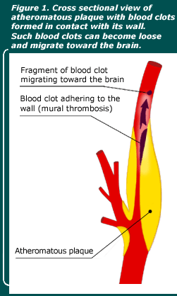
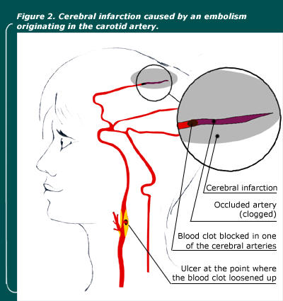
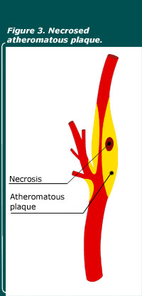
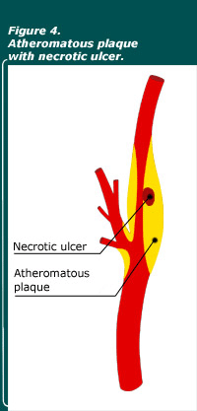
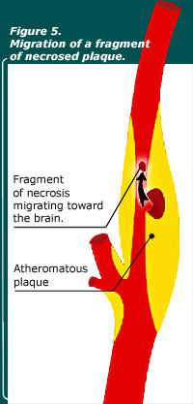
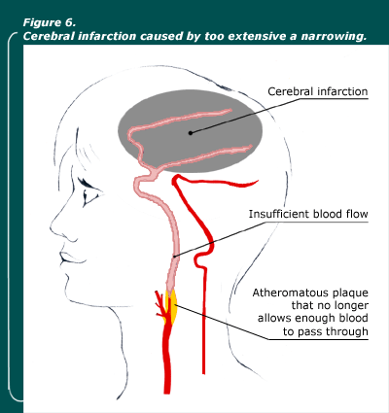
Infarction
ONLY IN MALES’ SLIDES
In male slide only picture 1 & 2 were there, the rest are extra for more understanding
1
2
3
4
5
6

Slide 26
Cerebrospinal fluid
ONLY IN FEMALES’ SLIDES
Volume = 150 ml.
Rate of production= 500 ml/d .
Lumbar CSF pressure= 70-180 mm hg.
The lumber pressure of CSF means: we will measure the pressure of CSF from the lumber region.
Absorption of CSF is proportionate to CSF pressure.
At pressure of 112 mm (normal average): filtration and absorption are equal.
Below pressure of 68 mm CSF, absorption stops.
This fluid is present in the ventricles of the brain, cisterna around brain and in the subarachnoid space around both the brain and the spinal cord.
All these chambers are connected with one another, and the pressure of the fluid is maintained at a constant level.

Slide 27
Cerebral microcirculation
Extra
The metabolic rate of the brain gray matter where the neuronal cell bodies lie is about four times as great as that of white matter; so, the number of capillaries and rate of blood flow are also about four times as great in the gray matter.
An important structural characteristic of the brain capillaries is that:
mostly are much less “leaky” than the blood capillaries, because they are supported on all sides by “glial feet” which are small projections from glial cells, provide physical support to prevent overstretching of the capillaries in case of high capillary blood pressure.
The walls of the small arterioles leading to the brain capillaries greatly thickened in people who develop high blood pressure, and these arterioles remain significantly constricted all the time to prevent transmission of the high pressure to the capillaries.

Slide 28
Composition of the CSF
ONLY IN FEMALES’ SLIDES
Functions of the CSF
You DON’T have to memorize the table.
Substance | CSF | Plasma
Na+ | 147 | 150
K+ | 2.9 | 4.6
HCO3- | 25 | 24.8
PCO2 | 50 | 39.5
pH | 7.33 | 7.4
Osmolality Glucose | 289 64 | 289 100
1. Protective function(cushioning):
In air brain weight =1400 gm, but in its water bath of CSF, brain weight = 50 gm, making it suspended and floated effectively.
2. Facilitation of pulsatile cerebral blood flow.
3. Distribution of peptides, hormones, neuroendocrine factors and other nutrients and essential substances to cells of the brain.
4. Wash away waste products.
The composition of CSF is nearly the same as brain ECF.
osmotic pressure, approximately equal to that of plasma.
sodium ion concentration is approximately equal to that of plasma.
chloride ion, about 15 percent greater than in plasma.
potassium ion, approximately 40 percent less.
glucose about 30 percent less.

Slide 29
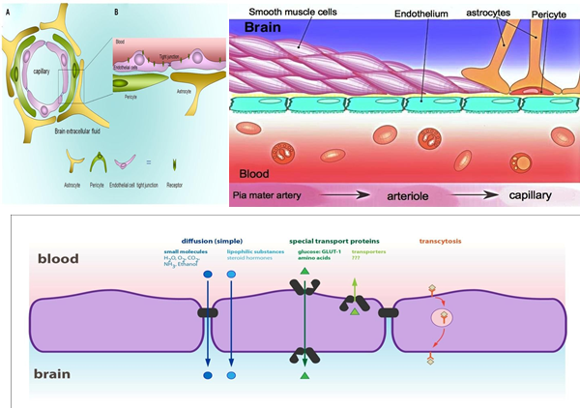
Blood brain barrier BBB
ONLY IN FEMALES’ SLIDES
It is between blood & CSF & brain tissue.
It is formed at:
Choroid plexus epithelial cells and.
At brain tissue capillary membrane (endothelial cells) formed by the tight junctions between capillary endothelial cells of the brain capillaries and between epithelial cells in the choroid plexus.
Penetration of substances into the brain:
Molecules pass easily: H2O, CO2, O2, lipid-soluble substances(as steroid hormones).
Molecules not pass: proteins, antibodies, non- lipid-soluble large molecules.
Slight penetration: cl, Na, K.
Glucose: its passive penetration is slow, but is transported across brain capillaries by GLUT1.
Functions of BBB:
Maintains the constancy of the environment of the neurons in the CNS.
Protection of the brain from endogenous and exogenous toxins.
Prevent escape of the neurotransmitters into the general circulation.

Slide 30
Factors disturb the autoregulation
ONLY IN MALES’ SLIDES
Noxious stimuli such as:
Hypoxia due to occlusive cerebro-vascular disease.
Trauma from head injury.
Brain compression from tumors, hematoma, cerebral edema. These factors results in the loss of normal cerebral blood flow (CBF) autoregulation.
Summary
The circle of willis is a vital formation of arteries at the base of the brain.
Brain receives its blood supply from four main arteries, the two internal carotid arteries and the two vertebral arteries.
Normal blood flow through the brain of the adult person averages 50 to 65 milliliters per 100 grams of brain tissue per minute.
The main system regulate CBF a. myogenic / pressure auto-regulation b.neurogenic auto-regulation.
Carbon dioxide concentration, hydrogen ion concentration, and oxygen concentration have potent effects in controlling the cerebral circulation.
Noxious stimuli such as hypoxia, trauma / head injury or brain compression from tumors, hematomas or cerebral edema, results in the loss of normal cerebral blood flow / auto regulation.

Slide 31
Doctors’ notes
Brain receive its blood supply from four main arteries: two internal carotid arteries, two vertebral arteries.
Brain accounts for 2% of the body weight yet use 20% of o2 consumption. (He stressed this point).
Factors effecting: (most important 3 myogenic, neurogenic, and metabolic).
High blood pressure (above 150) causes vasogenic edema, low blood pressure (below 50) causes ischemia.
Both low and high blood pressure will cause headaches. High blood pressure headache will also be accompanied with neck / jaw pain.
Cerebral circulatory system has mainly sympathetic innervation. ANS and neurochemical control has minor role.
Pressure and metabolic autoregulation is most important.
The sympathetic nervous system normally constricts the large and intermediate-sized brain arteries enough to prevent the high pressure from reaching the smaller brain blood vessels.
Noxious stimuli (hypoxia, trauma) / head injury or brain compression from tumors, hematomas or cerebral edema, results in loss of normal cerebral blood flow/auto regulation.

Slide 32
Thank you!
اعمل لترسم بسمة، اعمل لتمسح دمعة، اعمل و أنت تعلم أن الله لا يضيع أجر من أحسن عملا.
The Physiology 436 Team:
Team Leaders:
Lulwah Alshiha
Laila Mathkour
Mohammad Alayed
Females Members:
Reem Alshathri
Rawan Alqahtani
Zaina Alkaff
Males Members:
Abdullah Alsaeed
Contact us:
References:
Females’ and Males’ slides.
Guyton and Hall Textbook of Medical Physiology (Thirteenth Edition.)

