Slide 1
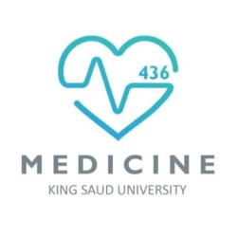

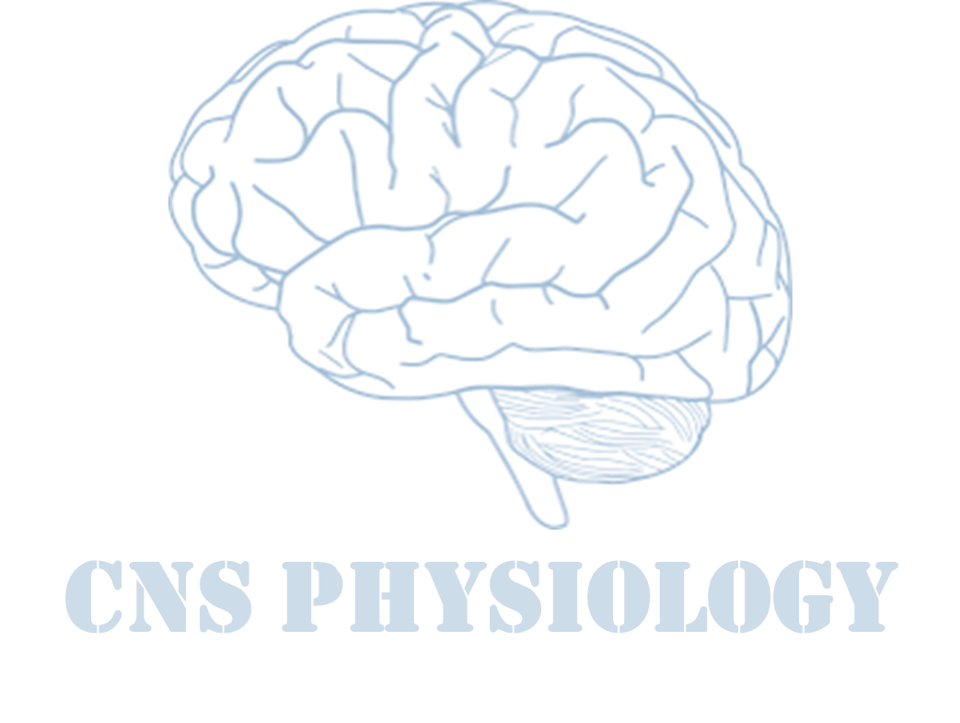

Text.
Important
Formulas
Numbers
Doctor notes
Extra notes and explanation
Lecture No.21
« حسبنا الله، سيؤتينا الله من فضله، إنا إلى ربنا راغبون»

Slide 2
Physiology of Speech
Objectives:
Describe brain speech areas as Broca’s, Wernicke’s and insula.
Explain sequence of events in speech production.
Explain speech disorders as aphasia with its types, dysarthria, and acalculia.
Explain difference between aphasia and dysarthria.

Slide 3
Overview
ONLY IN FEMALES’ SLIDES
It is the highest function of the nervous system.
Involves understanding of spoken & printed words.
It is the ability to express ideas in speech & writing.
Types of speech
1. Spoken speech:
Understanding spoken words & expressing ideas in speech.
2. Written speech:
Understanding written words and expressing ideas in writing.
Extra picture

Slide 4
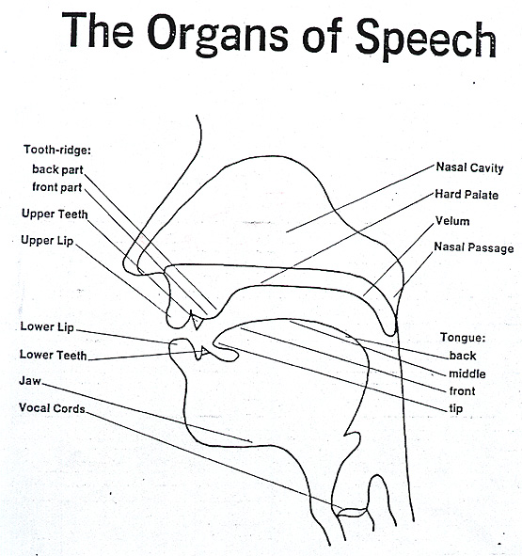
Speech
ONLY IN MALES’ SLIDES
Definition: speech may be defined as the means of communication between the two individual or group of individuals.
Speech structures:
  Oral Cavity.
  Nasal Cavity.
  Pharynx.
  Larynx.

Slide 5
Basic events in speech production
ONLY IN MALES’ SLIDES
Events in speech production
Initiation
Phonation
Articulation
Action that initiates the flow
Action that modulates the quality of sounds
Action that modulates or articulates

Slide 6
Basic events in speech production (initiation)
ONLY IN MALES’ SLIDES
Setting the airstream in motion:
  Creating airstream is an essential process of sound production.
  Change in pressure.
Three mechanisms of initiation:
  Pulmonic: pulmonic airstream mechanism via lungs 95% of human speech sounds are produced in this way.
  Glottalic: airstream mechanism via glottis.
  Velaric: airstream mechanism via velum.
Direction of air flow:
1. Egressive / pressure Sound
  Exhalation: Deflation of lungs and consequent compression of the air (Hello…..Hello).
  2. Ingressive / suction Sound
  Inhalation: Sucking air into the lungs (Hi…..Hi).

Slide 7
Basic events in speech production (Articulation)
ONLY IN MALES’ SLIDES
Basic events in speech production (Phonation)
Phonation is a process of changing air stream.
Sound production by passage of air over the vocal cord.
Produce speech sounds, air stream distorted in one way or another.
Phonation is mainly achieved at larynx, vocal cord.
Major components:
    Vocal cords, Glottis, Epiglottis.
    Three cartilages:
    Thyroid
    Arytenoid
    Cricoid
Contribution by structures to shape airflow.
A variety of speech sounds can be produced in terms of another way of air stream change – Articulation.
Articulation is done mainly at vocal cord.
  An specific part of the vocal apparatus involved in the production of a speech sound.
  Active articulators:
    Lips.
    Tongue.
    lower jaw.
    velum

Slide 8
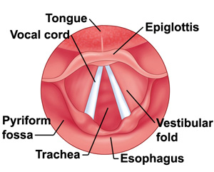
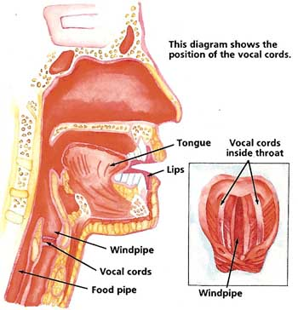
Cont. Basic events in speech production (Articulation)
ONLY IN MALES’ SLIDES
Muscular movements of the mouth, tongue, larynx, vocal cords.
Responsible for the intonations, timing, and rapid changes in intensities of the sequential sounds.

Slide 9
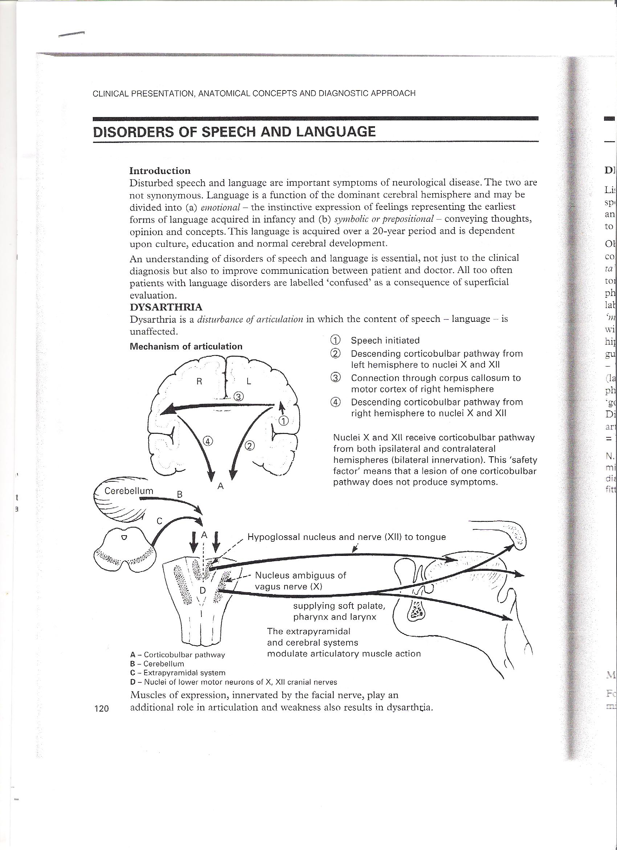
Mechanism of articulation
ONLY IN MALES’ SLIDES

Slide 10
Communications
ONLY IN MALES’ SLIDES
communications
Sensory communication
Motor communications
Auditory communication
Taking
Visual communication
Writing
Steps of communications:
Collection of sensory input
Integration
Hearing and articulation mechanism
Motor execution
Auditory and visual

Slide 11
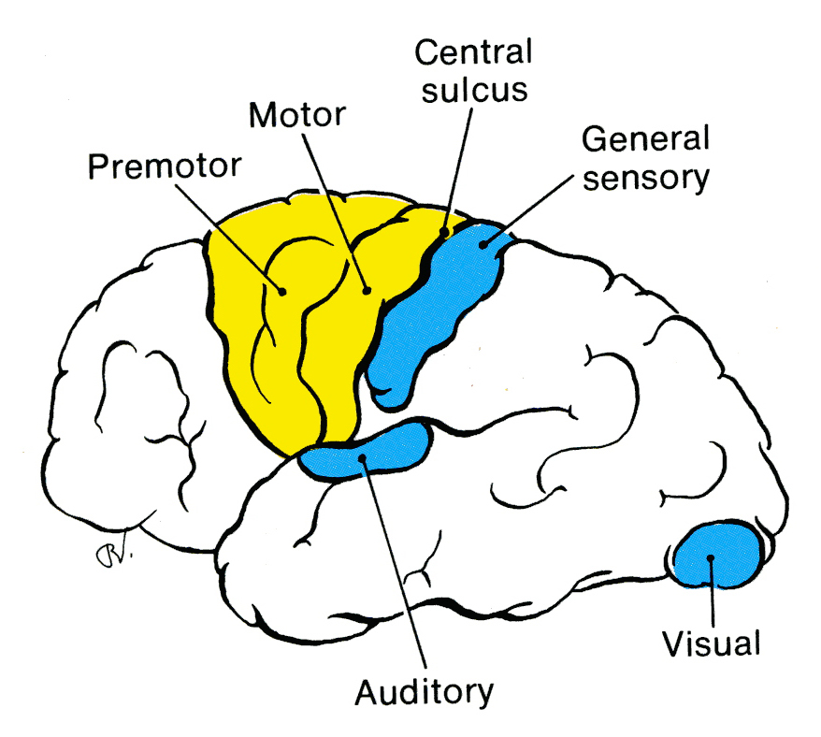
Main sensory areas of the cortex
Extra
The somatic sensory area is located in the parietal lobe posterior to the central sulcus.
Visual sensations are received in the visual area in the posterior lobe.
Auditory sensations are received in the temporal lobe close to the lateral sulcus.
Olfactory sensations are received deep inside the temporal lobe.

Slide 12
Brain areas concerned with language
Wernick’s area: understanding (comprehension) of speech.
Broca’a area: motor area of speech , production of words.
Speech articulation area → in insula.
Motor cortex: controls muscles of speech production.
Angular gyrus.
Assoc Areas (only in male).
Arcuate fasiculus (only in female).

Slide 13
Wernick’s area
ONLY IN FEMALES’ SLIDES
Wernick’s area
At the posterior end of the superior temporal gyrus. في كل منطقة يصير فيها lesion يصير عندنا disorder مختلف. | Closely associated with 1 & 2 auditory areas
Responsible about comprehension of auditory & visual information, then project it to Broca`s area via arcuat fasiculus. | Interpretations of sensory experience
Formation of thought in response to sensory experience. المنطقة مرتبطة بالسمع والفهم – اختيار الكلمات وترتيبها – التخطيط واختيار الردود. | Choice of words to express thoughts

Slide 14
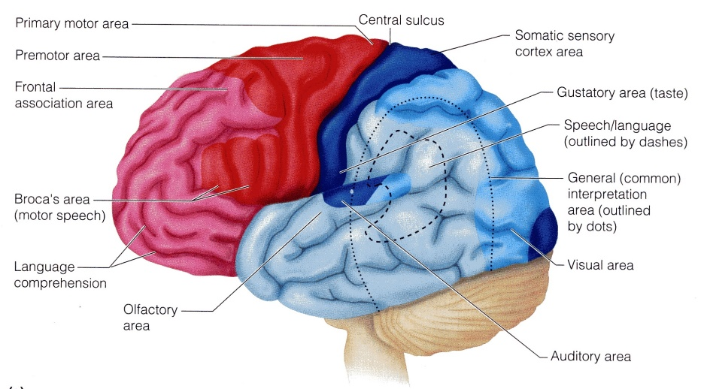
Broca's area
ONLY IN FEMALES’ SLIDES
At the lower end of premotor area.
Process information received from W. Area into detailed & co-ordinated pattern for vocalization.
Then project it to motor cortex to initiate the appropriate movement of the lips & larynx to produces speech.
In adult who learn second language during
adulthood. The MRI shows portion of Broca`s
area concerned with it is adjacent to but
separate from area concerned with the native
language.
تتكون عندهم broca’s area صغيرة في الدماغ «منطقة مرتفعة»
But in children who learn second language early
in life there is only single area involved for both
languages, It’ll diffuse in one area.
Extra picture

Slide 15
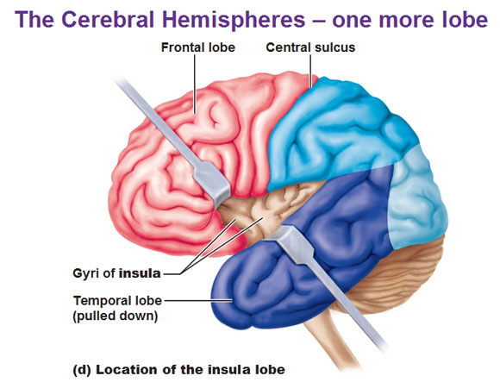
Agular gyrus and insula
ONLY IN FEMALES’ SLIDES
Agular gyrus:
  Angular gyrus (brodmann area 39) → a region of the brain in the parietal lobe
  Leis behind Wernikes area fused posteriorly into the visual cortex.
  Function: interpretation of information obtained from reading from visual cortex.
Insula:
  It is a portion of the cerebral cortex folded deep within the lateral sulcus.
  Hand and eye motor function.
  It’s important in motor execution.

Slide 16
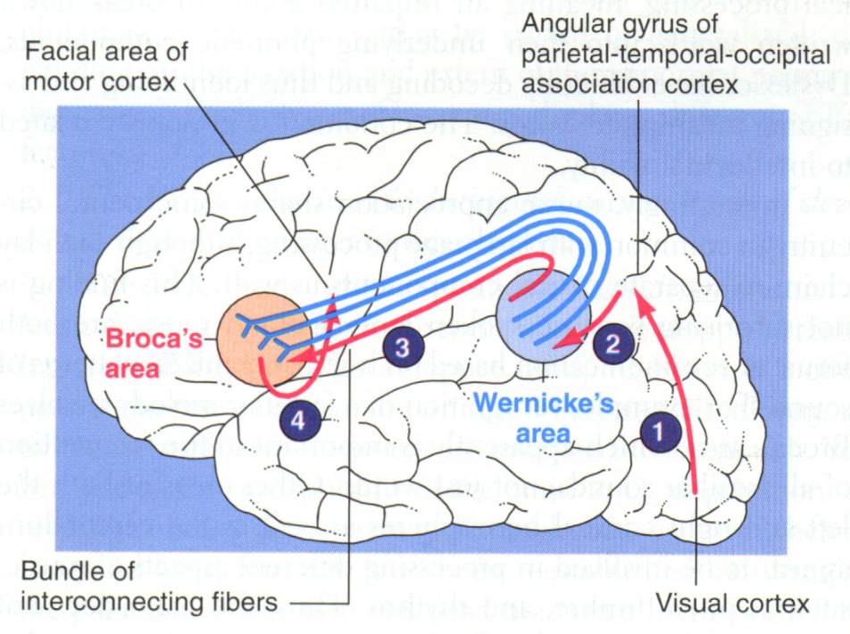
Summary of the speech pathway
ONLY IN FEMALES’ SLIDES
Wernick’s area receive information from both auditory & visual areas.
Project it to Broca's areas via arcuat fasiculus.
Broca`s area process information received into co-ordinated pattern of vocalization & then project that pattern to the motor area.
Initiation of movement of muscle of speech in
tongue, larynx & lips.
If writing is concerned, then information received from wernick’s area is processed in the area of hand skills.
Co-ordinated pattern of muscle movement projected to the arms & hand region of the motor cortex.
Initiation of necessary muscle movement in the hand & arms required for writing a particular word.

Slide 17
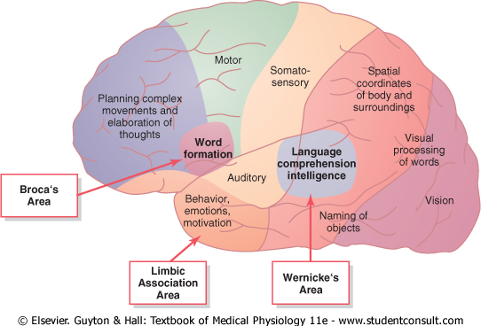
Speech centres
ONLY IN MALES’ SLIDES
Broca's Area. A special region in the frontal cortex, called Broca's area, provides the neural circuitry for word formation. This area, is located partly in the posterior lateral prefrontal cortex and partly in the premotor area. It is here that plans and motor patterns for expressing individual words or even short phrases
are initiated and executed. This area also works in close
association with Wernicke's language comprehension
center in the temporal association cortex.

Slide 18
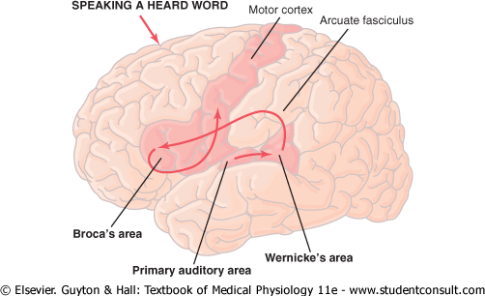
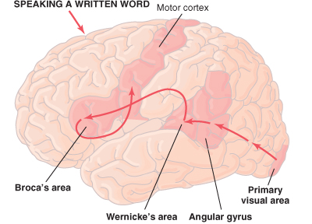
Auditory language perception
ONLY IN MALES’ SLIDES
Visual Language (Reading)

Slide 19
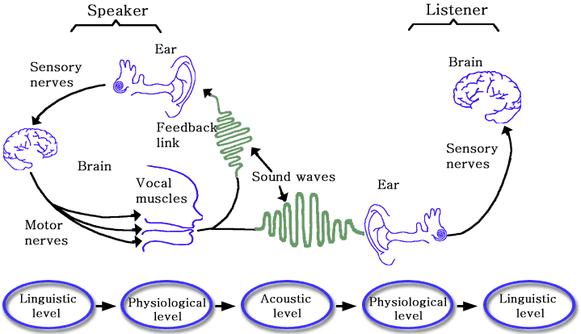
The speech chain
ONLY IN MALES’ SLIDES

Slide 20
Association areas
ONLY IN MALES’ SLIDES
These areas receive and analyze signals simultaneously from multiple regions of both the motor and sensory cortices as well as from sub-cortical structures.
The most important association areas are parieto occipitotemporal association area prefrontal association area limbic association area.
Parieto-occipitotemporal association areas:
  Analysis of the Spatial Coordinates of the Body.
  Area for Language Comprehension.
  Area for Initial Processing of Visual Language (Reading).
  Area for Naming Objects.

Slide 21
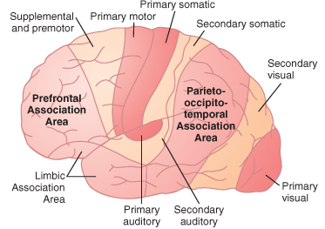
Primary, secondary and association areas
ONLY IN MALES’ SLIDES

Slide 22
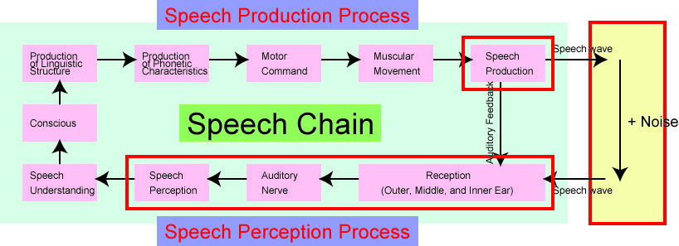
Speech production propcess
ONLY IN MALES’ SLIDES

Slide 23
Speech disorder
ONLY IN FEMALES’ SLIDES
Speech disorder
Aphasia
Dysarthria
Dyscalculia
Abnormality of language function due to injury of language centres in cerebral cortex.
Comprehension or expression of words will be affected Due to thrombus or embolism of cerebral vessels, trauma
Abnormality in articulation (motor dysfunction).
Due to neurological conditions involving motor function (upper or lower motor neuron lesion).
مشاكل في النطق وليس اللغة
Difficulty in learning or comprehending arithmetic and mathematics.
Seen in developmental disorder.
مشكلة في العمليات الحسابية ومالها علاقة بالنطق أو اللغة.
Motor or Broca`s aphasia (non fluent)
Sensory or Wernikes aphasia (fluent)
Conductive aphasia (fluent)
Anomic aphasia

Slide 24
Aphasia types
ONLY IN FEMALES’ SLIDES
Motor or Broca`s aphasia (non fluent):
  Lesion of Broca`s area.
  Patient will understand spoken & written words but find it difficult to speech or to write.
  Poorly articulated speech, slow with great effort & abnormal rhythm.
  In some cases speech may be limited to 2-3 words.
Insula damage:
  Progressive non-fluent aphasia.
  deterioration of normal language function.
  non fluent + normasl comprehension.
  Intact other non-linguistic cognition.
  Degdegenerative disorders.
  الفهم والادراك طبيعيان فقط الكلام والكتابة تأثروا
Degdegenerative disorders:
  Atrophy of the left anterior insular cortex.

Slide 25
Cont.
ONLY IN FEMALES’ SLIDES
Aphasia types
Sensory or wernikes aphasia (fluent) | Lesion of wernikes area +/- arcuate fasucul. Impaired comprehension. Loss of intellectual function. يقدر يقرأ ويسمع لكن عنده loss of cognitive function Failure to interprets meaning of written or spoken words. Meaningless & excessive talk (in sever cases). كلامهم مخربط – وما يفهمون الأوامر – loss of planning / choice making
Conductive aphasia (fluent) | Lesion of nerve fibres of arcuate fasiculus. Patient understand speech of others but can not repeat it. Meaningless speech.
Anomic aphasia | Lesion of angular gyrus, thus B. & W. Are intact, (Where visual information are processed). Speech & auditory comprehension is normal but visual comprehension is abnormal, due to visual information is not processed & not transmitted to w. Area. السمع سليم لكن فهم الصور والرسومات غير موجود Dyslexia (word blindness) interruption in the flow of visual experience into W. Area from visual area*.
Difference between wernick’s and conductive aphasia:
Wernick’s = loss of intellectual
Conductive = patient can understand
*في حالة ال word blindness نفترض أنه عندنا طفل في أولى ابتدائي يتعلم حرف الباء ولكن هو مايقدر يشوفه فلما يعطونه كلمة زي بابا هوا يشوفها ا ا أو يشوف الباء مقلوبة فبالتالي ما يستطيع يتعلم ويرسب ويحسبونه صعوبات تعلم ولكن في الحقيقة هو اساسا ما يشوف الحرف. نفس الشي ممكن يكون بدل الحرف رقم ما يقدر يشوفه.

Slide 26
Speech disorders
ONLY IN MALES’ SLIDES
Area | Lesion faetures
Auditory association areas | Word deafness
Visual association areas | Word blindness called dyslexia
Wernicke's aphasia | Unable to interpret the thought
Broca's area causes | Motor aphasia
Global aphasia | Unable to interpret the thought Motor aphasia

Slide 27
Aphasia
ONLY IN MALES’ SLIDES
Aphasia is loss of or defective language from damage to the speech centres within the left hemisphere.
In aphasia there is no damage to vision, hearing or motor paralysis.The damage is in speech centers in categorical hemispheres.
Global aphasia:
  This means the combination of the expressive problems of Broca's aphasia and the loss of comprehension of Wernicke's.
  The patient can neither speak nor understand language. It is due to widespread damage to speech areas and is the commonest aphasia after a severe left hemisphere infarct. Writing and reading are also affected.
Aphasia
Expressive | Receptive
Non fluent. Understanding normal but voice production defective. | Broca's area
Fluent: meaningless words with loss of comprehension / understanding. | Wernick’s area conduction aphasia
Anomic: unable to name the objects. | Angular gyrus
Global: mixture of all. | Widespread damage to speech areas

Slide 28
Dysarthria
ONLY IN MALES’ SLIDES
Disorder articulation
Dysarthria: means disorder in articulation ex: slurred speech.
Dysarthria disturbances of the articulation. In some individuals who has no abnormality in the speech centre or in its pathways results in stuttering speech.
Speaking softly or barely able to whisper.
Slow rate of speech.
Rapid rate of speech with a "mumbling" quality.
Limited tongue, lip, and jaw movement.
Abnormal intonation (rhythm) when speaking.
Changes in vocal quality ("nasal" speech or sounding "stuffy").
Hoarseness.
Slurred speech.
Language is intact,.
Paralysis, slowing or in coordination of muscles of articulation or local discomfort causes various different patterns of dysarthria.
Examples:
Gravelly' speech of upper motor neuronal lesions of lower cranial nerves.
Jerky, ataxic speech of cerebellar lesions (scannimg speech).
The monotone of parkinson's disease (slurred).
Speech in myasthenia that fatigues and dies away. Many aphasic patients are also somewhat dysarthric.

Slide 29
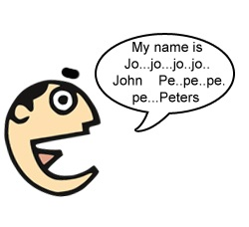
Stuttering
ONLY IN MALES’ SLIDES
Stuttering affects the fluency of speech.
Talking with involuntary repetition of sounds, especially initial consonants.
It begins during childhood and, in some cases, lasts throughout life.
The disorder is characterized by disruptions in the production of speech sounds, also called ‘disfluencies’.
Have right cerebral dominance and widespread overactivity in the cerebral cortex and
cerebellum. This includes
increased activity of the
supplementary motor area.
Sound production by passage of air over the vocal cord.
Dysphonia: Abnormal sound production due to problem in vocal cord e.g., paralysis, CVA, other causes.
Causes:
Paralysis of both vocal cord e.g whispering sound and inspiratory strider.
Paralysis of left vocal cord: The voice becomes week and cough bovine. Mainly due to recurrent laryngeal palsy.

Slide 30
Right hemisphere
(the representational hemisphere)
ONLY IN FEMALES’ SLIDES
Left hemisphere
(the categorical hemisphere)
لا يوجد dominant and non dominant كلهم شغالين بس على حسب المهمة اللي الشخص يبغى يسويها أي واحد يشتغل أكثر.
The right hemisphere controls the left side of the body
Temporal and spatial relationships*
Analyzing nonverbal information
مثل لغة الجسد
The left hemisphere controls the right side of the body
Produce and understand language
understanding and manipulating language: recognition, use, and understanding of words and symbols
Communicating emotion
recognition of emotion
مرتبط بالمشاعر والجوانب الروحانية أكثر.
Recognition of tunes, rhythms
Speech
Identification of objects by name
Mathematics, logic, analysis
Holistic problem solving
*عادة الأشخاص اللي يستخدمون اليد اليسار في حياتهم اليومية يبدعون كمهندسين ومصممين ديكور لأن عندهم تصور للعلاقات بين الأشياء من ناحية المسافات وغيرها.

Slide 31
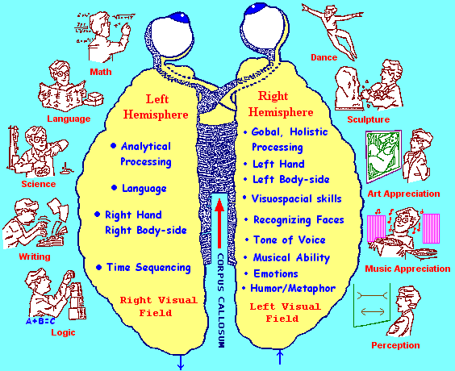
Summary of right & left hemisphere
ONLY IN FEMALES’ SLIDES

Slide 32






Thank you!
اعمل لترسم بسمة، اعمل لتمسح دمعة، اعمل و أنت تعلم أن الله لا يضيع أجر من أحسن عملا.
The Physiology 436 Team:
Team Leaders:
Lulwah Alshiha
Laila Mathkour
Mohammad Alayed
Females Members:
Lama Alfawzan Zaina Alkaff
Males Members:
Hassan Alshammari
Abdulaziz Alseffay
Contact us:
References:
Females’ and Males’ slides.
Guyton and Hall Textbook of Medical Physiology (Thirteenth Edition.)

