Slide 1
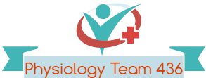
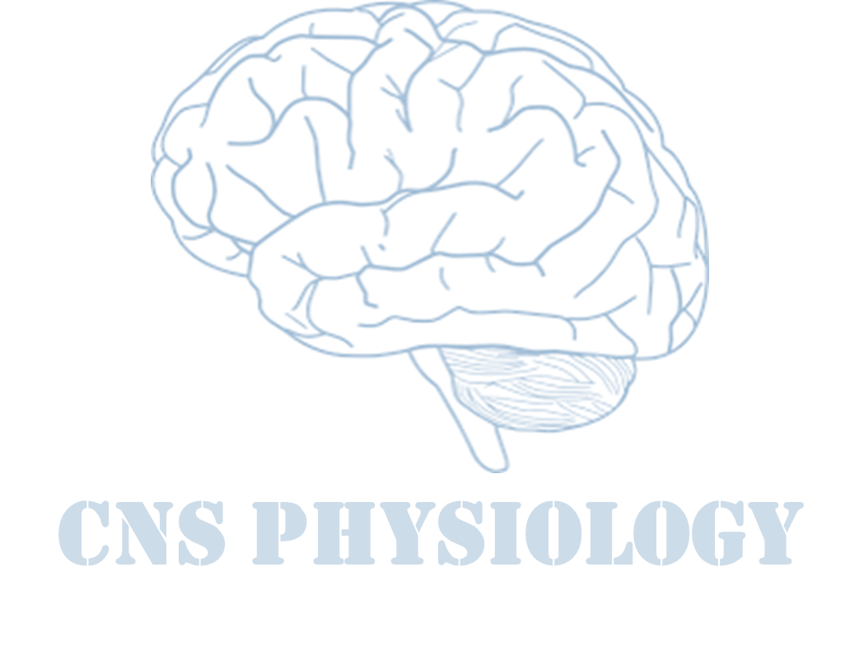
Text.
Important
Formulas
Numbers
Doctor notes
Extra notes and explanation
Lecture No.22
“ Work hard in silence,
Let the success make the noise”.

Slide 2
Spasticity and Increased Muscle Tone
Objectives:
1-Define spasticity and rigidity and hypertonia.
2-Describe the neurophysiology of spasticity.
3-Describe the causes of spasticity and rigidity.

Slide 3
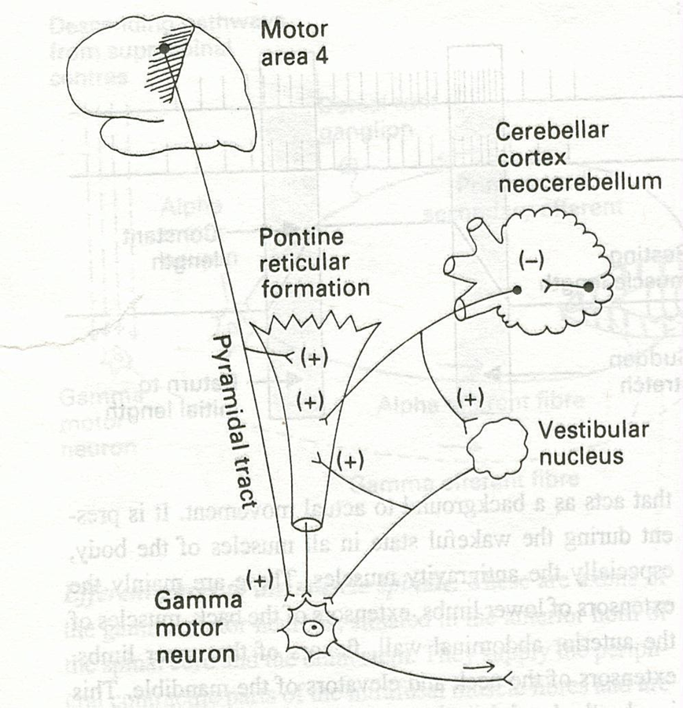
Muscle tone
ONLY IN MALES’ SLIDES
Hypertonia refers to increased resistance to passive lengthening (passive stretch) of a muscle or muscles group. This may mean increased stiffness of the muscle.
Hypertonicity could be due to a neural drive problem such as 1) spasticity 2) rigidity.
Increased Gamma efferent discharge is the main cause of increased muscle tone. how?
Facilitatory supra spinal centers to gamma motor neurons.
Resistance of a muscle to stretch is often referred to as its tone or tonus.
Muscle tone is static component of stretch reflex .It is a continuous mild muscle contraction that acts as background to actual movement.
A hypertonic muscle is one in which the resistance to stretch is high because of hyperactive stretch reflexes.
ONLY IN FEMALES’ SLIDES
يعني لما احرك يد المريض رح يصير فيه مقاومة كأني افتح باب وسببها اصابة في جزء من مسار التوصيل من الاعلى الى الاسفل

Slide 4
Spasticity
As described by Lance (1980): “it is a motor disorder, characterised by increase in tonic stretch reflexes (muscle tone) with exaggerated tendon jerks, resulting from hyper-excitability of the dynamic stretch reflex as one component of the upper motor neurone (UMN) syndrome.
Flexor spasticity in the upper limb & extensor spasticity in the lower limb.
كلما ازيد السرعة تزيد المقاومة وتكون مع حركة وحدة يعني مثلا لما نسوي فليكشن نلقى مقاومة بس اكستنشن ما نلقى مقاومه
Involvement of the corticospinal tract is often associated with UMNL and spasticity.
There are a number of clinical features that are associated with spasticity:
hypereflexia, flexor spasticity in the upper limb & extensor spasticity in the lower limb.
UMN lesions Spasticity is of Clasp Knife Type* : describe a sudden release of tone after an initial hypertonia of selected joint movement
ONLY IN MALES’ SLIDES
Spasticity is velocity dependent increased resistance to passive movement (stretch) of the muscle due to abnormally high muscle tone (hypertonia) which varies with the speed of displacement of a joint.
The faster you stretch the muscle the greater the resistance.
Spasticity is clearly neural in nature and is a associated with the – UMNL.
Spasticity is usually uni- directional.
*يعني يكون فيه صعوبة في التحريك في بداية الحركة بس بعدين تصير طبيعيه، مثل معناها كسارة البندق يعني تكسرين القشره في البداية بعدين تصير الحركة اسهل

Slide 5
Cont.
Spasticity is characterized by hyper-excitability of both types of stretch reflex:
Increase in tonic static stretch reflexes (muscle tone) as one component of the upper motor neurone (UMN) syndrome.
Exaggerated tendon jerks, resulting from hyper-excitability of the dynamic stretch reflex as one component of the upper motor neuron (UMN) syndrome.
A simple way to assess spasticity is by fast flexion or extension of selected joint, typically the elbow or knee, to elicit a sudden increase in tone.
This demonstrate the velocity dependent nature of spasticity.
Spasticity with the increased muscle tone together cause a contraction and deformity of a limb.
Hypertonia & spasticity is a feature of altered muscle performance.
Usually in Upper Motor Neuron Syndrome (UMNS ).
Patients complain of stiffness & inability to relax.
Muscles become permanently "tight" or spastic.
The condition can interfere with walking, movement, or speech.
ONLY IN FEMALES’ SLIDES

Slide 6
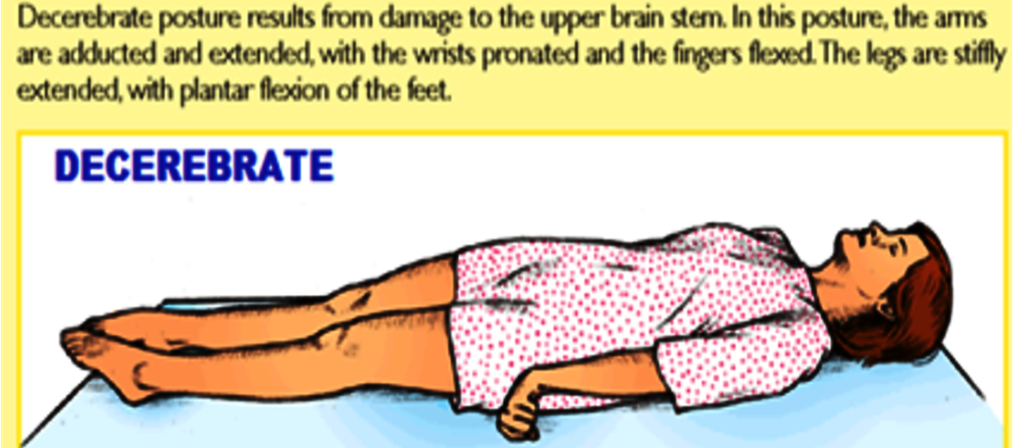
Rigidity
Rigidity is increased neural activity throughout the range of muscle movement and is not velocity dependent.
In Rigidity resistance is present in both agonist and antagonist. (is bi-directional)
Rigidity is usually extra-pyramidal in origin &includes other features of increased muscle tone.
Is often associated with basal ganglia disease such as Parkinson’s disease.
Stiffness is different from rigidity . Stiffness is a principal symptom of the patient (complain).
Other types of Rigidity:
Decerebrate rigidity :
(extension of head & 4 limbs extensors ).
Decorticate rigidity:
(extensor rigidity in legs & moderate flexion of arms if head unturned ).
Rigidity in parkinsonism:
1- Lead pipe rigidity**
2- Cog-wheel rigidity*
A relatively uniform rigidity in both agonist and antagonist muscle
Passive movement of an extremity meets with a constant dead feeling resistance like a lead pipe throughout the range of movement.
The one feels that resistance varies rhythmically when applying a passive movement.
It is because of an underlying resting tremor associated with rigidity.
ONLY IN FEMALES’ SLIDES
*زي عقرب الساعه لما يتحرك تلاحظ انه يرجع شوي
**متخشب زي البايب(انبوب حديد) لما تحاول تحرك المريض حيضل ثابت ماقدر حتى ارجعه زي اول

Slide 7
Features of UMN Syndrome
In UMN syndrome (lesion) the motor neurones are free from (loss of) descending inhibition from the brain of the Higher Motor-inhibitory centers (medullary RF & basal ganglia) resulting in un-antagonized excitatory input from brain stem excitatory centers as (pontine RF+vestibular N) through Vestibulospinal & reticulospinal excitatory tracts to gamma motoneurones causing hypertonia & spasticity of muscles.
This results in : (1) State of ongoing (unremitting) contraction of muscles (due to hyperactive gamma activity ) (2) decreased ability to control movement (3) increased resistance felt on passive stretch.
Weakness and decreased muscle control .
Clonus Repetitive jerky motions (clonus), especially when limb moved & stretched suddenly.
No remarkable muscle wasting , but disuse atrophy
“ clasp-knife spasticity ”= increased resistance at the begining of muscle stretch due to increased extensor muscle tone then a sudden collapse in resistance due to inhibition of extensor motor neurons by GTOs (golgi tendon organs)*
Exaggerated tendon jerks
Extensor plantar reflex = Babinski sign ( dorsiflexion of the big toe and fanning out of the other toes ).
Absent abdominal reflexes.
العضلات موجوده بس صعوبة تحريكها ادى الى قلة استخدامها فيصير عندنا اتروفي
Spasticity & hypertonia, frequently called
ONLY IN MALES’ SLIDES
*لما اشد يده وهي اصلا هايبرتونيك فرح ازود التنشن فيصير عندنا انفيرس ستريتش ريفلكس

Slide 8
Spasticity and Rigidity
ONLY IN FEMALES’ SLIDES
Spasticity | Rigidity
is resistance to passive stretch + an involuntary + velocity-dependent + unidirectional → resistance to movement | is resistance to passive movement + an involuntary + not velocity-dependent + bidirectional → resistance to movement
A-(UMNS) syndrome include : | B-Causes of Rigidity
Cerebral palsy Stroke Spinal cord injury Multiple Sclerosis Acquired brain injury ( trauma , etc ) | -Parkinsonism -Decerebrate & decorticate rigidity

Slide 9
(1) Cerebral palsy
Caused by brain damage due to lack of oxygen (as near drowning or near suffocation ), that cause damage to the motor control centers of the developing brain.
Includes disorders apparent at birth or in childhood due to intrauterine or neonatal brain damage (or after birth up to about age three by meningitis).
ممكن يسبب ايضا التخلف العقلي يكون بسبب نقص الاوكسجسن اما بسبب الغرق او عند الولادة
Causes:
hypoxia in utero and/or during parturition
neonatal cerebral hemorrhage and/or infarction
trauma, neonatal or during parturition
prolonged seizures
Status epilepticus
Hypoglycemia
kernicterus
ONLY IN MALES’ SLIDES
ONLY IN MALES’ SLIDES

Slide 10
(2) Multiple Sclerosis
Is an auto-immune demyelinating disease , in which the body's own immune system attacks and damages the myelin sheath of myelinated nerves mainly of brain ,SC ,and optic nerve.
Loss of myelin sheath (demyelination) prevents axons from saltatory conduction of action potentials causing muscle weakness& wasting.
Disease onset usually occurs in young adults, and it is more common in females.
The disease can attack any part of the CNS , and when it causes demyelination of descending motor tracts in the brainstem & spinal cord , the subject develops spasticity and other signs of UMNS .
The disease frequently remits and relapses because of remylination & restore of function and during acute attacks intravenous corticosteroids can improve symptoms.
During acute attacks intravenous corticosteroids can improve symptoms.

Slide 11
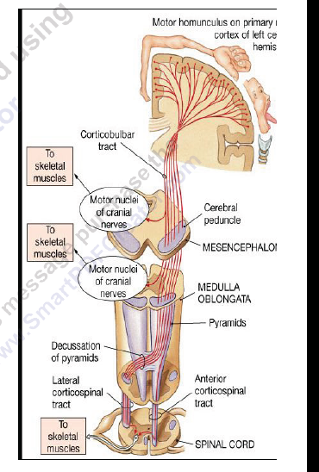
(3) STROKE
Cause :
Haemorrhagic stroke as in cerebral haemorrhage.
Ischaemic stroke as in thrombosis or embolism.
both cause death of brain tissues, results in paralysis in the opposite half of the body.
A lesion in Corona Radiata on one side can cause Monoplegia in a contralateral limb (UL or LL, according to site).
A lesion in the Internal Capsule on one side may cause Hemiplegia or Hemiparesis on the contralateralside ( with the picture of upper motor neuron syndrome )UMNL.
ONLY IN MALES’ SLIDES

Slide 12
(4) Complete transection of spinal cord
Ex: following tumor or trauma
The higher the level of the section, the more serious are the consequences.
If the transection is in the upper cervical region immediate death follows, due to paralysis of all respiratory muscles.
In the lower cervical region below the 5th cervical segment diaphragmatic respiration is still possible, but the patient suffers complete paralysis of all four limbs (quadriplegia).
Transection lower down in the thoracic region allows normal respiration but the patient ends up with paralysis of both lower limbs (paraplegia). الأطراف السفلية فقط))
Stages :- a. spinal shock ( 2-6 weeks ) b. recovery of reflex activity c. paraplegia in extension

Slide 13
A. Spinal shock In the immediate period following transection there is:
complete loss of spinal reflex activity below the level of the lesion .
Loss of all sensations (anesthesia) and voluntary movement ( paralysis) below the level of the lesion , due to interruption of all sensory and motor tracts
Loss of tendon reflexes and superficial reflexes (abdominal , plantar & withdrawal reflexes ) below the level of lesion
The loss of muscle tone (flaccidity) and absence of any muscle activity (muscle pump ) lead to decreased venous return causing the lower limbs to become cold and blue in cold weather.
The wall of the urinary bladder becomes paralysed and urine is retained until the pressure in the bladder overcomes the resistance offered by the tone of the sphincters and dribbling occurs. This is known as retention with overflow*.
Loss of vasomotor tone occurs, due to interruption of fibers that connect the vasomotor centres in the medulla oblongata with the lateral horn cells of the spinal cord, which project sympathetic vasoconstrictor impulses to blood vessels. vasodilatation causes a fall in blood pressure; the higher the level of the section, the lower the blood pressure.
Bedsores due to pressure of body-weight against underlining support
* ما عنده احساس ولا يقدر يحرك الجزء اللي يكون تحت منطقة الاصابه لانه يكون مقطوع.
**العضلة تكون مره ضعيفة ماتقدر تنقبض عشان تزيد الضغط، يعني كلما زادت كمية الurine بحيث يقدر يتجاوز التون حق السفيكتر رح يطلع.
This stage varies in duration but usually lasts a maximum of 2-6 weeks, after which some reflex activity recovers

Slide 14
B/ Stage of return of reflex activity
As the spinal shock ends , spinal reflex activity appears again this partial recovery may be due to :
Increase in the natural degree of excitability of the spinal cord neurons below the level of the section:
To make up for the loss of supraspinal facilitatory influences.
To sprouting of fibers from remaining other inputs. (عن طريق زيادة التفرعات)
Denervation supersensitivity to excitatory neurotransmitters.
Disinhibition of motoneurons as a result of absence of inhibitory impulses from higher motor centres.
Features of the stage of recovery of reflex activity:
Gradual rise of arterial blood pressure: due to return of spinal vasomotor activity in the lateral horn cells. But, since vasomotor control from the medulla is absent, the blood pressure is not stable.
Return of spinal reflexes:
Flexor reflexes return earlier than extensor ones.
Babiniski sign ( extensor plantar reflex) is one of the earliest signs of this stage +/- flexion reflex
- Tendon reflexes also recover earlier in flexors.
- As a result, flexor spastic tone causes the lower limbs to take a position of slight flexion, a state referred to as paraplegia in flexion. -The return of the stretch reflex ( & consequently muscle tone) , and vasoconstrictor tone in arterioles and venules , improve the circulation through the limbs.

Slide 15
Cont…
هنا يكون زي الاطفال لو جمع كمية من البول يقدر يطلعها بس مايتحكم فيها بس في السباينل شوك يكون لازم يجمع كميات كثيرة عشان ينزل Retention with over flow
(3) Recovery of visceral reflexes: return of micturition, defecation & erection reflexes.
However , voluntary control over micturition and defecation , and the sensation of bladder and rectal fullness are permanently lost. (Automatic micturition)
(4) Sexual reflexes, consisting of erection or ejaculation on genital manipulation , recover.
(5) Mass reflex appears in this stage :
A minor painful stimulus to the skin of the lower limbs will not only cause withdrawal of that limb but will evoke many other reflexes through spread of excitation (by irradiation) to many autonomic centers. So the bladder and rectum will also empty, the skin will sweat, the blood pressure will rise .
Since effective regeneration never occurs in the human central nervous system, patients with complete transection never recover fully.
Voluntary movements and sensations are permanently lost.
however, patients who are rehabilitated and properly managed may enter into a more advanced stage of recovery.

Slide 16
C/ Stage of extensor paraplegia
هنا ترجع الاكتسنسورز بعد الفلكسرز بس تكون اقوى منها وغالبا يصير يقدر يوقف
(1) During this stage the tone in extensor muscles returns gradually to exceed that in the flexors. The lower limbs become spastically extended.
Extensor reflexes become exaggerated, as shown by tendon jerks and by the appearance of clonus.
The positive supportive reaction becomes well developed and the patient can stand on his feet with appropriate support.
(2) The flexor withdrawal reflex which appeared in the earlier stage is associated during this stage with the crossed extensor reflex.

Slide 17
Hemisection of the Spinal Cord ( Brown-Sequard syndrome)
Occurs as a result of unilateral lesion or hemisection of the spinal cord ( e.g. due to stab injury, bullet , caraccident,or tumor).
The manifestations of the Brown-Sequard syndrome depend on the level of the lesion.( Let us take an example of such injury involving the thoracic spinal cord).
A. At the level of the lesion:
all manifestations occur on the same side:
1. Paralysis of the lower motor neuron type.
2. Loss of all sensations in the areas supplied by the afferent fibers that enter the spinal cord in the damaged segments +/- band of hyperesthesia.
3. Vasodilatation of the blood vessels that receive vasoconstrictor fibers from the damaged segment.
B. Ipsilaterally below the level of the lesion :
UMNL/spastic lower limb (spasticity) &CLONUS
هنا المسؤول الدورسال كولم اللي حيسوي كروس في الميدلا
2.Fine touch, position and vibration sense are lost.
3.Vasodilatation.
C. Contralaterally below the level of the lesion :
Pain and temperature sensations are lost.
هنا المسؤول هو السباينوثلامك تراكت وهو يسوي كروس بعد السكند اوردر نيورون في السباينل كورد

Slide 18
Thank you!
اعمل لترسم بسمة، اعمل لتمسح دمعة، اعمل و أنت تعلم أن الله لا يضيع أجر من أحسن عملا.
The Physiology 436 Team:
Team Leaders:
Lulwah Alshiha
Laila Mathkour
Mohammad Alayed
Females Members:
Anwar Alajmi
Lina alwakeel
Males Members:
Contact us:
References:
Females’ and Males’ slides.
Guyton and Hall Textbook of Medical Physiology (Thirteenth Edition.)

