Slide 1
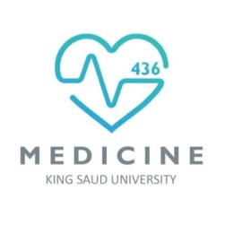

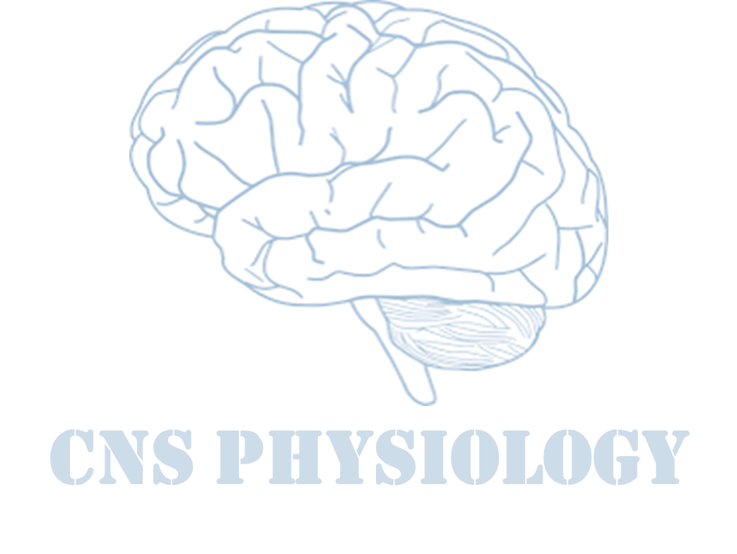

Text.
Important
Formulas
Numbers
Doctor notes
Extra notes and explanation
Lecture No. 23
« إنًّ معي ربي سيهدين »

Slide 2
Aging and changes in the brain
Objectives:
Definition of aging and its consequences
Theories and terms used
Body changes in aging
Describe Important clinical conditions
Brain changes in aging
Memory changes in aging
Carotid hypersensitivity
Elaborate Geriatric syndrome

Slide 3
What is aging ?
Successful aging
Aging is the progressive, universal decline first in functional reserve and then in function that occurs in organisms over time.
Aging is not a disease; however, the risk of developing disease is increased, often dramatically, as a function of age.
A Developmental issue. Healthy older persons are a resource for their families, their communities and economy”- WHO brasilia declaration on aging, July 1996.
Scientists used to try to stop ageing but this is impossible so they found out ways for successful ageing.
Active engagement with life
Low probability of disease or disability
High cognitive and physical function capacity
If we develop these function by deep mental thinking, we will increase the number of neurons and arborization.
Category | Interval
Elderly – Young old | 65 – 74
Aged – The middle old | 75 – 84
Very Old – Oldest old | 85+
ONLY IN MALES’ SLIDES

Slide 4
Aging terms
Universal aging: age changes that everyone shares (ex: Grey hair and wrinkles)
Probabilistic aging: age changes that may happen to some (ex: Type two diabetes).
Probabilistic from “probability”
Chronological aging: degrees of aging (ex: 50 decades different from 80).
Social aging: society's expectations of a person’s behavior as he/she grows older.
Biological aging: a person’s physical state as he/she ages.

Slide 5
Aging theories
Aging theories
Hypothesis | How it may work?
Genetic يبدأ الاجينج فيها من اليوم الاول في حياتنا بحيث تتغير اداء بعض الجينات واعدادها | Aging is a genetic program activated in post-reproductive life when an individual's evolutionary mission is accomplished.
Oxidative stress We relate a lot of diseases that we don’t know their etiology to oxidative stress that’s why they invented a lot anti oxidants. | Accumulation of oxidative damage to DNA, proteins, and lipids interferes with normal function and produces a decrease in stress responses.
Mitochondrial dysfunction | A common deletion in mitochondrial DNA with age compromises function and alters cell metabolic processes and adaptability to environmental change.
Hormonal changes زي الناس الي تنام وتصحى بدري يكون معدل عمل الهرمونات عندهم ممتاز | The decline and loss of circadian rhythm in secretion of some hormones produces a functional hormone deficiency state.

Slide 6
Cont.
Telomere¹ shortening | Aging is related to a decline in the ability of cells to replicate.
Defective host defenses | The failure of the immune system to respond to infectious agents and the over-activity of natural immunity create vulnerability to Infection.
Accumulation of senescent cells | Renewing tissues become dysfunctional through loss of ability to renew.
¹ The telomeres are special structures on the chromosome ends that are essential for providing protection from enzymatic end-degradation and maintaining chromosomal and genomic stability. This is the reason why adequate telomere structure (including the presence of telomere-binding proteins) remains pivotal for avoiding cellular dysfunction.

Slide 7
Doctors’ notes
Mitochondria uses its O2 to oxidize food residues such as glucose and fatty acids to generate oxygen and at this level the oxygen free radical generate such as super oxide and hydrogen free radicals which will damage the protein and DNA and affect the cell function.
Hormones have diurnal variation some are secreted at morning and others are secreted at night(during sleep).
Exmaple:
Corticosteroids are secreted at morning.
Melatonin is secreted at night.
Aging disturb the secretion of biological hormones.

Slide 8
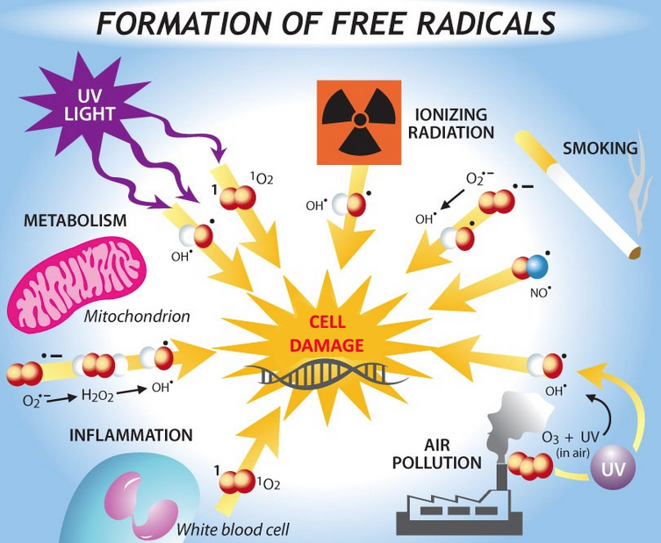
Oxygen free radicals (FR) and reactive oxygen species (ROS) resources
Cell metabolism.
Environment. (Radiation)
Lifestyle. (Smoking)
Pollution.
Diet.
Infection.
Oxygen free radicals and reactive oxygen species (ROS) come from many sources.
The most important for the cell is likely to be FR generated from oxidative phosphorylation in the mitochondrion respiratory chain.
ONLY IN MALES’ SLIDES

Slide 9
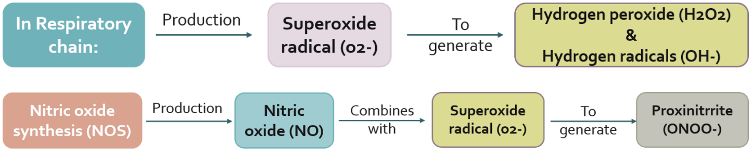
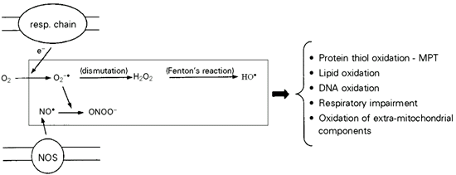
Mitochondria produce ROS
From 435
The respiratory chain produces superoxide radicals which generate peroxynitrite in the end after series of reactions.
All these ROS may cause mitochondrial and cellular damage if present in excess.. Vitamin E, Vitamin C and citation in green tea are factors that help increase antioxidants which will degrade oxygen free radicals.

Slide 10
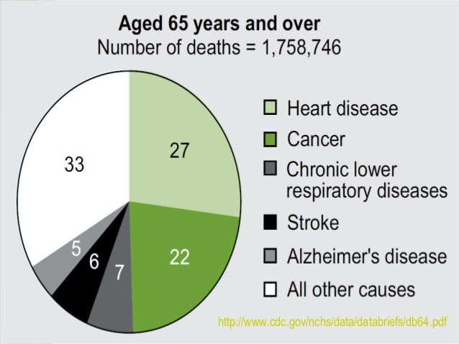
Leading causes of death age 65+
“medical diagnoses”
Heart disease | 32%
Cancer | 22%
Stroke | 8%
Chronic respiratory | 6%
Flu/pneumonia | 3%
Diabetes | 3%
Alzheimer's disease | 3%

Slide 11
Aging characterization and changes
Changes in appearance²
Related aging changes
Declines in kidney, pulmonary, and immune functions
A lower metabolic rate
That’s why gaining wait is easy
Increased
Decreased
Consequences in pharmacokinetics
Aging is characterized by
Declines in kidney, pulmonary, and immune functions
Longer reaction times
Body fat
Height
Due to decrease in Body muscle, bone and water
Lean body
A functional decline in audition, olfaction, and vision
Declines in certain memory functions
Declines in sexual activity and in women menopause
Body water

Slide 12
Aging in nervous system
Pink color refer to (ONLY IN FEMALES’ SLIDES)
Brown color refer to (ONLY IN Males’ SLIDES)
Aging in nervous system
Changes | consequences
Decreased brain weight | Drug toxicities
 | Delirium
Decreased Cerebral blood flow | Altered mood لذلك يكون عرضه اكثر لضعف في الذاكرة بسبب قلة السيريبرال بلود فلو Decreased IQ scores
Decreased Memory Just the short term memory بس الاشياء القديمة يقدر يتذكرها | Decreased IQ scores
Alteration in CNS neurotransmitters | “Benign senile forgetfulness”
Decreased vibratory sense | Increased postural instability
 | Altered gait
 | Falls, accidents

Slide 13
Aging in nervous system (structure-function related)
Structure | Regional function
Basal ganglia The iron that is accumulated in basal ganglia comes from the destruction from the RBCs that happens every day (this iron suppose to go to the iron storage in). | Becomes bright in appearance due to iron accumulation.
Subarachnoid space | Increase in size due to brain shrinkage.
Hippocampus | Reduction in size due to cell loss in the structure.
Ventricles | Increase in size due brain shrinkage.
Matter | Reduction in size due to neuronal atrophy in the deep brain.

Slide 14
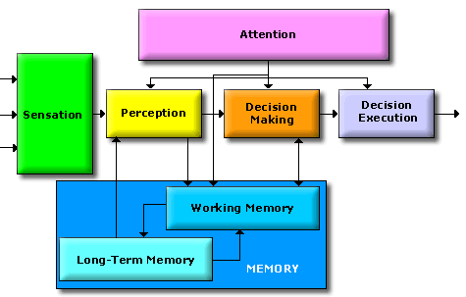
Cognitive changes in aging (mental processing)
Attention and Sensation are both included in three things : perception , decision making and decision execution. And all these can be affected or reduced with aging.
There are two types of memories known as:
Long-term memory.
Short-term memory: working memory.
مثال لطيف:
مثل لما صديقتي تلمسني واحس ان اللمسة لمسة حنيّنة والتفت واتذكر انها صديقتي من 10سنوات وينتج عني ردة فعل اني احضنها مثلا، ونقيس عليها اشياء كثير مثل لما نمسك حاجة ساخنة فإذا صار فيه خطأ في العملية راح ينتج تأخير في ردة الفعل او خطأ في الفعل نفسه.

Slide 15
Nervous system changes
What happens to the nervous system when we get older?
Aging leads to increased cerebral amyloid.
Average amount of brain protein is reduced with a marked loss in multiple enzymes (carbonic anhydrase and the dehydrogenases) but with a relative increase in abnormal proteins such as amyloid in tangles and plaques.
Loss of RNA (messenger and transcription) but not DNA.
Loss of lipids, and lipid turnover rate, and a decrease in catabolism and synthesis.
Neuronal loss is normal in the aging brain but the ability to learn remains generally unchanged.
There is loss of dendritic arborization^{3.}
Recall memory is affected more than cognitive function in normal aging.
Cerebral atrophy shows up on CTs and MRI scans.
Reduced Sympathetic nervous system activity.
Reduced Neurotransmitter levels. Ex: Dopamine, Serotonin, Glutamate (Intellectual functioning defined as “Stored” memory increases with age Problem solving skills increase with age).
Changes in sleep patterns.
Abnormalities in EEG tracings.
Increased risk of stroke.
Lowered seizure threshold.
لذلك نقدر نتعلم ايا كان عمرنا لكن المشكلة هي مشكلة الذاكرة وليست القدرة
على التعلم
So we have to differentiate between cognitive function and memory impairment

Slide 16
Geriatric⁴ syndromes
Dementia and delirium
Falls
Urinary incontinence
Pressure ulcers
Functional decline

Slide 17
Dementia and Delirium
Dementia and Delirium
Dementia | Delirium
Syndrome of progressive decline in which multiple intellectual abilities deteriorate , causing both cognitive and functional impairment. خرف يعني الفنكنشين حقت المخ متعطلة وتتبعها تعطل في الاعضاء | An acute state of confusion. It may be the only manifestation of a life-threatening illness in the older adult. e.g. infection, Drugs. May be because of a cerebral circulation dysfunction (e.g. cerebral stroke). يعني فجأة يفصل ويسألك انت مين او انا وين ؟

Slide 18
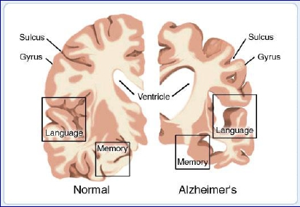
Alzheimer’s disease
Alzheimer’s disease is defined as premature aging of the brain, usually beginning in mid-adult life and progressing rapidly to extreme loss of mental powers similar to that seen in very very old age.
Features:
An amnesic type of memory impairment
Deterioration of language (loss of vocabulary and expressions).
Visuospatial deficits (Difficulties in identifying directions and shapes circle, square).
يعني مشكلة في الاتجاهات والاشكال وعلاقة الاشياء ببعضها لذلك كثير منهم يطلع من البيت وما يعرف يرجع
Motor and sensory abnormalities, gait disturbances, and seizures are uncommon until the late phases of the disease.

Slide 19
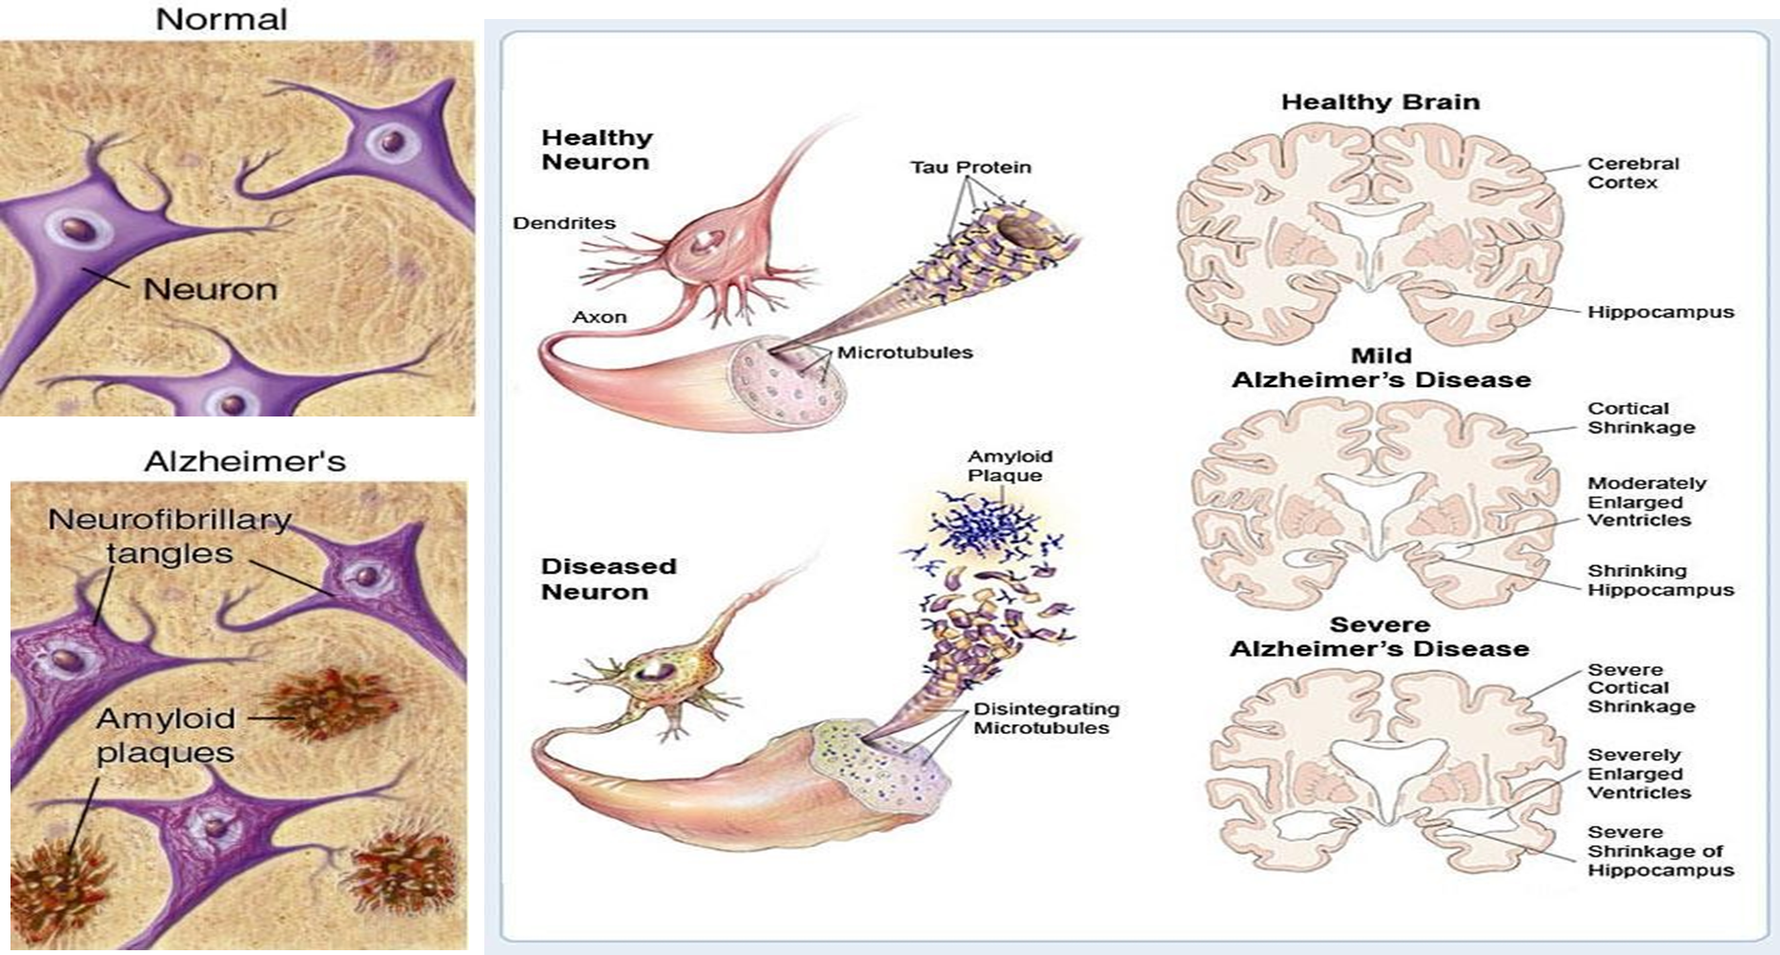
Cont.
لاحظوا كيف حجم الدماغ يقل مثل
White matter and cortex

Slide 20
Amyloid plaques
Neurofibrillary tangles
It is hallmark of Alzheimer's disease .
There is accumulation of amyloid plaques between nerve cells (neurons) in the brain.
Amyloid is a general term for protein fragments that the body produces normally.
Beta amyloid is a protein fragment snipped from an amyloid precursor protein (APP).
In a healthy brain, these protein fragments are broken down and eliminated. In Alzheimer's disease, the fragments accumulate to form hard, insoluble plaques.
It is normal to find amyloid plaques in the brain of a person who is 80 but when you see it in a person who is 40-50 this would be due to Alzahimer’s disease.
These are insoluble twisted fibers found inside the brain's cells. Consist primarily of a protein called tau, which forms part of a structure called a microtubule. The microtubule helps transport nutrients and other important substances from one part of the nerve cell to another.
In Alzheimer's disease, however, the tau protein is abnormal and the microtubule structures collapse.
يعني تشابكات بين النيوروفايبيرز

Slide 21
Control of blood pressure
Baroreceptor reflex
Cont.
ONLY IN MALES’ SLIDES
ONLY IN MALES’ SLIDES
Quick operation (within few second).
Mediated through autonomic nerves.
Adjusts CO & TPR to restore BP to normal.
Influence heart & blood vessels.
Pressure on the carotid sinus,
produced by the tight collar or carotid massage can cause:
  Vasodilatation
  Marked bradycardia
  Fainting or syncope
Short-term Control
(Rapid)
Baroreceptor reflex
Control of
blood pressure
Long-term Control
(Slow)
Renal compensation

Slide 22
Carotid sinus hypersensitivity
The ”Carotid sinus syncope” occurs: when there is an exaggerated vagal response to carotid sinus stimulation.
Carotid sinus hypersensitivity is provoked by:
wearing a tight collar,
looking upwards or turning the head.
Carotid sinus syndrome occurs in the elderly and mainly results in bradycardia. (Vasodilation)
Most common etiologies of atrioventricular block.
Do not massage both carotids simultaneously.
يصير فيه ديفيكت في الباروريسيبتر لذلك يتكون كاروتيد ساينس
*FROM 435
  Carotid sinus hypersensitivity (CSH) is an exaggerated response to carotid sinus baroreceptor stimulation. It results in dizziness or syncope from transient diminished cerebral perfusion. Although baroreceptor function usually diminishes with age, some people experience hypersensitive carotid baroreflexes. For these individuals, even mild stimulation to the neck results in marked bradycardia and a drop in blood pressure.

Slide 23
Vision
Loss of ability to see items that are close up begins in the 40’s (Presbyopia).
Size of pupil grows smaller with age: focusing becomes less accurate.
Pupil less sensitive to light.
Opacaification of lens (Cataract).
Lens of eye yellows making it more difficult to see red and green colors.
Sensitivity to glare increases.
Night vision not as acute.
Arcus Senilis.

Slide 24
Hearing
Presbycusis: Part of normal aging (35% people over 60 years of age have
bilateral, symmetric & progressive impairment for high pitched sounds
sensorineyral hearing loss).
Cerumen impaction: is one of the most common reversible cause of
condutive hearing loss in elderly.
Sensorineural hearing loss:
Damage to the hair cells of the organ of Cortimay be caused by intense noise,
viral infections, ototoxic drugs (e.g., salicylates, aminoglycoside antibiotics,
furosemide and chemotherapeutic agents such as cisplatin), fractures of the
temporal bone, meningitis, cochlear otosclerosis, Ménière's disease and Aging.
ONLY IN MALES’ SLIDES

Slide 25
Disorders of the sense and taste
Disorders of the sense and taste are caused by
Transport loss
Neural loss
Sensory gustatory loss
Sensory loss
Caused by:
Aging
Neoplasm
Endocrine disorders
Radiation therapy to the oral cavity and pharynx
A vast number of drugs particularly that interfere with the turnover such as antithyroid and antineoplastic agents
Inflammatory and degenerative diseases in the oral cavity and viral infection

Slide 26
Pain and sense of touch
With age, skin is not as sensitive as in youth.
Contributing factors include:
Loss of elasticity
Loss of pigment
Reduced fat layer
Safety Implications:
Lessened ability to recognize dangerous levels of heat
Lessened ability of body to maintain temperature
Tendency to develop bruises, skin tears more easily

Slide 27
Sexual dysfunction
ONLY IN FEMALES’ SLIDES
Erectile dysfunction (ED) is not considered a normal part of the aging process. Nonetheless, it is associated with certain physiologic and psychological changes related to age.
In the Massachusetts Male Aging Study (MMAS), a community-based survey of men between the ages of 40 and 70, 52% of responders reported some degree of ED. Complete ED occurred in 10% of respondents, moderate ED occurred in 25%, and minimal ED in 17%.

Slide 28
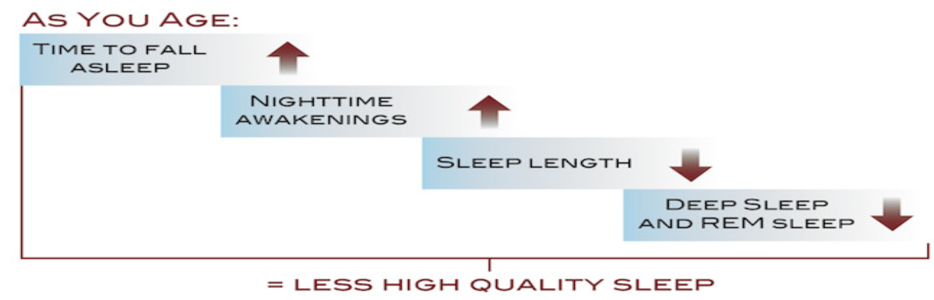
Sleep Patterns
It tends to become more fragmented, with more awakenings during the night.
Total sleep time stays the same or is slightly decreased (6.5 to 7 hours per night).
The transition between sleep and waking up is often abrupt, which between sleep and waking up is often abrupt, which makes older people feel like they are a lighter sleeper than when they were younger.
Three or four awakenings each night.
The proportion of slow wave sleep.
Decreases relative to total sleep time, but the proportion of sleep that is REM sleep ↓ or unchanged.

Slide 29
Brief geriatric assessment instruments
مو مطلوب حفظ الTests
بس اقرؤوها للاحتياط
Domain | Instrument | Comment
Cognition | - | -
Dementia | MMSE⁶ | Widely studied and accepted
 | Timed time and change test | Sensitive and quick
Delirium | CAM⁷ | Sensitive and easy to apply
Affective disorder | GDS⁸ 5-question form | Rapid screen
Visual impairment | Snellen chart | Universally used
Hearing impairment | Whispered voice | No special equipment needed
 | Pure tone audiometry | Can be performed by trained office staff
⁶ The Mini–Mental State Examination used extensively in clinical and research settings to measure cognitive impairment.
⁷ The Geriatric depression scale.
⁸ Geriatric depression scale.

Slide 30
Cont.
Domain | Instrument | Comment
Dental health | DENTAL^{C} | -
Nutritional status | Weight loss of >4.5 kg (>10 lb) in 6 months or weight | -
Gait and balance | "Timed Get Up and Go" test | Requires no special equipment

Slide 31






Thank you!
اعمل لترسم بسمة، اعمل لتمسح دمعة، اعمل و أنت تعلم أن الله لا يضيع أجر من أحسن عملا.
The Physiology 436 Team:
Team Leaders:
Lulwah Alshiha
Laila Mathkour
Mohammad Alayed
Females Members:
Reema Alshayea
Ghada Alhadlaq
Rania Alessa
Males Members:
Mohammed nasr
Contact us:
References:
Females’ and Males’ slides.
Guyton and Hall Textbook of Medical Physiology (Thirteenth Edition.)

