Slide 1


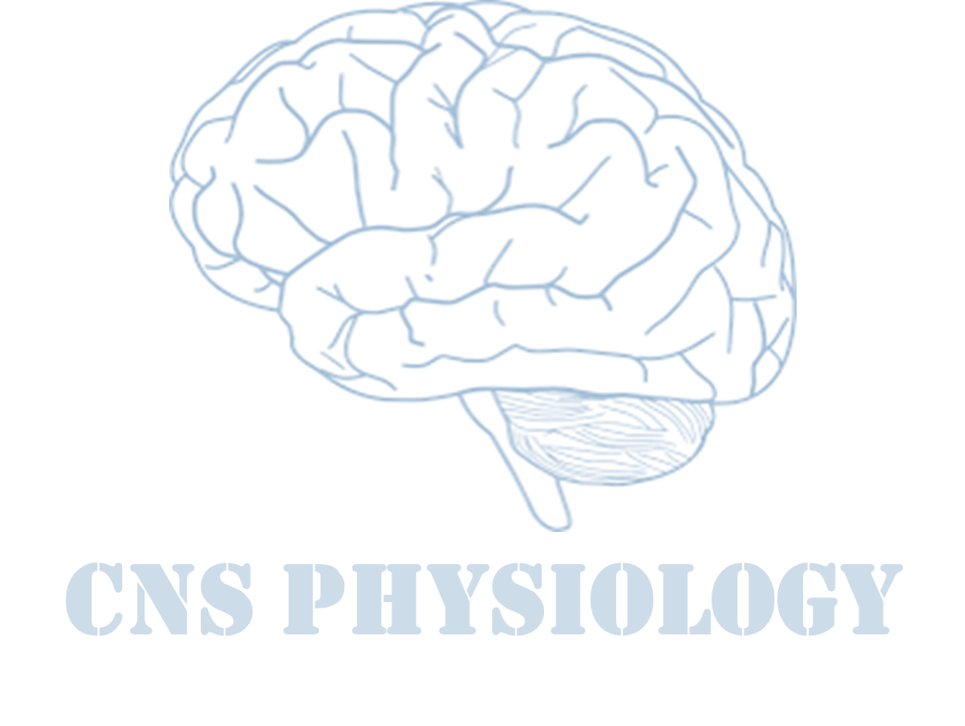

Text
Important
Formulas
Numbers
Doctor notes
Notes and explanation
Lecture No.24
“You Will Never Have This Day Again, So Make It Count ”.

Slide 2
UPPER & LOWER MOTOR NEURON LESION
Objectives:
Appreciate what is meant by upper and lower motor neurons and their functional anatomy
Explain and differentiate between features of lesions of the upper and lower motor neurons
Describe effects of lesions in pyramidal tracts
Describe effects of lesions in the internal capsule
Explain the manifestations of complete spinal cord transection and hemisection
Explain features of Brown Sequard Syndrome
Correlate the site of lesion with pattern of loss of sensations
Describe facial, bulbar and pseudobulbar palsy

Slide 3
introduction
ONLY IN MALES’ SLIDES
31 segments: embryological development → growth of cord lags behind → mature spinal cord ends at L1.
Upper cervical cord lesions produce quadriplegia and weakness of the diaphragm.
Lesions at C4-C5 produce quadriplegia.

Slide 4
Comaprison between upper & lower motor neuron lesions
ONLY IN MALES’ SLIDES
Two sets of neurons are important
Upper motor neurones
Lower motor neurones
Paralysis affect movements.
Wasting not pronounced.
Spasticity Muscles
hypertonic (Clasp Knife).
Tendon reflexes increased.
Superficial reflexes diminished.
Babinski’s sign +ve.
NCV- normal
No denervation potentials in EMG
Characteristic of upper motor neurone lesions:
no wasting.
Loss of skilled finger/toe movements
increased tone of claspknife Type.
weakness most evident
in anti-gravity muscles.
increased reflexes and clonus.
• extensor plantar responses.
Individual muscle or group of muscles are affected.
Wasting pronounced.
Flaccidity. Muscles hypotonic.
Tendon reflexes diminished or absent.
Ncv- abnormal
Denervation potentials in EMG (fibrillations)
Muscle contractures
Trophic changes in skin and nails.
Characteristic of upper motor neurone lesions:
Wasting.
Fasciculation (tapping produce it)
Decreased tone (i.E. Flaccidity)
Weakness.
Decreased or absent reflexes.
Flexor or absent plantar responses.

Slide 5
Cont.
ONLY IN MALES’ SLIDES

Slide 6
UMNs control lower LMNs through two different pathways
UMNs control lower LMNs through two different pathways
Pyramidal tracts
Extra pyramidal tracts
Lateral (Medullary) Reticulospial (powerfully suppress extensor spinal reflex activity).
Pontine Reticulospial
(facilitate extensor spinal reflexes).
Lateral vestibulospinal
(facilitate ipsilateral extensor motor neurons and gamma motor neurons)
Corticobular tract.
Medial vestibulospil (terminate at C3).
Rubrospinal tract
(facilitate flexor motor neurons).
Tectospinal
(terminate in upper cervical cord)
ONLY IN FEMALES’ SLIDES
Origin of extrapyramidal tracts: From area (6) and area (4) → descends to corpus striatum
→ Globus pallidus → from the globus pallidus fibers pass to:
1- Reticular formation 2- Vestibular nuclei 3- Red nucleus 4-Tectum of mibrain → these nuclei give the extrapyramidal tracts.

Slide 7
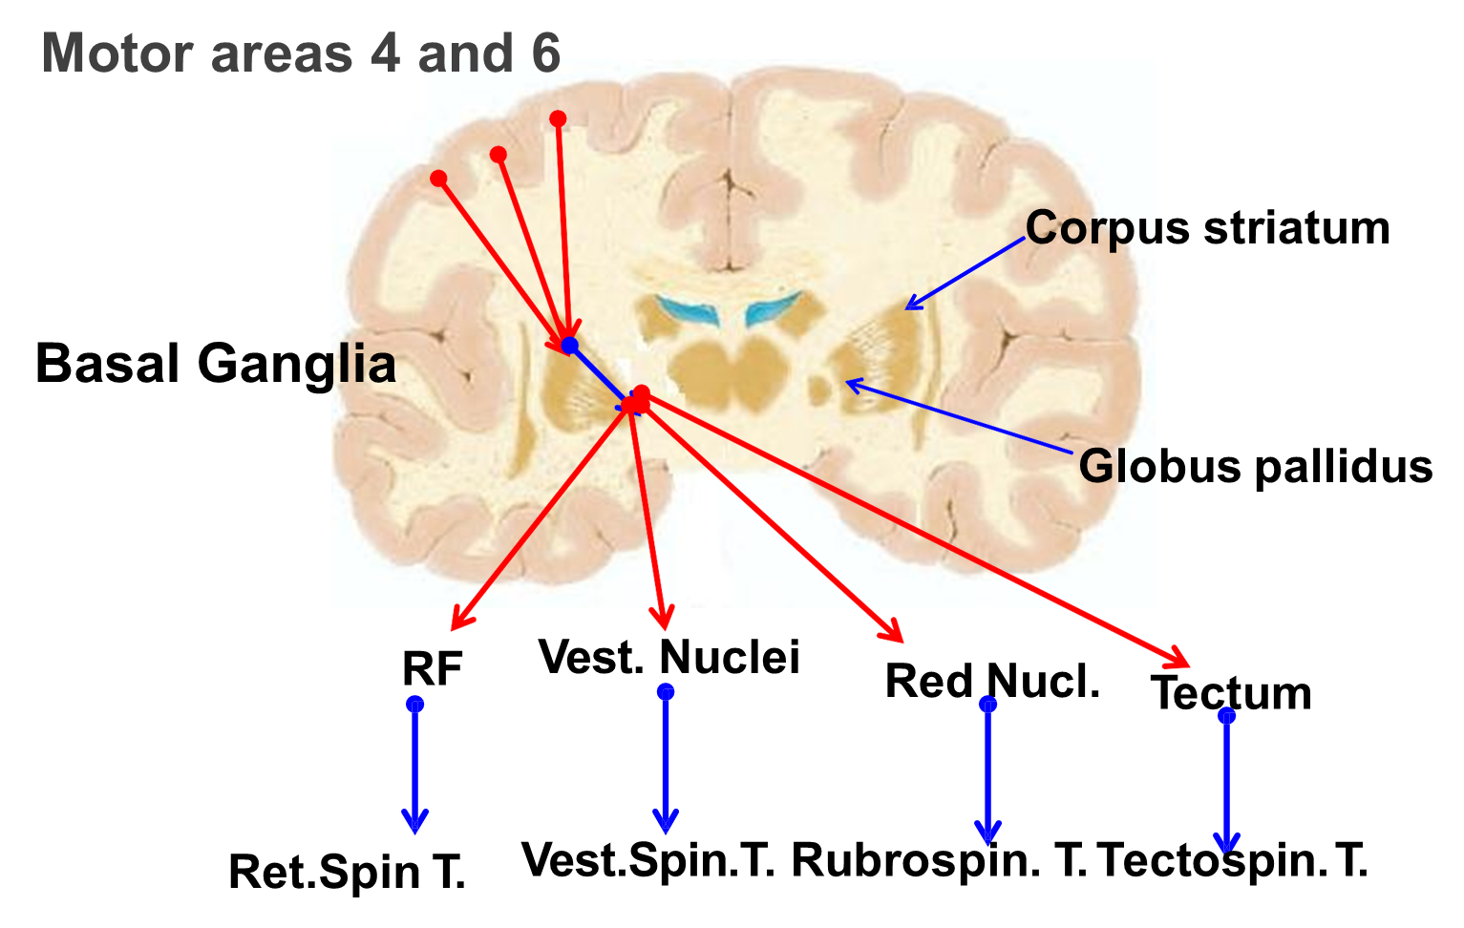
Extra pyramidal tracts
ONLY IN FEMALES’ SLIDES

Slide 8
UMNs control lower LMNs through two different pathways
Extra
UMNs control lower LMNs through two different pathways
Pyramidal tracts
Extra pyramidal tracts
There is > 1 million of fibers in each corticospinal tract.
97 % of these are small (<4 µm) and conduct background tonic signals to the the spinal cord.
Only 3% of the fibers are large:
(16 µm) fast conducting (Aβ-type).
These fibers originate from giant:
Betz cells ( 60 µm).
These cells are found only in:
the primary motor cortex.
There are about 34,000 of these large Betz cell fibers in each corticospinal tract.

Slide 9
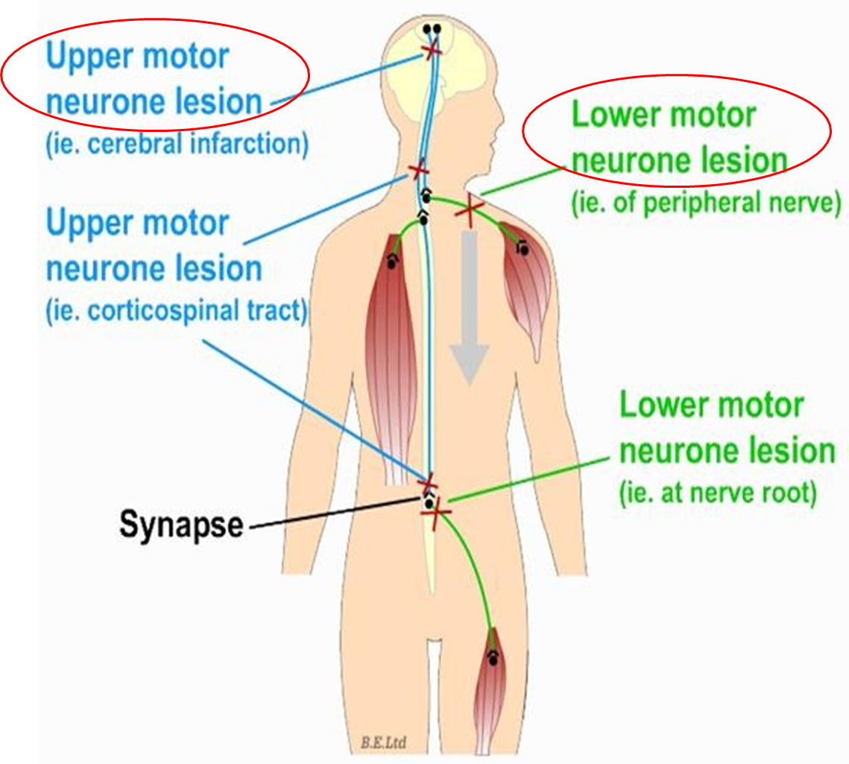
What are upper & lower motor neuron lesions?
ONLY IN FEMALES’ SLIDES
Lesions
UMNL
LMNL
Is a lesion of the descending neural pathway above the level of lower motor neurons.
Causes:
Trauma
Tumour
Vascular disorders as thrombosis or hemorrhage
Most common site is the internal capsule.
It is damage of the lower motor neurons (the spinal AHCS and the cranial motor nuclei or their axons) resulting in skeletal ms paralysis
Causes:
Trauma
Neuropathy
causes weakness (ipsilateral) of all facial
expression muscles. The angle of the mouth falls; unilateral
dribbling develops. Frowning (frontalis) and eye closure are
weak. Corneal exposure and ulceration occur if the eye does
not close during sleep.
cause weakness of the
lower part of the face on the opposite side. Frontalis is
spared: normal furrowing of the brow is preserved; eye
closure and blinking are largely unaffected. Lower motor
neurone (LMN) lesions.
ONLY IN MALES’ SLIDES
ONLY IN MALES’ SLIDES

Slide 10
Causes of upper & lower motor neuron lesions
ONLY IN FEMALES’ SLIDES
Causes of upper & lower motor neurons lesions
UMNL
LMNL
Cerebral stroke by haemorrhage (symptoms: depending on the site of injury, paralysis), thrombosis or embolism. The most common site is internal capsule.
Spinal lesion (transaction): tumor or trauma or hemosection (brown squared syndrome).
Anterior horn cell lesions (ex: poliomyelitis, motor neuron disease).
Why not posterior or lateral? Because posterior is sensory and lateral is autonomic.
Spinal root lesions or peripheral nerve lesion ( e.g. nerve injury by trauma or compressive lesion)
(Trauma, neuropathy)

Slide 11
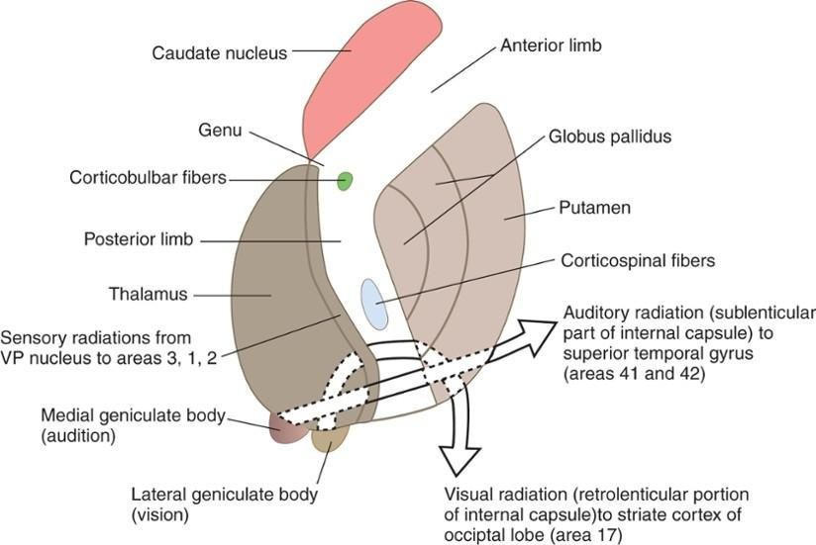
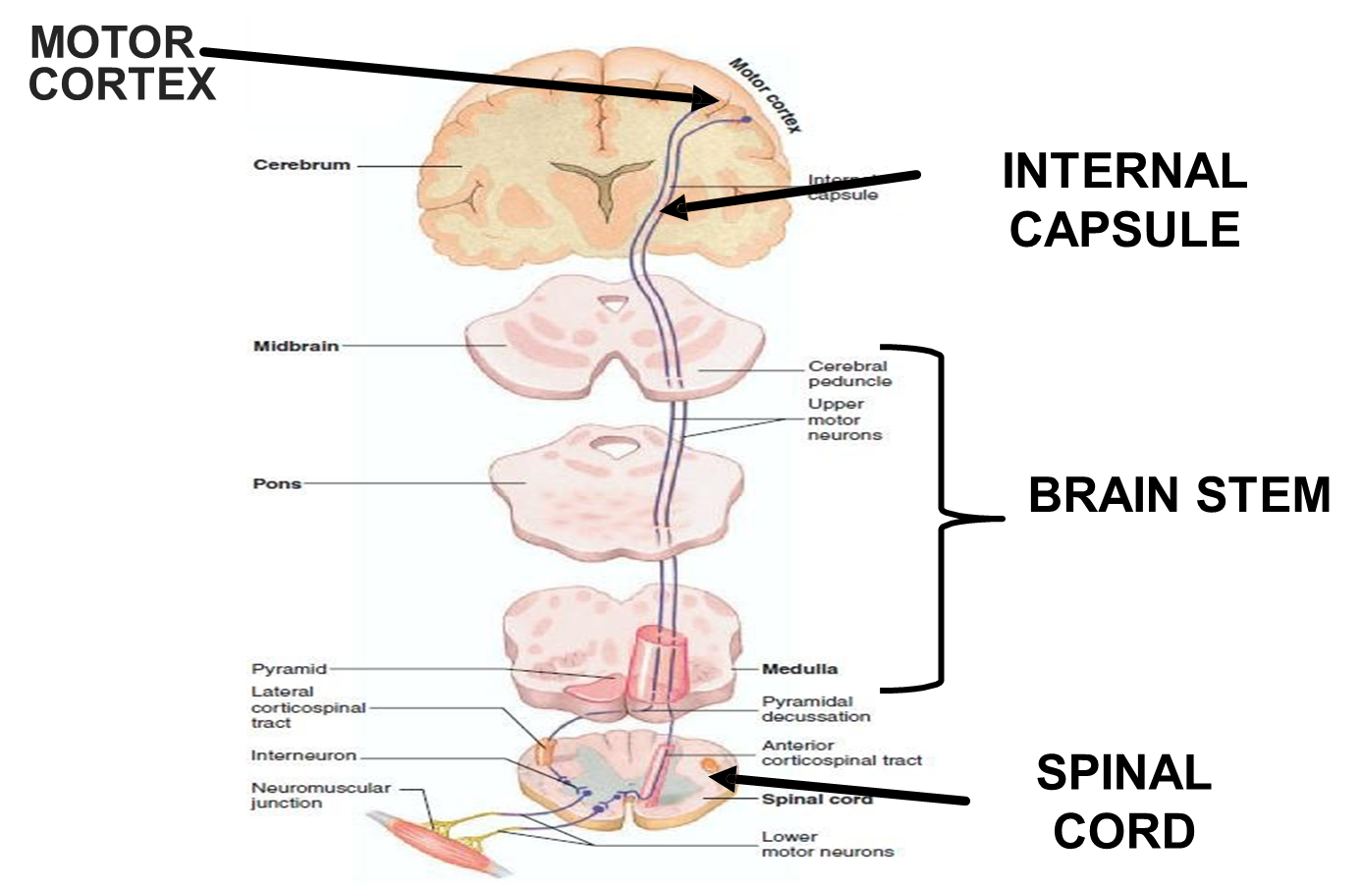
UMNL
ONLY IN FEMALES’ SLIDES
Internal Capsule

Slide 12
Hallmarks of motor neuron lesions
ONLY IN FEMALES’ SLIDES
As a doctor, you need to examine and diagnose the patient before he goes to the MRI or other investigations.
 | UMNL | LMNL
Extent of paralysis | Widespread (affects movements) | Localized (individual muscle or group of muscles are affected)
Site of paralysis | Opposite side to lesion (because of the decussation of fibers, e.g. pyramidal decussation) | Same side of lesion
Tone of muscles | Increased tone( hypertonia ) and spasticity clasp-knife spasticity | Decreased tone (hypotonia), flaccidity paralysis
Deep reflexes | Brisk ( exaggerated) tendon jerks (tendon reflexes) the reflex when examining with a hammer: very strong | Diminished or absent
Superficial reflexes | Absent, diminished | Absent
Planter reflex | Extensor plantar reflex , positive babinski sign ( dorsiflexion of the big toe and fanning out of the other toes ), or just an upgoing toe . | Flexor or absent
Muscle waisting | No marked muscle wasting , but minor wasting may occur due to (Di-use atrophy) Weakness most evident in antigravity muscles | Marked muscle wasting (atrophy)
Clonus | Clonus present ( rhythmic oscillation on tendon stretch ) لما نسوي له فليكشن يصير فيه تذبذبات | No clonus
Fasciculations (seen ) - fibrillation potentials by EMG | No fasciculations No fibrillation potential (no denervation potentials in EMG) | Fasciculations may be seen (tapping produce it) & Fibrillation by EMG (denervation potentials)
NCV (nerve conduction velocity) | Normal | Abnormal
Other |  | Muscle contractures and trophic changes in skin and nails

Slide 13
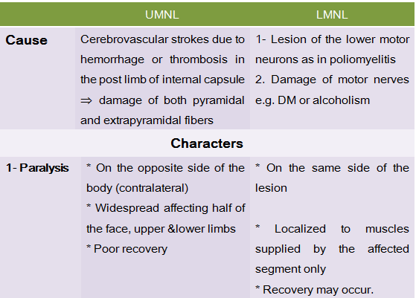
UMNL & LMNL
ONLY IN FEMALES’ SLIDES

Slide 14
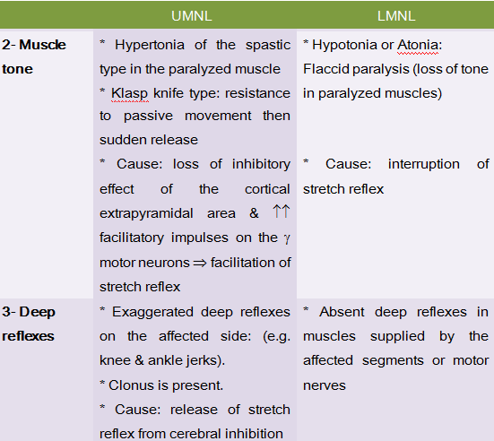
Cont.
ONLY IN FEMALES’ SLIDES

Slide 15
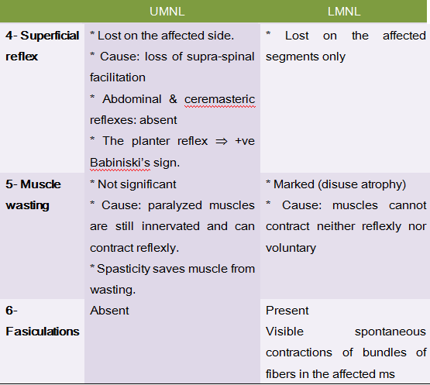
Cont.
ONLY IN FEMALES’ SLIDES

Slide 16
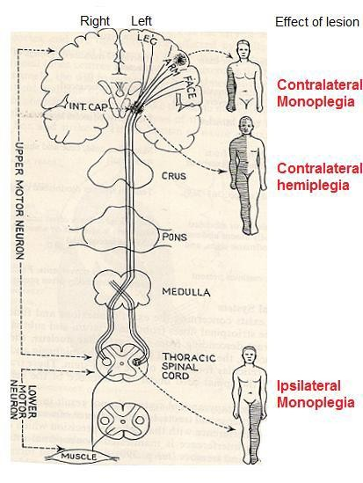
Effect of a lesion in different parts of the motor system
ONLY IN FEMALES’ SLIDES
Lesions of pyramidal tract cause paralysis of the UMNL type below the level of the lesion.
The side affected and the extent of paralysis vary according to the site of the lesion
Side affected | Extent of paralysis
Area 4 | Restricted paralysis (ex: Contralateral monoplegia, paralysis of one limb Because area 4 is widespread and is rarely damaged completely)
Corona radiata | This leads to contralateral monoplegia or hemiplegia, depending on the extent of the lesion.
Internal capsule | This often leads to contralateral hemiplegia because almost all fibers are injure
Brain stem | Contralateral hemiplegia & ipsilateral paralysis of the cranial nerves as follows: Midbrain lesion: the III and IV Pons lesion: V, VII and VIII. Medulla lesion: IX, X, XI and XII
Bilateral lesion in brain stem is rare and leads to quadriplegia and bilateral paralysis of the cranial nerves.

Slide 17
Effects of a unilateral lesion in posterior limb of internal capsule
Extra
Such lesion is called cerebral stroke.
It is usually caused by thrombosis or haemorrhage of lenticulo- striate artery (a branch of the middle cerebral artery).
Patients pass into an acute then chronic stage.
1- Acute stage
2- Chronic (permanent or spastic ) stage
lasts a few days up to 2-3 weeks. It is characterized by acute UMNL manifestations in the opposite side:
  Paralysis including the upper and lower limbs, the lower parts of the face and half of the tongue.
  Hemianaethesia (loss of all sensations, due to damage of the thalamocortical fibers).
  Hypotonia and areflexia & loss of the superficial reflexes.
  Babinski's sign may be present.
The main manifestations of this stage include:
Contralateral hemiplegia (paralysis of the opposite half of the body) of the UMNL type (partial recovery occurs after a variable period (possible walking), but the fine skilled movements are permanently lost).
Permanent loss of fine sensations in the opposite side, but the crude sensations recover gradually.
Contralateral homonymous hemianopia (loss of vision in the two corresponding haves of the visual fields opposite to side of lesion due to injury to optic radiation
Injury of left optic radiation causes blindness of the right halves of visual field
Diminished hearing power in both ears (by about 50 %), because of damage of auditory radiation.
Manifestations of this stage are similar to those of LMNL, but the extent of paralysis is much more than that of LMNL.

Slide 18
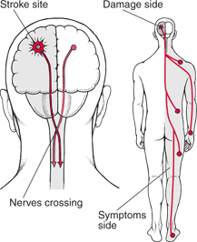
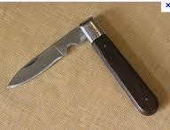
Damage of posterior limb of internal capsule (UMNL)
ONLY IN FEMALES’ SLIDES
Damage of posterior limb of internal capsule
Most commonly the posterior limb
Motor loss
(Hemiplegia) contralateral
Sensory loss
(Loss of somatic sensation, Vision and Hearing)
1- contralateral paralysis
2- contralateral paresis
3- spasticity (increased ms tone)
(loss of only voluntary movements) of the distal muscles of the limbs, lower facial muscles and muscles of the tongue.
(weakness i.e., the muscles retains some movements) of the axial muscles and upper facial muscles.
Axial ms: are supplied by descending motor tracts other than CBS whereas ms of the upper face are ipsilaterally innervated by CBS tract.
of the skeletal ms due to increased supraspinal facilitation to γ motor neurons.
A lesion at the level of internal capsule interrupts the descending inhibitory cortical fibers which feeds the inhibitory reticulospinal tract leaving the facilitatory
vestibulospinal and reticulospinal to act.
This spasticity is of the clasp-knife type
سكينة لما نفتحها تنفتح على طول، بس لما نسكرها بشكل بسيط ونترك تنفتح بسرعة بنفسها

Slide 19
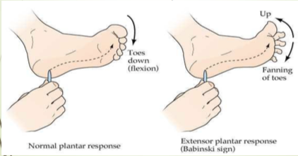
Cont.
ONLY IN FEMALES’ SLIDES
Damage of posterior limb of internal capsule
Motor loss
(Hemiplegia)
Sensory loss
(Loss of somatic sensation, Vision and Hearing)
4- Exaggerated tendon jerk & clonus
5- Positive Babinski's sign
6- Minimal atrophy
7- Normal response to electric stimulation
due to increased supraspinal facilitation.
The paralyzed ms show no or minimal atrophy as the lower motor neuron is intact and the ms contracts reflexly.
Normal response of the paralyzed ms to electric stimulation:
a) Faradic current produces clonic or tetanic contractions
b) Galvanic current produces contractions that occur only at closing (make) and opening (break) of the circuits.
CCC > ACC > AOC > COC

Slide 20
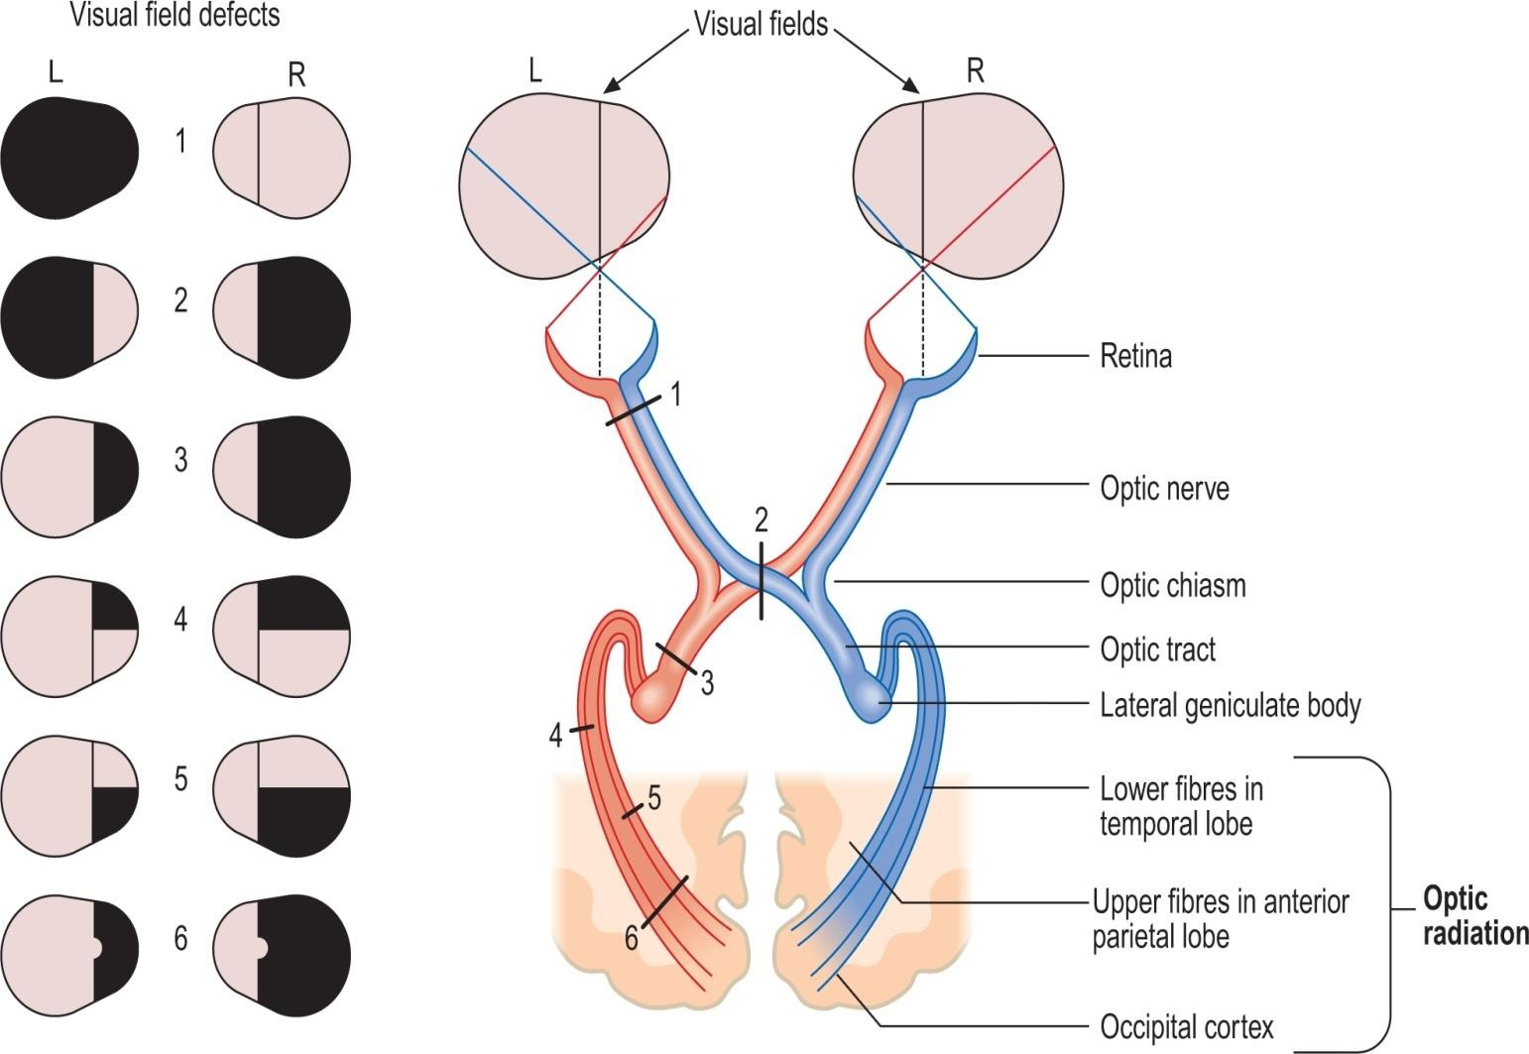
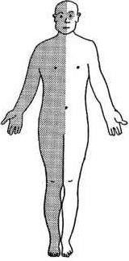
Cont.
ONLY IN FEMALES’ SLIDES
Damage of posterior limb of internal capsule
Motor loss
(Hemiplegia)
Sensory loss
(Loss of somatic sensation, Vision and Hearing)
Bilateral diminution
Contralateral homonymous hemianopia
Contralateral hemianaesthesia
Bilateral diminution of hearing acuity.
No complete loss of hearing as both ears are bilaterally represented in both cortices.
Loss of vision in the two opposite halves of the field of vision.
Loss of all sensations on the opposite side of the body.
Important: Complex and overlapping function exist between Pyramidal and extra pyramidal systems for example while doing fine work like needle work (Pyramidal system) one has to subconsciously assume a particular posture of arms( extra pyramidal system) that enables to do your work

Slide 21
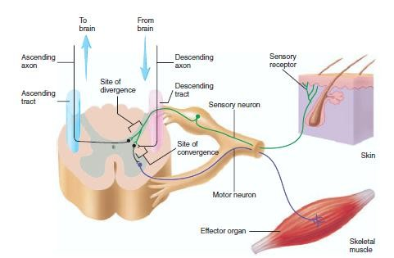
Spasticity
ONLY IN FEMALES’ SLIDES
Facilitatory RF and VST
Inhibitory RF

Slide 22
Remember
ONLY IN MALES’ SLIDES

Slide 23
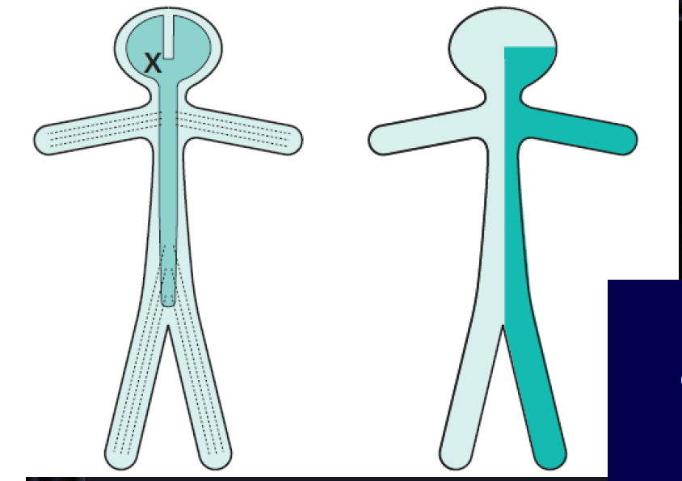
Comparison
ONLY IN MALES’ SLIDES
Contralateral monoparesis | A lesion situated peripherally in the cerebral hemisphere, i.e. involving part of the motor homunculus only, produces weakness of part of the contralateral side of the body, e.g. the contralateral leg. If the lesion also involves the adjacent sensory homunculus in the postcentral gyrus, there may be some sensory loss in the same part of the body.
Contralateral hemiparesis | Lesions situated deep in the cerebral hemisphere, in the region o the internal capsule, are much more likely to produce weakness of the whole of the contralateral side of the body, face, arm and leg Because of the funnelling of fibre pathways in the region of the internal capsule, such lesions commonly produce significan contralateral sensory loss(hemianaesthesia) and visual loss (homonymous hemianopia), in addition to the hemiparesis.

Slide 24
Cont.
ONLY IN MALES’ SLIDES
Ipsilateral hemiparesis | A unilateral high cervical cord lesion will produce a hemiparesis similar to that which is caused by a contralateral cerebral hemisphere lesion, except that the face cannot be involved in the hemiparesis, vision will be normal, and the same dissociation of sensory loss (referred to above) may be found below the level of the lesion.
A spinal cord lesion more usually causes upper motor neurone signs in both legs, often asymmetrically since the pathology rarely affects both sides of the spinal cord equally…
Paraparesis | Paraparesis, if the lesion is at or below the cervical portion of the spinal cord.

Slide 25
Cont.
ONLY IN MALES’ SLIDES
Ipsilateral monoparesis | A unilateral lesion in the spinal cord below the level of the neck produces upper motor neurone weakness in one leg. There maybe posterior column (position sense) sensory loss in the same leg, and spinothalamic (pain and temperature) sensory loss in the contralateral leg. This is known as dissociated sensory loss, and the whole picture is sometimes referred to as the Brown-Séquard syndrome.
Tetraparesis or quadriparesis | Tetraparesis or quadriparesis, if the lesion is in the upper cervical cord or brainstem.

Slide 26
Cont.
ONLY IN MALES’ SLIDES
Generalized LMN weakness | Generalized LMN weakness may result from pathology affecting the LMNs throughout the spinal cord and brainstem, as in motor neuron disease or poliomyelitis. Generalized limb weakness (proximal and distal), trunk and bulbar weakness characterize this sort of LMN disorder.
 | Generalized LMN weakness may also result from widespread damage to the axons of the LMNs. This is the nature of peripheral neuropathy (also called polyneuropathy). The axons of the dorsal root sensory neurons are usually simultaneously involved. The LMN weakness and sensory loss tend to be most marked distally in the limbs.

Slide 27
Cont.
ONLY IN MALES’ SLIDES
LMN weakness of one spinal root | LMN weakness may be confined to the distribution of one spinal root (above) or one individual peripheral nerve (below). In such circumstances, the LMN signs are found only in the muscles supplied by the particular nerve root or peripheral nerve in question. Almost always there is sensory impairment in the area supplied by the nerve or nerve root. Examples of such lesions are an S1 nerve root syndrome caused by a prolapsed intervertebral disc, or a common peroneal nerve palsy caused by pressure in the region of the neck of the fibula.

Slide 28
Remember
ONLY IN MALES’ SLIDES
Motor neuron diseases
Selectively affect motor neurons, that control voluntary muscle activity
Amyotrophic lateral sclerosis
UMN + LMN
Primary lateral sclerosis
UMN
Progressive muscular atrophy
LMN
Bulbar palsy- bulbar
LMN
Pseudobulbar palsy- bulbar
UMN
Spinal cord
Transverse myelitis
Anterior spinal artery syndrome
Brown-Sequard syndrome
Upper sensory level for all sensations,
LMN signs at the level of lesion, flaccid paralysis (spinal shock)UMN signs distally, Bladder/Bowel involved
Upper sensory level for pain/temperature, sparing of posterior columns, UMN signs distally
I/L spastic paralysis & loss of joint/position sense, C/L loss of pain/temperature sensation

Slide 29
Damage of lower motor neuron (LMNL)
ONLY IN FEMALES’ SLIDES
Damage of lower motor neuron (LMNL)
Structural changes
Functional changes
In Nerve (degeneration and regeneration
In muscle (atrophy and increase Ach receptors
Flaccid paralysis
Fasciculation and fibrillation
Dennervation supersensitivity
Reaction of degeneration

Slide 30
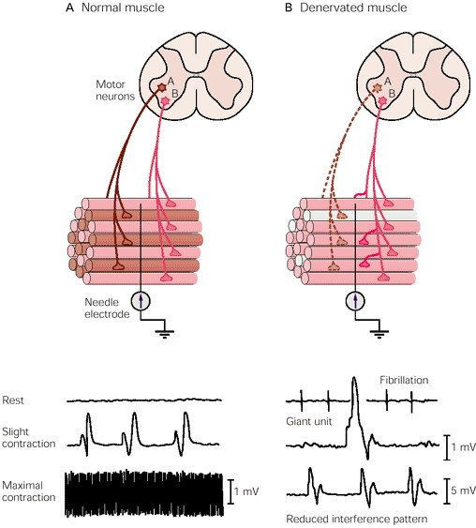
Cont. Functional changes
ONLY IN FEMALES’ SLIDES
Flaccid paralysis:
  Paralysis of denervated ms with loss of all types of movements, "voluntary, postural and reflex".
  All reflexes are lost including stretch reflex resulting in loss of ms tone and tendon jerk (flaccidity).
  The extent of paralysis is usually limited to a small group of ms.
Fasiculations and fibrillations:
  Appears few days or weeks after denervation.
  Disappear when the motor nerve completely degenerates or successful re-innervation of the ms occurs.
Fasiculations:
  Synchronous visible contraction of the motor unit (all ms fibers) supplied by the injured axon.
  Result from spontaneous generation of action potential (injury potentials) in distal segment of the injured axon.
Fibrillations:
  As degeneration of the injured
  axon continues, the axon terminals
  are now separate from the main
  axon and hence, from each other.
  Injury potentials are still
  generated along the terminals leading to asynchronous contraction of the individual ms fibers attached to terminals.
  Invisible to the observer and detected only by EMG (Electromyogram).
Denervation supersensitivity:
  Denervated ms becomes supersensitive to acetylcholine.
  This is due to increase in the number of A.Ch. receptors which cover the entire surface of ms cell membrane.

Slide 31
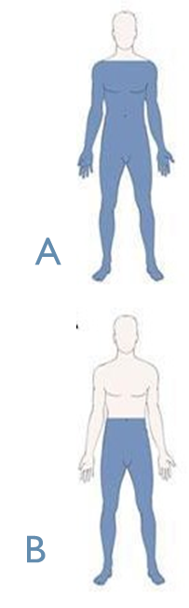
Transection of spinal cord
The effects of spinal cord transection are dependent on whether it is
Complete transection
Hemisection
The effects of complete transection of the spinal cord (e.g. tumor or trauma) vary according to
the level of transection.
In the upper cervical region immediate death follows, due to paralysis of all respiratory muscles
Voluntary movements and sensations are permanently lost.
In lower cervical region below C5
Quadriplegia
(paralysis in 4 limbs, A)
A. Spinal shock (2-6 weeks )
In the thoracic
region
Paraplegia
(paralysis in both Lower limbs, b)
B. Recovery of reflex activity
C. Paraplegia in extensors

Slide 32
Paraplegia Stages
Extra
Paraplegia Stages
A. Spinal shock (2-6 weeks )
B. Recovery of reflex activity
C. Paraplegia in extensors
loss of sensations accompanied by motor paralysis with initial loss but gradual recovery of reflexes Immediately following transection there is:
Paralysis of all muscles below the lesion.
Loss of reflexes and loss of tone (flaccidity).
Loss of all sensations (anaesthesia) and voluntary movements below the level of the lesion due to interruption of all sensory and motor tracts.
Loss of muscle tone (flaccidity), and vasomotor tone (vasodilation) leading to fall in blood pressure.
Bladder urinary retention with overflow due to paralysis of the wall of the urinary bladder.
Cause of spinal shock:
sudden withdrawal of supraspinal facilitation on the spinal alpha motor neurons i.e loss of continual tonic discharge transmitted along the excitatory pontine reticulospinal, vestibulospinal and corticospinal tracts.

Slide 33
Cont.
Extra
Paraplegia Stages
A. Spinal shock (2-6 weeks )
B. Recovery of reflex activity
C. Paraplegia in extensors
As the spinal shock ends, spinal reflex activity returns.
The partial recovery may be due:
Increased excitability of the spinal cord neurons presumably to compensate for the loss of supraspinal facilitatory influences.
Disinhibition of motor neurons as a result of absence of inhibitory impulses from higher motor centers.
Hypersensitivity to excitatory neurotransmitters.
Features of this stage:
Gradual rise of arterial blood pressure due to return of spinal vasomotor activity in the lateral horn cells.
Exaggerated tendon reflexes and spasticity.
Return of visceral reflexes (micturition & defecation).
Mass reflex: a minor painful stimulus to the skin of the lower limbs causes:
o Withdrawal and evoke other autonomic reflexes (bladder and rectum emptying, sweating , blood pressure rise through spread of excitation (by irradiation)
Voluntary movements and sensations are permanently lost
Human patients with complete transection never recover fully because effective regeneration never occurs in the human`s CNS.

Slide 34
Cont.
Extra
Paraplegia Stages
A. Spinal shock (2-6 weeks )
B. Recovery of reflex activity
C. Paraplegia in extensors
The tone in extensor muscles returns gradually to exceed that in the flexors.
The lower limbs become spastically extended.
Extensor reflexes become exaggerated, as shown by tendon jerks and by the appearance of clonus.
The positive supportive reaction returns and the patient can stand on his feet with appropriate support.
Return of the withdrawal reflex and crossed extensor reflex.

Slide 35
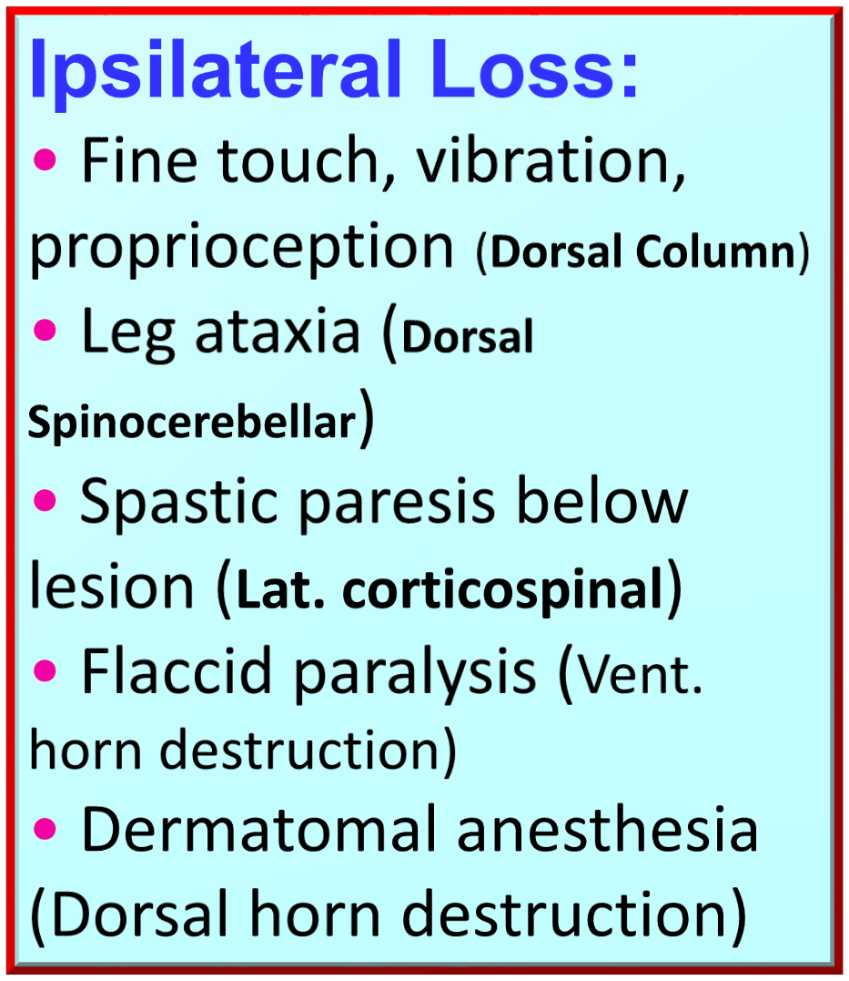
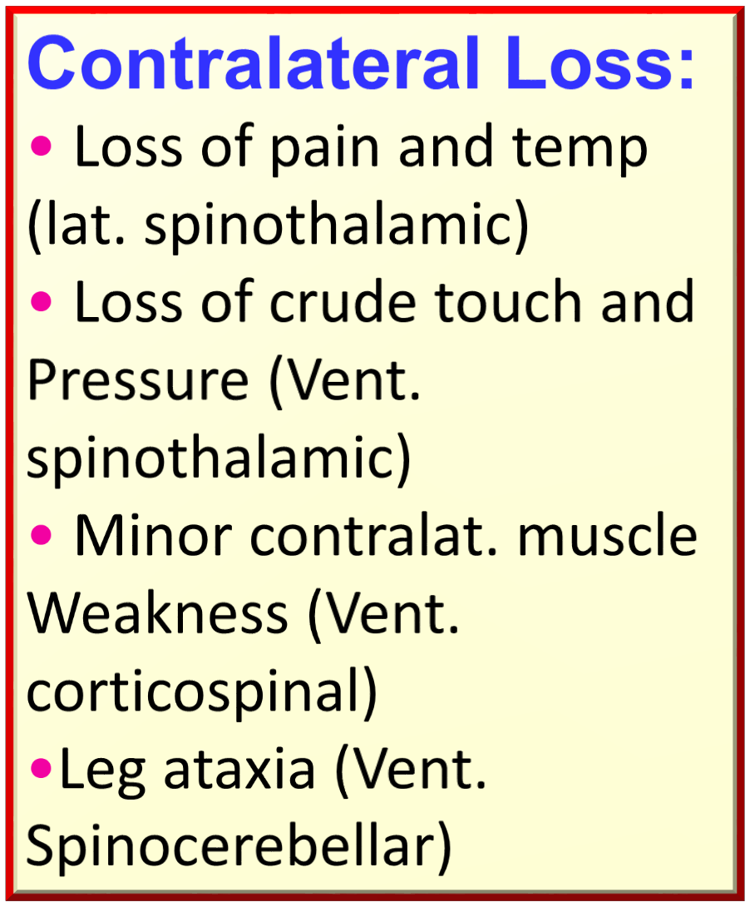
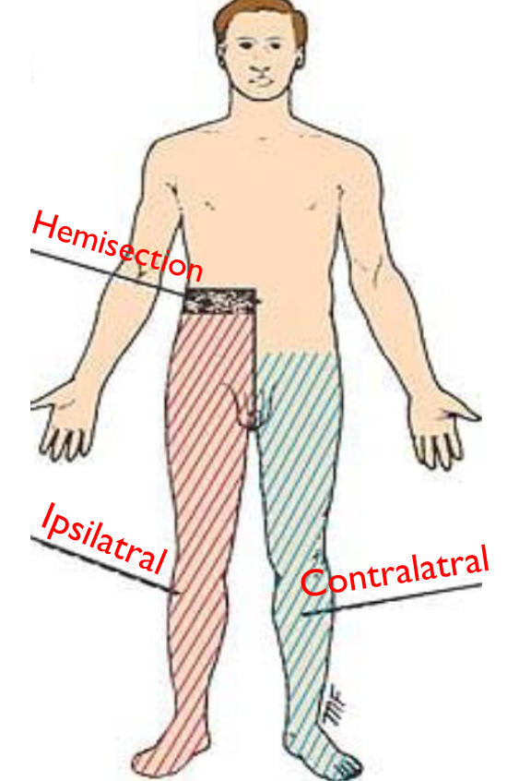
Transection of spinal cord
ONLY IN MALES’ SLIDES
The effects of spinal cord transection are dependent on whether it is
Complete transection
Hemisection
Brown-Séquard syndrome: hemisection of spinal cord (hemiparaplegic syndrome).E.g stab injury, bullet, tumor, car accident.

Slide 36
Cont.
ONLY IN MALES’ SLIDES
Ipsilateral lower motor neuron paralysis in the segment of the lesion and muscular atrophy. These signs are caused by damage to the neurons on the anterior gray column and possibly by damage to the nerve roots of the same segment.
Ipsilateral spastic paralysis below the level of the lesion.
  An ipsilateral Babinski sign is present, and depending on the segment of the cord damaged, an ipsilateral loss of the superficial abdominal reflexes and cremasteric reflex occurs.
  All these signs are due to loss of the corticospinal tracts on the side of the lesion. Spastic paralysis is produced by interruption of the descending tracts other than the corticospinal tracts.
Ipsilateral band of cutaneous anesthesia in the segment of the lesion. This results from the destruction of the posterior root and its entrance into the spinal cord at the level of the lesion.
Ipsilateral loss of tactile discrimination and of vibratory and proprioceptive sensations below the level of the lesion. These signs are caused b destruction of the ascending tracts in the posterior white column on the same side of the lesion.
Contralateral loss of pain and temperature sensations below the level of the lesion. This is due to destruction of the crossed lateral spinothalamic tracts on the same side of the lesion.
  Because the tracts cross obliquely, the sensory loss occurs two or three segments below the lesion distally.
Contralateral but not complete loss of tactile sensation below the level of the lesion. This condition is brought about by destruction of the crossed anterior spinothalamic tracts on the side of the lesion. Here, again, because the tracts cross obliquely, the sensory impairment occurs two or three segments below the level of the lesion distally. The contralateral loss of tactile sense is incomplete because discriminative touch traveling in the ascending tracts in the contralateral posterior white column remains intact.

Slide 37
Comparison between bulbar and pseudobulbar palsy
ONLY IN MALES’ SLIDES
Bulbar palsy | Psedobulbar palsy
B/L LMN defect of IX-XII cranial nerves | B/L UMN defect of IX-XII cranial nerves
Dysphagia (liquid>solid), nasal regurgitation, slurred speech | Dysphagia, dysarthria, emotional lability
Nasal speech, wasted tongue with fasciculation, absent gag reflex | Slow indistinct speech, spastic tongue, brisk jaw jerk Frontal release signs

Slide 38
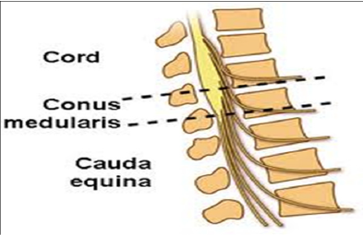
Cauda equina and conus medullaris lesions
ONLY IN MALES’ SLIDES
Conus medullaris | cauda equina
B/L saddle anaesthesia | asymmetric leg weakness and sensory loss
Prominent bowel, bladder symptoms, impotence | Relative sparing of bowelbladder function
Bulbocavernous ( S2-s4) and anal reflexes (s4-s5) are absent | Variable areflexia in lower extremities
Muscle strength largely preserved | Low back and radicular pain

Slide 39
Extramedullary and intramedullary syndromes
ONLY IN MALES’ SLIDES
Extramedullary lesions | Intramedullary lesion
radicular pain is often prominent there is early sacral sensory loss (lateral spinothalamic tract) spastic weakness in the legs (corticospinal tract) due to the superficial location of leg fibers in the corticospinal tract Early UMN signs | Tend to produce poorly localized burning pain rather than radicular pain Spare sensation in the perineal and sacral areas ("sacral sparing"), reflecting the laminated configuration of the spinothalamic tract with sacral fibers outermost; corticospinal tract signs appear later. Late UMN signs

Slide 40






Thank you!
اعمل لترسم بسمة، اعمل لتمسح دمعة، اعمل و أنت تعلم أن الله لا يضيع أجر من أحسن عملا.
The Physiology 436 Team:
Team Leaders:
Lulwah Alshiha
Laila Mathkour
Mohammad Alayed
Females Members:
Amira Niazy
Rana Barasain
Dania Alkelabi
Heba Alnasser
Amal Alshaibi
Males Members:
Basel Almeflh
Contact us:
References:
Females’ and Males’ slides.
Guyton and Hall Textbook of Medical Physiology (Thirteenth Edition.)

