Slide 1
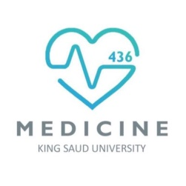
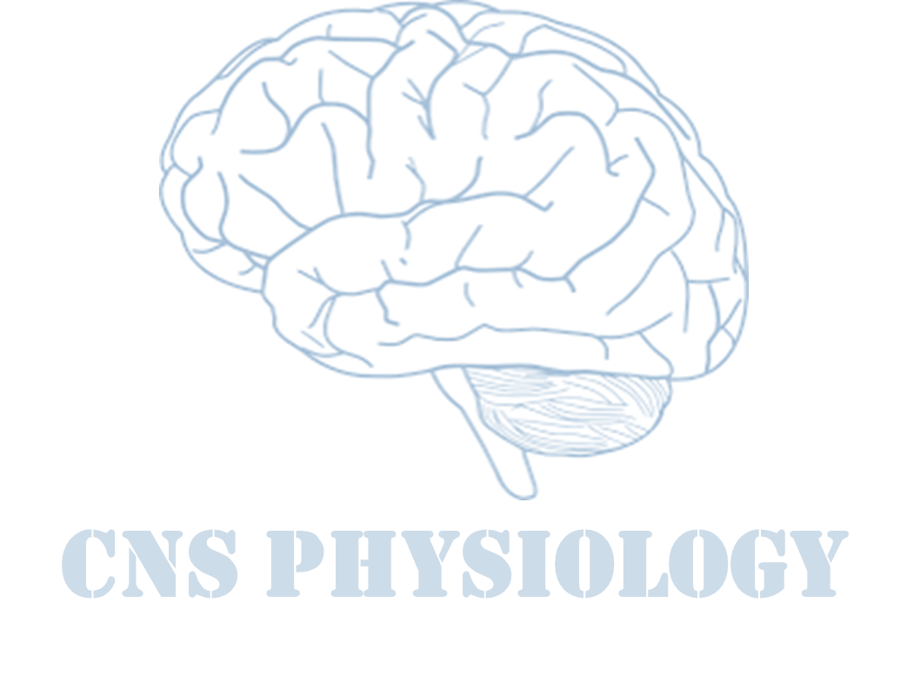
Text
Important
Formulas
Numbers
Doctor notes
Notes and explanation
Lecture No.25
“If It Doesn’t Challenge You, It Won’t Change You”

Slide 2
Brain Neurotransmitters
Objectives:
1-Describe the functions of glutamergic system
2- Describe the functions of NTs of the brain stem
(the noradrenergic & serotonergic systems)
3-Describe the functions of NTs of the basal ganglial (cholinergic, dopaminergic, GABAergic systems)
4-Appreciate that many drugs and CNS disorders affect function of brain neurotransmitters

Slide 3
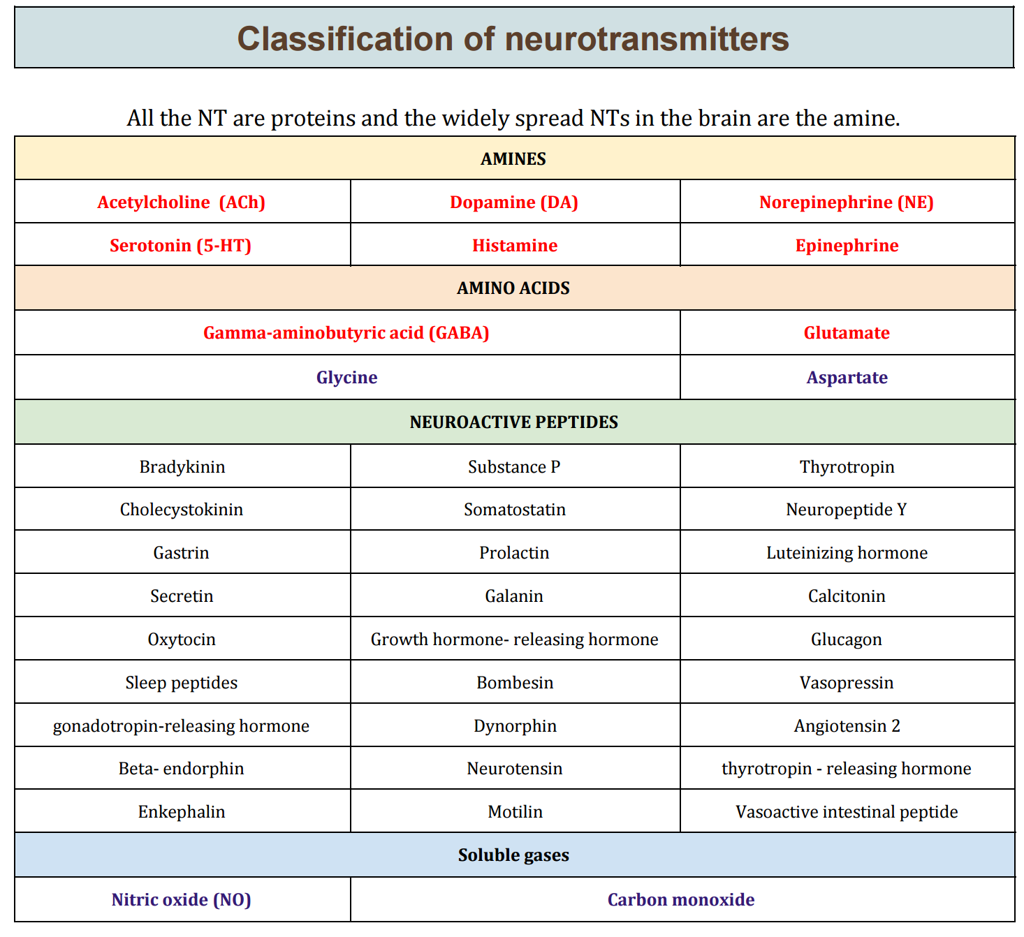
Definition & Classification of Neurotransmitters
Chemical substances released by electrical impulses into the synaptic cleft from synaptic vesicles of presynaptic membrane
Diffuses to the postsynaptic membrane
Binds to and activates the receptors
Leading to initiation of new electrical signals or inhibition of the post-synaptic neuron
Amines are small molecule neurotransmitters
Amino Acids are large molecule NTs
Nitric oxide, Carbon monoxide and hydrogen sulfide are gaseous neurotransmitters
Team435 physiology

Slide 4
Classes of receptors
Extra
Criteria that Define a Substance as a NT
The substance must be present within the pre-synaptic neuron
Enzymes & precursors are present in pre-synaptic neuron
The substance must be released in response to depolarization
The release must be Ca²⁺ dependent
Specific receptors must be present on the postsynaptic cell
Substances are referred to as "putative" neurotransmitters if they follow some but not all criteria
A neurotransmitter requires a target
Metabotropic | Ionotropic
transmembrane receptor acts through a secondary messenger | Ligand gated ion channel

Slide 5
Synthesis & Recycling of Small- Molecule Neurotransmitters
Extra
Synthesis & Recycling of Neuropeptides
In the neuronal cell body
Enzymes are produced
In the axon
Enzymes transported by slow axonal transport
Within presynaptic terminal cytoplasm
Enzymes & precursors are needed to synthesize NTs
In the vesicles
At synaptic cleft
NTs are released and taken up into the nerve terminal
NTs are loaded into the synaptic vesicle via transporters
40 to 60 NTs
small clear-core vesicle
At the cell body
Peptide NTs (pro-peptides) & enzymes are synthesized
In the golgi apparatus:
Enzymes and pro-peptides are packaged into vesicles
In the axon
Fast axonal transport of these vesicles to the synaptic terminals
At the terminal
vesicles
Large dense-core vesicles
On stimulus
Vesicle fusion and exocytosis
In the synaptic cleft
the peptides diffuse or degraded by enzymes
Enzymes modify pro-peptides
Fast axonal transport 50-400
mm/day
Less than 8 mm/day

Slide 6
How are neurotransmitters released
Extra
Some of NTs Systems in the Brain
Noradrenergic system (Noradrenaline)
Cholinergic system (Acetylcholine)
Glutamergic system (Glutamate)
GABAergic system (GABA)
Serotoninergic system (Serotonin)
Dopaminergic system (Dopamine)

Slide 7
1) norepinephrine system
The Locus Coeruleus / Nucleus Coeruleus
Location: Nucleus Coeruleus is in the pons.
Responds/activated: by stress and panic (physiological)
Co-ordinates responses via: projections to thalamus, cerebral cortex, cerebellum, hippocampus, amygdala, hypothalamus, autonomic brainstem centers, and the spinal cord (Very wide-spread projection system)
Activated during: Sleep, Attention/Vigilance
Deactivated/decreased: Their firing decreases markedly during slow-wave sleep. and virtually disappears during REM sleep.
Locus coeruleus neurons fire as a function of vigilance and arousal
Irregular firing during quiet wakefulness and sustained activation during stress
Stress causes very high levels of LC activity
Norepinephrine (NE) Implicated in Stress-
Related Disorders
Depression
Withdrawal from some drugs of abuse
Other stress-related disorders such as panic disorder

Slide 8
ONLY IN MALES’ SLIDES
Norepinephrine system
Noradrenaline (NA): is a catecholamine that is synthesized from Dopamine
It is released from sympathetic nerves, the adrenal medulla and brain stem neurons
It acts on both α- and β-adrenergic receptors (G-protein-coupled receptors)
NA is believed to play a role in both
learning and memory.
Functions
Attentiveness & Vigilance
Learning
Aggressive behaviour
Fight-or-Flight response
It constitutes part of the Reticualr Activating System (RAS) → attention# vigilance
Disorders (in both male and female slides)
Depression and panic disorders
Withdrawal from some drugs of abuse
Deficiencies in NA
Alzheimer’s disease
Parkinson’s disease
Korsakoff’s syndrome (chronic alcoholism)

Slide 9
Extra
Cont.
It constitutes part of the Reticualr Activating System (RAS) → alertness
The LC is activated by similar stimuli to those that activate ANS
ANS mobilizes the body
LC mobilizes the brain for action
●
Drugs that suppress LC have a powerful sedating effect because LC controls arousal level

Slide 10
Cont.
PGi: Nucleus paragigantocellularis
PrH: Perirhinal Cortex

Slide 11
2) Acetylcholine
Major neurotransmitter in the peripheral nervous system. Produced by the neurons in the parietal lobes of the brain
Acetylcholine (Ach) is the 1st neurotransmitter to be identified (about 90 years ago)
It is released by lower motor neurons and neurons in many brain regions
Ach-related disorders:
Alzheimer’s Disease- the most common form of dementia that is associated with acetylcholine Damage to Ach producing cells in the basal forebrain (death of Ach neurons)
Bipolar disorder
Mood swings
Depression
Mental attension
Myasthenia gravis
Associated with:
Thought, Memory, Muscular coordination, Speed of information processing in the brain, Production of myelin sheath
Mental processes influenced by Ach(Functions):
Learning, Memory, Sleeping, Dreaming, Wakefulness, Anger & aggression, sexuality and thirst.

Slide 12
Acetylcholine
ONLY IN MALES’ SLIDES
Ach is released from cholinergic neurons of:
1-The basal forebrain nuclei (nucleus basalis & septal )
The nucleus basalis (Meynert) provides innervation to the entire cortex, amygdala, hippocampus & thalamus.
The medial septal nuclei
provide cholinergic innervation to the cerebral cortex, hippocampus, and amygdala
Inhibitors of acetylcholinesterase in the brain are the main drugs used to treat Alzheimer’s disease.
2- ponto- mesencephalic cholinergic complex
project to basal ganglia, thalamus, cerebellum hypothalamus, reticular formation
Degeneration in Alzheimer's disease

Slide 13
Acetylcholine
ONLY IN MALES’ SLIDES
Acts on 2 cholinergic receptors:
Nicotinic (ionotropic)
(antagonist-Curare): excitatory
Muscarinic (metabotropic)
(antagonist-Atropine):
Excitatory or inhibitory
Five subtypes (M1-M5): all present in the brain
Excitatory
M1 receptors most involved in cognitive functioning (evidence from Knockout mice and pharmacologic human studies with M1 blocking drugs)
M2 blocking agents may facilitate cognition in animals (but these drugs are not being used in humans at this point).
M3 receptors do not seem to play much of a role in cognition (animal studies).
M4 and M5 functions in the brain are unknown

Slide 14
3) Glutamate
It is the most commonly found neurotransmitter in the brain. (king of NTs, ~50% neurons).
It is always excitatory.
Glutamate is formed (alpha
ketoregulation) Kreb’s cycle → carried into astrocytes → converted to glutamine → passed on to glutaminergic neurones
Reduced level in:
Stroke
Autism
Intellectual disability
Alzheimer’s disease
Important role in
Learning
Memory

Slide 15
ONLY IN MALES’ SLIDES
Glutamate
Glutamate (can cause excitotoxicity) is converted in astrocytes into glutamine (not toxic) and passed onto glutaminergic neurons
Wide spread, but high levels in hippocampus; hypofunction of NMDA receptors in this area and prefrontal cortex is associated with schizophrenia
Functions
Learning/memory (hippocampus)
Motor coordination (cerebellum)
Disorders
Excess Glutamate activity is implicated in some types of epileptic seizures .
Under some pathological conditions , such Stroke , ALS (Amyotrophic Lateral Sclerosis) , and Alzheimer's diseases, it acts as an excitotoxin ,producing excessive influx of calcium into the neurons and causing neuronal death

Slide 16
ONLY IN MALES’ SLIDES
Cont.
2- Ionotropic receptors (ligand-gated ion channels).
Three types:
AMPA receptors (α-amino-3-hydroxy-5-methylisoxazole-4- propionate)
Kainate receptors (kainate is an acid isolated from seaweed),
NMDA receptors (for N-methyl- D-aspartate); play a role in synaptic plasticity related to learning and memory
Are widely distributed in the brain; they are of two types:
1- Metabotropic receptors (G protein-coupled receptors): mGluR1-mGluR11
Found in hippocampus, cerebellum and the cerebral cortex
Activate biochemical cascades, leading to modification of other proteins such as ion channels.
Fast excitatory
transmission
slow transmission

Slide 17
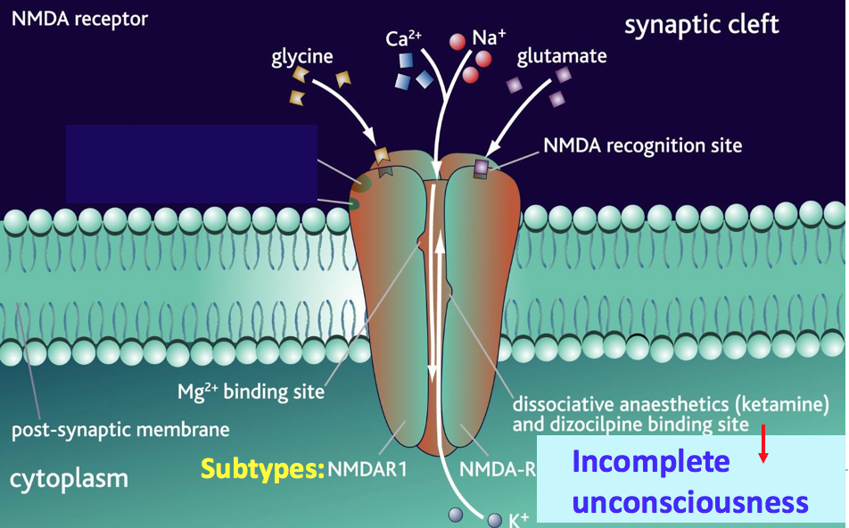
ONLY IN MALES’ SLIDES
Cont.
NMDA Receptors
Permits passage of Na⁺ and large amounts of Ca²⁺. They are unique:
Glycine is essential for their normal response to glutamate.
The channel is blocked by Mg²⁺ ion at normal membrane potentials
This blockade is removed by depolarization (caused by e.g. AMPA)
Binding site for dissociative anaesthetics (blockade e.g. ketamine)
The channel opens only when both glycine and glutamate bind to the receptor

Slide 18
4) Gamma Aminobutyric Acid (GABA)
Inhibitory neurotransmitter of CNS and is also found in retina. (GABA is the main inhibitory neurotransmitter in the central nervous system)
Formed by decarboxylation of glutamate.
GABAergic inhibition is seen at all levels of the CNS
(Hypothalamus, hippocampus, cerebral cortexand cerebellar cortex.
GABA interneurones are abundant in the brain, with 50% of the inhibitory synapses in the brain being GABA mediated.
There are three types of GABA receptors
e.g. GABA_{A B & C.}
GABA _{A & B} receptors are widely
Distributed in CNS.
GABA_{C} are found in retina only
GABA _{B} are metabotropic (G-
protein) in function. (increase K⁺ conductance and decrease Ca⁺² influx).
GABA A and C receptors (ionotropic) have multiple binding sides (for benzodiazepine and barbiturates). The channel is a Cl⁻ channel (not Na⁺)

Slide 19
Functions & Disorders of GABAergic System
ONLY IN MALES’ SLIDES
Cont.
The fabulous GABA receptor
Multiple binding sites
Functions
Presynaptic inhibition
GABAA receptors in the CNS are chronically stimulation to regulate neuronal excitability
Disorders
Seizures (under activity of GABA)
Depressant drugs (alcohol, barbiturates)
work by increasing GABA activity
Activation of GABA receptors cause IPSPs

Slide 20
5) Serotonin
The serotonin pathways in the brain:
The principal centers for serotonergic neurons are:
the rostral and caudal raphe nuclei
Projections:
axons ascend to the cerebral cortex, limbic & basal ganglia Serotonergic nuclei in the brain stem
descending axons (terminate in the medulla& spinal cord
Serotonin (5-HT) Disorders
Depression
Anxiety

Slide 21
The Serotonin System
ONLY IN MALES’ SLIDES
Serotonin is synthesized from the amino acid tryptophan, which is abundant in meat
Our bodies cannot make tryptophan (must get from diet)
Tryptophan deprivation alters brain chemistry and mood
There is only a few 100,000`s of 5-HT neurons in human brain
There is 14 serotonin receptors (excitatory or inhibitory) in different parts of CNS (most are metabotropic, except 5-HT₃)
Mice in which the gene for 5-HT2 C receptors has been
knocked out are obese

Slide 22
ONLY IN MALES’ SLIDES
The Serotonin System
Extra
Functions:
Improved Mood
Decrease appetite
Sleep
Neurons in caudal raphe nuclei project to:
Cerebellum
Medulla
Spinal cord
Neurons in rostral raphe nuclei project to:
Thalamus
Basal ganglia
Limbic system
Cerebral cortex
Disorders:
Depression
Anxiety and suicide
Aggressiveness
Serotonin innervates the entire CNS
Drugs (e.g. Prozac) that prolong serotonin’s actions relieve symptoms of depression & obsessive disorders

Slide 23
6) Dopaminergic Pathways
Dopamine is transmitted via three major pathways
The first extends from the substantia nigra to the caudate nucleus-putamen (neostriatum) | concerned with sensory stimuli and movement.
The second pathway projects to the mesolimbic forebrain | Related to cognitive, reward and emotional behavior
The third pathway, known as the tubero- infundibular system | Related to neuronal control of the hypothalmic-pituatory endocrine system.
31

Slide 24
The Dopaminergic System
ONLY IN MALES’ SLIDES
Dopamine is a catecholamine that is synthesized from tyrosine
It is present in 3 principal circuits in the brain:
1-Nigrostriatal
2-Mesolimbic & Mesocortical
3-Tuberoinfundibular
❶❷
❸
Five dopaminergic receptors (D1-D5) .
Overstimulation of D2 receptors is thought to be related to schizophrenia
❶ Nigrostriatal
❷ Mesolimbic & Mesocortical
❸ Tuberoinfundibular

Slide 25
ONLY IN MALES’ SLIDES
The Dopaminergic System
1- The Nigrostriatal circuit:
extends from the substantia nigra to the striatum (caudate nucleus-putamen)
This circuit is concerned with motor control.
Death of neurons in this pathway is linked to Parkinson's disease
2-The Mesolimbic & Mesocortical system
extends from the ventral tegmental area (VTA) to:
Nucleus accumbens
Amygdala & Hippocampus
Prefrontal cortex
Concerned with memory, motivation, emotion, reward, desire & addiction
Dysfunction is connected to hallucinations and schizophrenia
3-Tuberoinfundibular system
extends from infundibular region (median eminence of hypothalamus ) to:
- Pituitary gand
It is concerned with:
Regulation of hormones
Maternal behavior
(nurturing)
Pregnancy

Slide 26
The dopaminergic system
Functions
Motor & hormonal control
Memory & motivation
Emotion & reward
Desire & addiction
Disorders
Parkinson’s disease (decreased levels of dopamine)
Schizophrenia (over-activity at DA synapses)
Hallucinations
Cocaine elevate activity at dopaminergic synapses
EUPHORIA

Slide 27
The three happy neurotransmitters
Extra
Lets you sleep
Gives you
energy
Sets your pleasure

Slide 28
Some mechanisms of drug action
Extra

Slide 29
Summary
Neurotransmitter | Postsynapti c effect | Derived from | Site of synthesis | Postsynaptic receptor | Fate | Functions
1.Acetyl choline (Ach) | Excitatory | Acetyl co- A + Choline | Cholinergic nerve endings Cholinergic pathways of brainstem | 1.Nicotinic 2.Muscarini c | Broken by acetyl cholinesterase | Cognitive functions e.g. memory Peripheral action e.g. cardiovascular system
Catecholamines Epinephrine (adrenaline) | Excitatory in some but inhibitory in other | Tyrosine produced in liver from phenylalanin e | Adrenal medulla and some CNS cells | Excites both alpha α & beta β receptors | 1.Catabolized to inactive product through COMT & MAO in liver 2.Reuptake into adrenergic nerve endings 3.Diffusion away from nerve endings to body fluid | For details refer ANS. e.g. fight or flight, on heart, BP, gastrointestinal activity etc. Norepinehrine controls attention & arousal, sleep/wake cycle.
ii.Norepinephrine | Excitatory | Tyrosine, found in pons. Reticular formation, locus coerules, thalamus, mid-brain | Begins inside axoplasm of adrenergic nerve ending is completed inside the secretary vesicles | α₁ α₂ β₁ β₂
iii. Dopamine | Excitatory | Tyrosine | CNS, concentrated in basal ganglia and dopamine pathways e.g. nigrostriaal, mesocorticolim bic and | D₁ to D₅ receptor | Same as above | Sensory motor Cognetive/emotion al behavior Endocrine Hypothalamic Decreased dopamine in

Slide 30
Cont.
Neurotransmitt er | Postsynaptic effect | Derived from | Site of synthesis | Postsynaptic receptor | Fate | Functions
3. serotonin (5HT) | Excitatory | Tryptophan | CNS, Gut (chromaffin cells) Platelets & retina | 5-HT₁ to 5-HT ₇ 5-HT ₂ A receptor mediate platelet aggregation & smooth muscle contraction | Inactivated by MAO to form 5- hydroxyindoleace tic acid(5-HIAA) in pineal body it is converted to melatonin | Mood control, sleep, pain feeling, temperature, BP, & hormonal activity
4. Histamine | Excitatory | Histidine | Hypothalamus | Three types ^{H}1, ^{H}2 ,^{H}3 receptors found in peripheral tissues & the brain | Enzyme diamine oxidase (histaminase) cause breakdown | Arousal, pain threshold, blood pressure, blood flow control, gut secretion, allergic reaction (involved in sensation of itch)
5. Glutamate | Excitatory 75% of excitatory transmissio n in the brain | By reductive amination of Kreb’s cycle intermediate α – ketoglutarate. | Brain & spinal cord e.g. hippocampus | Ionotropic and metabotropic receptors. Three types of ionotropic receptors e.g. NMDA, AMPA and kainate receptors. | It is cleared from the brain ECF by Na ⁺ dependent uptake system in neurons and neuroglia. | Long term potentiation involved in memory and learning by causing Ca⁺⁺ influx.

Slide 31
Cont.
Neurotransmitt er | Postsynaptic effect | Derived from | Site of synthesis | Postsynaptic receptor | Fate | Functions
6. Aspartate | Excitatory | Acidic amines | Spinal cord | Spinal cord | Aspartate & Glycine form an excitatory / inhibitory pair in the ventral spinal cord
7. Gama amino butyric acid(GABA) | Major inhibitory mediator | Decarboxylati on of glutamate by glutamate decarboxylas e (GAD) by GABAergic neuron. | CNS | GABA – A increases the Cl ⁻ conductance, GABA – B is metabotropic works with G – protein GABA transaminase catalyzes. GABA – C found exclusively in the retina. | Metabolized by transamination to succinate in the citric acid cycle. | GABA – A causes hyperpolarization (inhibition) Anxiolytic drugs like benzodiazepine cause increase in Cl⁻ entry into the cell & cause soothing effects. GABA – B cause increase conductance of K⁺ into the cell.
8. Glycine | Inhibitory | Is simple amino acid having amino group and a carboxyl group attached to a carbon atom | Spinal cord | Glycine receptor makes postsynaptic membrane more permeable to Cl⁻ ion. | Deactivated in the synapse by simple process of reabsorbtion by active transport back into the presynaptic membrane | Glycine is inhibitory transmitted found in the ventral spinal cord. It is inhibitory transmitter to Renshaw cells.

Slide 32
Thank you!
اعمل لترسم بسمة، اعمل لتمسح دمعة، اعمل و أنت تعلم أن الله لا يضيع أجر من أحسن عملا.
The Physiology 436 Team:
Team Leaders:
Lulwah Alshiha
Laila Mathkour
Mohammad Alayed
Females Members:
Ashwag Almajed
Hanin Bashaikh
Hayfaa Alshaalan
Males Members:
Qais Almuhaideb
Contact us:
References:
Females’ and Males’ slides.
Guyton and Hall Textbook of Medical Physiology (Thirteenth Edition.)

