Slide 1


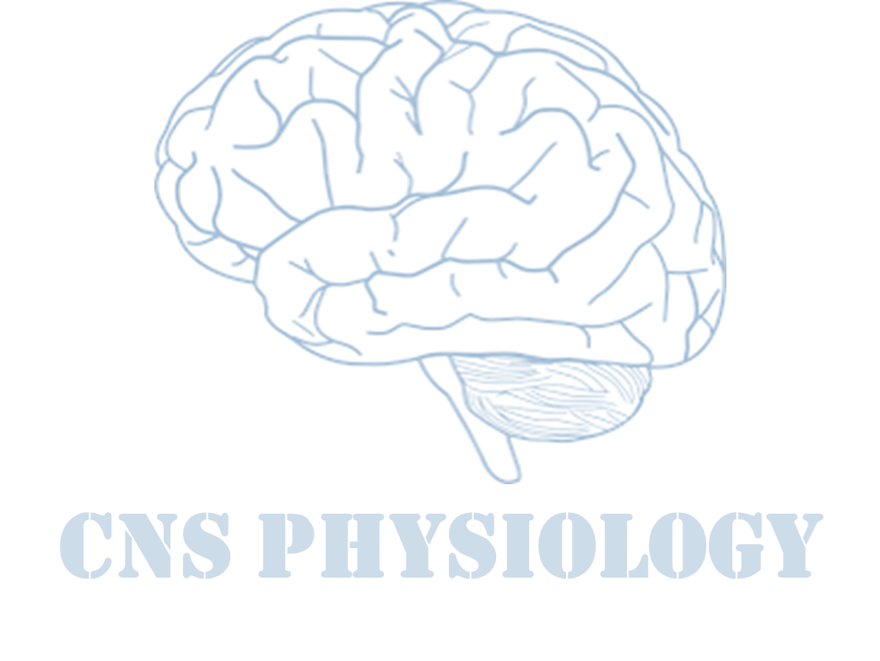

Text
Important
Formulas
Numbers
Doctor notes
Notes and explanation
Lecture No.26
“ Chase Every Dream You Have. Only You Can Reach Your Goals. No One Else Can Achieve Them For You”

Slide 2
Physiology of basal ganglia & regulatory mechanisms
Objectives:
Name different parts of basal ganglia.
List important functions of basal ganglia.
Describe neuronal connections of basal ganglia and their neurotransmitters.
Describe disorders of the basal ganglia.

Slide 3
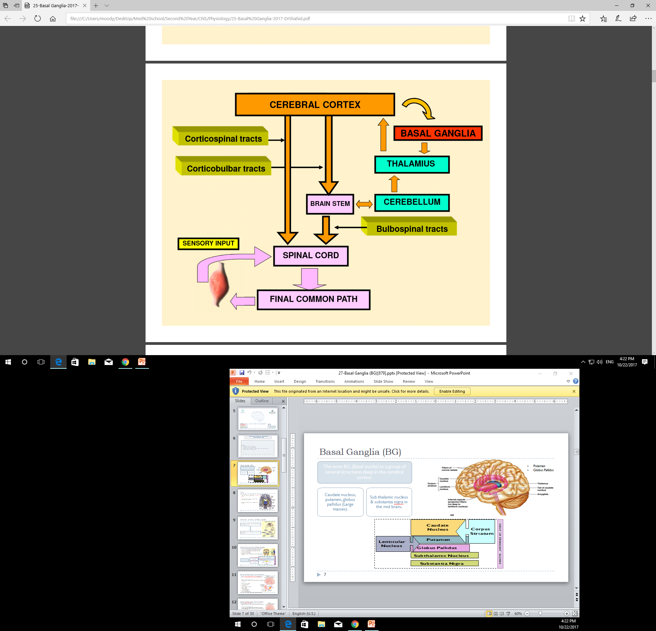
Overview of motor activity control
Cerebellum controls rapid movement

Slide 4
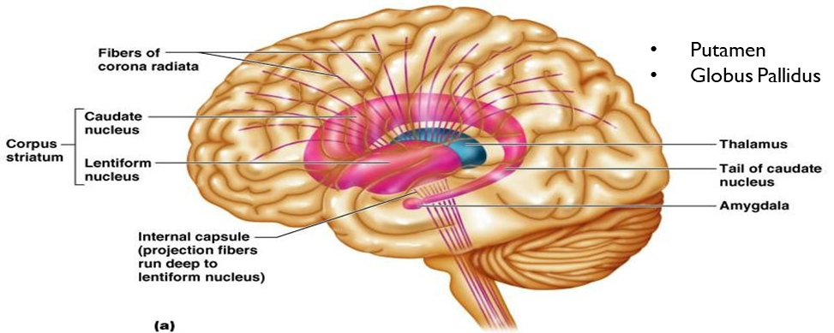
Basal ganglia (BG)
Patient with basal ganglia disorder will have tremors while rest
كانه قاعد يسبِّح بالمسبحة
The term BG (Basal nuclei) to a group of several structures deep in the cerebral cortex:
Caudate nucleus, putamen, globus pallidus (Large masses).
Sub thalamic nucleus & substantia nigra in the mid brain.
Electrical signals come from Basal ganglia before cerebral cortex in electrodes recording. Because Basal ganglia control the function of cerebral cortex. In case of destruction of basal ganglia all the signals will come without control resulting in rigidity or tremors

Slide 5
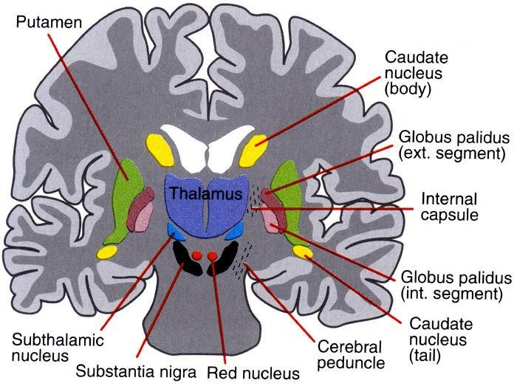
Cont.
Caudate nucleus (yellow) and Putamen (green) are called the striatum or neostriatum (but not internal capsule).
Globus Pallidus (GP) is divided into external (GPE) and internal (GPI) segments.
Substania nigra is divided into pars compacta and pars reticulta.

Slide 6
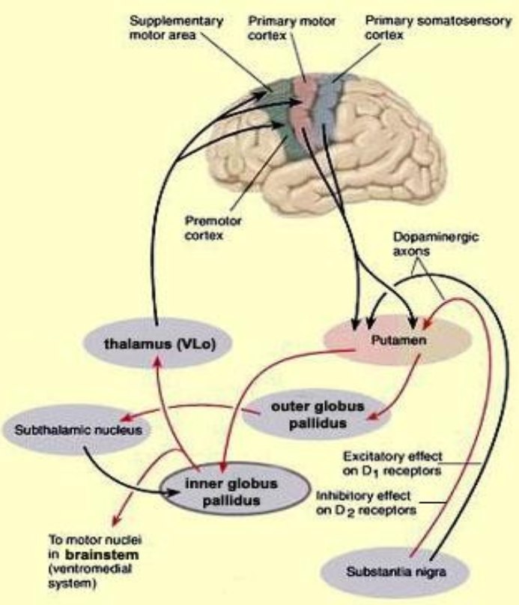
Neuronal circuitry of Basal ganglia
Connection between basal nuclei and other structures, like cerebral cortex.
BG receive most of their input from the cerebral cortex (motor area) and projects to the Neostriatum.
Return almost all their output signals back to the cerebral cortex (motor area) via the thalamus.
Main input of basal ganglia is from cerebral cortex (motor area).
Main output of basal ganglia to the cortex via the thalamus.

Slide 7
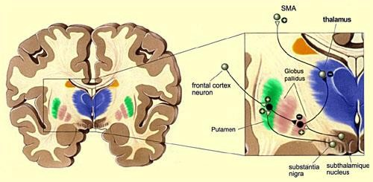
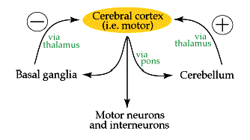
Neural Connections of Basal Ganglia
Information from various areas of the cortex passes through the basal ganglia.
Then it returns to the supplementary motor area (SMA) via the thalamus.
The BG are connected with cerebral cortex, thalamus and brain stem.
There are also interconnections.
between various nuclei of the BG.
The circuitry of the BG is very complex but is characterized by multiple parallel loops & side chains.
Limbic circuit involved in giving motor expression to emotions like, smiling, aggressive or submissive posture.
The putamen circuit (motor loop) concerned with learned movement.
The basal ganglia are connected with the cerebral cortex through two main circuits:
Occulomotor loop concerned with voluntary eye movement
[ saccadic movement].
The caudate circuit (cognitive loop) concerned with cognitive control of sequences of motor pattern. Basically it is concerned with motor intentions.
Cognition = إدراك
Thinking process using sensory input with information already in memory

Slide 8
Neuronal pathways of the putamen
Mostly from premotor, supplementary motor cortex, and SSC (Somatosensory Cortex).
Then to the internal portion of GP, and back to the motor cortex via the thalamus.
Executes Learned Patterns of Motor Activity:
Basal ganglia function in association with the corticospinal system to control complex patterns of motor activity.
Examples are:
  writing of letters of the alphabet.
  cutting paper with scissors.
  hammering nails.
  shooting a basketball through a hoop.
  passing a football.
  throwing a baseball.
  the movements of shoveling dirt.
  most aspects of vocalization.
  controlled movements of the eyes.
  virtually any other of our skilled movements, most of them performed subconsciously.

Slide 9
Neuronal pathways of the caudate
Mostly from association areas of the cortex.
Mainly areas that also integrate the different types of sensory and motor information into usable thought patterns.
Cognitive Control of Sequences of Motor Patterns:
Cognition means the thinking processes of the brain, using both sensory input to the brain plus information already stored in memory. Thoughts are generated in the mind by a process called cognitive control of motor activity.
Example: A person seeing a lion approach and then responding instantaneously and automatically by:
turning away from the lion
beginning to run
even attempting to climb a tree.
Thus, cognitive control of motor activity determines subconsciously, and within seconds, which patterns of movement will be used together to achieve a complex goal.

Slide 10
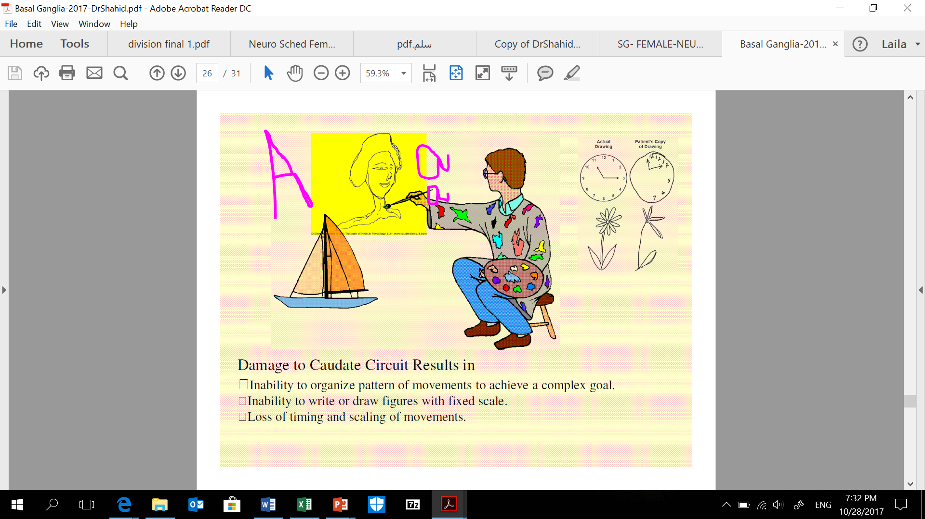
Cont.
Change the timing and to scale the intensity of movements.
Two important capabilities of the brain in controlling movement are:
To determine how rapidly the movement is to be performed.
To control how large the movement will be.
For instance, a person may write the letter "a" slowly or rapidly. Also, he or she may write a small "a" on a piece of paper or a large "a" on a chalkboard. Regardless of the choice, the proportional characteristics of the letter remain nearly the same.
Damage of the caudate circuit result in:
  Inability to organize pattern of movements to achieve a complex goal.
  Inability to write or draw figures with fixed scale.
  Loss of timing and scaling of movements.

Slide 11
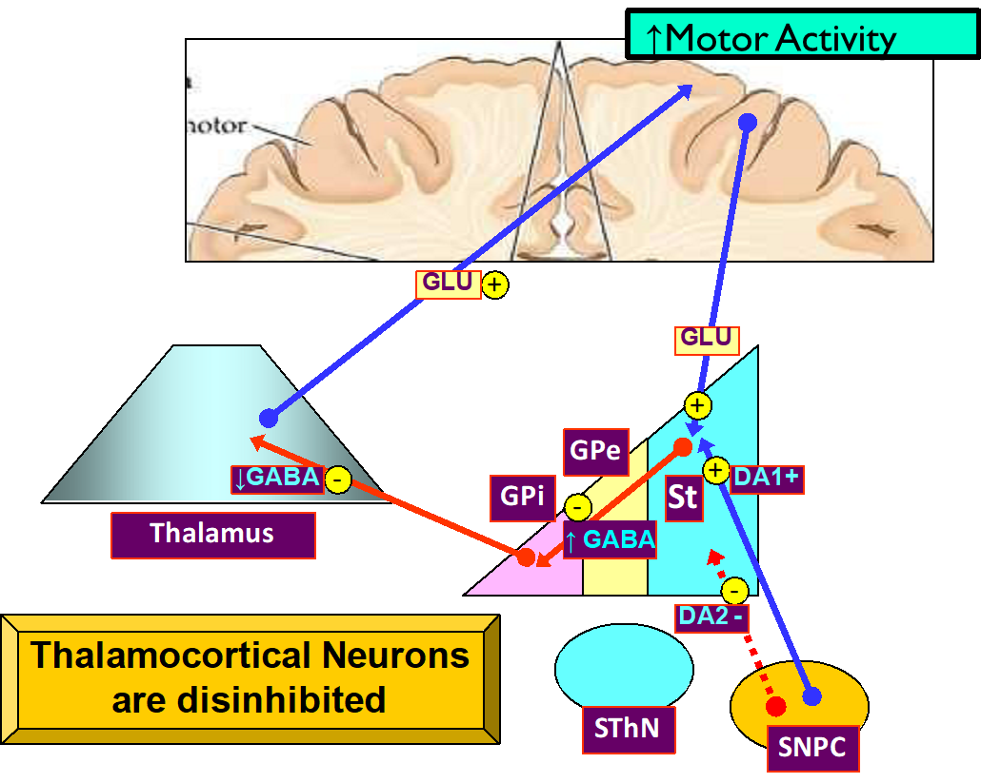
Direct basal ganglial pathway
Extra
Direct connection of basal ganglia and cortex via thalamus.
Decrease secretion of GABA
End result, they are disinhibited, stop the inhibition.

Slide 12
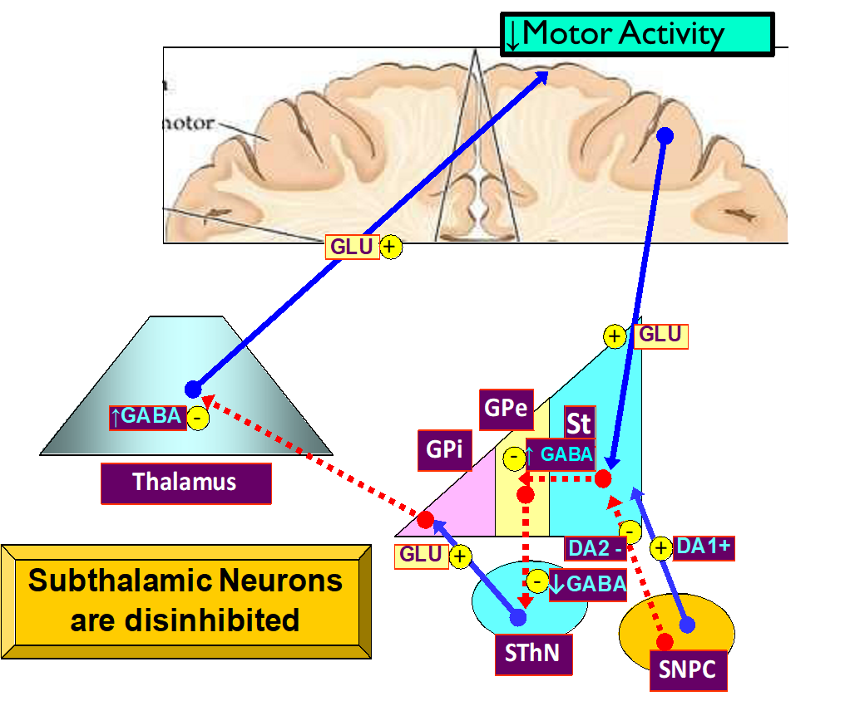
Indirect basal ganglial pathway
Extra
Indirect pathway inputs are widespread and diffuse
Inhibit the release of glutamte (Excitatory neurotransmitter).

Slide 13
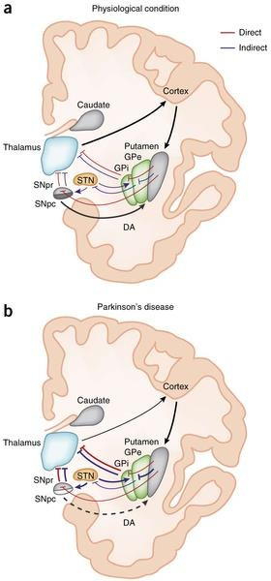
Cont.
Extra
In the physiological condition:
DA arising from the SNPC is thought to activate D1-expressing striatal MSNs of the direct pathway (red lines) and to inhibit D2-expressing striatal neurons of the indirect pathway (blue lines).
The output:
nuclei GPI and SNPR project to the thalamus, which in turn sends efferent that complete the cortico-basal ganglia-thalamo-cortical loop.
In Parkinson's disease, degeneration of nigral neurons reduces DA receptor stimulation in striatal MSNs. The imbalance between direct and indirect pathways results into abnormal activation of output nuclei and over-inhibition of thalamic neurons projecting to the cortex.

Slide 14
Both direct and indirect basal ganglial pathway
Direct increase motor activity facilitate movement
Indirect decrease motor activity supress the movement

Slide 15
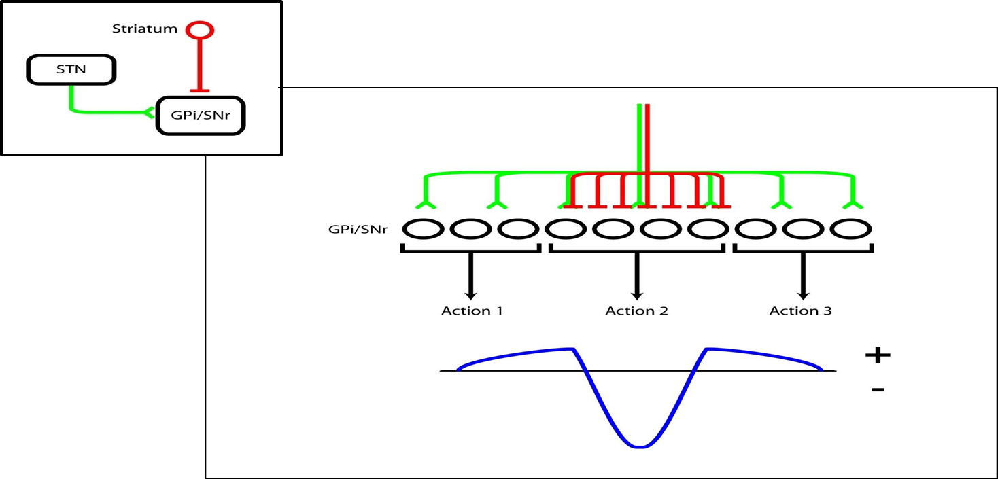
Cont.
Extra
Together, these inputs create a center-surround mechanism for action selection.
Normal motor function needs balance between direct and indirect pathways.

Slide 16
Cont.
Extra
Cont.
Movement modulation occurs through disinhibition of thalamocortical target regions.
Competing alternatives are actively inhibited.

Slide 17
Direct and indirect pathways together facilitate action selection
ONLY IN FEMALES’ SLIDES
Activation of direct pathway facilitates movement.
Activation of indirect pathway suppresses movement.
Direct output makes focal inhibitory contact on GPI/SNR.
Indirect output makes diffuse, widespread excitatory contact on GPI/SNR.
Co-activation of these pathways facilitates action selection through center-surround mechanism.

Slide 18
Why do we need to ‘sharpen’ selection mechanisms?
Extra
Why do we need to ‘sharpen’ selection mechanisms?
Multiple/ambiguous stimuli in our environment often demand our attention/action
(e.g: visual stimuli).
However, we’re often confined to making a single action to address these stimuli
(e.g: a saccade).
Particularly where conflicting needs are present, action may require active inhibition.

Slide 19
Action selection (in action)
Extra
Direct and indirect pathways together facilitate action selection
Multiple/ambiguous stimuli in our environment often demand our attention/action.
However, we’re often confined to making a single action to address these stimuli (e.g., a saccade).
Selection through surround inhibition likely occurs on large and small scales – i.e., not only saccade left or right, but how far
to saccade.
Activation of direct pathway facilitates movement.
Activation of indirect pathway suppresses movement.
Direct output makes focal inhibitory contact on GPi/SNr.
Indirect output makes diffuse, widespread excitatory contact on GPi/SNr.
Co-activation of these pathways facilitates action selection through center-surround mechanism.

Slide 20
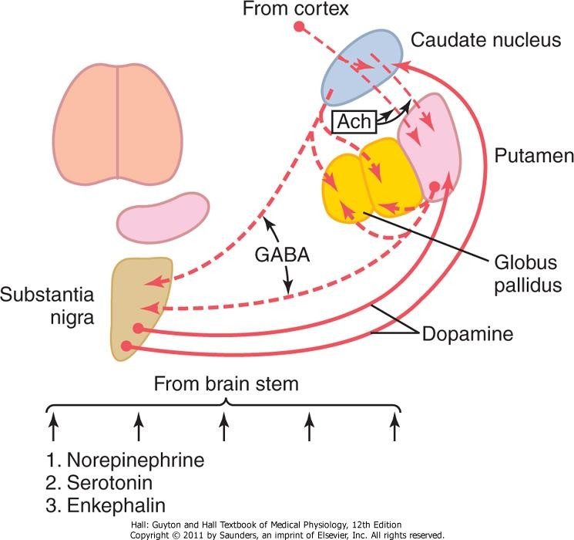
Neurotransmitters of the BG
Dopamine
From SN to Putamen and Caudate nucleus
GABA
From these nuclei to globos pallidus and SN.
Acetylcholine
From cortex to caudate nucleus and putamen.
Other neurotransmitters such as SP & Enkephalin are also present and may act as co-transmitters.
Several NTs (NA, 5HT, Enk) from the brain stem.
Multiple excitatory glutamate pathways (not shown) that balance the inhibitory effects of GABA, Dopamine and 5HT.
Imbalance of the amount of these NTs result in various BG disorders.
Dopamine effects on direct and indirect pathways:
Dopamine signaling through D2 receptors in the indirect pathway suppresses striatal activity.
Dopamine signaling through D1 receptors in the direct pathway:
Facilitates strong, phasic inputs
Suppresses weak inputs
ONLY IN FEMALES’ SLIDES

Slide 21
Metabolic characteristics
Basal ganglia
ONLY IN FEMALES’ SLIDES
Functions
Control movements
Cognition
Disorders
Movements (Ataxia Rate, Range, Force, Direction)
Basal Ganglia
Planning and programing of movements
Speech
Posture
Gait
Mental activity
High Oxygen consumption.
High Copper content in Wilson’s disease.
Copper intoxication:
  Autosomal Recessive.
  Copper binding protein Ceruloplasmin is low → Lenticular degeneration occurs and patients choreiform movements and dystonia.
  Copper needs to be moderate, not too much or not too little.

Slide 22
Movement disorders
Brown color refer to (ONLY IN Males’ SLIDES)
Diseases of the BG lead to two general types of disorder:
1. Hyperkinetic: movements are excessive and abnormal.
  Chorea.
    Huntington’s Disease
    Saint Vitus Dance (Sydenham’s Chorea)
  Athetosis.
  Hemiballismus \ Ballism: involuntary movement.
  Dystonia.
  Tardive dyskinesia.
  Wilson’s disease.
2. Hypokinetic:
  Akinesia: difficulty in initiating movement.
  Bradykinesia: slowness of movement.
  Parkinson disease.
  Drug induced eg:MPTP
  Dopamine receptor blockers eg: neuroleptics & antipsychotic drugs.
Lesions affect indirect pathway predominantly

Slide 23
Cont.
Movement disorder | Features | Lesion
Chorea | Multiple quick involuntary, random/purposeless movements at rest, usually most prominent in the appendicular muscle. | Atrophy of the striatum. Huntington Chorea. Saint vitus dance (post streptococcal infection).
Athetosis | Slow writhing movements of hand, neck, face & tongue, which are usually more severe in the appendicular muscles. | Diffuse hypermyelination of corpus striatum and thalamus.
Hemiballismus | Wild flinging movements of half of the body. | Hemorrhagic destruction of contralateral subthalamic n. Hypertensive patients.
Parkinsonism | Pill rolling tremor of the fingers at rest, lead pipe rigidity and akinesia. Akinesia = no movement looks dead at the end stage of disease. Because of imbalance of direct and indirect pathways. | Degeneration of substantia nigra.

Slide 24
Abnormal Function in Putamen circuit
Extra
Abnormal Function in Putamen circuit
Athetosis
Chorea
Ballismus
It is characterized by continuous slow writhing (twisting and turning) movements of the hand, arm, neck and face.
There is high degree of hyper-tonia.
It is due to degeneration of the globus pallidus.

Slide 25
Cont.
Extra
Abnormal Function in Putamen circuit
Athetosis
Chorea
Ballismus
Rapid involuntary dancing `jerky` movements of the extremities and facial muscles during rest & increased by muscular activity and emotion.
Accompanied by hypotonia
It is due to lesion in the caudate and putamen
It is explained by loss of GABA-ergic neurons.

Slide 26
Cont.
Extra
Abnormal Function in Putamen circuit
Athetosis
Chorea
Ballismus
Sudden, intense and violent movements of an entire limb.
It is due to a lesion in the subthalamus.
If only one subthalamic nucleus is destroyed, involuntary movements are confined to the contralateral side (hemi- ballismus)
The resulting loss of excitatory input to gpi leads to dis-inhibition of the cortical and brain stem motor mechanisms.

Slide 27
Disorders of The Basal Ganglia
Extra
Huntington`s chorea
It is an inherited autosomal dominant disorder. It occurs in the 3rd to 4th decade of life.
1
It is due to mutation in a gene that codes for a protein called huntingtin whose function is unknown (but toxic)
2
3
No treatment is currently available for the fatal disease.
8
9
4
It is due to selective degeneration of the GABA-ergic neurons in the striatum
This loss of GABA-ergic pathway to the GPe releases inhibition, permitting the hyperkinetic features of the disease to develop
An early sign is a jerky hand when reaching to touch a spot
7
6
5
Then a progressive dementia (loss
of memory) is followed by death usually within 10-15 years after the symptoms onset.
Speech becomes slurred and then incomprehensible
Later hyperkinetic movements appear and gradually increase and become incapacitating.

Slide 28
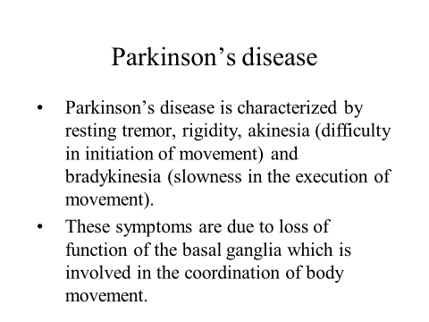

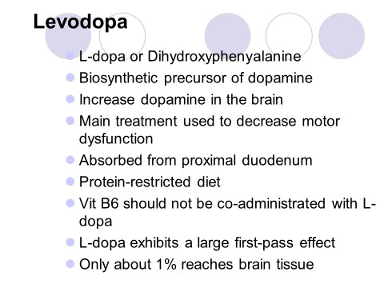
Parkinson’s Disease
Now they do surgery (deep brain stimulation) in the beginning of the disease, by electrical stimulation but it will not stop the degeneration, or could treat by dopamine neuronal stem cell but with side effects.
Described by James Parkinson.
Degeneration of dopaminergic nigrostriatal neurons (60-80 %).
Phenthiazines (tranquilizers drugs) .
Methyl-Phenyl-Tetrahydro-Pyridine (MPTP). The oxidant MPP+ is toxic to SN.
Five cardinal features:
ONLY IN FEMALES’ SLIDES
Tremor
Rigidity
Akinesia & Bradykinesia
Postural Changes
Speech Changes

Slide 29
Doctors’ Notes
The putamen circuit passes through putamen and the other nuclei and bypasses the caudate.
The putamen circuit takes its input from premotor area, supplementary motor area and somatosensory cortex and goes to the basal ganglia circuits via the thalamus back to the cortex (primary motor area and premotor area and part of the supplementary motor area).
If a neuron receives both inhibitory and excitatory signals, it depends on the net effect (the stronger signal’s effect).
Both direct and indirect circuits work at the same time to regulate the movements.

Slide 30






Thank you!
اعمل لترسم بسمة، اعمل لتمسح دمعة، اعمل و أنت تعلم أن الله لا يضيع أجر من أحسن عملا.
The Physiology 436 Team:
Team Leaders:
Lulwah Alshiha
Laila Mathkour
Mohammad Alayed
Females Members:
Aseel Alsulimani
Reema Alshayea
Males Members:
Fahad Alfayez
Mohammad Nusser
Contact us:
References:
Females’ and Males’ slides.
Guyton and Hall Textbook of Medical Physiology (Thirteenth Edition.)

