Slide 1
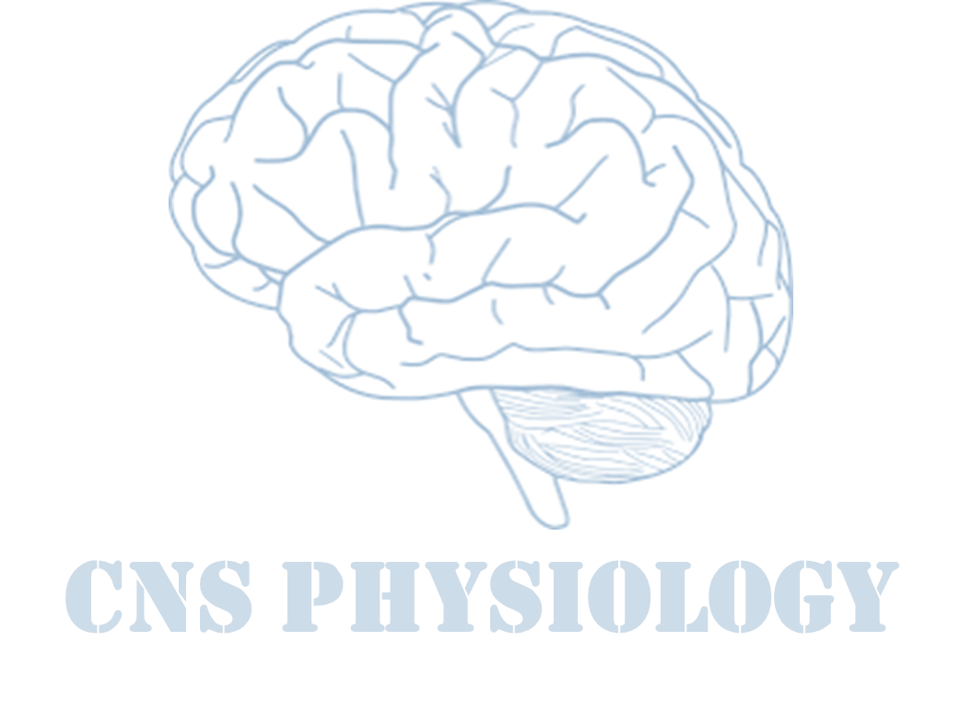
Text
Important
Formulas
Numbers
Doctor notes
Notes and explanation
Lecture No.27
“When You Feel Like Quitting, Think About Why You Started”

Slide 2
Pain modulation
Objectives:
Intensity of the pain can be altered by various extrinsic and intrinsic mechanisms, extrinsic mechanism such as rubbing or shaking of an injured area. Or applying ice pack, or stimulation with an electric vibrator at the site of pain all gives some relief from pain, pain can be modulated by giving analgesic drugs e.g.morphine.
Describe orally and evaluate critically the mechanism of pain by extrinsic and intrinsic factors as a team. (Cognitive / team work)
Reduce the intensity of pain with two methods by applying ice pack and stimulating the site of pain by electric vibrator on a mannequins (Psychomotor)
Prescribe independently at least one analgesic medicine with its correct route and dose (Cognitive / Psychomotor).

Slide 3
What is pain modulation ?
ONLY IN FEMALES’ SLIDES
It means pain perception variability (the degree to which a person reacts to pain).
i.e. A decrease or an increase in the sensation of pain caused by inhibition or facilitation of pain signals.
Inhibition:
Spinal (segmental) inhibition: Gate control theory.
Supraspinal (descending) inhibition.
Facilitation:
Peripheral sensitization (release of chemicals after tissue injury).
Central sensitization (Dis-inhibition).

Slide 4
Nociceptive & Neuropathic Pain
ONLY IN MALES’ SLIDES
Nociceptive: pain is detected by specialized transducers connected to A-delta and C-fibers (stimuli from somatic and visceral structures).
Neuropathic: pain damage to nerves (trigeminal
neuralgia, postherpetic pain, diabetic neuropathy).
4 Basic Processes:
Transduction: nociceptors free nerve endings
Transmission.
Perception of Pain: At cortical Level.
Modulation of Pain: Changing or inhibiting pain impulses in the descending tract (brain spinal cord) ‘norepinephrine and serotonin’.

Slide 5
Chemical agents that produce pain
ONLY IN MALES’ SLIDES
Nociceptors are activated by: Bradykinin, serotonin, Histamine, K+ ion, Acids, acetyl choline, & proteolytic enzymes.
Nociceptors are sensitized by: Prostaglandins & substance P.

Slide 6
The gate theory of pain control
ONLY IN FEMALES’ SLIDES
Special neurons in the the dorsal horn of spinal cord (SGR) form the gate through which pain impulses must pass to reach brain.
4 types of neurons are involved:
C- fibres (slow pain) or {C-nociceptor}.
A-Beta fibres (light touch).
Inhibitory interneurons.
Projection neuron.

Slide 7
Cont.
ONLY IN FEMALES’ SLIDES
1
C-nociceptors
Signals to Brain
Inhibitory
interneuron
+
Projection
-
-
Skin
The gate
+
myelinated
3 4
neuron
+
Spinal cord
Aβ-fiber (touch)
2
The gate is ‘closed`by β-fibre
afferents & ‘opened`by C-nociceptors
7

Slide 8
Gate opened or closed by 3 factors
ONLY IN FEMALES’ SLIDES
Messages from the brain
Activity in pain nerves opens the gate
Gate
Transmission nerve cells
Activity in other sensory nerves closes the gate
(ex: rubbing the affected area).
To the brain

Slide 9
Cont.
ONLY IN FEMALES’ SLIDES
Projection neuron receives input from both C-fibers and Aβ fibers.
Impulses coming along type C pain fibers cause the release of substance P from these fibers and inhibits the inhibitory interneuron (open the gate).
While impulses coming along Aβ fibers tend to keep the gate closed by activating the inhibitor interneuron(close gate).
This theory implies that a non-painful stimulus can reduce transmission of a noxious stimulus.

Slide 10
Cont.
ONLY IN FEMALES’ SLIDES

Slide 11
Cont.
ONLY IN FEMALES’ SLIDES
Central Nervous System
Aβ fibers
Close
Substantia Gelatinosa
Response
Pain Transmission
C fibers
Open

Slide 12
Cont.
ONLY IN MALES’ SLIDES
Implies a non-painful stimulus can block the transmission of a noxious stimulus. Is based on the premise that the gate, located in the dorsal horn of the spinal cord, modulates the afferent nerve impulses.
A-Delta fibres (sharp pain).
C fibres (dull pain).
A-Beta fibres that carry messages of light touch

Slide 13
Conditions that open or close the gate
ONLY IN MALES’ SLIDES
Conditions that open or close the gate
 | Conditions that open the gate | Conditions that close the gate
Physical conditions | Extent of the injury | Medication
 | Inappropriate activity level | Counterstimulation, ex: massage
Emotional conditions | Anxiety or worry | Positive emotions
 | Tension | Relaxation
 | Depression | Rest
Mental conditions | Focusing on the pain | Intense concentration or distraction
 | Boredom | Involvement and interest in life activities

Slide 14
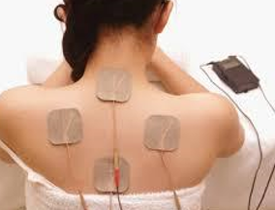
Cont.
ONLY IN FEMALES’ SLIDES
What is the central control trigger
The gate-control theory is the basis for:
The gate theory explains the pain relief by skin rubbing, shaking the painful part, trans cutaneous electrical nerve stimulation TENS & acupuncture.
All are supposed to stimulate mechanoreceptors that activate neurons of dorsal column, the collaterals relieve pain.
Specialised nerve impulses arise in the brain itself and travel down the spinal cord to influence the gate.
It can send both inhibitory and excitatory messages to the gate sensitising it to either C or A-β fibres.
The inhibitory neurons make a pain blocking agent called encephalin.
Encephalin is an opiate substance similar to heroin which can block substance P, the neurotransmitter from the C fibers, and this keeps the gate closed.

Slide 15
Transcranial direct current stimulation (TDCS)
ONLY IN MALES’ SLIDES
It is a non-invasive procedure in which a device sends a small Direct Current (DC) across electrodes in the areas of interest on the scalp to modulate brain function.
This current flow can increases or decreases the neuronal excitability in the specific area being stimulated, based on which type of stimulation.
When the current passes from the anode to the cathode, it may increase the activity of the brain at the anode site and decrease the activity of the brain near the cathode site.

Slide 16
Transcutaneous electrical nerve stimulation (tens)
ONLY IN MALES’ SLIDES
Inhibition of pain transmission by tactile sensory signals
The gate-control mechanism of pain modulation and serves as the rationale behind the use of transcutaneous electrical nerve stimulation (TENS) for pain relief.
TENS uses electrodes to activate Aα and Aβ fibers in the vicinity of the injury.
Stimulation of large type Aβ sensory fibers from peripheral tactile receptors depress transmission of pain signals from the same body area by lateral inhibition in the spinal cord.
The simultaneous physical and psychogenic excitation of the central analgesia system is the basis of pain relief by ACUPUNCTURE.

Slide 17
Cont.
Referred pain
ONLY IN MALES’ SLIDES
Pain that is not felt in the diseased structure itself, but at another place in the body far away from the site of origin.
Visceral and deep somatic pain are often referred, but superficial pain is not.
Mechanism of referred pain.
Convergence of peripheral & visceral pain on the same second order neuron that project to brain.
Facilitation theory: Impulses from diseased viscus pass through afferents which give collaterals to ST neurons receiving pain fibers from skin dermatomes.
Convergence:
Branches of visceral pain fibers synapse in the spinal cord on the same second-order Neurons that receive pain signals from the skin.

Slide 18
Cont.
ONLY IN MALES’ SLIDES
Cont.
Dermatomal rule:
When visceral pain is referred to the surface of the body, the person generally
localizes it in the
dermatomal segment
from which the
visceral organ
originated in the
embryo, not
necessarily where the
visceral organ now lies.
Localization of visceral pain “visceral” and the “parietal” pain transmission pathways.
When pain is both localized and referred it is called radiating pain.

Slide 19
Pain suppression (“analgesia”) system in the brain and spinal cord
Ascending Pain
Pathway
Descending Pain
Pathway

Slide 20
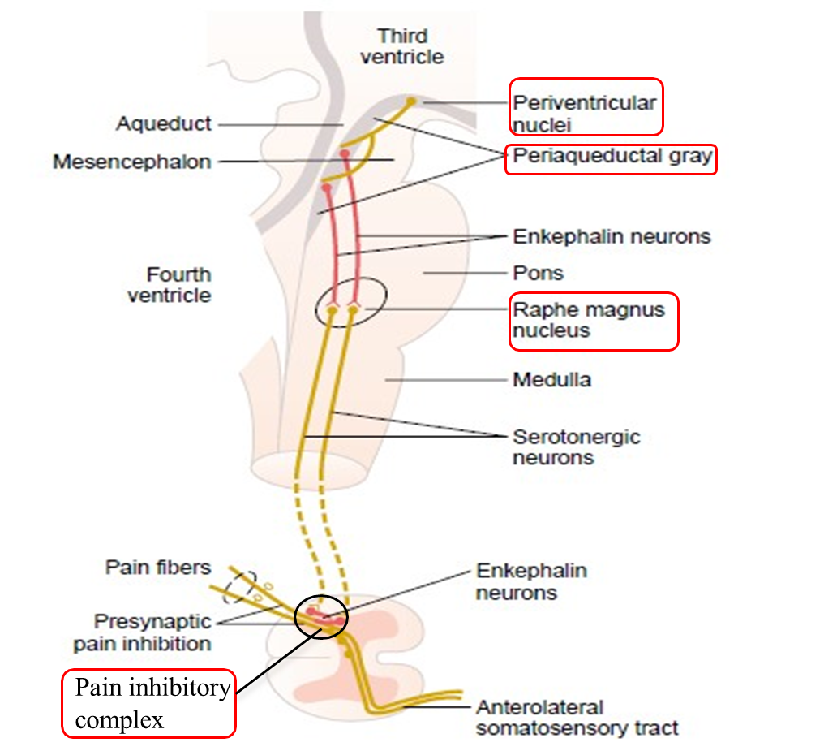
Supra spinal modulation (special pain control analgesic system)
ONLY IN FEMALES’ SLIDES
This is a specific system that blocks pain transmission in CNS. Its major constituents are:
The periventricular and periaqueductal gray areas: of the mesencephalon and upper pons surround portions of the third and fourth ventricles and the aqueduct of Sylvius.
Raphe magnum nucleus: a thin midline nucleus located in the lower pons and upper medulla.
Pain inhibitory complex: In dorsal horn of SC. It consists of multiple short encephalinergic neurons that terminate on central endings of pain conducting afferent fibers.
When stimulated, the released encephalin cause pre & postsynaptic inhibition of pain transmission.
It prevents the release of substance P from pain nerve endings.
Analgesia system of the brain and spinal cord, showing (1) inhibition of incoming pain signals at the cord level and (2) presence of enkephalin-secreting neurons that suppress pain signals in both the cord and the brain stem.

Slide 21
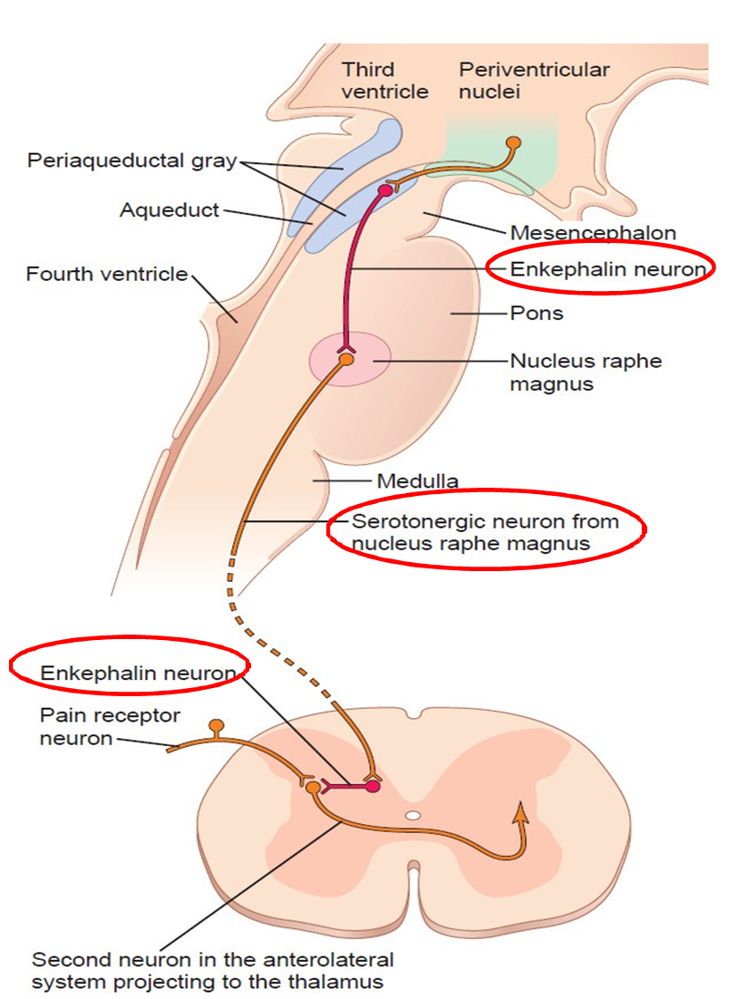
Supra spinal modulation (special pain control analgesic system)
ONLY IN MALES’ SLIDES
Enkephalin neurons from periaqueductal gray and periventricular areas of the mesencephalon and upper pons send signals to…
Raphe magnus nucleus, in the lower pons and upper medulla from these nuclei, second-order N go down the dorsolateral columns in the spinal cord & secrete serotonin which act on local neurons to secrete encephalin.
A pain inhibitory complex in the dorsal of spinal cord.
At this point, the analgesia signals can block the pain before it is relayed to the brain.

Slide 22
Cont.
ONLY IN MALES’ SLIDES
Activation of the presynaptic OR leads to a decrease in Ca⁺⁺ influx, resulting in a decrease in release of glutamate and substance P.
Activation of the postsynaptic OR hyperpolarizes the dorsal horn interneuron by causing an increase in K+ conductance.
Decrease duration of the EPSP in the dorsal horn neuron.
Activation of OR on dorsal root ganglia cell bodies also contributes to reduced transmission from nociceptive afferents.

Slide 23
Opioid peptides and pain modulation
ONLY IN FEMALES’ SLIDES
Opioid peptides are morphine-like substances present in body.
They are natural analgesic substances that act by binding to opiate receptors in analgesic system and dorsal horn of sc on central ending of pain conducting pain fibers.
Site of release of opioid peptides:
Endorphin: Are found in PAG where they inhibit GABAnergic interneurons that normally suppress the anti-nociceptor neurons.
Enkephalin: It is used by interneurons in lamina II responsible for inhibiting the nocioceptor-specific spinothalamic neurons.
Dynorphin: In hypothalamus, PAG, reticular formation, and dorsal horn.
Endogenous morphine: In terminals forming synapses with neuron having μ-opioid receptors in pain modulating pathways.

Slide 24
Mechanism of actions of opioid peptides on pain transmission
ONLY IN FEMALES’ SLIDES
They exerts their analgesic effects by acting at various sites in peripheral & CNS:
Direct effect:
Inhibiting discharge of nociceptor neurons.
Inhibiting release of substance P from central terminal of nociceptor neurons.
Cause inhibition of dorsal horn spinothalamic neuron.
B. Indirect effect:
Activating the descending inhibitory pathway be exciting.
PAG neurons.
Activating neurons in the brain stem which suppress pain transmission directly or indirectly via activation of encephalinergic containing inhibitory interneurons.

Slide 25
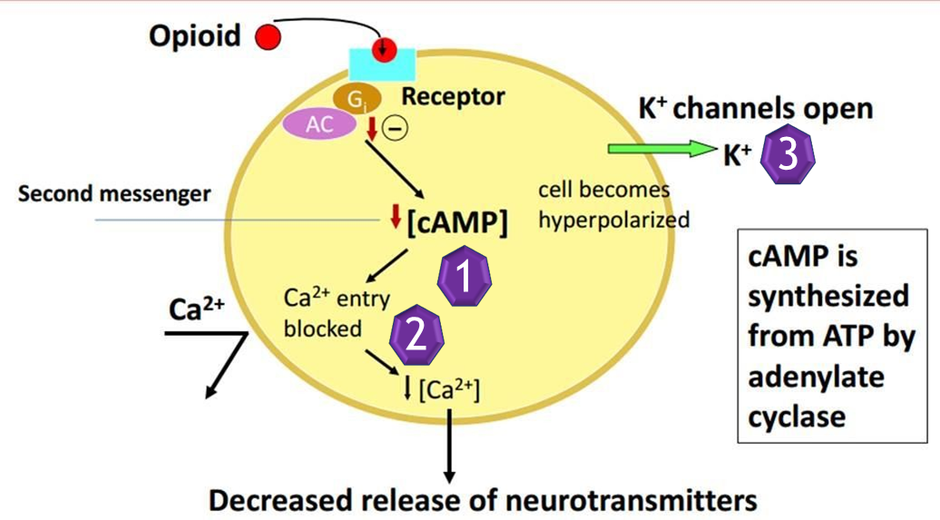
Cellular actions of opioid peptides
ONLY IN FEMALES’ SLIDES
Reduction of cAMP synthesis by inhibiting Adenyl cyclase.
Inhibition of transmitter release by inhibiting opening of Ca++ channels.
Hyperpolarization by facilitating opening of voltage gated K+ channels.

Slide 26
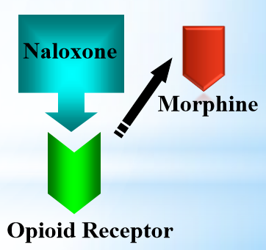
Opioid Antagonist: Naloxone
ONLY IN FEMALES’ SLIDES
Used to reverse opioid overdose.
Displaces receptor-bound opioids.
Good for overcoming respiratory and CV depression.

Slide 27
Pain facilitation: peripheral sensitization
ONLY IN FEMALES’ SLIDES
Inflammatory mediators can directly activate nociceptors or cause their sensitization (decrease threshold).

Slide 28
Pain Facilitation: Dis-inhibition
ONLY IN FEMALES’ SLIDES
Pain transmission is controlled by inhibitory interneurons
Loss of these inhibitory interneurons after excessive release of glutamate results in increased excitability of projection neurons and thus enhanced pain sensation

Slide 29
Neurotransmitters for pain modulation
ONLY IN FEMALES’ SLIDES
Serotonin
Noradrenaline
Encephalin
The serotonergic and noradrenergic neurons are crucial in the supraspinal modulation.
Destroying these neurons with neurotoxins blocks the their analgesic actions.

Slide 30
Analgesia occurs as follows
ONLY IN FEMALES’ SLIDES
Periventricular nucleus projects to PAG.
PAG projects neurons containing aspartate & glutamate that stimulate raphe magnus nucleus (RMN).
RMN projects serotoninergic neurons, this in addition to noradrenergic neurons project from locus coeruleus in medulla to dorsal horn. They block pain signals by activating PIC.

Slide 31
Congenital analgesia
ONLY IN MALES’ SLIDES
A well-known case of congenital insensitivity to pain is a girl referred to as ‘Miss C' who was a student at McGill university in Montreal in the 1950s.
She was normal in every way, except that she could not feel pain. When she was a child she had bitten off the tip of her tongue and had suffered third-degree burns by kneeling on a radiator.
she did not feel any pain when she was given strong electric shocks or when exposed to very hot and very cold water. When these stimuli were presented to her she showed no change in heart rate, blood pressure or respiration.
She died at the age of 29 as a result of her condition, because she damaged her knees, hips and spine.

Slide 32
Stress induced analgesia
ONLY IN FEMALES’ SLIDES
Phantom pain sensations
Pain suppression response that occurs during or following exposure to a stressful or fearful stimulus.
It’s a well known phenomenon seen when the soldier is wounded in battle field but feels no pain until the battle is over.
The cause is not known may be it is similar to gate control hypothesis.
Perceptions that an individual experiences relating to a limb or an organ that is not physically part of the body.

Slide 33
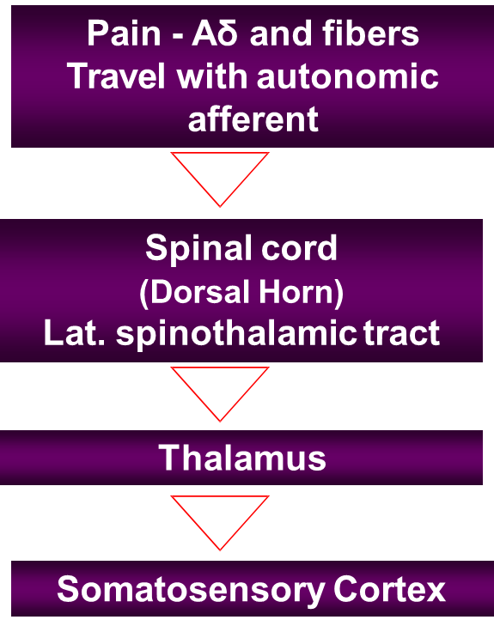
Characteristics of visceral pain
ONLY IN MALES’ SLIDES
Poorly localized.
Associated with nausea and autonomic disturbance.
Often referred.
Cutting, crushing are not painful when applied to viscera.
Pain is caused by distension, ischemia and inflammation.

Slide 34
Pain scales
ONLY IN MALES’ SLIDES
Visual Analog Scale
Locate area of pain on a picture
McGill pain questionnaire
Evaluate sensory, evaluative, & affective components of pain.
20 subcategories, 78 words.
numerical value
adjectives

Slide 35
Cont.
ONLY IN MALES’ SLIDES

Slide 36
Placebo effect
ONLY IN MALES’ SLIDES
Fibromyalgia: pain without injury
Placebo stems from the Latin word for “I shall please”
Used to describe pain reduction obtained from a mechanism other than those related to the physiological effects of the tx.
Linked to psychological mechanisms
All Treatments ™ have some degree of placebo effect
Most studies involving TM involving the use of a sham TM (ultrasound set at the intensity of 0) and an actual treatment have shown ↓ levels of pain in each group.
The occurrence of body-wide pain in the absence of tissue damage, as in fibromyalgia, interferes with all aspects of a person's life and undermines their credibility.
The problem is that normal activities can be exhausting, sleep is disturbed, the ability to concentrate is impaired, gastrointestinal function is often abnormal, persistent headaches are common, and the unrelenting pain that no one can see is often detrimental to their personal and professional lives--as it creates a "credibility gap."

Slide 37
Phantom limb pain
ONLY IN MALES’ SLIDES
Phantom limbs give impression of pressure and pain
Even if phantom limb is experienced as spatially detached from the body, it is still felt to belong to the patient.
Paraplegic people experience phantom limbs. They can even experience continually cycling legs.
It is the emotional and motivational systems that cause the phantom limb experience.
Our brain can reorganize if sensory input is cut off at the ventral posterior thalamic nucleus even after that part is amputated.

Slide 38
Thalamic syndrome
ONLY IN FEMALES’ SLIDES
It is a neurological condition that results from a brain stroke affecting the thalamus.
Cause: Obstruction of the thalmogeniculate branch of the posterior cerebral artery.
Affects posterior thalamic nuclei.
Causes prolonged severe pain.

Slide 39
Trigeminal neuralgia
ONLY IN FEMALES’ SLIDES
It is excruciating intermittent pain by stimulation of trigger area in the face.
e.g. Washing of face, combing hair, blast of air on face.
It results from compression of trigeminal nerve root by blood vessels.

Slide 40
Neuropathic pain
ONLY IN FEMALES’ SLIDES
Mechanism of pain relief
Pain caused by a primary lesion or dysfunction in the nervous system.
Classification:
Central NP-Damage of CNS
Peripheral NP- Damage to PNS
Resistant to the current analgesic therapy.
Can persist for years.
Clinical symptoms: Hyperalgesia, allodyni and spontaneous pain
Examples: post herpetic neuralgia, diabetic neuropathy
and after chemotherapy.
Block production of inflammatory mediators .e.g. Aspirin & nonsteroidal anti-inflammatories.
Exogenously administration of opioid like drugs.
Sympathectomy can be useful.
Electrical stimulation of the dorsal column.
Selective activation of large diameter afferent fibers by transcutaneous electrical nerve stimulation.
Stimulation of brainstem sites or administration of drugs which can modify serotoninergic or adrenergic neurons e.g. antidepressants.

Slide 41
This acquired tolerance is different from addiction
ONLY IN MALES’ SLIDES
Opiate Tolerance
receptor desensitization
compensatory adaptations in neuronal circuit
learning mechanisms
Physical Dependence
compensatory adaptations in neuronal circuit
Drug Withdrawal
removal of opiate unmasks compensatory adaptations
Drug Addiction
Psychological addiction is extremely rare during treatment of pain
This acquired tolerance is different from addiction, which refers to a psychological craving.
Psychological addiction rarely occurs when morphine is used to treat chronic pain, provided the patient does not have a history of drug abuse.

Slide 42
Terms frequently used
Pink color refer to (ONLY IN FEMALES’ SLIDES)
Brown color refer to (ONLY IN Males’ SLIDES)
Hyperalgesia | Excessive Pain (e.g due to sun burn)
Allodynia | Pain caused by any other sensation e.g. touch will cause pain.
Muscular Pain | Less blood flow in the muscles (ischemia).
Causalgia | Burning pain.
 | burning pain Both develop after wound or disease has ended. Triggered by a simple stimulus e.g. breeze or vibration.
Stress analgesia | Mild degree of pain is not felt if the other part of the body has excessive pain.
Neuralgia | sharp pain along a nerve pathway.
Thalamic Syndrome | Obstruction of the thalmogeniculate branch of the posterior cerebral artery Affects posterior thalamic nuclei Patient suffers from prolonged severe pain.

Slide 43
Applied
Summary
ONLY IN MALES’ SLIDES
Pain can be modulated by the balance of activity between nociceptive and non-nociceptive afferent inputs (the gate control theory)
Pain can be controlled by central mechanisms through pain control descending inhibitory pathways
Endogenous opioids contribute to the pain control system
Serotonin and noradrenaline are the other non-opioid neurotransmitters that are involved in pain control mechanisms
Pain modulation is bidirectional: can be inhibited or facilitated during chronic pain states
1. What will happen if sensory area SI is removed?
Ans. persons ability to interpret the quality of pain & precise location of pain will be affected.
2. Why patient with chronic pain syndrome have difficulty in sleeping?
Ans. Paleospinothalamic pathway sends information to reticular formation and thalamic nuclei which are part of brain activating / alerting system, therefore chronic pain syndrome causes difficulty in sleep.

Slide 44
Summary
Pain can be modulated by the balance of activity between nociceptive and non-nociceptive afferent inputs (the gate control theory)
Pain can be controlled by central mechanisms through pain control descending inhibitory pathways
Endogenous opioids contribute to the pain control system
Serotonin and noradrenaline are the other non-opioid neurotransmitters that are involved in pain control mechanisms
Pain modulation is bidirectional: can be inhibited or facilitated during chronic pain states

Slide 45
Thank you!
اعمل لترسم بسمة، اعمل لتمسح دمعة، اعمل و أنت تعلم أن الله لا يضيع أجر من أحسن عملا.
The Physiology 436 Team:
Team Leaders:
Lulwah Alshiha
Laila Mathkour
Mohammad Alayed
Females Members:
Sarah Alshamrani
Amal Alqarni
Leena alwakeel
Males Members:
Fahad Alfayez
Contact us:
References:
Females’ and Males’ slides.
Guyton and Hall Textbook of Medical Physiology (Thirteenth Edition.)

