Slide 1
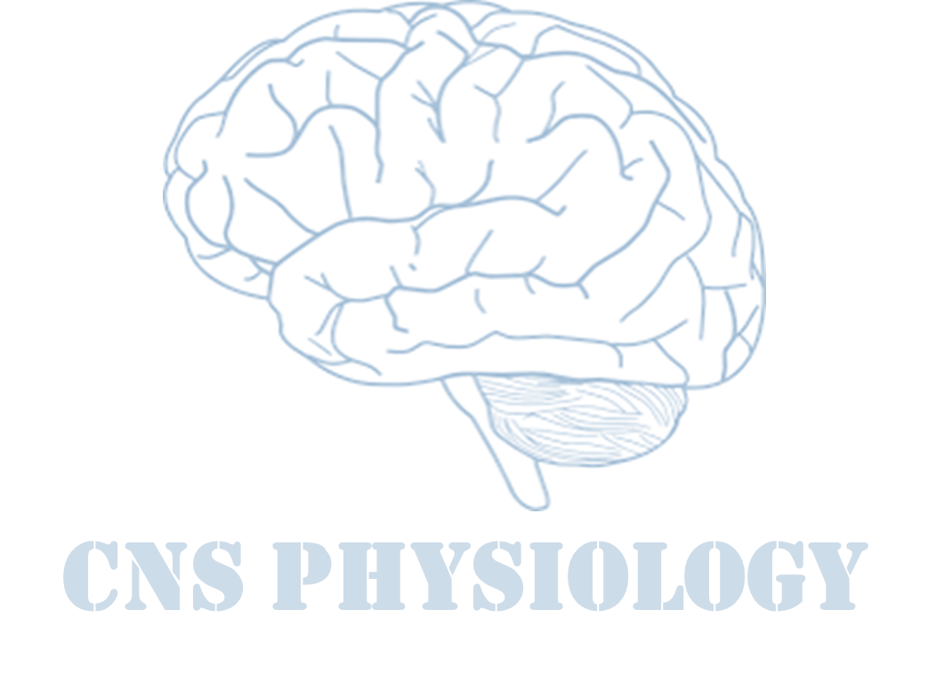
Text
Important
Formulas
Numbers
Doctor notes
Notes and explanation
Lecture No.29
آخر محاضرة لهذا البلوك ☺ الحمدلله على التمام

Slide 2
Pathophysiology and epilepsy
Objectives:
Define Epilepsy.
Etio-pathology of Epilepsy.
Types of Epilepsy.
Role of Genetic in Epilepsy.
Clinical Features.
Role of Electro Physiological tests in the diagnosis of Epilepsy.

Slide 3
Definition of seizure and epilepsy
Definition of seizure and Epilepsy
Epilepsy
Seizure
Abnormal , excessive electrical discharge of a group of neurons within the brain.
Seizures are symptoms of a disturbance in brain function , which can be due to epilepsy or other causes.
When a person has recurrent ( 2 or more) , unprovoked seizures →“ epileptic “.
A seizure is a sudden surge in electrical activity in the brain that causes an alteration in sensation, behavior, or consciousness.
Hence seizures can be a symptom of epilepsy.
Loss of consciousness, or convulsions.

Slide 4
Seizure classification
ONLY IN FEMALES’ SLIDES
Epilepsy & seizures

Slide 5
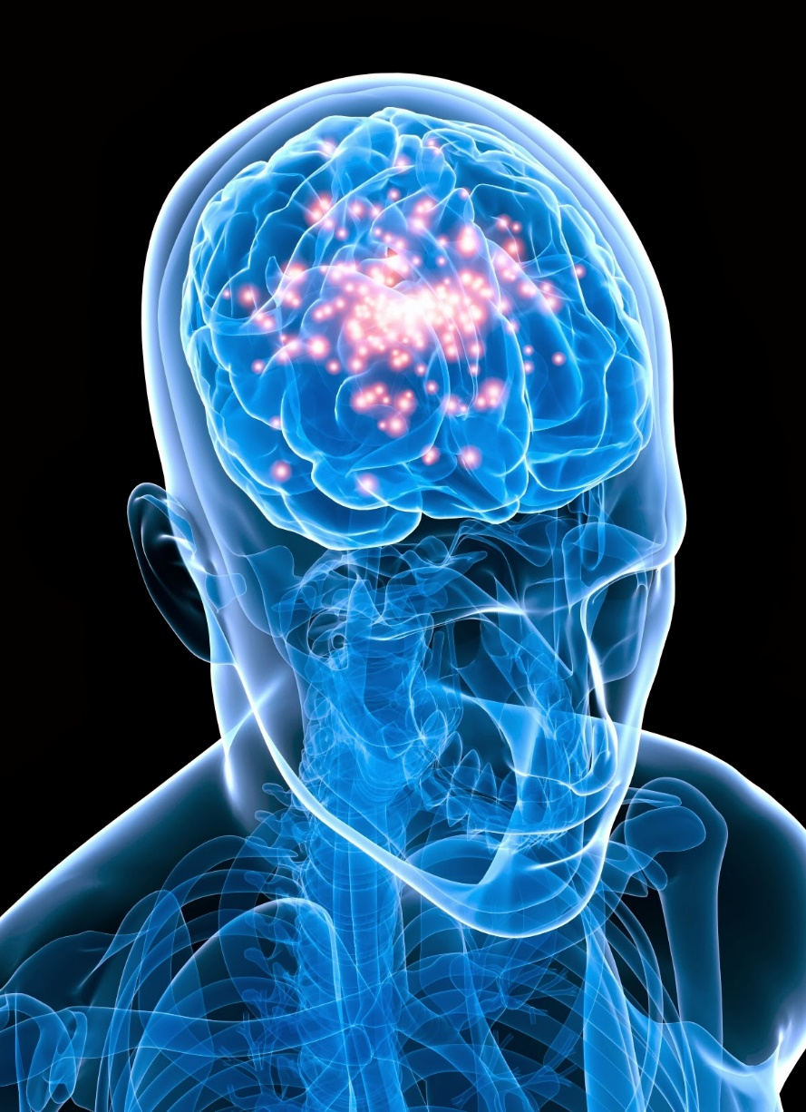
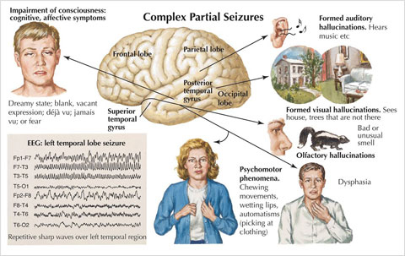
Provoked seizures
Definition:
Seizures induced by somatic disorders originating outside the brain.
E.g. fever, infection, syncope, head trauma, hypoxia, toxins, cardiac arrhythmias

Slide 6
Partial seizures
Simple partial seizures: manifest motor, somatosensory, and psychomotor symptoms without impairment of consciousness.
Complex partial seizures: manifest impairment of consciousness with or without simple partial symptoms.
Focal/partial psychomotor (temporal lobe) seizure :
Epileptic seizures which originate in the temporal lobe of the brain.
The seizures involve sensory changes, for example smelling an unusual odor that is not there, and disturbance of memory.
Auditory & visceral hallucinations, déjà vu (over familiatry).
The most common cause is mesial temporal sclerosis.
Clonic seizure: Contraction of agonist and relaxation of antagonist muscles.
Tonic seizure: Contraction of both agonist and antagonist muscles.
No loss of consciousness
loss of consciousness
Jerky movement

Slide 7
Generalized seizures
ONLY IN MALES’ SLIDES
Generalized seizures definition:
Manifest a loss of consciousness (convulsive or non-convulsive).
Generalized seizures include:
Generalized tonic- clonic seizures (GTC) (grand mal epileptic seizure ).
absence seizures (petit mal epileptic seizures).
GTC are convulsive and absence are nonconvulsive .
Simple partial seizures can progress to complex partial seizures, and complex partial seizures can secondarily become generalized.
Seizures affect all ages. Most cases of epilepsy are identified in childhood, and several seizure types are particular to children.
Generalized seizures cause a loss of consciousness due to the involvement of the thalamus.

Slide 8
Cont.
ONLY IN FEMALES’ SLIDES
Manifest a loss of consciousness:
Generalized seizures include:
Myoclonic (are brief shock-like jerks of a muscle or group of muscles).
Clonic (rapidly alternating contraction and relaxation of a muscle, in other words, repeated jerking).
Tonic ( the tone is greatly increased and the body, arms, or legs make sudden stiffening movements).
Tonic-clonic seizures (Grand Mal epileptic seizure).
Atonic (Lose of muscles strength).
Absence seizures (Or non-convulsive).
(Petit mal epileptic seizures)
a. Loss of contact with environment for 5 to 30 seconds.
b. Appears to be day dreaming or may roll eyes, nod head, move hands, or smack lips.
c. Resumes activity and is not aware of seizure.

Slide 9
Seizure classification & clinical manifestations
Focal / Partial seizures → their onset (start) is limited to part of the cerebral hemisphere.
Generalized seizures → those that involve the cerebral cortex diffusely (All of it) from the beginning (generalized seizures)

Slide 10
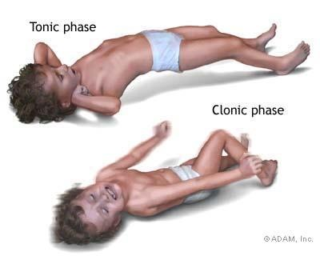
Cont.
The onset of a seizures:
Small group of abnormal neurons undergo:
prolonged depolarizations.
Rapid firing of repeated action potentials.
Spread to adjacent neurons or neurons with which they are connected into the process.
Clinical seizure:
A clinical seizure occurs when the electrical discharges of a large number of cells become abnormally linked together, creating a storm of electrical activity in the brain.
Seizures may then spread to involve adjacent areas of the brain or through established anatomic pathways to other distant areas.

Slide 11
1. Generalized tonic-clonic (grand mal) seizure
ONLY IN MALES’ SLIDES
2. Absence (petit mal) seizure
A +/- aura:
peculiar sensation or dizziness; then sudden onset of seizure with loss of consciousness.
Tonic phase : Rigid muscle contraction in which clenched jaw and hands, eyes open with pupils dilated, lasts 30 to 60 seconds.
clonic phase : Rhythmic, jerky contraction and relaxation of all muscles in with incontinence and frothing at the lips, may bite tongue or cheek, lasts several minutes.
postictal state: Sleeping or dazed for up to several hours.
Loss of contact with environment for 5 to 30 seconds.
Appears to be day dreaming or may roll eyes, nod head, move hands, or smack lips.
Resumes activity and is not aware of seizure.

Slide 12
Clinical manifestation of seizure
Aetiology of seizures
The clinical manifestations of a seizure reflect the area of the brain from which the seizure begins (i.e., seizure focus) and the spread of the electrical discharge.
Clinical manifestations accompanying a seizure are numerous and varied, including:
indescribable bodily sensations
"pins and needles" sensations
smells or sounds
fear or depression
Hallucinations
momentary jerks or head nods
staring with loss of awareness
Convulsions → i.e., (involuntary muscle contractions) lasting seconds to minutes.
Epileptic:
Idiopathic (70-80%).
Cerebral tumor.
Neurodegenerative disorders Secondary to
Cerebral damage: e.g. congenital infections, intraventricular haemorrhage.
Cerebral dysgenesis/malformation: e.g. hydrocephalus.
Non-epileptic:
Febrile convulsions.
Metabolic:
Hypoglycemia.
HypoCa, HypoMg, HyperNa, HypoNa.
Head trauma.
Meningitis.
Encephalitis.
Poisons/toxins.

Slide 13
Pathophysiology of epilepsy (at molecular level)
Cortical cell membrane level.
Instability of the nerve cell membrane → Polarization abnormalities (excessive polarization, hypopolarization, or lapses in repolarization), allowing the cell to be more susceptible to activation → Hypersensitive neurons with lowered thresholds for firing and firing excessively, related to→
Excess of Excitatory (acetylcholine - or Glutamate – related activity).
Decreased inhibitory ( GABA – related activity).
Together and /or (2) above→ leading to instability of cell-membrane & lowered threshold for excitation→ excessive polarization, hypopolarization allowing the cell to be more susceptible to activation spontaneously or by any ionic imbalances in the immediate chemical environment of neurons.
ONLY IN FEMALES’ SLIDES

Slide 14
Electroencephalogram ( EEG)
ONLY IN MALES’ SLIDES
Purple Color Refer To ( Both In Males’ And Females’ Slides).
Pink Color Refer To ( Only In Females’ Slides).
Measuring electrical activity of the brain (without stimulation).
EEG › diagnosis, classifying seizures › therapeutic decisions.
EEG is helpful for establishing the diagnosis, classifying seizures correctly, and making therapeutic decisions.
In combination with appropriate clinical findings, epileptiform EEG patterns termed spikes or sharp waves strongly support a diagnosis of epilepsy.
EEG in patients with seizures :
focal epileptiform discharges indicate focal epilepsy.
generalized epileptiform activity indicates a
generalized form of epilepsy.
Most EEGs are obtained between seizures, and interictal
abnormalities alone can never prove or eliminate a
diagnosis of epilepsy.
Epilepsy can be definitely established only by recording a
characteristic ictal discharge during a clinical attack.

Slide 15
Genetic Epilepsy
Functional neurophysiological investigation
Some types linked to genes (run in families).
Genetic abnormalities, increasing a person's susceptibility to seizures that are triggered by an environmental factor.
Several types of epilepsy have now been linked to defective genes for ion channels, the "gates" that control the flow of ions in to and out of cells and that regulate neuron signaling.
Example: Lafora's disease, has been linked to a gene that helps to break down carbohydrates.
Jacksonian epilepsy:
Focal motor seizures begin in motor areas of the cerebral cortex, usually begins with twitching of the thumb, finger, toe, or angle of the mouth.
ONLY IN FEMALES’ SLIDES
Electromyography (EMG) and nerve conduction studies.
Electroencephalography (EEG).
Evoked potentials (EP).
Polysomnography (sleep study to diagnose disorders associated with abnormal sleep).
Intraoperative monitoring, Intraoperative neurophysiologic monitoring.
Functional MRI.
ONLY IN MALES’ SLIDES

Slide 16
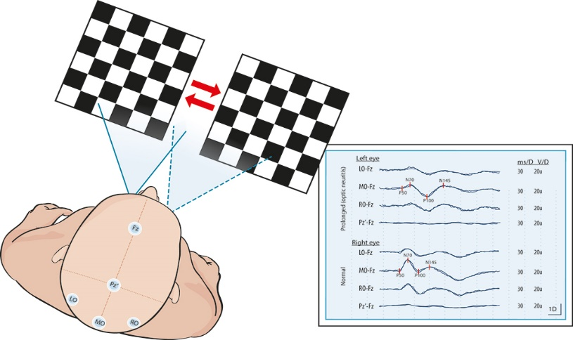
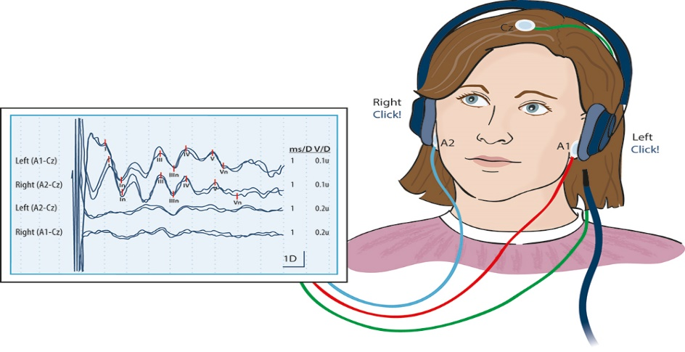
Evoked potential (EP)
ONLY IN FEMALES’ SLIDES
Cont.
Measure the electrical activity of the brain in response to stimulation of specific sensory nerve pathways.
Detect the slowing of electrical conduction caused by damage.
Auditory EP.
Visual EP.
Visual evoked potential:
Auditory evoked potential:

Slide 17
شكر وعرفان
من لا يشكر الناس لا يشكر الله..
لحظات من الشكر والتقدير والعرفان، لكل من ساهم بإخراج وإنجاز هذا العمل من الإجازة الصيفية وحتى انتهاء البلوك.
شكر عظيم لأعضاء الفريق وللقادة الأكاديميين على إخلاصهم وجهدهم وتفانيهم في العمل ولا تنسوهم من دعواتكم، الله يسهل لهم أمرهم ويبارك لهم بوقتهم.
ﺗﻢ ﺑﺤﻤﺪ الله وتوفيقه وتيسيره الإنتهاء ﻣﻦ ﻣﺤﺎﺿﺮات ﻓﺮﯾﻖ ﻋﻠﻢ وﻇﺎﺋﻒ اﻷﻋﻀﺎء ﻓﻲ ﺑﻠﻮك اﻟﺠﻬﺎز اﻟﻌﺼﺒﻲ اﻟﻨﻔﺴﻲ .. نسأل الله أن نكون قد وفقنا في تقديم الأفضل، ونعتذر عن أي تقصير...
تحياتنا...
ﻗﺎدة اﻟﻔﺮﯾﻖ

Slide 18
Thank you!
اعمل لترسم بسمة، اعمل لتمسح دمعة، اعمل و أنت تعلم أن الله لا يضيع أجر من أحسن عملا.
The Physiology 436 Team:
Team Leaders:
Lulwah Alshiha
Laila Mathkour
Mohammad Alayed
Females Members:
Reem Alshathri
Males Members:
Mohammad Nasr
Abdullah Alsaeed
Faisal Alfawaz
Contact us:
References:
Females’ and Males’ slides.
Guyton and Hall Textbook of Medical Physiology (Thirteenth Edition.)

