Slide 1
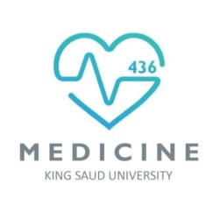
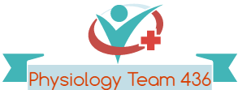
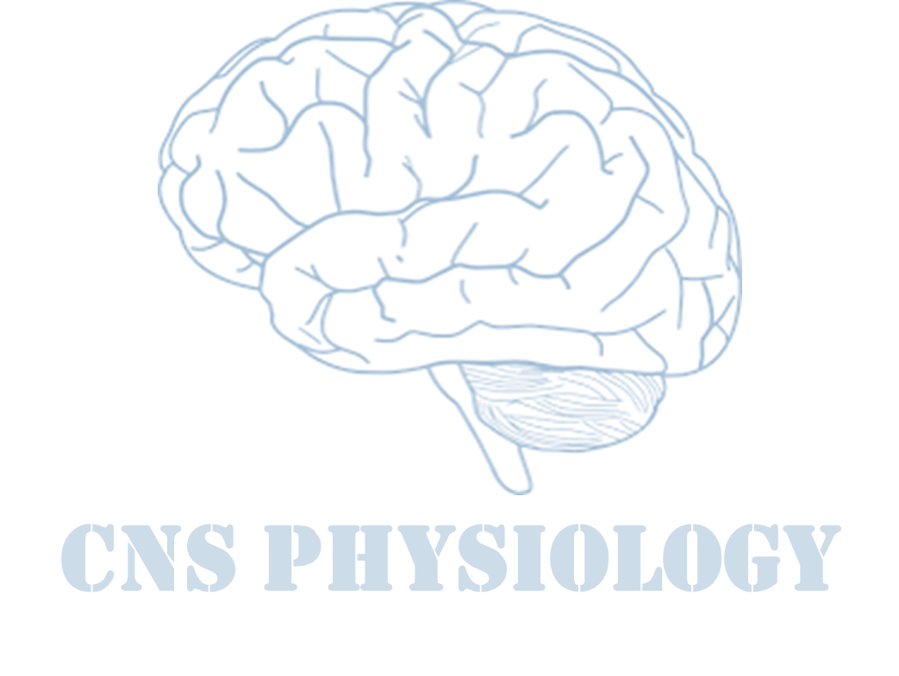

Text
Important
Formulas
Numbers
Doctor notes
Notes and explanation
Lecture No.3
“Failure Is Simply The Opportunity To Begin Again, This Time More Intelligently”

Slide 2
Physiology of the autonomic nervous system
Objectives:
The anatomy of somatic and autonomic nervous system.
Sympathetic and parasympathetic nerves.
Pre and post ganglionic neurons.
Functions of sympathetic and parasympathetic nerves in head & neck, chest, abdomen and pelvis.
Neurotransmitters release at pre and post ganglionic sympathetic / parasympathetic nerve endings.
Various responses due to stimulation of the sympathetic / parasympathetic nervous system.

Slide 3
Introduction
ONLY IN FEMALES’ SLIDES
The autonomic nervous system is a subdivision of the Efferent nervous system and then the autonomic nervous system has 2 subdivisions, sympathetic and parasympathetic.
The nervous system monitors and controls almost every organ / system through a series of positive and negative feedback loops.
The Central Nervous System (CNS): Includes the brain and spinal cord.
The Peripheral Nervous System (PNS): Formed by neurons & their process present in all the regions of the body.
  It consists of :
    cranial nerves arises from the brain
    spinal nerves arising from the spinal cord.
  The peripheral NS is divided into:
    Somatic Nervous system
    Autonomic nervous system

Slide 4
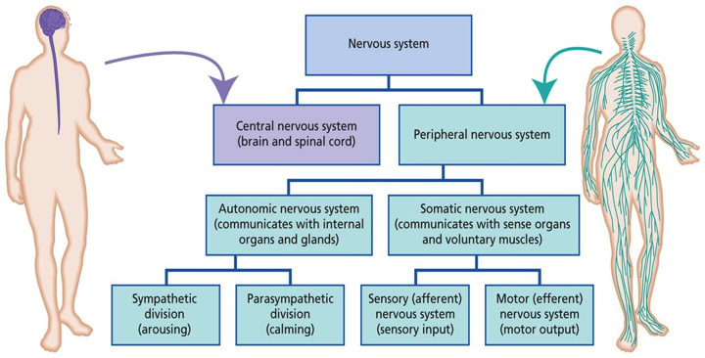
THE NERVOUS SYSTEM
ONLY IN MALES’ SLIDES

Slide 5
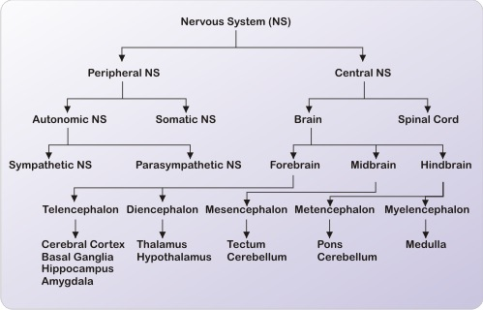
Cont.
ONLY IN MALES’ SLIDES

Slide 6
Anatomical Divisions of the Nervous System
Nervous system
CNS: brain and spinal cord
Sensory (Afferent) division
Motor (Efferent) division
PNS: cranial and spinal nerves.
Somatic
General:
-Touch and pain
- Temperature
- Proprioception
Special:
Hearing, vision, and smell.
Visceral (Autonomic)
Visceral
Somatic
General:
- Temperature
- Pain
-Chemical changes
Special:
Taste.
Innervation of smooth and cardiac muscles (non-skeletal/non-somatic) and glands ,Ex: cardiac/smooth muscle ,Internal organs and skin.
Innervation of all skeletal muscles.
Sympathetic division
Parasympathetic division

Slide 7
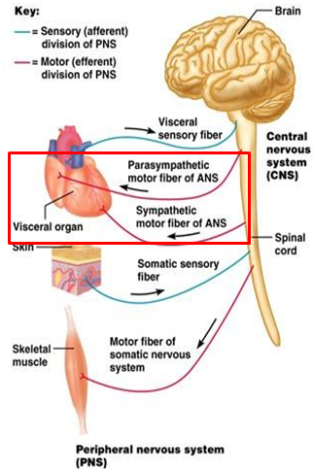
What is Autonomic Nervous System?
ANS is the Efferent portion of the peripheral nervous system that controls involuntary (subconsciously) to adapt the changes in environment by regulating individual organ, homeostasis and visceral functions such as:
  Control of heart rate and force of contraction
  Constriction and dilatation of blood vessels
  Contraction and relaxation of smooth muscle
  Visual accommodation
  Secretions from exocrine and endocrine glands.
Divisions of ANS:
  Sympathetic
  Parasympathetic
  Enteric Nervous System : neurons that control the function of the gastrointestinal tract.
ANS is activated by : centers located in the spinal cord, brain stem, hypothalamus and also cerebral cortex
especially the limbic cortex can transmit signals to the lower centers, influence autonomic control.
ANS operates by visceral reflexes ; Subconscious sensory signals from a visceral organ enter the autonomic ganglia, brain stem or hypothalamus and then return subconscious reflex responses directly back to the visceral organ to control its activities.
Subconsciously = not under conscious control.
ONLY IN MALES’ SLIDES

Slide 8
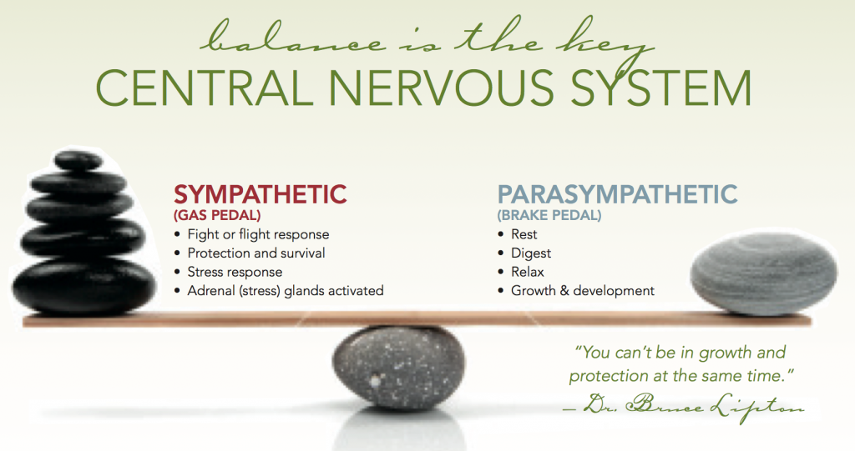
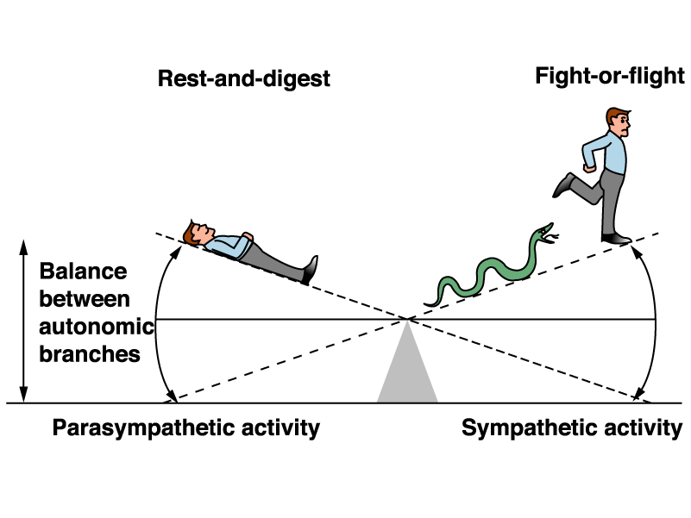
THE AUTONOMIC NERVOUS SYSTEM
ONLY IN MALES’ SLIDES
The striking characteristics of ANS is the rapidity and intensity with which it can change visceral functions:
Heart rate can be doubled within 3-5 sec.
Blood pressure can be doubled or decreased low enough to cause fainting within 10-15 sec.
Sweating can begin within seconds.
The urinary bladder may empty involuntarily, also within seconds.

Slide 9
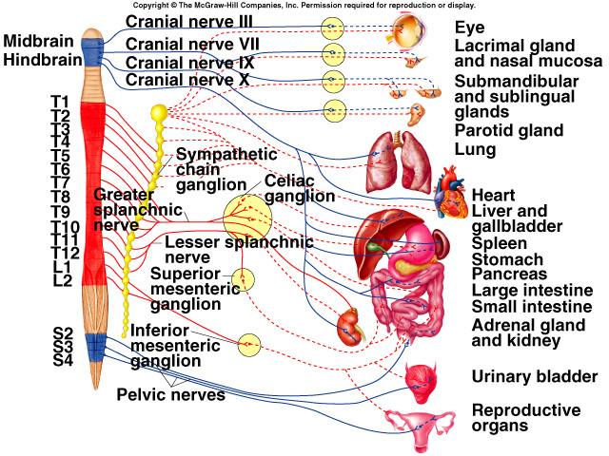
Distribution of the sympathetic and parasympathetic nervous system
ONLY IN MALES’ SLIDES
Blue= parasympathetic.
Red: sympathetic

Slide 10
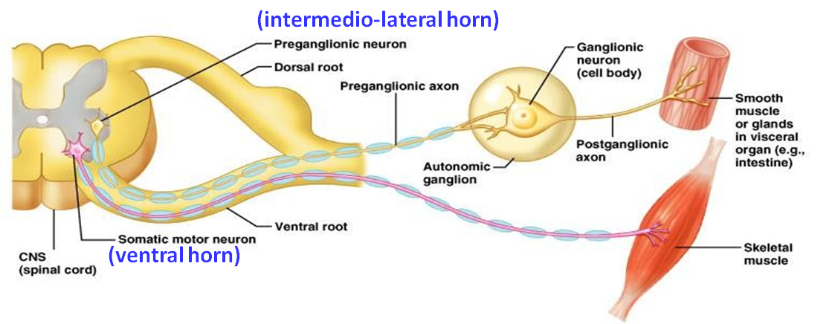
Comparison Between Autonomic and Somatic motor systems
Basic anatomical difference between the motor pathways of the voluntary somatic nervous system (to skeletal muscles) and those of the autonomic nervous system:
Somatic motor system | Autonomic nervous system (Not under voluntary control)
One motor neuron extends from CNS to skeletal muscle. Cell bodies of motor neurons reside in CNS (brain or spinal cord). Their axons (sheathed in spinal nerves) extend all the way to their skeletal muscles. | Chain of two motor neuron: 1st: Preganglionic neuron (in brain or cord). 2nd: Postganglionic neuron (Cell body in ganglion outside CNS).
Axons are thickly myelinated, conduct impulses rapidly. | Conduction is slower due to lightly/thinly or unmyelinated axons.
No autonomic ganglion, only one neuron inside the Nervous system. | Myelin sheath and node of Ranvier play a major rule is increasing the conduction of impulses. The conduction is slower because the preganglionic neuron is myelinated and postganglionic neuron is unmyelinated.

Slide 11
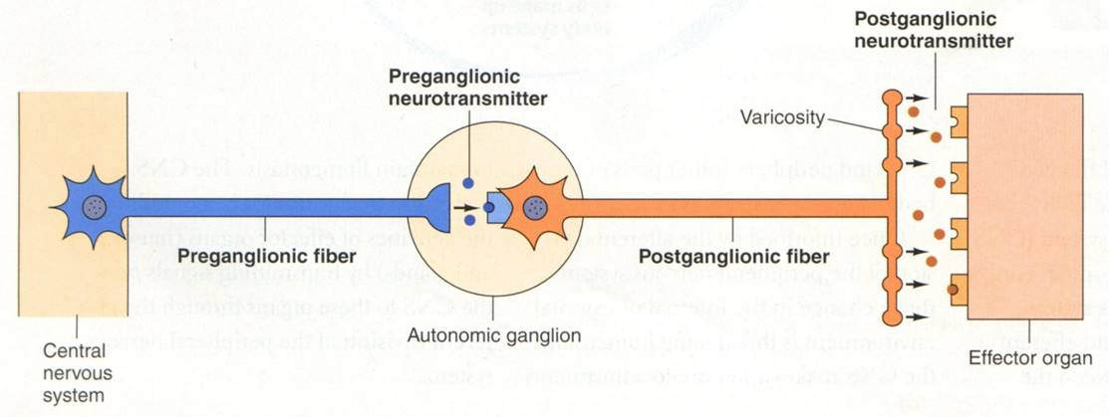
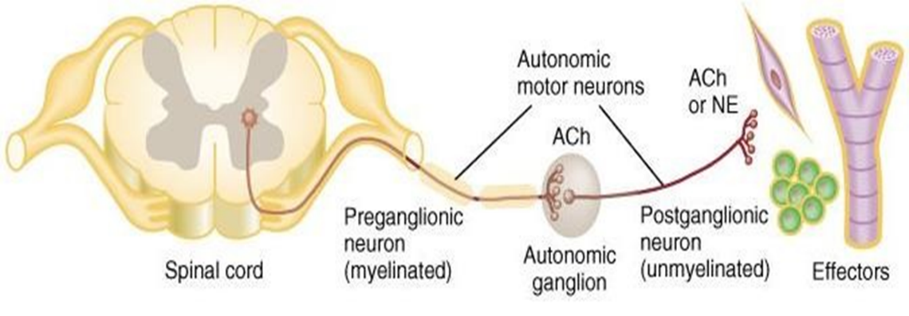
Basic anatomy of the ANS
ONLY IN MALES’ SLIDES
Preganglionic neuron:
Postganglionic neuron:
Cell body in brain or spinal cord
Axon is myelinated (Aβ-type) that extends to autonomic ganglion
Cell body is outside in CNS in an autonomic ganglion
Axon is unmyelinated (C-type) that terminates on an effector cell (organ)
A single preganglionic neuron synapses with 8-9 postganglionic neurons
Process :
  Axon of 1st (preganglionic) neuron leaves CNS to synapse with the 2nd (ganglionic) neuron.
  Axon of 2nd (ganglionic) neuron extends to the organ it serves.
2 ganglion, preganglionic inside the nervous system but postganglionic is outside the nervous system

Slide 12
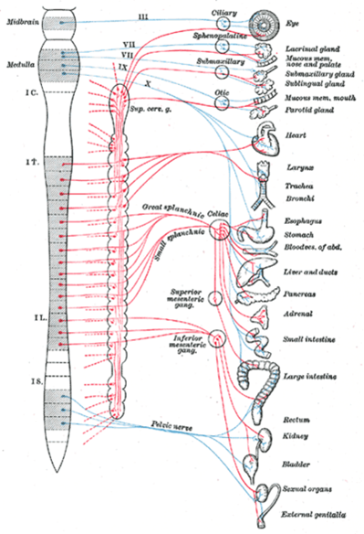
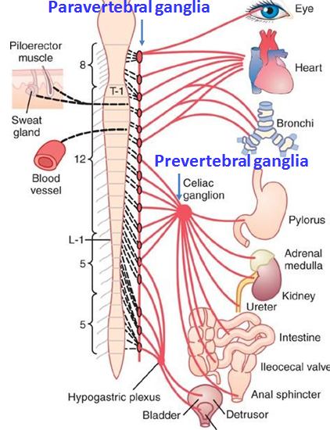
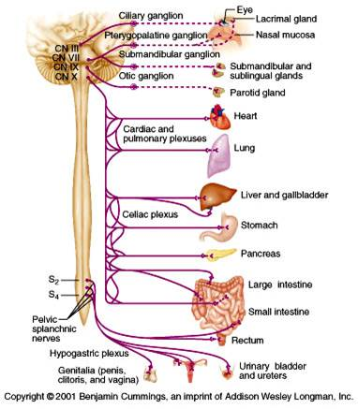
Locations of autonomic ganglia
ONLY IN FEMALES’ SLIDES
Sympathetic and parasympathetic systems are consists of myelinated pre-ganglionic fibers which make synaptic connections with un-myelinated postganglionic fibers and then innervate the effector organ. These synapses usually occur in clusters called ganglia.
Sympathetic ganglia location:
Parasympathetic ganglia location:
Paravertebral ganglia: Two (bilateral) Trunk (chain) ganglia near vertebral bodies.
Prevertebral ganglia near large blood vessel in gut: celiac, superior mesenteric & inferior mesenteric.
All the red lines are outside the CNS (Ganglia trunk).
Has only :
Terminal ganglia: in the wall of organ (or close to it)
Blue= Parasympathetic Red= Sympathetic

Slide 13
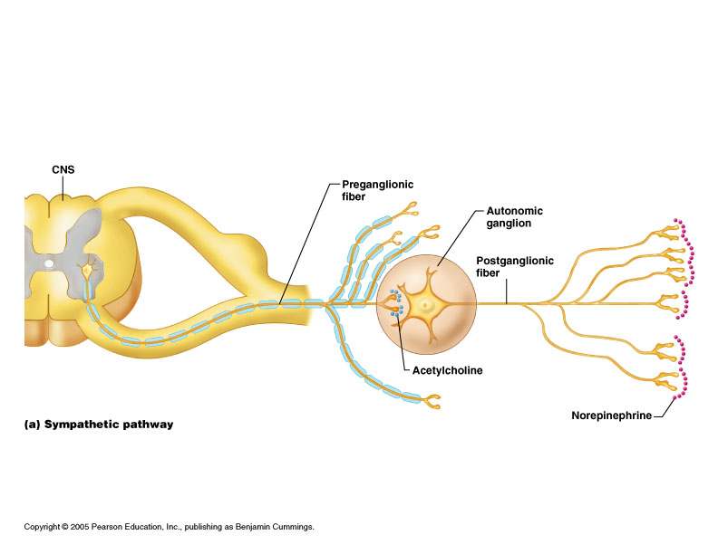
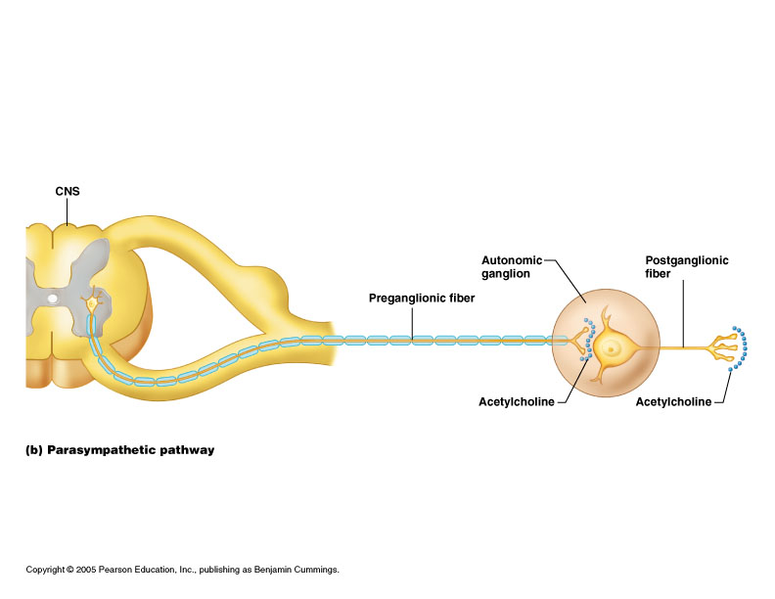
characteristics
Sympathetic:
Parasympathetic:
Preganglionic: Short, lightly myelinated fibers to ST.
Postganglionic: Long, unmyelinated fibers, terminating at effectors.
Sympathetic axons – highly branched.
Ganglia as we said is close to spinal cord.
Preganglionic: Long preganglionic fibers.
Postganglionic: Short postganglionic fibers.
  Parasympathetic axons – few branches.
terminal ganglia on or near effectors (target organs).
All preganglionic, (sympathetic or parasympathetic are myelinated) originate from lateral horn of spinal cord, but motor system from anterior and sensory from dorsal

Slide 14
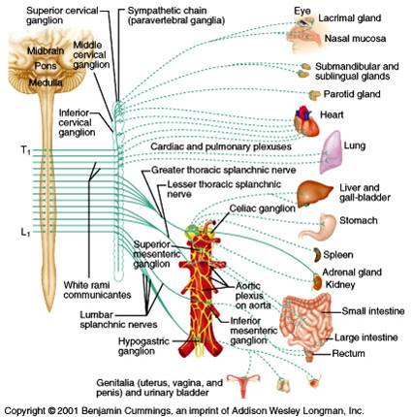
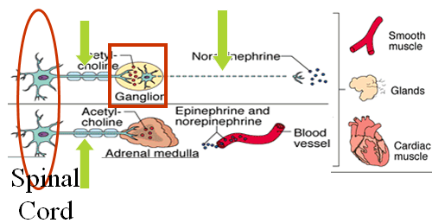
Sympathetic division of the ANS
The 2 divisions originate from different regions of the CNS.
A. Sympathetic division originates from thoracic & lumbar levels of spinal cord. (Thoracolumbar lateral horns, T1- L2).
Nerve fibers originate between T1 & L2.
Sympathetic fibers from cord segment T-1
generally pass up the sympathetic chain to terminate in the head;
  T-2 to terminate in the neck
  T-3, T-4, T-5, and T-6 into the thorax
  T-7, T-8, T-9, T-10, and T-11 into the abdomen
  T-12, L-1, and L-2 into the legs.
ONLY IN MALES’ SLIDES

Slide 15
Function of Sympathetic nervous system
The sympathetic system enables the body to be prepared for fear, flight or fight.
Under stress condition
Sympathetic responses include an increase in heart rate, blood pressure and cardiac output.
Diversion of blood flow from the skin and splanchnic vessels to those supplying skeletal muscle. (No need for a lot of blood in the skin under stress so there will be vasoconstriction, so the blood will go to the brain, decrease blood supply to skin and GIT)
Bronchioles dilate, which allows for greater alveolar oxygen exchange.
Blood flow to skeletal muscles, lungs is not only maintained, but enhanced (by as much as 1200%), in case of skeletal muscles.
Decrease saliva, في حالة الخوف يكون الريق ناشف
Increased (Far vision) pupil size, contraction of sphincters ( No time to go the bathroom even if you feel full ) and metabolic changes such as the mobilization of fat and glycogen
increases heart rate and the contractility of cardiac cells (myocytes), thereby providing a mechanism for the enhanced blood flow to skeletal muscles.
Sympathetic nerves dilate the pupil and relax the lens, allowing more light to enter the eye.
Also known as the “E” division:
Exercise.
Excitement.
Emergency.
Embarrassment

Slide 16
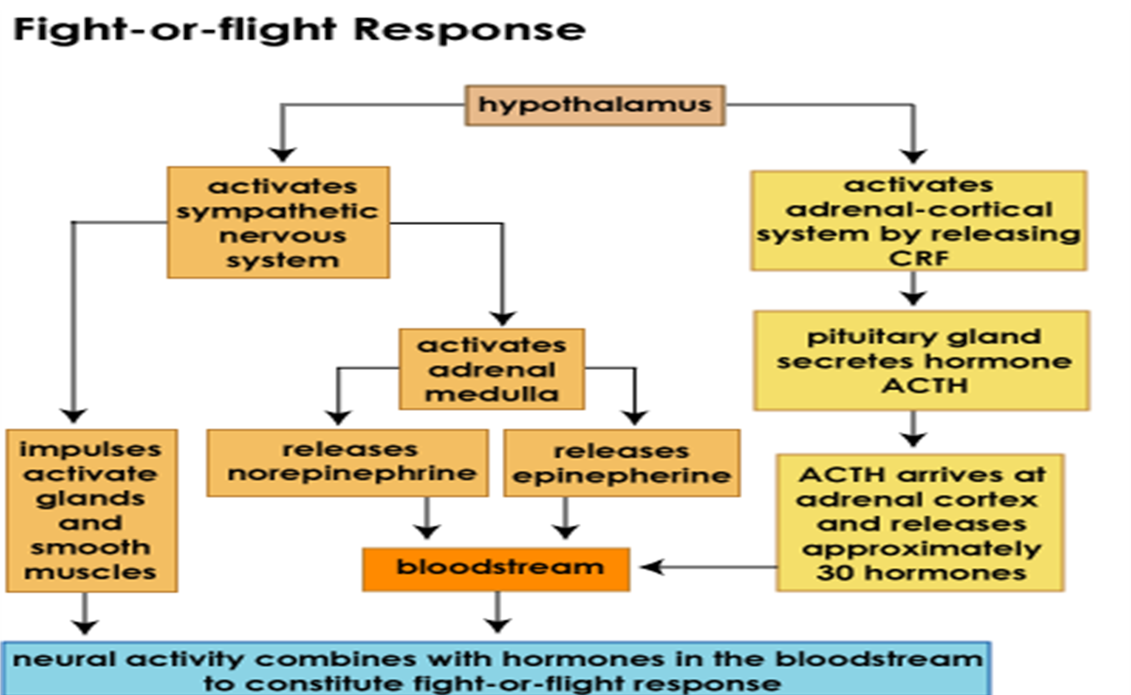
The sympathetic nervous system

Slide 17
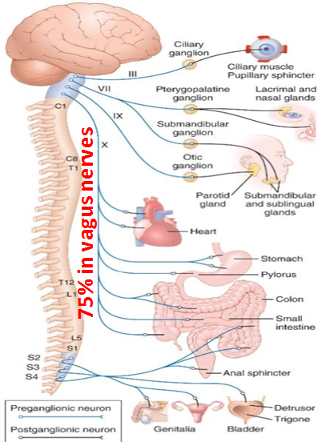

Parasympathetic ANS Dominates During Relaxed Situations
Parasympathetic division originates from:
motor nuclei of the cranial nerves (III, VII, IX and X) in the brain stem.
2nd, 3rd, & 4th [S2-S4] sacral levels of CNS. (craniosacral)
The Parasympathetic division of the
ANS is sometimes referred to as the
“craniosacral outflow ” division because its
nerve fibers arise from the Central
Nervous System directly from the brain
in the cranium and from spinal chord
between the sacral vertebrae.
Dual innervation allows the precise control over the activity of a visceral organ.
The cranial nerves III, VII, IX and X is classified as Parasympathetic nerves.

Slide 18

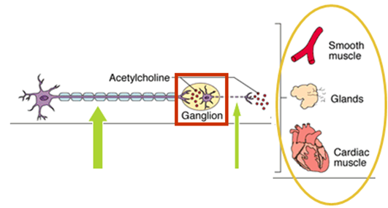
Parasympathetic nervous system
ONLY IN FEMALES’ SLIDES
The cranial nerves III, VII and IX affect the pupil and salivary gland secretion.
Vagus nerve (X) carries fibres to the heart, lungs, stomach, upper intestine, ureter.
The sacral fibres form pelvic plexuses which innervate the distal colon, rectum, bladder and reproductive organs.
Responsible for stimulation of “Rest & Digest” or “Feed & Breed” activities
Also known as the “D” division:
  Digestion.
  Defecation.
  Diuresis.
Elicits responses that are usually (but not always) opposite to those caused by sympathetic division.
Conservation of body energy.
In physiological terms, the parasympathetic system is concerned with conservation and restoration of energy, as it causes a reduction in heart rate and blood pressure, and facilitates digestion and absorption of nutrients, and consequently the excretion of waste products.
Normally dominate over
sympathetic impulses.
SLUDD type responses: salivation, lacrimation, urination, digestion & defecation.
3 “Decreases” decreased HR, diameter of airways and diameter of pupil.
Paradoxical fear when there is no escape route or no way to win causes massive activation of parasympathetic division
loss of control over urination and defecation
ONLY IN MALES’ SLIDES

Slide 19
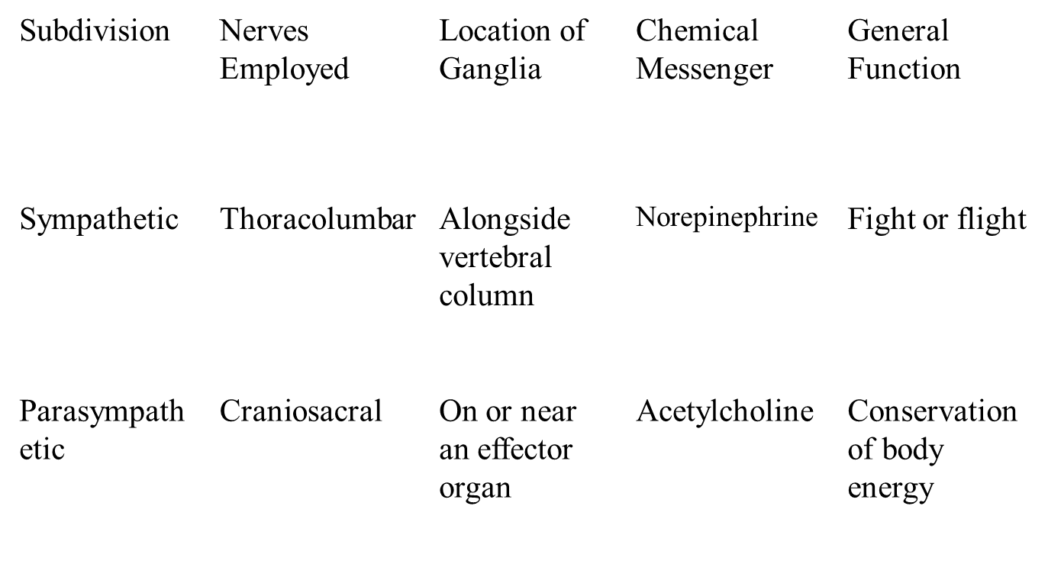
The autonomic nervous system

Slide 20
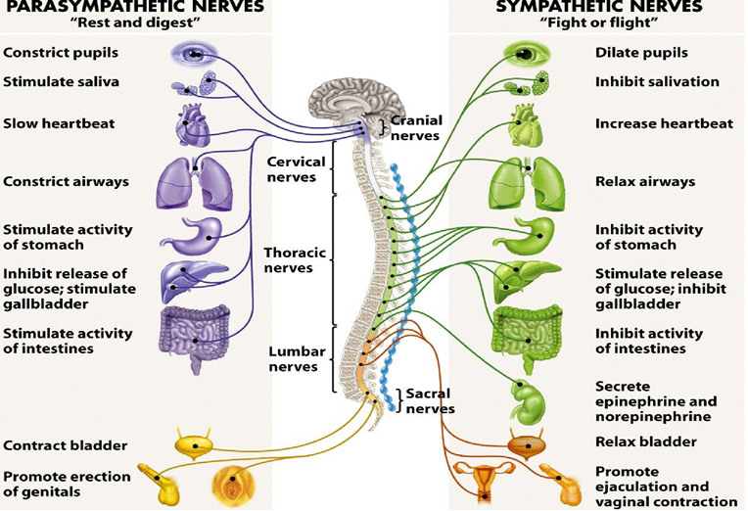
ONLY IN MALES’ SLIDES
Summary of main functions of ANS

Slide 21
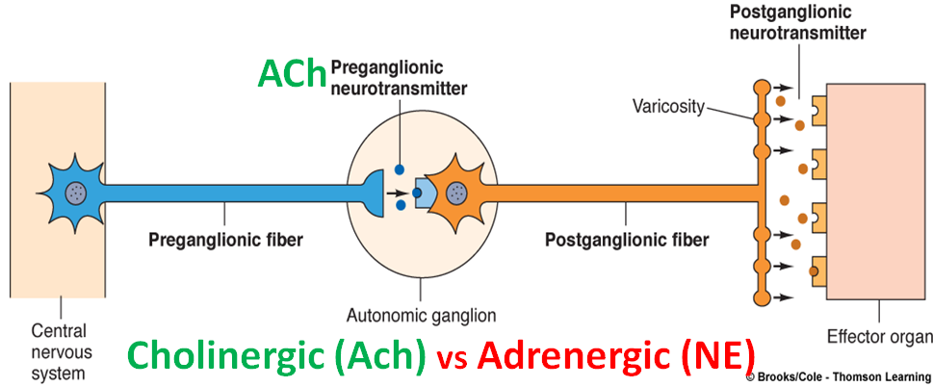
Neurotransmitters & Receptors of the ANS
ANS Neurotransmitters: Classified as either cholinergic or adrenergic neurons based upon the neurotransmitter released.
Adrenergic= release norepinephrine\epinephrine (NE).
Cholinergic= release acetylcholine (ACh).
The ACh acts on two types of receptors, the muscarinic and nicotinic cholinergic receptors.
All cholinergic receptors on the postganglionic neurons of sympathetic and parasympathetic systems and on the adrenal gland are nicotinic.
All cholinergic receptors on effector cells are muscarinic.

Slide 22
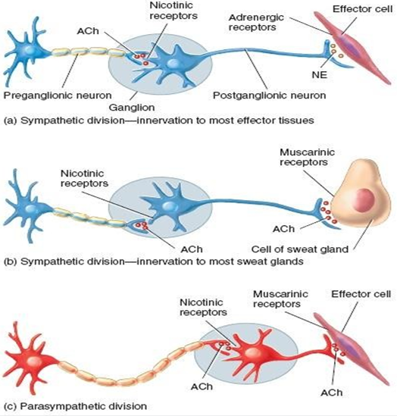
Cholinergic & Adrenergic Receptors
Cholinergic & adrenergic receptors
Sympathetic | Parasympathetic
All preganglionic fibers of ANS release acetylcholine (ach) (cholinergic).
MOST postganglionic sympathetic fibers release norepinephrine (adrenergic), except at sweat glands and some blood vessels in skeletal muscles where they release ach. | All parasympathetic postganglionic fiber release acetylcholine (ach) (cholinergic).

Slide 23
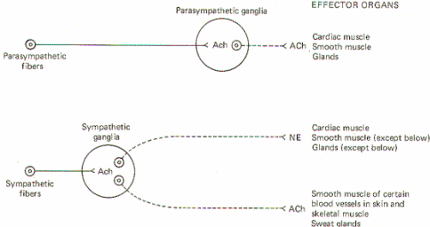
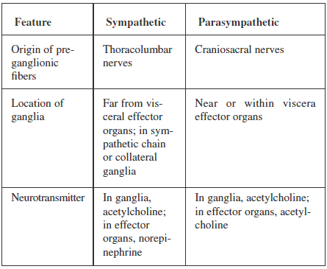
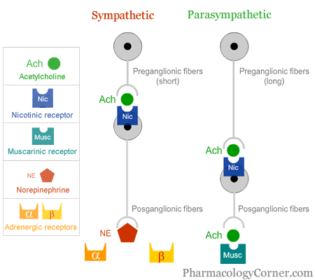
Neurotransmitters of autonomic nervous system
Neurotransmitter released by pre-ganglionic axons:
  Acetylcholine for both branches (cholinergic).
Neurotransmitter released by postganglionic axons:
  Sympathetic – most release norepinephrine (adrenergic).
  Parasympathetic – release acetylcholine.

Slide 24
The autonomic nervous system
Acetylcholine activates mainly two types of receptors. They are called muscarinic and nicotinic receptors.
Muscarine activates only muscarinic receptors whereas nicotine activates only nicotinic receptors; acetylcholine activates both of them.
Muscarinic receptors are found on all effector cells that are stimulated by the postganglionic cholinergic neurons of either the parasympathetic nervous system or the sympathetic system.
Nicotinic receptors are found in the autonomic ganglia at the synapses between the preganglionic and postganglionic neurons of both the sympathetic and parasympathetic systems.

Slide 25
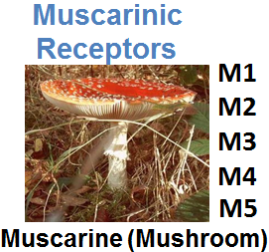
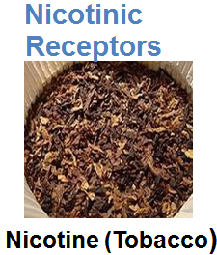
Receptors
Extra
ONLY IN MALES’ SLIDES
Cholinergic receptors:
Adrenergic receptors:
They are named after the drugs that bind to them:
Muscarinic (G-protein coupled) Receptors (bind muscarine)
Nicotinic (ligand-gated) Receptors (bind nicotine)
The Sympathetic NS Acts on two types of receptors α and β :
α1-receptors: their activation usually produces excitation (most target tissues).
α2-receptors: their activation usually produce inhibition (digestive organs)
β1-receptors:. They cause an excitatory response (mainly in heart).
β2-receptors: their activation in general causes inhibition (blood vessels and airways).
β3-receptors:
Blocker: Atropine blocks M receptors and is used to inhibit salivary and bronchial secretion before surgery.

Slide 26
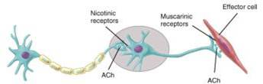
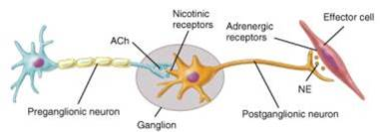
Receptors
ONLY IN FEMALES’ SLIDES
The parasympathetic nervous system uses only acetylcholine (ACh) as its neurotransmitter.
The ACh acts on two types of receptors, the muscarinic and nicotinic cholinergic receptors.
Most transmissions occur in two stages: When stimulated, the preganglionic nerve releases ACh at the ganglion, which acts on nicotinic receptors of the postganglionic nerve.
The postganglionic nerve then releases ACh to stimulate the muscarinic receptors of the target organ.
The Sympathetic NS Acts on two types of receptors : α and β.
What do the receptors do?
Activation of α receptors leads to smooth muscle contraction e.g.blood vessel.
Activation of β2 receptors leads to smooth muscle relaxation.
Activation of β1 receptors leads to smooth muscle contraction (especially in heart).

Slide 27
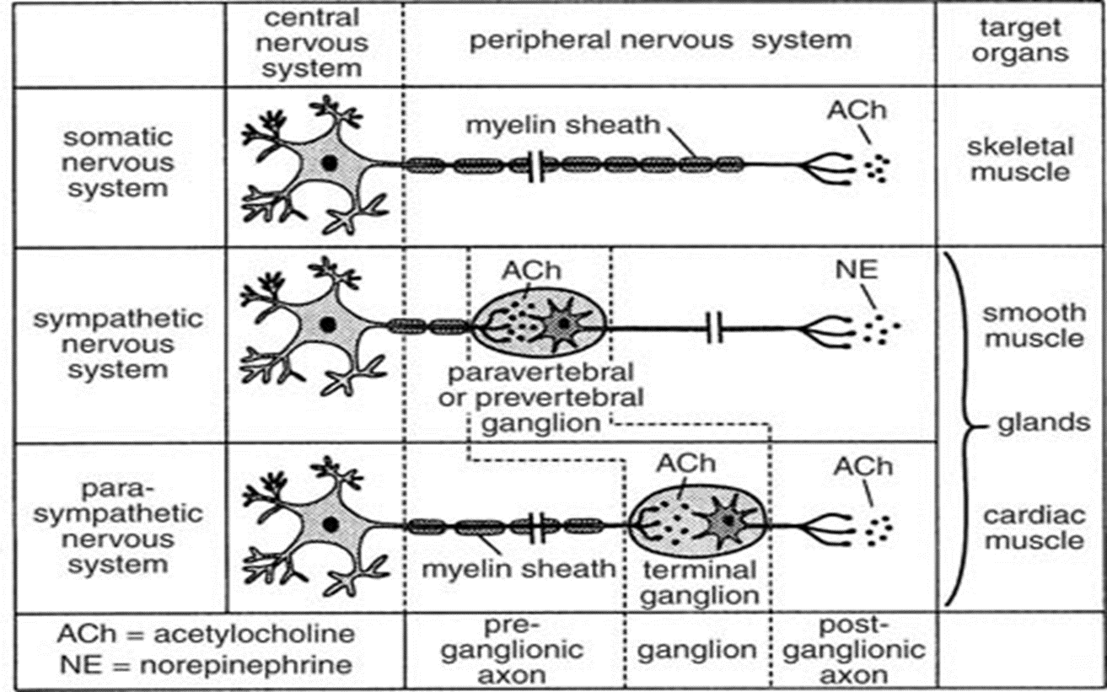
Cont.
ONLY IN MALES’ SLIDES

Slide 28
Physiological functions of the autonomic nervous system
ONLY IN MALES’ SLIDES
Physiological functions of the autonomic nervous system
Structure | Sympathetic (adrenergic) | Parasympathetic (muscarinic) | Structure | Sympathetic (adrenergic) | Parasympathetic (muscarinic)
Endocrine | - | - | circulatory system | - | -
Pancreas (islets) | Α2: decreases secretion | - | cardiac output | increases | M2: decreases
Adrenal medulla | N: secretes epinephrine | - | SA node: heart rate (chronotropic) | β, β2: increases | M2: decreases
Urinary system | - | - | cardiac muscle: contractility (inotropic) | β, β2: increases | M2: decreases (atria only)
Bladder wall | Β2: relaxes | Contracts | conduction at AV node | β1: increases | M2: decreases
Ureter | Α1: contracts | Relaxes | vascular smooth muscle | M3: contracts Α= contracts β2 = relaxes | -
Sphincter | Α1: contracts; β2 relaxes | Relaxes | platelets | α2: aggregates | -
Sweat gland secretions | M: stimulates (major contribution) α1: stimulates (minor contribution) | - | mast cells - histamine | β2: inhibits | -
Arrector pili | Α1: stimulates | - | circulatory system | - | -

Slide 29
Physiological functions of the autonomic nervous system
ONLY IN MALES’ SLIDES
Physiological functions of the autonomic nervous system
Structure | Sympathetic (adrenergic) | Parasympathetic (muscarinic) | Structure | Sympathetic (adrenergic) | Parasympathetic (muscarinic)
respiratory system | - | - | lacrimal glands (tears) | decreases | M3: increases
smooth muscles of bronchioles | β2: relaxes (major contribution) α1: contracts (minor contribution) | M3: contracts | kidney (renin) | secretes | -
nervous system | - | - | parietal cells | - | M1: secretion
pupil of eye | α1: relaxes | M3: contracts | liver | α1, β2: glycogenolysis, gluconeogenesis | -
ciliary muscle | β2: relaxes | M3: contracts | GI tract motility | decreases | M1, M3: increases
digestive system | - | - | smooth muscles of GI tract | α, β2: relaxes | M3: contracts
salivary glands: secretions | β: stimulates viscous, amylase secretions α1= stimulates potassium cation | stimulates watery secretions | sphincters of GI tract | α1: contracts | M3: relaxes

Slide 30
The stress reaction
ONLY IN FEMALES’ SLIDES
When stress occurs, the sympathetic nervous system is triggered.
Norepinephrine is released by nerves, and epinephrine is secreted by the adrenal glands. By activating receptors in blood vessels and other structures, these substances ready the heart and working muscles for action.
Acetylcholine is released in the parasympathetic nervous system, producing calming effects.
The digestive tract is stimulated to digest a meal, the heart rate slows, and the pupils of the eyes become smaller. The neuroendocrine system also maintains the body’s normal internal functioning.
Chronic stress:
When glucocorticoids or adrenaline are secreted in response to the prolonged psychological stress commonly encountered by humans, the results are not ideal.
Normally, bodily systems gear up under stress and release hormones to improve memory, increase immune function, enhance muscular activity, and restore homeostasis. If you are not fighting or fleeing, but standing frustrated in a supermarket checkout line or sitting in a traffc jam, you are not engaging in muscular exercise.
Yet these systems continue to be stimulated, and when they are stimulated chronically, there are different consequences: Memory is impaired, immune function is suppressed, and energy is stored as fat.

Slide 31
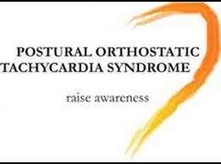
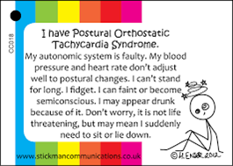
Response to stress
ONLY IN FEMALES’ SLIDES

Slide 32
Summary
ONLY IN FEMALES’ SLIDES
The autonomic nervous system
Subdivision | Nerves Employed | Location of Ganglia | Chemical Messenger | General Function
Sympathetic | Thoracolumbar | Alongside vertebral column | Norepinephrine | Fight or flight
Parasympathetic | Craniosacral | On or near an effector organ | Acetylcholine | Conservation of body energy
Physiological functions of the autonomic nervous system
Structure | Sympathetic | Parasympathetic
Iris (eye muscle) | Pupil dilation | Pupil constriction
Salivary glands | Saliva prod. reduces | Saliva prod. induced
Oral/Nasal mucosa | Mucus prod. reduced | Mucus prod. induced
Heart | Heart rate and force increased | Heart rate and force decreased.
Structure | Sympathetic | Parasympathetic
Lung | Bronchial muscle relaxed (Because we need more oxygen) | Bronchial muscle contracted
Stomach | Peristalsis reduced | Gastric juice secreted; motility increased
Small intestine | Motility reduced | Digestion increased
Large intestine | Motility reduced | Secretions and motility increased
Structure | Sympathetic | Parasympathetic
Liver | Increased conversion of glycogen to glucose (Because we need more energy )
Kidney | Decreased urine secretion | Increased urine secretion
Adrenal medulla | Norepinephrine and epinephrine secreted
Bladder | Wall relaxed Sphincter closed | Wall contracted Sphincter relaxed
Blood sample of stimulated adrenal medulla will have more noradrenaline and adrenaline

Slide 33
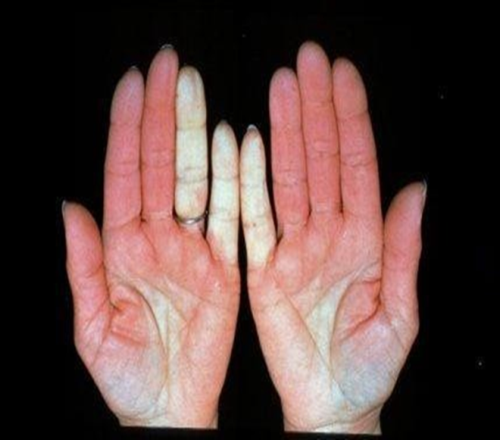
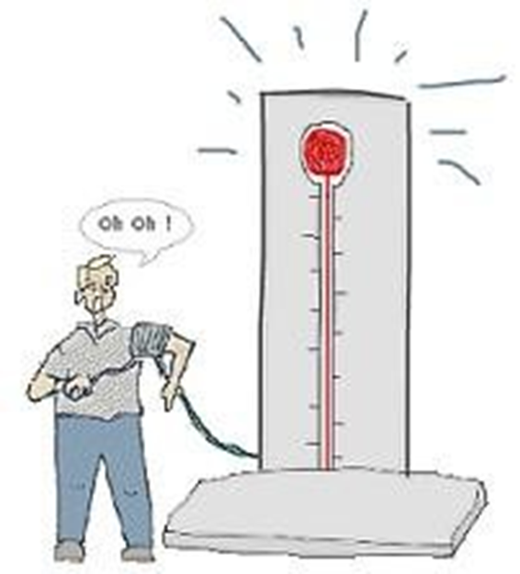
Disorders of the ANS
Extra
Raynaud’s disease:
Hypertension – high blood pressure
Characterized by constriction of blood vessels
It is an exaggeration of vasomotor responses to cold or emotional stress
During an attack, the fingers and toes can change colors from white to blue to red.
Can result from overactive sympathetic vasoconstriction.

Slide 34






Thank you!
اعمل لترسم بسمة، اعمل لتمسح دمعة، اعمل و أنت تعلم أن الله لا يضيع أجر من أحسن عملا.
The Physiology 436 Team:
Team Leaders:
Lulwah Alshiha
Laila Mathkour
Mohammad Alayed
Females Members:
Aseel Alsulimani
Lina alwakeel
Hayfaa Alshaalan
Males Members:
Hassan Alshammari
Contact us:
References:
Females and Males slides.
Guyton and Hall Textbook of Medical Physiology (Thirteenth Edition.)

