Slide 1
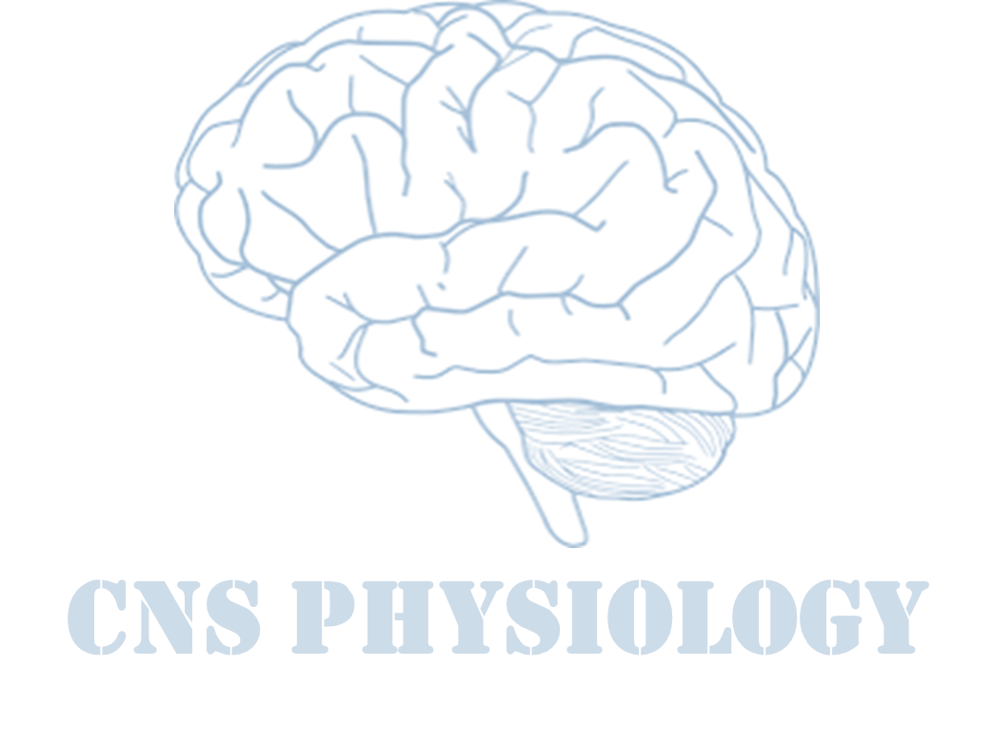
Text.
Important
Formulas
Numbers
Doctor notes
Extra notes and explanation
Lecture No.4
« إنًّ معي ربي سيهدين »
We recommended you to study Embryology lecture first.

Slide 2
Spinal cord functions and reflexes
Objectives:
Describe the general structure and function of the spinal cord
Distinguish between the functional role of gray matter and white matter
Classify reflexes into superficial and deep, and describe the components of a monosynaptic and a polysynaptic reflex arc.
Compare and contrast the features of a stretch reflex, a Golgi tendon reflex, a withdrawal reflex, and a cross extensor reflex.
Appreciate the clinical importance of reflexes (their use as a diagnostic tool for assessment of nervous system function).

Slide 3
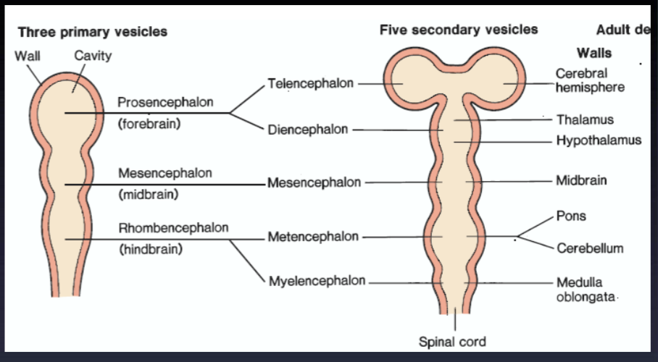
Embryonic development
ONLY IN MALES’ SLIDES
Video of (Early Neural development ) Duration: 2 mins

Slide 4
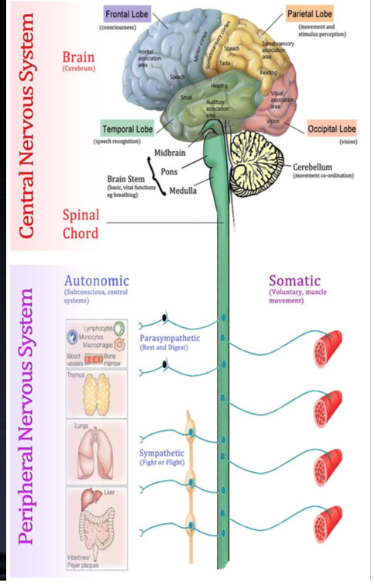
The nervous system
ONLY IN MALES’ SLIDES
Higher brain or cortical level:
Control all lower centers, thought processes, memory
Lower brain or subcortical level:
Subconscious activities of the body are controlled in the lower areas of the
Brain, the medulla, pons, mesencephalon, hypothalamus, thalamus, cerebellum, and
basal ganglia.
Spinal cord level:
Walking.
Withdrawal.
Anti gravity reflexes.
Local blood vessels gastrointestinal, urinary/defecation.

Slide 5
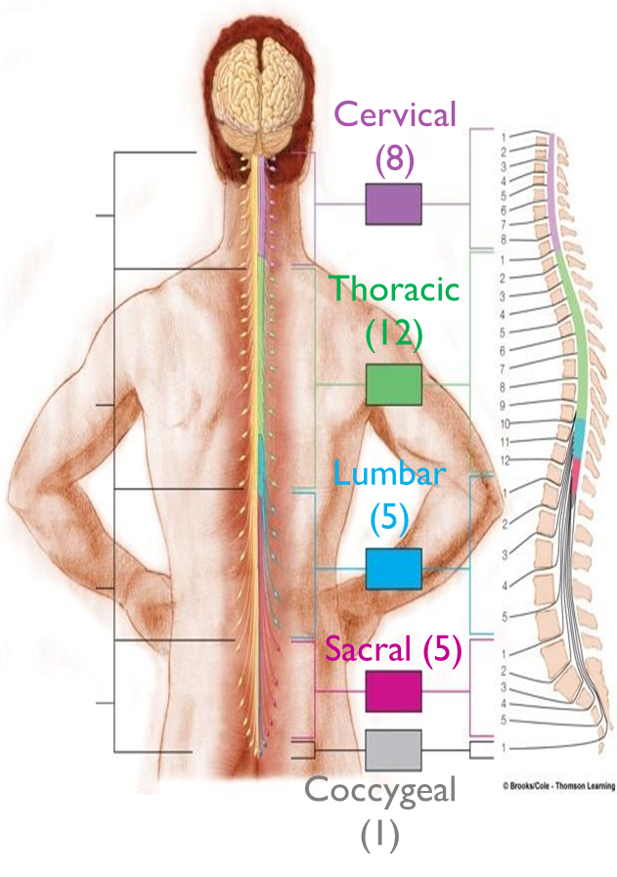
The Spinal Cord (SC)
It is about 45 cm long and 2 cm in diameter.
The spinal cord has a grey matter filled with neurons.
It is composed of about 100 million neurons and even more neuroglia.
It is continuous with the brain and together they make up the CNS (central nervous system).
The spinal cord has 31 pairs of spinal nerves.
Each spinal nerve has
Dorsal
(posterior) roots:
Ventral
(anterior) roots:
Contains afferent (sensory) nerves coming from receptors.
The cell body of these neurons is located in dorsal (posterior) root ganglion (DRG).
Carries efferent (motor) fibers.
The cell body of these motor fibers is located in the ventral (anterior) horn of the spinal cord.

Slide 6
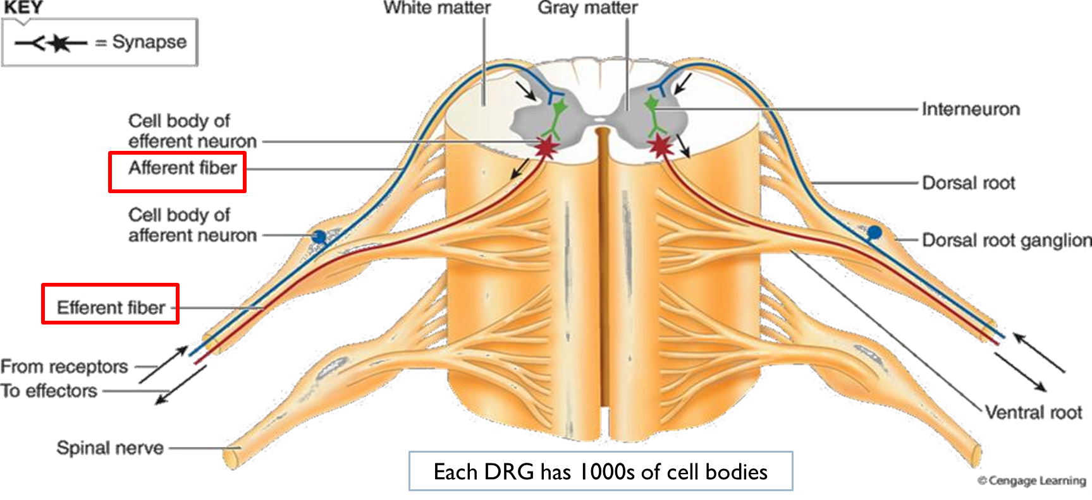
The Spinal Cord

Slide 7
Spinal cord organization
Extra
The structural organization of the spinal cord can best be studied in a cross section of the cord which reveals:
An outer band of white matter surrounding
An inner core of grey matter (H shaped)
Divided into bundles (funiculi), each bundle (tract) contains nerve fibers travelling between the spinal cord and the brain.
These bundles form the spinal cord ascending (sensory) and descending (motor) pathways.
The white matter on each side is divided into 3 broad areas called columns:
1. The dorsal (posterior) column.
2. The lateral column.
3. The ventral (anterior) column.
In the grey matter of the spinal cord and brain, clusters of neuronal cell bodies from functional groups called neuclei.
Sensory neuclei receive input from receptors via sensory neurons.
Motor neuclei provide output to effector tissues via motor neurons.
Can be divided into 3 functional zones:
1. The dorsal (posterior) grey horn contains axons of sensory neurons and cell bodies of interneurons.
2. The lateral grey horn contains cell bodies of autonomic motor neurons.
3. The anterior grey horn contains cell bodies of somatic motor neurons.

Slide 8
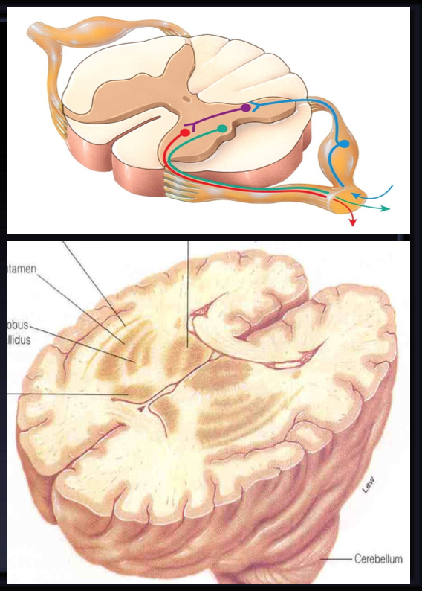
The nervous system
ONLY IN MALES’ SLIDES
How brain functions?
Collection of sensory input.
Central integration.
Motor output.
Grey matter:
The grey matter consists of neuron cell bodies and dendrites and is found in the
cortex (surface layer) of the brain and deep within brain nuclei.
White matter:
White matter consists of axon tracts (the myelin produces the white color). The
adult brain consists of an estimated 100 billion (1011) neurons, and weighs about
1.5 kg. The cerebral blood flow receives 20% of the total cardiac output.

Slide 9
Spinal cord organization
White matter
Gray matter
1
1
2
2
3
3

Slide 10
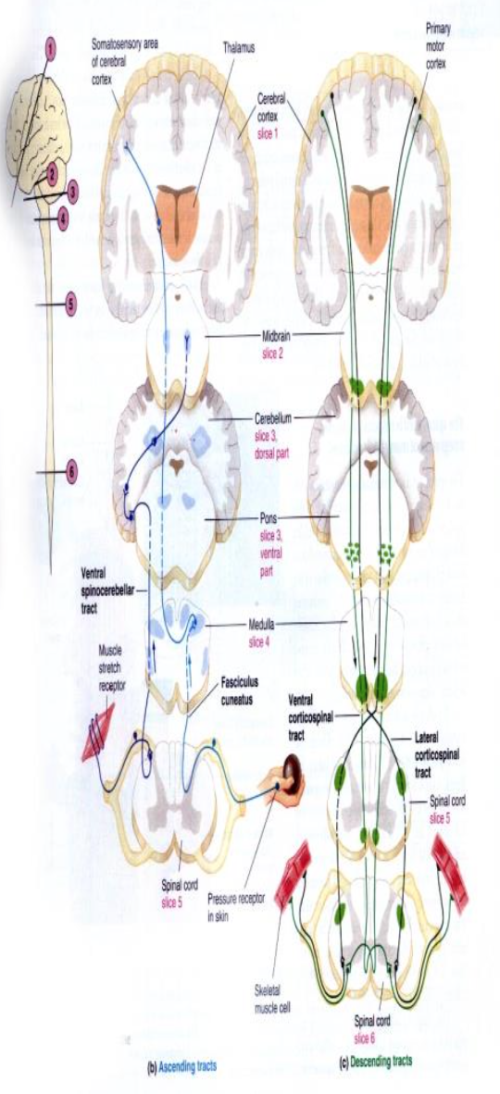
Functions of the spinal cord
ONLY IN FEMALES’ SLIDES
The two-way traffic along the spinal cord:
A-Sensory signals from receptors enter the cord through the sensory (posterior) roots,
then every sensory signal travels to two separate destinations:
One branch of the sensory nerve terminates in the gray matter of the cord and elicits
local segmental cord reflexes
Another branch transmits signals to higher levels in the cord , or to the brain stem, or
even to the cerebral cortex through:
A. spinal ascending sensory tracts as:
Dorsal Column Tracts ( Gracile &Cuneate ).
Lateral & Anterior Spinothalamic Tract.
Spinocerebellar Tracts.
B. Spinal decending motor tracts:
Motor signals & brain motor commands pass through descending motor tracts & then to
spinal efferent motor nerves to skeletal muscles to execute motor functions.

Slide 11
The organization of the spinal cord for motor functions
ONLY IN FEMALES’ SLIDES
What is the motor unit?
وحدة انقباض العضلة
It is the axon + nerve fibers that innervates that muscle.
Anterior horn cells: alpha motor neurons and gamma motor neurons. (these motor neurons are only found in the spinal cord)
Located in each segment of the anterior horns of the cord grey matter, several thousand neurons that are 50 to 100 percent larger than other neurons.
They give rise to nerve fibers that leave the cord in the anterior roots and directly innervate the skeletal muscle fibers.
They give rise to large type A alpha (Aa) motor nerve fibers.
Alpha motor neurons
14 micrometers in diameter.
They are the majority (70% of the neurons)
They are thick, myelinated with very high velocity, they innervate extrafusal muscle fibers (fibers that contract)
Branch in the muscle and innervate the large skeletal muscle fibers called extrafusal fibers.
Anterior horn cells
Along with the alpha motor neurons, are smaller gamma motor neurons.
They transmit impulses through much smaller type A fibers.
Gamma motor neurons
5 micrometers in diameter
They innervate intrafusal muscle fibers (fibers that don’t contract)
They are scattered in between alpha motor.
Go to special skeletal muscle fibers called intrafusal fibers.

Slide 12
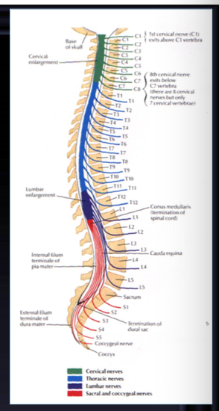
Spinal cord functions
ONLY IN MALES’ SLIDES
Center for Spinal Cord Reflexes (Somatic & Autonomic).
Gateway and conduction pathway for all tracts.
Gateway for Pain control systems.
What is a Reflex?
A reflex is a fast, predictable, automatic response to changes in the environment.
Terms to remember:
Reflex Arc.
Ipsilateral.
Contralateral.
Monosynaptic.
Polysynaptic.
reciprocal innervation

Slide 13
Functions of the spinal cord
ONLY IN FEMALES’ SLIDES
The spinal cord serves two basic functions:
1. The two-way traffic along the spinal cord
2. Generating Spinal Reflexes
Sensory signals from the receptors enter the cord through the sensory (posterior) roots, then every sensory signal travels to two separate destinations:
One branch of the sensory nerve terminates in the grey matter of the cord and elicits local segmental cord reflexes.
Another branch transmits signals to higher levels in the cord, or to the brain stem, or even to the cerebral cortex through spinal ascending sensory tracts as:
Dorsal column tracts (gracile and cuneate).
Lateral spinothalamic tract and anterior spinothalamic tract.
Spinocerebellar tracts.
Motor signals and brain motor commands pass through descending motor tracts and spinal efferent motor nerves to skeletal muscles to excute motor functions.
Reflexes = ردود أفعال
We have other types of reflexes in the brain like corneal reflex, coughing reflex.

Slide 14
Interneurons & interneuron pool
ONLY IN FEMALES’ SLIDES
Interneurons are present in the grey matter in the dorsal horns, the anterior horns, and the intermediate areas between them.
These cells are about 30 times as numerous as the anterior motor neurons, small and highly excitable, often exhibiting spontaneous activity.
Diverging, converging, and repititive-discharge.
They are excitatory or inhibitory.
Different types of neuronal circuits are found in the interneuron pool
The neurons or interneurons are organized in specialized circuits, either parallel or reverberating.
Parallel
Reverbrating
afferent and efferent are parallel to each other (input parallel to output).
Reverberating = إعادة تنشيط
“Re stimulation /Re-excitation”
Like a circle
v

Slide 15
Renshaw Cells
ONLY IN FEMALES’ SLIDES
Renshaw cells: they are small neurons located in the anterior horns of the spinal cord, in close association with the motor neurons.
As the anterior motor neuron axon leaves the body of the neuron, it sends collateral branches to adjacent Renshaw cells.
These are inhibitory cells that transmit inhibitory signals to the surrounding motor neurons by lateral inhibition/stimulation of each motor neurons tends to inhibit adjacent motor neurons.
This lateral inhibition helps to focus or sharpen the signals from each motor neuron.
(allow transmission of the primary signal in the desired direction while suppressing the tendency for signals to spread laterally)

Slide 16
Important characteristics of neuronal circuits
Sensory afferent enter spinal cord via dorsal (posterior) root, as they enter the neuronal pool they undergo:
1. Divergence of signals
2. Reciprocal inhibition
3. Convergence of signals
Diverge means that a signal from a single input spreads to many neurons (many outputs).
In the spinal cord, divergence helps a signal to spread to a wide area. It is important for weak signals entering a neuronal pool to excite far greater numbers of nerve fibers leaving the pool.
Next slide.
Convergence means signals from multiple inputs converge to excite or inhibit a single neuron. Multiple action potentials converging on the neuron from multiple terminals provide enough spatial summation (spatial means at the same time, because we have another type of summation which is temporal summation, the potentials does not come at the same time) to bring the neuron to the threshold required for discharge.
The neurons are almost never excited by an action potential from a single input terminal, multiple stimuli summate and collect together at the same time.
Convergence allows summation of information.
In the same tract/path to cause amplification of the signal.
In multiple tracts (e.g. pain signals can be relayed by different ascending tracts) to transmit the signal to separate areas.
From a single source.
Multiple separate sources (excitatory or inhibitory)

Slide 17
Cont.
2. Reciprocal inhibition: (عكسية أو تبادلية)
Reciprocal inhibition is always polysynaptic
Agonist: monosynaptic
Antagonist: polysynaptic
Stimulation of flexor muscle accompanied by inhibition of extensor through inhibitory interneurons, (and vice versa), the neuronal circuit that causes this reciprocal relation is called reciprocal innervation. Reflex contraction of an agonist muscle is accompanied by inhibition of the antagonist.
The input fiber directly excites the excitatory output pathway, but it stimulates an intermediate inhibitory neuron (neuron 2) which secretes different type of transmitter substance to inhibit the second output pathway from the pool, preventing over activity in many parts of the spinal cord. (and prevents opposition (تعاكس) between the two muscles).
Sometimes an input signal through an input fiber causes:
An excitatory output signal in one direction (ǂ1)
Simultaneously, an inhibitory output signal going elsewhere (ǂ3)
Question:
Which neurotransmitter could be released from inhibitory interneurons?
Answer:
GABA OR
Glycine
ONLY IN MALES’ SLIDES

Slide 18
Cont.
Divergence:
Convergence:
ONLY IN MALES’ SLIDES
Note:
Neurons are almost never excited by a single action potential from a single input terminal.
Temporal or spatial summation is required.

Slide 19
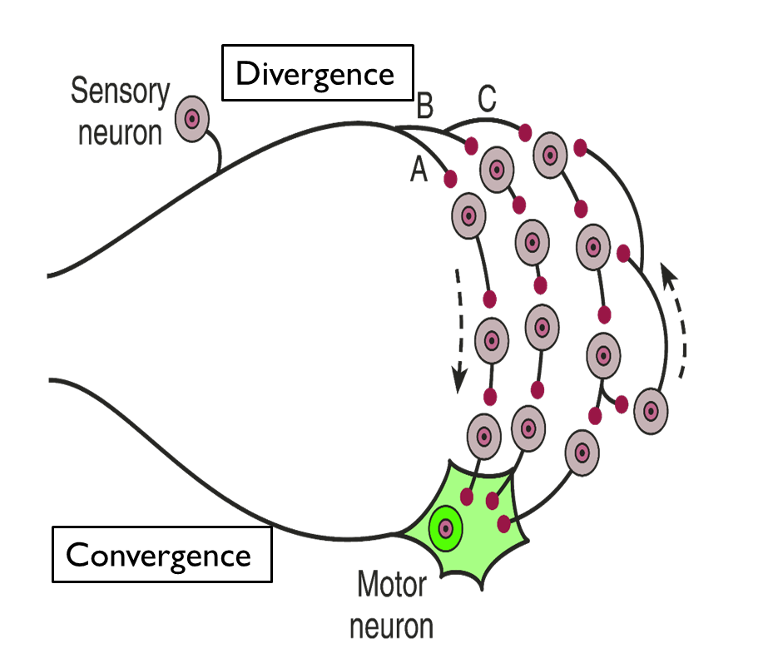
Cont.
ONLY IN FEMALES’ SLIDES
Output from one neuron onto many.
Each postsynaptic neuron receives input from the same presynaptic neuron, but may react to it differently.
In a divergent neural circuit, the axon of one neuron branches to send information to multiple target neurons.
Divergent output allows the same signal to reach many different neurons.

Slide 20
Cont.
Sensory afferent enter spinal cord via dorsal (posterior) root, as they enter the neuronal pool they undergo:
4. Synaptic delay (central delay) and reaction time
5.Irradiation and recruitment
6.Signal prolongation
Is the time of reflex to pass through neurons of the spinal cord.
Synaptic delay
Reaction time
Is the minimal period of time required for transmission of a neuronal signal from a presynaptic neuron to a postsynaptic neuron to a postsynaptic neuron. Its duration is about 0.5 ms per synapse (monosynaptic) (longer in polysynaptic reflex which is > 2 ms).
Number of synapses in a reflex = central delay/0.5 ms (for knee jerk it equals 0.6 msc = one synapse), and it has 5 processes:
Release of neurotransmitter.
Diffusion of neurotransmitter to postsynaptic membrane.
Action of neurotransmitter on membrane receptor.
Action of the receptor to increase ion channel permeability.
Inward diffusion of Na⁺ for generation of action potentials.
Reaction time= reflex time= synaptic delay + time spent in conduction of action potentials through the afferent and efferent nerves.
The time between the application of the stimulus and the response is called the reaction time.
In humans, the reaction time for a stretch reflex such as the knee jerk is 19-24 ms.
The conduction velocities of the afferent and efferent fiber types are known and the distance from the muscle to the spinal cord can be measured. This is responsible for most of the reaction time.
ONLY IN FEMALES’ SLIDES

Slide 21
Cont.
Sensory afferent enter spinal cord via dorsal (posterior) root, as they enter the neuronal pool they undergo:
4. Synaptic delay (central delay) and reaction time
5.Irradiation and recruitment
6.Signal prolongation
Strong stimuli can generate activity in the interneuron pool that spreads up and down the spinal cord to more and more motor neurons, this is called stimulus irradiation.
The increase in the number of active motor units is called recruitment of motor units.
Often the output discharge ( initiated by a signal entering a spinal pool ) is prolonged for a few milliseconds or many minutes after the incoming signal is over.
This prolongation is due to:
ONLY IN MALES’ SLIDES
Synaptic afterdischarge
Reverberatory (oscillatory) circuit
Is caused by positive feedback within the circuit in which the output neuron sends a collateral nerve fiber back to input neuron itself making it discharge repetitively for a long time.
The signal prolongation prolongs the protective response of reflex.

Slide 22
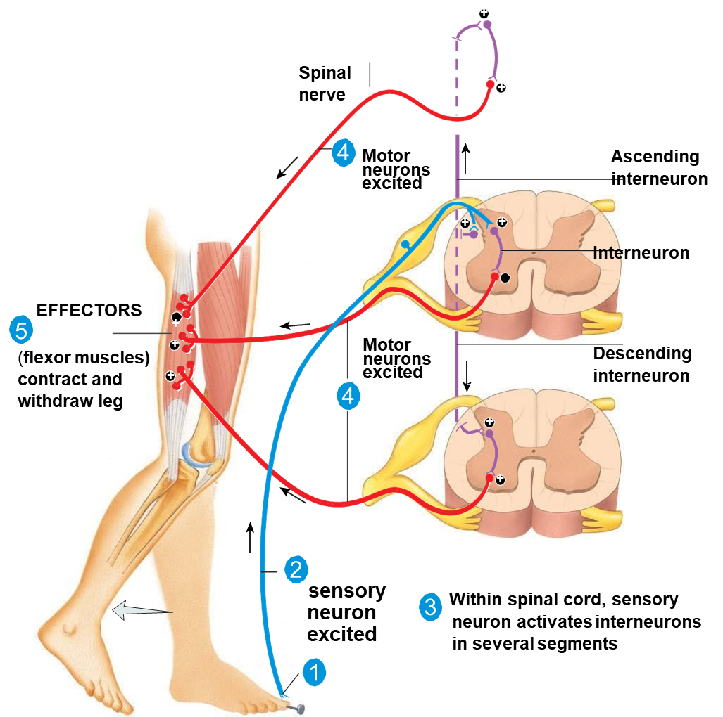
Cont.

Slide 23
Cont.
ONLY IN FEMALES’ SLIDES
Reverberatory (oscillatory) circuit:
The simplest reverberatory circuits involves only a single neuron, the output neuron sends a collateral nerve fiber back to its own dendrites or soma to restimulate the input neuron itself and so the circuit may discharge repetitively for a long time and causes signal prolongation (allow prolonged discharge of the same motor neurons by a single stimulus).
A more complex circuits in which both facilitatory and inhibitory fibers involved on the reverberating circuit.
A facilitatory signal enhances the intensity and frequency of reverberation, whereas an inhibitory signal depresses or stops the reverberation.
Most reverberating pathways are constituted of many parallel fibers.
This picture shows a few additional neurons in the feedback circuit, which causes a longer delay between initial discharge and the feedback signal. For example: itching reflex, As soon as we start itching it becomes more itchy. يعني تنشط نفسها أو Repetition of stimulus.
This picture shows a still more complex system in which both facilitatory and inhibitory fibers interact in the reverberating circuit: (this is to balance between them): A facilitatory signal enhances the intensity and frequency of reverberation. An inhibitory signal depresses or stops the reverberation.
This picture shows that most reverberating pathways are constituted of many parallel fibers. In such a system, the total reverberating signal can be either weak or strong, depending on how many parallel nerve fibers are momentarily involved in the reverberation.

Slide 24
Cont.
ONLY IN FEMALES’ SLIDES
After-discharge, (after stoppage):
A signal entering a pool causes a prolonged output discharge of AHCs called After-
discharge, lasting a few milliseconds to as long as many minutes after.
The incoming signal is over.
Synaptic after-discharge:
when excitatory synapses discharge on the surfaces of dendrites or soma of a neuron, a postsynaptic electrical potential (PSP) develops in the neuron and lasts for many milliseconds. (because the NTs are still coming out).
As long as this potential lasts, it can continue to excite the neuron, causing it to transmit a continuous train of output impulses (a series of repetitive discharges).
This causes maintained reflex action and response continue for some time after cessation of stimulus.

Slide 25
Spinal reflexes
ONLY IN FEMALES’ SLIDES
If there is any spinal motor reflex, the effector would be a muscle.
The functional unit of cns, it is a rapid, automatic (involuntary) response to a stimulus a stimulus could be mechanical electrical, etc. The stimulation goes to the spinal cord and cause a response. (E.G. Pinprick causes withdrawal response) that involves neurons only in the spinal nerves and spinal cord.
The spinal cord and its associated spinal nerves contain neural circuits that control reflexes.
Reflexes are very important in defending against harmful stimuli and maintaining body support.
It involves sensory receptors, sensory afferent neurons, spinal cord motor neurons and spinal nerves (reflex arc).
Reflex arc (reflex circuit) is the pathway followed by nerve impulses that produce a reflex.

Slide 26
Functional components of reflex arc
The Male dr said 7 not 5 and they are :
1. Stimulus 2. Sensory receptor
3. Sensory neuron 4. Integration center
5. Motor neuron 6. Effector
7. Action
Functional components of reflex arc*
1.Sensory receptor
(in the skin)
It responds to a specific stimulus, by producing a graded potential called a Generator Potential(GP).
If a GP reaches the threshold level of depolarization, it will trigger one or more nerve impulses in the sensory neuron.
ONLY IN FEMALES’ SLIDES
2.Sensory neuron
The sensory signal in the form of APs propagate along the axon of the sensory neuron to the axon terminals which are located in the grey matter of the spinal cord or brain stem.
The signal is relayed to brain regions that allows conscious awareness that the reflex has occurred. or to motor neurons directly or via interneurons.
3.Integrating center
In the simplest type of reflex, the integrating center is a single synapse between a sensory neuron termed Monosynaptic Reflex Arc.
A Polysynaptic Reflex Arc involves more the 2 types of neurons and more than one CNS synapse.
APs generated in the integrating center propagate out of the CNS along the efferent axons to the effector.
There are 2 types of motor neurons:
they are large with large myelinated fibers (axons), form 70% of ventral root, supply extrafusal muscle fibers (2/3 of skeletal muscle fibers).
4.Motor (Efferent) neuron
Alpha motor neurons
they are small with small axons, form 30% of ventral root, that supply intrafusal muscle fiber (muscle spindles = 1/3 of skeletal muscle fibers).
Gamma motor neurons
5.Effector
Is the part of the body that responds to the motor nerve impulse, such as a muscle or a gland. Its response is called a reflex.
If the effector is skeletal muscle, the reflex is a somatic reflex.
If the effector is a smooth muscle, cardiac muscle, or a gland, the reflex is an autonomic (visceral) reflex.
*We don’t call this pathway a tract because it is circular, it starts with a receptor and ends with an effector.The reflex arc is purely spinal, does not have any brain effect.

Slide 27
Cont. THIS SLIDE IS VERY IMPORATANT
ONLY IN MALES’ SLIDES
Make sure to remember the levels.

Slide 28
Doctor’s notes
Important for reflexes:
If the spinal cord is cut the reflexes are present but the proper actions are is absent because the nerves can’t reach the brain.
Eg, a cat with a cut spinal cord is unable to walk or stand but if u hold the cat and let her paws touch the ground her legs will extend and strengthen due to a reflex from the spinal cord and this strength is able to lift her but if you leave the cat it will fall because the signal cant reach the brain so there is no balance and the cat can’t send signals to its legs.

Slide 29
Cont. Integrating center
ONLY IN FEMALES’ SLIDES
(Inside the spinal cord, can be in the dorsal or ventral horns or in between)
One or more grey matter neurons within the spinal cord acts as an integrating center.
In the simplest type of reflex, the integrating center is a single synapse between a sensory neuron and a motor neuron.
When a reflex arc consists of only two neurons in an animal (one sensory neuron and one motor neuron) it is defined as monosynaptic. A reflex pathway having only one synapse in the CNS is termed a monosynaptic reflex arc.
More often, the integrating center consists of one or more interneurons, which may relay impulses to other interneurons as well as to a motor neuron.
A polysynaptic reflex arc involves more than two types of neurons and more than one cns synapse.
Note:
Interneurons can be:
Excitatory
Inhibitory
ONLY IN MALES’ SLIDES

Slide 30
Summary
ONLY IN FEMALES’ SLIDES

Slide 31
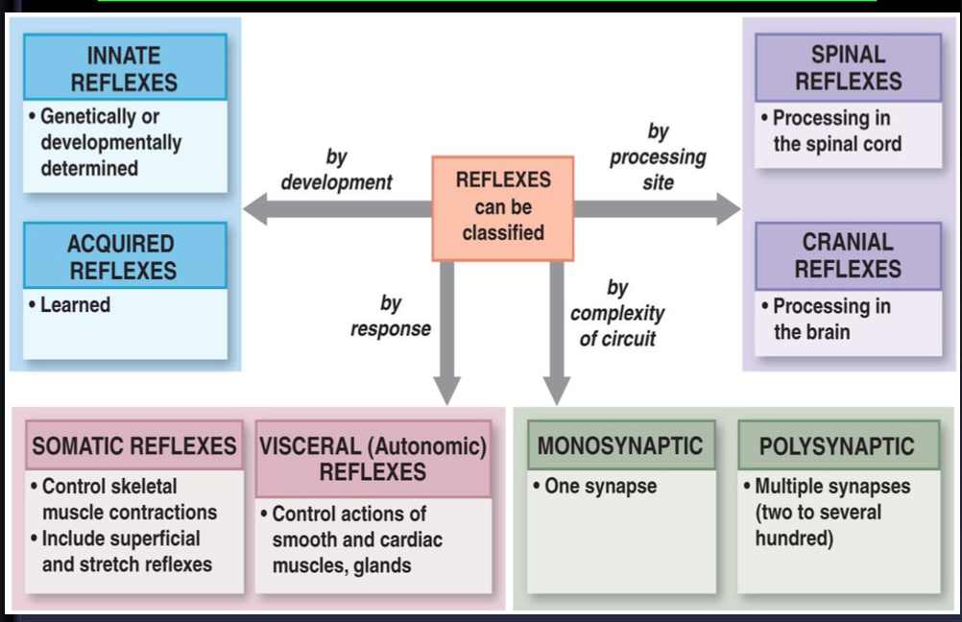
Classification of reflexes
ONLY IN MALES’ SLIDES

Slide 32
Spinal Cord Reflexes
ONLY IN MALES’ SLIDES
Spinal Cord Reflexes
Stretch
Ms Tone
Classification of reflexes
Somatic
Monosynaptic or stretch reflex or tendon jerk
eg.
Bicep jerk.
triceps jerk. supinator jerk. knee jerk.
ankle jerk
Flexor
Withdrawal
Extensor
Standing
Posture
Stepping
Rhythmic
Walking
Scratching
Polysynaptic reflex
eg.
Withdrawal reflex.
Abdominal reflex.
Plantar reflex.
Vasomotor
vascular tone
Visceral reflex
Visceral reflexes are polysynaptic
(Very important)
eg.
Micturation, defecation reflex
Autonomic (Vegetative)
Micturitio/
Defecation
Bladder/Bowl

Slide 33
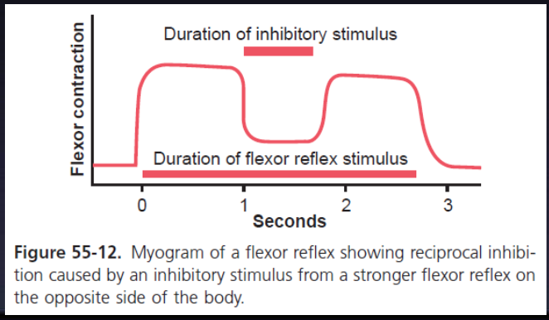
Reciprocal inhibition and reciprocal innervation
ONLY IN MALES’ SLIDES
When a stretch reflex excites one muscle, it often simultaneously inhibits the antagonist muscles, which is the phenomenon of reciprocal inhibition, and the neuronal circuit that causes this reciprocal relation is called reciprocal innervation.

Slide 34
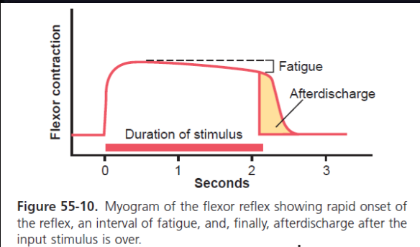
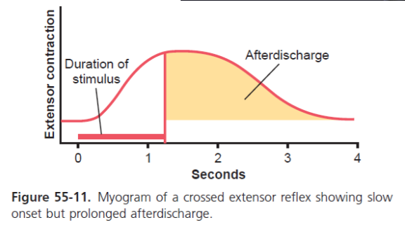
Reflexes
ONLY IN MALES’ SLIDES
Flexor reflex and the withdrawal reflexes:
In the spinal or decerebrate animal, almost any type of cutaneous sensory stimulus from a limb is likely to cause the flexor muscles of the limb to contract, thereby with drawing the limb from the stimulating object. This reflex is called the flexor reflex.
Crossed extensor reflex:
About 0.2 to 0.5 second after a stimulus elicits a flexor reflex in one limb, the opposite limb begins to extend. This reflex is called the crossed extensor reflex.
Extension of the opposite limb can push the entire body away from the object, causing the painful stimulus in the with-drawn limb.

Slide 35
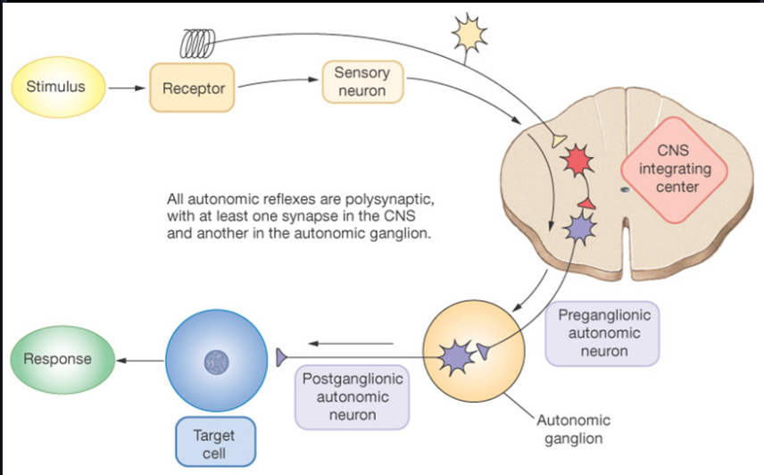
Cont.
ONLY IN MALES’ SLIDES

Slide 36
Reflexes of posture and locomotion
ONLY IN MALES’ SLIDES
Autonomic Reflexes in the Spinal Cord
Stepping and walking movements:
Rhythmical stepping movements of a single limb.
Reciprocal stepping of opposite limbs.
Diagonal stepping of all four limbs “mark time”reflex.
Galloping reflex.
Scratch reflex:
Position sense that allows the paw to find the exact point of irritation on the surface of the body.
A to-and-fro scratching movement.
Spinal cord reflexes that cause muscle spasm
Muscle spasm resulting from a broken bone.
Abdominal muscle spasm in persons with peritonitis.
Muscle cramps.
Segmental autonomic reflexes are integrated in the spinal cord:
Changes in vascular tone resulting from changes in local skin heat.
Sweating, which results from localized heat on the surface of the body.
Intestinointestinal reflexes that control some motor functions of the gut.
Peritoneointestinal reflexes that inhibit gastrointestinal motility in response to peritoneal irritation.
Evacuation reflexes for emptying the full bladder.
Mass reflex:
In a spinal animal or human being, some times the spinal cord suddenly becomes excessively active, causing massive discharge in large portions of the cord by painful stimulus.

Slide 37
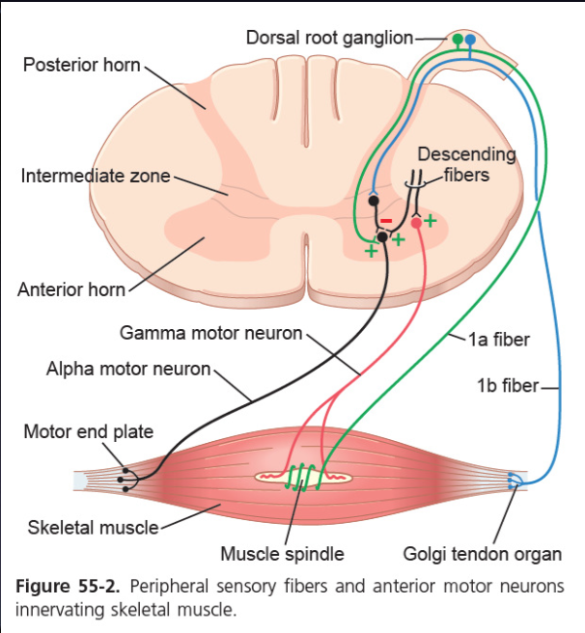
Autonomic reflexes in the spinal cord
ONLY IN MALES’ SLIDES

Slide 38
Types of spinal reflexes
ONLY IN FEMALES’ SLIDES
Spinal Cord Reflexes
Monosynaptic
(one synapse)
Afferent nerve fibers synapse directly with motor neurons
(No interneuron, (one synapse between the afferent and efferent neurons)
e.g. stretch reflex)
According to the number of synapses
Polysynaptic
(2 or more synapses)
Afferent nerve fibers synapse with one or more interneurons. e.g. withdrawal, abdominal and visceral reflexes
Deep reflexes
generated by stimulation of receptors deep in muscle and tendons.
A reflex below the skin ( like muscle reflexes).
Tendon jerks: Reflexes that can be produced by the hammer.
Golgi tendon organ reflex: In the tendon not the muscle.
Withdrawal: like pinprick.
Stretch reflexes (Tendon jerks) are monosynaptic, such as knee-jerk/patellar reflex and ankle jerk.
The receptor for all these is the muscle spindle ( located deep within the muscle itself).
Superficial reflexes
Are polysynaptic reflexes; the receptors are superficial in the skin. E.g. withdrawal, abdominal and plantar reflexes.
Inverse stretch reflex (Golgi Tendon organ reflex) is polysynaptic. T
he receptor is called Golgi Tendon Organ present deep in the muscle tendon.
According to site of the sensory receptor
Visceral
generated by stimulation of receptors in wall of viscera, such as urination, defecation.

Slide 39
Cont. THIS SLIDE IS VERY IMPORTANT
ONLY IN FEMALES’ SLIDES
Types of Spinal Reflexes
Reflex | Stimulus | Clinical test
Stretch (myotatic) reflex | Rapid stretch of muscle | Tap on muscle tendon
Inverse stretch reflex (autogenic inhibition) | Large force on tendon | Pull on muscle when rested
Flexor reflex (withdrawal) | Sharp painful stimulus | None – stepping on nail

Slide 40
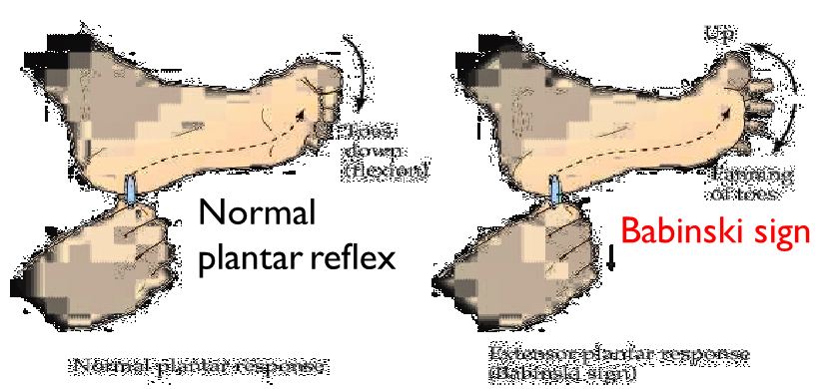
Superficial and deep reflexes
Deep reflexes
Superficial reflexes
Generated by stimulation of receptors deep in muscle and tendons (muscle spindle and Golgi tendon organ).
Examples:
Stretch reflexes (tendon jerk).
Knee-jerk (patellar reflex).
Ankle jerk.
Generated by stimulation of superficial receptors in the skin.
Examples:
Withdrawal reflexes.
Abdominal reflexes.
Plantar reflexes.

Slide 41
Withdrawal Reflex (Polysynaptic)
ONLY IN MALES’ SLIDES
Mediated by: nociceptors (pain receptors).
The response is: reflex contraction of the flexor muscles causing withdrawal of the limb from painful stimulus.

Slide 42
Crossed Extensor Reflexes
ONLY IN MALES’ SLIDES
Withdrawal reflex: Flexion of the injured limb to withdraw from noxious stimulus.
Crossed extensor reflex: Extension of the opposite limb to support full weight of the body.
Explanation:
When a person steps on a painful stimulus(needle) the withdrawal reflex will happen and the person will lift his leg up as a reflex from the pain, then comes the crossed extensor reflex which will extend your other leg to compensate for the weight changing and prevent the person from falling.

Slide 43
Cont.
ONLY IN FEMALES’ SLIDES
While pushing the body away from the injurious agent by withdrawal R, the crossed extensor reflex supporting the body weight against gravity.
Flexion and withdrawal of the stimulated limb (with opposite response) causes extension of the opposite limb which occurs with strong stimulus because of several reasons: why?
(الإصابة لازم تكون قوية عشان يصير irradiation فبالتالي تنرسل إشارات للطرف الثاني ويسوي ردة فعل معاكسة).
Signals from sensory nerves cross the opposite side of the cord to excite extensor muscles.
It does not begin until 200 to 500 milliseconds (because the whole process takes time) after onset of the initial pain stimulus, because many interneurons are involved in the circuit between the incoming sensory neuron and the motor neurons of the opposite side of the cord.
After the painful stimulus is removed, the crossed extensor reflex has an even longer period of after-discharge, results from reverberating circuits among the interneuronal cells.
The prolonged after-discharge is of benefit in holding the pained area of the body away from the painful object.
Mostly in the lower limb to support balance.
Reciprocal innervations occurs also in crossed extensor reflex, How? (the legs have opposite actions). Flexor in the opposite limb are inhibited while extensors are excited because while pushing the body away from the injurious agent by withdrawal R, the crossed extensor reflex supporting the body weight against gravity.

Slide 44
Cont.
ONLY IN FEMALES’ SLIDES

Slide 45
Withdrawal reflex (flexor/nociceptive reflex)
ONLY IN FEMALES’ SLIDES
A superficial polysynaptic reflex:
1
2
3
Stimulation of pain receptors of hand (a pin-prick, heat, or wound)
Impulses to spinal cord in a delta or C fibers
Interneurons pool
6
5
4
move the hand away from the injurious stimulus
Stimulate hand flexor muscles
Motor neurons

Slide 46
Characteristic of withdrawal reflex
ONLY IN FEMALES’ SLIDES
Characterized, involves the basic types of circuits:
1. Diverging circuits to spread the reflex to the necessary muscles for withdrawal.
Stimulation of flexor muscle accompanied by inhibition of extensors through inhibitory interneurons.
Reflex contraction of an agonist muscle is accompanied by inhibition of the antagonist.
2. Circuits to inhibit the antagonist muscles, called reciprocal inhibition circuits.
Cause:
Different conduction velocities of afferents, some are slowly and others are rapidly conducting fibers.
Different number of interneurons with short and long pathways to the motor neurons (AHCs). Impulses do not reach AHCs at the same time but reach them gradually, so maintained stimulation allows more neurons to be stimulated. (some are closer and some are further, so it is gradual, starting from closer to further)
Motor unit recruitment: If a repetitive and strong stimulus is maintained, there will be gradual increase in the force of the muscle contraction until the maximum force is reached, due to gradual recruitment/activation of more and more motor neurons. (to give maintained and strong response).
3. Recruitment*: Gradual and slow activation of more number of motor neurons (AHCs) on stim of afferent nerve in a reflex are by maintained, repetitive stimulus.
4. After-discharge circuits: Circuits to cause after-discharge lasting many fractions of a second after the stimulus is over.
The duration of after-discharge depends on the intensity of the sensory stimulus that elicited the reflex.
Causes:
Presence of reverberating circuit restimulate AHCs.
Value/prolong the protective response of reflex.
5. Irradiation: Spread of impulses up and down to different segments and motor neurons in the spinal cord.
Next slide
6. Pattern of Withdrawal: The pattern of withdrawal that results when the flexor reflex is elicited depends on which sensory nerve is stimulated.
Next slide

Slide 47
Cont.
ONLY IN FEMALES’ SLIDES
5. Irradiation: Spread of impulses up and down to different segments and motor neurons in the spinal cord.
A strong stim in sensory afferent irradiates to many segments of spinal cord due to divergence.
The extent of the response in a reflex depends on the intensity of the stimulus:
6. Pattern of withdrawal: the pattern of withdrawal that results when the flexor reflex is elicited depends on which sensory nerve is stimulated*.
Thus, a pain stimulus on the inward side of the arm elicits not only contraction of the flexor muscles of the arm but also contraction of abductor muscles to pull the arm outward. This is called the principle of “local sign”.
The more intense the stimulus**.
Greater spread of activity in the spinal cord
Involving more and more motor neurons
More response
Types of stimulus
Weak stimulus
Irradiates to small number of neurons, so it causes weak flexion of limb.
Strong stimulus
Irradiates to large number of neurons, so it causes withdrawal of affected limb and extension of opposite limb. (as in crossed extensor reflex)
* في نفس مكان الستيميوليشن يحدث الريسبونس.
** مثال: لما تنجرح من ورقة بتكون ردة الفعل بسيطة، لكن كل ما زاد المسبب زادت ردة الفعل.

Slide 48
Cont.
ONLY IN FEMALES’ SLIDES

Slide 49
Thank you!
اعمل لترسم بسمة، اعمل لتمسح دمعة، اعمل و أنت تعلم أن الله لا يضيع أجر من أحسن عملا.
The Physiology 436 Team:
Team Leaders:
Lulwah Alshiha
Laila Mathkour
Mohammad Alayed
Females Members:
Heba Alnasser
Ghada Alhadlaq
Ghada Almazrou
Males Members:
Mohammad Nusser
Contact us:
References:
Females and Males slides.
Guyton and Hall Textbook of Medical Physiology (Thirteenth Edition.)

