Slide 1
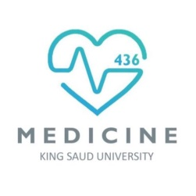
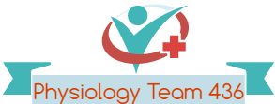
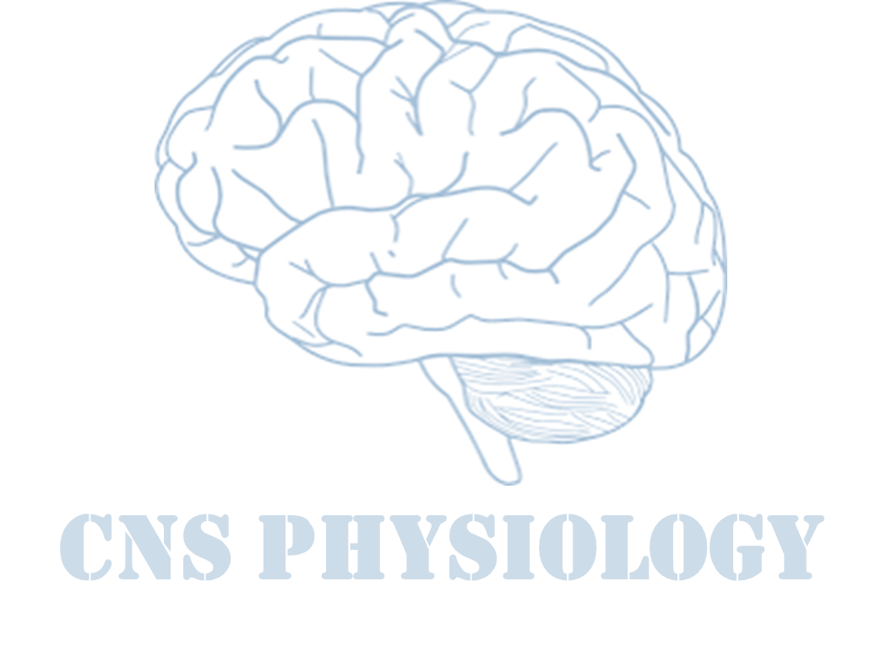
Text
Important
Formulas
Numbers
Doctor notes
Notes and explanation
Lecture No.6
“Don’t Follow The Majority, Follow The Right way”
We recommended you to study the anatomy of brainstem, the ascending and descending tracts lectures first.
We recommended you to read this lecture from neuroanatomy book. You can find the book on the team drive, page 91-101

Slide 2
Physiology of Brainstem
Objectives:
Know what is brainstem.
What are its internal structures.
What are its functions.
What will happen if damaged e.g brain death.

Slide 3
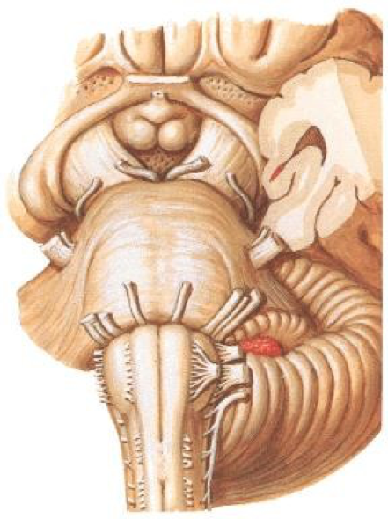
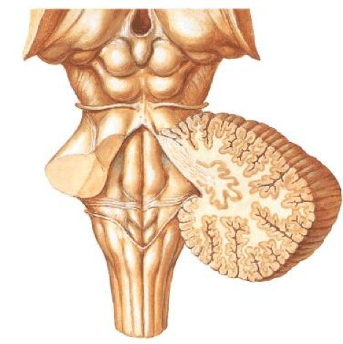
The brainstem
The brain stem is the lower portion of the brain that connects the cerebrum with spinal cord.
It provides a pathway for nerve fibers between the brain and spinal cord.
Anterior surface of brainstem
Posterior surface of brainstem
Cerebral
Peduncles
Superior colliculus
Trochlear nerve
Oculomotor nerve
Inferior colliculus

Slide 4
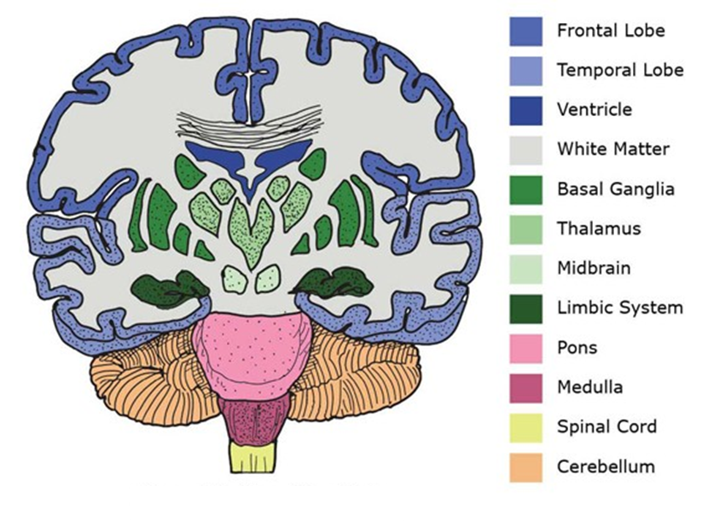
Layers of brainstem
Ventral layer of brainstem is motor in function.
Middle layer is sensory in function & contains medial lemniscus which conveys sensory information from dorsal column.
Extra picture for understanding

Slide 5
Components of brainstem
Brainstem where 1 cm tumor can lead to death.
Basic structure of brain stem:
Roof plate
Tegmentum
Basal portion
Brainstem
Midbrain
Pons
Medulla oblongata
The superior, middle and inferior cerebellar peduncles connect the cerebellum to the midbrain, pons and medulla respectively

Slide 6
Components of midbrain
Brainstem
Midbrain
Pons
Medulla oblongata
The superior, middle and inferior cerebellar peduncles connect the cerebellum to the midbrain, pons and medulla respectively
It constitutes center for visual reflexes
It sends its superior brachium to the lateral geniculate body of the thalamus.
Like turning head to the source of light
Lateral geniculate body: center of vision in the thalamus
Tectum
(Most posterior)
The superior colliculus
The inferior colliculus
It is associated with auditory pathway
It sends its inferior brachium to the medial geniculate body of the thalamus.
The cerebral aqueduct runs through the midbrain, beneath the colloculi.
Turning head towards source of sound.
Medial geniculate body of the thalamus: relay between the inferior colliculus (ic) and the auditory cortex (ac).
Cerebral peduncle:
Lies in ventral side.
Transmits axons of upper motor neurons from the somatomotor cortex to the spinal cord.
Tegmentum (middle)
Lies ventral to the cerebral aqueduct. Several nuclei, tracts and the reticular formation is contained here.
Cerebral peduncle* (crus cerebri)
Transmits axons of upper motor neuron
*cerebral NOT Cerebellar, don’t confuse between the CerebeLLar and cerebral. CerebeLLar peduncles connect the brainstem to the cerebellum.

Slide 7
Internal structure of Midbrain
Midbrain
“Internal structures”
Periaqueductal Gray
Substantia Nigra
Central Tegmental tract
Reticular formation
Around the cerebral aqueduct
contains neurons involved in analgesia and pain modulation/desensitization
1.Occulomotor nerve (CN III) nucleus
2.Trochlear nerve (CN IV) nucleus
3.Red Nucleus: gives out Rubrospinal (motor nucleus that sends a descending tract to the lower motor neurons)
Nigra means black and it is black due to melanin pigments.
Involved in control of motor function
Part of basal ganglia
A concentration of neurons in the ventral portion of midbrain
It is involved in motor function
They secrete Dopamine.
Degeneration of Substantia Nigra is associated with Parkinson’s disease.
Directly anterior to the floor of the 4th
ventricle.
This is a pathway by which many tracts project up to the cortex and down to the spinal cord.
Contains neurons that form the core of the midbrain.
It contains LMN
It is involved in the pain desensitization pathway
It is involved in the arousal and consciousness systems
It contains the locus ceruleus, which is involved in intensive alertness modulation and in autonomic reflexes.

Slide 8
Components of Pons, Medulla oblongata
Brainstem
Midbrain
Pons
Medulla Oblongata
Continuous with the spinal cord.
Fasiculus gracilis and Fasiculus cuneatus:They carry sensation for fine touch, pressure and proprioception.
The superior, middle and inferior cerebellar peduncles connect the cerebellum to the midbrain, pons and medulla respectively
Is the middle portion of the brain stem
At the level of the midpons, the large trigeminal nerve (CN V) emerges.
Between the basal pons, cranial nerve 6 (abducens), 7 (facial) & 8 (vestibulo-cochlear) emerge (medial to lateral).
Is the lowermost portion of the brain stem
Ventral view
Dorsal view
Pyramids which contain the fibers of the corticospinal (pyramidal)
Just lateral to pyramids in the upper medulla are the olives, containing inferior olivary nuclei
Emerging from the anterolateral sulci are the hypoglossal nerve (CN XII) rootlets.
Lateral (and dorsal) to the olives are the rootlets for glossopharyngeal (IX) & vagus (X) cranial nerves.
Moving lateral on each side is the fasciculus gracilis.
The posterior median fissure.
Lateral to that is the fasciculus cuneatus.
Superior to each of these, are the gracile and cuneate tubercles, respectively. Underlying these are their respective nuclei.
In the midline are the motor nuclei for vagus and hypoglossal cranial nerves.

Slide 9
Brain stem motor functions
Brain stem serves as a way station for “command signals” from higher neural centers.
The autonomic nervous system is activated mainly by centers located in the spinal cord, brain stem, and hypothalamus (cardiovascular gastrointestinal autonomic reflexes).
Functions of brain stem nuclei in controlling subconscious, stereotyped movements (anencephaly) motor branch of the fifth cranial nerve, and the chewing process is controlled by nuclei in the brain stem and also swallowing, salivary secretion, vomiting (chemoreceptor trigger zone).
The actual mechanics of feeding are controlled by centers in the brain stem.
Vasomotor center for cv control (baroreceptors) in medulla.
Many of the behavioral functions elicited from the hypothalamus and other limbic structures are also mediated through the reticular nuclei in the brain stem and their associated nuclei.
Accommodation is controlled by parasympathetic nerves by 3rd cn.
Brain stem neurohormonal systems in the human brain for activating four neurohormonal systems.
Although the micturition reflex is an autonomic spinal cord reflex, it can also be inhibited or facilitated by centers in the cerebral cortex or brain stem in pons.
Neural pathways for control of eye movements. Also shows brain stem nuclei for the third, fourth, and sixth cranial nerves by medial longitudinal fasciculus.
Auditory nervous pathways → superior olivary nucleus.
Nucleus of tractus solitarious→ taste pathway→sup & inf salivatory nuclei.
Bulboreticular facilitatory area of brain stem for gamma efferent system (stabilizes joints).
Control of cerebral activity by continuous excitatory signals from the brain stem (reticular excitatory area of the brain stem→bulboreticular facilitory area→it is the same brain stem reticular area that transmits facilitorysignals downward to the spinal cord to maintain tone in the antigravity muscles and to control levels of activity of the spinal cord reflexes.

Slide 10
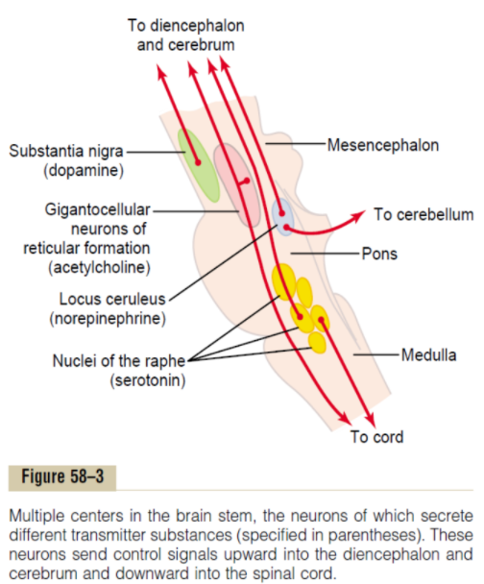
Neurohormonal systems in the brain
ONLY IN MALES’ SLIDES
Role of the brain stem in controlling motor functions
Brain stem areas in the human brain for activating four neurohormonal systems:-
The locus ceruleus and the norepinephrine system. Important role in causing dreaming, thus leading to a type of sleep called rapid eye movement sleep (REM sleep).
The substantia nigra and the dopamine system.
The raphe nuclei and the serotonin system. At cord suppress pain and in higher centers cause normal sleep.
The giganto-cellular neurons
of the reticular excitatory area and
the acetylcholine system. Activation
of these acetylcholine neurons
leads to an acutely awake and
excited nervous system.
1. Control of respiration
2. Control of the cardiovascular system
Role of the brain stem in controlling motor functions
3. Partial control of gastrointestinal function
4. Control of many stereotyped movements of the body
5. Control of equilibrium
6. Control of eye movements

Slide 11
Functions of brainstem
Functions of Brainstem
Conduct functions
All information related from the body to the cerebrum and cerebellum and vice versa, must traverse the brain stem.
origin of cranial nerves (CN III-XII)
integrative functions
conjugate eye movement
Ascending ( sensory ) tracts*
coming from the body to the brain include:
1. Spinothalamic tract for pain and temperature sensation.
2. Dorsal column tracts, fasciculus Gracilis, and fasciculus Cuneatus for touch, Proprioceptive and Pressure sensation.
Descending (motor) tracts**
The corticospinal tract (UMN): runs through the crus cerebri, the basal part of the pons and the medullary pyramids, 70-90% of fibers cross in the pyramidal decussation to form the lateral corticospinal tract, destined to synapse on lower motor neurons in the ventral horn of the spinal cord.
2. Most medial part of the medulla.
3. Corticospinal (UMNs) tract that originates in the cerebral cortex.
4. Other UMNs that originate in the brainstem from:
A.Vestibular nucleus
b. Red nucleus
C. Reticular nuclei
also descend and synapse in the spinal cord.
* Spinothalamic also called anterolateral system.
**Descending tracts includes: pyramidal, corticospinal and extra-pyramidal.

Slide 12
Origin and function of cranial nerves
The brain stem provides the main motor and sensory innervation to the face and neck via the cranial nerves (CN III-XII).
The fibers of cranial nerve nuclei except for olfactory & optic nerve either originating from, or terminating in, the cranial nerve nuclei in brain stem.
Origin and Function of Cranial Nerves
Midbrain (eye movement)
Pons
Medulla
CN III (oculomotor): constrict pupils. Responsible for near vision and accommodation
CN IV (trochlear).
CN V (trigeminal): chewing and sensation front of the head.
CN VI (abducens): eye movement.
CN VII (facial): moves face, taste, salivates, cries.
CN VIII (acoustic): hearing regulates balance.
CN IX (glossopharyngeal): tastes, salivates, swallows, monitors carotid and sinus bodies).
CN X (vagus): tastes, swallows, lifts palate, talking, communication to and from thoraco-abdominal viscera.
CN XI (accessory): turns head, lifts shoulder.
CN XII (hypoglossal): moves tongue.
Sensory (1-2-8) | Motor (3-4-6-11-12) | Mixed ( 5-7-9-10)
CN I, CN II, CN VIII | CN III, CN IV, CN VI, CN XI, CN XII | CN V, CN VII, CN IX, CN X

Slide 13
Functions of brainstem, integrative functions
Functions of Brainstem
Conduct functions
origin of cranial nerves (CN III-XII)
integrative functions
conjugate eye movement
It controls consciousness & sleep cycle (alertness and arousal) through reticular formation (RAS).
2. It has got center for cardiovascular, respiratory & autonomic regulation .
3. It has centers for Brainstem Reflexes , such as cough reflex , gag reflex , swallowing, and vomiting, visual & auditory orientation reflexes required for head movements.
4. Contributes to maintenance of body balance through the vestibular nuclei.
5. Plays role in motor control:
a. Substantia Nigra ( which is a part of the basal ganglia ) is involved in control of movement.
b. Midbrain also contain Red nucleus which regulate the motor activity through cerebellum.
6. Pain sensitivity control: Periaqueductal grey matter of mesencephalon is an area which is rich in endogenous opioid and is important in modulation of painful stimuli
• Inferior and superior colliculi are situated on the dorsal surface of the midbrain and is involved in auditory & visual processing required for head movements.

Slide 14
Functions of brainstem, conjugate eye movement
Functions of Brainstem
Conduct functions
origin of cranial nerves (CN III-XII)
integrative functions
conjugate eye movement
The frontal eye field (FEF) projects to the opposite side at the midbrain-pontine junction, and then innervates the paramedian pontine reticular formation (PPRF).
From there, projections directly innervate the lateral rectus (contralateral to FEF) and the medial rectus muscle (ipsilateral to FEF).
The left FEF command to trigger conjugate eye movements to the right.
ONLY IN FEMALES’ SLIDES
Conjugate eye movement refers to motor coordination of the eyes that allows for bilateral fixation on a single object.
Several centers in the brainstem are involved.
Horizontal conjugate gaze is controlled by:
1.The nuclei of 3rd and 6th Cranial nerves ,
2.The Paramedian Pontine Reticular Formation, and
3.The nucleus prepositus hypoglossi-medial vestibular nucleus.
Vertical conjugate gaze is controlled by the nuclei of 3rd and 4th Cranial nerves

Slide 15
Brainstem
Part | Function | Cranial Nerves | Signs and symptoms of lesion
Midbrain | Nerve pathway to cerebral hemispheres. Auditory and Visual reflex centers. | 1. CN III - Oculomotor (motor) (Related to eye movement). 2. CN IV - Trochlear (motor) (Superior oblique muscle of the eye which rotates the eye down and out) | Cranial Nerve (CN) deficits: Ipsilateral CN III, CN IV palsy and ptosis (drooping). Pupils: - Size: Midposition to dilated. - Reactivity: Sluggish to fixed. Movement: Abnormal extensor. Respiratory: Hyperventilating. Loss of consciousness (LOC): Varies
Pons | Respiratory Center | 1. CN V - Trigeminal (motor and sensory). (Skin of face, tongue, teeth, muscle of mastication). 2. CN VI - Abducens (motor). (Lateral rectus muscle of eye which rotates eye outward). 3. CN VII - Facial (motor and sensory). (Muscles of facial expression). 4. CN VIII – Acoustic (sensory). (Hearing). | Pupils size: Pinpoint LOC: Semi-coma Movement: Abnormal extensor. Respiratory: - Apneustic (Abnormal respiration marked by sustained inhalation). - Hyperventilation. CN Deficits: CN V, CN VI, CN VII, CN VIII.
Medulla Oblingata | Crossing of motor tracts. Cardiac Center. Respiratory Center. Vasomotor Center (nerves having muscular control of the blood vessel walls) Centers for cough, gag, swallow, and vomit. | CN IX - Glossopharyneal (mixed). (Muscles & mucous membranes of pharynx, the constricted openings from the mouth & the oral pharynx and the posterior third of tongue). CN X - Vagus (mixed). (Pharynx, larynx, heart, lungs, stomach). CN XI - Accessory (motor). (Rotation of the head and shoulder). CN XII - Hypoglossal (motor). (Intrinsic muscles of the tongue). | Movement: Ipsilateral paralysis. Pupils: - Size: Dilated. - Reactivity: Fixed. Respiratory: Abnormal breathing patterns CN Palsies: Inability to control movement. Absent cough, gag. LOC: Comatose. damage of medulla can lead to serious condition because it has the most important centers such as respiratory and cardiac centers..
Midbrain lesion: Source of light applied to the eye causes constriction which signifies occulomotor nerve intact.
Pay attention to function of each nerve because you can be asked about specific nerve lesions.

Slide 16
Brainstem function tests
To test: | Look for, Ask about:
reticular formation | Alertness, Consciousness & Sleep. Corticospinal tract: Motor power, reflexes Pain response ex. Facial grimacing on firm pressure over the supra orbital ridge
respiratory center | look for the normal pattern of respiration
cardiovascular center | Look for normal circulatory function
brainstem reflexes | Pupilary and corneal reflexes. Vestibulo-ocular reflex: Injection of iced water into the ear will produce eyes movement. No eye movement > Brainstem injury / death
Oculo-cephalic reflex | Rapidly turn the head 90° on both sides Normal response = deviation of the eyes to the opposite side of head turning Brain death = oculocephalic reflexes are absent (no Doll’s eyes) = no eye movement in response to head movement
Gag reflex | Absent in brain death
Cough reflex | Absent in brain death

Slide 17
Neuroanatomy corner
We recommended you to read this lecture from Neuroanatomy bock. You can find the bock on the team drive, page 91-101
Brainstem lesions:
unilateral brain stem lesion caused by stroke, tumour or multiple sclerosis causes ipsilateral cranial nerve dysunction, contralateral spastic hemiparesis, hyperreexia and an extensor plantar response (upper motor neurone lesion), contralateral hemisensory loss and ipsilateral incoordination.
A bilateral lesion destroys the ‘vital centres’ that control breathing and the circulation, leading to coma and death .

Slide 18
Thank you!
اعمل لترسم بسمة، اعمل لتمسح دمعة، اعمل و أنت تعلم أن الله لا يضيع أجر من أحسن عملا.
The Physiology 436 Team:
Team Leaders:
Lulwah Alshiha
Laila Mathkour
Mohammad Alayed
Females Members:
Najd Altheeb
Reema Alshayea
Reem Alshathri
Males Members:
Mohammad Almutlaq
Contact us:
References:
Females and Males slides.
Neuroanatomy An Illustrated Colors Text 5th.

