Slide 1
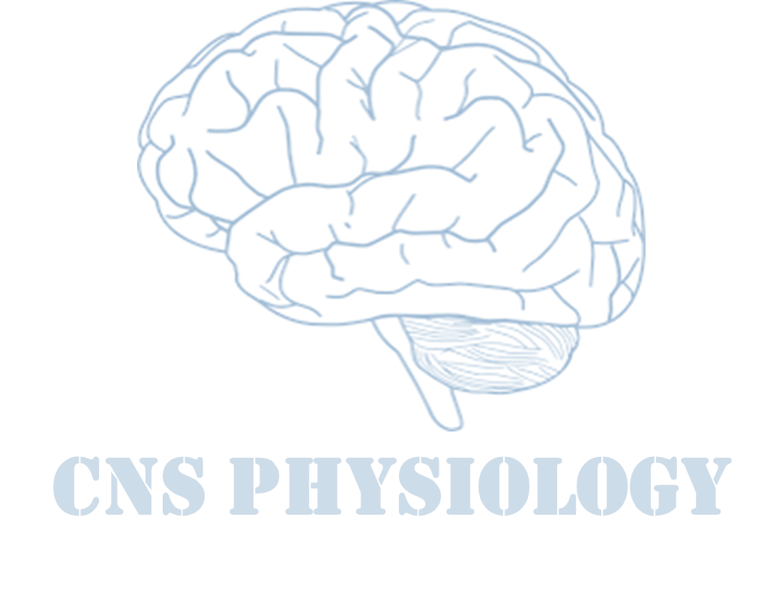
Text
Important
Formulas
Numbers
Doctor notes
Notes and explanation
Lecture No.7
“والله إن المسألة تُغلق في وجهي، فأستغفر الله ألف مرة فتُفتح لي “
ابن تيمية

Slide 2
Physiology of sleep
Objectives:
Explain the differences between sleep and coma.
Define NREM (non-rapid eye movement, SWS) and REM (rapid eye movement) sleep.
Describe how NREM and REM sleep are distributed during a normal night sleep in the average adult human.
Describe the behavioral and autonomic features associated with NREM and REM sleep.
Describe EEG, as a physiological tool, is being used to delineate in which stage of sleep (or wakefulness) a person is.
Appreciate how the total sleep duration and different sleep stages vary with different ages in normal humans.
Describe the current theories about the neural basis of sleep.

Slide 3
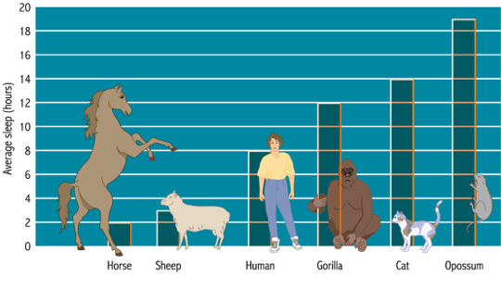
What is sleep?
Theories of sleep
Sleep (Physiological definition): is a state of unconsciousness from which a subject can be aroused by appropriate sensory or other stimuli.
Sleep may also be defined as a normal, periodic, inhibition of the reticular activating system. ( Anatomical definition)
Awake: This is the state of readiness / alertness and ability to react consciously to various stimuli.
Coma: is a state of unconsciousness from which a person cannot be aroused by any external stimuli.
Normal sleep requirements:
New born = 15 - 20 hours.
Children = 10 -15 hours.
Adults = 6 - 9 hours.
Old age = 5 - 6 hours.
ONLY IN MALES’ SLIDES
Restoration theory: Body wears out during the day and sleep is necessary to put it back in shape. This is further supported by findings that many of the major restorative functions in the body like muscle growth, tissue repair, protein synthesis, and growth hormone release occur mostly, or in some cases only, during sleep.
Preservation and protection theory: Sleep preserve energy and it provides activity. For example, both body temperature and caloric demand decrease during sleep, as compared to wakefulness.
ONLY IN FEMALES’ SLIDES

Slide 4
Why do we sleep?
ONLY IN FEMALES’ SLIDES
Proximate explanation | Ultimate explanation
Feeling tired (melatonin) ↑ | sustains our ability to reproduce successfully, by maintaining good health
Consolidate energy and experiences.
Restore body cells and promote protein anabolism.
Maintain hormonal secretions, immune function.
Maintain hormonal secretions, immune function

Slide 5
Cont.
ONLY IN FEMALES’ SLIDES
Why Do We Sleep?
Sleep theory
#1 – To Rest
Sleep theory
#2 – To Heal
Sleep theory
#3 – To Learn
Sleep theory
#4 – To Dream
To gain relief from this hyperactive state.
Sleep also allows us to heal our bodies. The immune system (our ability to fight diseases) sleep deprivation affects our metabolism (our internal chemical reactions). It may also help us save energy for when we most need it.
People who don’t sleep they’ll have low immunity and then nervous breakdown which may lead to death.
Sleep may help human brain get better organized – by filing away important memories and discarding unwanted information.
Dreaming appears to be a by-product of REM sleep. So is it possible that the main reason why we sleep is to dream? If so, why do we dream?

Slide 6
Cont.
Extra
Why Do We Sleep?
Restoration, or repair
Protection with the circadian cycle
Circadian synthesis of hormones
Consolidation of learning
Waking life disrupts homeostasis
Sleep may conserve some energy
Remodelling of synaptic function

Slide 7
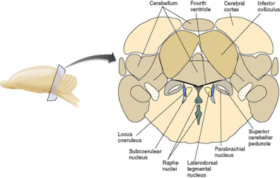
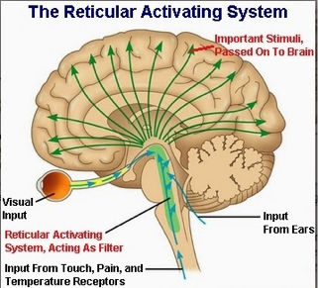
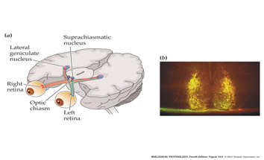
The reticular activating system
ONLY IN FEMALES’ SLIDES
A diffuse network of nerve pathways in the brainstem connecting the spinal cord, cerebrum, and cerebellum, and mediating the overall level of consciousness.= 5 - 6 hours.
So when we cut it (inhibit it) we will fall asleep.

Slide 8
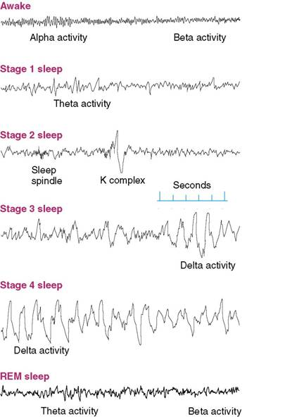
Stages of sleep: recorded by EEG
ONLY IN FEMALES’ SLIDES
It can be done while the patient is sleeping or awake depending on his condition
EEG waves
Waves | Frequency | Type of activity | Recorded from | Associated with / occurs
Alpha | 8 – 12 hz | Smooth electrical activity | Brain | Associated with a state of relaxation.
Beta | 13 – 30 hz | Irregular electrical activity | Brain | Associated with a state of arousal.
Theta | 3.5 – 7.5 hz | - | - | Occurs intermittently during early stages of slow wave sleep and REM sleep.
Delta | Less than 4 hz | Regular, synchronous electrical activity | Brain | Occurs during the deepest stages of slow-wave sleep.
Notice that the waves of REM stage similar to the waves when the person is awake

Slide 9
EEG waves
Waves | Frequency The frequencies of brain waves range from 0.5-500 hz. | Recorded from | Seen in | Occur | Diagram | Other
Alpha | 8-13 hz | Most marked in the parieto-occipital | In all age groups but are most common in adults | Occur rhythmically on both sides of the head but are often slightly higher in amplitude on the nondominant side, especially in right-handed individuals Occur with closed eyes , relaxation, wondering mind. |  | -
Beta | Greater than 13 hz | - | In all age groups. | - |  | Small in amplitude , usually symmetric and more evident anteriorly.
Theta | 3.5-7.5 hz | - | During sleep at any age | - |  | In awake adults, these waves are abnormal if they occur in excess. Theta and delta waves are known collectively as slow waves.
Delta | 3 hz or less | - | Normally seen in deep sleep in adults as well as in infants and children. | - |  | Delta waves are abnormal in the awake adult. Often, have the largest amplitude of all waves. Delta waves can be focal (local pathology) or diffuse (generalized dysfunction).
Extra

Slide 10
Sleep centre
ONLY IN MALES’ SLIDES
Normal sleep is under control of the reticular activating system in the upper brain stem and diencephalon.
Sleep is promoted by a complex set of neural and chemical mechanisms:
Daily rhythm of sleep and arousal: suprachiasmatic nucleus of the hypothalamus which regulate pineal gland’s secretion of melatonin (increased melatonin makes us sleepy).
1- SWS (Slow-Wave Sleep)
2- REM sleep (Rapid Eye Movement )
because in this type of sleep EEG waves are generally of low frequency .
It is also called Non-Rapid Eye Movement (NREM) sleep because , unlike the other type of sleep it is not associated with rapid eye movements .
Raphe nuclei of the medulla and pons and the secretion of serotonin.
Because in this type of sleep the the person makes rapid movements by his eyes, in spite of the fact that he is sleeping.
Neurons of the pons

Slide 11
Reticular activating system
ONLY IN MALES’ SLIDES
Consists of two parts:
1-Mesencephalic part:
2-Thalamic part:
Composed of area of grey matter of mid brain and pons, when this area is stimulated, nerve impulses going to thalamus and disperse to the cerebral cortex. This greatly effects the cortical activity. Mesencephalic part causes consciousness.
Consists of grey matter in the thalamus. When the thalamic part is stimulated, it develops activity in the cerebral cortex. Thalamic part causes arousal that is awakening from deep sleep (sensory input, pain, light).
The RAS and cerebral cortex continue to activate each other through a feedback system.
The RAS also has a feedback system with the spinal cord.

Slide 12
Types of sleep
ONLY IN FEMALES’ SLIDES
Sleep is promoted by a complex set of neural and chemical mechanisms:
Daily rhythm of sleep and arousal: suprachiasmatic nucleus of the hypothalamus pineal gland’s.
Secretion of melatonin.
Types of sleep
1- Slow-wave sleep (non-REM)
2- Rapid Eye Movement Sleep (REM)
75% of sleep time.
restful.
Decrease in vascular tone.
Decrease in BP (10-30% )
Decrease in Resp. rate.
Decrease in BMR
It is not associated with rapid eye movement
EEG: Theta + delta waves.
If dreams occur they are not remembered as they are not consolidated in memory.
In this type of sleep, EEG waves are generally of low frequency.
Is so called because of rapid eye movement.
Occur in episodes of 5-30 min, recurring every 90 min.
Tiredness shortens the duration of each episode.
As you become restful through the night, the duration of each episode increases.
Active dreaming, remembered later.
More difficult to awake a person than in slow-wave sleep.
In this type of sleep, rapid eye movements occur (Neurons of the pons)
Dreams which occur during REM can be remembered while those during NREM can not

Slide 13
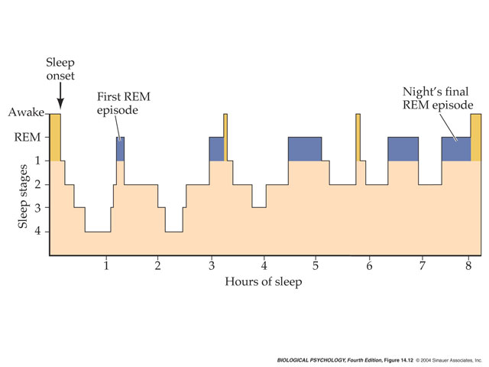
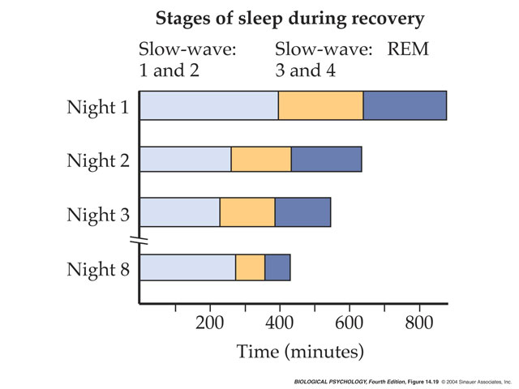
Types of sleep
ONLY IN MALES’ SLIDES
Types of sleep
1-Non rapid eye movement sleep (slow wave sleep – dreamless)
2- Rapid Eye Movement Sleep (dreamful)
In normal sleep bouts of REM sleep lasting for 5-20 minutes usually appear on the average after every 90 minutes.
The first such period occurring 80-100 minutes after the person falls asleep.
REM duration decreases with each cycle.
When the person is in extreme sleep, the duration of each bout of REM is very short.
It may even be absent
These two types of sleep alternate with each other.

Slide 14
Cont.
ONLY IN MALES’ SLIDES
Characteristics of Rapid eye movement sleep:
Active dreaming.
Difficult to arouse by sensory stimuli.
Decreased muscle tone through the body.
Heart rate and respiration become irregular which is characteristic of a dream state.
Brain is highly active in REM sleep and brain metabolism may be increased by 20%.
EEG: Pattern shows brain wave of wakefulness, REM sleep is a type of sleep in which the brain is quite active.

Slide 15
ONLY IN MALES’ SLIDES
EEG waves in wakefulness
Sleep and EEG
Awake, but non-attentive.
Large.
Regular alpha waves.
Awake and attentive.
Low amplitude.
Fast.
Irregular beta waves

Slide 16
REM sleep (paradoxical sleep)
ONLY IN FEMALES’ SLIDES
In a normal night of sleep, episodes of REM sleep lasting 5 to 30 minutes usually appear on the average every 90 minutes.
REM sleep is not as restful as SWS. It occupies 80% of total sleep time in premature infants & 50% in full term neonates.
When the person is extremely sleepy, each episode of REM sleep is short, and it may even be absent.
Conversely, as the person becomes more rested through the night, the durations of the REM episodes increase.
There are several important characteristics of REM sleep:
There are rapid eye movements.
Muscle tone throughout the body ( except eye muscles ) is exceedingly depressed (due to excitation of reticular inhibitory centers).
Since during REM there is eye movement ,so the muscles are contracted.
Therefore , it is not surprising that REM sleep is also called paradoxical sleep : the paradox being that although the person is asleep , he may seem ( because of his eye movements , etc ) awake.
The portion of REM sleep falls rapidly and plateaus at about 25% until it falls further in old age.
Children have more total sleep time and stage 4 sleep than adults.
HR & RR are irregular.
Erection of penis.
Engorgement of clitoris.
REM sleep is a type of sleep in which the brain is quite active , but this brain:
is not aware cut off the external world.
its activity is not channeled into purposeful external motor activity.

Slide 17
Stages of sleep
ONLY IN FEMALES’ SLIDES
Stages of sleep
NREM Sleep (SWS)
People dream in this stage but they do not remember there dreams
REM Sleep*
Low voltage
fast activity
Stage 1 NREM
Stage 2 NREM
Stage 3 NREM
Stage 4 NREM
when a person is initially falling asleep.
Characterized by low-amplitude, fast activity.
Alpha waves diminish and Theta waves appear on EEG.
This is the first stage of true sleep
Marked by appearance of Sleep Spindles . These are bursts of alpha-like 10-14 z , 50 uV waves .
Lower frequency
( mainly theta), higher amplitude EEG waves. Body temperature begin to fall. BP decreases. Difficult to awaken the person. This stage occurs about 20-25 minutes after falling asleep.
Still slower frequency ( mainly delta ) & still higher amplitude waves. The differences is that the dreams in SWS are not remembered but in REM, dreams can be remembered.
*People dream in this stage and they do remember their dreams.

Slide 18
Stages of sleep
ONLY IN MALES’ SLIDES
Stages of sleep
A- NREM Sleep (SWS)
B- REM Sleep
Low voltage
fast activity
Stage 1 NREM
Stage 2 NREM
Stage 3 NREM
Stage 4 NREM
This stage is an initial stage between awakening and sleep.
It normally lasts from 1-7 minutes.
The person feels relaxed with eyes closed.
If awakened, the person will frequently say that he has not been sleeping.
EEG findings: Alpha waves diminish and Theta waves appear on EEG.
This is the first stage of true sleep.
The person experiences only light sleep.
It is a little harder to wake the person.
Fragment of dream may be experienced.
Eye may slowly roll from side to side.
EEG findings: Shows sleep spindles (sudden, sharply, pointed waves 12-14 HZ (cycles/sec).
This is the period of moderately deep sleep.
The person is very relaxed.
Body temperature begin to fall.
B.P decreases.
Difficult to awaken the person.
This stage occurs about 20-25 minutes after falling asleep.
EEG findings: Shows mixture of sleep spindles and delta waves.
Deep sleep starts.
Person become fully relaxed.
Respond slowly if awakened.
EEG findings: Dominated by Delta waves.
Note: Most sleep during each night is of a slow wave.
Lasts for 80-90 minutes.
Dreams / nightmares even occur.
The difference is that the dreams in slow wave sleep are not remembered but in REM, dreams can be remembered.

Slide 19
Sleep stages ( NREM )
Extra

Slide 20
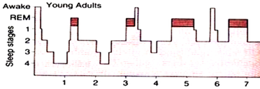
Distribution of Sleep Stages
ONLY IN FEMALES’ SLIDES
SWS occupies most of the total night sleep time ( around 75-80% ) , it is interrupted by intervening REM sleep periods ,approximately every 90 minutes (In young adults).
In a typical night of sleep, a young adult (1) first enters NREM sleep passes through stages 1 , 2 , 3 and 4 SWS , and then, 60-100 minutes from sleep onset , goes into the first REM sleep episode.
This cycle is repeated at intervals of about 90 minutes throughout the 8 hours or so of a night sleep.
There are 4-6 (8 hours sleep) sleep cycles per night ( and 4-6 REM periods per night).
As the night goes on there is progressive reduction in stages 3 and 4 sleep and a
progressive increase in REM sleep.
In a young adult SWS ( NREM sleep) occupies 75-80% of a night sleep time , & REM
sleep occupies 20-25 % of the sleep time.
As long as the people become older their REM period decrease.
REM sleep periods are shown in red*
*Notice that you start with stage 1,2,3,4 then go back to stage 1 before you enter REM stage.

Slide 21
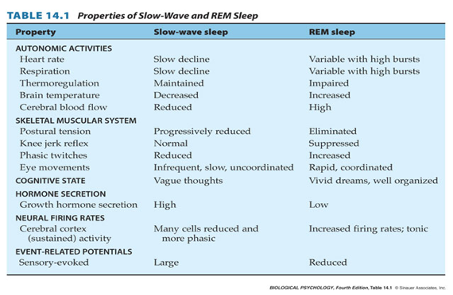
Characteristics of SWS and REMS

Slide 22
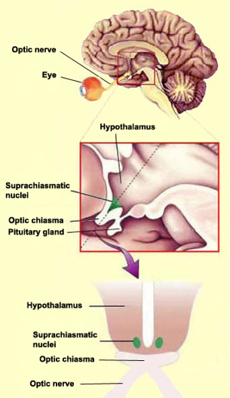
Physiological changes during sleep
CVS: Pulse Rate, cardiac output, blood pressure, and vasomotor tone are decreased but the blood volume is increased. If the pulse rate is high during sleeping, it is a sign of hyperthyroidism.
Respiration:
Tidal volume and rate of respiration are decreased.
BMR is decreased 10-15%.
Urine volume: Urine volume is decreased.
Secretions: Salivary / lacrimal secretions are reduced, gastric/sweet secretions are
increased.
Muscles: Relaxed.
Superficial reflexes are unchanged except planter reflex.
Deep reflexes are reduced.
Effects produced by awakening after 60-100 hours: Equilibrium disturbed,
Meuromuscular junction fatigue, Threshold for pain is lowered, Some cells shrink.
Extra

Slide 23
1- neural control of arousal
ONLY IN FEMALES’ SLIDES
Neural Control of Arousal
Acetylcholine
Norepinephrine
Locus ceoruleus
Serotonin (5-HT)
Raphe nucleus
- One of the most important neurotransmitters involved in arousal.
- Two groups of acetylcholinergic neurons located in the pons and basal forebrain, produce activation and cortical desynchrony when they are stimulated.
Catecholamine agonists produce arousal and sleeplessness; effects appear to be mediated by the locus coeruleus in the dorsal pons.
A dark-colored group of noradrenergic cell bodies located in the pons near the rostral end of the floor of the fourth ventricle; involved in arousal and vigilance
Appears to play a role in activating behavior; almost all of the brain’s serotonergic neurons are found in the raphe nucleus, located in the medullary and pontine regions of the brain.
A group of nuclei located in the reticular formation of the medulla, pons, and midbrain, situated along the midline; contain serotonergic neurons.
Catecholamine agonists produce arousal and sleeplessness; effects appear to be mediated by the locus coeruleus in the dorsal pons.
Catecholamine agonists produce arousal and sleeplessness; effects appear to be mediated by the locus coeruleus in the dorsal pons.

Slide 24
Cont.
ONLY IN FEMALES’ SLIDES
Neural Control of Arousal
Histamine
Tuberomammillary nucleus
Hypocretin
A neurotransmitter implicated in control of wakefulness and arousal; a compound synthesized from histidine, an amino acid.
A nucleus in the ventral posterior hypothalamus, just rostral to the mammillary bodies; contains histaminergic neurons involved in cortical activation and behavioral arousal.
A peptide also known as orexin, produced by neurons whose cell bodies are located in the hypothalamus; their destruction causes narcolepsy.
Catecholamine agonists produce arousal and sleeplessness; effects appear to be mediated by the locus coeruleus in the dorsal pons.
Catecholamine agonists produce arousal and sleeplessness; effects appear to be mediated by the locus coeruleus in the dorsal pons.

Slide 25
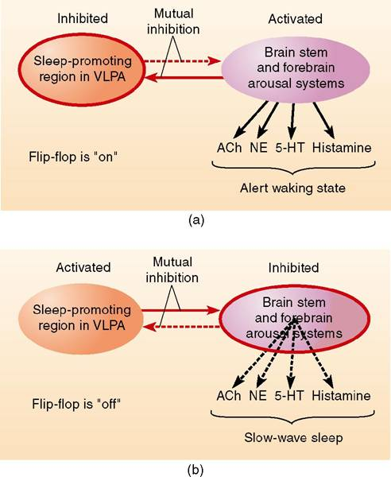
2&3- neural control of REM and SWS
ONLY IN FEMALES’ SLIDES
Physiological Mechanisms of Sleep and Waking
Neural Control of REM sleep
Neural Control of Slow-Wave Sleep
PGO wave (Pontine, Geniculate, Occipital)
Ventrolateral preoptic area (VLPA)
Bursts of phasic electrical activity originating in the pons, followed by activity in the lateral geniculate nucleus and visual cortex, a characteristic of REM sleep.
- A group of GABAergic neurons in the preoptic area whose activity suppresses alertness and behavioral arousal and promotes sleep.
- Destruction of this area has been reporter to result in total insomnia, coma, and eventual death in rats.

Slide 26
4- the executive mechanism
ONLY IN FEMALES’ SLIDES
The Executive Mechanism
Peribrachial area
Carbachol
Medial pontine reticular formation (MPRF)
Magnocellular nucleus
The region around the brachium conjunctivum, located in the dorsolateral pons; contains acetylcholinergic neurons involved in the initiation of REM sleep.
A drug that stimulates acetylcholine receptors.
A region that contains neurons involved in the initiation of REM sleep; activated by acetylcholinergic neurons of the peribrachial area.
A nucleus in the medulla; involved in the atonia (muscular paralysis) that accompanies REM sleep.
Catecholamine agonists produce arousal and sleeplessness; effects appear to be mediated by the locus coeruleus in the dorsal pons.

Slide 27
Mechanism of sleep
Extra
Mechanism of Sleep
NREM Sleep promoting systems
Preoptic area
Lateral Hypothalamus & Basal forebrain
Medulla oblongata
VLPO and MNPO; are active during NREM sleep
The neurons in these nuclei contain the inhibitory neurotransmitter GABA and the inhibitory neuropeptide galanin, and they innervate all the arousal-promoting regions, including the LDT/PPT, LC, DR, TMN, and also the orexin neurons . Thus, the VLPO and MNPO are hypothesized to promote sleep by coordinating the inhibition of arousal regions during NREM and REM sleep.
Contain scattered GABAergic neurons that are active during NREM sleep.
150 Some of these cells may directly innervate the cortex, and it is possible that they modulate cortical networks to promote slow wave activity.
Medullary synchronizing zone at the level of NTS.
stim……synchronization + sleep.
Catecholamine agonists produce arousal and sleeplessness; effects appear to be mediated by the locus coeruleus in the dorsal pons.

Slide 28
Theories of sleep
ONLY IN FEMALES’ SLIDES
Although several theories of sleep have been proposed , most current evidence is in favor of the following :
1. Serotonin, produced by the Raphe Nuclei , induces SWS sleep.
2. The mechanism that triggers REM sleep is located in the Pontine Reticular Formation & the Ponto-Geniculo-Occipital circuit is instrumental in generation of REM sleep.
3. The hormone Melatonin ( released from the Pineal Gland ) plays an important role in day-night alternation of sleep .

Slide 29
Biological clocks
ONLY IN FEMALES’ SLIDES
The Suprachiasmatic Nucleus
Suprachiasmatic nucleus
Melanopsin
Intergeniculate leaflet (IGL)
A nucleus situated atop the optic chiasm. It contains a biological clock responsible for organizing many of the body’s circadian rhythms.
A photopigment present in ganglion cells in the retina whose axons transmit information to the SCN, the thalamus, and the olivary pretectal nucleus.
A part of the lateral geniculate nucleus that receives information from the retina and projects to the SCN; terminals release neuropeptide Y at the SCN.
Catecholamine agonists produce arousal and sleeplessness; effects appear to be mediated by the locus coeruleus in the dorsal pons.

Slide 30
Role of serotonin & melatonin in SWS
ONLY IN FEMALES’ SLIDES
Stimulation of Raphe Nuclei ( which are situated in the lower pons & medulla ) induces SW.
2. Destruction of the Raphe Nuclei makes the animal sleepless for several days until it dies.
3. administration of drugs that block serotonin formation make the animal sleepless for several days.
4. Transecting the brainstem at the level of the midpons , leaves the animal in a state of intense wakefulness for a period of days.
The above-mentioned transection cuts the nerves going from the inhibitory serotonin-secreting Raphe Nuclei to the Bulboreticular Facilitory Area of the RAS .
What does this mean? It means that the serotonin-secreting Raphe fibers normally inhibit the Bulboreticular Facilitory Area to produce sleep .
5. injections of melatonin induce sleep.
6. Stimulation of the Suprachiasmal Nucleus ( SCN) of hypothalamus by light falling on the retina →inhibits Melatonin release from Pineal Galnd → produces wakefulness.

Slide 31
Melatonin as Circadian Controller of Sleep-Wake Cycles
ONLY IN FEMALES’ SLIDES
Genesis of REM sleep
Alternating “ Sleep-Wake Cycles ”are under marked Circadian Control.
“ Circadian Control/Rhythm ” : means regulation of a biological rhythm ( e.g. sleep-wakefulness , hormone secretion , etc ) by day-night cycles.
Darkness ( e.g., at night ) stimualtes the Pineal Gland to secrete the hormone melatonin.
Melatonin inhibits the RAS & thereby induces SWS.
Daylight falling on the retina stimulates the Suprachiasmal Nucleus (SCN) of hypothalamus.
SCN inhibits melatonin secretion by the Pineal Gland , & thereby it inhibits sleep and promotes wakefulness.
Pons:
The mechanism producing REM sleep is located in pontine reticular formation.
Large cholinergic ponto-geniculo-occipital (PGO) spikes arise in this area and are thought to initiate REMsleep.
Discharge of noradrenergic neurons of locus ceruleus + discharge of serotonergic neurons of midbrain raphe causes wakefulness. They become silent when PGO active during REM.

Slide 32
Physiological mechanisms of sleep & waking
Extra
Acetylcholine:
Neurons in the laterodorsal and pedunculopontine tegmental nuclei (LDT/PPT) may help generate the cortical activation and atonia of REM sleep.
The LDT/PPT is the main source of ACh to the thalamus, and ACh depolarizes thalamic neurons to promote the transmission of information through the thalamus, driving the cortical activation that is probably required for the complex dreams of REM sleep.
The LDT/PPT neurons may also activate atonia-promoting neurons in the ventromedial medulla.
These medullary cells release GABA and another inhibitory neurotransmitter glycine onto spinal and brainstem motor neurons during REM sleep, producing hyperpolarization and inhibition.
This descending inhibition is clearly important for atonia as drugs that block glycine signaling such as strychnine can markedly increase muscle tone in REM sleep and wakefulness.

Slide 33
Sleep disorders/burden
ONLY IN FEMALES’ SLIDES
70 million people in the US suffer from sleep problems [50% have chronic sleep disorder].
Insomnia = 30 million.
sleep apnea= 18 million.
Narcolepsy= 250,000 Americans have.
Motor Car Accidents= 100,000.
traffic fatalities= 1500 drowsy driving / annum.
Approximately 16 billion$ annually to the cost of health care in the US and result in 50 billion$ annually in lost productivity.

Slide 34
Disorders of sleep
ONLY IN MALES’ SLIDES
Disorders of sleep:
Insomnia: Inability to sleep.
Somnolence: Extreme sleepness.
Disorders of slow wave sleep:
Sleep talking / sleep walking (common in children).
Night tremors: Are seen in III , IV stage of slow wave sleep (common in children).
Disorders of REM sleep:
Nightmare = Frightening dreams, awake from REM.
Sleep paralysis = Subject is awake but unable to speak or move. Sleeping Sickness.
Somnambulism: Walking during sleep.
Night terrors: Sudden arousal from sleep and intense fear accompanied by physiological reactions (e.g. rapid heart rate, perspiration) that occur during slow-wave sleep.
Narcolepsy: Excessive sleepiness may occur while talking, sitting, decreased ability to regulate sleep.
Sleep apnea: Failure of breathing when asleep.

Slide 35
Disorders of Sleep
ONLY IN FEMALES’ SLIDES
Disorders of Sleep
Insomnia
Drug dependency insomnia
Sleep apnea
Narcolepsy
habitual sleeplessness; inability to sleep.
Reported to affect approximately 25% of the population occasionally, and 9% regularly.
There appears to be no single definition of insomnia.
One of the most important causes of insomnia seems to be sleeping medication.
Insomnia is not a disease, but rather may be a symptom of pain, discomfort, or other physical ailment.
It may happen in people who used to use sleeping pills and then the suddenly left it.
An insomnia caused by the side effects of ever increasing doses of sleeping medications.
Cessation of breathing while sleeping.
It occurs usually in overweigh person
A sleep disorder characterized by periods of irresistible sleep, attacks of cataplexy, sleep paralysis, and hypnagogic hallucinations.
Catecholamine agonists produce arousal and sleeplessness; effects appear to be mediated by the locus coeruleus in the dorsal pons.

Slide 36
Cont.
ONLY IN FEMALES’ SLIDES
Disorders of sleep
Sleep attack
Cataplexy
Sleep paralysis
Hynagogic hallucination
REM behavior disorder
REM sleep behavior
A symptom of narcolepsy; an irresistible urge to sleep during the day, after which the person awakes feeling refreshed.
A symptom of narcolepsy; complete paralysis that occurs during waking.
A symptom of narcolepsy; paralysis occurring just before a person falls asleep.
A symptom of narcolepsy; vivid dreams that occur just before a person falls asleep; accompanied by sleep paralysis.
A neurological disorder in which the person does not become paralyzed during REM sleep and thus acts out dreams.
Catecholamine agonists produce arousal and sleeplessness; effects appear to be mediated by the locus coeruleus in the dorsal pons.
Catecholamine agonists produce arousal and sleeplessness; effects appear to be mediated by the locus coeruleus in the dorsal pons.

Slide 37
Thank you!
اعمل لترسم بسمة، اعمل لتمسح دمعة، اعمل و أنت تعلم أن الله لا يضيع أجر من أحسن عملا.
The Physiology 436 Team:
Team Leaders:
Lulwah Alshiha
Laila Mathkour
Mohammad Alayed
Females Members:
Deena Alnowaiser
Lama AlTamimi
Heba Alnasser
Hanin Bashaikh
Shahd Alsowaidan
Males Members:
Ali al-subaie
Contact us:
References:
Females and Males slides.
Guyton and Hall Textbook of Medical Physiology (Thirteenth Edition.)

