Slide 1
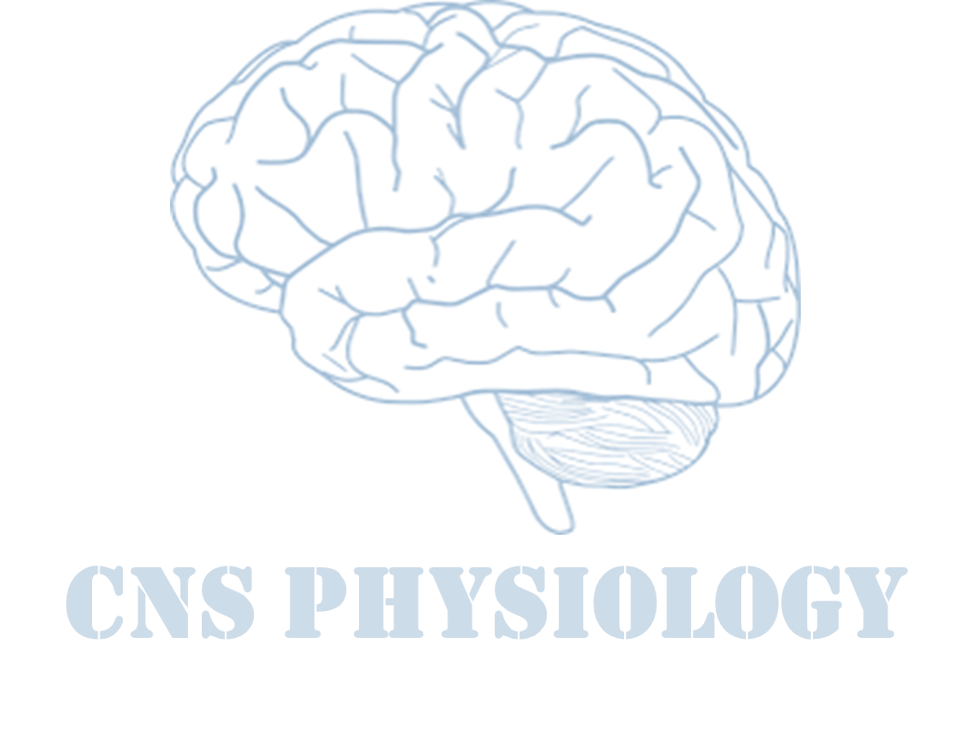
Text.
Important
Formulas
Numbers
Doctor notes
Extra notes and explanation
Lecture No.8
(وَجَعَلَ لَكُمُ السَّمْعَ وَالْأَبْصَارَ وَالْأَفْئِدَةَ لَعَلَّكُمْ تَشْكُرُونَ) صدق الله العظيم

Slide 2
Mechanism of Hearing
Objectives:
1-Describe sound characteristics and explain the difference between discrimination of loudness & pitch (tone).
2- Describe the steps involved in transmission of sound waves into neuronal activity in the inner ear.
3- Differentiate between the functions of the inner and outer hair cells.
4- Appreciate that deafness can be caused by defects in either conduction or neural processing of sound waves.

Slide 3
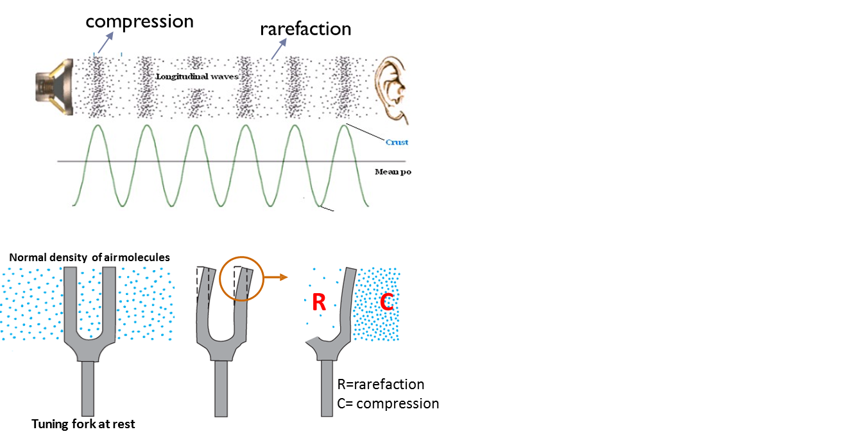
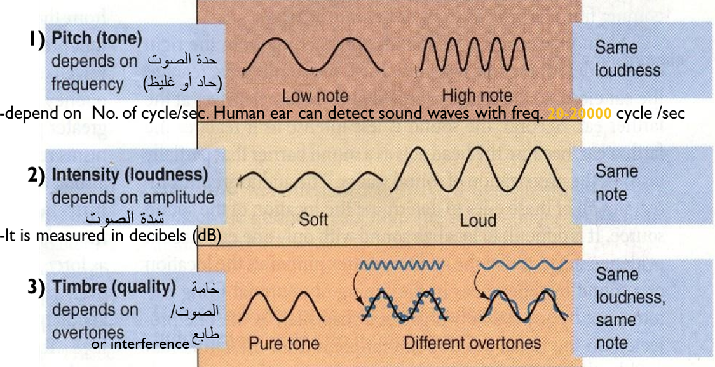
Characteristics of sound
Sound is: a mechanical wave (travelling vibration of air). Or it is a vibration that propagates as an audible wave of pressure, through a transmission medium such as gas, liquid or solid.
Sound waves are alternating regions of compression and rarefaction (expansion) of air molecules by vibrating body.
Characteristics of Sound:

Slide 4
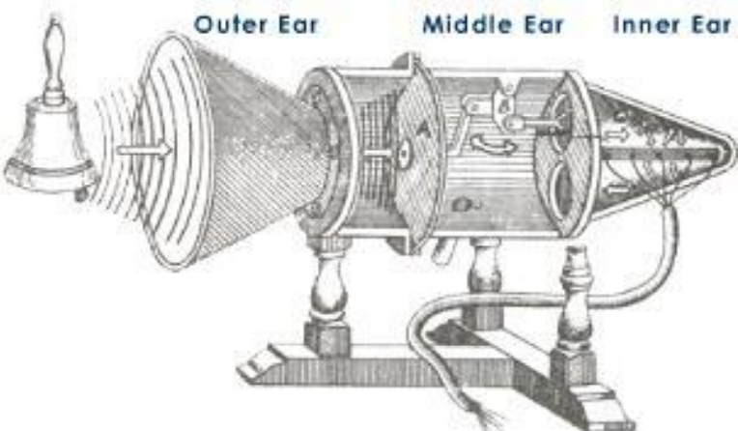
Cont.
ONLY IN MALES’ SLIDES
In human physiology and psychology, sound is the reception of such waves and their perception by the brain
Hearing: Hearing is the ability to perceive sound by detecting vibrations through the ear. Humans have a narrow range of hearing compared to other species 20 Hz - 20,000 Hz.

Slide 5
Doctors’ notes
When fork vibrates inward and outward, the air molecules surrounding it compress and rarefact.
This change in air molecules pressure produces sound waves.
Measurements of these waves are:
frequencyالتردد or tone: (number of cycles per second) and it is the reason why letters have different sounds (letter G has more cycles than letter C) and humans can hear frequencies between 20-20000 per second while animals can hear more and less and thus sometimes we see birds hiding before storms start.
amplitude/loudness/intensity: (how loud the voice is ex: raising the volume of TV).
timbre(quality): if we have pure tone of one sound or overtones of more than one tone overlapping.
Ex: when someone has flu, vocal cord is covered by mucous and thus each point produces a different tone in the same time and they overlap thus producing a low quality voice بحة

Slide 6
Relative magnitude of common sounds
Extra
Sound | Loudness in Decibels (dB) | Comparison to Faintest Audible Sound (Hearing Threshold =0.0002 db)
Rustle of leaves | 10 dB | 10 times louder
Ticking of Watch | 20 dB | 100 times louder
Whispering | 30 dB | 1000 times louder
Normal Conversation | 60 dB | 1 million times louder
Food Blender, Lawn Mower, Hair Drier | 90 dB | 1 billion times louder
Ambulance Siren | 120 dB | 1 trillion louder
Takeoff of Jet Plane | 150 dB | 1 quadrillion times Louder
Hearing sensitivity is 15-20 dB less in absence of ossicular system and tympanic membrane

Slide 7
Anatomy of the ear
ONLY IN FEMALES’ SLIDES
The ear consists of
External ear
Middle ear
Inner ear
Pinna
Air filled cavity
Cochlea: is a snail like, coiled fluid-filled tubular system laying deep in the temporal bone. Contains the hearing sensory organ (organ of corti).
Bony labyrinth.
Membranous labyrinth.
External canal
Ossicles (bones)
Tympanic Membrane
Malleus*
Incus
Stapes
(with its foot sitting on the oval window of the inner ear)
For the eardrum to move freely, the resting air pressure on both sides of eardrum must be equal.
(funnel shaped, pointing inward)
Muscles
tensor tympan
stapeduis
* Malleus is connected to the tympanic membrane by its lower end and to incus bone by its lower end.
Wax has a bactericidal agent.

Slide 8
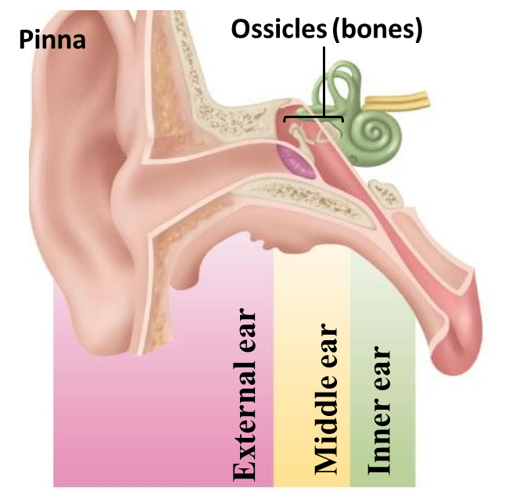
Functions of ear
**
dust stick to wax covering the external canal.
hair filtrating the air.
warming of air (low temperature damages cochlea).
Functions of Ear:
Hearing (parts involved → External ear, Middle ear, Internal ear).
Equilibrium (parts involved → Internal ear).
The ear consists of
External ear
Middle ear
Inner ear
Sound localisation (front, back, high, low): Pinna provides clues about location of sound.(Alter amplitude)
Sound collection: act as funnel* to collect sound, Gathers and focuses sound energy on tympanic membrane (ear drum).
Protection**. + Wax.
Ossicles amplify vibrations of tympanic membrane to oval window.
This is needed for movement of sound waves in the fluid of the inner ear.
protection from constant loud noise, but not sudden noise, latency of 40-80 msec.
magnifying effect.
transduction: convert sound waves (mechanical) into nerve impulses.
Transmission: sound auditory signals to the CNS.
Inner ear:
Cochlea (hearing function).
semicircular canals (hearing and balance).
* Ear drum is not flat instead its funnel shape collects the waves on one central point of the tympanic membrane.

Slide 9
Functions of ear: Middle ear
It is a space between tympanic membrane and the inner ear (opens via eustachian tube into nasopharynx).
Other function of the tube: draining accumulated fluids inside cochlea into nasopharynx, ex: when fluid accumulate due to infection
Ossicles:
Manbrium of the malleus attached to → the back of the tympanic membrane.
And its short process attached to→ the incus.
The incus then articulates with →the head of the stapes.
And stapes’s foot plate attached to → the oval window.
Muscles:
They help us to reduce and minimize the sound sound.
Muscles contract reflexly in response to constant loud sound (over 70db).
Contraction of the tensor tympani pulls the manubruim & makes
the tympanic m. Tens. Thus decreasing the vibration.
Contraction of the stapeduis pull the foot plate outward so thatvibration are reduced.
Protection from constant loud noise, but not sudden noise, latency of 40-80 msec.

Slide 10
Cont.
Transmission of sound through the middle ear:
sound waves vibrate the tympanic membrane → Tympanic membrane moves the handle of malleus → Incus moves → Stapes move in & out of the oval window → pressure transmitted through cochlea → cause stimulation of hair cells in the organ of corti → which will stimulate the auditory nerve.
Middle ear magnifying effect:
The force from a large surface area (drum/Tympanic membrane) is concentrated to a small (oval window) at a ratio of 17:1
Lever action of ossicles: increase the force of movement 1:3 times.
The total increase is 17 × 1.3 = 22 times.
ONLY IN FEMALES’ SLIDES
Two mechanisms of magnifying sound:
1- The size of tympanic membrane is 17 times bigger than the membrane covering the oval window so the waves are magnified (concentrated) 17 times on the oval window (pats الخفافيش has very large tympanic membranes thus they can hear more efficiently).
2- the size difference between the 3 ossicles is 1.3 (and they work like gears أتراس الساعة each bone makes the next one moves more).
Guyton corner:
The ossicular lever system does not increase the movement distance of stapes, as is commonly believed. Instead, the system actually reduces the distance but increases the force of movement about 1.3 times.

Slide 11
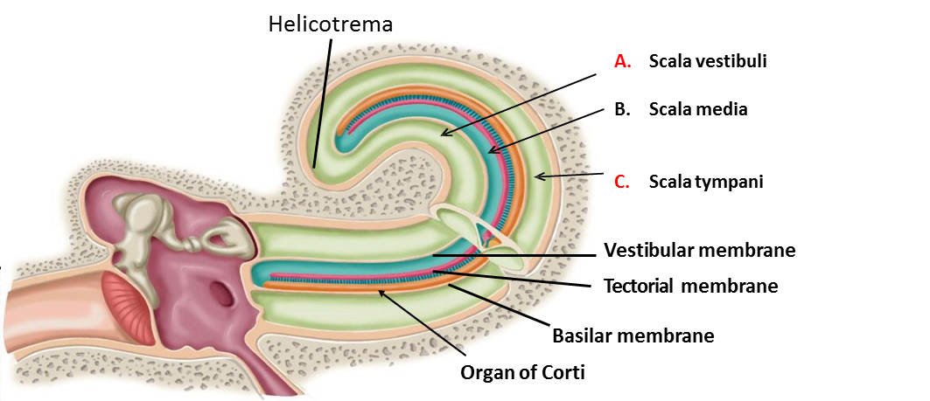
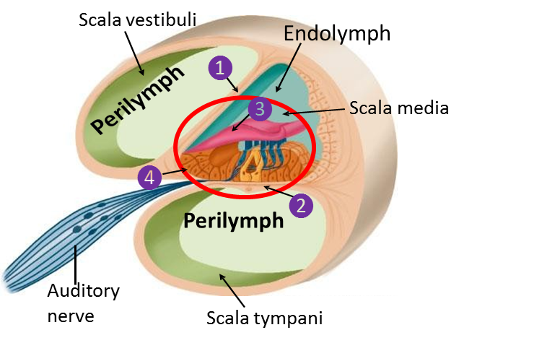
Cochlea
The cochlea is a system of 3 coiled tubes (divided by the basilar membrane & the reissners membrane) through its length filled with fluid:
Scala vestibule.
B. Scala media (cochlear duct):
Vestibular membrane: separates scala media from scala vestibule (very thin).
Basilar membrane: separates scala media from scala tympani.
Tectorial membrane: attached to the sterocelia of hair cells.
Organ of corti (hearing sense organ) with hairs of cells (stereocilia)
C. Scala tympani.
Organ of corti:
Located (resting) on the basilar m.
Contain inner & outer hair cells
Extend from base to apex
Tube | Na | K
Scala Vestibuli * | high | low
Scala Tympani * | high | low
Scala Media ** | low | high
* Similar to extra cellular fluid.
** Similar to intracellular fluid.

Slide 12
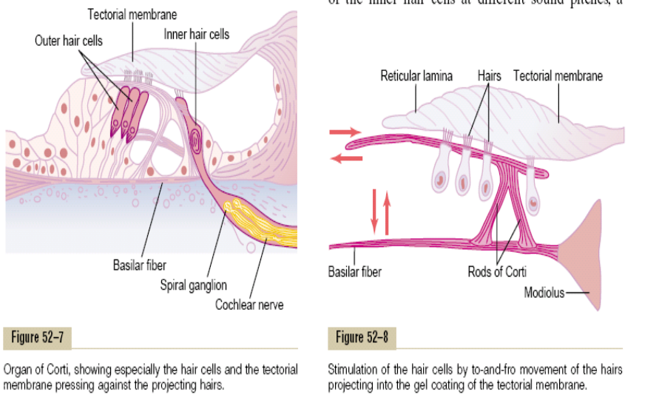
Cochlea
ONLY IN MALES’ SLIDES

Slide 13
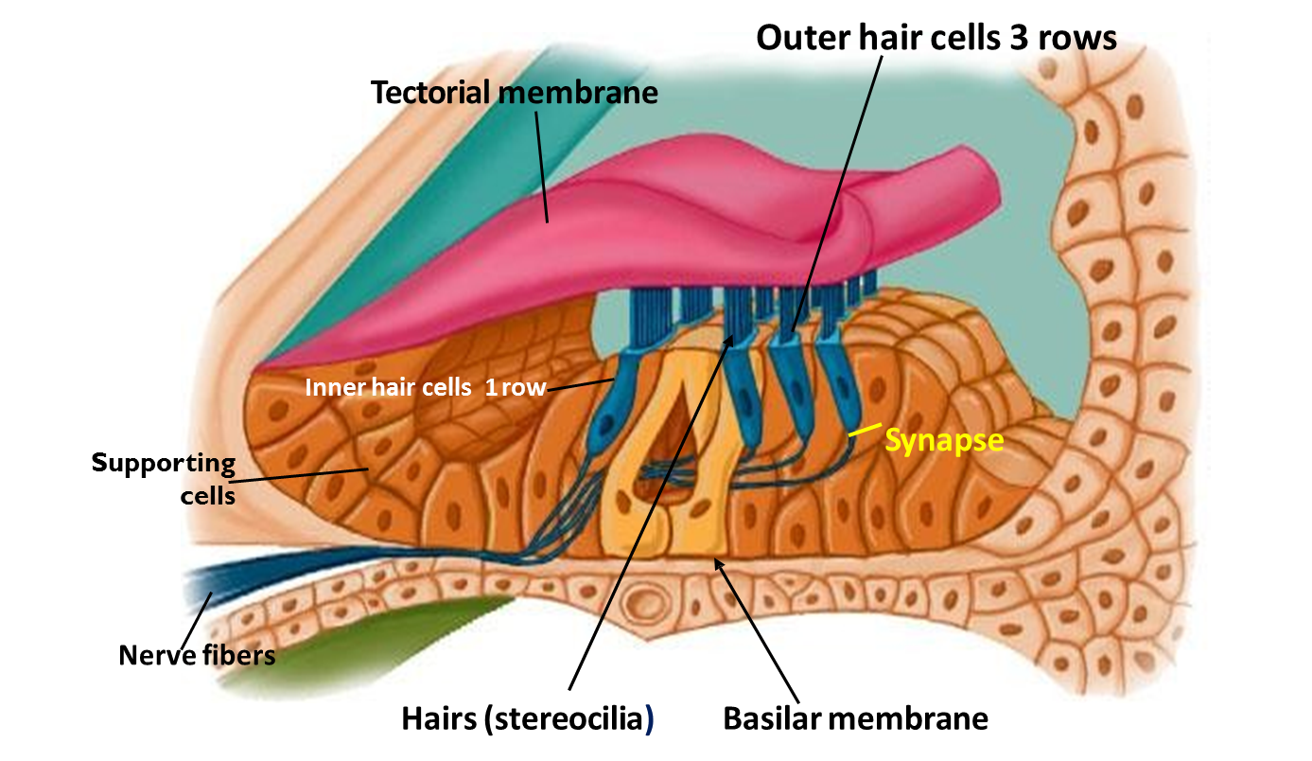
Cochlea: hair cells
Steroclia extend from the top
Arrangement:
Three rows of outer hair cells (attached to the reticular lamina or tectorial membrne)
One row of inner hair cells (not attached to tectorial membrane)
Functions:
Function of hair cells
inner hair cells | outer hair cells
Striocellia not embedded in tectorial membrane, but bent by fluid movement under the tectorial membrane. They are primary receptors for sound, transducing fluid movement in cochlea into action potential in the auditory nerve. | Large number, but stimulate only small fraction of nerve fibres in the cochlear nerve. If damaged, significant loss of hearing (they control the sensitivity of inner hair cells to particular sound frequency).
ONLY IN FEMALES’ SLIDES

Slide 14
Doctors’ explanations of previous slide
We hear through inner hair cells… outer hair cells control the ability of inner hair cells to hear; that is by a two way mechanism between the outer hair cells and the brain:
First from outer hair cells → to nerve fibers → to brain.
Then from brain to basilar membrane (to make basilar membrane more tense or more loose similar to musical instruments) شبيه بأوتار الاَلات الموسيقية
So outer hair cells controls the reflex between the brain and basilar membrane.
When basilar membrane is tense the inner hair cells will be in touch with outer hair cells… but when the basilar membrane is loose inner hair cells will be a bit away of outer hair cells downward لما يرخي البازيلار ممبرين الإنر هير سلز تكون نازلة لتحت and thus when tectorial membrane moves up and down the inner hair cells won’t be as sensitive to outer hair cells as before.
So this mechanism determine inner hair cells sensitivity to different frequencies.
مشابهة للآلات الموسيقية الوترية لما يكون الوتر مشدود يكون الصوت مختلف عن لما يكون الوتر مرخي.

Slide 15
Receptors & endocochlear potentials
Sound transmission into the inner ear → cause upper & lower movements of the reticular membrane (tectorial membrane).
produce bending of steriocillia of the hair cells → alternatively open & close cation channels at the tip of the steriocillia.
(inward current) → depolarization.
(outward current) → hyperpolarization.
the net results is depolarization.
Production of cells receptors potentials → release of neurotransmitter → production of action potentials.
Inner hair cells communicate via a chemical synapse (Glutamate) with the terminals (dendrites) of spiral ganglion neurons.
These 1st order (type 1) neurons are bipolar.
The collection of their cell bodies form the spiral ganglion.
Their axons (central) (form the auditory nerve; cranial nerve VIII) make their way and synapse on the cochlear nucleus in the medulla.

Slide 16
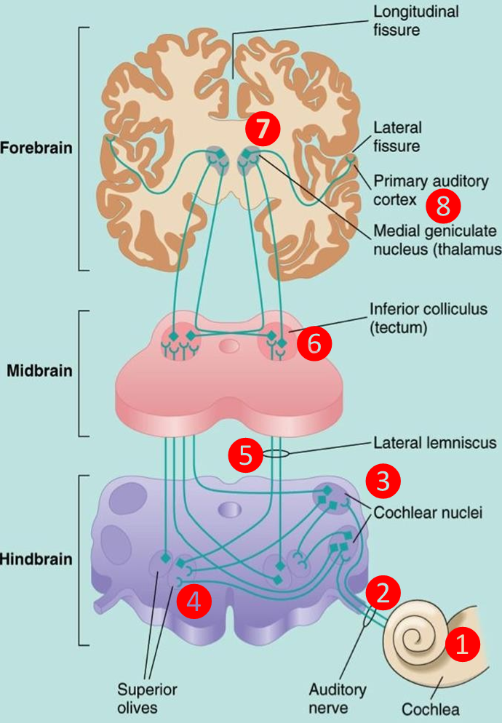
The central auditory pathway
This pathway begins in the organ of corti:
Spiral ganglion neurons (Cochlea).
Cochlear nerve (VIII).
Cochlear nuclei (Medulla).
Superior olivary complex (Pons) (bilateral).
Lateral lemniscus.
Inferior colliculus (Midbrain).
Medial geniculate nucleus (Thalamus).
End in the primary auditory cortex (are 41& 42, superior temporal gyrus in the temporal lobe of the brain).
Fibres end in the auditory area, where it is heard, then interpretation occurs in the auditory association areas (wernikes area)*.If wermikes area damaged will hear the sound but we can not interpret the meaning of sound.
There is a bilateral cortical connection of auditory area.
Thus damage to one side only slightly reduces hearing.
There are 4 relay stations in CNS for sound signals.
* Wernikes area is in posterior end of superior temporal gyrus, It is next to primary auditory area so we can hear by the primary area but understand what’s heard by Wernikes area.

Slide 17
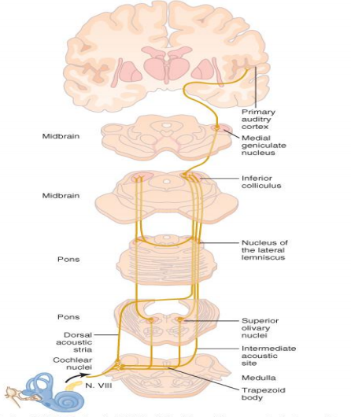
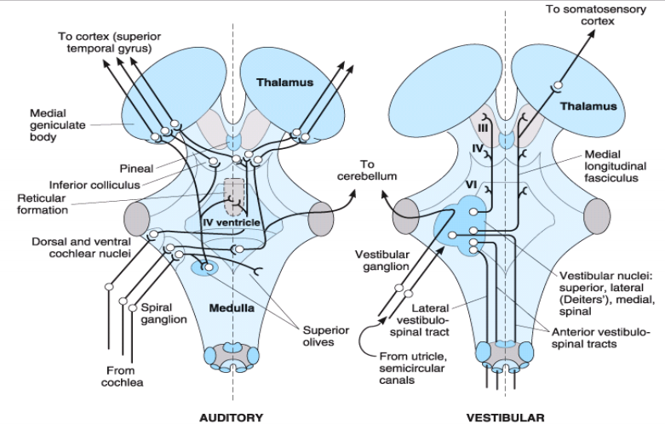
Cont.
ONLY IN MALES’ SLIDES

Slide 18
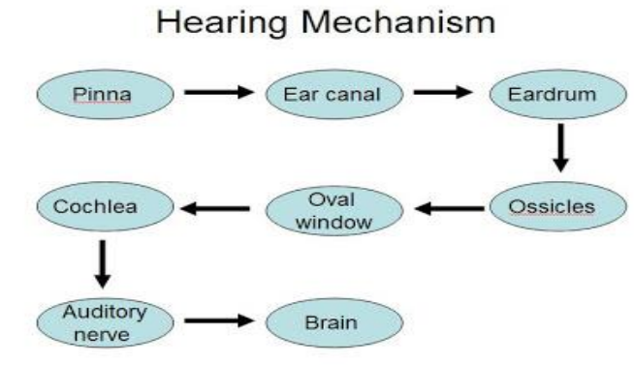
The central auditory pathway
ONLY IN MALES’ SLIDES
Organ of Corti:
Located within the cochlea.
Hearing receptors.
hair cells on the basilar membrane.
Gel-like tectorial membrane is capable of bending hair
cells.
Cochlear nerve attached to hair cells transmits nerve
impulses to auditory cortex on temporal lobe.

Slide 19
Events involved in activating hair cells This Slide Is Very Important
ONLY IN MALES’ SLIDES

Slide 20
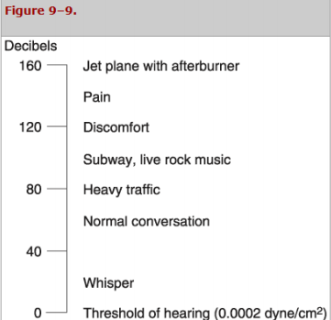
Masking effect
Presence of one sound decreases an individual's ability to hear other sounds. This phenomenon is known as masking.
Presence of background noise affect the ability to hear another sound, due to some receptors are in refractory period.
Masking is more clear if two sound are having the same frequencies.
Noise pollution:
Noise pollution is an environmental hazard
Exposure to sound intensity above 80dB may damage outer hair cells
Sound localization:
Differences in the time arrival of the sound wave at the ears (time-lag).
Differences in the loudness.
ONLY IN MALES’ SLIDES
ONLY IN FEMALES’ SLIDES

Slide 21
Cont.
Conduction of sound wave
Extra
Conduction of sound wave
Air conduction | Bone conduction
Normal situation of hearing, sound travel in air causes vibration of Tympanic m., transmitted by ossicles to the oval window. | Sound cause vibration of skull bones directly transmitting the sound vibration to the cochlea Ex: when placing tuning fork on the head or mastoid process.
Tonotopic mapping of frequency in the basilar membrane

Slide 22
Typical hearing disorders
Deafness
Conductive hearing loss
Perceptive Sensorineural (nerve)
Inadequate transmission of sound through external or middle ear due to:
Blocked auditory canal (wax, fluid).
Repeated infection
Perforated drum.
Restriction of ossicular movements (e.G. By fibrosis or calicification) / destruction of ossicles, repeated infection may lead to this fibrosis and adhesions.
Osteosclerosis (pathological fixation of stapes on the oval window).
All sound frequencies are equally affected.
Bone conduction is better than air conduction, because air conduction is disturbed.
Normally: air conduction is better than bone conduction.
Both air and bone conduction is disturbed.
Hearing loss caused by disruption anywhere in pathway from hair cells to the auditory cortex / congenital or damage to cochlea or auditory nerve pathway due to:
Loss of hair cells (explosion, chronic loud noise).
Damage to vestibulocochlear nerve (VIII).
Damage to nuclei / tracts to the cortex.
Toxins (antibiotics, gentamycine), Damages cochlea if used for more than 2-3 weeks.
Inflammation.
Vascular.
Tumour.
Both air and bone conduction are affected.
* Neuronal presbycusis: degenerative age related process occurs as hair cells wear out with use (loss of ~ 40% of hair cells by age 65)
* Cochlear implants have become available (do not restore normal hearing!)

Slide 23
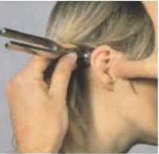
Hearing tests
Hearing tests
1. rinne’s test
2. Weber’s tes
3. Audiometer
The base of a vibrating tuning fork is placed on mastoid process until the sound is not heard.
Then the prongs of the fork held in air near the ear.
Normal subject continue to hear near ear (positive test).
If not reveres the test (if heard near the mastoid process, negative test)
A vibrating tuning fork is placed on the middle of the head.
The patient answers where the sound is coming from: the left ear, the right ear, or both.
Weber test results:
Normal hearing will indicate sound in both ears.
Conductive loss: sound travels towards the poor ear (lateralization to bad ear).
Nerve loss: sound travels towards the good ear
Air phone connected to electronic device emitting tones of low & high frequencies.
For assessment of degree of deafness.
ONLY IN FEMALES’ SLIDES

Slide 24
Hearing tests
ONLY IN MALES’ SLIDES

Slide 25
Thank you!
اعمل لترسم بسمة، اعمل لتمسح دمعة، اعمل و أنت تعلم أن الله لا يضيع أجر من أحسن عملا.
The Physiology 436 Team:
Team Leaders:
Lulwah Alshiha
Laila Mathkour
Mohammad Alayed
Females Members:
Ghada Almazrou
Dania Alkelabi Ghada Alskait
Zeena Alkaff
Males Members:
Talal alenezi
Contact us:
References:
Females and Males slides.
Guyton and Hall Textbook of Medical Physiology (Thirteenth Edition.)

