Slide 1


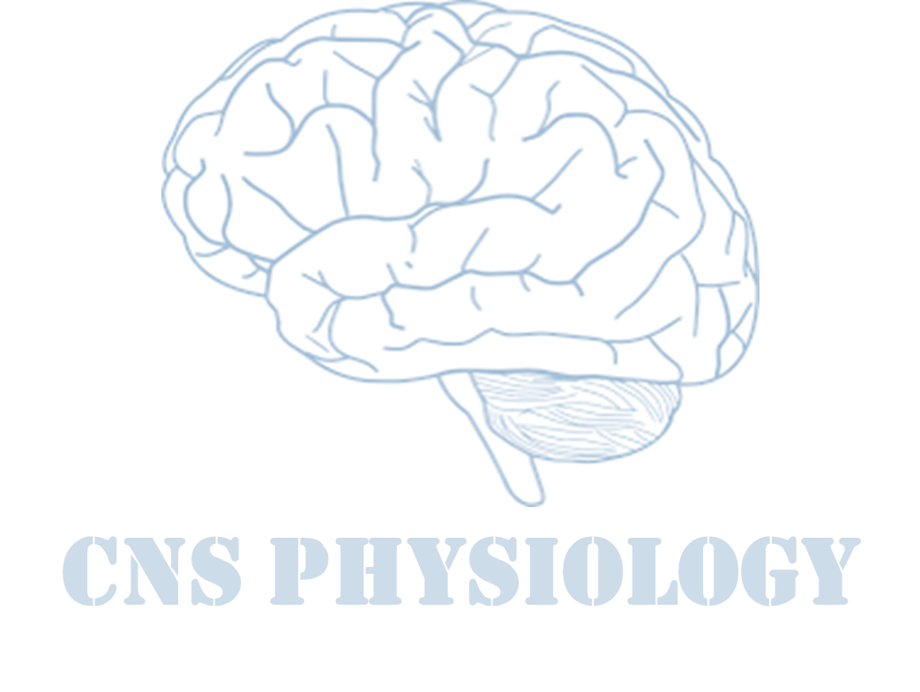

Text
Important
Formulas
Numbers
Doctor notes
Notes and explanation
Lecture No.9
)وَاللَّهُ أَخْرَجَكُم مِّن بُطُونِ أُمَّهَاتِكُمْ لَا تَعْلَمُونَ شَيْئًا وَجَعَلَ لَكُمُ السَّمْعَ وَالْأَبْصَارَ وَالْأَفْئِدَةَ ۙ لَعَلَّكُمْ تَشْكُرُونَ(

Slide 2
Vision (Eyes and refraction)
Objectives:
Describe different components of the eye and function of each and understand the eye protection media.
Describe the refraction of light as it passes through the eye to the retina, identifying the refractive media of the eye.
Describe the refractive error that account for myopia, hypermetropia, presbyopia and astigmatism and their correction by eye glasses or contact lenses.
Know layers of retina, blind spot, and fovea centralis-explain the differing light sensitivities of the fovea, peripheral retina and optic disk.

Slide 3
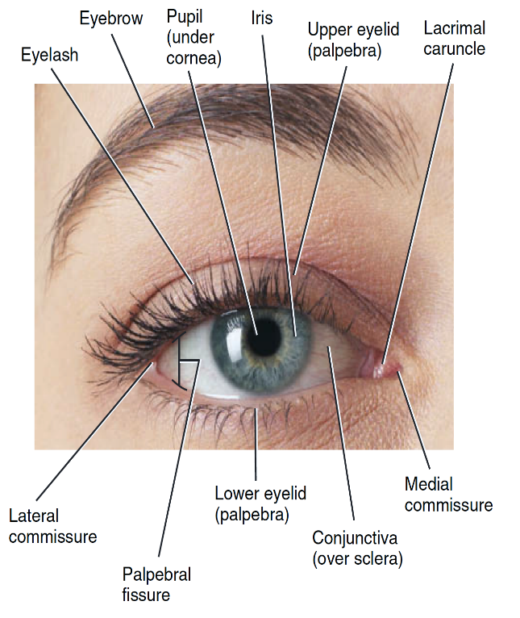
The Eye
Human vision is one of the most complex visual systems among animals.
The eye is a complex sensory organ, which is capable of transduction physical stimuli of light rays into electrical and chemical signals that can be interpreted by the brain to construct physical images.
ONLY IN FEMALES’ SLIDES
The eye has:
Refracting media
Coats:
Sclera, Choroid & Retina
- Post 2/3 Retina
-Ant 1/6 Chornea
Functions of vision:
Discrimination:
Light vs Dark
Detect color:
Adaptive value of color vision
Detection of movement

Slide 4
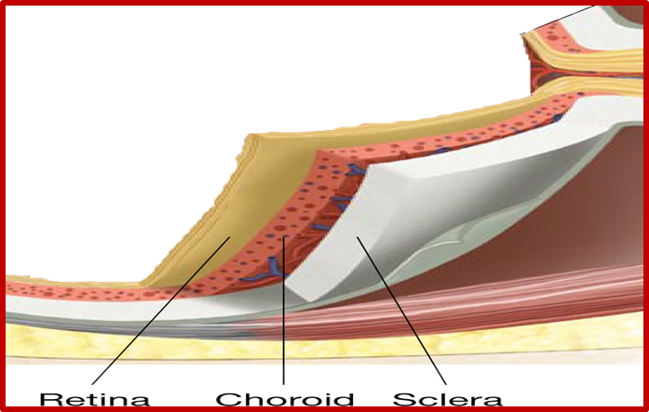
Anatomy of the eye
ONLY IN FEMALES’ SLIDES
The eye is a fluid-filled sphere enclosed by three specialized tissue layers.
1- The sclera: it is a tough outer covering of connective tissue.
2- The middle layer is the choroid, containing blood vessels.
3- The retina: it is the innermost layer which contains light sensitive cells.
Sclera: (thick, white fibrous tissue for protection with spherical appearance).
Choroids are inside sclera, highly vascular.
The capillaries in the choroid are the primary source of nourishment for retinal photoreceptors & oxygen to rods and cones.
Post 2/3 of choroid has retina (innermost layer lining).
there are five basic classes of neurons in the retina:
Photoreceptors
bipolar cells
ganglion cells
horizontal cells
amacrine cells
Cornea: (modified ant 1/6 of sclera) to allow light to enter the eyes, transparent and avascular.
Refractive or diopteric power 40-45 D at it’s anterior surface.
Q. From where it gets it’s nutrition?
Ans. Tears & aqueous humor.

Slide 5
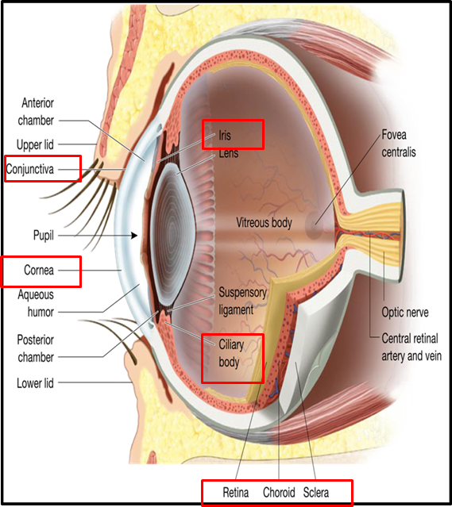
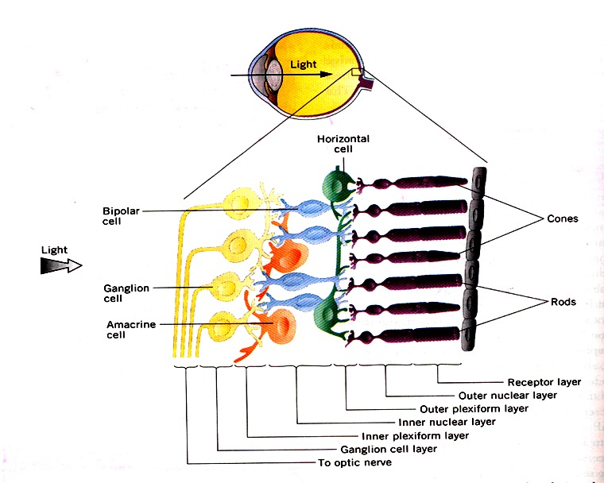
Layers of the eye
ONLY IN MALES’ SLIDES
The eye consists of 3 layers:
Outer fibrous layer:
Consists of:
1-Sclera
2-Cornea:
is transparent anterior portion.
3-Conjuctiva:
lines the eyelids and covers the sclera.
It is a transparent epithelium.
Middle Vascular Layer:
Consists of:
1-Iris:
Is the colored part of the eye.
Has aperture (pupil) control & allow light to enter the eye.
2-Ciliary body:
Ciliary body consists of:
- Ciliary muscles
- Ciliary glands
- Suspensory ligaments which attached to the lens
3-Choroid
Retina
consists of 10 layers (the most imp are:
1-Outer pigmented portion part:
Absorb light and prevents its reflection. Also, it stores large quantities of vitA; imp precursor of the photosensitive chemicals of the rods and cons.
2-Inner neural part:
containing Photoreceptors called Rods and Cones .
Pupil: Appears black because: as you look through the lens, you see the heavily pigmented back of the eye (choroid & retina).

Slide 6
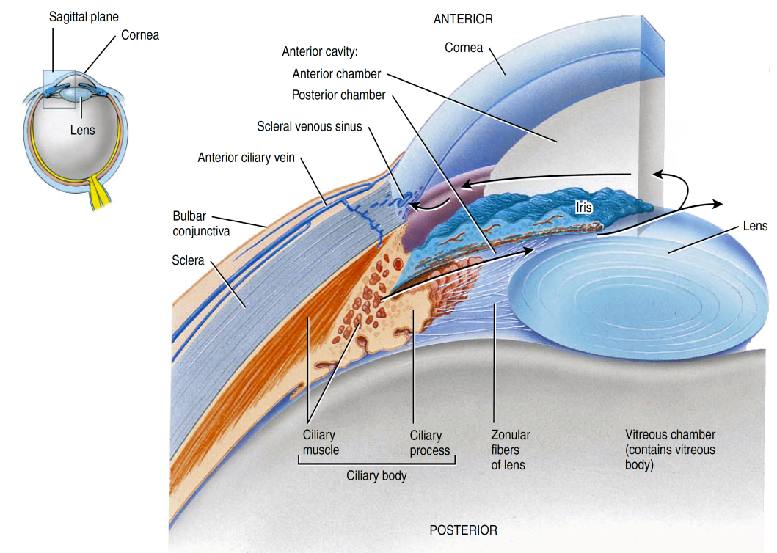
Cont. (Cornea)
ONLY IN FEMALES’ SLIDES
In humans, the cornea has resident immune cells.
The cornea has no blood supply (it gets oxygen directly through the air).
O2 first dissolves in the tears and then diffuses throughout the cornea.
In the open eye, the environment supplies almost all O2 needed for tissue respiration.
However, In the closed eye about 2⁄3 of the O2 demand is met by diffusion from the capillaries, and the rest from the anterior chamber.
Cornea takes it’s nutrients from:
1-Aqueous humor
2-O2 in tears
Conjuctiva: زي السولوفان اللي بنغطي فيه الهدأيا
Holds tears that’s filed with O2 to the cornea
Diopter:وحدة قياس انكسار الضوء

Slide 7
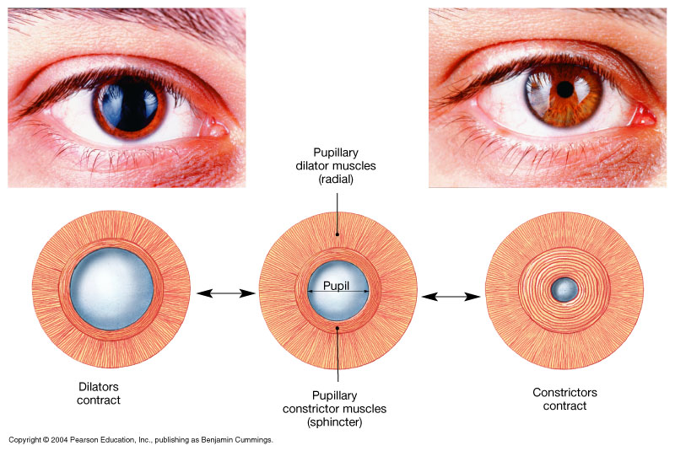
Cont.
ONLY IN FEMALES’ SLIDES
Conjunctiva:
  Transparent membrane covers the anterior surface of eye, reflected on inner surface of eyelids.
  Covered with: thin film of tears for protection, wetness, cleaning.
Pupil:
  Behind center of cornea, control & allow light to enter the eye. Appears black because: as you look through the lens, you see the heavily pigmented back of the eye (choroid & retina).
Iris: Colored part.
  Has radial muscle dilates the pupil as in dim light > supplied by sympathetic. (mydriasis)
  Has circular muscles constrict the pupil as in bright light > supplied by parasympathetic. (miosis)
The Pupillary Muscles: consists of > Radial and Circular parts.
Eyes appear brown to black when the iris contains a large amount of melanin, and blue due to low melanin.
Iris: the darker it gets the more milanin it contains
Ciliary muscle: part of the choroid that becomes a muscle, it suspenses the lens, pulls on it by the suspensory ligaments.
Lens has refractive power less than the cornea but it plays a more important role in focusing images.
الأجزاء اللحمية في العينUvea.

Slide 8
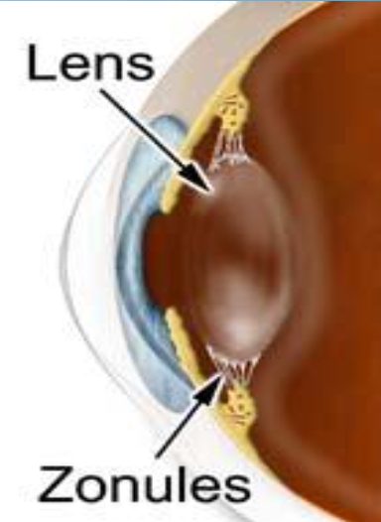
Cont.
Ciliary muscles (body): Thick ant part of choroid to which attached suspensory ligaments (Zonule).
The Ciliary Body (& its suspensory ligament ) and lens divide the eye into :
Anterior cavity → contains a fluid called Aqueous Humor.
Posterior cavity → contains fluid called Vitreous Humor.
Lens: transparent, biconvex, semisolid, diopteric power 15-20 D, held in place by zonule.
(lens ligament = suspensory ligament).
Attached to ant part of cilliary body.
Crystallins: proteins found within the cells of the lens, and are arranged like the layers of an
onion which make the refractive media of the lens.
Function of the lens: helps focus images on the retina to facilitate clear vision.
Uvea: = Choroid + iris + cilliary muscles.

Slide 9
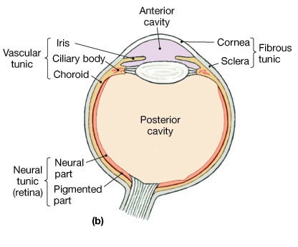
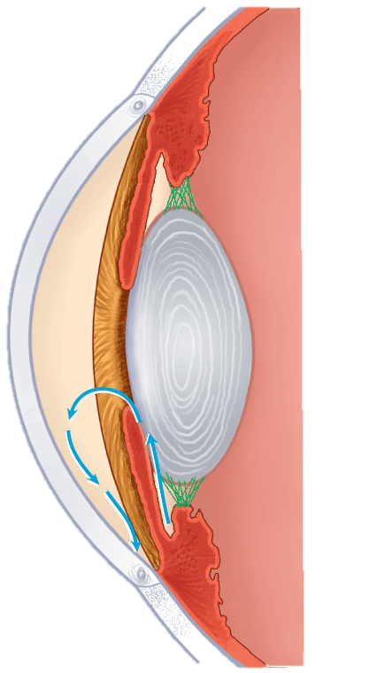
The Anterior & Posterior Cavities
ONLY IN MALES’ SLIDES
The Ciliary Body (& its suspensary ligament ) and lens divide the eye into :
Anterior Cavity ( which contains a fluid called Aqueous Humor ).
Posterior Cavity ( which contains fluid called Vitreous Humor).
Furthermore , the Iris further divides the Anterior cavity into :
Anterior Chamber ( in front of the iris, between iris and cornea).
Posterior Chamber ( behind the iris ; between the iris and lens +between iris and ciliary muscles).
Posterior Chamber
Anterior Chamber
CILIARY BODY
POSTERIOR
CHAMBER
SUSPENSORY
LIGAMENT
ANTERIOR
CAVITY
ANTERIOR
CHAMBER
IRIS
POSTERIOR CAVITY
CONTAIN VITREOUS
HUMOR
FLOW OF AQUEOUS
HUMOUR
CILIARY BODY INSIDE
CILIARY MUSCLE
CANAL OF SCHLEMM

Slide 10
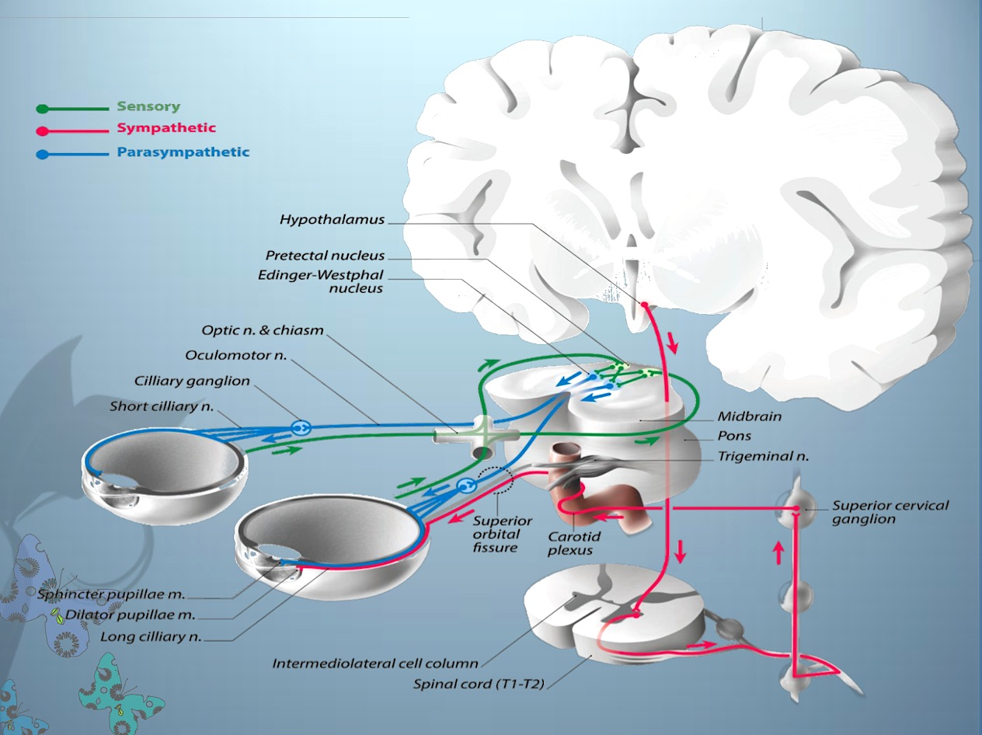
Cont.
ONLY IN FEMALES’ SLIDES

Slide 11
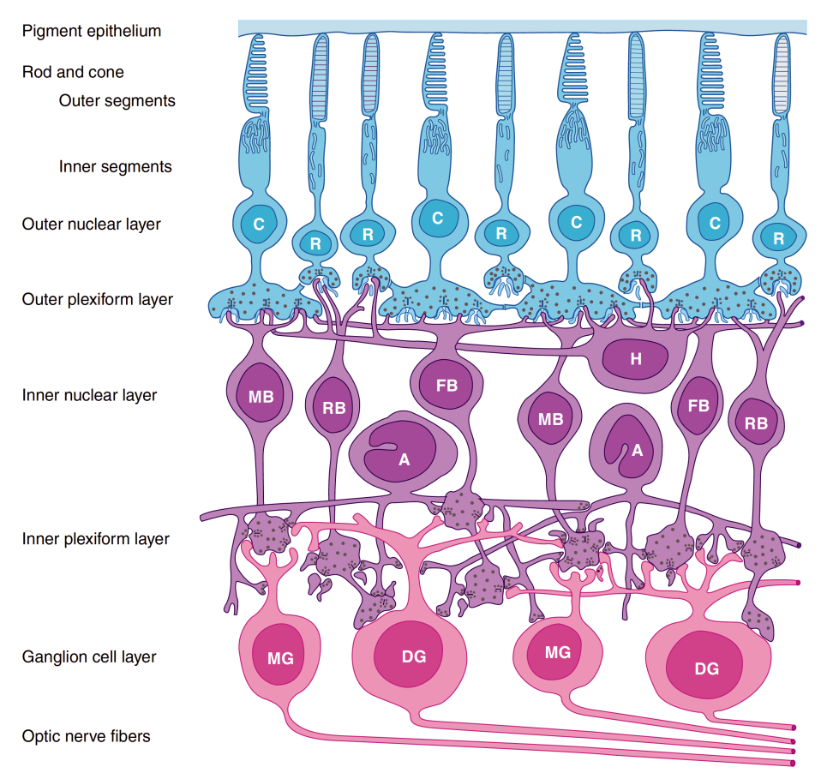
Cont. (Retina)
Retinal cells:
there are five basic classes of neurons in the retina:
photoreceptors,
bipolar cells,
ganglion cells,
horizontal cells,
amacrine cells.
Outer nuclear layer: (cell bodies of rodes and cones).
Outer plexiform layer: (mainly of horizontal cells, they make synaptic connections with receptors.)
Inner plexiform layer: (amacrine cells, they make synaptic connections with ganglion cells) the inner plexiform layer is interposed between the inner nuclear and ganglion cell layers.
Ganglion cell layer.
Optic nerve fibers (1.2 million fibers).

Slide 12
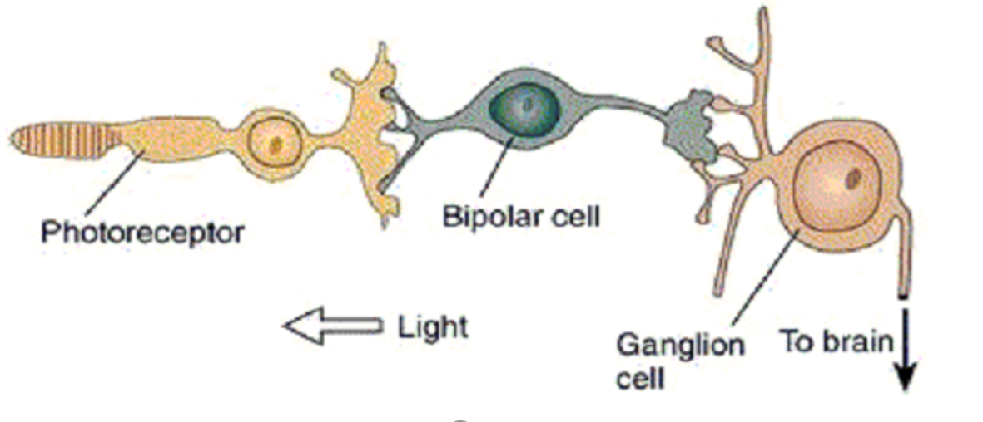
Retina: neural circuitry
Light hits photoreceptors, sends signal to the bipolar cells
Bipolar cells send signal to ganglion cells
Ganglion cells send signal to the brain

Slide 13
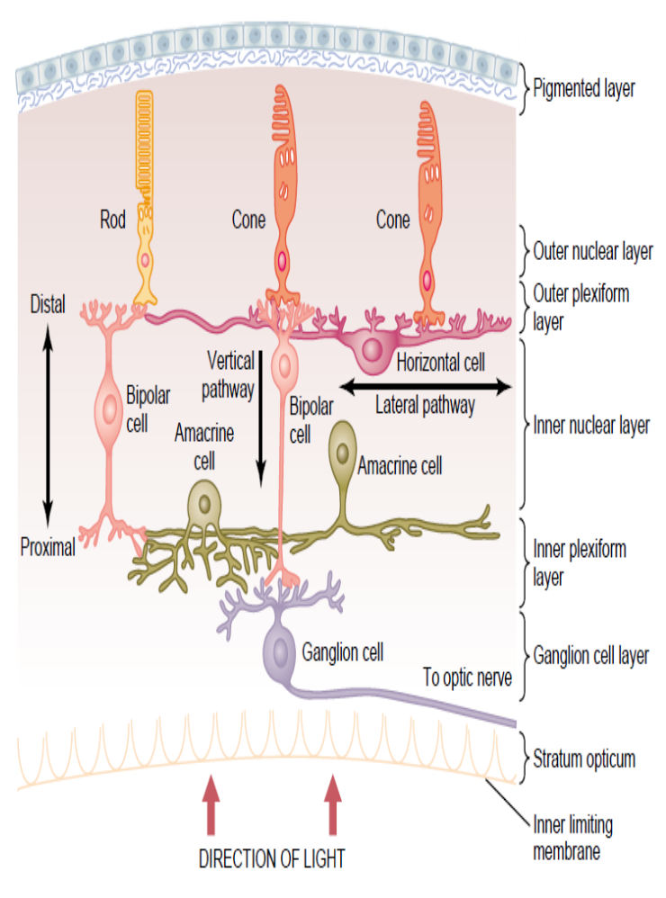
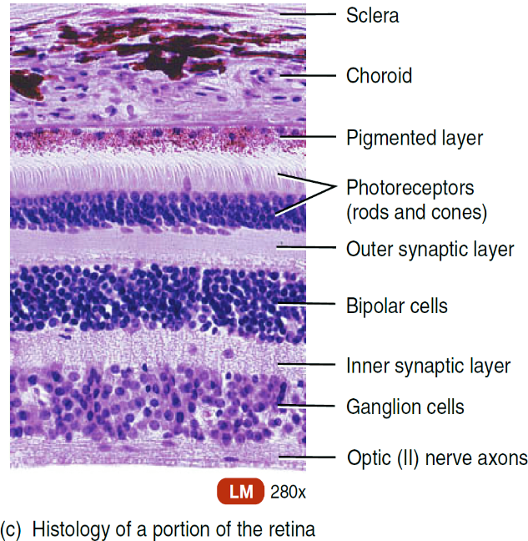
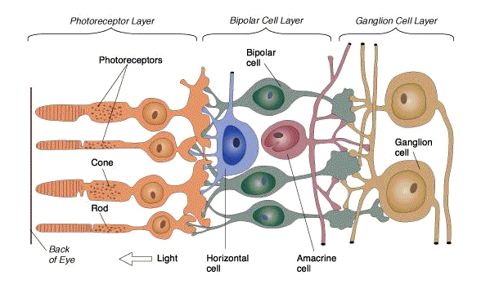
Retinal layers
Light Pathway

Slide 14
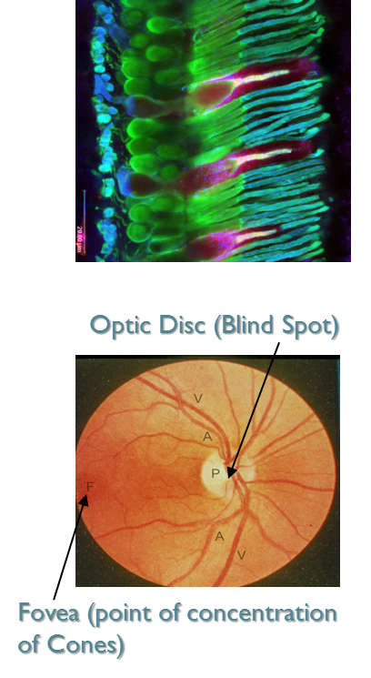
Cont. (Retina)
Photoreceptors:
Their outer and inner segments, but not cell bodies (rodes 90-120 millions, cones 4.5-6 millions). Photoreceptors cells are responsible for capturing light and transforming this into generator potential to be used by the nervous system.
Rods:
Are best for vision in dim light (scotopic vision)
Are better than cones for detection of flicker (sudden movements of objects).
Cones are best for:
Vision in daylight or bright light (photopic vision)
Color Vision (color perception)
Perception of detail (acuity of vision)
Macula & Fovea Centralis:
An important part of the retina is the Macula Lutea.
At the center of the Macula a depression we find the Fovea Centralis yellow pigmented spot at post pole of eye.
In the Fovea we find the (densely packed) maximum concentration of cones (only cones) > consequently > the Fovea is the point of maximal visual activity in the retina for colors vision and details detection, (there is no blood vessels).
when attention is attracted to or fixed on an object, the eyes are normally moved so that light rays coming from the object fall on the fovea.
Optic Disc (Blind Spot ):
point of exit of optic nerve fibers, contains no photoreceptors (but has a lot of blood vessels).
Photoreceptors are not distributed uniformly across the retina.
Optic Disc(blind spot) area: 3mm Superior and medial to the fovea.
It’s the place where the optic nerves and vessels are.
The image must be projected on the fovea exactly to be seen with full resolution.

Slide 15
Light pathway in the eye:
ONLY IN FEMALES’ SLIDES
light passes through the lens system of the eye
then through the vitreous humor, it enters the retina from the inside of the eye
it passes first through the ganglion cells and then through the plexiform and nuclear layers
it finally reaches the layer of rods and cones located all the way on the outer edge of the retina
in the central foveal region of the retina, the inside layers are pulled aside to decrease this loss of acuity. This allows light to pass unimpeded to the cones.
The visual acuity is decreased by this passage through such non-homogenous tissue
Light absorbed by pigment cell layer that contain melanin pigment & cones to rest of layers finally to ganglion cell layer then impulses pass from rodes to optic nerve

Slide 16
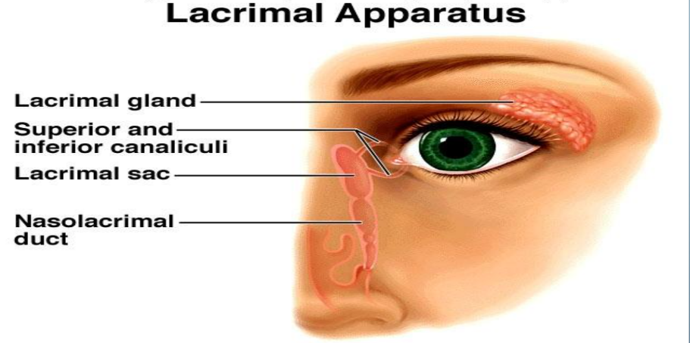
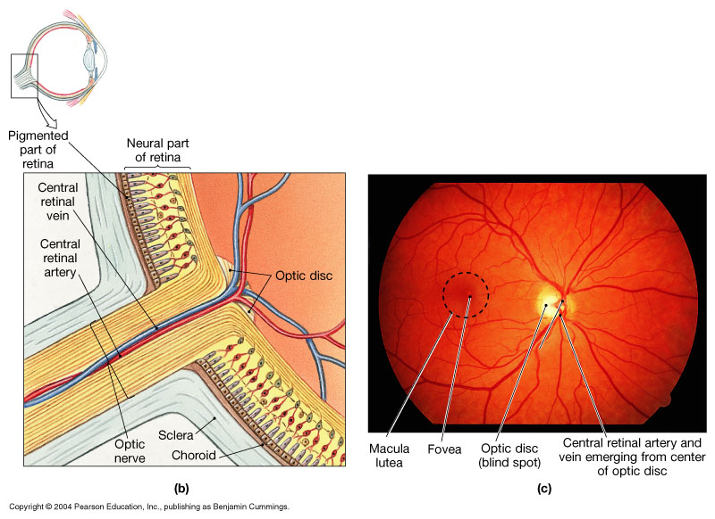
Organization of the retina/external protection of eyes
Bony orbit.
Eye lids (keeps cornea moist) with their lashes.
Conjunctiva (tears to lubricate and disinfectant).
Tears from lacrimal gland has antibacterial, lubricating effect ,keep cornea moist & clear & provide nutrition to the cornea ( lacrimal glands >superior&inferior canaliculi >gets stored in lacrimal sac> gets to the nose via nasolacrimal duct) (has lysosymes and antibacterial and antimicribial effect).
Müller cells are the major glial element of the retina:
located in: the inner nuclear layer.
Form architectural support structure providing metabolic support to retina.
maintaining synaptic levels of neurotransmitters.
They can be differentiate into a neural progenitor following injury to the retina.
act as light conductor which funnels light to the rods and cone cells.
ONLY IN FEMALES’ SLIDES

Slide 17
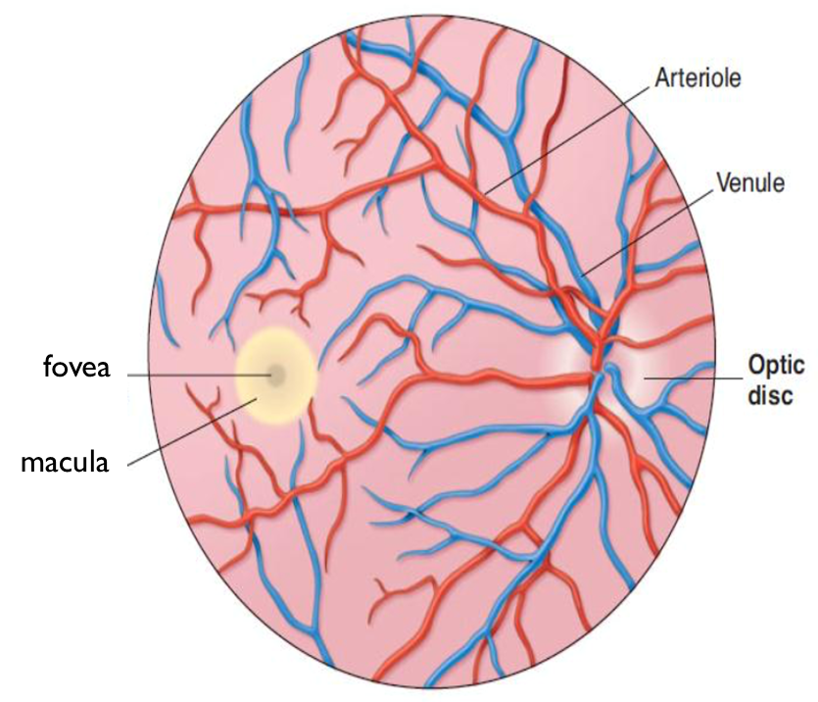
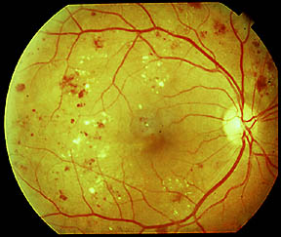
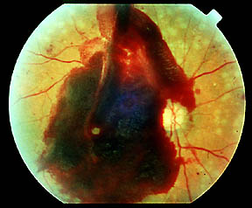
Retinopathy
Retinopathy in diabetes:
Vessels have weak walls causes hemorrhaging (then fibrosis will lead to detachment of retina) and blindness.
Normal

Slide 18
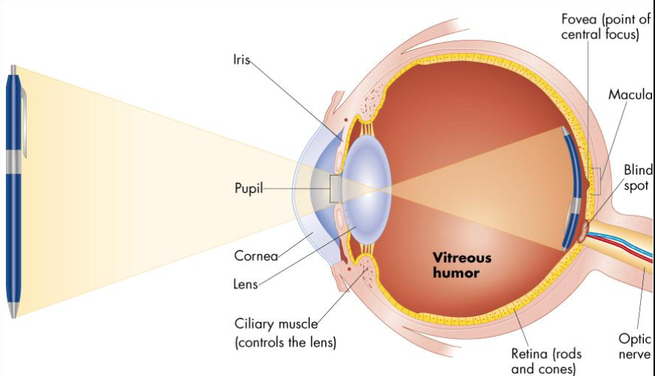
Lenses
The lens system of the eye will focus an image on the retina upside down.
The image is inverted and reversed with respect to the object.
However, the brain perceives objects in the upright position despite the upside-down orientation on the retina.
The reason the world does not look inverted and reversed is that the brain ”learn” early in life to coordinate visual images with the orientations of objects.

Slide 19
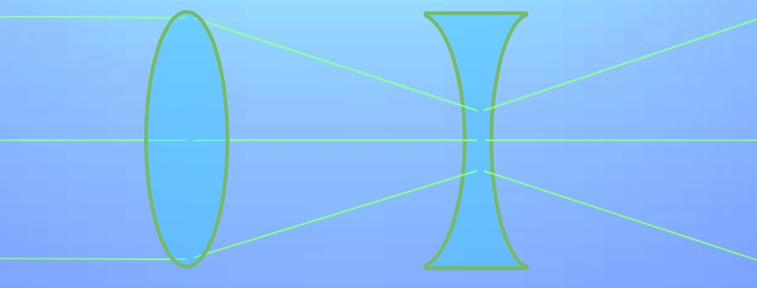
Diopters and concave lenses
ONLY IN FEMALES’ SLIDES
Concave lenses “Neutralize” the refractive power of convex lenses.
Thus, Placing A 1-Diopter concave lens immediately in front of A 1-Diopter convex lens results in a lens system with zero refractive power
The refractive power of concave lenses cannot be stated in terms of the focal distance beyond the lens because the light rays diverge rather than focus to a point
For example where a concave lens diverges light rays at the same rate that A 1-Diopter convex lens converges them, the concave lens is said to have a dioptric strength of -1.
Diopters for a concave lens are measured by how much it neutralizes the refractive power of a convex lens

Slide 20
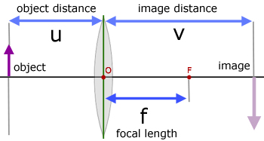
Focal length of a lens
ONLY IN FEMALES’ SLIDES
There is a difference in focal length between these lenses, due to the curvature of the lens.
The focal length of a lens is expressed in the following formula: 1/f = 1/a + 1/b
F is the focal length of the lens for parallel rays.
A is the distance from the point source of light to the lens.
B is the focal length on the other side of the lens.

Slide 21
Refractive media of the eye
The interface between air and the anterior surface of the cornea.
The interface between the posterior surface of the cornea and the aqueous humor.
The interface between the aqueous humor and the anterior surface of the lens of the eye.
The interface between the posterior surface of the lens and the vitreous humor.
A total refractive power of 59 diopters when the lens is accommodated for distant vision.
1-Cornea:
Its diopteric power is 40-45 diopter at its anterior surface.
About two thirds of the 59 diopters of refractive power of the eye is provided by the anterior surface of the cornea.
The principal reason for this is that the refractive index of the cornea is markedly different from that of air, (whereas the refractive index of the eye lens is not greatly different from the indices of the aqueous humor and vitreous humor).
- N.B/ The internal index of air is 1
- the cornea, 1.38
- the aqueous humor, 1.33
- the crystalline lens, 1.40
- the vitreous humor, 1.34.

Slide 22
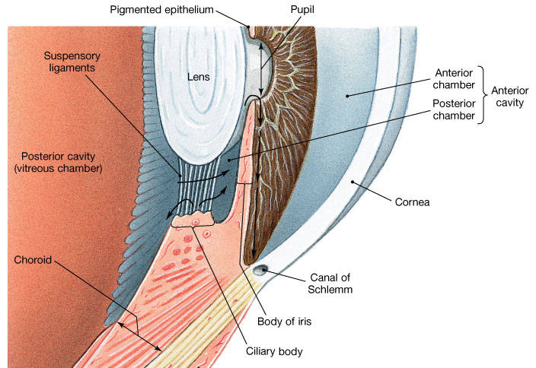
Cont.
2- The aqueous humour:
Transparent, slightly gelatinous (gel-like) fluid similar to plasma, continually being formed and reabsorbed.
The balance between its formation and reabsorption regulates the total volume and pressure of the intraocular fluid
Function:
Nourishing cornea and iris.
Causes intraocular pressure 10-20mm hg.
Obstruction of it’s outlet leads to increased intraocular pressure, a critical risk factor for glaucoma.
Fluid produced by ciliary body by active secretion by ciliary processes
To posterior chamber
To pupil
To anterior chamber
Drained into canal of schlemm at angle of anterior chamber
Which is a venous channel at the junction between
The iris and the cornea ( anterior chamber angle ).
To veins
It’s important to know it’s a refractive medium but it’s so liitle we don’t have to know it’s refractive power value.
It’s very very important because it controls the intraocular pressure.
Gives nutrients to cornea and iris.

Slide 23
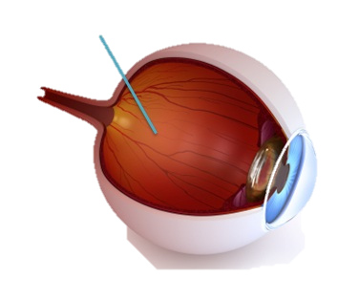
Cont.
3- The Vitreous Humour:
is the transparent, colorless, gelatinous mass.
It fills the vitreous chamber between the posterior surface of lens of the eye and the retina.
The vitreous humour is clear and allows light to pass through.
For nourishing retina & keep spheroid shape of the eye.
Both water and dissolved substances can diffuse slowly in the vitreous humors.
Vitreous humour remains from birth.
4- The Lens
Has diopteric power 15-20 D
(1/3 refractive power of eye) , more important than cornea.
Importance of the internal lens is that, in response to nervous signals from the brain, its curvature can be increased markedly to provide “accommodation”.
”Recap” refractive media of the eye:
Cornea (40-45db)
Aqueous humor (very little)
Lens (15-20db)
Vitreous humor
total refractive power of the eye= 56-60db

Slide 24
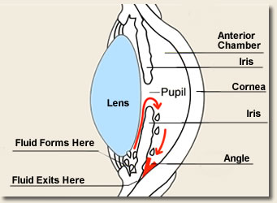
Glaucoma
ONLY IN MALES’ SLIDES
Glaucoma is an eye condition that develops when too much fluid pressure builds up inside of the eye.
The increased internal pressure can damage the optic nerve, which transmits images to the brain.
Without treatment, glaucoma can cause blindness within few years.
Glaucoma is most often inherited, meaning it is passed from parents to children.
Less common causes of glaucoma include a blunt or chemical injury to the eye, severe eye infection, blockage of blood vessels in the eye and inflammatory conditions of the eye.
Glaucoma usually occurs in both eyes, but it may involve each eye to a different extent.
Build up of Aqueous Humor Volume
Increases pressure in eye
Damages nerve
Meds/surgery

Slide 25
Cont.
ONLY IN FEMALES’ SLIDES
Glaucoma is when intraocular pressure more than 20mmHg
Why it causes damage of optic nerve?
obstruction of aqueous humour outlet causes an Increase in intraocular pressure
excessive aqueous humour pushes the lens backwards into vitreous which pushes against the retina.
this compression causes retinal and optic nerve damage
Blindness
This lack of nutrition of the optic nerve fibers, which causes death of the involved fibers
the axons of the optic nerve are compressed at the optic disc

Slide 26
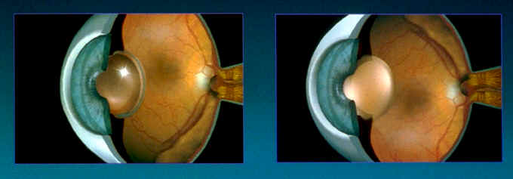
Cataract
Lens clouds up.
Must be removed.
Typical to replace lens with implant.
Can get clouding repeat.
Laser removal.
Cataracts occurs in older people is a cloudy or opaque area or areas in the lens the proteins in some lens fibers become denatured and coagulate to form opaque areas When a cataract has obscured light transmission so greatly that it impairs vision.
Cataracts: الموية البيضاء، هي عبارة عن بروتينات مترسبة في داخل العدسة
The lens becomes opaque so when you look at the patients eye you’ll see grey spots inside the lens.
تمنع عبور الضوء فيحطون له عدسة صناعية
Happens with elders or with diabetic patient or trauma.

Slide 27
Binocular vision
are the areas in the centre of visual field of the two eyes in which any object in this area will be seen by both eyes.
Binocular Vision for:
Large visual field.
cancel the effect of blind spot.
stereoscopic vision.
one eye lesion does not affect vision.
Monocular and binocular visual fields:
The dashed line encloses the visual field of the left eye.
the solid line, that of the right eye.
The common area (heart-shaped in the center) is viewed with binocular vision.
The colored areas are viewed with monocular vision.

Slide 28
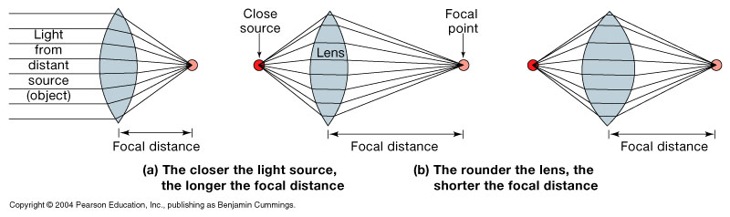
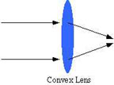
Lenses - Principles of Optics
(image forming mechanism)
ONLY IN MALES’ SLIDES
Image Formation:
Principles of Optic:
principle focus:
parallel rays strike biconvex lens refracted in a point is PF.
principle axis:
PF lies on line pass through centers of lens curvatures.
Principal focal distance:
distance between lens & PF.
Biconvex lens(converge) & biconcave lens(diverge)

Slide 29
Cont.
ONLY IN FEMALES’ SLIDES
Biconvex lens(converge) & biconcave lens(diverge).
Diopter ( The distance beyond a convex lens at which parallel rays converge to a common focal point ).
Ex: if Principal focal distance of a lens is 25cm, so its R.P= 1/ 0.25 meter = 4D
The greater the curvature of the lens, the greater the refractive power of the eye.
If the lens has exactly the proper curvature, parallel light rays passing through each part of the lens will be bent exactly enough so that all the rays will pass through a single point, which is called the Focal point.
Light source
Light source

Slide 30
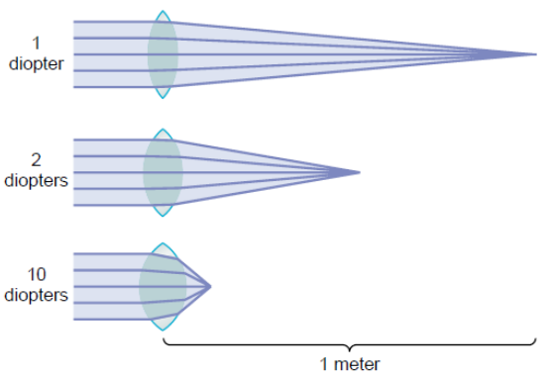
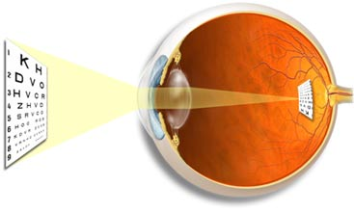
Emmetropic: objects focused on retina (normal)
Diopter:
Measurement of refractive power.
Diopter = 1 / Principal focal distance in meters.
Exp/ if Principal focal distance of a lens is 25cm, so its R.P= 1/ 0.25 meter = 4D
Emmetropic eye:
Normal eye has image on retina , has diopteric power of 59D
Lens-retina distance =17mm (in males’), 15mm (in females’ slides).
The greater the curvature of the lens, the greater the refractive
power of the eye.
Example: if principle focal distance is in cm and you’re asked to find it’s refrective power: 1 over (value in cm/100)= (Value in meters)db.
Diopteric power of the eye:
Cornea 40-45 D (max refraction) Lens 15-20 D
Accomodation by lens .... +12 D
ONLY IN FEMALES’ SLIDES

Slide 31
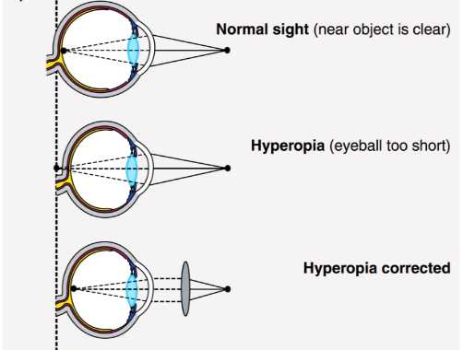
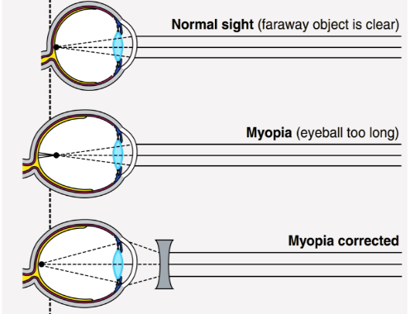
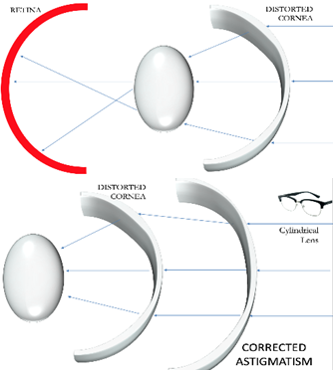
Errors of refraction
Errors of refraction
Hypermetropia
(hyperopia = far-sightedness)
Myopia (nearsightedness)
Astigmatism
Presbyopia
Short eyeball, focus behind retina,
An affected individual has to use accommodation even for distant objects to bring image on retina causes muscular effort on cilliary muscle & prolonged convergence , this leads to headache & finally squint & hypertrophy of ciliary muscle
correction by biconvex lens.
Genetic, large eye ball, long anteroposterior diameter,
refractive power of lens system or cornea due to its too curved surface or due to long antero-posterior diameter of the eye
cause image to focus in front of retina
Correction by biconcave lens to diverge rays before strike lens)
Uneven & ununiformed corneal curvature, very rare ununiformed lens curvature
Rays refracted to diff focus blurred vision
Correction by cylindrical lens
(eye near point receeds by age due to loss of
accomodation )
Focus behind retina
correction by biconvex lens
ONLY IN FEMALES’ SLIDES

Slide 32
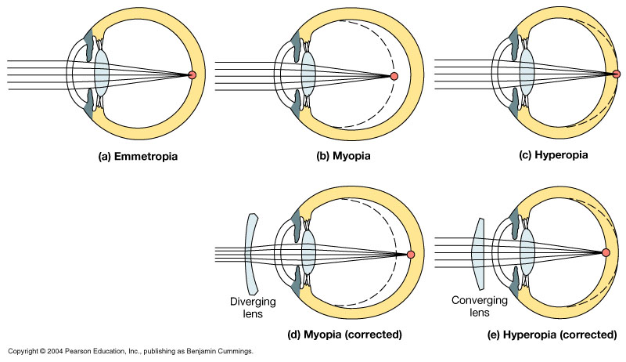
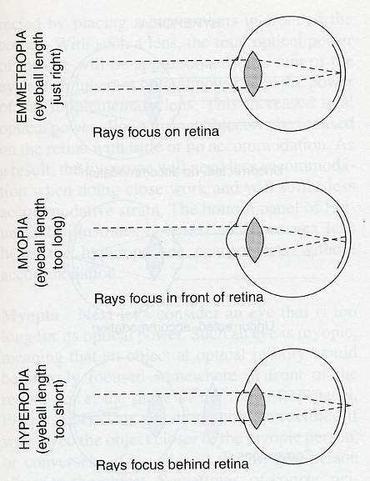
Image focusing
Emmetropic Eye:
can see all distant objects clearly with its ciliary muscle relaxed & see close objects clearly with ciliary muscles contracted.
Normal eye = Emmetropia
ONLY IN FEMALES’ SLIDES

Slide 33
Doctors’ notes
Rods are more sensitive than cones, their threshold stimulus is lower.
Cones are more accurate than rods.
Albinos lose the melanin in the pigmented layer of retina causing light to reflect; that’s why albinos have vision problems.
Fovea centralis is the area of maximal visual capacity because:
It contains cones only in high concentration.
Each cone is connected to 1 bipolar neurons ( in other areas, many photoreceptors connect to 1 bipolar neuron).
No blood vessels, it’s transparent.
Muscles of miosis: pupillary sphincters and circular muscles, controlled by parasympathetic ns.
Muscles of mydriasis: pupillary dilators and radial muscles, controlled by sympathetic ns.
Albinos lose the melanin in the pigmented layer of retina causing light to reflect; that’s why albinos have vision problems.

Slide 34






Thank you!
اعمل لترسم بسمة، اعمل لتمسح دمعة، اعمل و أنت تعلم أن الله لا يضيع أجر من أحسن عملا.
The Physiology 436 Team:
Team Leaders:
Lulwah Alshiha
Laila Mathkour
Mohammad Alayed
Females Members:
Amal AlShaibi
Lama AlTamimi
Males Members:
Qaiss Almuhaideb
Abdullatif Alabdullatif
Contact us:
References:
Females’ and males’ slides.
Guyton and hall textbook of medical physiology (thirteenth edition.)

